Slide 1
Main
08
MAIN Memory
Kai Bu
kaibu@zju.edu.cn
http://list.zju.edu.cn/kaibu/cmpt300
Notes:
In today’s lecture, we’ll start investigating memory hierarchy.
Through previous lectures, we already know that memory is a storage medium.
It’ll store information like the instructions compiled from your program as well as the data those instructions will process.

Slide 2
MAIN Memory
where CPU fetches instructions,
and reads & writes data
Notes:
Apparently [get addicted to saying this word after watching this video:) https://www.youtube.com/watch?v=xQ06G6Epyo4],
memory is central to the operation of our computer system.
As your program cannot work until it’s loaded into memory first, and then fetched by the CPU for execution.
During the execution, they may cause additional loading from and storing to specific memory addresses/locations.
Today we’ll be discussing a series of complex yet interesting memory management techniques.
So please concentrate. And there’ll be some memory related questions in the mid-term exam.

Slide 3
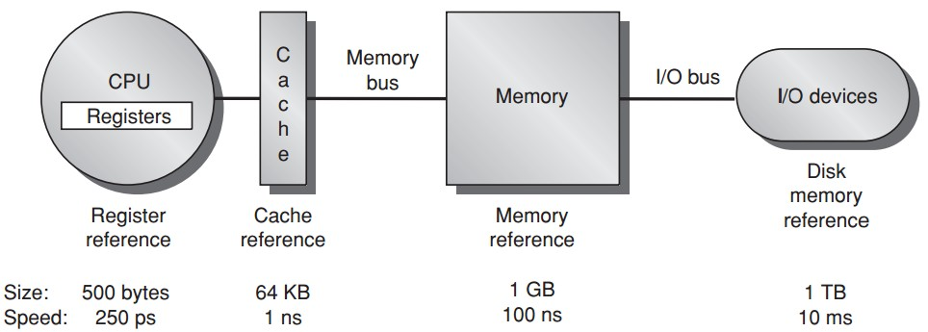
Memory Hierarchy
Notes:
Here’s a high level view of the entire memory hierarchy.
After a memory request leaves the CPU, it’ll first enter local registers on the CPU chip,
If the requested data are not found in registers, the request will proceed to cache,
Again, if not found, the request proceeds to memory,
And if not found again, finally invoke the I/O operation, access disk drive, and load the requested data from disk to memory…;
Since disk holds everything the CPU may want, then why bother to install the other intermediary storage medium such as memory, cache, and registers?
It’s about speed:
As shown in this figure, for storage closer to the CPU, it has a much faster speed but much smaller size and usually a much higher cost.
Memory will be today’s focus.

Slide 4
what if memory-access abuse?
Notes:
What do you consider of the memory access process?
When your program wants to request certain from memory, can it arbitrarily access any location of the memory?
What do you think will happen if any process can arbitrarily access any memory location?

Slide 5
what if memory-access abuse?
interfere with another process,
usurp the operating system
Notes:
Interfere with another process;
If the accessed location happens to store OS code, then usurp the operating system and may control over the entire computer system.
Then, how can we protect memory access?

Slide 6

Memory Protection
Base register
smallest legal physical
memory address
Limit register
size of the range
a process can access
Notes:
To protect memory access, we need to limit the range of memory space a process can access.
To this end, the OS specifies two address requirements for each process to satisfy.
The first one is Base, it specifies the smallest legal physical memory address, and is stored in the base register;
The other one is Limit, it specifies the size of the range a process can access. It’s stored/held in the limit register.
Example explanation.: In this example, the process of interest is assigned with base 300,040 and limit 120,900.
When this process accesses memory by sending out a memory request with a certain address,
how can the operating system use base and limit to determine whether to permit or reject the request?

Slide 7

Memory Protection
Notes:
Here’s how:
Procedure of address protection based on base&limit

Slide 8
when do decide where to load?
Notes:
To make memory protection work, the OS needs to first have memory allocation ready, right?
That is, for each process, it has already assigned a range of memory space and has been loaded therein.
Then the question is, when is such loading decision made?

Slide 9

Address Binding
Input queue
of processes on disk that
wait to be loaded into mem
Binding of instr & data addr
to memory addresses
can be done at any step of:
compile time, load time, and
execution time
Notes:
The procedure of assigning a process with a specific range of memory space is called address binding.
It can be done at compile time, load time, or execution time.

Slide 10
when if less mem than asked?
Notes:
Considering that multiprogramming enables our computer to simultaneously serve many processes, and memory size is much smaller than disk drive.
Then what if jointly all processes ask for more memory space than is available?

Slide 11

Swapping
Ready queue of processes with memory images in memory or on thee backing store
If a scheduled
proc is not in mem
AND insufficient mem space for it,
dispatcher swaps out
an in-memory process
and swaps in the scheduled process
Notes:
We can use the swapping technique to make memory be used in turn by all processes.
Specifically, we introduce another large storage medium, which is usually the disk drive, to serve as the backing store.
A ready process can be queued in either memory or backing store.
For a ready process that is already loaded in memory, it can immediately start running once after being scheduled.
But for ready processes queued on backing store, it depends.
If a ready process on backing store is scheduled to run and luckily there is still sufficient available memory to allocate, then we simply allocate the process with enough memory and complete its execution.
Otherwise, we have to swap out some processes from memory to backing store. And the released memory will be allocated to the newly scheduled one.

Slide 12
how to organize mem alloc?
Notes:
How to organize memory allocation

Slide 13

Contiguous Mem Allocation
Each process is contained in a single section of memory that is contiguous to the section containing the next process
Notes:
A straightforward scheme is contiguous memory allocation.
It simply place each process in a single section of memory that is contiguous to the section containing the next process.
In this case, a logical address deals with only relative memory address inside its requested memory space, which is upper bounded by the limit.
Upon memory access, the OS first verify whether the requested address is out of limit,
If not, it’ll translate the virtual address to the physical address by adding the logical address to the base (starting address of the process), which is stored in relocation register.

Slide 14
Multiple-Partition
Divide memory into several fixed-sized partitions
Each partition may contain exactly one process
When a partition is free, a process is selected from the input queue and is loaded into the free partition
When the process terminates, the partition becomes available for another process
Notes:
We can also let each memory range to allocate have the same size.
In this case, we are following the multiple-partition scheme.
**each process still occupies a contiguous memory range;
But different processes are not necessarily contiguous

Slide 15
Variable-Partition
OS keeps a table indicating which parts of memory are available and which are occupied
Holes: contiguous available memory
Which hole to fill?
Notes:
Partitions can have variable sizes.
In partition schemes, OS needs to keep a table indicating which parts of memory are available and which are occupied.
Clearly, after some time of running, memory contains interleaved available and occupied ranges.
A contiguous available memory range can be viewed as a hole.
Then upon memory allocation to the next process, the OS needs ot decide which hole to use;

Slide 16
Dynamic Storage-Allocation
First fit
allocate the first hole that is big enough
Best fit
allocate the smallest hole that is big enough
Worst fit
allocate the largest hole (that is big enough)
Notes:
There are three possible strategies to decide which available memory range to allocate.

Slide 17
Dynamic Storage-Allocation
external fragmentation
First fit
allocate the first hole that is big enough
Best fit
allocate the smallest hole that is big enough
Worst fit
allocate the largest hole (that is big enough)
Notes:
First fit and best bit are susceptible to external fragmentation,

Slide 18
Dynamic Storage-Allocation
external fragmentation:
enough available mem to
satisfy a request but none
available pieces can
First fit
allocate the first hole that is big enough
Best fit
allocate the smallest hole that is big enough
Worst fit
allocate the largest hole (that is big enough)
Notes:
Which corresponds to the issue that although jointly all available memory ranges can satisfy a memory request,
But individually, none of them is large enough for the request.
How to deal with that?

Slide 19
Compaction
Solution to external fragmentation:
shuffle the memory contents so as to place all free memory together in one large block;
relocation cost!
Notes:
Merge available memory by relocation.
Relocation is expensive.

Slide 20
Compaction
Solution to external fragmentation:
shuffle the memory contents so as to place all free memory together in one large block;
relocation cost!
What would you do?

Slide 21
Noncontiguous Addr Space
Permit the logical address space of processes to be noncontiguous
Allow a process to be allocated physical memory wherever such memory is available
Two techniques:
segmentation and paging
Notes:
For each process, its occupied memory space is not necessarily contiguous

Slide 22
Segmentation
Logical address as a two tuple:
<segment-number, offset>
Example: C compiler might create the following separate segments for a program
the code
global variables
the heap, from which memory is allocated
the stacks used by each thread
the standard C library

Slide 23
Segmentation
Logical address as a two tuple:
<segment-number, offset>
how to map two-dimensional programmer-defined address into one-dimensional physical addresses?

Slide 24

Segmentation
s: segment number
d: offset

Slide 25
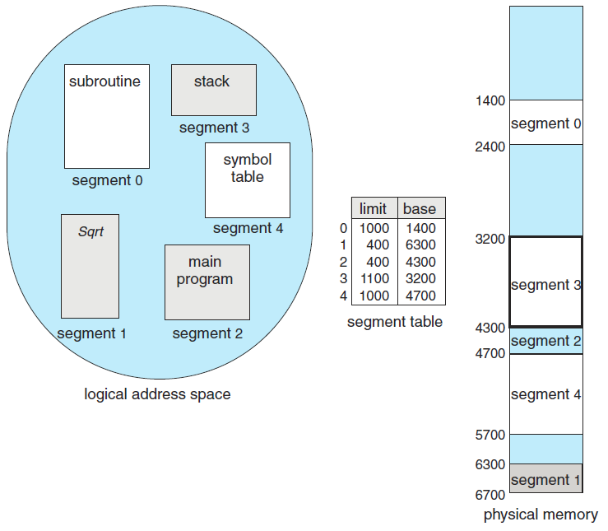
Segmentation
Example
variable size
external fragmentation still
compaction needed

Slide 26
Paging
Use fixed-size pages (in logical address space)/frames (in physical address space), each containing a number of fixed-size blocks
Avoid external fragmentation
Need no compaction

Slide 27

Paging
Notes:
Example: four processes, each with one page allocated.
Virtual pages 0, 1, 2, 3 are mapped to physical pages 1, 4, 3, 7, respectively.

Slide 28


Paging
logical address
Notes:
Each page contains four blocks;
Virtual page mapped to physical page;
But inside a page, same layout;
This reduces the size of page table, as it does not need to maintain entries for each block inside a page;

Slide 29

Paging
address translation
by Memory Management Unit (MMU)
Notes:
Since block layout inside a virtual page and its corresponding physical page is the same,
The address translation need not bother the page-offset part

Slide 30
how large is a page table?
Notes:
So far, a page table has to maintain an entry for each page,
Since there might be many pages in memory, then how large can a page table be?

Slide 31
Page Table Size
Example:
32-bit virtual/physical address,
4KB page,
page table size?

Slide 32
Page Table Size
Example:
32-bit virtual/physical address,
4KB page,
page table size?
Solution
total memory size: 2³² bytes
no. of pages/entries: 2³²/2¹² = 2²⁰
entry size: 32 bits = 4 bytes
page table size = 4B x 2²⁰ = 4 MB
byte addressed mem

Slide 33
access page table first
to access data
Notes:
Usually, the page table itself should also be stored in memory;
For accessing a data block, the OS needs to access page table from memory first,
After address translation, the OS needs to access memory again for the requested data.

Slide 34
access page table first
to access data
two memory accesses for one request!
Notes:
So, two memory accesses for one request

Slide 35
how
to access data faster?
two memory accesses for one request!

Slide 36
Translation Look-aside Buffer
TLB
a special, small, fast-lookup hardware cache
TLB entry
page number and frame number
Parallel lookup
the requested page number is compared with all page numbers in TLB simultaneously
Notes:
Use a special cache called TLB.

Slide 37

TLB

Slide 38
Effective Mem-Access Time
Hit ratio
the percentage of times that that page number of interest is found in TLB
example: 80% hit ratio, 100 ns if hit
200 ns if miss
Effective memory-access time =
0.80 x 100 + (1 – 0.80) x 200 = 120 ns
Notes:
Given that TLB is very small in size,
There should be two possible cases, in one we can successfully find the virtual address in TLB, we call this case as TLB hit,
In the other one we just can’t, and we call this case as TLB miss.
Apparently, TLB hit promises faster memory access than TLB miss does. As the former requires one memory access while the latter requires two.

Slide 39
Effective Mem-Access Time
Hit ratio
the percentage of times that that page number of interest is found in TLB
example: 99% hit ratio, 100 ns if hit
200 ns if miss
Effective memory-access time =
0.99 x 100 + (1 – 0.99) x 200 = 101 ns

Slide 40

Valid-Invalid Bit
Valid if the page is in the process’s logical address space
Invalid otherwise
Example:
5 pages mapped to 5 frames;
so only 5 valid entries;
Notes:
Another key point to pay attention to is that each process usually has its own page table.
So the OS needs to clearly specify which pages a process can access;
Using valid-invalid bit in each entry of the page table;

Slide 41
but pages can be shared

Slide 42
Reentrant Code / Pure Code
Never change during execution
Can be executed simultaneously by two or more processes
Processes should have respective data pages

Slide 43

Shared Pages
editor
shared by three procs

Slide 44
how to structure a page table?

Slide 45

Hierarchical Paging
Page table can be large
Divide it into smaller pieces
Indexed by a page table of page tables
unused page tables need not be loaded;
and thus saves memory space
Notes:
https://www.youtube.com/watch?v=8kBPRrHOTwg

Slide 46

Two-level Page Table
search over page table

Slide 47

Hashed Page Tables
hash page number
avoid search
linked list of collided ones;
three fields of each item:
page no., frame no.,
pointer

Slide 48
Hashed Page Tables
hash page number
search over the list until
finding matching page no.

Slide 49

Inverted Page Tables
One entry per physical address
<process-id, page-number, offset>

Slide 50
Inverted Page Table
Decrease the amount of memory for storing one table per process
Increase the amount of time to search the table
Use a hash table to hash a virtual addr to a physical address;
then directly go to that entry for search

Slide 51
Review
How to organize memory allocation?
How to translate virtual addresses?
How to speed up address translation?
How to structure a page table?

Slide 52

Chapter 8
Notes:
The contents to be discussed can be found in chapter 8.

Slide 53
Reminder
Assignment 1
Due: June 21, 2018 on CourSys
Midterm Exam
AQ3150, 11:30 – 13:20
June 26, 2018
Coverage: Chapters 1-8

Slide 54
?

Slide 55
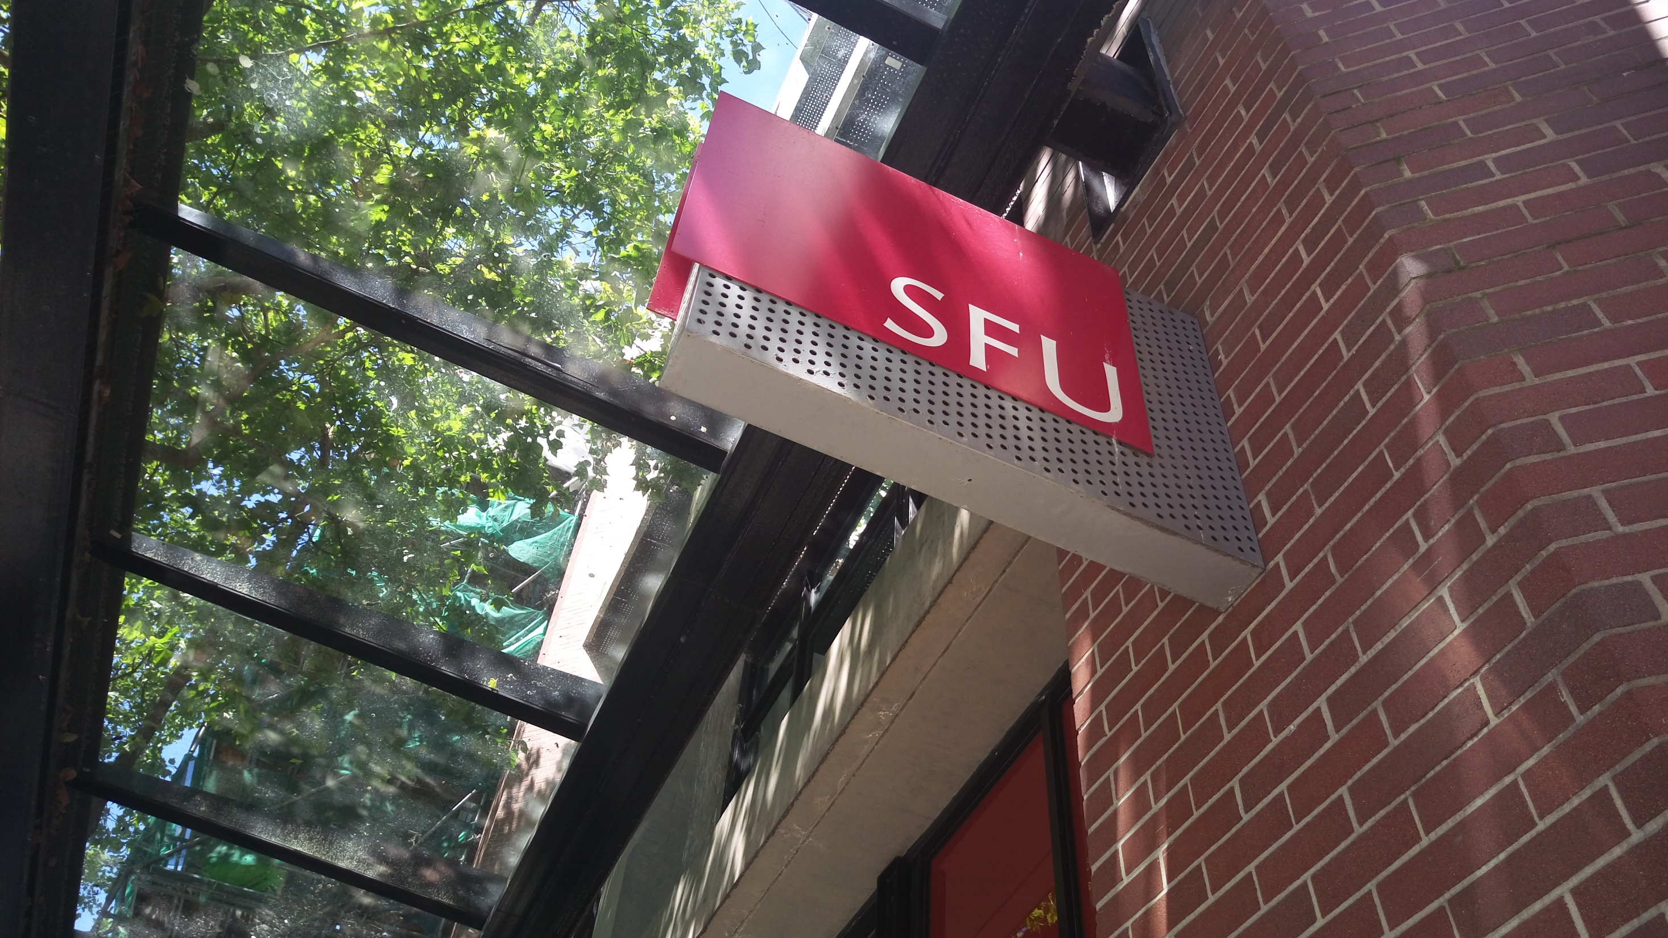
Thank You

Slide 56
#What’s More
A Guide for Potential Grad Students: Should You Go To Graduate School?
By Brian
The Impossible Decision
by Joshua Rothman

