Slide 1
Virtual Memory
09
Kai Bu
kaibu@zju.edu.cn
http://list.zju.edu.cn/kaibu/cmpt300
Notes:
In today’s lecture, let’s continue with virtual memory.
Previously, we have already discussed various memory-management strategies used in computer systems.
All those strategies have the same goal: to keep many processes in memory simultaneously to allow multiprogramming.
However, they tend to require that an entire process be in memory before it can execute.

Slide 2
Virtual Memory
processes not completely in memory
programs possibly larger than memory
Notes:
In contrast, virtual memory is a technique that allows the execution of processes that are not completely in memory.
One major advantage is that programs can be larger than physical memory.

Slide 3


Slide 4
which part of program to load?
Notes:
Into memory

Slide 5
Demand Paging
Load pages only as they are needed
Counter Example:
a program starting with a list of available options from which the user is to select;
loading the ENTIRE program into memory results in loading the executable code for all options, regardless of whether or not an option is ultimately selected by the user;

Slide 6
whether a page is now in/out?
Notes:
Into memory

Slide 7

Valid-Invalid Bit
valid: page in memory
invalid: invalid address or
invalid: page out of memory

Slide 8
Valid-Invalid Bit
out
valid: page in memory
invalid: invalid address or
invalid: page out of memory
Notes:
Out pages are in a secondary storage, which is usually a hard disk…;

Slide 9
whether a page is now in/out?
Notes:
What do you think will happen if out pages…/ invalid pages?

Slide 10
whether a page is now in/ouch!
Notes:
Performance degradation;
As need to access memory for swapping in pages to memory
Slow down program execution

Slide 11
whether a page is now in/ouch!
Page Fault:
access to a page marked invalid
cause a trap to the operating system
Notes:
Call this case – accessing a page marked invalid – a page fault
https://en.wikipedia.org/wiki/Trap_(computing)

Slide 12

adf
handling a page fault

Slide 13
adf
check internal page table
valid OR invalid memory access?
handling a page fault
Notes:
We check an internal table (usually kept with the process control block)
for this process to determine whether the reference was a valid or an
invalid memory access.
Here we need to notice that the validity we are checking is about the memory access per se,
that is, whether its requested address is within the logical address space of the process.

Slide 14
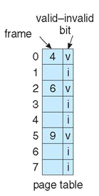
adf
example: invalid
if access address 9
check internal page table
valid OR invalid memory access?
handling a page fault
Notes:
For example, if the logical address space of a process spans across only logical address 0 through 7,
Then it’ll be an invalid memory access if the process tries to access address 9.

Slide 15
adf
invalid memory access:
terminate the process;
valid memory access:
check valid-invalid bit;
handling a page fault
Notes:
If the reference was invalid (not in logical addr space), we need to terminate the process.
If it was valid, we need to further check the valid-invalid bit in the corresponding page table entry;

Slide 16
adf
invalid memory access:
terminate the process;
valid memory access:
check valid-invalid bit:
if v: load page to CPU;
if i: cause a trap to OS;
handling a page fault
Notes:
If the valid-invalid bit is set as valid, page is already loaded in memory, use the physical address in the entry to fetch page from memory, and transmit it to the CPU;
If the valid-invalid bit is set as invalid, the page has not been loaded into memory yet.
Cause a trap to the operating system, which will load that page from disk to memory.

Slide 17
adf
find a free frame from
the free-frame list
handling a page fault
Notes:
We find a free frame (by taking one from the free-frame list, for example),
which is allocated to the page that’s about to be loaded into memory.

Slide 18
adf
schedule a disk operation;
read the desired page;
into the newly allocated frame;
handling a page fault
Notes:
We schedule a disk operation to read the desired page into the newly
allocated frame.

Slide 19
adf
modify
the internal page table
handling a page fault
Notes:
When the disk read is complete, we modify the internal table kept with
the process and the page table to indicate that the page is now in memory.

Slide 20
adf
restart
the trapped instruction
handling a page fault
Notes:
We restart the instruction that was interrupted by the trap.

Slide 21
how fast is demand paging?
Notes:
How to

Slide 22
how fast is demand paging?
effective access time =
(1 - p) x ma + p x page fault time
memory access time
probability of a page fault
Notes:
How to

Slide 23
Effective Access Time
Example:
avg page-fault service time: 8 millisec
memory access time: 200 nanoseconds
Effective access time =
(1 - p) x 200ns + p x 8ms =
200 + 7,999,800 x p
8.2 microseconds if p = 1/1,000
slow down by a factor of 40!
Notes:
Significant delay by page faults;
That is, handling a page fault is usually slow

Slide 24
page in every demanded page?
Notes:
Then, should we handle every page fault?

Slide 25
page in every demanded page?
page sharing
Notes:
Use page sharing, upon demanding a page,
If that page is already loaded for some other processes, and can be shared,
Then no need to service a page fault

Slide 26
page in every demanded page?
page sharing
of fork()-ed processes
Notes:
This applies especially to processes created by fork() system call

Slide 27
Copy-on-Write
after fork() creates a child process that is a duplicate of its parent,
instead of duplicating the pages belonging to the parent,
copy-on-write allows the parent and child processes initially to shared the same pages
if either process writes to a shared page, a copy of the shared page is created
Notes:
and the technique is called copy-on-write;

Slide 28

Copy-on-Write
before process 1 modifies page C

Slide 29

Copy-on-Write
after process 1 modifies page C

Slide 30
what if no mem for demand?
Notes:
As more processes demand more memory space, there might be cases when no sufficient memory space is left for allocating to a new page.

Slide 31
Page Replacement
If no frame is free,
find one that is not currently being used
and free it;
use the freed frame to hold the page for
which the process faulted
Notes:
In this case, we need to replace

Slide 32

Page Replacement
Notes:
This figure illustrates the four steps taken by a page replacement process

Slide 33
Page Replacement
find the location of
the desired page on the disk

Slide 34
Page Replacement
find a free frame:
if there is a free one, use it;
if no, use page-replacement alg to select victim page;
write the victim frame to the disk; change page table
and frame table accordingly

Slide 35
Page Replacement
read the desired page into the newly freed frame;
change the page and frame tables;

Slide 36
Page Replacement
continue the user process
from where the page fault occurred

Slide 37
Page Replacement
Limitation:
two page transfers
for replacing one page

Slide 38
Page Replacement
Solution:
use modify/dirty bit to indicate that
an in-memory page has been modified;
only modified need be written back to disk;

Slide 39
which page to replace?

Slide 40
FIFO Page Replacement
First in, first out
Associate with each page the time when
that page was brought into memory
When a page must be replaced,
choose the oldest page
Notes:
The simplest page-replacement algorithm is a first-in, first-out algorithm.
A FIFO replacement algorithm associates with each page the time when that page was brought into memory.
When a page must be replaced, the oldest page is chosen.

Slide 41
FIFO Page Replacement
Example: reference string
page number sequence during a process’s memory references
7, 0, 1, 2, 0, 3, 0, 4, 2, 3, 0, 3, 2, 1, 2, 0, 1, 7, 0, 1
for a memory with three frames,
which are initially empty
Notes:
The simplest page-replacement algorithm is a first-in, first-out algorithm.
A FIFO replacement algorithm associates with each page the time when that page was brought into memory.
When a page must be replaced, the oldest page is chosen.

Slide 42
FIFO Page Replacement
Example: reference string
page number sequence during a process’s memory references
7, 0, 1, 2, 0, 3, 0, 4, 2, 3, 0, 3, 2, 1, 2, 0, 1, 7, 0, 1
first three references all fault

Slide 43
FIFO Page Replacement
Example: reference string
page number sequence during a process’s memory references
7, 0, 1, 2, 0, 3, 0, 4, 2, 3, 0, 3, 2, 1, 2, 0, 1, 7, 0, 1
4th reference 2 replaces first-in 7

Slide 44
FIFO Page Replacement
Example: reference string
page number sequence during a process’s memory references
7, 0, 1, 2, 0, 3, 0, 4, 2, 3, 0, 3, 2, 1, 2, 0, 1, 7, 0, 1
5th reference 0 already in memory

Slide 45
FIFO Page Replacement
Example: reference string
page number sequence during a process’s memory references
7, 0, 1, 2, 0, 3, 0, 4, 2, 3, 0, 3, 2, 1, 2, 0, 1, 7, 0, 1
6th reference 3 replaces oldest 0

Slide 46
FIFO Page Replacement
Example: reference string
page number sequence during a process’s memory references
7, 0, 1, 2, 0, 3, 0, 4, 2, 3, 0, 3, 2, 1, 2, 0, 1, 7, 0, 1
7th reference 0 replaces oldest 1

Slide 47

FIFO Page Replacement
Example: reference string
page number sequence during a process’s memory references
7, 0, 1, 2, 0, 3, 0, 4, 2, 3, 0, 3, 2, 1, 2, 0, 1, 7, 0, 1
Notes:
The entire memory access procedure and page replacement therein

Slide 48

Belady’s Anomaly
larger memory → more page faults
Ex.: 1, 2, 3, 4, 1, 2, 5, 1, 2, 3, 4, 5
FIFO:
3 frames → 19 faults
4 frames → 10 faults
Notes:
But the FIFO page replacement algorithm is susceptible to belady’s anomaly problem:
That is, increasing the number of page frames results in an increase in the number of page faults for a given memory access pattern.
OR: the page-fault rate may increase as the number of allocated frames increases;

Slide 49
Optimal Page Replacement
OPT or MIN
Replace the page that will not be used
for the longest period of time
Yield the lowest page-fault rate of all
algorithms for a fixed number of frames
Never suffer from Belady’s anomaly

Slide 50
Optimal Page Replacement
Example: reference string
page number sequence during a process’s memory references
7, 0, 1, 2, 0, 3, 0, 4, 2, 3, 0, 3, 2, 1, 2, 0, 1, 7, 0, 1
for a memory with three frames,
which are initially empty

Slide 51
Optimal Page Replacement
Example: reference string
page number sequence during a process’s memory references
7, 0, 1, 2, 0, 3, 0, 4, 2, 3, 0, 3, 2, 1, 2, 0, 1, 7, 0, 1
first three references all fault

Slide 52
Optimal Page Replacement
Example: reference string
page number sequence during a process’s memory references
7, 0, 1, 2, 0, 3, 0, 4, 2, 3, 0, 3, 2, 1, 2, 0, 1, 7, 0, 1
2 gets in
7 gets replaced as 0, 1 r needed sooner

Slide 53

Optimal Page Replacement
Example: reference string
page number sequence during a process’s memory references
7, 0, 1, 2, 0, 3, 0, 4, 2, 3, 0, 3, 2, 1, 2, 0, 1, 7, 0, 1
Notes:
The entire memory access procedure and page replacement therein

Slide 54
Optimal Page Replacement
Example: reference string
page number sequence during a process’s memory references
7, 0, 1, 2, 0, 3, 0, 4, 2, 3, 0, 3, 2, 1, 2, 0, 1, 7, 0, 1
future knowledge of ref string
is hard to know
Notes:
The entire memory access procedure and page replacement therein

Slide 55
LRU Page Replacement
Least Recently Used:
Use recent past as an approximation of the near future
Replace the page that has not been
used for the longest period of time

Slide 56

LRU Page Replacement
Example: reference string
page number sequence during a process’s memory references
7, 0, 1, 2, 0, 3, 0, 4, 2, 3, 0, 3, 2, 1, 2, 0, 1, 7, 0, 1
Notes:
The entire memory access procedure and page replacement therein

Slide 57
LRU Page Replacement
Example: reference string
page number sequence during a process’s memory references
7, 0, 1, 2, 0, 3, 0, 4, 2, 3, 0, 3, 2, 1, 2, 0, 1, 7, 0, 1
first three references all fault
Notes:
The entire memory access procedure and page replacement therein

Slide 58
LRU Page Replacement
Example: reference string
page number sequence during a process’s memory references
7, 0, 1, 2, 0, 3, 0, 4, 2, 3, 0, 3, 2, 1, 2, 0, 1, 7, 0, 1
2 gets in
7 gets replaced as it has not been used
for the longest time
Notes:
The entire memory access procedure and page replacement therein

Slide 59
LRU Page Replacement
Example: reference string
page number sequence during a process’s memory references
7, 0, 1, 2, 0, 3, 0, 4, 2, 3, 0, 3, 2, 1, 2, 0, 1, 7, 0, 1
3 gets in
1 gets replaced as it has not been used
for the longest time
Notes:
The entire memory access procedure and page replacement therein

Slide 60
LRU Page Replacement
Example: reference string
page number sequence during a process’s memory references
7, 0, 1, 2, 0, 3, 0, 4, 2, 3, 0, 3, 2, 1, 2, 0, 1, 7, 0, 1
need hardware support to track
page reference times
Notes:
The entire memory access procedure and page replacement therein

Slide 61
LRU-Approximation
Associate a reference bit with each page
table entry
Initialize all reference bits as 0
Set the reference bit whenever the page
is referenced
Use reference bits to determine which
pages have (not) been used

Slide 62
Second-Chance Algorithm
Follow a FIFO replacement algorithm
If ref bit is 0, replace
If ref bit is 1, give it a second chance
clear its ref bit AND now its arrival time
Implement as a circular queue

Slide 63

Second-Chance Algorithm
degenerate to FIFO
if all reference bits are set

Slide 64
Enhanced Second-Chance
Use both reference bit and modify bit
(0,0) neither recently used nor modified
best page to replace
(0,1) not recently used but modified
not quite as good, write before replace
(1,0) recently used but clean
probably will be used again soon
(1,1) recently used and modified
probably will be used again soon
write before replace

Slide 65
no ordering info in ref bits

Slide 66
Additional-Reference-Bits
Introduce more reference bits
Keep an 8-bit byte per page in a table
in memory to track the history of page
use for the last eight time periods
At regular intervals, shift the ref bit for
each page into the high-order bit of its
8-bit byte;
shift the other bits right by 1 bit;
discard the low-order bit;

Slide 67
Additional-Reference-Bits
Example:
00000000
page has not been used for 8 periods
11111111
page used at least once in each period
11000100 vs 01110111
the former has been used more recently

Slide 68
Counting-Based
Keep a counter of the number of
references that have been made to
each page
LFU: Least Frequently Used
replace the page w/ smallest counter
MFU: Most Frequently Used
replace the page w/ largest counter;
consider smallest-count pages just
brought in and yet to be used;

Slide 69
how many frames for a proc?

Slide 70
how many frames for a proc?
cannot allocate more than available
Notes:
Cannot exceed the amount of available frames

Slide 71
how many frames for a proc?
cannot allocate more than available
allocate > a minimum no. of frames
Notes:
Meanwhile, should allocate at least a minimum number of frames to guarantee performance,
As handling page fault takes time

Slide 72
Equal Allocation
Evenly split m frames among n procs:
m/n frames per process
Example:
93 frames and 5 processes;
each process gets 18 frames;
three leftover frames as a free-frame
buffer pool;

Slide 73
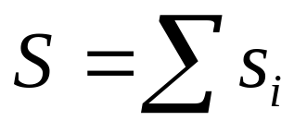
Proportional Allocation
Allocate available memory to
each process according to its size
s_{i}: size of virtual mem of proc p_{i}
total virtual mem size:
m: total no. of available frames
a_{i} : no. of frames to allocate to p_{i}
a_{i} = s_{i}/S x m

Slide 74
Proportional Allocation
Allocate available memory to
each process according to its priority
The ratio of frames for process p_{i}
depends not on the relative sizes
but rather on the priorities OR
a combination of size and priority

Slide 75
whose frames to replace?

Slide 76
whose frames to replace?
global replacement:
replace any from the set of all frames;
local replacement:
replace 1 of its own set of allocated frames;

Slide 77
thrashing in page replacement

Slide 78
thrashing in page replacement
highly frequent paging for a process
that does not have enough frames;
Notes:
In fact, look at any process that does not have “enough” frames. If the
process does not have the number of frames it needs to support pages in
active use, it will quickly page-fault. At this point, it must replace some page.
However, since all its pages are in active use, it must replace a page that will
be needed again right away. Consequently, it quickly faults again, and again,
and again, replacing pages that it must bring back in immediately.
This high paging activity is called thrashing. A process is thrashing if it is
spending more time paging than executing.

Slide 79
thrashing in page replacement
highly frequent paging for a process
that does not have enough frames;
a thrashing proc spends more time
paging than executing;

Slide 80
thrashing in page replacement
highly frequent paging for a process
that does not have enough frames;
a thrashing proc spends more time
paging than executing;
affects non-thrashing procs as well;

Slide 81
thrashing: how to prevent?

Slide 82
Working-Set Model
Leverage program locality:
pages that are actively used together;
Process executes from locality to locality
Need continuous measure of locality

Slide 83

Working-Set Model
Leverage program locality:
pages that are actively used together;
Process executes from locality to locality
Need continuous measure of locality
Example:
= 10

Slide 84
Page-Fault Frequency
A more direct approach
Adjust frame allocation according to
page fault frequency
Specify upper and lower bound of
page fault frequency
If exceed upper bound, frame++
If falls below lower bound, frame--

Slide 85
user processes so far

Slide 86
what if kernel processes?

Slide 87
what if kernel processes?
may require less than a page;
may require contiguous pages;

Slide 88
Buddy System
Allocate memory from a fixed-size
segment consisting of physically
contiguous pages
Use a power-of-2 allocator, that is,
double alloc size till satisfying request
i.e., 4 KB, 8 KB, 16 KB, and so forth
E.g., a request for 11 KB is allocated
with 16 KB
Notes:
We now examine two strategies for managing free memory that is assigned to kernel processes: the buddy system, and slab allocation

Slide 89

Buddy System
Gradually divide mem into buddies
Example:
256 KB available
request 21 KB

Slide 90
Buddy System
Gradually divide mem into buddies
Example:
256 KB available
request 21 KB
Coalescing
combine adjacent buddies
to form larger segments
fragmentation issue
request 21, but allocate 32

Slide 91
Slab Allocation
a slab contains physically contiguous
pages
Pre-allocate slabs to different caches
Each cache is for a type of kernel object,
is divided into chunks the size of objects
When kernel requests mem for an obj,
slab allocator returns same amount of
memory from the cache
No fragmentation, fast allocation

Slide 92

Slab Allocation

Slide 93
Review
When is virtual memory?
What is demand paging?
How to replace pages?
How to allocate pages among processes?

Slide 94
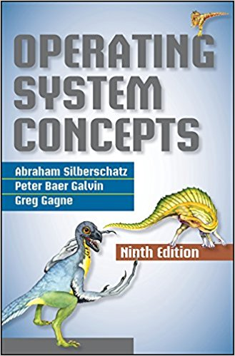
Chapter 9
Notes:
The contents to be discussed can be found in chapters 3 and 4.

Slide 95
Reminder
Assignment 2
Available: July 03, 2018
Due: July 19, 2018 on CourSys
Makeup Midterm Exam
TASC 1 9409, 14:30 – 16:20
July 05, 2018
Coverage: Chapters 1-8

Slide 96
?

Slide 97
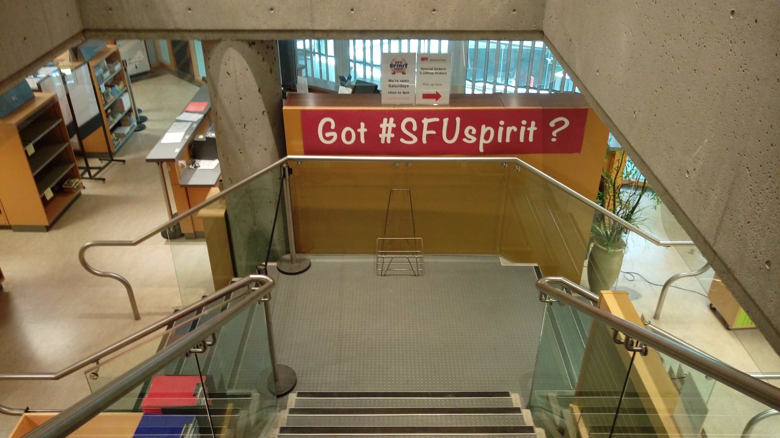
Thank You
Good Luck with Exam

Slide 98
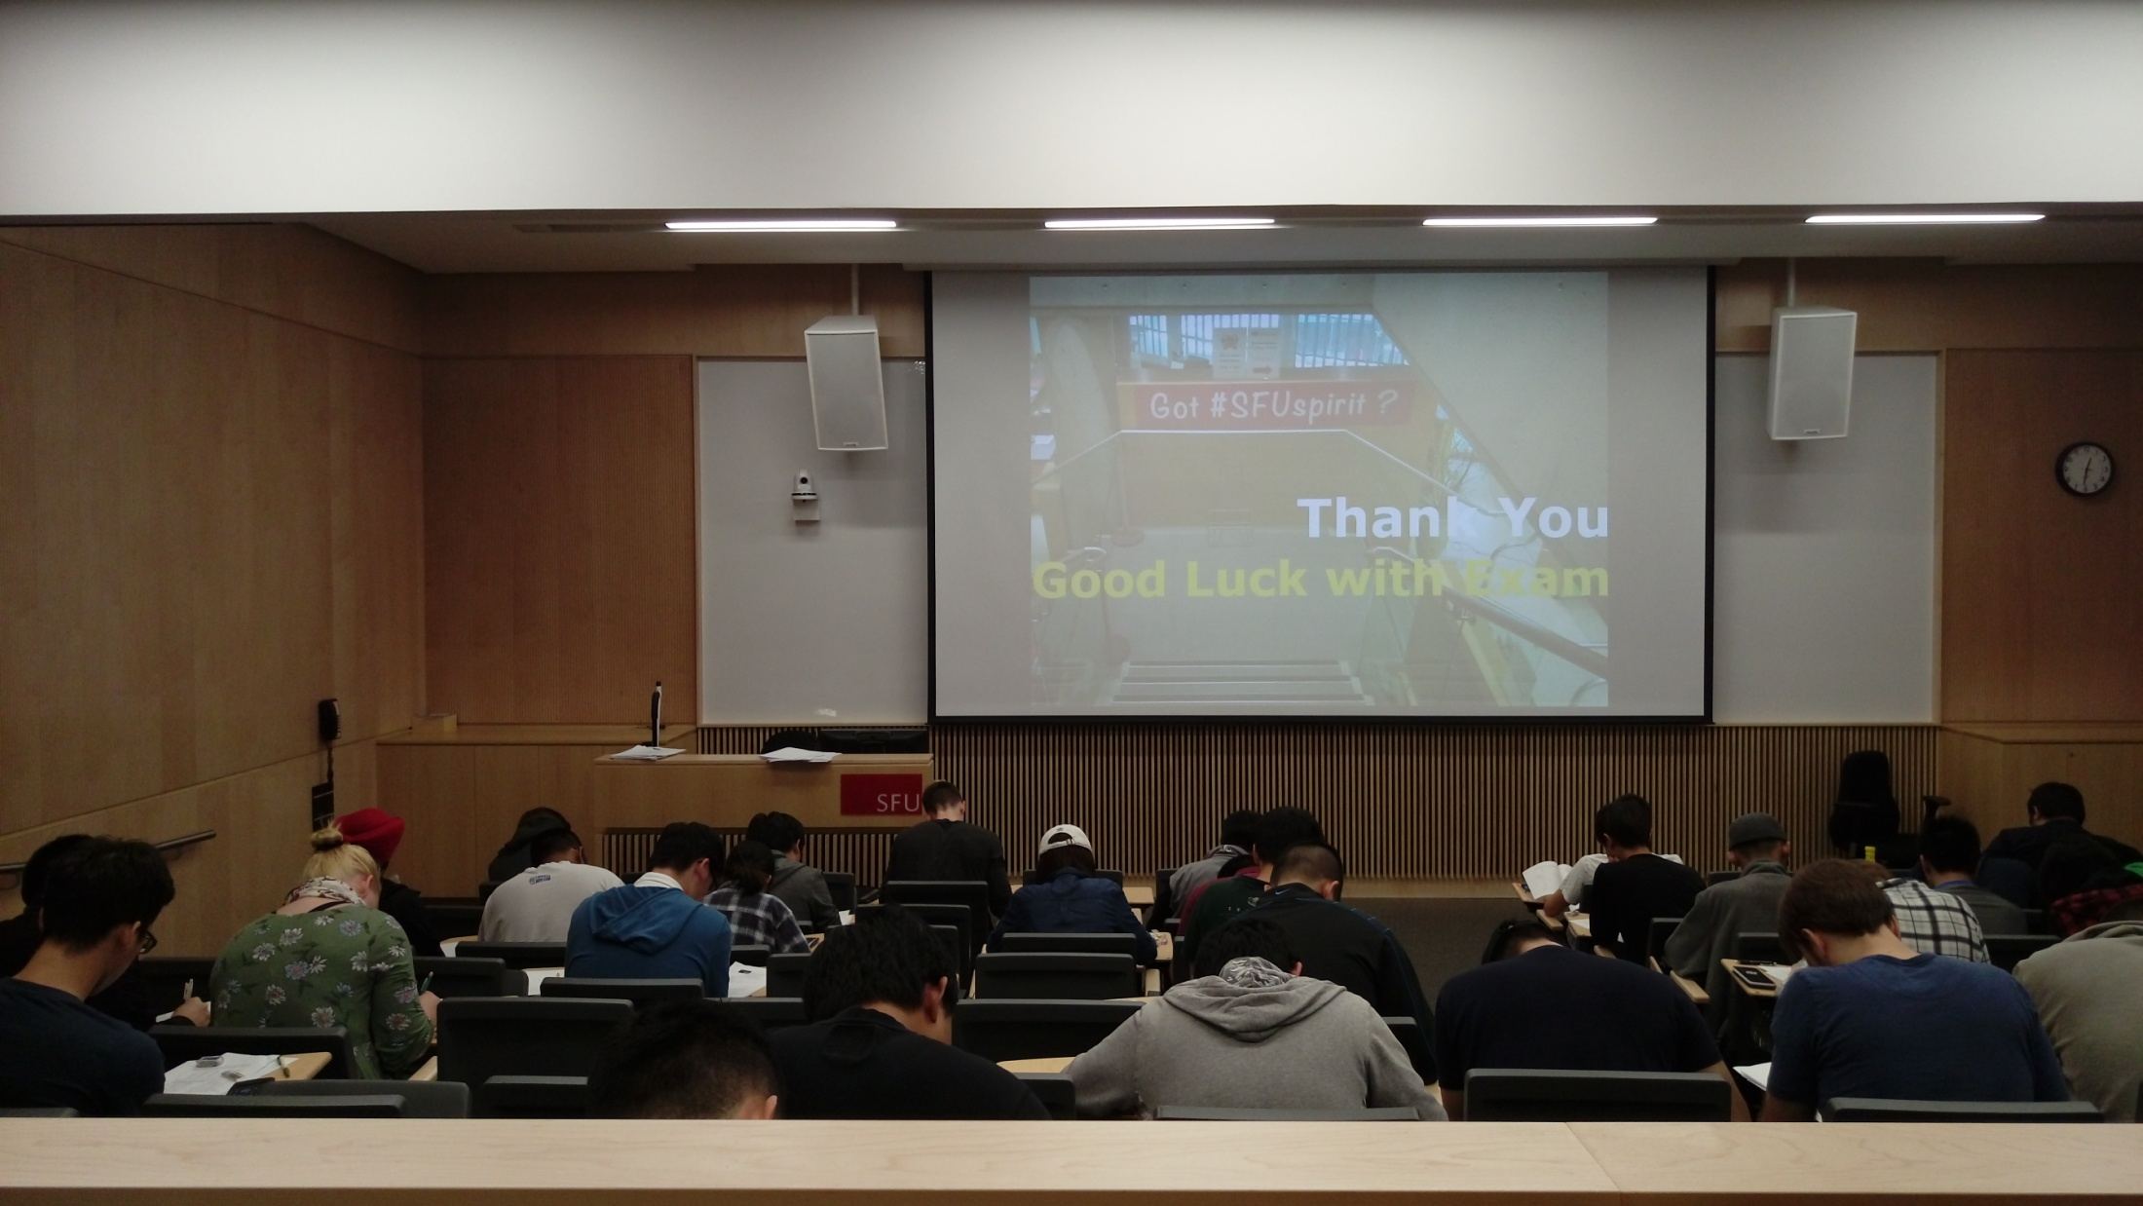
Bonus Coffee for
The Highest-Scoring SFUer

Slide 99
#What’s More
Your Body Language May Shape Who You Are
by Amy Cuddy
5 Ways to Kill Your Dreams
by Bel Pesce

