Slide 1
Lecture 1: Welcome
Computer Architecture
Kai Bu
kaibu@zju.edu.cn
http://list.zju.edu.cn/kaibu/comparch

Slide 2
Instructor
Kai Bu 卜凯
Assistant Professor, College of CS, ZJU
Ph.D. from Hong Kong PolyU, 2013
Research Interests: wireless networking,
network security (e.g., RFID, software-
defined networking, Android)
http://list.zju.edu.cn/kaibu

Slide 3
Join LIST!
Lab for Internet and Security Technology
浙江大学互联网安全实验室
http://list.zju.edu.cn/

Slide 4

Textbook
Computer Architecture:
A Quantitative Approach
5th edition
John L. Hennessy
David A. Patterson

Slide 5
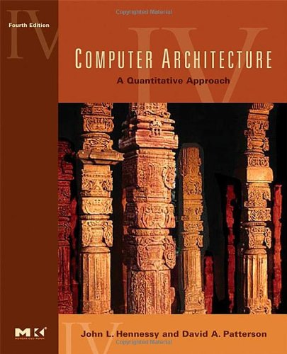
Textbook
Computer Architecture:
A Quantitative Approach
4th edition
John L. Hennessy
David A. Patterson
Other instructors may stick to the 4th ed
We’ll coordinate to keep the harmony
of the course content.

Slide 6
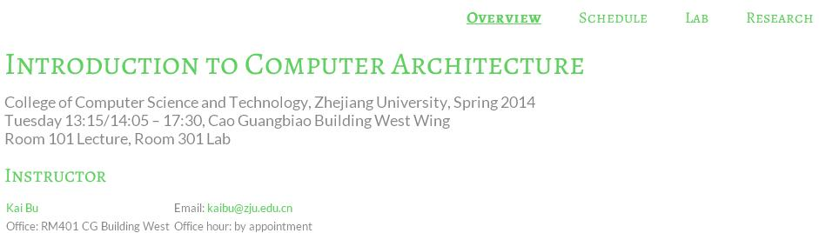
Course Website
http://list.zju.edu.cn/kaibu/comparch/

Slide 7
Syllabus
Reference syllabus by Prof. Jiang
http://list.zju.edu.cn/kaibu/comparch/Syllabus_2013spring.pdf

Slide 8
Components
Lectures
Labs
Research Warm-up

Slide 9
Components
Lectures
Labs
Research Warm-up

Slide 10
Lectures
Chapter 1: Fundamentals of Computer Design
classes of computers
trends in tech, power, cost
dependability
performance measurement, report
quantitative principles of comp design

Slide 11
Lectures
Appendix A: Instruction Set Principles and Examples
classifying instruction set architecture
memory addressing
type and size of operands
operation in the instruction set
instructions for control flow
encoding an instruction set
the role of compilers
MIPS architecture

Slide 12
Lectures
Appendix C: Pipelining: Basic and Intermediate Concepts
pipeline principles
pipeline hazards
implementation hurdles and solutions
MIPS R4000 pipeline
instruction level parallelism (Chapter 3)

Slide 13
Lectures
Chapter 2: Memory Hierarchy Design
cache performance (App B.2)
six basic cache optimizations (App B.3)
ten advanced optimizations for cache performance;
memory tech and optimizations
virtual memory (App B.4)
protection of virtual memory (App B.5)
virtual memory and virtual machines
design of memory hierarchies

Slide 14
Lectures
Chapter 5: Multiprocessors
symmetric shared-memory architecture
distributed shared-memory
directory-based coherence

Slide 15
Components
Lectures
Labs
Research Warm-up

Slide 16
Labs
5 lab sessions
Pipeline implementation

Slide 17
Labs
Lab 1
warmup Spartan 3E and ISE environment;
update verilog code of multi-cycle CPU to 3E board;
add one new branch instruction;

Slide 18
Labs
Lab 2
implement 5-stage pipelined CPU with 15 MIPS instructions;
Lab 3
implement stall technique against pipelining hazards;
Lab 4
implement forwarding paths toward faster CPU;
Lab 5
implement a pipelined CPU with 31 MIPS instructions;
use predict-not-taken policy to solve control hazard;

Slide 19
Labs
Call for volunteer lab assistants
help tutor & check the demo during lab sessions;
get bonus credit via active class participation;

Slide 20
Components
Lectures
Labs
Research Warm-up

Slide 21
Research Warm-up
Grading: Bonus 5%
75% Literature Review
25% Presentation

Slide 22
Research Warm-up
Requirements
Find a research topic you are interested in: e.g., computer architecture, computer network, network security;
Read 2-3 latest papers from recent CCF A conferences;
Write a review and prepare a presentation.

Slide 23
Research Warm-up
Notes: The review should cover
What is the research problem?
Why is it important?
What are the solutions?
Any limitations?
What would you do?
More on http://list.zju.edu.cn/kaibu/comparch/research.html

Slide 24
Grading
4% | Class participation & performance
16% | Homework
8% | Pop quiz
32% | Lab assignments
40% | Final exam (closed-book)
Bonus 5% | Research Warm-up
Bonus 5% | Active class prticipation

Slide 25
How will I teach?

Slide 26
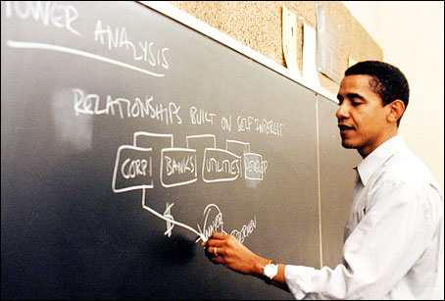
Not that professional yet…

Slide 27
My very first time teaching this course.
You know what to expect.

Slide 28
But the upside is

Slide 29
I was still a student until not very long ago.

Slide 30
I still clearly remember how it feels as a student.
This might ease your leaning process.

Slide 31
Teaching Plan
Keep it Simple
Focus on the core concepts
Try to help you more easily understand
Teaching in English for the most part
in accordance with the textbook.

Slide 32
Study Group
45 students
6 groups
Group discussion & tutoring
Peer evaluation

Slide 33
?

Slide 34

Who’s Who

Slide 35
Ready?

