Slide 1
Lecture 3: Instruction Set
Principles
Kai Bu
kaibu@zju.edu.cn
http://list.zju.edu.cn/kaibu/comparch

Slide 2

Appendix A

Slide 3
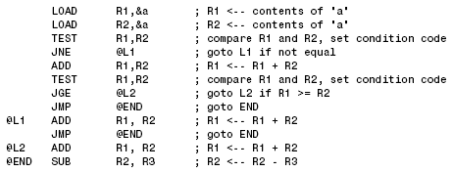
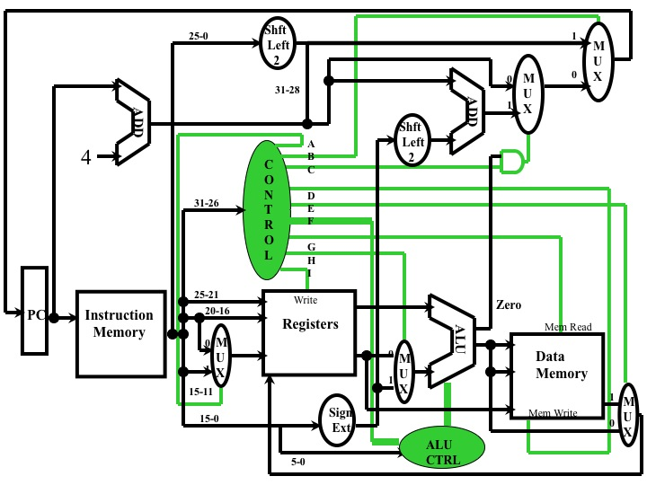
ISA: Instruction Set Architecture
programmer-visible instruction set

Slide 4
Outline
ISA Classification
Memory Addressing
Operand Type and Size
Operations
Control Flow Instructions
Encoding an Instruction Set
Compiler
All in MIPS
Assignment 1 & Lab 1
extra lab opening hours: Mon – Thu
13:00 – 16:00

Slide 5
Outline
ISA Classification
Memory Addressing
Operand Type and Size
Operations
Control Flow Instructions
Encoding an Instruction Set
Compiler
All in MIPS
Assignment 1 & Lab 1
extra lab opening hours: Mon – Thu
13:00 – 16:00

Slide 6
ISA Classification
Classification Basis
the type of internal storage:
stack
accumulator
register
ISA Classes:
  stack architecture
  accumulator architecture
  general-purpose register architecture (GPR)

Slide 7
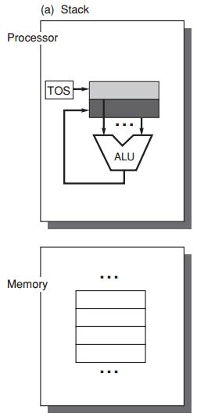
ISA Classes:
Stack Architecture
implicit operands
on the Top Of the Stack
C = A + B
Push A
Push B
Add
Pop C
First operand removed from stack
Second op replaced by the result

Slide 8
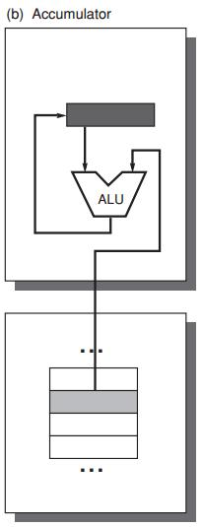
ISA Classes:
Accumulator Architecture
one implicit operand: the accumulator
one explicit operand: mem location
C = A + B
Load A
Add B
Store C
accumulator is both an implicit
input operand and a result

Slide 9
ISA Classes:
General-Purpose Register Arch
Only explicit operands
registers
memory locations
Operand access:
direct memory access
loaded into temporary storage first

Slide 10
ISA Classes:
General-Purpose Register Arch
Two Classes:
register-memory architecture
any instruction can access memory
load-store architecture
only load and store instructions can access memory

Slide 11
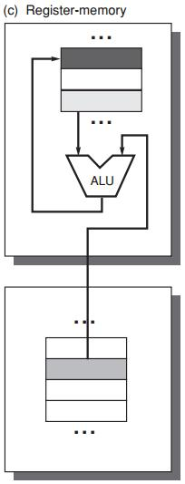
ISA Classes:
General-Purpose Register Arch
Two Classes:
register-memory architecture
any instruction can access mem
C = A + B
Load R1, A
Add R3, R1, B
Store R3, C

Slide 12
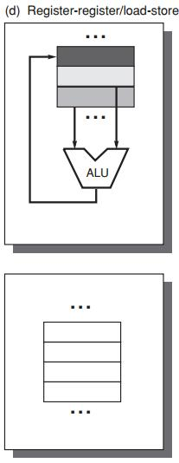
ISA Classes:
General-Purpose Register Arch
Two Classes:
load-store architecture
only load and store instructions
can access memory
C = A + B
Load R1, A
Load R2, B
Add R3, R1, R2
Store R3, C

Slide 13
GPR Classification
ALU instruction has 2 or 3 operands?
2 = 1 result&source op + 1 source op
3 = 1 result op + 2 source op
ALU instruction has 0, 1, 2, or 3 operands of memory address?

Slide 14
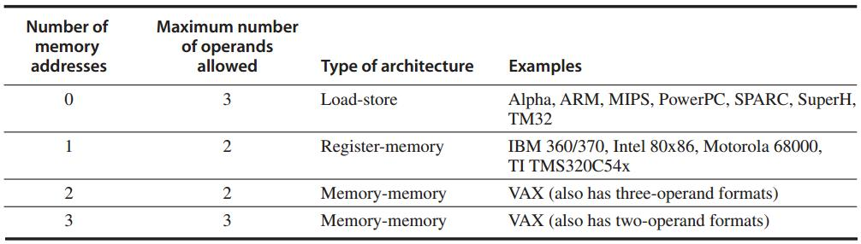
GPR Classification
Three major classes
Register-register

Slide 15
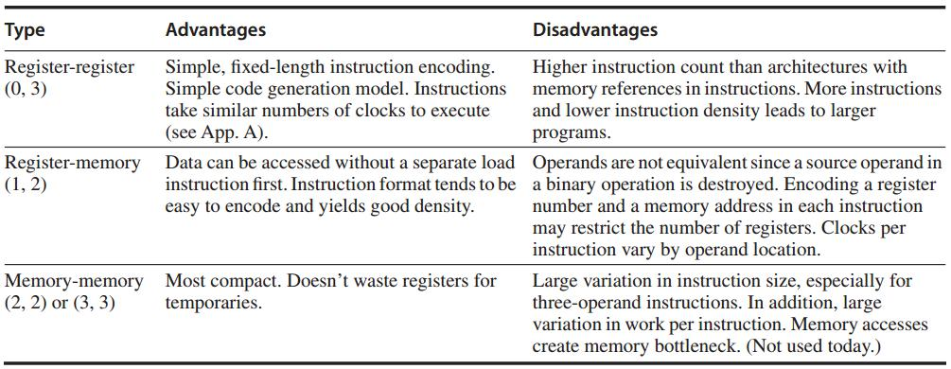
GPR Classification

Slide 16
Outline
ISA Classification
Memory Addressing
Operand Type and Size
Operations
Control Flow Instructions
Encoding an Instruction Set
Compiler
All in MIPS
Assignment 1 & Lab 1
extra lab opening hours: Mon – Thu
13:00 – 16:00

Slide 17
Memory Addressing
Byte addressing
Byte ordering in memory: 0x12345678
Little Endian
78 | 56 | 34 | 12
Big Endian
12 | 34 | 56 | 78

Slide 18
Memory Addressing
Address alignment
object width: s bytes
address: A
aligned if A mod s = 0

Slide 19
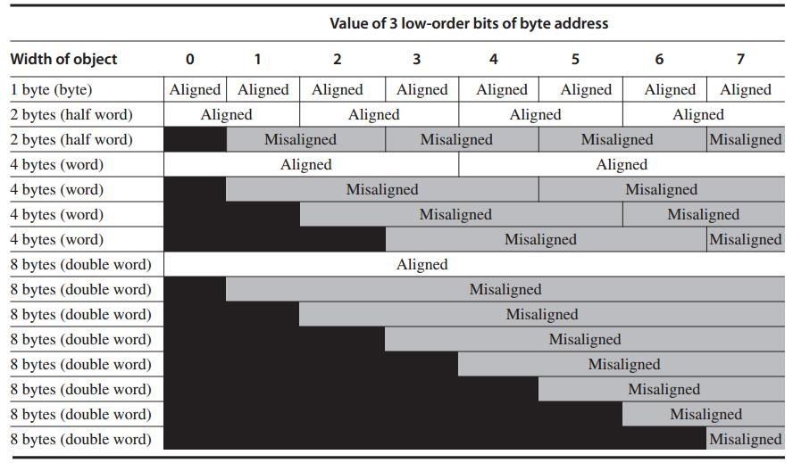
Each misaligned object requires two memory accesses

Slide 20
Addressing Modes
How instructions specify addresses
of objects to access
Types
constant
register
memory location – effective address

Slide 21
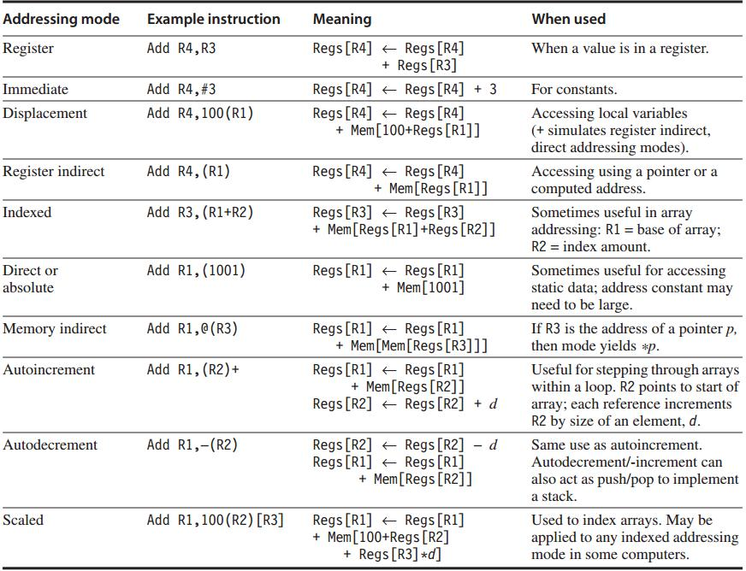
frequently used

Slide 22
Outline
ISA Classification
Memory Addressing
Operand Type and Size
Operations
Control Flow Instructions
Encoding an Instruction Set
Compiler
All in MIPS
Assignment 1 & Lab 1
extra lab opening hours: Mon – Thu
13:00 – 16:00

Slide 23
Operand Type and Size
Type | Size in bits
ASCII character | 8
Unicode character Half word | 16
Integer word | 32
Double word Long integer | 64
IEEE 754 floating point – single precision | 32
IEEE 754 floating point – double precision | 64
Floating point – extended double precision | 80

Slide 24
Outline
ISA Classification
Memory Addressing
Operand Type and Size
Operations
Control Flow Instructions
Encoding an Instruction Set
Compiler
All in MIPS
Assignment 1 & Lab 1
extra lab opening hours: Mon – Thu
13:00 – 16:00

Slide 25
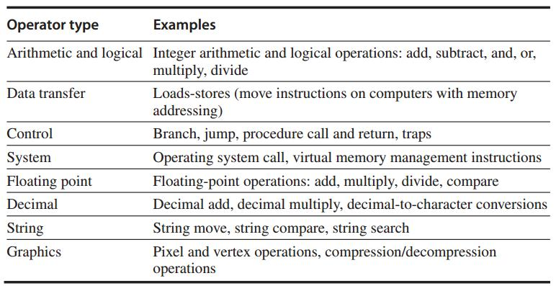
Operations

Slide 26
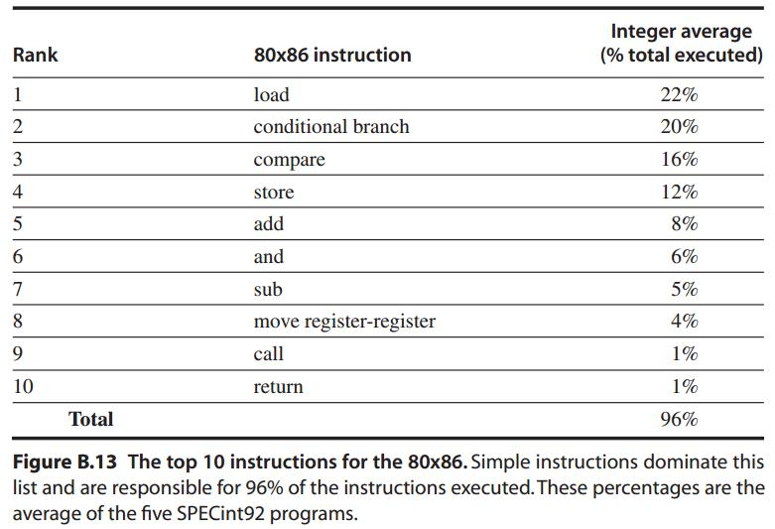
Simple Operations are the most widely executed

Slide 27
Outline
ISA Classification
Memory Addressing
Operand Type and Size
Operations
Control Flow Instructions
Encoding an Instruction Set
Compiler
All in MIPS
Assignment 1 & Lab 1
extra lab opening hours: Mon – Thu
13:00 – 16:00

Slide 28
Control Flow Instructions
Four types of control flow change
Conditional branches – most frequent
Jumps
Procedure calls
Procedure returns

Slide 29
Control Flow: Addressing
Explicitly specified destination address
exception: procedure return as target is not known at compile time
PC-relative
destination addr = PC + displacement
Dynamic address: for returns and indirect jumps with unknown target at compile time
e.g., name a register that contains the target address

Slide 30
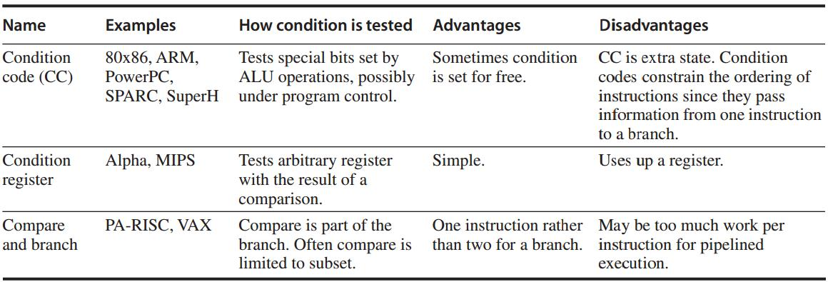
Conditional Branch Options
http://www.ece.mtu.edu/ee/faculty/cchigan/EE3170/EE%203170%20Lecture%207-Branches.pdf

Slide 31
Procedure Invocation Options
Control transfer
State saving
Return address – in a special link register or just a GPR
How to save registers?

Slide 32
Procedure Invocation Options
Caller Saving
the calling procedure saves the registers that it wants preserved for access after the call
Callee Saving
the called procedure saves the registers it wants to use

Slide 33
Outline
ISA Classification
Memory Addressing
Operand Type and Size
Operations
Control Flow Instructions
Encoding an Instruction Set
Compiler
All in MIPS
Assignment 1 & Lab 1
extra lab opening hours: Mon – Thu
13:00 – 16:00

Slide 34
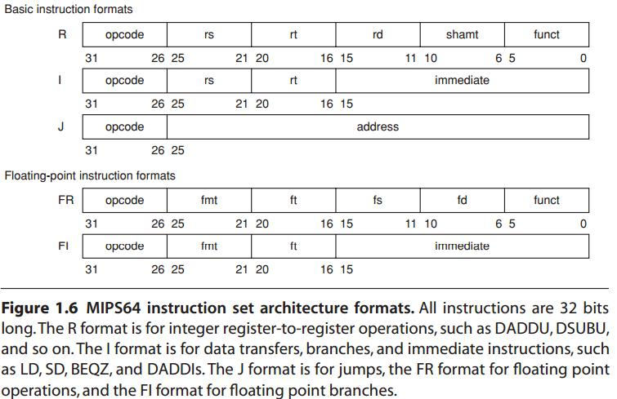
Encoding an ISA
Fixed length: ARM, MIPS – 32 bits
Variable length: 80x86 – 1~18 bytes
http://en.wikipedia.org/wiki/MIPS_architecture
Start with a 6-bit opcode.
R-type:
three registers,
a shift amount field,
and a function field;
I-type:
two registers,
a 16-bit immediate value;
J-type:
a 26-bit jump target.

Slide 35
Encoding an ISA
Opcode for specifying operations
Address Specifier for specifying the addressing mode to access operands

Slide 36
Encoding an ISA
Balance several competing forces for encoding:
1. desire to have more registers and addressing modes;
2. impact of the size register and addressing mode fields on the average instruction/program size
3. desire to encode instructions into lengths easy for pipelining

Slide 37
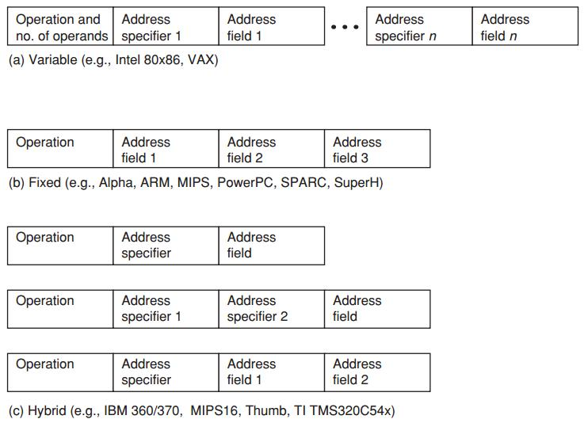
Encoding an ISA
Variable allows all addressing modes to be with all operations
Fixed combines the operation and addressing mode into the opcode
Hybrid reduces the variability in size and work of the variable
architecture but provide multiple instr lengths to reduce code size

Slide 38
Outline
ISA Classification
Memory Addressing
Operand Type and Size
Operations
Control Flow Instructions
Encoding an Instruction Set
Compiler
All in MIPS
Assignment 1 & Lab 1
extra lab opening hours: Mon – Thu
13:00 – 16:00

Slide 39
The Role of Compilers
Why understand compiler for designing and implementing ISA?
desktop and server apps programmed in high-level languages;
instructions executed are the output of a compiler;
compiler significantly affects the performance of a computer;

Slide 40
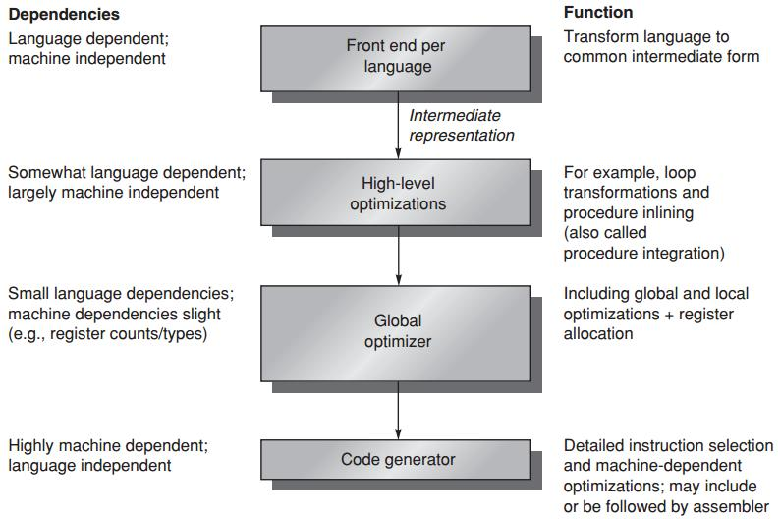
Compiler Structure

Slide 41
Compiler Goals
Correctness
all valid programs must be compiled correctly
Speed of the compiled code
Others
fast compilation
debugging support
interoperability among languages

Slide 42
Compiler Optimizations
High-level optimizations
are done on the source with output fed to later optimization passes
Local optimizations
optimize code only within a straight-line code fragment
Global optimizations
optimize across branches and transform for optimizing loops
Register allocation
associates registers with operands
Processor-dependent optimizations
leverage specific architectural knowledge

Slide 43
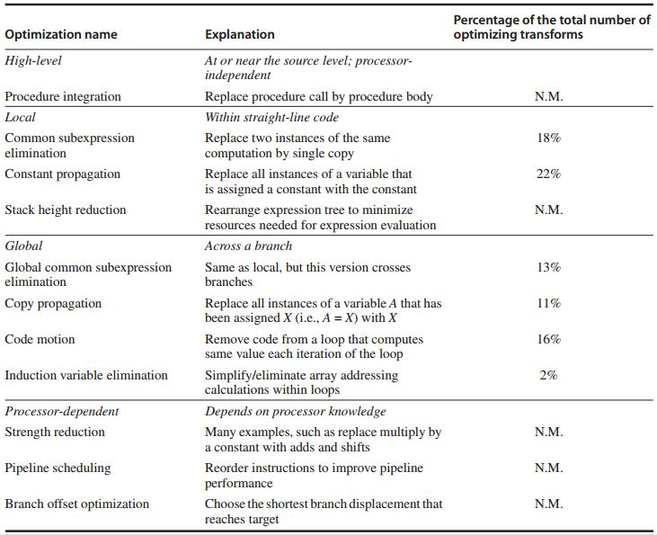

Slide 44
Data Allocation vs
Register Allocation
Where high-level languages allocate data
Stack: for local variable
Global data area: statically declared objects, e.g., global variable, constant
Heap: for dynamic objects
Register allocation is much more effective for stack-allocated objects for global variables;
Register allocation is essentially impossible for heap-allocated objects because they are accessed with pointers;

Slide 45
Compiler Writer’s Principles
Make the frequent cases fast
and the rare case correct
Driven by instruction set properties

Slide 46
Compiler Writer’s Principles
Provide regularity
keep primary components of an instruction set (operations, data types, addressing modes) orthogonal/independent
Provide primitives, not solutions
Simplify trade-offs among alternatives
instruction size, total code size, register allocation (in register-memory arch, how many times a variable should be referenced before it is cheaper to load it into a register)
Provide instructions that bind the quantities known at compile time as constants
instead of processor interpreting at runtime a value that was known at compile time

Slide 47
Outline
ISA Classification
Memory Addressing
Operand Type and Size
Operations
Control Flow Instructions
Encoding an Instruction Set
Compiler
All in MIPS
Assignment 1 & Lab 1
extra lab opening hours: Mon – Thu
13:00 – 16:00

Slide 48
All in MIPS

Slide 49
MIPS
Microprocessor without Interlocked Pipeline Stages
64-bit load-store architecture
Design for pipelining efficiency, including a fixed instruction set encoding
Efficiency as a compiler target

Slide 50
MIPS: Registers
32 64-bit general-purpose regs (GPRs)
R0 … R31 – for holing integers
32 floating-point regs (FPRs)
F0 … F31 – for holding up to 32 single-precision (32-bit) values or 32 double-precision (64-bit) values
The value of R0 is always 0

Slide 51
MIPS: Data Types
64-bit integers
32- or 64-bit floating point
For 8-bit bytes, 16-bit half words, 32-bit words:
loaded into the general-purpose registers (GPRs)
with either zeros or the sign bit replicated
to fill the 64 bits of GPRs

Slide 52
MIPS: Addressing Modes
Directly support immediate and displacement, with 16-bit fields
Others:
register indirect: placing 0 in the 16-bit displacement field
absolute addressing: using register 0 (with value 0) as the base register
Aligned byte addresses of 64-bits

Slide 53
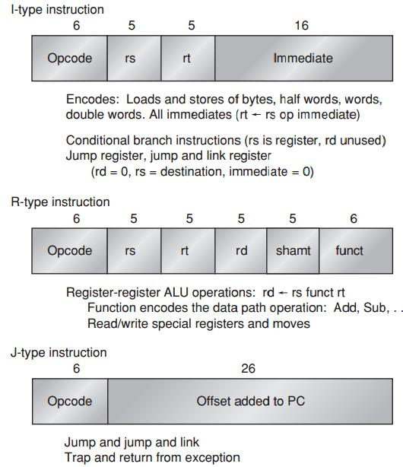
MIPS: Instruction Format

Slide 54
MIPS Operations
Four classes
loads and stores
ALU operations
branches and jumps
floating-point operations

Slide 55
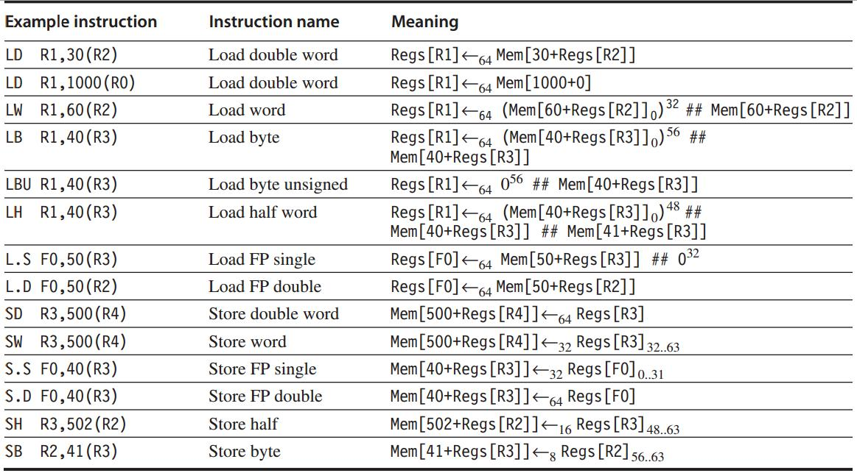
MIPS: Loads and Stores

Slide 56
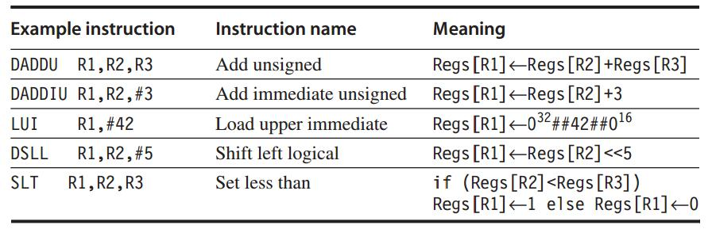
MIPS: ALU Operations

Slide 57
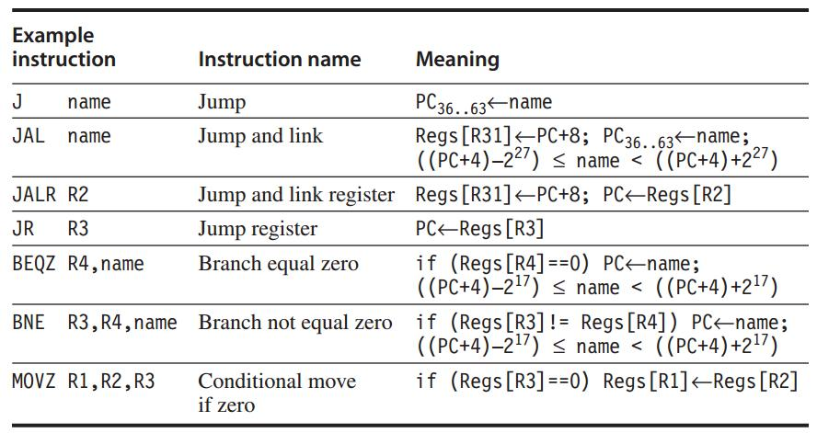
MIPS: Control Flow Instructions
Jumps and Branches
http://www.cs.umd.edu/class/sum2003/cmsc311/Notes/Mips/jump.html

Slide 58
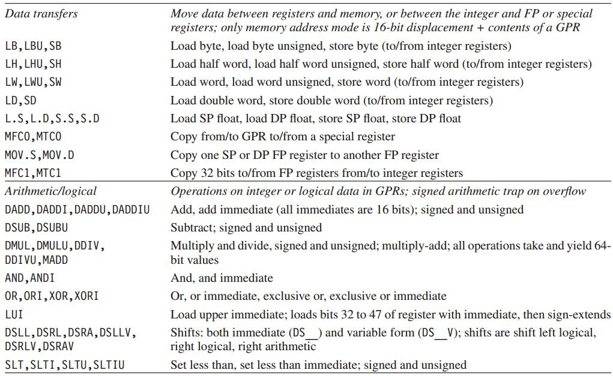
MIPS: Floating-Point Operations

Slide 59
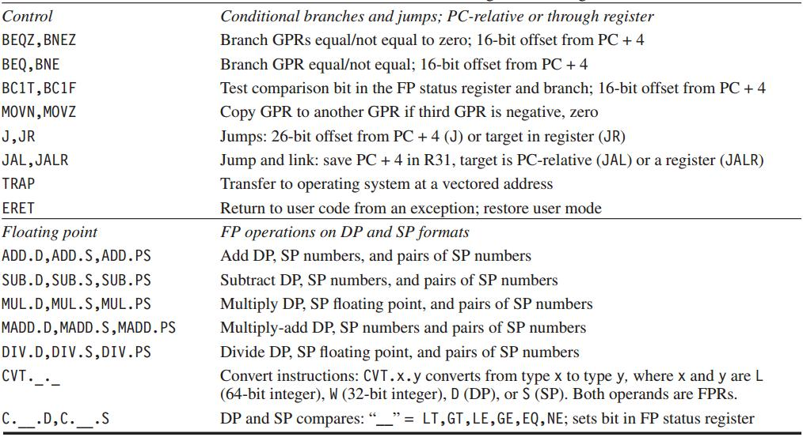
MIPS: Floating-Point Operations

Slide 60
?

Slide 61
Assignments
Assignment 1 due Mar 18, 2014
25’ x 4
http://list.zju.edu.cn/kaibu/comparch/Assignment-1.pdf
Lab 1 due Mar 25, 2014
http://list.zju.edu.cn/kaibu/comparch/lab1.pdf
extra lab opening hours: Mon – Thu
13:00 – 16:00

