Slide 1
Lecture 5: Pipelining
Implementation
Kai Bu
kaibu@zju.edu.cn
http://list.zju.edu.cn/kaibu/comparch

Slide 2
Lab 1 Report Submission
http://10.78.18.200:8080/Platform/
Register with @zju.edu.cn email addr
Report Due Date: March 28
Demo 70% + Report 30%
report template: http://list.zju.edu.cn/kaibu/comparch/Lab_report_template.doc

Slide 3

Appendix C.3-C.4

Slide 4
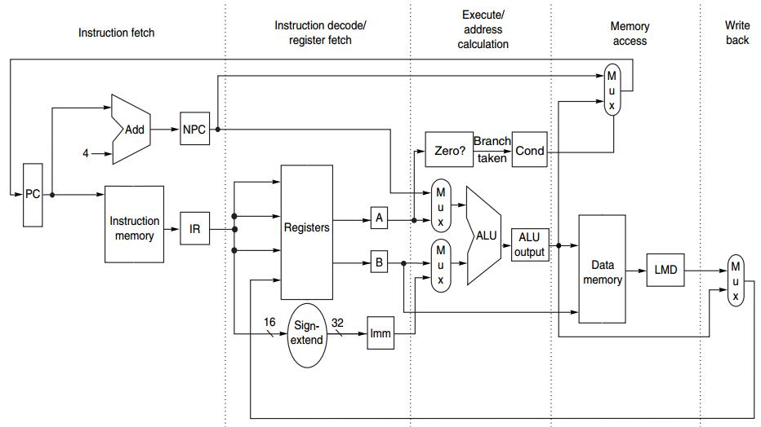
Data Path
Underneath Pipelining
IF ID EX MEM WB

Slide 5
Outline
Unpipelined MIPS
Pipelined MIPS
Other Pipelining Challenges

Slide 6
Outline
Unpipelined MIPS
Pipelined MIPS
Other Pipelining Challenges

Slide 7
MIPS Instruction
at most 5 clock cycles per instruction
IF ID EX MEM WB

Slide 8
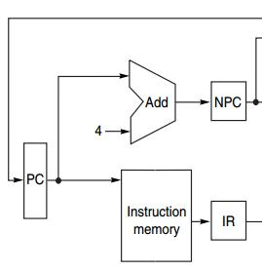
MIPS Instruction
IF ID EX MEM WB
Instruction Fetch cycle
IR ← Mem[PC];
NPC ← PC + 4;
IR: instruction register
NPC: next sequential PC

Slide 9
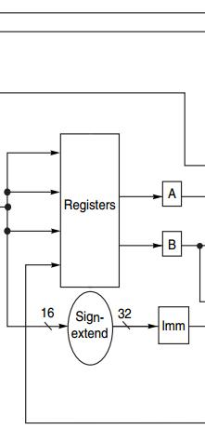
MIPS Instruction
IF ID EX MEM WB
Instruction Decode/register fetch
A ← Regs[rs];
B ← Regs[rt];
Imm ← sign-extended
immediate field
of IR
(lower 16 bits)

Slide 10
MIPS Instruction
IF ID EX MEM WB
Execution/effective address cycle
ALU operates on the operands from ID:
4 functions depending on the instr type -Memory reference
-Register-register ALU instruction
-Register-immediate ALU instruction
-Branch
Notes:
Note that different from the RISC implementation instance in previous lecture, MIPS’s EX stage has four types of functions; with one more function - branch

Slide 11
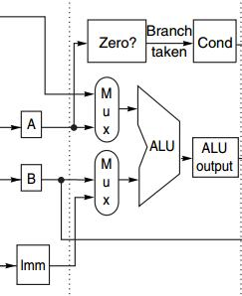
MIPS Instruction
IF ID EX MEM WB
Execution/effective address cycle
-Memory reference
ALUOutput ← A + Imm;
ALU adds the operands
Notes:
Note that different from the RISC implementation instance in previous lecture, MIPS’s EX stage has four types of functions; with one more function - branch

Slide 12
MIPS Instruction
IF ID EX MEM WB
Execution/effective address cycle
-Register-register ALU instr
ALUOutput ← A func B;
ALU performs the operation
specified by function code
on the value in register A
and on the value in register B
Notes:
Note that different from the RISC implementation instance in previous lecture, MIPS’s EX stage has four types of functions; with one more function - branch

Slide 13
MIPS Instruction
IF ID EX MEM WB
Execution/effective address cycle
-Register-Immediate ALU Instr
ALUOutput ← A op Imm;
ALU performs the operation
specified by opcode
on the value in register A
and on the value in register Imm
Notes:
Note that different from the RISC implementation instance in previous lecture, MIPS’s EX stage has four types of functions; with one more function - branch

Slide 14
MIPS Instruction
IF ID EX MEM WB
Execution/effective address cycle
-Branch
ALUOutput ← NPC + (Imm<<2);
Cond ← (A == 0);
ALUOutput -> branch target
BEQZ: comparison against 0
Notes:
Note that different from the RISC implementation instance in previous lecture, MIPS’s EX stage has four types of functions; with one more function - branch

Slide 15
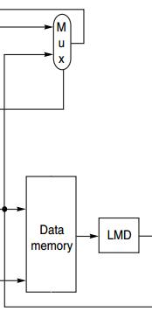
MIPS Instruction
IF ID EX MEM WB
MEMory access/branch completion
update PC for all instr: PC ← NPC;
-Memory Access
LMD ← Mem[ALUOutput]; load
Mem[ALUOutput] ← B; store
-Branch
if (cond) PC ← ALUOutput;

Slide 16
MIPS Instruction
IF ID EX MEM WB
Write-Back cycle
-Register-register ALU instruction
Regs[rd] ← ALUOutput;
-Register-immediate ALU instruction
Regs[rt] ← ALUOutput;
- Load instruction
Regs[rt] ← LMD; Load Memory Data reg

Slide 17
Put It All Together

Slide 18
MIPS Instruction
IF ID EX MEM WB
IR ← Mem[PC];
NPC ← PC + 4;

Slide 19
MIPS Instruction
IF ID EX MEM WB
A ← Regs[rs];
B ← Regs[rt];
Imm ← sign-extended
immediate field
of IR (lower 16 bits)

Slide 20
MIPS Instruction
IF ID EX MEM WB
ALUOutput ← A + Imm;
ALUOutput ← A func B;
ALUOutput ← A op Imm;
ALUOutput ← NPC + (Imm<<2);
Cond ← (A == 0);

Slide 21
MIPS Instruction
IF ID EX MEM WB
LMD ← Mem[ALUOutput]; Mem[ALUOutput] ← B;
if (cond) PC ← ALUOutput;

Slide 22
MIPS Instruction
IF ID EX MEM WB
Regs[rd] ← ALUOutput;
Regs[rt] ← ALUOutput;
Regs[rt] ← LMD;

Slide 23
MIPS Instruction Demo
Prof. Gurpur Prabhu, Iowa State Univ http://www.cs.iastate.edu/~prabhu/Tutorial/PIPELINE/DLXimplem.html
Load, Store
Register-register ALU
Register-immediate ALU
Branch

Slide 24
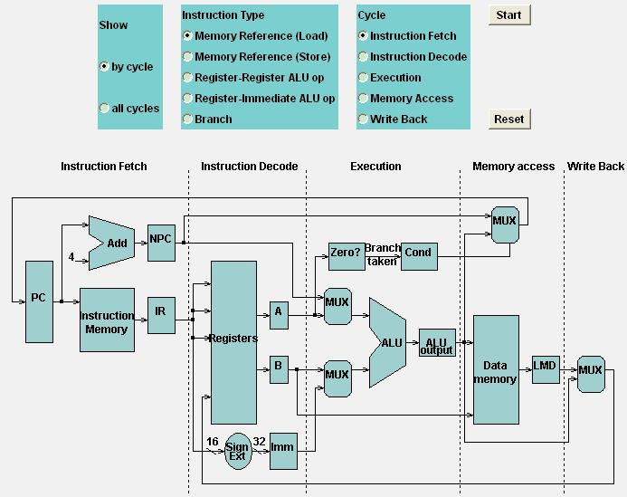
Load

Slide 25
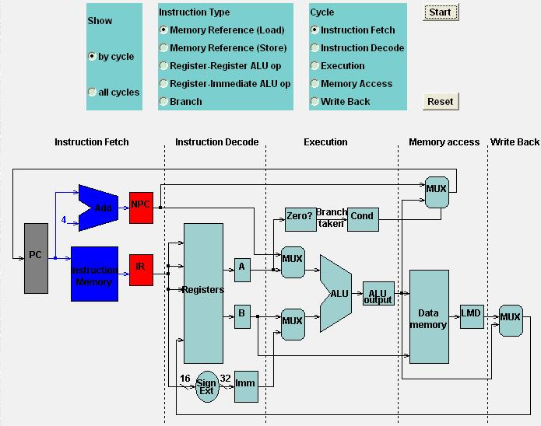
Load

Slide 26
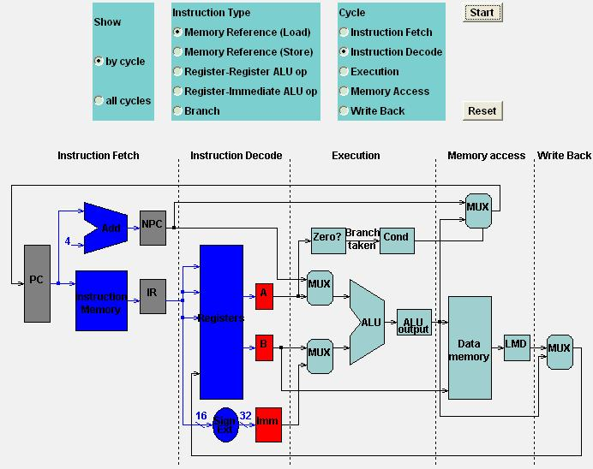
Load

Slide 27
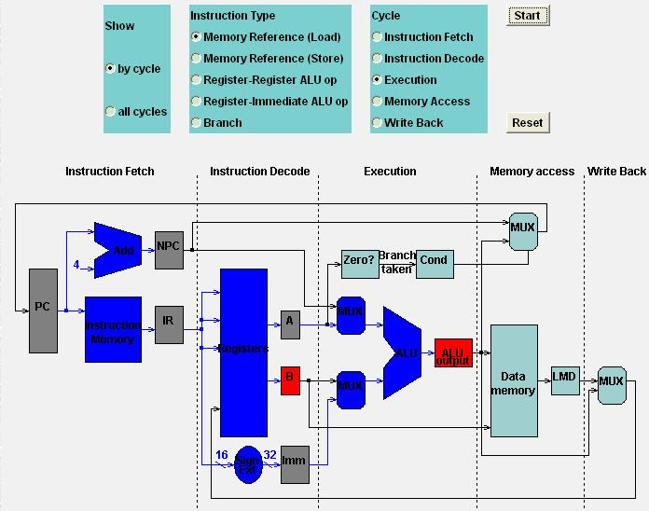
Load

Slide 28
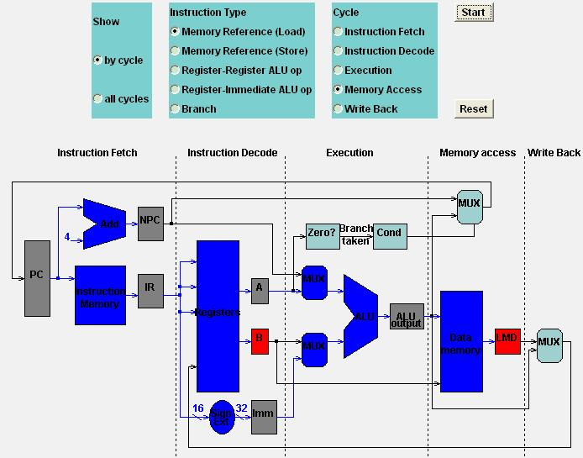
Load

Slide 29
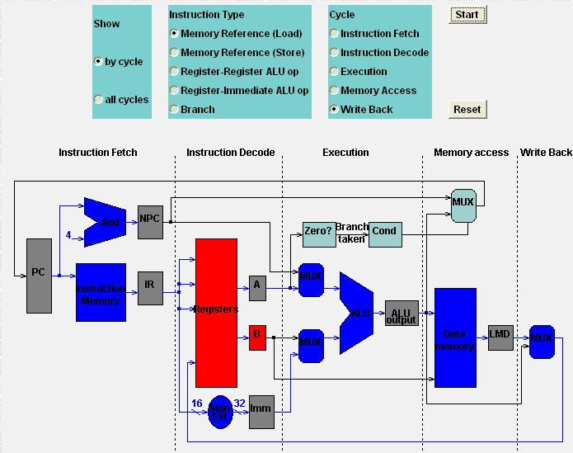
Load

Slide 30
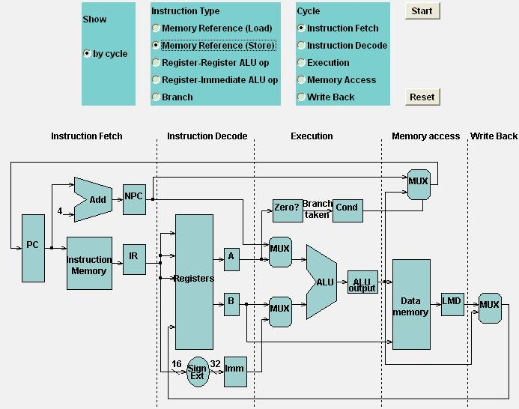
Store

Slide 31

Store

Slide 32
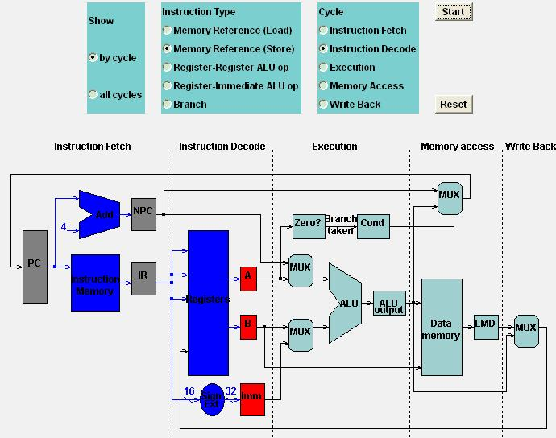
Store

Slide 33
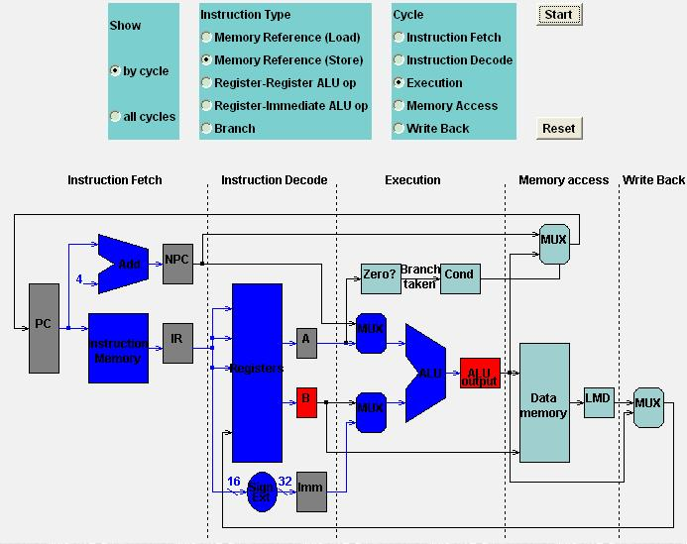
Store

Slide 34
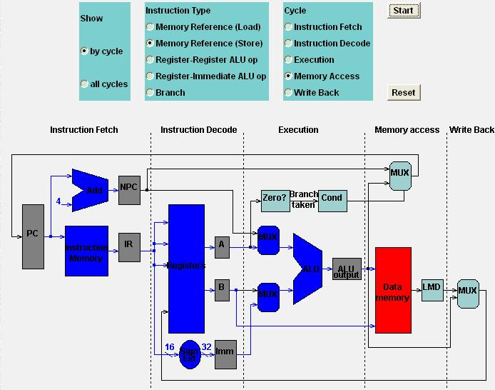
Store

Slide 35

Store

Slide 36
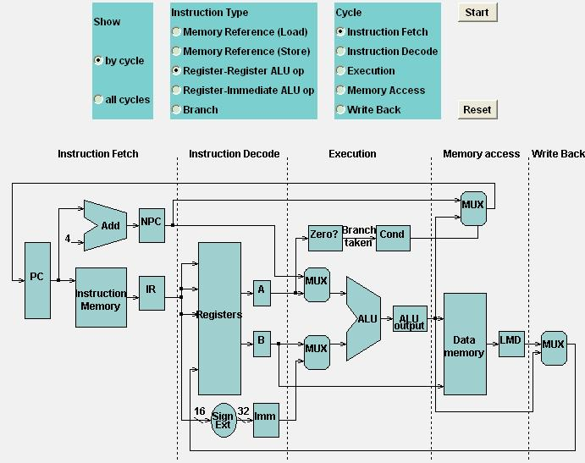
Register-Register ALU

Slide 37
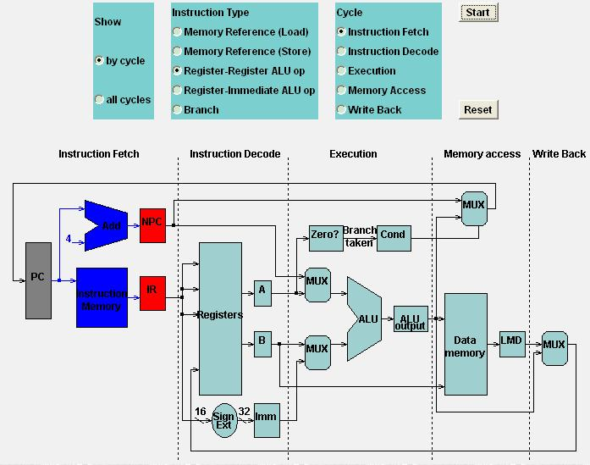
Register-Register ALU

Slide 38

Register-Register ALU

Slide 39
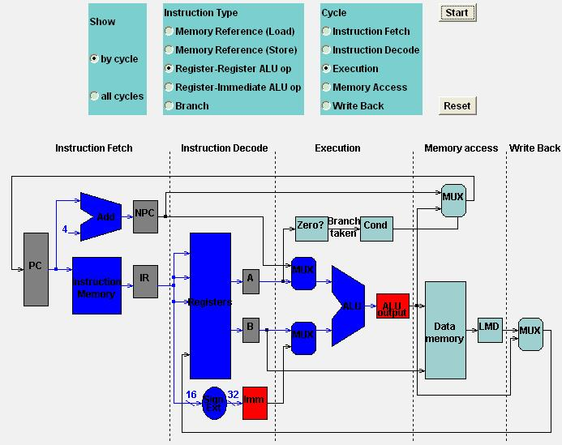
Register-Register ALU

Slide 40
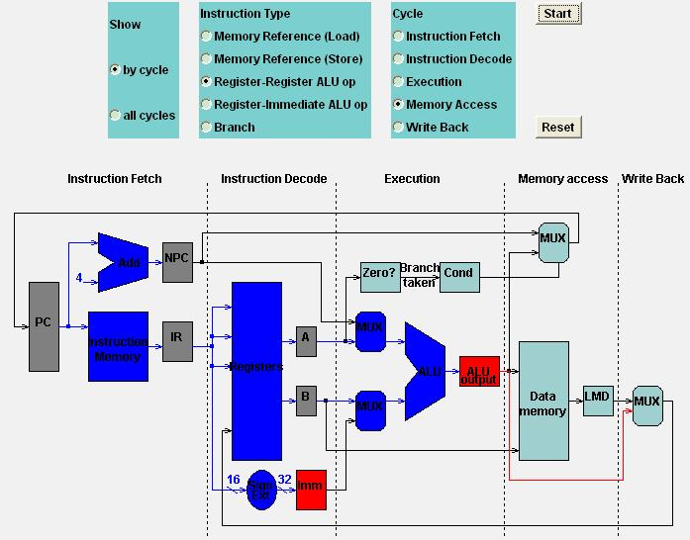
Register-Register ALU

Slide 41
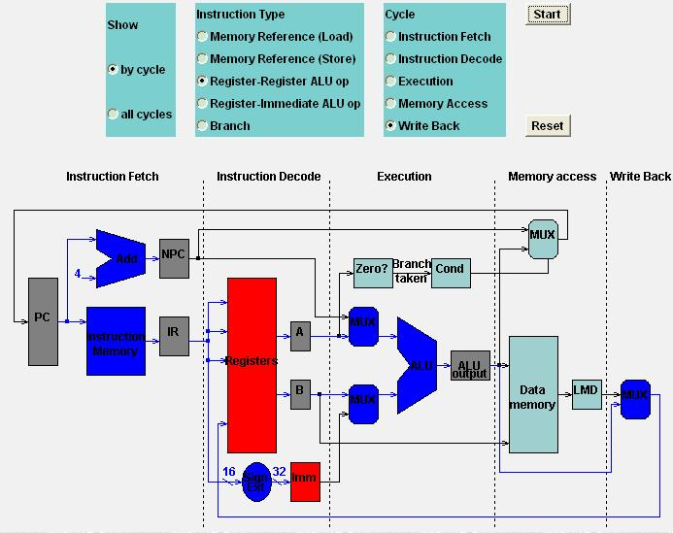
Register-Register ALU

Slide 42
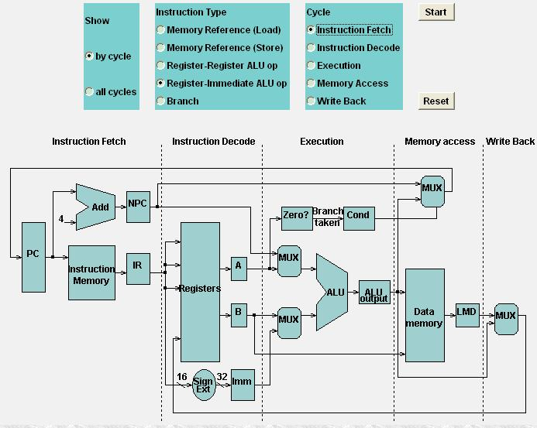
Register-Immediate ALU

Slide 43
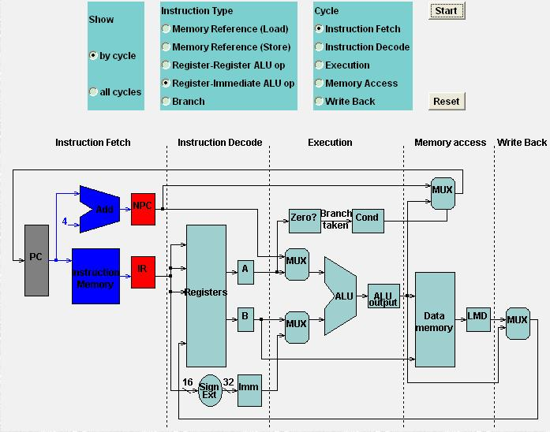
Register-Immediate ALU

Slide 44

Register-Immediate ALU

Slide 45
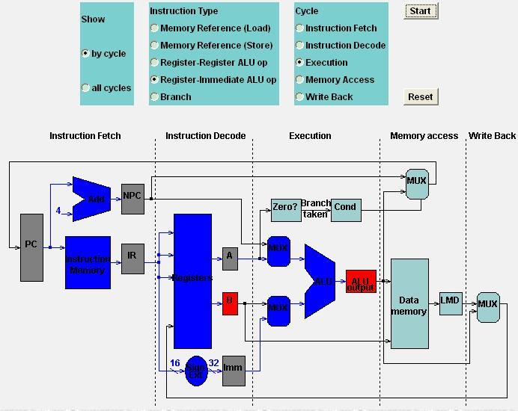
Register-Immediate ALU

Slide 46
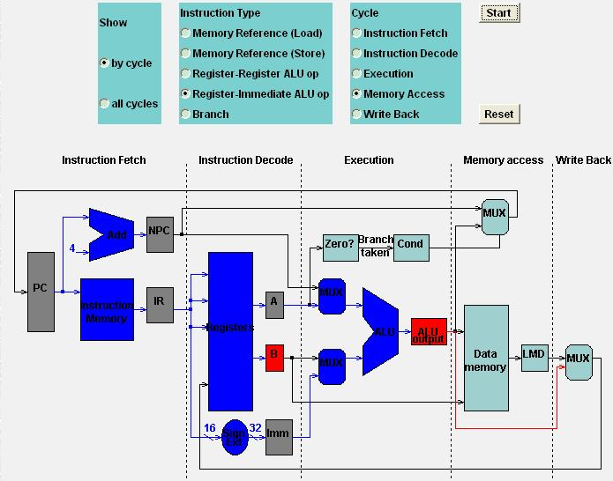
Register-Immediate ALU

Slide 47
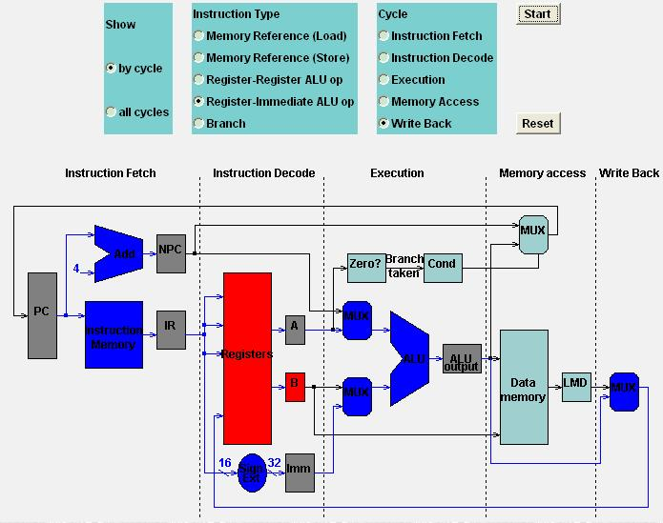
Register-Immediate ALU

Slide 48
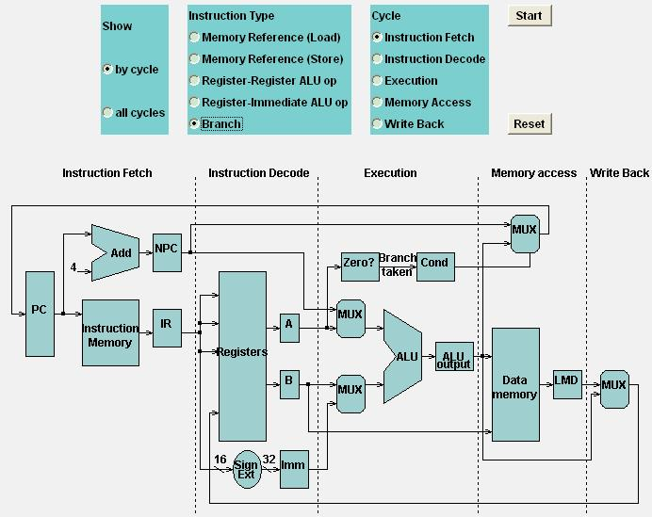
Branch

Slide 49

Branch

Slide 50
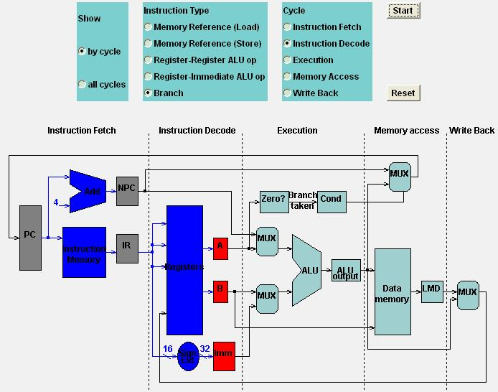
Branch

Slide 51
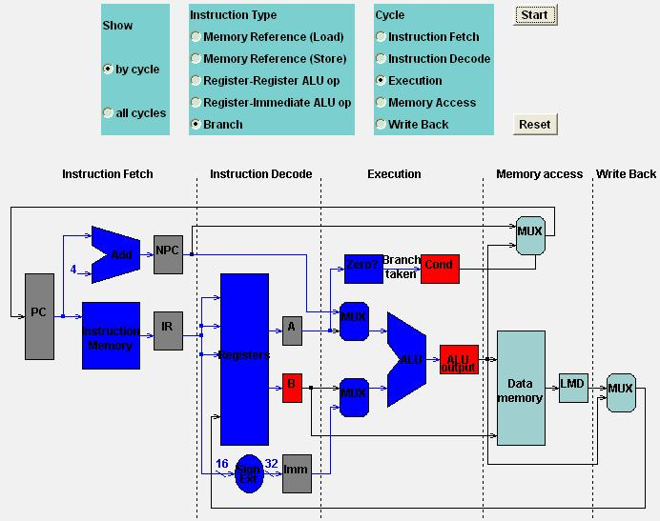
Branch

Slide 52
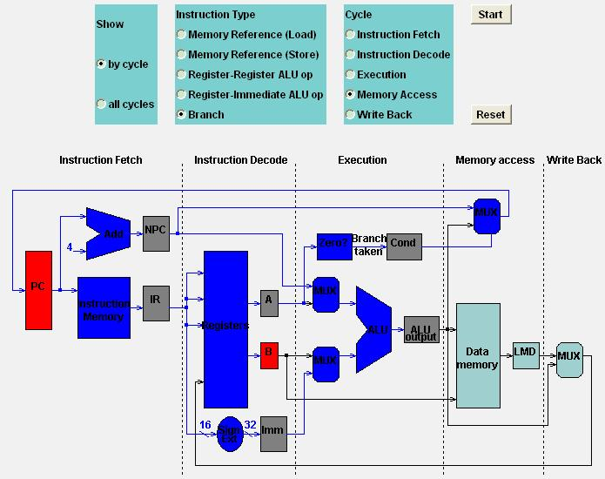
Branch

Slide 53

Branch

Slide 54
Outline
Unpipelined MIPS
Pipelined MIPS
Other Pipelining Challenges

Slide 55
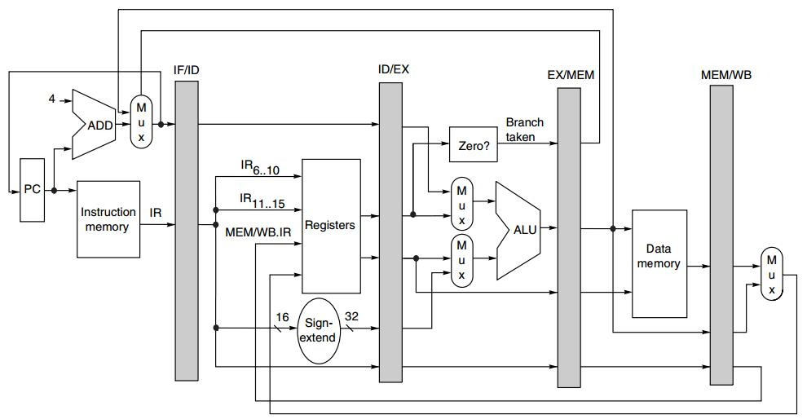
Pipelined MIPS
Pipeline
Registers/Latches
NPC
IR
A
B
IMM
Cond
ALUOutput
LMD

Slide 56
Instruction Type decides
actions on a pipeline stage

Slide 57
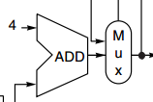
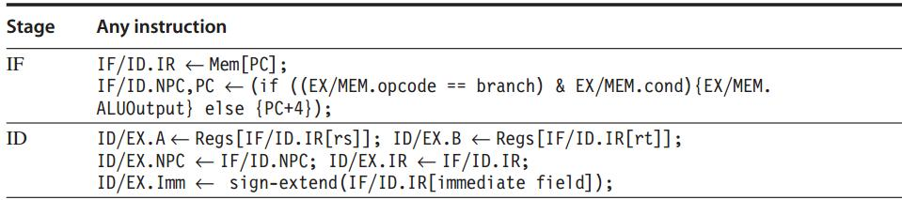
Pipelined MIPS: IF, ID
The first two stages are independent of instruction type because the instruction is not decoded until the end of ID;
PC update

Slide 58
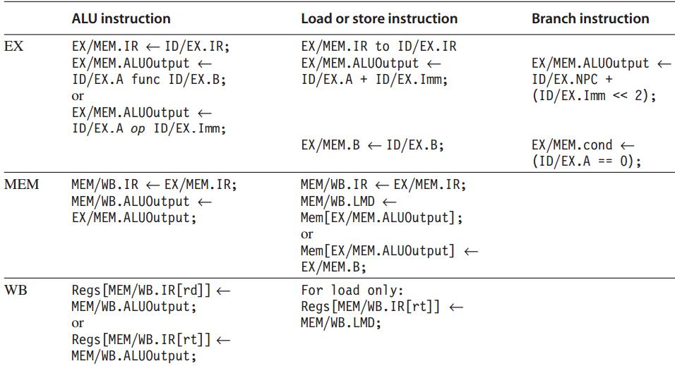
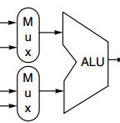

Pipelined MIPS: EX, MEM, WB
Any value needed on a later pipeline stage must be placed in a pipeline register,
and copied from one pipeline register to the next,
until it is no longer needed.

Slide 59
Data Hazard
Instruction Issue: ID -> EX
If a data hazard exists, the instruction is stalled before it is issued.
For integer pipeline, data hazards and forwarding can be checked during ID
Detect hazards by comparing the destination and sources of adjacent instruction

Slide 60
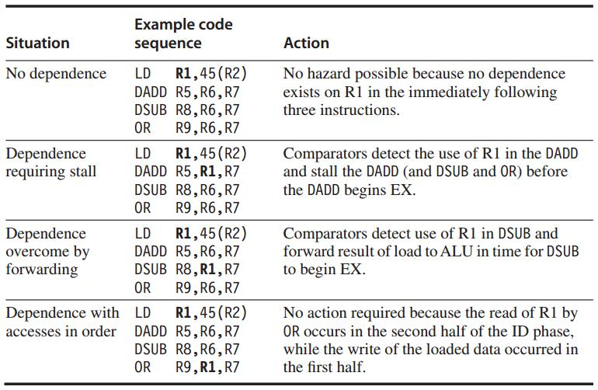
Data Hazard Example
Data hazards from Load
Comparison between the destination of Load
and the sources on the following two instr

Slide 61
Stall
Prevent instructions in IF and ID from advancing
Change the control portion of ID/EX to be a no-op
Recirculate the contents of IF/ID registers to hold the stalled instr

Slide 62
Forwarding
Data path: from the ALU or data memory output to the ALU input, the data memory input, or the zero detection unit.
Compare the destination registers of EX/MEM.IR and MEM/WB.IR against the source registers of ID/EX.IR and EX/MEM.IR

Slide 63
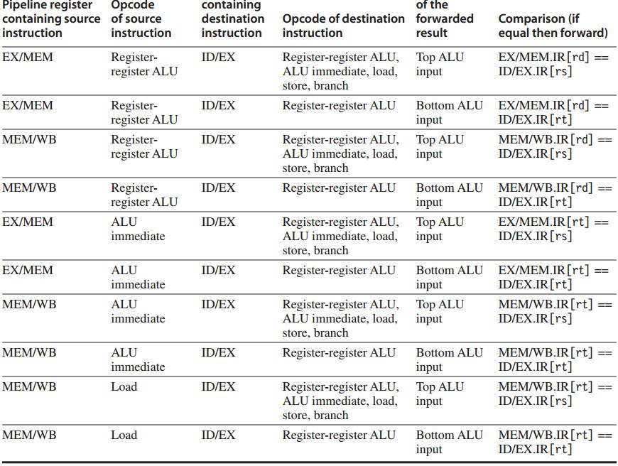
Example:
forwarding result is an ALU input

Slide 64
Forwarding: hw change
NextPC
ID/EX
EX/MEM
MEM/WR
Registers
mux
ALU
Data
Memory
mux
mux
Immediate
Source → sink
EX/Mem.ALUoutput → ALU input
MEM/WB.ALUoutput → ALU input
MEM/WB.LMD → ALU input

Slide 65
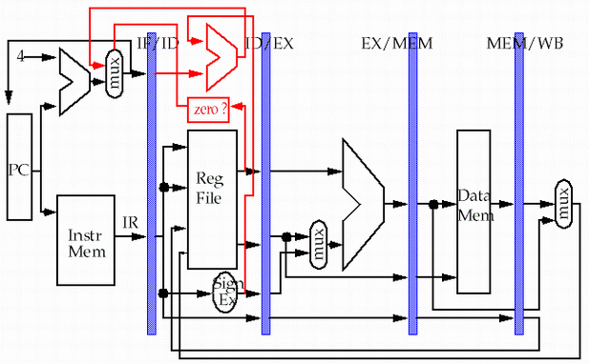
Forwarding: hw change
?
store
load
MEM/WB.LMD → DM input

Slide 66
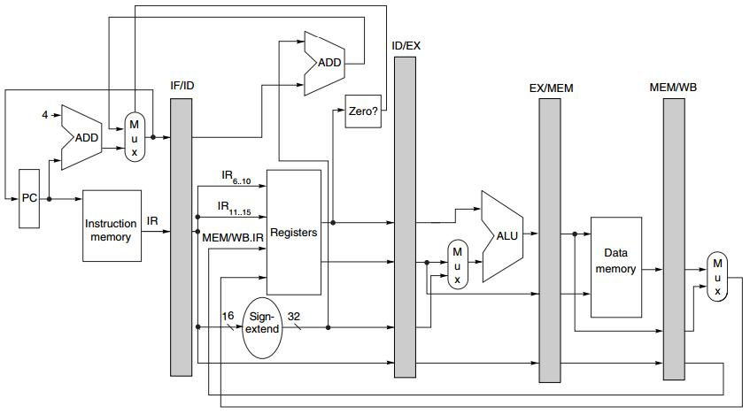
Branch
Move zero test to the ID stage
with an additional ADDer computing target address

Slide 67
Outline
Unpipelined MIPS
Pipelined MIPS
Other Pipelining Challenges

Slide 68
Exceptions: Instruction Execution Order
interrupt/fault/exception
When the normal execution order of instruction is changed
May force CPU to abort the instructions in the pipeline before they complete

Slide 69
Exceptions
Type
I/O device request
invoking os service from user program
tracing instruction execution
breakpoint
integer arithmetic overflow
FP arithmetic anomaly
page fault
misaligned memory address
memory protection violation
using undefined/unimplemented instruction
hardware malfunctions
power failure

Slide 70
Exceptions: Requirements
Synchronous vs asynchronous
User requested vs coerced
User maskable vs user nonmaskable
Within vs between instructions
Resume vs terminate

Slide 71
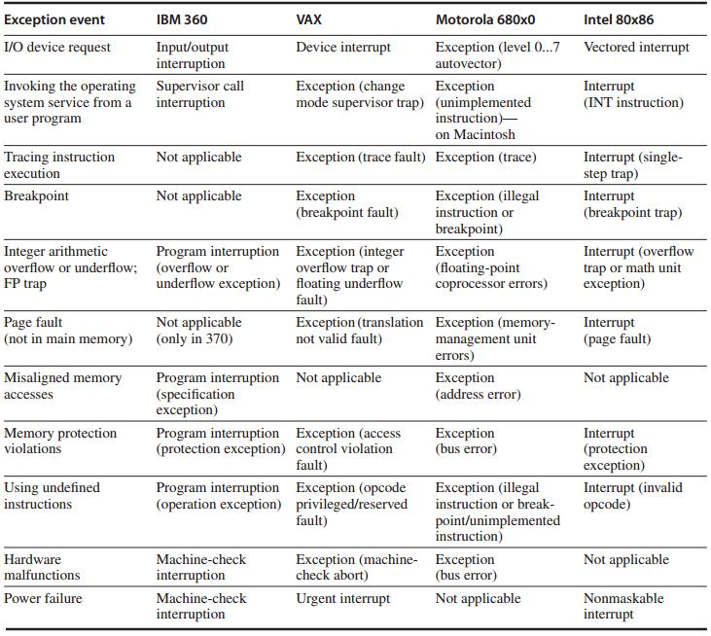

Slide 72
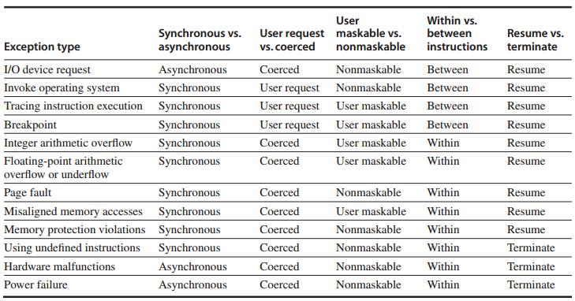

Slide 73
Instruction Set Complications
Instruction set specific factors that make pipelining harder to implement
PP. C-49 – C.51

Slide 74
?

