Slide 1
Lecture 6: Pipelining
MIPS R4000 and More
Kai Bu
kaibu@zju.edu.cn
http://list.zju.edu.cn/kaibu/comparch

Slide 2
Lab 2
Demo due April 15
Report due April 21
Assignment 2
http://list.zju.edu.cn/kaibu/comparch/Assignment-2.pdf
Due April 15

Slide 3

Appendix C.5-C.7

Slide 4
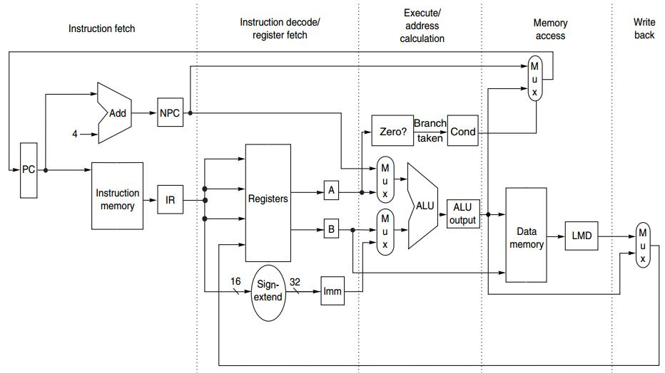
Integer Op in 1 CC
IF ID EX MEM WB

Slide 5
Multicycle FP Operation
Floating-point (FP) operations take more time than integer operations do
To complete an FP op in 1 cc:
a slow clock?
many logic in FP units?

Slide 6
Multicycle FP Operation
FP pipeline
allow for a longer latency for op;
two changes over integer pipeline:
repeat EX;
use multiple FP functional units;

Slide 7
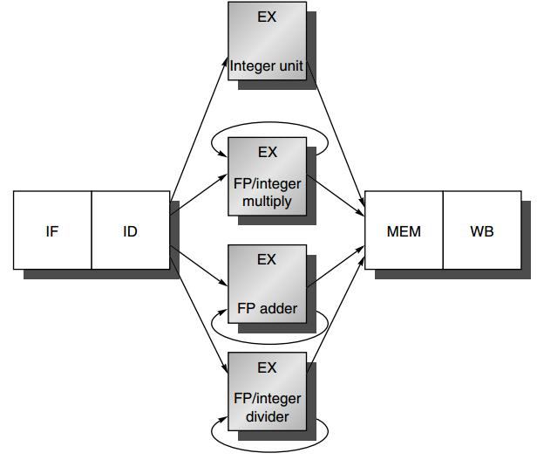
FP Pipeline

Slide 8
Outline
Multicycle FP Operations
Hazards and Forwarding
MIPS R4000 Pipeline

Slide 9
Outline
Multicycle FP Operations
Hazards and Forwarding
MIPS R4000 Pipeline

Slide 10
FP Pipeline
loads and stores
integer ALU operations
branches
FP and integer multiplier
FP add
FP subtract
FP conversion
FP and integer divider

Slide 11
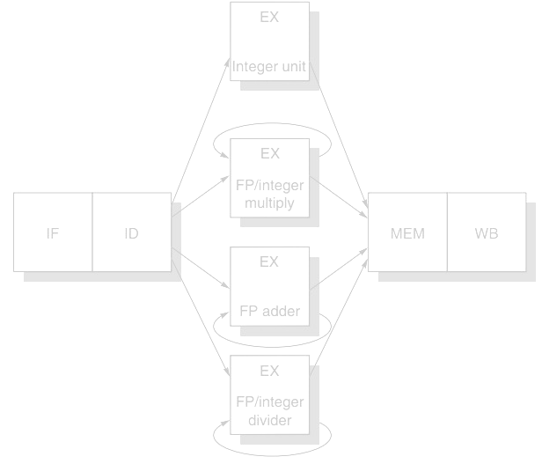
FP Pipeline
EX is not pipelined
No other instruction using that functional unit may issue until the previous instruction leaves EX
If an instruction cannot proceed to EX, the entire pipeline behind that instruction will be stalled

Slide 12
FP Pipeline
Latency
the number of intervening cycles between an instruction that produces a result and an instruction that uses the result
Initiation/Repeat Interval
the number of cycles that must elapse between issuing two operations of a given type

Slide 13
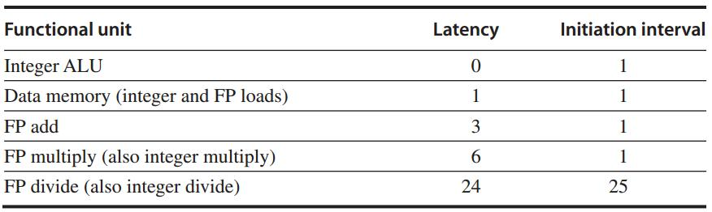
FP Pipeline
Essentially, pipeline latency is 1 cycle less than the depth of the execution pipeline
e.g., FP add takes 4 stages

Slide 14
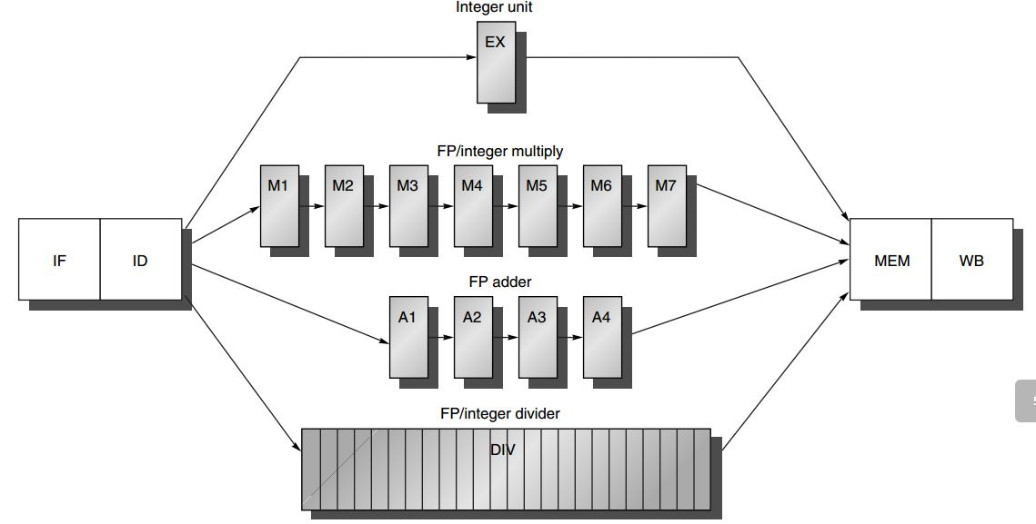
Generalized FP Pipeline
EX is pipelined (except for FP divider)
Additional pipeline registers
e.g., ID/A1
FP divider: 24 CCs

Slide 15
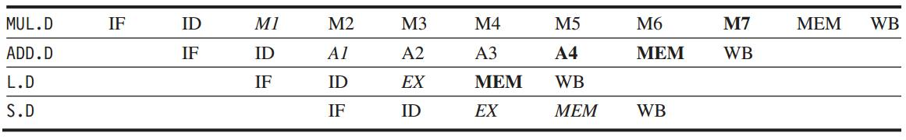
Generalized FP Pipeline
Example
italics: stage where data is needed
bold: stage where a result is available

Slide 16
Outline
Multicycle FP Operations
Hazards and Forwarding
MIPS R4000 Pipeline

Slide 17
Hazard
Divider is not fully pipelined – structural hazard

Slide 18
Hazard
Instructions have varying running times, maybe >1 register write in a cycle - structural hazard

Slide 19
Hazard
Instructions no longer reach WB in order – Write after write (WAW) hazard

Slide 20
Hazard
Instructions may complete in a different order than they were issued – exceptions

Slide 21
Hazard
Longer latency of operations – more frequent stalls for RAW hazards

Slide 22
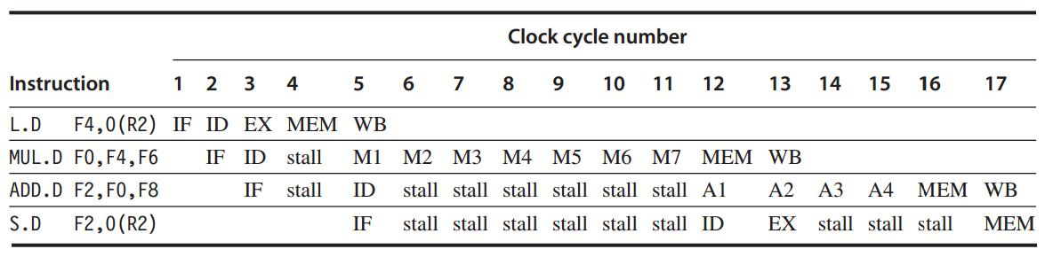
RAW Hazards

Slide 23
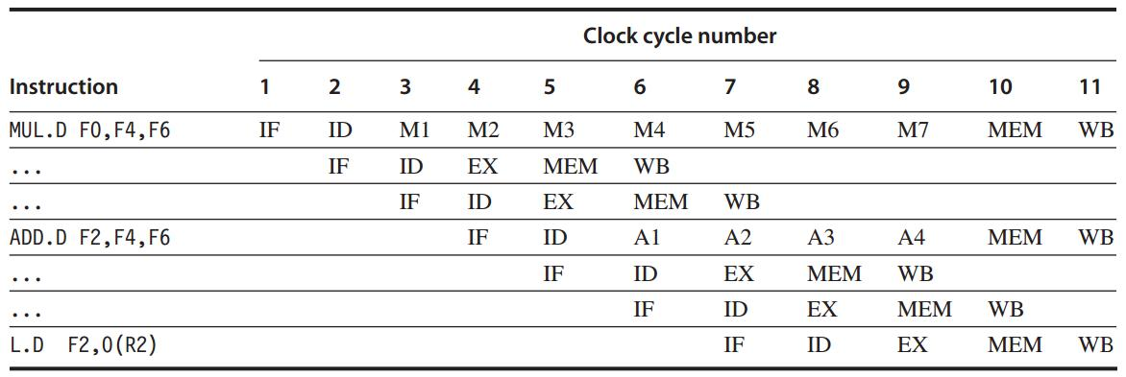
Structural Hazards

Slide 24
Structural Hazards
Interlock Detection
Method 1: track the use of the write port in the ID stage and stall an instruction before it issues
::a shift register tracks when already-issued instructions will use the register file;
if the instruction in ID is needs to use the register file at the same time, stall

Slide 25
Structural Hazards
Interlock Detection
Method 2: stall a conflicting instruction when it tries to enter MEM/WB
::could stall either issuing or issued one;
give priority to the unit with the longest latency;
more complicated: stall arises from MEM/WB

Slide 26
WAW Hazards
If L.D were issued one cycle earlier
L.D would write F2 one cycle earlier than ADD.D – WAW hazard
what if another instruction using F2 between them? --- No WAW

Slide 27
Hazard Detection in ID
1. Check for structural hazards
wait until the required functional unit is not busy (only for divides);
make sure the register write port is available when it will be needed;

Slide 28
Hazard Detection in ID
2. Check for RAW data hazards
wait until source registers are available when needed --- not pending destinations of issued instructions

Slide 29
Hazard Detection in ID
3. Check for WAW data hazards
determine if any instruction in A1 – A4, D, M1-M7 has the same register destination as this instruction;
if so, stall the issue of the instr in ID

Slide 30
Forwarding
Generalized with more sources
EX/MEM, A4/MEM, M7/MEM, D/MEM, MEM/WB
-> source registers of an FP instruction

Slide 31

Out-of-order Completion
ADD and SUB complete before DIV
Out-of-order completion: instructions are completing in a different order than they were issued

Slide 32
Out-of-order Completion
How to deal with out-of-order?
1. ignore the problem
2. buffer the results of an operation until all the operations issued earlier complete
3. tracking what operations were in the pipeline and their PCs
4. issue an instruction only if it is certain that all previous instructions will complete without exception

Slide 33
Outline
Multicycle FP Operations
Hazards and Forwarding
MIPS R4000 Pipeline

Slide 34
All in MIPS R4000

Slide 35
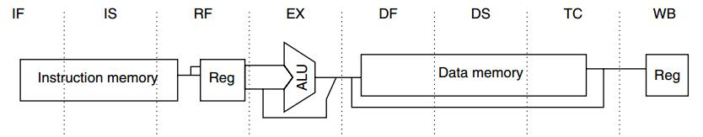
MIPS R4000
5-stage -> 8-stage
Higher clock rate

Slide 36
MIPS R4000
IF: first half of instruction fetch;
PC selection;
initiation of instruction cache access;

Slide 37
MIPS R4000
IS: second half of instruction fetch;
completion of instruction cache access;

Slide 38
MIPS R4000
RF:
instruction decode and register fetch;
hazard checking;
instruction cache hit detection;

Slide 39
MIPS R4000
EX: execution
effective address calculation;
ALU operation;
branch-target computation and condition evaluation;

Slide 40
MIPS R4000
DF: data fetch
first half of data access;

Slide 41
MIPS R4000
DS: second half of data fetch
completion of data cache access;

Slide 42
MIPS R4000
TC: tag check
determine whether the data cache access hit;

Slide 43
MIPS R4000
WB: write back
for loads and register-register operations;

Slide 44
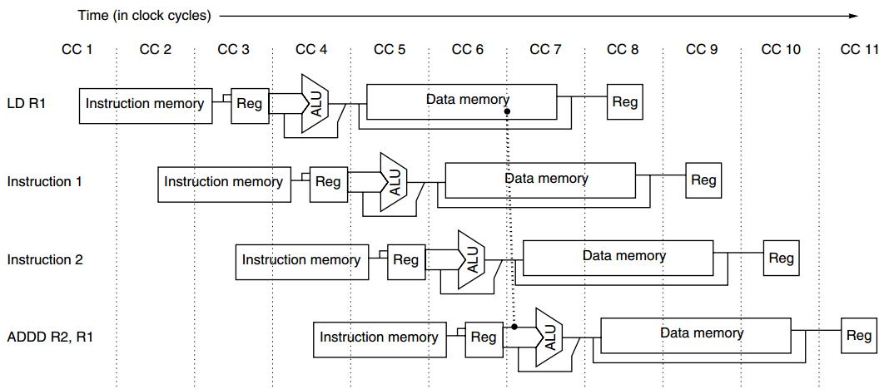
MIPS R4000
2-cycle load delay

Slide 45
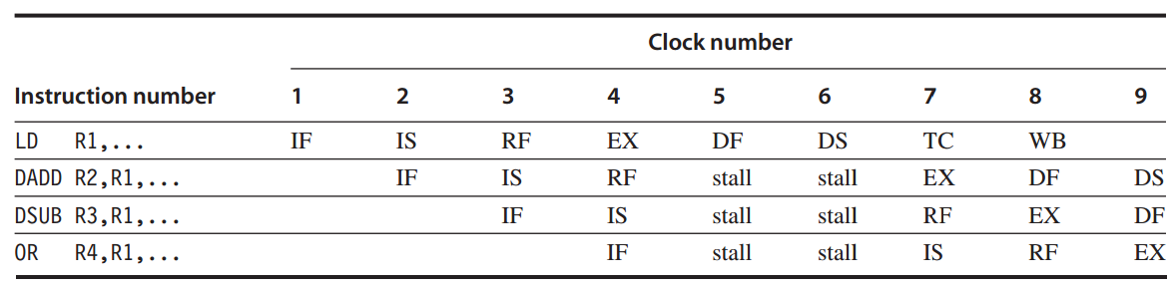
2-cycle load delay

Slide 46
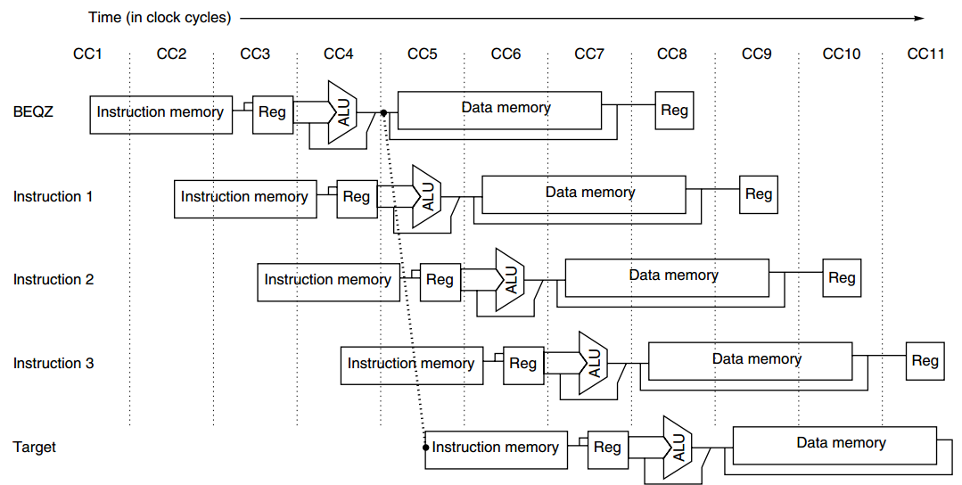
MIPS R4000
3-cycle branch delay:
predicted-not-taken

Slide 47
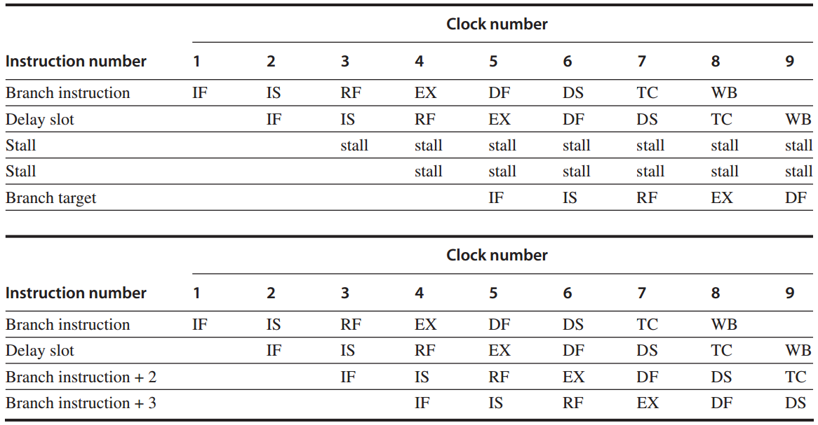
MIPS R4000
3-cycle branch delay:
predicted-not-taken

Slide 48
MIPS R4000
Forwarding
ALU/MEM or MEM/WB
-> EX/DF, DF/DS, DS/TC, TC/WB

Slide 49
MIPS R4000
FP Pipeline
FP unit with three functional units:
FP divider, FP multiplier, FP adder
2 cycles to 112 cycles

Slide 50
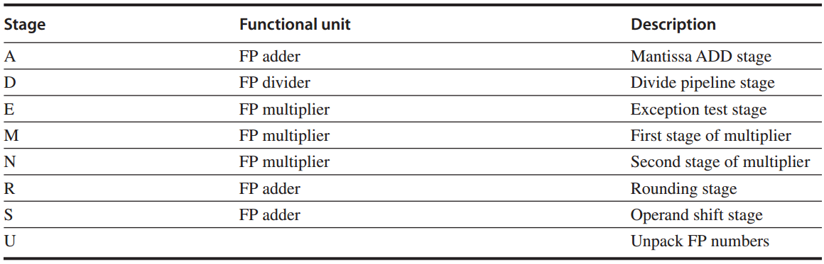
MIPS R4000
FP unit with eight different stages

Slide 51
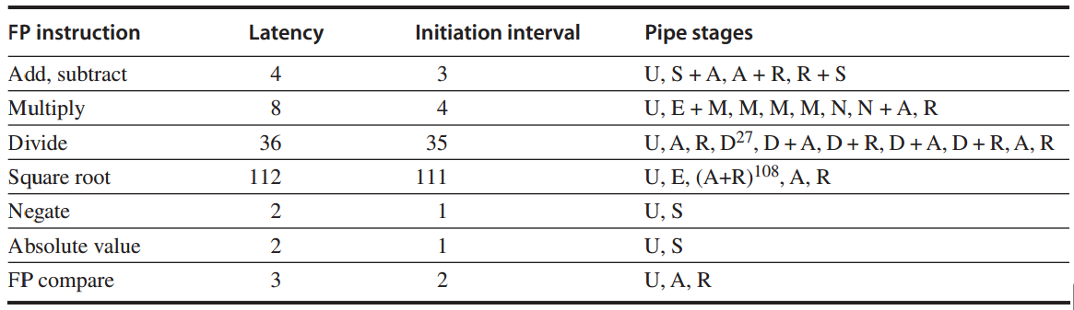
MIPS R4000
FP operations: latency and initiation interval

Slide 52
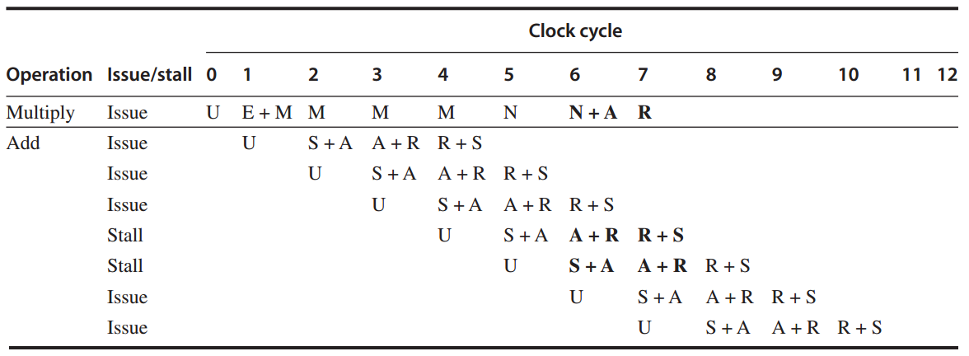
MIPS R4000
FP operations Example 1
FP multiply + FP add

Slide 53
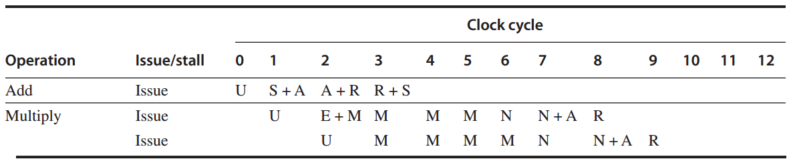
MIPS R4000
FP operations Example 2
FP add + FP multiply

Slide 54
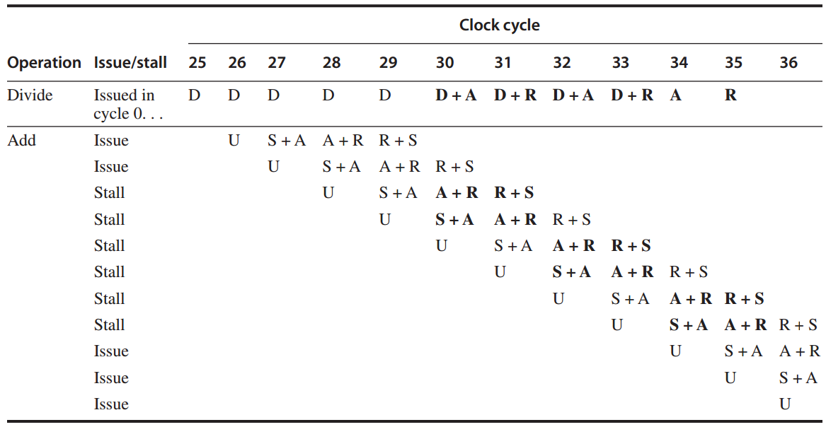
MIPS R4000
FP operations Example 3: divide + add

Slide 55
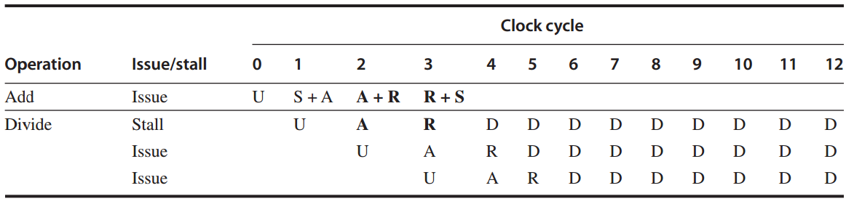
MIPS R4000
FP operations Example 4
FP add + FP divide

Slide 56
?

