Slide 1
Lecture 7: Pipelining
Review
Kai Bu
kaibu@zju.edu.cn
http://list.zju.edu.cn/kaibu/comparch

Slide 2

Appendix C
Lectures 4-6

Slide 3
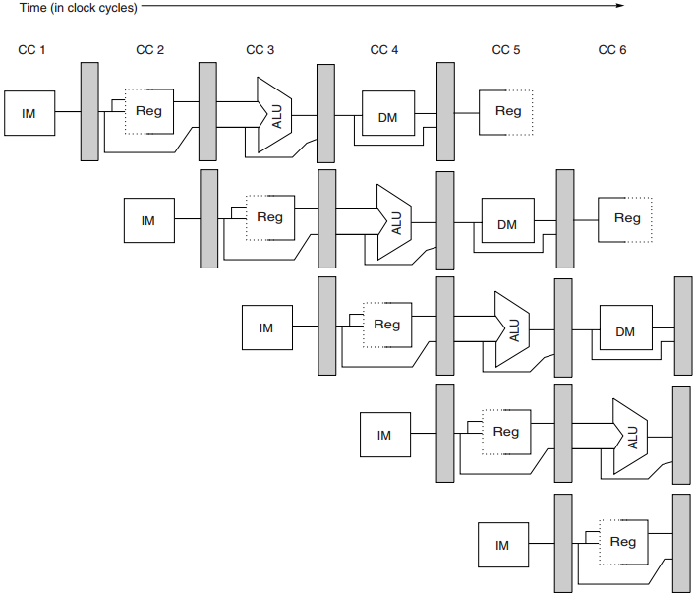
Pipelining
start executing one instruction
before completing the previous one

Slide 4
Outline
What’s Pipelining
How Pipelining Works
Pipeline Hazards
Pipeline with Multicycle FP Operations

Slide 5
Outline
What’s Pipelining
How Pipelining Works
Pipeline Hazards
Pipeline with Multicycle FP Operations

Slide 6
Laundry Example
Ann, Brian, Cathy, Dave
Each has one load of clothes to
wash, dry, fold.
washer
30 mins
dryer
40 mins
folder
20 mins
Notes:
Say four students each with a load of clothes to wash, dry, and fold.
The washer takes 30 mins, dryer 40 minis, and folder 20 mins.

Slide 7
Sequential Laundry
6 Hours
Time
30 40 20
30 40 20
30 40 20
30 40 20
A
Task Order
B
C
D
What would you do?
Notes:
When they perform the laundry tasks in a sequential fashion, A does the laundry first, and only when A completes can B start. Similarly, C after B, and D after C.
In this case, the sequential laundry will take up to 6 hours.
But the question is, will anybody do it like this in real life? Actually, after A uses the washer, B can immediately starts washing without further waiting.

Slide 8
Sequential Laundry
6 Hours
Time
30 40 20
30 40 20
30 40 20
30 40 20
A
Task Order
B
C
D
What would you do?
Notes:
And then B can start drying after A finishes drying, and start folding after A finishes folding.

Slide 9
Pipelined Laundry
3.5 Hours
Observations
A task has a series of stages;
Stage dependency:
e.g., wash before dry;
Multi tasks with overlapping stages;
Simultaneously use diff resources to speed up;
Slowest stage determines the finish time;
Time
30 40 40
40 40 20
A
Task Order
B
C
D
Notes:
Following this way, the laundry task execution will look like this. We call such laundry execution pipelined laundry, in which a laundry task can start before previous one completes.
The pipelined laundry takes only 3 and a half hours, which is much shorter than 6 hours taken by the sequential laundry.
Before we delve into the definition of pipelining in computer architecture, let’s see what observations we can get from this pipelined laundry example.
First, a task has a series of stages. For example, a laundry task has three stages, washing, drying, and folding.
Second, connecting stages have dependency upon each other. For example, you need to wash clothes before you dry them.
When there are multiple tasks to run, simultaneously using different resources can accelerate the execution.
A deeper observation is that the slowest stage determines the finish time. In this example, the dryer takes the longest time of 40 mins. And it’s obvious that the dryer decides when the last task will finish.

Slide 10
Pipelined Laundry
3.5 Hours
Observations
No speed up for individual task;
e.g., A still takes 30+40+20=90
But speed up for average task execution time;
e.g., 3.5*60/4=52.5 < 30+40+20=90
Time
30 40 40
40 40 20
A
Task Order
B
C
D
Notes:
Another important observation is that an individual task doesn’t become faster. For example. A still takes 90 mins for laundry.
On the contrary, it’s the average task execution time that becomes much shorter. In this case, four tasks take 3 and a half hours, with each taking about 52 mins, which is much shorter than the original 90 mins.

Slide 11
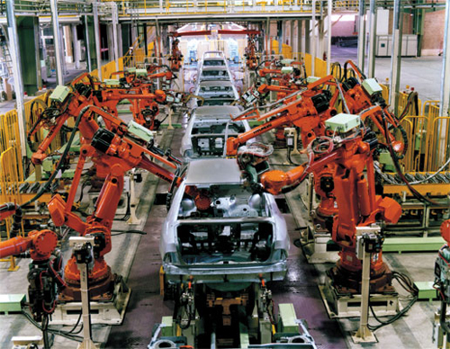
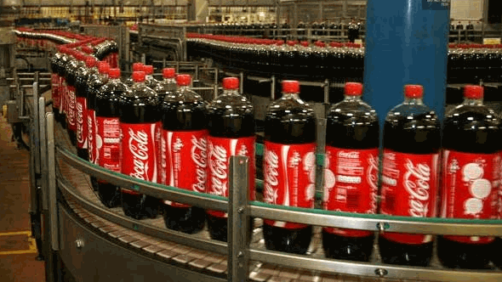
Assembly Line
Cola
Auto
Notes:
Another example analogous to pipelining is assembly line where many products can be assembled at the same time.

Slide 12
Pipelining
An implementation technique whereby multiple instructions are overlapped in execution.
e.g., B wash while A dry
Essence: Start executing one instruction before completing the previous one.
Significance: Make fast CPUs.
A
B
Notes:
Pipelining is an implementation technique whereby multiple instructions are overlapped in execution. Take the pipelined laundry for example. B uses the washer while A uses the dryer.
Its essence is to start executing one instruction before completing the previous one. And its significance is therefore to make fast CPUs.

Slide 13
Balanced Pipeline
Equal-length pipe stages
e.g., Wash, dry, fold = 40 mins
per unpipelined laundry time = 40x3 mins
3 pipe stages – wash, dry, fold
40min
T1
A
T2
B
A
T3
C
B
A
T4
D
C
B
Notes:
The ideal case for pipelining is balanced pipeline. In a balanced pipeline, all pipe stages have equal duration.
Consider again the laundry example with each stage taking 40 mins. Then the unpipelined laundry will take 40 times 3 mins to finish one task.
Now let’s recap how pipelined laundry will perform the four tasks.
In the first time duration T1, A uses the washer; In T2, A uses the dryer while B uses the washer; In T3, A uses the folder, B uses the dryer, while C uses the washer. Starting from T3, all resources are fully used in the same duration. Then the pipelined laundry takes 40 mins on average to complete one task. Based on this observation, we have two performance properties of balanced pipeline. One is the time per instruction by pipeline is equal to time per instruction on unpipelined machine over the number of pipe stages. The other is speed up by pipeline is equal to the number of pipe stages.

Slide 14
Balanced Pipeline
Equal-length pipe stages
e.g., Wash, dry, fold = 40 mins
per unpipelined laundry time = 40x3 mins
3 pipe stages – wash, dry, fold
40min
T1
A
T2
B
A
T3
C
B
A
T4
D
C
B
Notes:
In the first time duration T1, A uses the washer;
In T2, A uses the dryer while B uses the washer; In T3, A uses the folder, B uses the dryer, while C uses the washer. Starting from T3, all resources are fully used in the same duration. Then the pipelined laundry takes 40 mins on average to complete one task. Based on this observation, we have two performance properties of balanced pipeline. One is the time per instruction by pipeline is equal to time per instruction on unpipelined machine over the number of pipe stages. The other is speed up by pipeline is equal to the number of pipe stages.

Slide 15
Balanced Pipeline
Equal-length pipe stages
e.g., Wash, dry, fold = 40 mins
per unpipelined laundry time = 40x3 mins
3 pipe stages – wash, dry, fold
40min
T1
A
T2
B
A
T3
C
B
A
T4
D
C
B
Notes:
In T2, A uses the dryer while B uses the washer;
In T3, A uses the folder, B uses the dryer, while C uses the washer. Starting from T3, all resources are fully used in the same duration. Then the pipelined laundry takes 40 mins on average to complete one task. Based on this observation, we have two performance properties of balanced pipeline. One is the time per instruction by pipeline is equal to time per instruction on unpipelined machine over the number of pipe stages. The other is speed up by pipeline is equal to the number of pipe stages.

Slide 16
Balanced Pipeline
One task/instruction
per 40 mins
Equal-length pipe stages
e.g., Wash, dry, fold = 40 mins
per unpipelined laundry time = 40x3 mins
3 pipe stages – wash, dry, fold
Performance
Time per instruction by pipeline =
Time per instr on unpipelined machine
Number of pipe stages
Speed up by pipeline =
Number of pipe stages
40min
T1
A
T2
B
A
T3
C
B
A
T4
D
C
B
Notes:
In T3, A uses the folder, B uses the dryer, while C uses the washer.
Starting from T3, all resources are fully used in the same duration. Then the pipelined laundry takes 40 mins on average to complete one task. Based on this observation, we have two performance properties of balanced pipeline. One is the time per instruction by pipeline is equal to time per instruction on unpipelined machine over the number of pipe stages. The other is speed up by pipeline is equal to the number of pipe stages.

Slide 17
Pipelining Terminology
Latency: the time for an instruction to complete.
Throughput of a CPU: the number of instructions completed per second.
Clock cycle: everything in CPU moves in lockstep; synchronized by the clock.
Processor Cycle: time required between moving an instruction one step down the pipeline;
= time required to complete a pipe stage;
= max(times for completing all stages);
= one or two clock cycles, but rarely more.
CPI: clock cycles per instruction
Notes:
Here are some frequently used definitions about pipelining.
Latency is measured by the time for an instruction to complete.
Throughput is measured by the number of instructions a CPU can complete per second.
Clock cycle is the time duration of one lockstep of CPU.
Processor cycle is the time required to complete a pipe stage. As we observed from the laundry example, the slowest stage determines the length of a processor cycle. It usually spans one or two clock cycles.
CPI represents the number of clock cycles an instruction takes.

Slide 18
Outline
What’s Pipelining
How Pipelining Works
Pipeline Hazards
Pipeline with Multicycle FP Operations

Slide 19

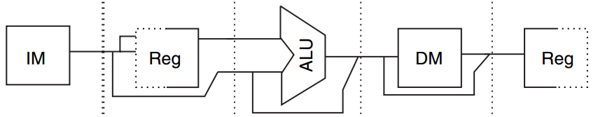
RISC: Five-Stage Pipeline
How it works
separate instruction and data mems to eliminate conflicts for a single memory between instruction fetch and data memory access.
Instr mem
Data mem
IF
MEM
Notes:
To achieve the pipelining, we need separate instruction memory and data memory.
Because both IF and MEM require memory access, if there is only one single memory, IF and MEM will have memory conflicts during the pipelining process.

Slide 20

RISC: Five-Stage Pipeline
How it works
use the register file in two stages;
either with half CC;
in one clock cycle, write before read
ID
WB
read
write
Notes:
Another technique for pipelining is to use the register file in two stages. One stage spans a half clock cycle.
To avoid data conflicts, the first stage performs write while the second stage performs read.
This way, the result from previous instruction’s WB cycle can be used by the current instruction’s ID cycle.

Slide 21
RISC: Five-Stage Pipeline
How it works
introduce pipeline registers between successive stages;
pipeline registers store the results of a stage and use them as the input of the next stage.
Notes:
Besides, for making a stage’s results as input of the next stage, RISC uses pipeline registers between successive stages.

Slide 22
RISC: Five-Stage Pipeline
How it works
Notes:
So here is the high level paradigm of RISC pipelining.

Slide 23
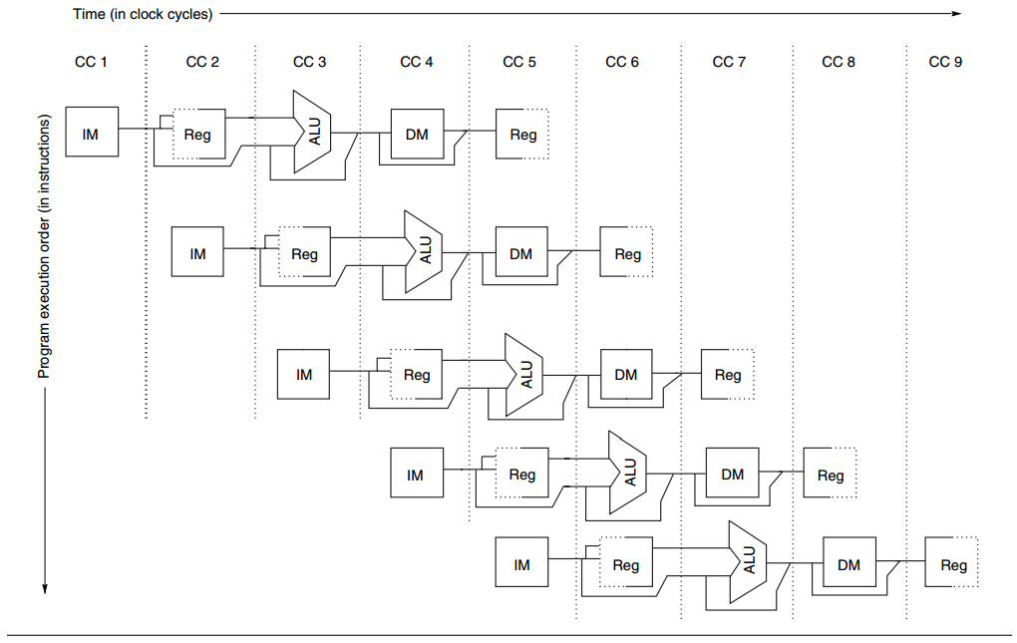
RISC: Five-Stage Pipeline
How it works - omit pipeline regs
for simplicity
but required in implementation
Notes:
For simplicity, some illustrations will omit pipeline registers. But please remember that they are definitely required in implementation.

Slide 24
RISC: Reduced Instruction Set Computer
at most 5 clock cycles per instruction – 1
IF ID EX MEM WB
Instruction Fetch cycle
send the PC to memory;
fetch the current instruction from mem;
PC = PC + 4; //each instr is 4 bytes
Notes:
RISC has at most 5 clock cycles per instruction.
The first cycle is IF for fetching the current instruction from memory.
To do so, the processor sends the program counter to memory, fetches the current instruction from there and then increments the program counter by 4.

Slide 25
RISC: Reduced Instruction Set Computer
at most 5 clock cycles per instruction – 2
IF ID EX MEM WB
Instruction Decode/register fetch cycle
decode the instruction;
read the registers (corresponding to register source specifiers);
Notes:
The second cycle is ID for decoding the current instruction.
It reads the registers for later operations.

Slide 26
RISC: Reduced Instruction Set Computer
at most 5 clock cycles per instruction – 3
IF ID EX MEM WB
Execution/effective address cycle
ALU operates on the operands from ID:
3 functions depending on the instr type - 1
-Memory reference: ALU adds base register and offset to form effective address;
Notes:
The third cycle is EX for calculating the effective memory address.
ALU operates on the operands fetched in the ID cycle.
There are 3 classes of functions according to the instruction type. The first class is memory reference, ALU adds base register and offset to form effective address.

Slide 27
RISC: Reduced Instruction Set Computer
at most 5 clock cycles per instruction – 3
IF ID EX MEM WB
Execution/effective address cycle
ALU operates on the operands from ID:
3 functions depending on the instr type - 2
-Register-Register ALU instruction: ALU performs the operation specified by opcode on the values read from the register file;
Notes:
The second class is register-register ALU instruction: in this case, ALU performs the operation specified by opcode on the values in the register file.

Slide 28
RISC: Reduced Instruction Set Computer
at most 5 clock cycles per instruction – 3
IF ID EX MEM WB
EXecution/effective address cycle
ALU operates on the operands from ID:
3 functions depending on the instr type - 3
-Register-Immediate ALU instruction: ALU operates on the first value read from the register file and the sign-extended immediate.
Notes:
The third class is register-immediate ALU instruction. For this type, ALU operates on the first value read from the register file and the immediate.

Slide 29
RISC: Reduced Instruction Set Computer
at most 5 clock cycles per instruction – 4
IF ID EX MEM WB
MEMory access
for load instr: the memory does a read using the effective address;
for store instr: the memory writes the data from the second register using the effective address.
Notes:
The fourth cycle is MEM for memory access. As aforementioned, there are two types of instructions affecting the memory. For load instruction, the memory does a read using the effective address.
For store instruction, the memory writes some data using the effective address.

Slide 30
RISC: Reduced Instruction Set Computer
at most 5 clock cycles per instruction – 5
IF ID EX MEM WB
Write-Back cycle
for Register-Register ALU or load instr;
write the result into the register file, whether it comes from the memory (for load) or from the ALU (for ALU instr).
Notes:
The fifth cycle is WB for writing the result into the register file.
The result may come from the memory if it’s a load instruction or from the ALU if it’s an ALU instruction.

Slide 31
RISC: Reduced Instruction Set Computer
3 classes of instructions - 1
ALU (Arithmetic Logic Unit) instructions
operate on two regs or a reg + a sign-extended immediate;
store the result into a third reg;
e.g., add (DADD), subtract (DSUB)
logical operations AND, OR
Notes:
RISC has 32 registers and 3 classes of instructions.
The first class is ALU instruction. It usually operates on two registers and stores the result into a third register. Typical ALU instructions include add, subtract, and logical operations such as AND, OR.

Slide 32
RISC: Reduced Instruction Set Computer
3 classes of instructions - 2
Load (LD) and store (SD) instructions
operands: base register + offset;
the sum (called effective address) is used as a memory address;
Load: use a second reg operand as the destination for the data loaded from memory;
Store: use a second reg operand as the source of the data stored into memory.
Notes:
The second class is Load and Store instructions that affect memory.
They first get the memory address by adding the base register and an offset. The load instruction uses a second register operand as the data destination while the store instruction uses a second register as the data source.

Slide 33
RISC: Reduced Instruction Set Computer
3 classes of instructions - 3
Branches and jumps
conditional transfers of control;
Branch:
specify the branch condition with a set of condition bits or comparisons between two regs or between a reg and zero;
decide the branch destination by adding a sign-extended offset to the current PC (program counter);
Notes:
The third class is branches and jumps that make conditional transfers of control.
We temporarily focus only on branches.
A branch instruction consists of two phases. The first phase specifies the branch condition to decide whether the branch should take effect. It’s just like an if-else in programming language. The branch condition can be verified via a set of condition bits or comparison between two registers.
If the branch condition is satisfied, the second phase decides the branch destination. That is, where to fetch the next instruction.

Slide 34
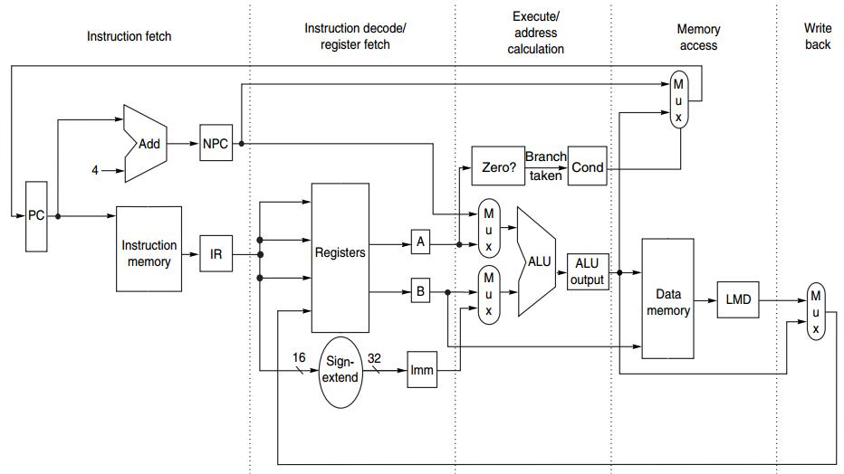
MIPS Instruction
at most 5 clock cycles per instruction
IF ID EX MEM WB

Slide 35
MIPS Instruction
IF ID EX MEM WB
IR ← Mem[PC];
NPC ← PC + 4;

Slide 36
MIPS Instruction
IF ID EX MEM WB
A ← Regs[rs];
B ← Regs[rt];
Imm ← sign-extended
immediate field
of IR (lower 16 bits)

Slide 37
MIPS Instruction
IF ID EX MEM WB
ALUOutput ← A + Imm;
ALUOutput ← A func B;
ALUOutput ← A op Imm;
ALUOutput ← NPC + (Imm<<2);
Cond ← (A == 0);

Slide 38
MIPS Instruction
IF ID EX MEM WB
LMD ← Mem[ALUOutput]; Mem[ALUOutput] ← B;
if (cond) PC ← ALUOutput;

Slide 39
MIPS Instruction
IF ID EX MEM WB
Regs[rd] ← ALUOutput;
Regs[rt] ← ALUOutput;
Regs[rt] ← LMD;

Slide 40
MIPS Instruction Demo
Prof. Gurpur Prabhu, Iowa State Univ http://www.cs.iastate.edu/~prabhu/Tutorial/PIPELINE/DLXimplem.html
Load, Store
Register-register ALU
Register-immediate ALU
Branch

Slide 41
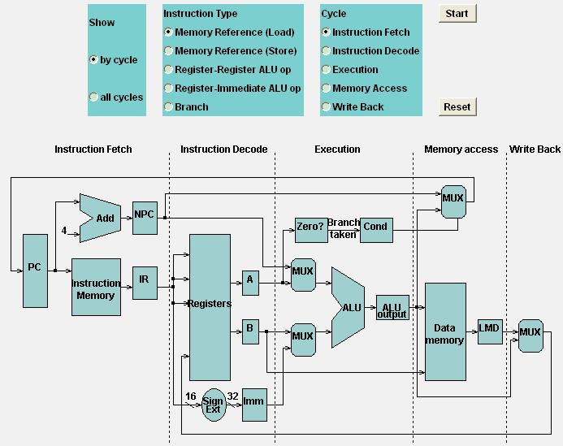
Load

Slide 42
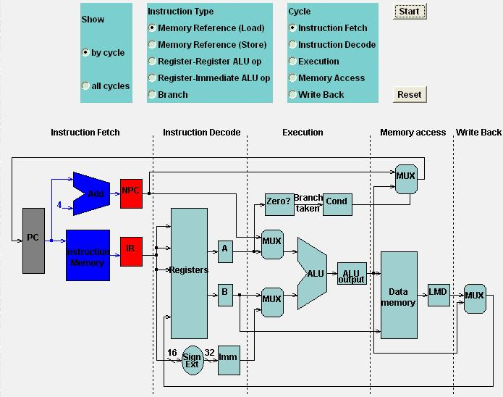
Load

Slide 43
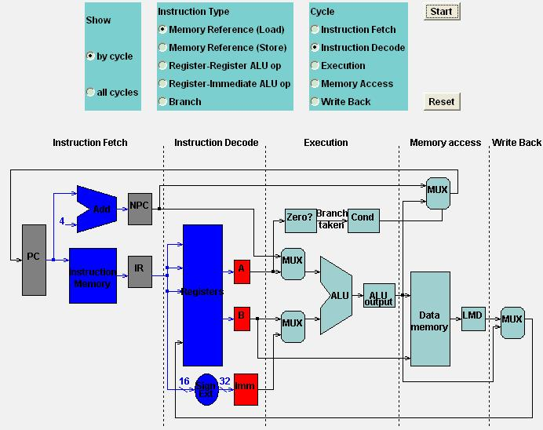
Load

Slide 44
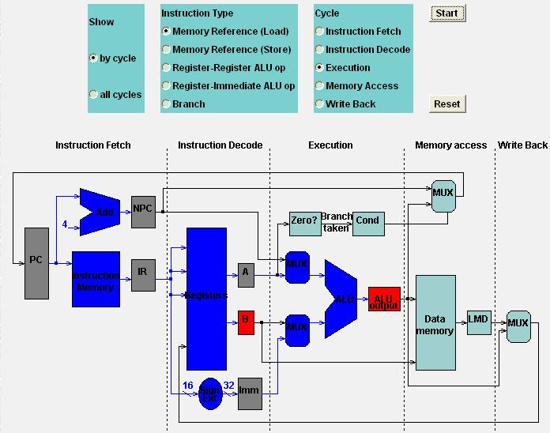
Load

Slide 45
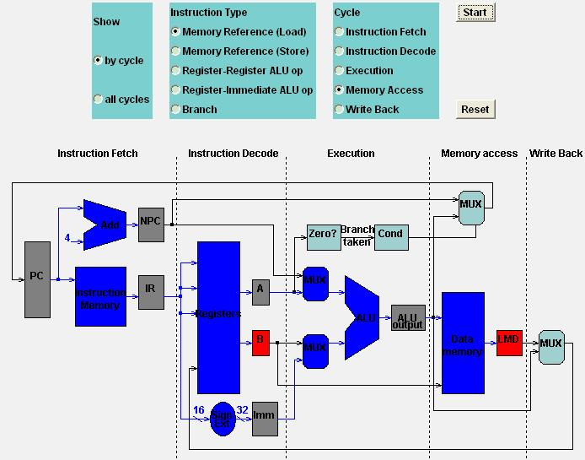
Load

Slide 46
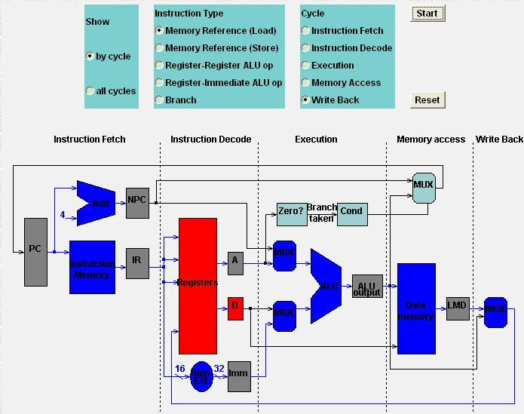
Load

Slide 47
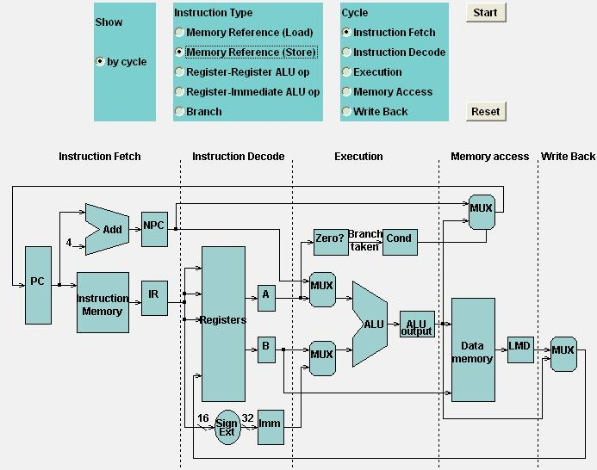
Store

Slide 48

Store

Slide 49
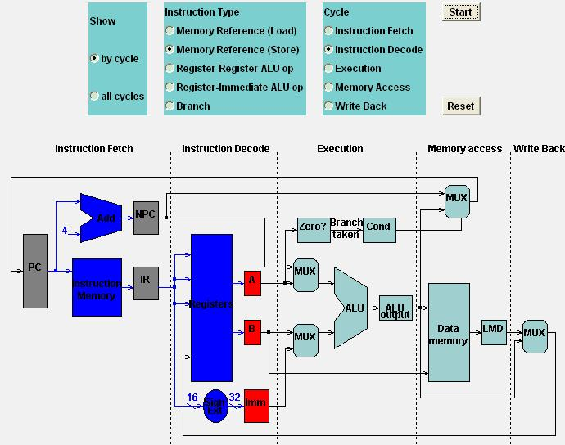
Store

Slide 50
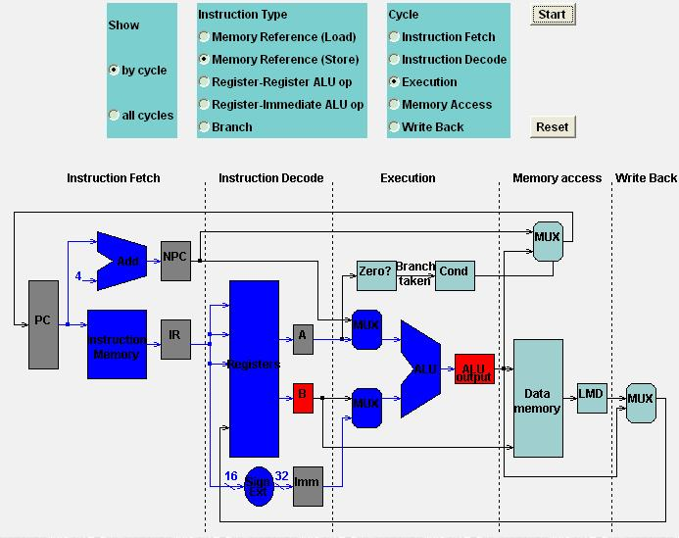
Store

Slide 51
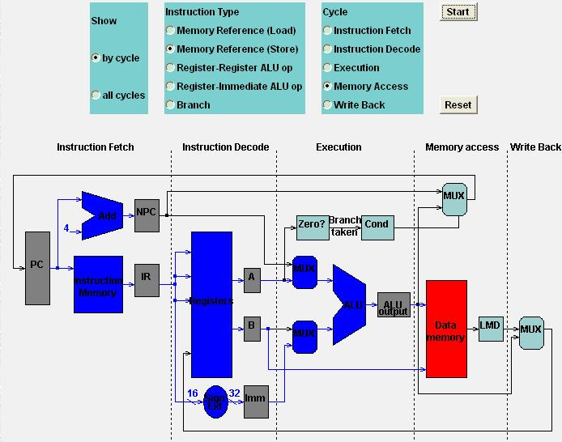
Store

Slide 52

Store

Slide 53
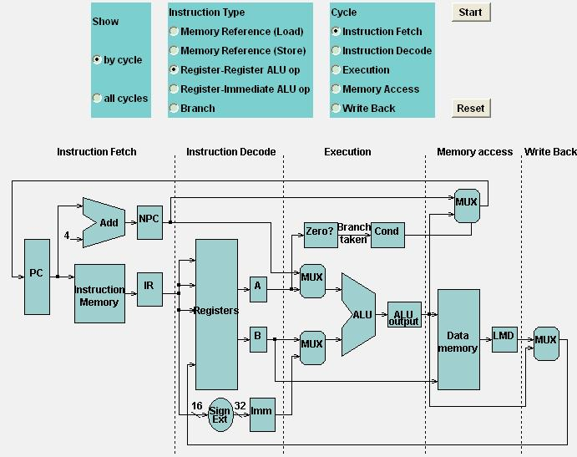
Register-Register ALU

Slide 54
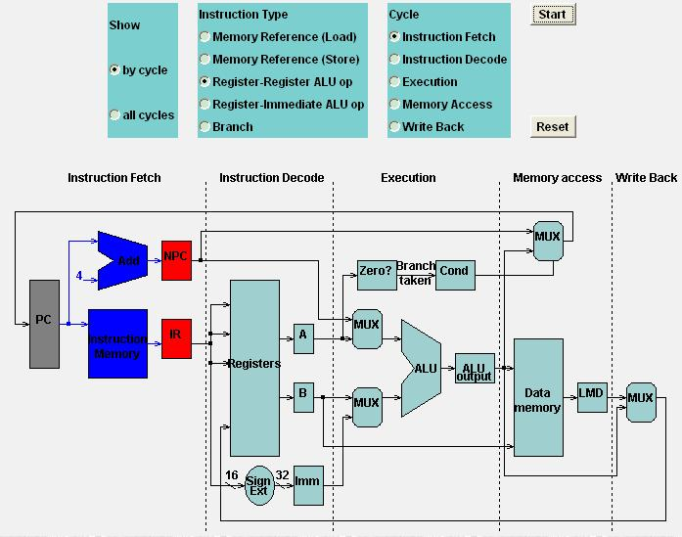
Register-Register ALU

Slide 55

Register-Register ALU

Slide 56
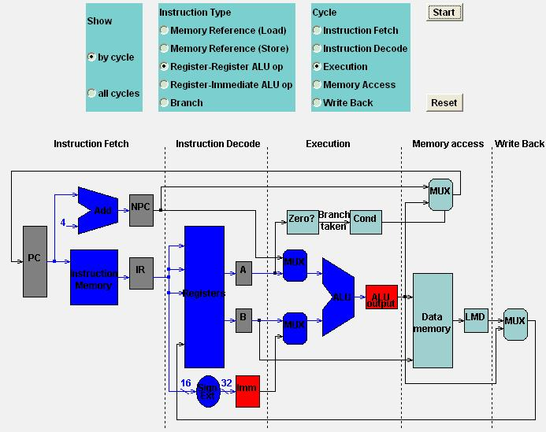
Register-Register ALU

Slide 57
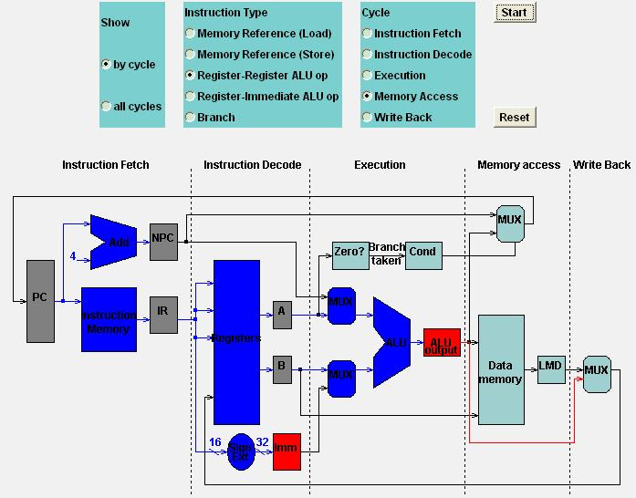
Register-Register ALU

Slide 58
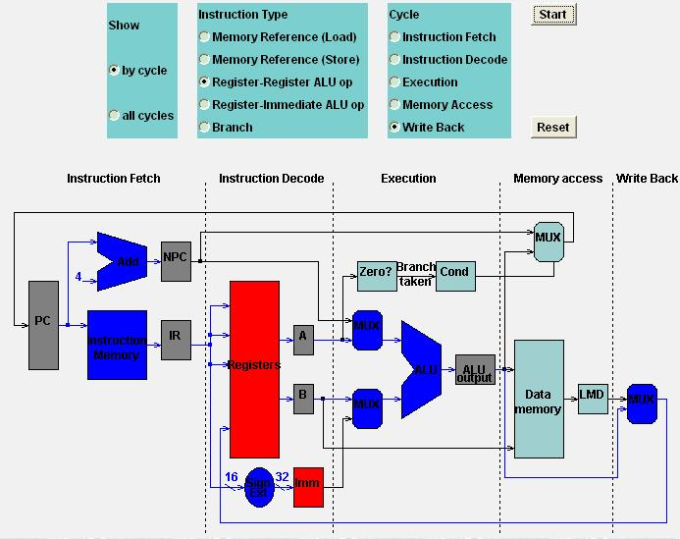
Register-Register ALU

Slide 59
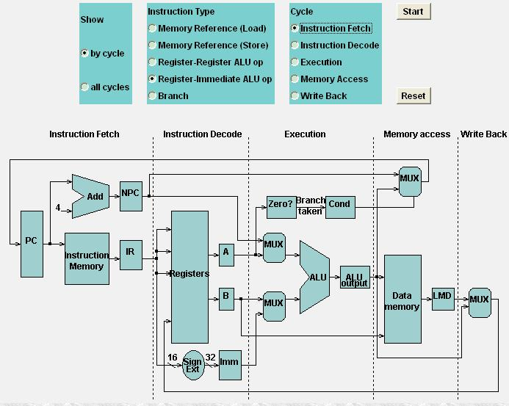
Register-Immediate ALU

Slide 60
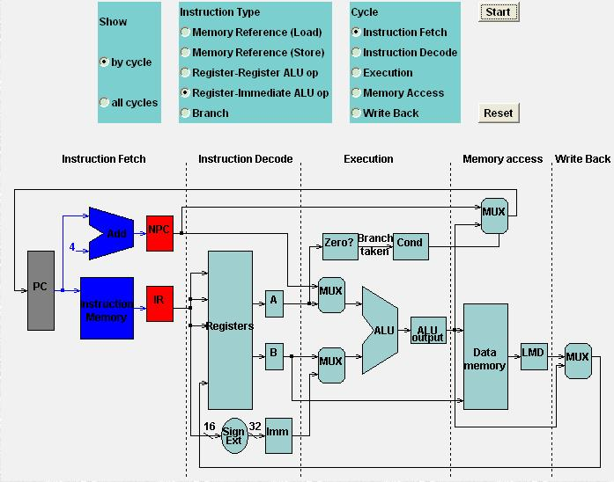
Register-Immediate ALU

Slide 61

Register-Immediate ALU

Slide 62
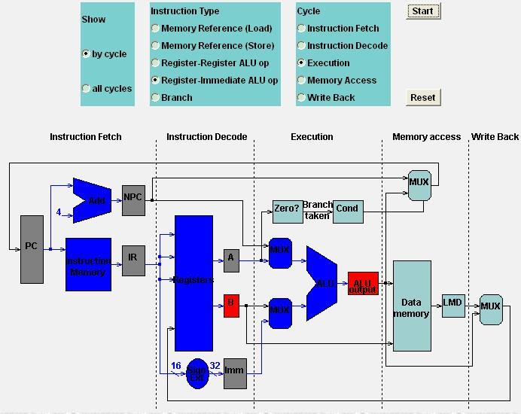
Register-Immediate ALU

Slide 63
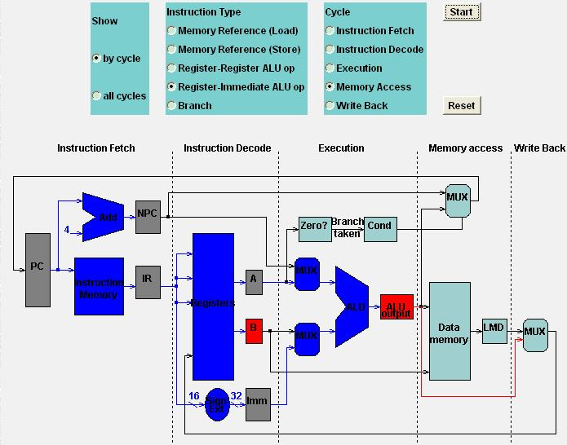
Register-Immediate ALU

Slide 64
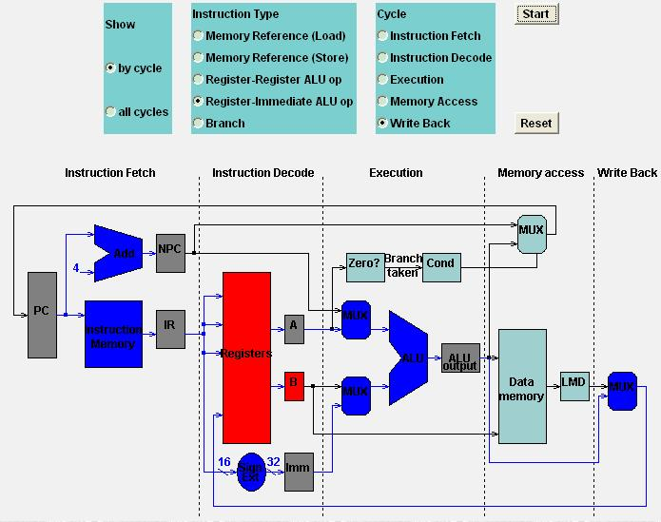
Register-Immediate ALU

Slide 65
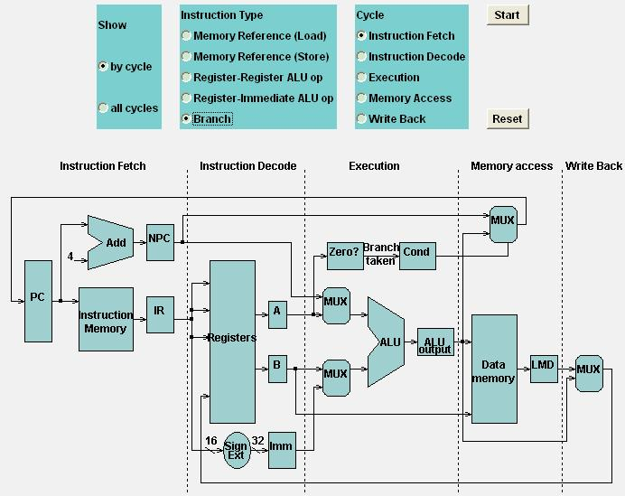
Branch

Slide 66

Branch

Slide 67
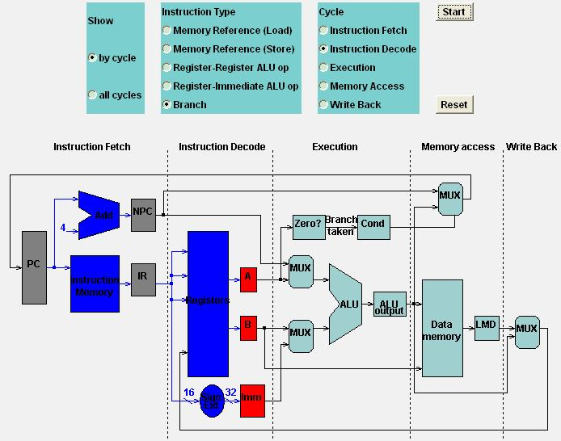
Branch

Slide 68
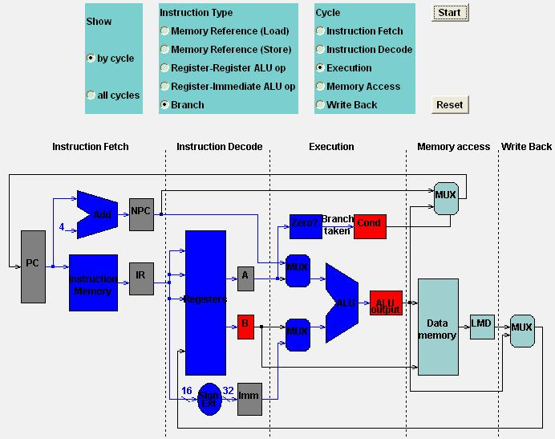
Branch

Slide 69
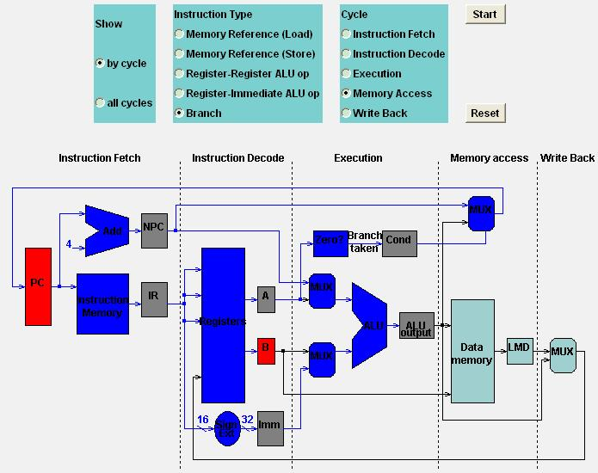
Branch

Slide 70

Branch

Slide 71
Outline
What’s Pipelining
How Pipelining Works
Pipeline Hazards
Pipeline with Multicycle FP Operations

Slide 72
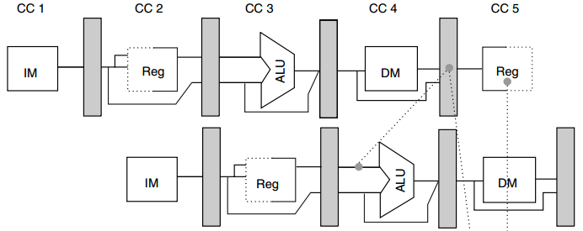
When Pipeline Is Stuck
R1
LD R1, 0(R2)
R1
DSUB R4, R1, R5
Notes:
Actually, in many cases, instructions cannot be fully pipelined.
In this example, R1 is ready by load instruction at the end of clock cycle 4;
But subtract instruction requires R1 at the beginning of clock cycle 4; in this case, the processor can not fully pipeline the two instructions as we expect.

Slide 73
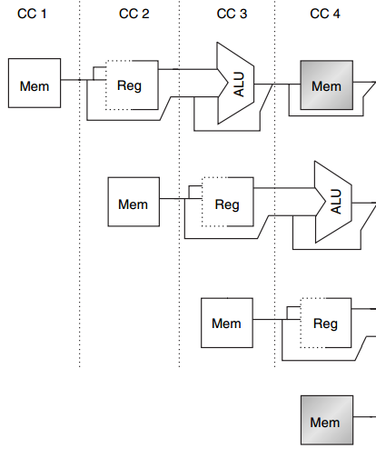
Structural Hazard
MEM
Example
1 mem port
mem conflict
data access
vs
instr fetch
Load
Instr i+1
Instr i+2
IF
Instr i+3
Notes:
Here’s an example of structural hazard due to memory conflict.
Assume the processor has only memory port.
A structural hazard will arise in clock cycle 4 when the load instruction reads data from memory and instruction i plus 3 fetches instruction from memory.

Slide 74
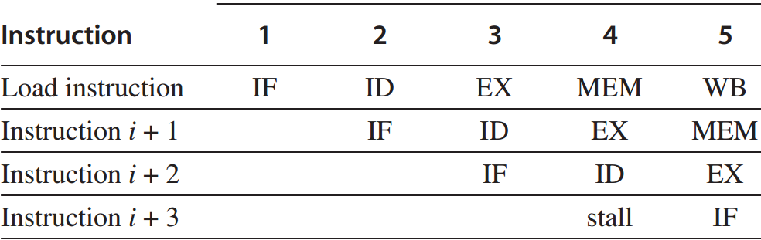
Structural Hazard
Stall Instr i+3
till CC 5
Notes:
The solution to this structural hazard is stall instruction i+3 for one clock cycle.

Slide 75
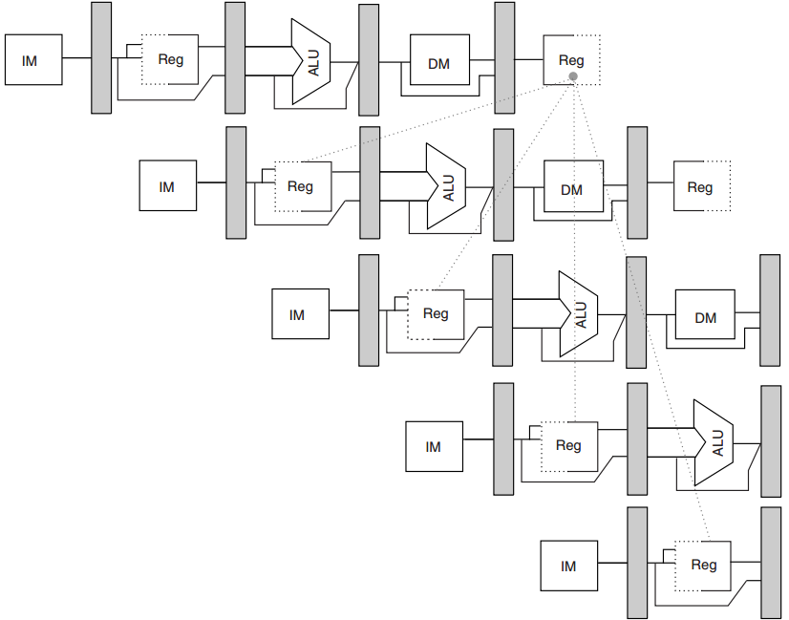
Data Hazard
R1
DADD
R1, R2, R3
DSUB
R4, R1, R5
AND
R6, R1, R7
No hazard
1st half cycle: w
2nd half cycle: r
OR
R8, R1, R9
XOR
R10, R1, R11
Notes:
In this example, the subtract and AND instructions need R1 before the add instruction prepares it. So R1 causes a data hazard that prevents normal pipelining of the subtract and AND instructions.
Note that the OR instruction has no hazard because the add instruction prepares R1 in the first half of the clock cycle while the OR instruction needs R1 till the second half.

Slide 76
Data Hazard
Solution: forwarding
directly feed back EX/MEM&MEM/WB
pipeline regs’ results to the ALU inputs;
if forwarding hw detects that previous ALU has written the reg corresponding to a source for the current ALU,
control logic selects the forwarded result as the ALU input.
Notes:
The solution to data hazard is forwarding.
It directly feeds back the results in pipeline registers connecting EX and MEM or MEM and WB to the ALU inputs.

Slide 77
Data Hazard: Forwarding
R1
DADD
R1, R2, R3
DSUB
R4, R1, R5
AND
R6, R1, R7
OR
R8, R1, R9
XOR
R10, R1, R11
Notes:
Back to the previous example,

Slide 78
Data Hazard: Forwarding
R1
EX/MEM
DADD
R1, R2, R3
DSUB
R4, R1, R5
AND
R6, R1, R7
OR
R8, R1, R9
XOR
R10, R1, R11
Notes:
The add instruction can directly provide the subtract instruction with R1 via its EX/MEM pipeline register.

Slide 79
Data Hazard: Forwarding
R1
MEM/WB
DADD
R1, R2, R3
DSUB
R4, R1, R5
AND
R6, R1, R7
OR
R8, R1, R9
XOR
R10, R1, R11
Notes:
Similarly, the add instruction can provide the AND instruction with R1 via its MEM/WB pipeline register.

Slide 80
Data Hazard: Forwarding
Generalized forwarding
pass a result directly to the functional unit that requires it;
forward results to not only ALU inputs but also other types of functional units;
Notes:
More generally, a processor can forward results to not only ALU inputs but also any other functional unit that requires it.

Slide 81
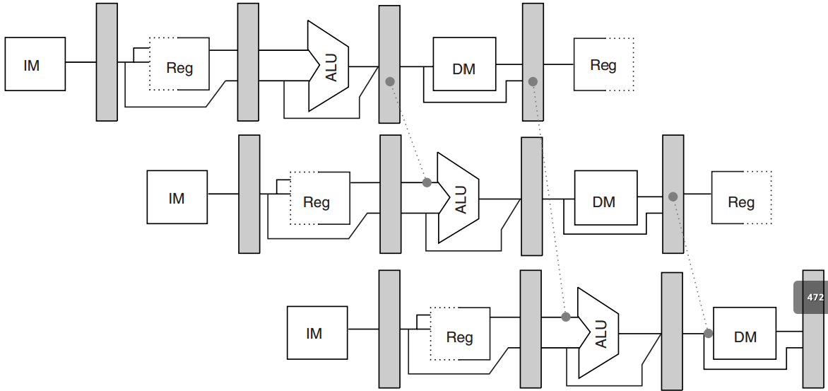
Data Hazard: Forwarding
Generalized forwarding
DADD
R1, R2, R3
R1
R1
R4
LD
R4, 0(R1)
R1
SD
R4, 12(R1)
R1
R4
Notes:
(LD R4, 0(R1): R4=mem(R1+0); from mem to reg)
(SD R4, 12(R1): mem(R1+12)=R4; from reg to mem)
In this example, R1 is forwarded to the ALU inputs while R4 is to memory input.

Slide 82
Data Hazard
Sometimes stall is necessary
MEM/WB
R1
LD
R1, 0(R2)
DSUB
R4, R1, R5
R1
Forwarding cannot be backward.
Has to stall.
Notes:
But a stall is still necessary sometimes.
In this example, the load instruction prepares R1 till it reaches the MEM/WB pipeline register at the end of clock cycle 4.
The subtract instruction, however, requires R1 at the beginning of clock cycle 4. So in this case, no forwarding can be backward and thus the subtract instruction has to stall for one clock cycle.

Slide 83
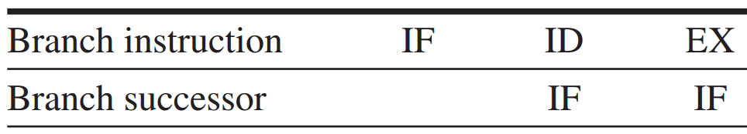
Branch Hazard
Redo IF
If the branch is untaken,
the stall is unnecessary.
essentially a stall
Notes:
Therefore, the IF in parallel with the branch’s ID clock cycle may fetch a wrong instruction.
A simple solution is to redo IF, which is essentially a stall. However, if the branch is untaken, the stall is absolutely unnecessary.

Slide 84
Branch Hazard: Solutions
4 simple compile time schemes – 1
Freeze or flush the pipeline
hold or delete any instructions after the branch till the branch dst is known;
i.e., Redo IF w/o the first IF
Notes:
There are four more solutions to branch hazard.
The first one is freeze or flush the pipeline. It simply holds or deletes any instruction after the branch till the branch destination is known.
It’s similar to Redo IF but without the first IF.

Slide 85
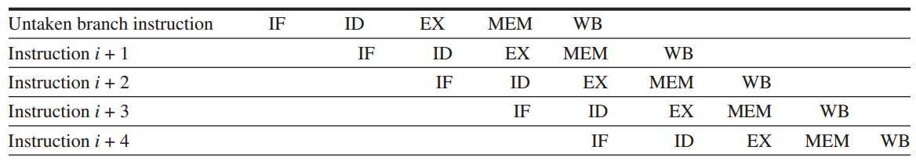
Branch Hazard: Solutions
4 simple compile time schemes – 2
Predicted-untaken
simply treat every branch as untaken;
when the branch is untaken,
pipelining as if no hazard.
Notes:
The second scheme is predicated-untaken. It simply treats every branch as untaken.
When the branch is really untaken, the pipelining proceeds as if no hazard exists.

Slide 86
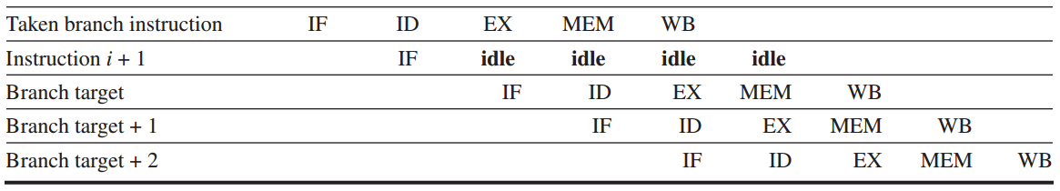
Branch Hazard: Solutions
4 simple compile time schemes – 2
Predicted-untaken
but if the branch is taken:
turn fetched instr into a no-op (idle);
restart the IF at the branch target addr
Notes:
But if the branch is taken, the processor will idle the fetched instruction and continue to process the instruction at the branch target address.

Slide 87
Branch Hazard: Solutions
4 simple compile time schemes – 3
Predicted-taken
simply treat every branch as taken;
not apply to the five-stage pipeline;
apply to scenarios when branch target addr is known before branch outcome.
Notes:
Opposite to predicted-untaken, another scheme is predicted-taken. It simply treats every branch as taken.
It doesn’t apply to the five-stage pipeline, so we don’t cover its details in this lecture.

Slide 88
Branch Hazard: Solutions
4 simple compile time schemes – 4
Delayed branch
delay the branch execution after the next instruction;
pipelining sequence:
branch instruction
sequential successor
branch target if taken
Branch delay slot
the next instruction
Notes:
The fourth scheme is delayed branch.
It directly delays the branch execution after the next instruction. In other words, it executes the next instruction first whether or not the branch is taken.

Slide 89
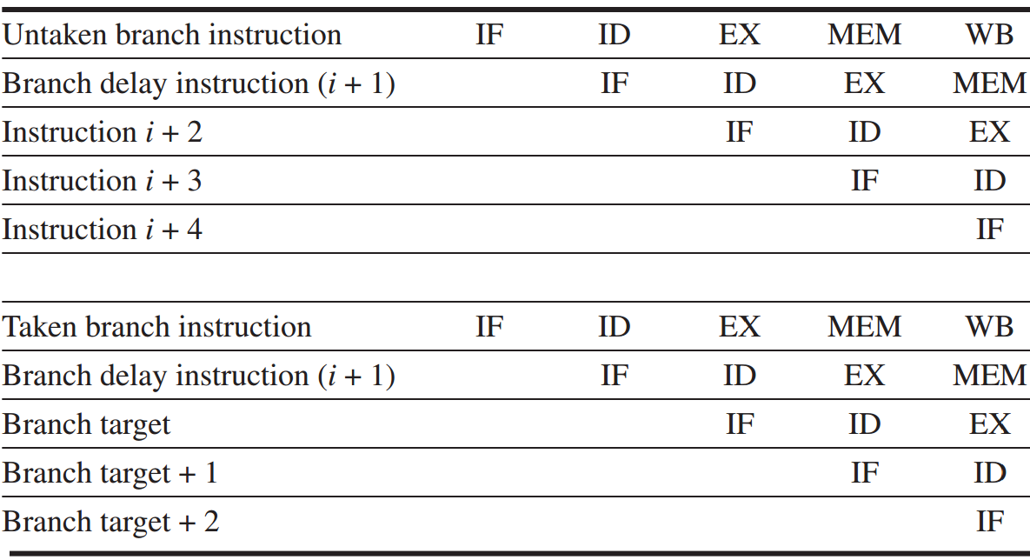
Branch Hazard: Solutions
Delayed branch
Notes:
Here are examples of delaying an untaken branch and a taken branch.
We can see that they have the same pipelining efficiency.

Slide 90
Outline
What’s Pipelining
How Pipelining Works
Pipeline Hazards
Pipeline with Multicycle FP Operations

Slide 91
Multicycle FP Operation
FP pipeline
allow for a longer latency for op;
two changes over integer pipeline:
repeat EX;
use multiple FP functional units;

Slide 92
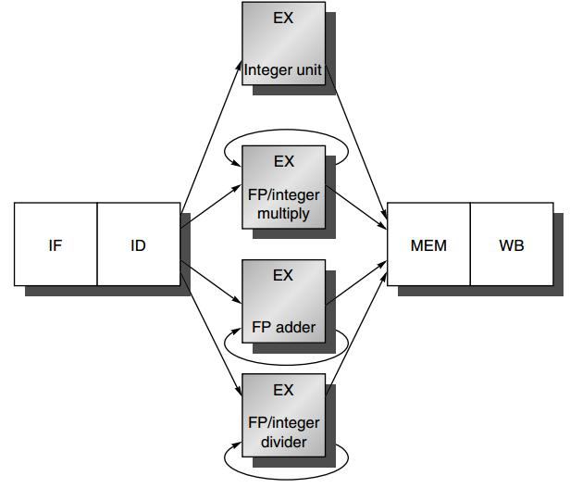
FP Pipeline
loads and stores
integer ALU operations
branches
FP and integer multiplier
FP add
FP subtract
FP conversion
FP and integer divider

Slide 93
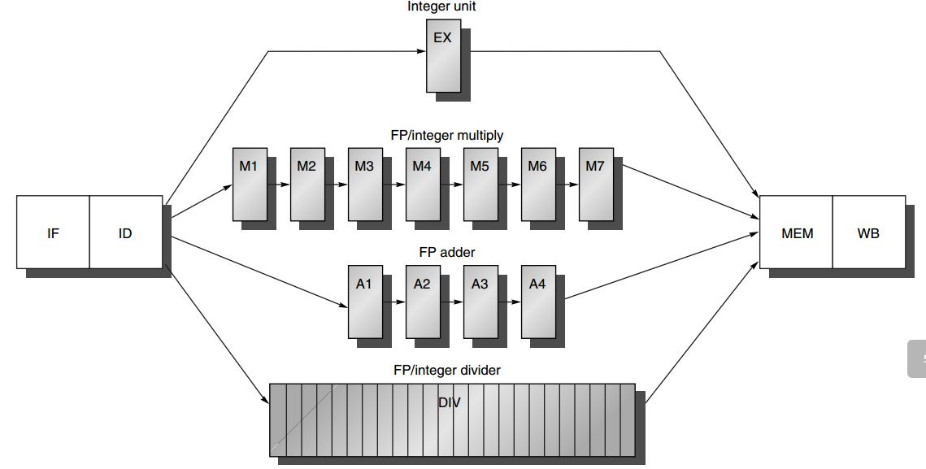
Generalized FP Pipeline
EX is pipelined (except for FP divider)
Additional pipeline registers
e.g., ID/A1
FP divider: 24 CCs

Slide 94
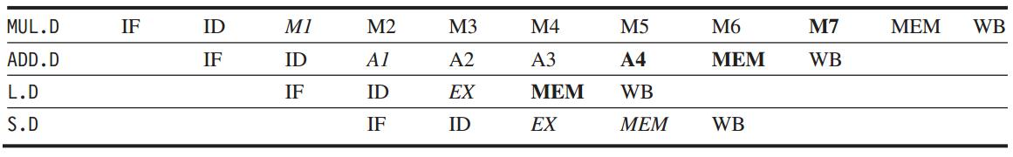
Generalized FP Pipeline
Example
italics: stage where data is needed
bold: stage where a result is available

Slide 95
Hazard
Divider is not fully pipelined – structural hazard

Slide 96
Hazard
Instructions have varying running times, maybe >1 register write in a cycle - structural hazard

Slide 97
Hazard
Instructions no longer reach WB in order – Write after write (WAW) hazard

Slide 98
Hazard
Instructions may complete in a different order than they were issued – exceptions

Slide 99
Hazard
Longer latency of operations – more frequent stalls for RAW hazards

Slide 100
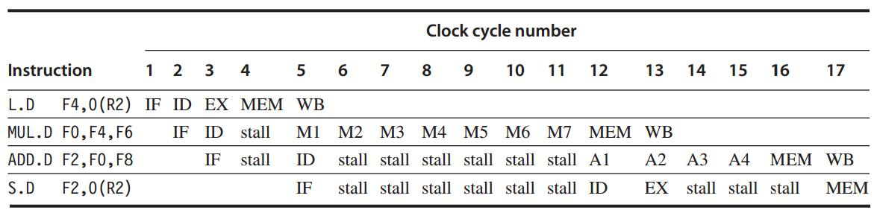
RAW Hazards

Slide 101
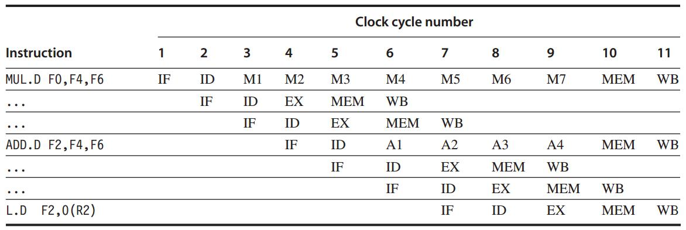
Structural Hazards

Slide 102
WAW Hazards
If L.D were issued one cycle earlier
L.D would write F2 one cycle earlier than ADD.D – WAW hazard
what if another instruction using F2 between them? --- No WAW

Slide 103
All in MIPS R4000

Slide 104
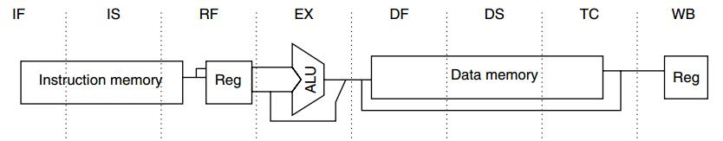
MIPS R4000
5-stage -> 8-stage
Higher clock rate

Slide 105
MIPS R4000
IF: first half of instruction fetch;
PC selection;
initiation of instruction cache access;

Slide 106
MIPS R4000
IS: second half of instruction fetch;
completion of instruction cache access;

Slide 107
MIPS R4000
RF:
instruction decode and register fetch;
hazard checking;
instruction cache hit detection;

Slide 108
MIPS R4000
EX: execution
effective address calculation;
ALU operation;
branch-target computation and condition evaluation;

Slide 109
MIPS R4000
DF: data fetch
first half of data access;

Slide 110
MIPS R4000
DS: second half of data fetch
completion of data cache access;

Slide 111
MIPS R4000
TC: tag check
determine whether the data cache access hit;

Slide 112
MIPS R4000
WB: write back
for loads and register-register operations;

Slide 113
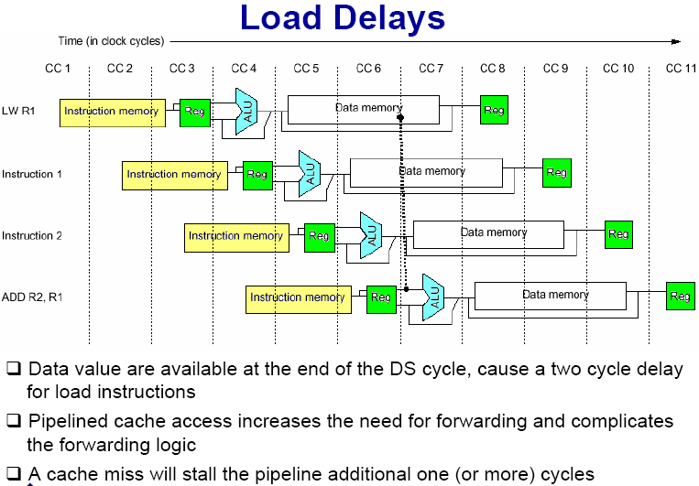
MIPS R4000
2-cycle load delay

Slide 114
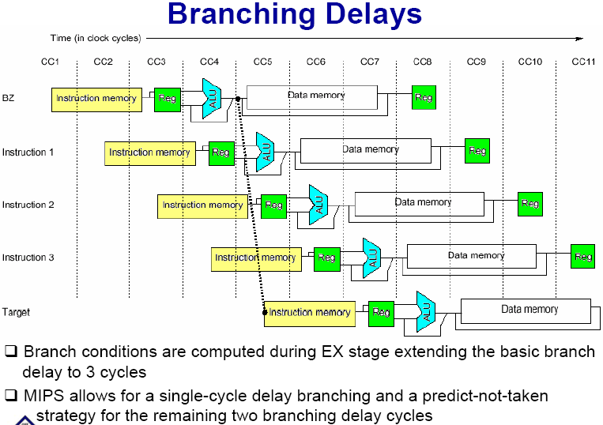
MIPS R4000
3-cycle branch delay

Slide 115
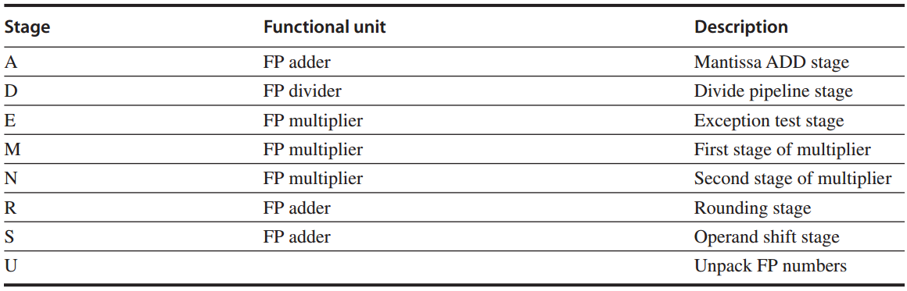
MIPS R4000
FP unit with eight different stages

Slide 116
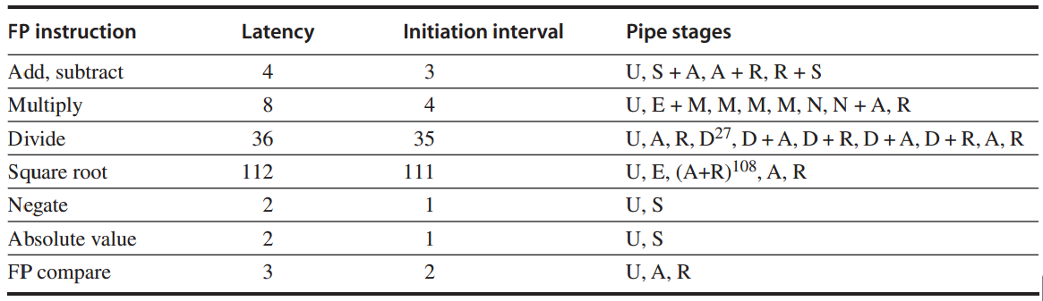
MIPS R4000
FP operations: latency and initiation interval

Slide 117
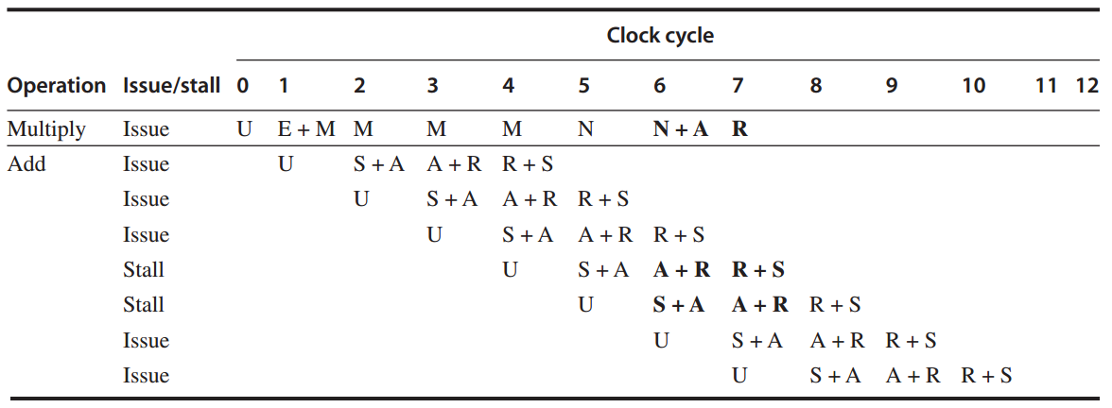
MIPS R4000
FP operations Example 1
FP multiply + FP add

Slide 118

MIPS R4000
FP operations Example 2
FP add + FP multiply

Slide 119

MIPS R4000
FP operations Example 3: divide + add

Slide 120

MIPS R4000
FP operations Example 4
FP add + FP divide

Slide 121
?

