Slide 1
Lecture 8: Memory Hierarchy
Cache Performance
Kai Bu
kaibu@zju.edu.cn
http://list.zju.edu.cn/kaibu/comparch

Slide 2
Lab 2 Demo
Report due April 21
Assignment 2 Submission

Slide 3

Appendix B.1-B.3

Slide 4
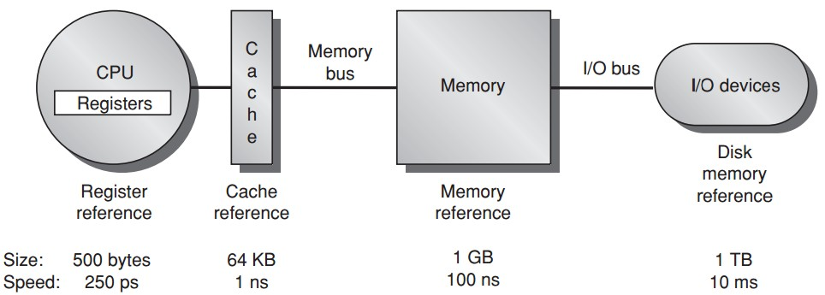
Memory Hierarchy

Slide 5
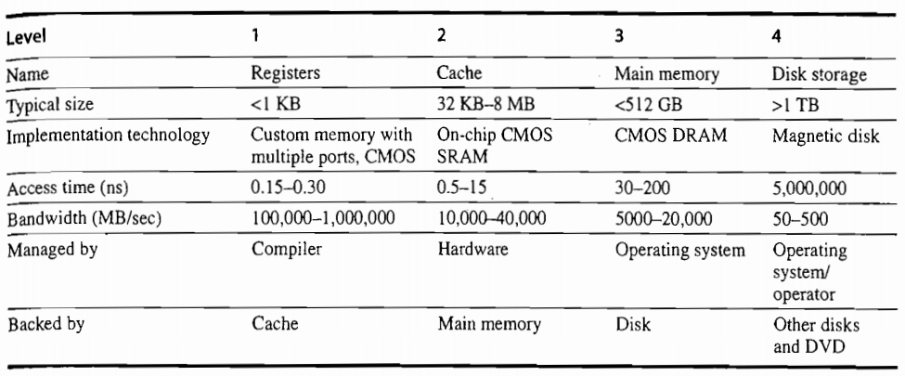

Slide 6
Memory Hierarchy
main memory + virtual memory
Virtual memory: some objects may reside on disk
Address pace split into pages
A page resides in either main mem or virtual mem
Palt: occurs when a page is not in cache or main memory;
need to move the entire page from disk to main memory

Slide 7
Outline
Cache Basics
Cache Performance
Cache Optimization

Slide 8
Outline
Cache Basics
Cache Performance
Cache Optimization

Slide 9
Cache
The highest or first level of the memory hierarchy encountered once the addr leaves the processor
buffering is employed to reuse commonly occurring items
Cache hit/miss
when the processor can/cannot find a requested data item in the cache

Slide 10
Cache Locality
Block/line run: a fixed-size collection of data containing the requested word, retrieved from the main memory and placed into the cache
Temporal locality: need the requested word again soon
Spatial locality: likely need other data in the block soon

Slide 11
Cache Miss
Time required for cache miss depends:
latency and memory bandwidth
Latency: the time to retrieve the first word of the block
Bandwidth: the time to retrieve the rest of this block

Slide 12
Outline
Cache Basics
Cache Performance
Cache Optimization

Slide 13
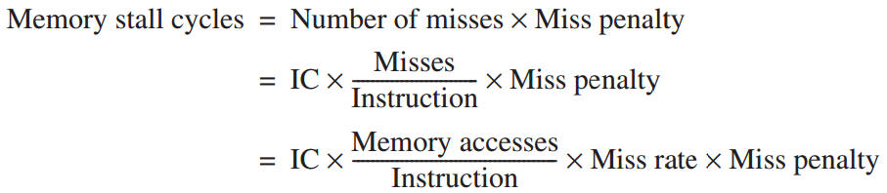
Cache Performance

Slide 14
Cache Performance
Example
a computer with CPI=1 when cache hit;
50% instructions are loads and stores;
2% miss rate, 25 cc miss penalty;
Q: how much faster would the computer be if all instructions were cache hits?

Slide 15
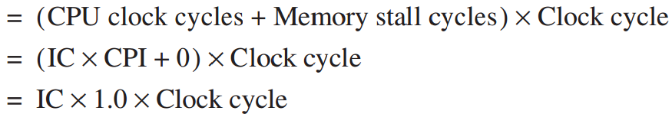
Cache Performance
Answer
always hit:
CPU execution time

Slide 16
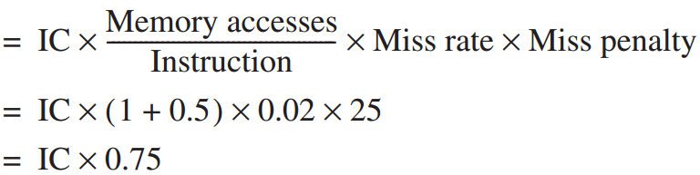
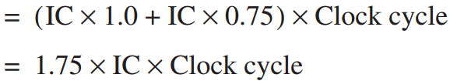
Cache Performance
Answer
with misses:
Memory stall cycles
CPU execution time_{cache}

Slide 17
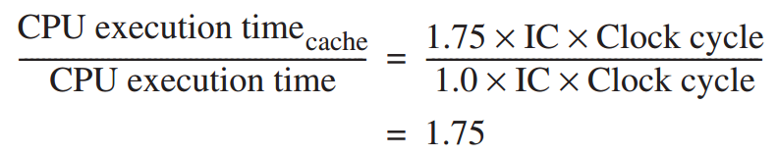
Cache Performance
Answer

Slide 18
Cache Performance
Memory stall cycles
the number of cycles during processor is stalled waiting for a mem access
Miss rate
number of misses over number of accesses
Miss penalty
the cost per miss (number of extra clock cycles to wait)

Slide 19
Block Placement
Direct Mapped
only one place
Fully Associative
anywhere
Set Associative
anywhere within only one set

Slide 20
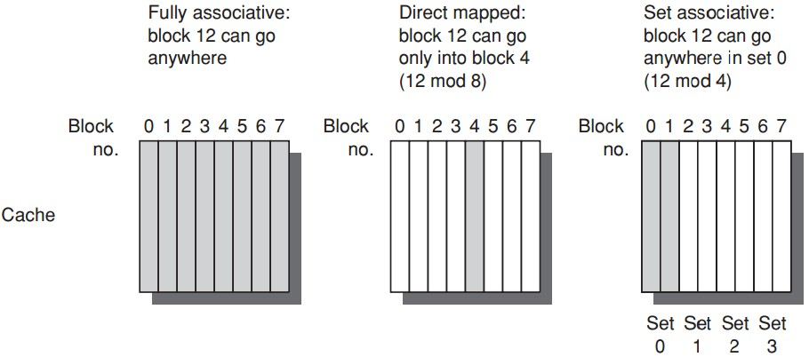
Block Placement

Slide 21
Block Placement
n-way set associative: n blocks in a set
Direct mapped = one-way set associative
i.e., one block in a set
Fully associative = m-way set associative
i.e., entire cache as one set with m blocks

Slide 22

Block Identification
Block address + block offset
Block address: tag + index
Index: select the set
Tag: check all blocks in the set
Block offset: the address of the desired data within the block chosen by index + tag;
Fully associative caches have no index field

Slide 23
Block Replacement
Cache miss, need to load the data to a cache block, which block to replace?
Random
simple to build
LRU: Least Recently Used
the block that has been unused for the longest time;
use spatial locality;
complicated/expensive;
FIFO: first in, first out

Slide 24
Write Strategy
Read together with tag checking
Must write after tag checking

Slide 25
Write Strategy
Write-through
info is written to both the block in the cache and to the block in the lower-level memory
Write-back
info is written only to the block in the cache;
to the main memory only when the modified cache block is replaced;

Slide 26
Write Strategy
Options on a write miss
Write allocate
the block is allocated on a write miss
No-write allocate
write miss not affect the cache;
the block is modified in the lower-level memory;
until the program tries to read the block;

Slide 27
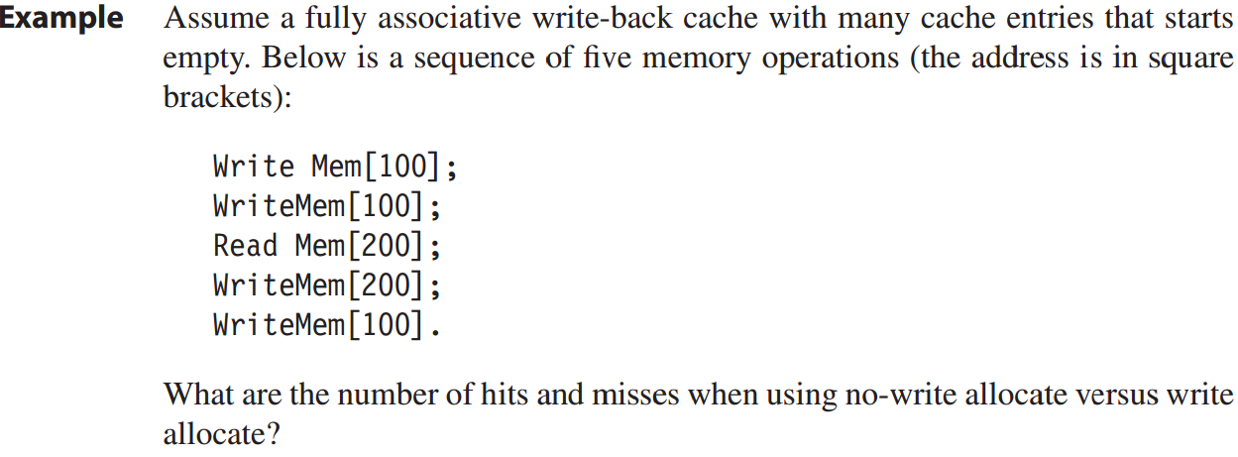
Write Strategy

Slide 28
Write Strategy
No-write allocate: 4 misses + 1 hit
cache not affected- address 100 not in the cache;
read [200] miss, block replaced, then write [200] hits;
Write allocate: 2 misses + 3 hits

Slide 29
Avg Mem Access Time
Average memory access time
=Hit time + Miss rate x Miss penalty

Slide 30
Example
16KB instr cache + 16KB data cache;
32KB unified cache;
36% data transfer instructions;
(load/store takes 1 extra cc on unified cache)
1 CC hit; 200 CC miss penalty;
Q1: split cache or unified cache has lower miss rate?
Q2: average memory access time?

Slide 31
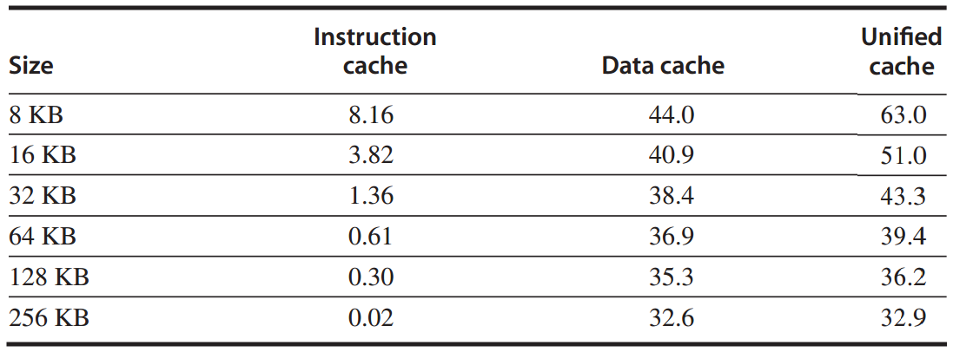
Example: miss rates

Slide 32
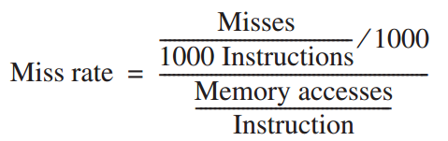



Q1

Slide 33
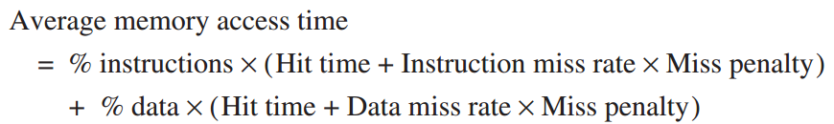
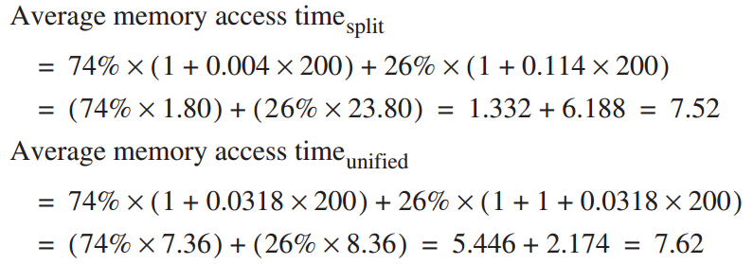
Q2

Slide 34
Cache vs Processor
Processor Performance
Lower avg memory access time may correspond to higher CPU time (Example on Page B.19)

Slide 35
Out-of-Order Execution
in out-of-order execution, stalls happen to only instructions that depend on incomplete result;
other instructions can continue;
so less avg miss penalty

Slide 36
Outline
Cache Basics
Cache Performance
Cache Optimization

Slide 37
Average Memory Access Time =
Hit Time + Miss Rate x Miss Penalty

Slide 38
Average Memory Access Time =
Hit Time + Miss Rate x Miss Penalty

Slide 39
Average Memory Access Time =
Hit Time + Miss Rate x Miss Penalty
Larger block size;
Larger cache size;
Higher associativity;

Slide 40
Reducing Miss Rate
3 categories of miss rates / root causes
Compulsory:
cold-start/first-reference misses;
Capacity
cache size limit;
blocks discarded and later retrieved;
Conflict
collision misses: associativty
a block discarded and later retrieved in a set;

Slide 41
Opt #1: Larger Block Size
Reduce compulsory misses
Leverage spatial locality
Increase conflict/capacity misses
Fewer block in the cache

Slide 42
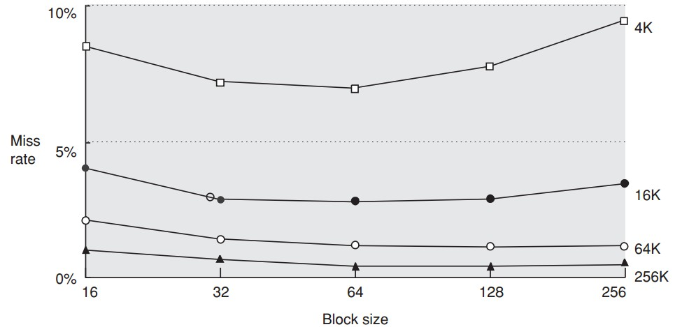

Slide 43
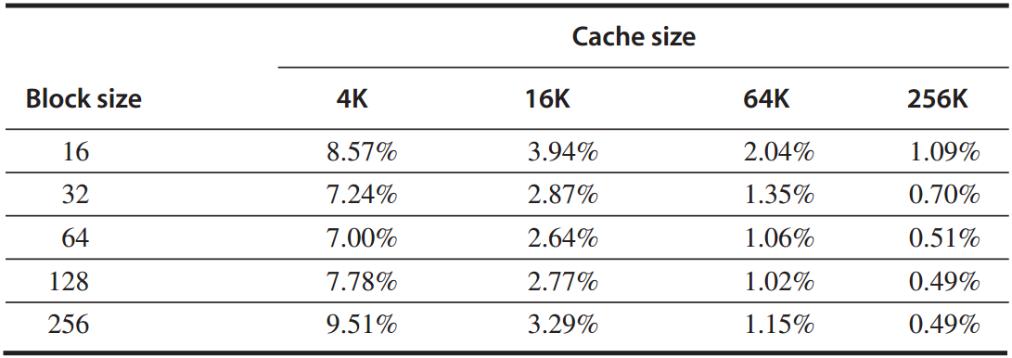
Example
given the above miss rates;
assume memory takes 80 CC overhead,
delivers 16 bytes in 2 CC;
Q: which block size has the smallest average memory access time for each cache size?

Slide 44
Answer
avg mem access time
=hit time + miss rate x miss penalty
*assume 1-CC hit time
for a 256-byte block in a 256 KB cache:
avg mem access time
= 1 + 0.49% x (80 + 2x256/16) = 1.5 cc

Slide 45
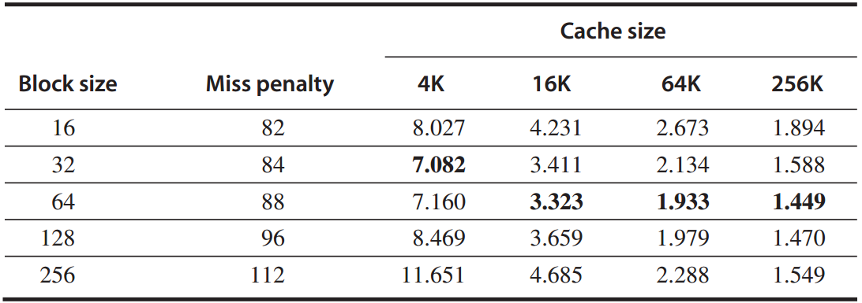
Answer
average memory access time

Slide 46
Opt #2: Larger Cache
Reduce capacity misses
Increase hit time, cost, and power

Slide 47
Opt #3: Higher Associativity
Reduce conflict misses
Increase hit time

Slide 48
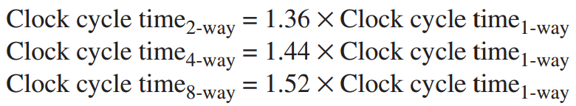
Example
assume higher associativity -> higher clock cycle time:
assume 1-cc hit time, 25-cc miss penalty, and miss rates in the following table;

Slide 49
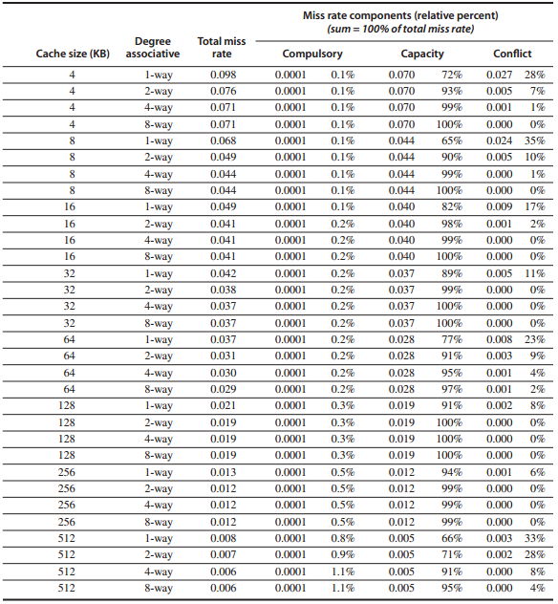
Miss rates

Slide 50
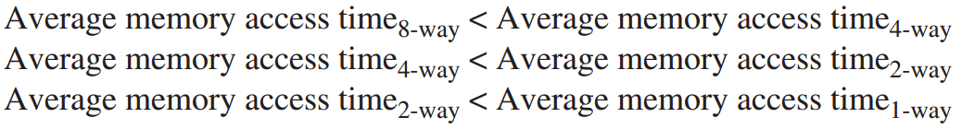
Question:
for which cache sizes
are each of the statements true?

Slide 51
Answer
for a 512 KB, 8-way set associative cache:
avg mem access time
=hit time + miss rate x miss penalty
=1.52x1 + 0.006 x 25
=1.66

Slide 52
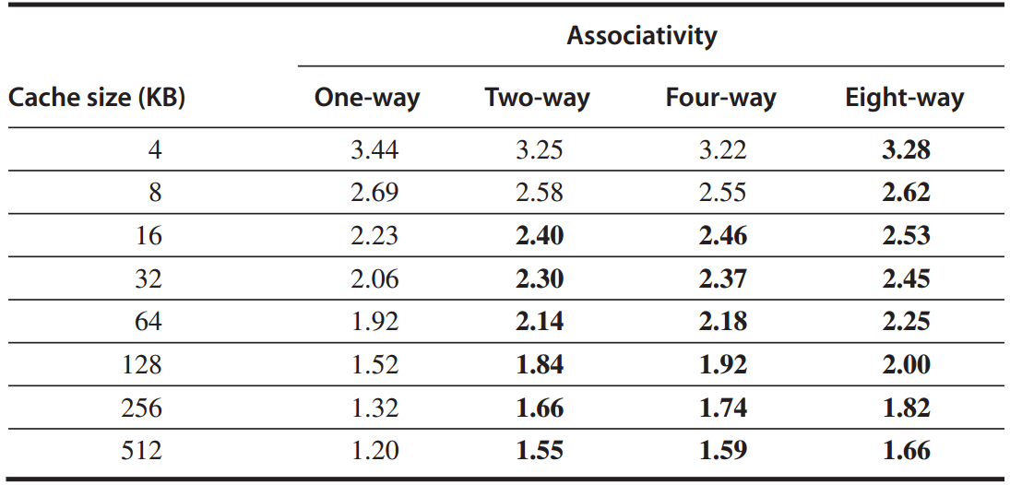
Answer
average memory access time

Slide 53
Average Memory Access Time =
Hit Time + Miss Rate x Miss Penalty
Multilevel caches;
Reads > Writes;

Slide 54
Opt #4: Multilevel Cache
Reduce miss penalty
Motivation
faster/smaller cache to keep pace with the speed of processors?
larger cache to overcome the widening gap between processor and main mem?

Slide 55
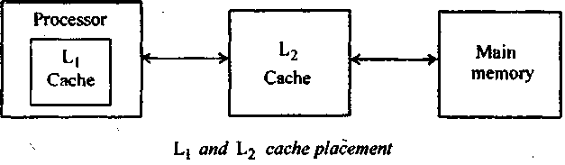
Opt #4: Multilevel Cache
Two-level cache
Add another level of cache between the original cache and memory
L1: small enough to match the clock cycle time of the fast processor;
L2: large enough to capture many accesses that would go to main memory, lessening miss penalty

Slide 56
Opt #4: Multilevel Cache
Average memory access time
=Hit time_{L1} + Miss rate_{L1} x Miss penalty_{L1}
=Hit time_{L1} + Miss rate_{L1}
x(Hit time_{L2}+Miss rate_{L2}xMiss penalty_{L2})
Average mem stalls per instruction
=Misses per instruction_{L1} x Hit time_{L2}
+ Misses per instr_{L2} x Miss penalty_{L2}

Slide 57
Opt #4: Multilevel Cache
Local miss rate
the number of misses in a cache
divided by the total number of mem accesses to this cache;
Miss rate_{L1}, Miss rate_{L2}
Global miss rates
the number of misses in the cache
divided by the number of mem accesses generated by the processor;
Miss rate_{L1}, Miss rate_{L1} x Miss rate_{L2}

Slide 58
Example
1000 mem references -> 40 misses in L1 and 20 misses in L2;
miss penalty from L2 is 200 cc;
hit time of L2 is 10 cc;
hit time of L1 is 1 cc;
1.5 mem references per instruction;
Q: 1. various miss rates?
2. avg mem access time?
3. avg stall cycles per instruction?

Slide 59
Answer
1. various miss rates?
L1: local = global
40/1000 = 4%
L2:
local: 20/40 = 50%
global: 20/10000 = 2%

Slide 60
Answer
2. avg mem access time?
average memory access time
=Hit time_{L1} + Miss rate_{L1}
x(Hit time_{L2}+Miss rate_{L2}xMiss penalty_{L2})
=1 + 4% x (10 + 50% x 200)
=5.4

Slide 61
Answer
3. avg stall cycles per instruction?
average stall cycles per instruction
=Misses per instruction_{L1} x Hit time_{L2}
+ Misses per instr_{L2} x Miss penalty_{L2}
=(1.5x40/1000)x10+(1.5x20/1000)x200
=6.6

Slide 62
Opt #5: Prioritize read misses over writes
Reduce miss penalty
instead of simply stall read miss until write buffer empties,
check the contents of write buffer,
let the read miss continue
if no conflicts with write buffer & memory system is available

Slide 63
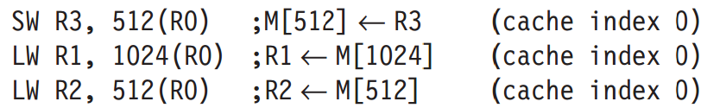
Opt #5: Prioritize read misses over writes
Why
for the code sequence, assume a direct-mapped, write-through cache that maps 512 and 1024 to the same block;
a four-word write buffer is not checked on a read miss.
R2≡R3 ?

Slide 64
Average Memory Access Time =
Hit Time + Miss Rate x Miss Penalty
Avoid address translation
during indexing of the cache

Slide 65
Opt #6: Avoid address translation during indexing cache
Cache addressing
virtual address – virtual cache
physical address – physical cache
Processor/program – virtual address
Processor -> address translation -> Cache
virtual cache or physical cache?

Slide 66
Opt #6: Avoid address translation during indexing cache
Virtually indexed, physically tagged
page offset to index the cache;
physical address for tag match;
For direct-mapped cache,
it cannot be bigger than the page size.
Reference: CPU Cache
http://zh.wikipedia.org/wiki/CPU%E9%AB%98%E9%80%9F%E7%BC%93%E5%AD%98

Slide 67
?

