Slide 1
Lecture 9: Memory Hierarchy
Virtual Memory
Kai Bu
kaibu@zju.edu.cn
http://list.zju.edu.cn/kaibu/comparch

Slide 2
Lab 3 Demo due May 13
Report due May 20
Lab 4 Demo due May 20
Report due May 27

Slide 3

Appendix B.4-B.5 some to be revisited in Ch 2

Slide 4
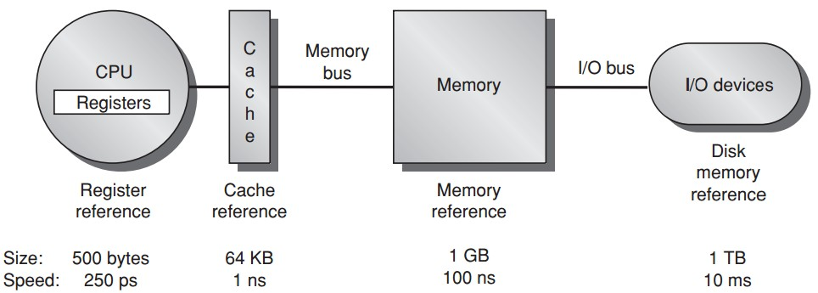
Memory Hierarchy
Larger memory for more processes?

Slide 5
Virtual Memory
Virtual memory
--shares a smaller amount of physical memory among many processes;
--divides physical memory into blocks and allocates them to different processes;
--automatically manages two levels of memory hierarchy,
main memory + secondary storage;

Slide 6
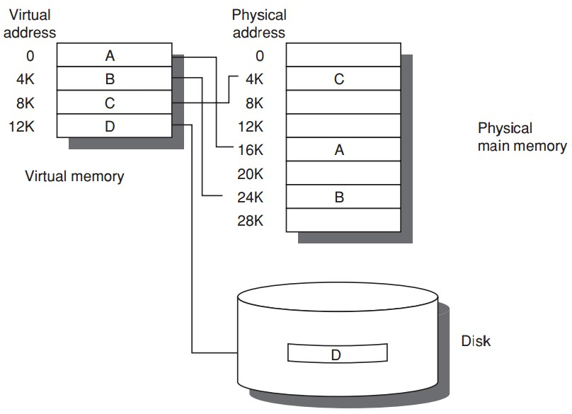
Virtual Memory

Slide 7
Virtual Memory
Program uses
discontiguous memory locations
Use secondary/non-memory storage

Slide 8
Virtual Memory
Program thinks
contiguous memory locations
larger physical memory

Slide 9
Virtual Memory
relocation
allows the same program to run in any location in physical memory

Slide 10
Virtual Memory
On program startup
OS copies program into RAM;
If not enough RAM, OS stops copying program & starts running loaded program segments in RAM;
When need un-loaded program segments, OS copies them from disk into RAM;
--OS need evict some loaded program segments in RAM;
----OS copies the evicted content back to disk if it is dirty (i.e., has been written into & changed)

Slide 11
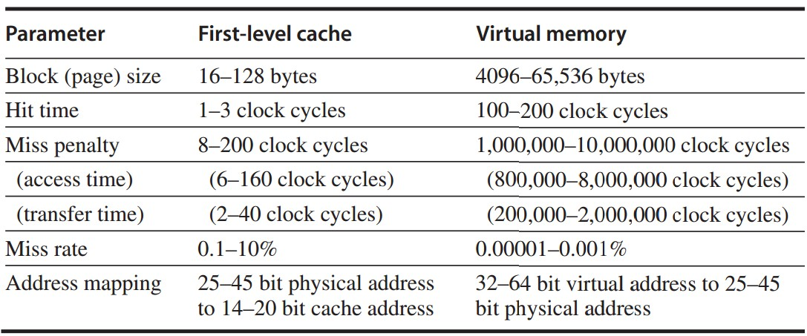

Slide 12
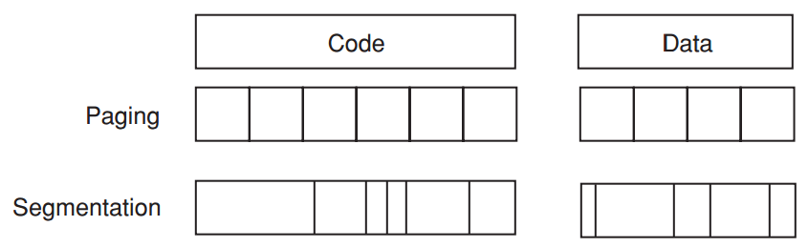
Virtual Memory
Paged virtual memory
page: fixed-size block
Segmented virtual memory
segment: variable-size block

Slide 13
Virtual Memory
Paged virtual memory
page address: page # + offset
Segmented virtual memory
segment address: seg # + offset

Slide 14
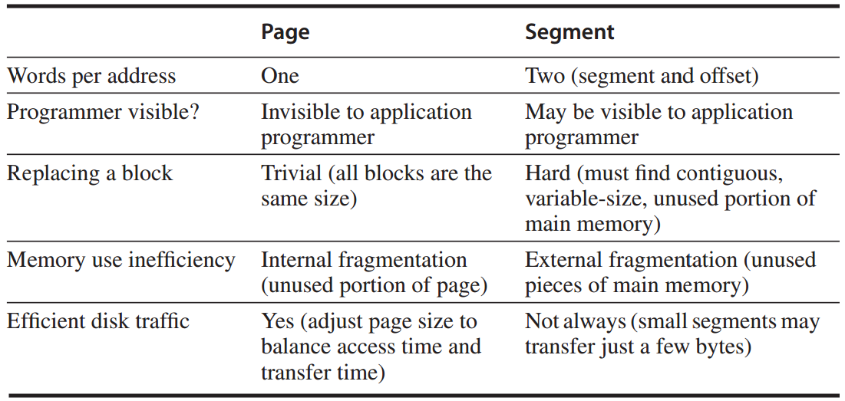

Slide 15
Outline
Four Memory Hierarchy Questions
Address Translation
Page Size Selection
Virtual Memory Meets Caches
Protection & Sharing among Programs

Slide 16
Outline
Four Memory Hierarchy Questions
Address Translation
Page Size Selection
Virtual Memory Meets Caches
Protection & Sharing among Programs

Slide 17
Four Memory Hierarchy Q’s
Q1. Where can a block be placed in main memory?
Fully associative strategy
OS allows blocks to be placed anywhere in main memory
Because of high miss penalty
access to a rotating magnetic storage device upon page/address fault

Slide 18
Four Memory Hierarchy Q’s
Q2. How is a block found if it is in main memory?
use a data structure
--contains phy addr of a block;
--indexed by page/segment number;
in the form of page table
--indexed by virtual page number;
--table size = the # of pages in the virtual address space

Slide 19
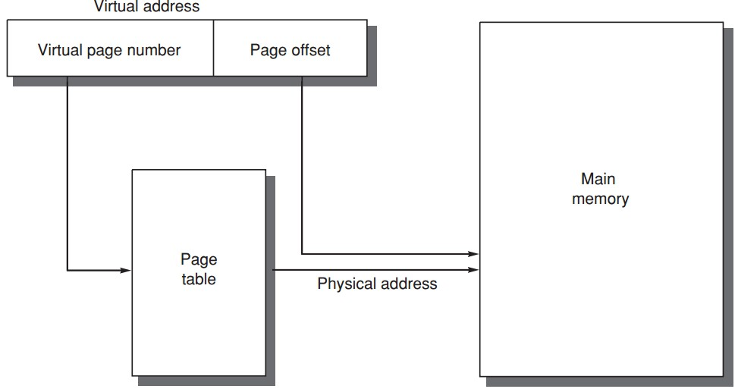
Four Memory Hierarchy Q’s
Q2. How is a block found if it is in main memory?
Segment addressing
add offset to seg’s phy addr;
Page addressing
concatenate offset to page’s phy addr;

Slide 20
Four Memory Hierarchy Q’s
Q3. Which block should be replaced on a virtual memory miss?
Least recently used (LRU) block
use/reference bit
--logically set whenever a page is accessed;
--OS periodically clears use bits and later records them to track the least recently referenced pages;

Slide 21
Four Memory Hierarchy Q’s
Q4. What happens on a write?
Write-back strategy
as accessing rotating magnetic disk takes millions of clock cycles;
Dirty bit
write a block to disk only if it has been altered since being read from the disk;

Slide 22
Outline
Four Memory Hierarchy Questions
Address Translation
Page Size Selection
Virtual Memory Meets Caches
Protection & Sharing among Programs

Slide 23
Address Translation
Page tables are often large and stored in main memory
Logically two mem accesses for data access:
one to obtain the physical address;
one to get the data;
Access time doubled
How to be faster?

Slide 24
Address Translation
Translation lookaside buffer (TLB)
/translation buffer (TB)
a special cache
that keeps address translations
TLB entry
--tag: portions of the virtual address;
--data: a physical page frame number, protection field, valid bit, use bit, dirty bit;

Slide 25
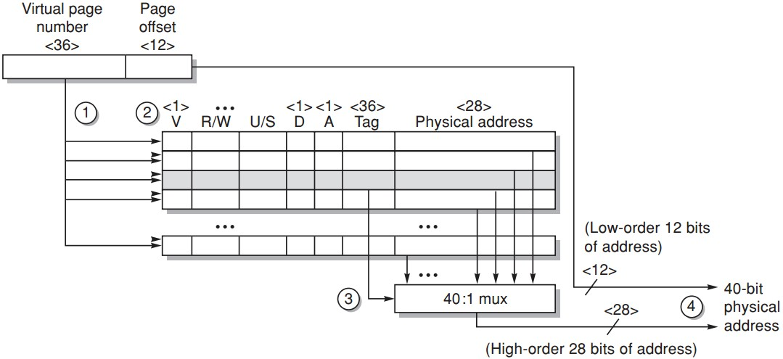
Address Translation
Example: Opteron data TLB
Steps 1&2: send the virtual address to all tags
Step 2: check the type of mem access against protection info in TLB

Slide 26
Address Translation
Example: Opteron data TLB
Steps 3: the matching tag sends phy addr through multiplexor

Slide 27
Address Translation
Example: Opteron data TLB
Steps 4: concatenate page offset to phy page frame to form final phy addr

Slide 28
Outline
Four Memory Hierarchy Questions
Address Translation
Page Size Selection
Virtual Memory Meets Caches
Protection & Sharing among Programs

Slide 29
Page Size Selection
Pros of larger page size
Smaller page table, less memory (or other resources used for the memory map);
Larger cache with fast cache hit;
Transferring larger pages to or from secondary storage is more efficient than transferring smaller pages;
Map more memory, reduce the number of TLB misses;

Slide 30
Page Size Selection
Pros of smaller page size
Conserve storage
When a contiguous region of virtual memory is not equal in size to a multiple of the page size,
a small page size results in less wasted storage.
Very large page size may waste more storage, I/O bandwidth and lengthen the time to invoke a process.

Slide 31
Page Size Selection
Use both: multiple page sizes
Recent microprocessors have decided to support multiple page sizes, mainly because of larger page size reduces the # of TLB entries and thus the # of TLB misses;
for some programs, TLB misses can be as significant on CPI as the cache misses;

Slide 32
Outline
Four Memory Hierarchy Questions
Address Translation
Page Size Selection
Virtual Memory Meets Caches
Protection & Sharing among Programs

Slide 33
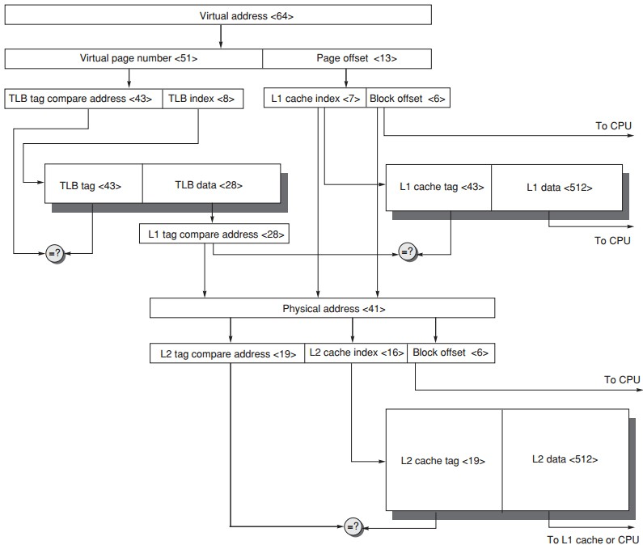
Virtual Memory
+ Caches
Cache: virtually indexed + physically tagged

Slide 34
Outline
Four Memory Hierarchy Questions
Address Translation
Page Size Selection
Virtual Memory Meets Caches
Protection & Sharing among Programs

Slide 35
Multiprogramming
Enable a computer to be shared by several programs running concurrently
Need protection and sharing among programs

Slide 36
Process
A running program plus any state needed to continue running it
Time-sharing
shares processor and memory with interactive users simultaneously;
gives the illusion that all users have their own computers;
Process/context switch
from one process to another

Slide 37
Process
Maintain correct process behavior
--computer designer must ensure that the processor portion of the process state can be saved and restored;
--OS designer must guarantee that processes do not interfere with each others’ computations;
Partition main memory so that several different processes have their state in memory at the same time

Slide 38
Process Protection
Proprietary page tables
processes can be protected from one another by having their own page tables,
each pointing to distinct pages of memory;
user programs must be prevented from modifying their page tables

Slide 39
Process Protection
Rings
added to the processor protection structure,
expands memory access protection to multiple levels.
The most trusted accesses anything
The second most trusted accesses everything except the innermost level
…
The civilian programs are the least trusted, have the most limited range of accesses.

Slide 40
Process Protection
Keys and Locks
a program cannot unlock access to the data unless it has the key
For keys/capabilities to be useful, hardware and OS must be able to explicitly pass them from one program to another
without allowing a program itself to forge them

Slide 41
Example 1: Intel Pentium
Segmented virtual memory
IA-32: four levels of protection
(0) innermost level, kernel mode;
(3) outermost level, least privileged mode;
separate stacks for each level to avoid security breaches between the levels

Slide 42
Example 1: Intel Pentium
Add bounds checking and memory mapping
base + limit fields
Add sharing and protection
global/local address space;
a field giving a seg’s legal access level;
Add safe calls from user to OS gates and inheriting protection level for parameters
call gate

Slide 43
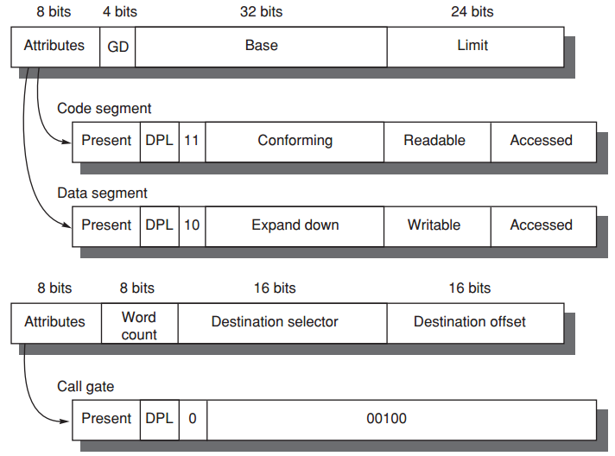
Example 1: Intel Pentium
Segment Descriptors

Slide 44
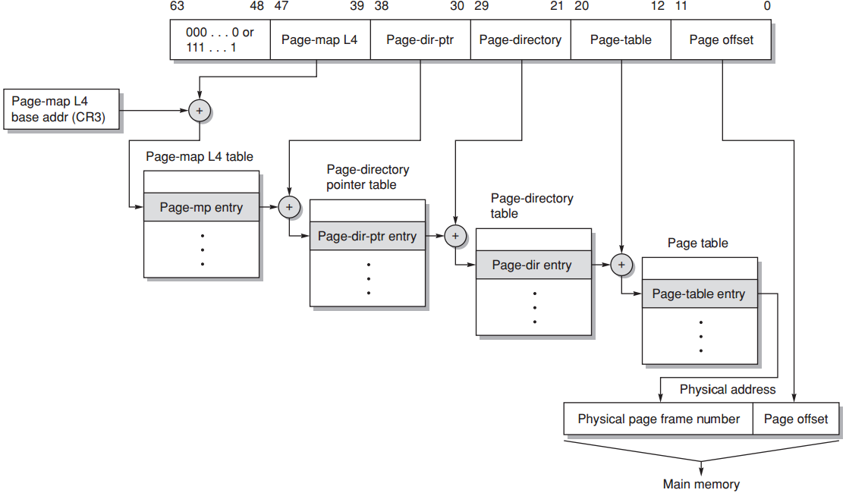
Example 2: 64-bit Opteron
Paged virtual memory
Multilevel hierarchical page table;
Page tables are protected from being written by user programs;
Sharing of memory between processes is accomplished by having a page table entry in each address space point to the same physical memory page;

Slide 45
?

