Slide 1
Lecture 10: Memory Hierarchy
Design
Kai Bu
kaibu@zju.edu.cn
http://list.zju.edu.cn/kaibu/comparch

Slide 2
Assignment 3 due May 13

Slide 3

Chapter 2
Appendix B

Slide 4
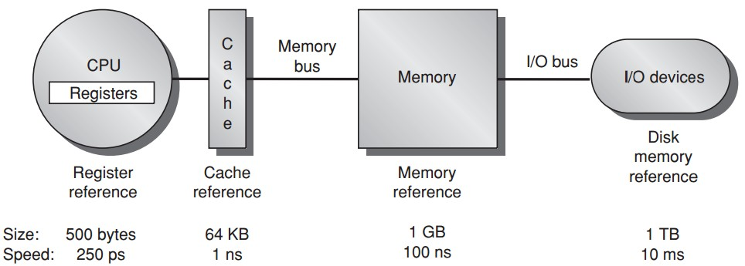
Memory Hierarchy

Slide 5
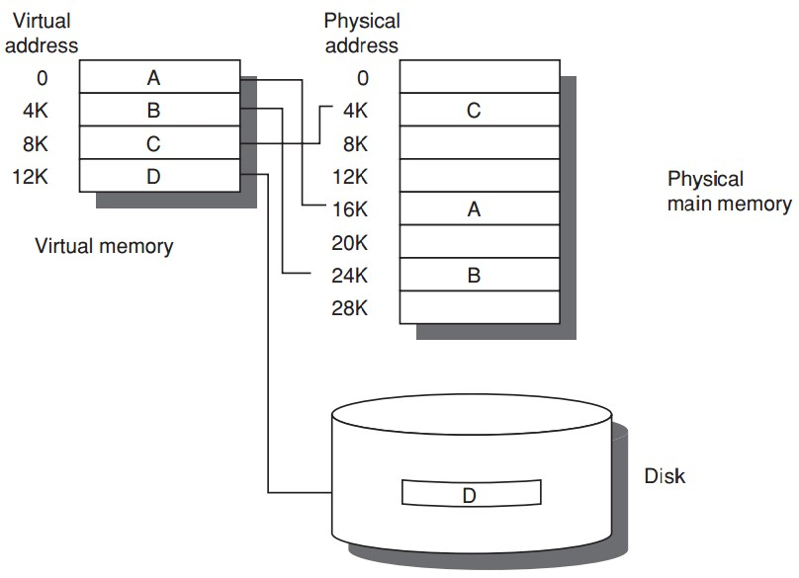
Virtual Memory
Larger memory for more processes

Slide 6
Cache Performance
Average Memory Access Time =
Hit Time + Miss Rate x Miss Penalty

Slide 7
Six Basic Cache Optimizations
1. larger block size
reduce miss rate; --- spatial locality;
reduce static power; --- lower tag #;
increase miss penalty, capacity/conflict misses;
2. bigger caches
reduce miss rate; --- capacity misses
increase hit time;
increase cost and (static & dynamic) power;
3. higher associativity
reduce miss rate; --- conflict misses;
increase hit time;
increase power;

Slide 8
Six Basic Cache Optimizations
4. multilevel caches
reduce miss penalty;
reduce power;
average memory access time =
Hit time_{L1} + Miss rate_{L1} x
(Hit time_{L2} + Miss rate_{L2} x Miss penalty_{L2})
5. giving priority to read misses over writes
reduce miss penalty;
introduce write buffer;

Slide 9
Six Basic Cache Optimizations
6. avoiding address translation during indexing of the cache
reduce hit time;
use page offset to index cache;
virtually indexed, physically tagged;

Slide 10
Outline
Ten Advanced Cache Optimizations
Memory Technology and Optimizations
Virtual Memory and Virtual Machines
ARM Cortex-A8 & Intel Core i7

Slide 11
Outline
Ten Advanced Cache Optimizations
Memory Technology and Optimizations
Virtual Memory and Virtual Machines
ARM Cortex-A8 & Intel Core i7

Slide 12
Ten Advanced Cache Opts
Goal: average memory access time
Metrics to reduce/optimize
hit time
miss rate
miss penalty
cache bandwidth
power consumption

Slide 13
Ten Advanced Cache Opts
Reduce hit time
small and simple first-level caches;
way prediction;
decrease power;
Reduce cache bandwidth
pipelined/multibanked/nonblocking cache;
Reduce miss penalty
critical word first;
merging write buffers;
Reduce miss rate
compiler optimizations; decrease power;
Reduce miss penalty or miss rate via parallelism
hardware/compiler prefetching; increase power;

Slide 14
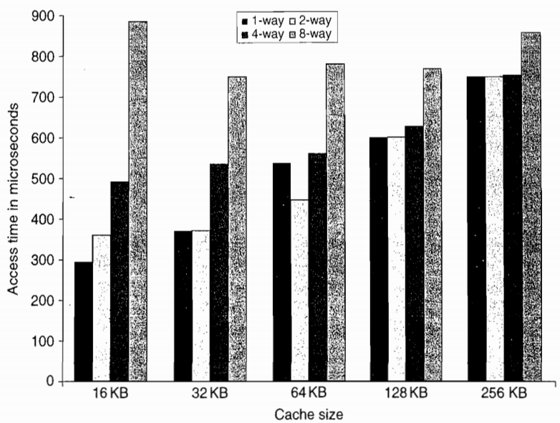
Opt #1: Small and Simple First-Level Caches
Reduce hit time and power

Slide 15
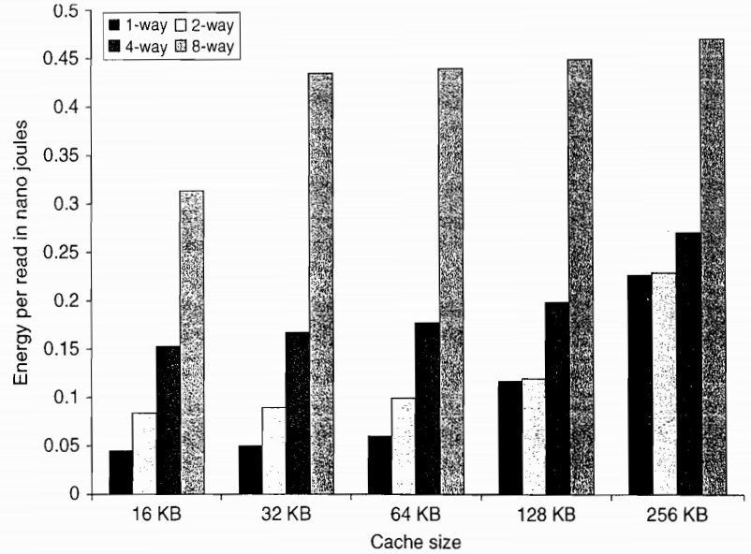
Opt #1: Small and Simple First-Level Caches
Reduce hit time and power

Slide 16
Opt #1: Small and Simple First-Level Caches
Example
a 32 KB cache;
two-way set associative: 0.038 miss rate;
four-way set associative: 0.037 miss rate;
four-way cache access time is 1.4 times two-way cache access time;
miss penalty to L2 is 15 times the access time for the faster L1 cache (i.e., two-way)
assume always L2 hit;
Q: which has faster memory access time?

Slide 17
Opt #1: Small and Simple First-Level Caches
Answer
Average memory access time_{2-way}
=Hit time + Miss rate x Miss penalty
=1 + 0.038 x 15
=1.38
Average memory access time_{4-way}
=1.4 + 0.037 x (15/1.4)
=1.77

Slide 18
Opt #2: Way Prediction
Reduce conflict misses and hit time
Way prediction
block predictor bits are added to each block to predict the way/block within the set of the next cache access
the multiplexor is set early to select the desired block;
only a single tag comparison is performed in parallel with cache reading;
a miss results in checking the other blocks for matches in the next clock cycle;

Slide 19
Opt #3: Pipelined Cache Access
Increase cache bandwidth
Higher latency
Greater penalty on mispredicted branches and more clock cycles between issues the load and using the data

Slide 20
Opt #4: Nonblocking Caches
Increase cache bandwidth
Nonblocking/lockup-free cache
allows data cache to continue to supply cache hits during a miss;

Slide 21
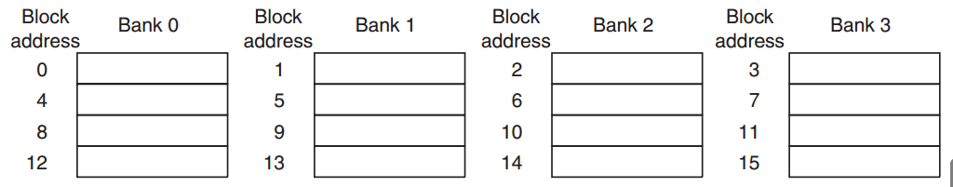
Opt #5: Multibanked Caches
Increase cache bandwidth
Divide cache into independent banks that support simultaneous accesses
Sequential interleaving
spread the addresses of blocks sequentially across the banks

Slide 22
Opt #6: Critical Word First
& Early Restart
Reduce miss penalty
Motivation: the processor normally needs just one word of the block at a time
Critical word first
request the missed word first from the memory and send it to the processor as soon as it arrives;
Early restart
fetch the words in normal order,
as soon as the requested word arrives send it to the processor;

Slide 23
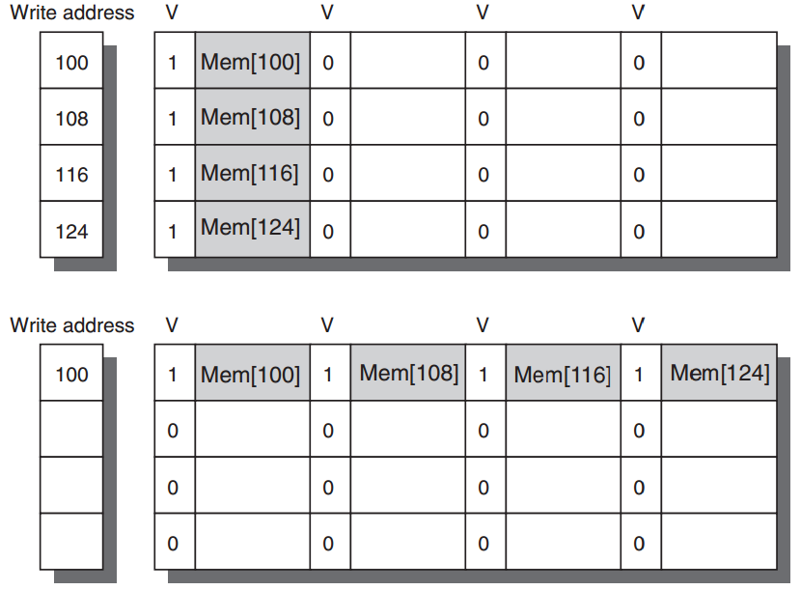
Opt #7: Merging Write Buffer
Reduce miss penalty
Write merging merges four entries into a single buffer entry

Slide 24
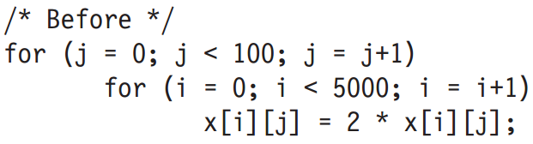
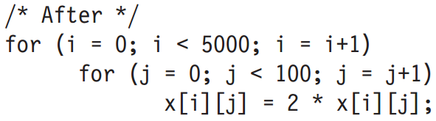
Opt #8: Compiler Optimizations
Reduce miss rates, w/o hw changes
Tech 1: Loop interchange
exchange the nesting of the loops to make the code access the data in the order in which they are stored

Slide 25
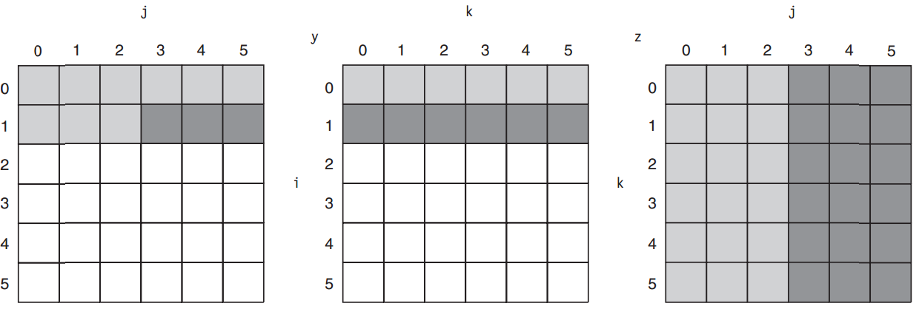
Opt #8: Compiler Optimizations
Reduce miss rates, w/o hw changes
Tech 2: Blocking
x = y*z; both row&column accesses
before

Slide 26
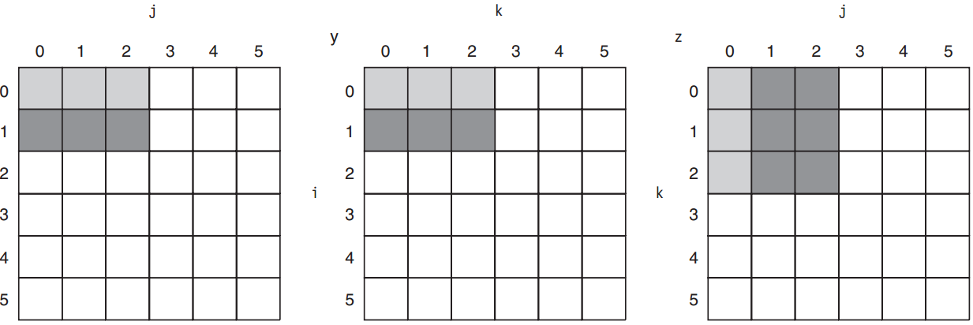
Opt #8: Compiler Optimizations
Reduce miss rates, w/o hw changes
Tech 2: Blocking
x = y*z; both row&column accesses
after; maximize accesses loaded data before they are replaced

Slide 27
Opt #9: Hardware Prefetching
Reduce miss penalty/rate
Prefetch items before the processor requests them, into the cache or external buffer
Instruction prefetch
fetch two blocks on a miss: requested one into cache + next consecutive one into instruction stream buffer
Similar Data prefetch approaches

Slide 28
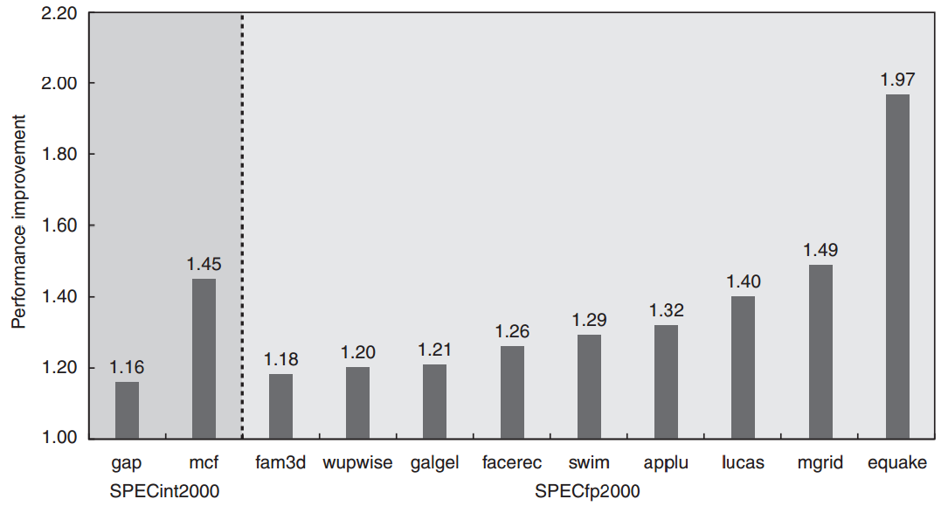
Opt #9: Hardware Prefetching

Slide 29
Opt #10: Compiler Prefetching
Reduce miss penalty/rate
Compiler to insert prefetch instructions to request data before the processor needs it
Register prefetch
load the value into a register
Cache prefetch
load data into the cache

Slide 30
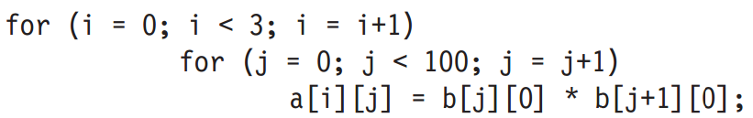
Opt #10: Compiler Prefetching
Example: 251 misses
16-byte blocks;
8-byte elements for a and b;
write-back strategy;
a[0][0] miss, copy both a[0][0],a[0][1] as one block contains 16/8 = 2;
so for a: 3 x (100/2) = 150 misses
b[0][0] – b[100][0]: 101 misses

Slide 31
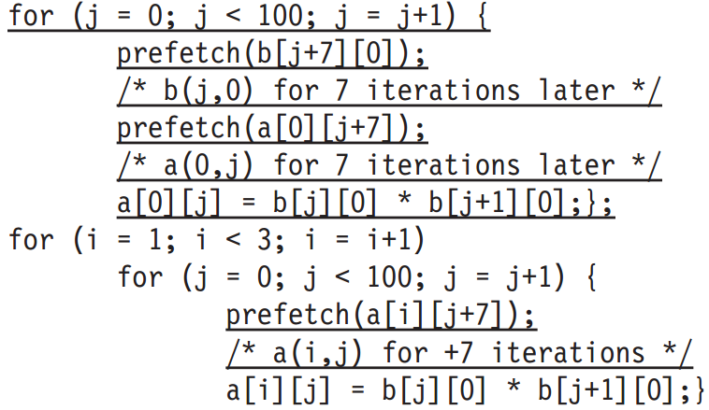
Opt #10: Compiler Prefetching
Example: 19 misses
7 misses: b[0][0] – b[6][0]
4 misses: 1/2 of a[0][0] – a[0][6]
4 misses: a[1][0] – b[1][6]
4 misses: a[2][0] – b[2][6]

Slide 32
Outline
Ten Advanced Cache Optimizations
Memory Technology and Optimizations
Virtual Memory and Virtual Machines
ARM Cortex-A8 & Intel Core i7

Slide 33
Main Memory
Main memory: I/O interface between caches and servers
Dst of input & src of output
Processor
Control
Secondary
Storage
(Disk)
Second
Level
Cache
(SRAM)
Main
Memory
(DRAM)
Datapath
On-Chip
Cache
Registers
Compiler
Hardware
Speed:
Fastest
Operating System
Slowest
Size:
Smallest
Biggest
Cost:
Highest
Lowest

Slide 34
Main Memory
Performance measures
Latency
important for caches;
harder to reduce;
Bandwidth
important for multiprocessors, I/O, and caches with large block sizes;
easier to improve with new organizations;

Slide 35
Main Memory
Performance measures
Latency
access time: the time between when a read is requested and when the desired word arrives;
cycle time: the minimum time between unrelated requests to memory;
or the minimum time between the start of on access and the start of the next access;

Slide 36
Main Memory
SRAM for cache
DRAM for main memory

Slide 37
SRAM
Static Random Access Memory
Six transistors per bit to prevent the information from being disturbed when read
Don’t need to refresh, so access time is very close to cycle time

Slide 38
DRAM
Dynamic Random Access Memory
Single transistor per bit
Reading destroys the information
Refresh periodically
cycle time > access time

Slide 39
DRAM
Dynamic Random Access Memory
Single transistor per bit
Reading destroys the information
Refresh periodically
cycle time > access time
DRAMs are commonly sold on small boards called DIMM (dual inline memory modules), typically containing 4 ~ 16 DRAMs

Slide 40
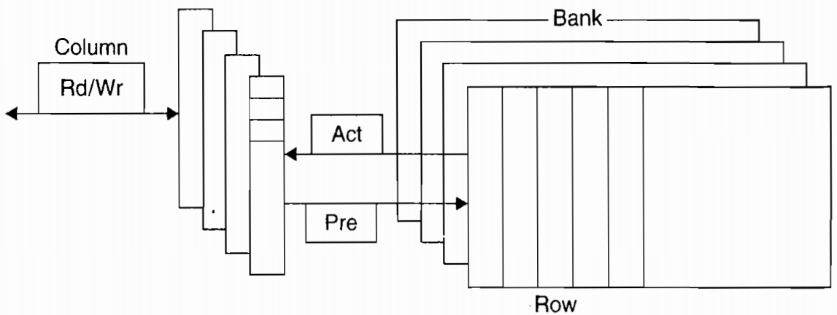
DRAM Organization
RAS: row access strobe
CAS: column access strobe

Slide 41
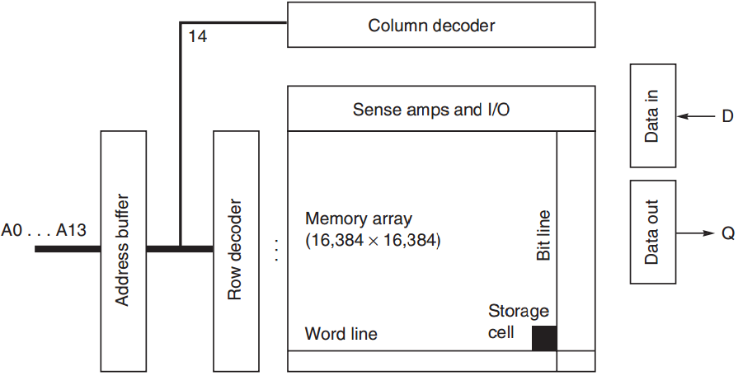
DRAM Organization

Slide 42
DRAM Improvement
Timing signals
allow repeated accesses to the row buffer w/o another row access time;
Leverage spatial locality
each array will buffer 1024 to 4096 bits for each access;

Slide 43
DRAM Improvement
Clock signal
added to the DRAM interface,
so that repeated transfers will not involve overhead to synchronize with memory controller;
SDRAM: synchronous DRAM

Slide 44
DRAM Improvement
Wider DRAM
to overcome the problem of getting a wide stream of bits from memory without having to make the memory system too large as memory system density increased;
widening the cache and memory widens memory bandwidth;
e.g., 4-bit transfer mode up to 16-bit buses

Slide 45
DRAM Improvement
DDR: double data rate
to increase bandwidth,
transfer data on both the rising edge and falling edge of the DRAM clock signal,
thereby doubling the peak data rate;

Slide 46
DRAM Improvement
Multiple Banks
break a single SDRAM into 2 to 8 blocks;
they can operate independently;
Provide some of the advantages of interleaving
Help with power management

Slide 47
DRAM Improvement
Reducing power consumption in SDRAMs
dynamic power: used in a read or write
static/standby power
Depend on the operating voltage
Power down mode: entered by telling the DRAM to ignore the clock
disables the SDRAM except for internal automatic refresh;

Slide 48
Flash Memory
A type of EEPROM (electronically erasable programmable read-only memory)
Read-only but can be erased
Hold contents w/o any power

Slide 49
Flash Memory
Differences from DRAM
Must be erased (in blocks) before it is overwritten
Static and less power consumption
Has a limited number of write cycles for any block
Cheaper than SDRAM but more expensive than disk
Slower than SDRAM but faster than disk

Slide 50
Memory Dependability
Soft errors
changes to a cell’s contents, not a change in the circuitry
Hard errors
permanent changes in the operation of one of more memory cells

Slide 51
Memory Dependability
Error detection and fix
Parity only
only one bit of overhead to detect a single error in a sequence of bits;
e.g., one parity bit per 8 data bits
ECC only
detect two errors and correct a single error with 8-bit overhead per 64 data bits
Chipkill
handle multiple errors and complete failure of a single memory chip

Slide 52
Memory Dependability
Rates of unrecoverable errors in 3 yrs
Parity only
about 90,000, or one unrecoverable (undetected) failure every 17 mins
ECC only
about 3,500 or about one undetected or unrecoverable failure every 7.5 hrs
Chipkill
6, or about one undetected or unrecoverable failure every 2 months

Slide 53
Outline
Ten Advanced Cache Optimizations
Memory Technology and Optimizations
Virtual Memory and Virtual Machines
ARM Cortex-A8 & Intel Core i7

Slide 54
VMM: Virtual Machine Monitor
three essential characteristics:
1. VMM provides an environment for programs which is essentially identical with the original machine;
2. programs run in this environment show at worst only minor decreases in speed;
3. VMM is in complete control of system resources;
Mainly for security and privacy
sharing and protection among multiple processes

Slide 55
Virtual Memory
The architecture must limit what a process can access when running a user process yet allow an OS process to access more
Four tasks for the architecture

Slide 56
Virtual Memory
1. The architecture provides at least two modes, indicating whether the running process is a user process or an OS process (kernel/supervisor process)
2. The architecture provides a portion of the processor state that a user process can use but not write
3. The architecture provides mechanisms whereby the processor can go from user mode to supervisor mode (system call) and vice versa
4. The architecture provides mechanisms to limit memory accesses to protect the memory state of a process w/o having to swap the process to disk on a context switch

Slide 57
Virtual Machines
Virtual Machine
a protection mode with a much smaller code base than the full OS
VMM: virtual machine monitor
hypervisor
software that supports VMs
Host
underlying hardware platform

Slide 58
Virtual Machines
Requirements
1. Guest software should behave on a VM exactly as if it were running on the native hardware
2. Guest software should not be able to change allocation of real system resources directly

Slide 59
Outline
Ten Advanced Cache Optimizations
Memory Technology and Optimizations
Virtual Memory and Virtual Machines
ARM Cortex-A8 & Intel Core i7

Slide 60
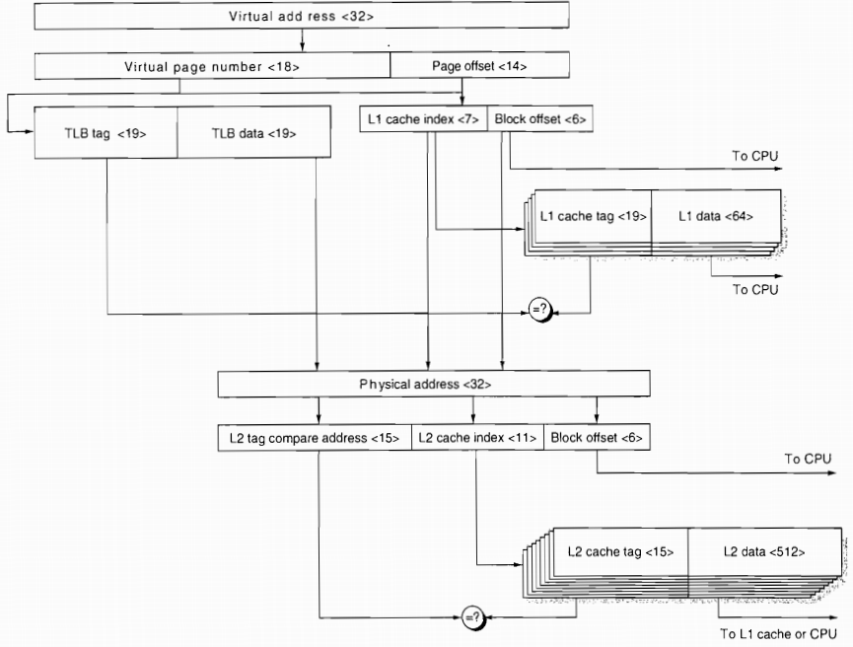
ARM Cortex A-8

Slide 61
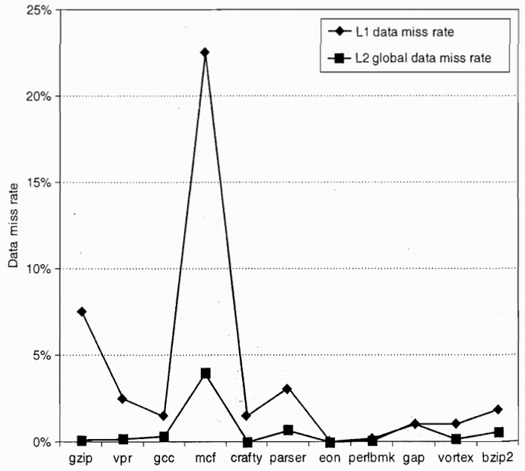
ARM Cortex A-8

Slide 62
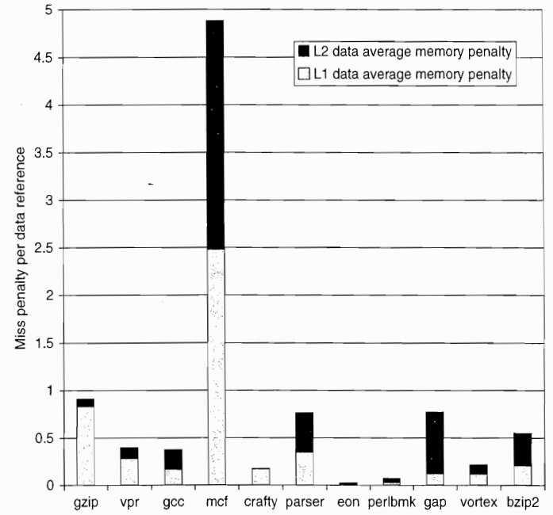
ARM Cortex A-8

Slide 63
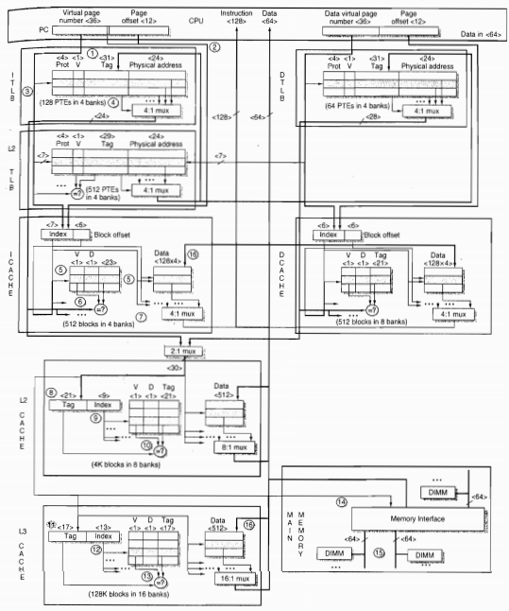
Intel Core i7

Slide 64
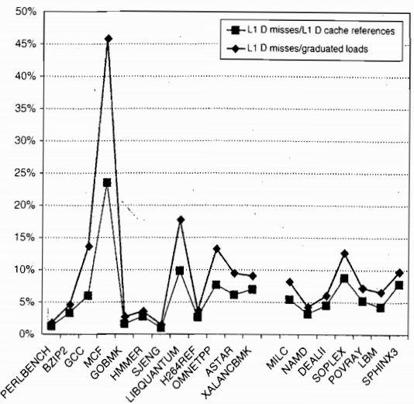
Intel Core i7

Slide 65
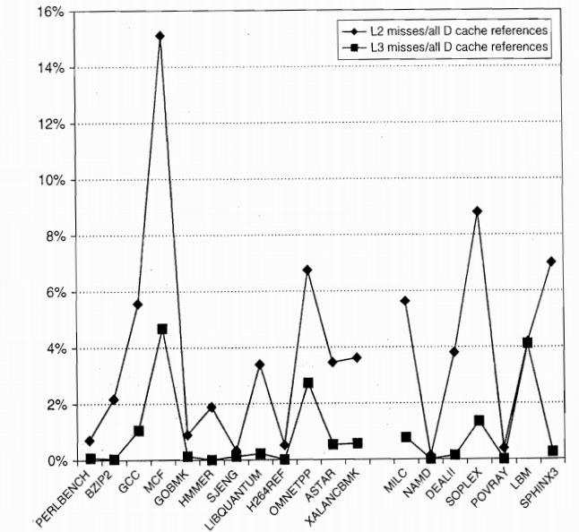
Intel Core i7

Slide 66
?

