Slide 1
Lecture 13: Multiprocessors
Kai Bu
kaibu@zju.edu.cn
http://list.zju.edu.cn/kaibu/comparch

Slide 2
Assignment 4 due June 3
Lab 5 demo due June 10
Quiz June 3

Slide 3

Chapter 5.1–5.4

Slide 4
ILP -> TLP
instruction-level
parallelism
thread-level
parallelism

Slide 5
MIMD multiple instruction streams multiple data streams
Each processor fetches its own instructions and operates on its own data

Slide 6
multiprocessors multiple instruction streams multiple data streams
computers consisting of tightly coupled processors
Coordination and usage are typically controlled by a single OS
Share memory through a shared address space

Slide 7
multiprocessors multiple instruction streams multiple data streams
computers consisting of tightly coupled processors
Muticore Single-chip systems with multiple cores
Multi-chip computers each chip may be a multicore sys

Slide 8
Exploiting TLP
two software models
Parallel processing
the execution of a tightly coupled set of threads collaborating on a single disk
Request-level parallelism
the execution of multiple, relatively independent processes that may originate from one or more users

Slide 9
Outline
Multiprocessor Architecture
Centralized Shared-Memory Arch
Distributed shared memory and directory-based coherence

Slide 10
Outline
Multiprocessor Architecture
Centralized Shared-Memory Arch
Distributed shared memory and directory-based coherence

Slide 11
Multiprocessor Architecture
According to memory organization and interconnect strategy
Two classes
symmetric/centralized shared-memory multiprocessors (SMP)
+
distributed shared memory multiprocessors (DMP)

Slide 12
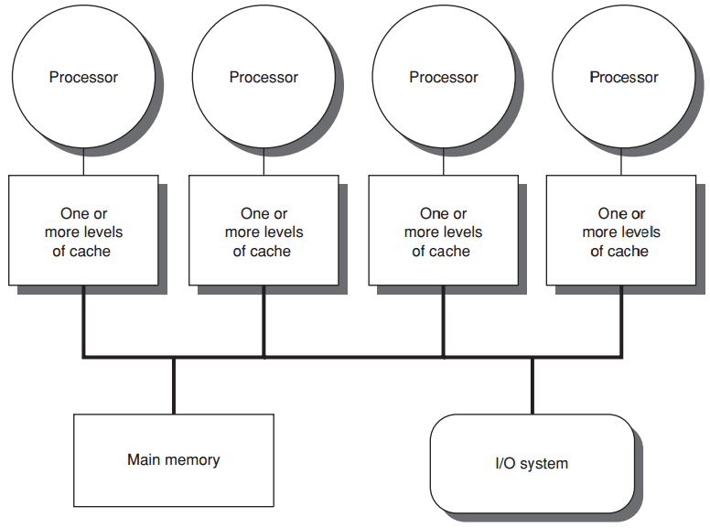
centralized shared-memory
eight or fewer cores

Slide 13
centralized shared-memory
Share a single centralized memory
All processors have equal access to

Slide 14
centralized shared-memory
All processors have uniform latency from memory
Uniform memory access (UMA) multiprocessors

Slide 15
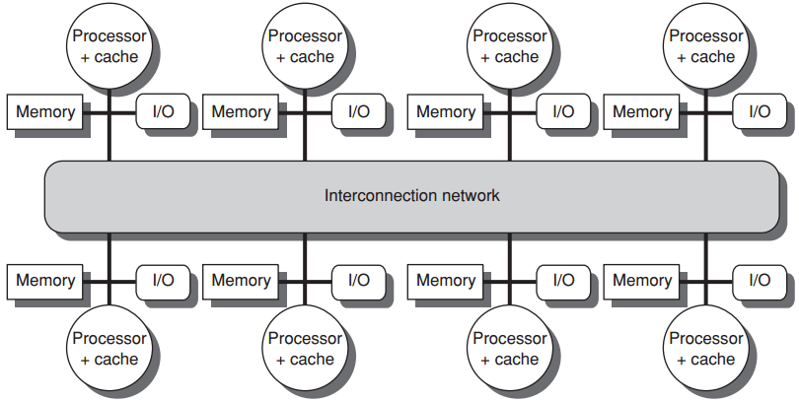
distributed shared memory
more processors
physically distributed memory

Slide 16
distributed shared memory
more processors
physically distributed memory
Distributing mem among the nodes
increases bandwidth & reduces local-mem latency

Slide 17
distributed shared memory
more processors
physically distributed memory
NUMA: nonuniform memory access
access time depends on data word loc in mem

Slide 18
distributed shared memory
more processors
physically distributed memory
Disadvantages:
more complex inter-processor communication
more complex software to handle distributed mem

Slide 19
Hurdles of Parallel Processing
Limited parallelism available in programs
Relatively high cost of communications

Slide 20
Hurdles of Parallel Processing
Limited parallelism available in programs
makes it difficult to achieve good speedups in any parallel processor
Relatively high cost of communications

Slide 21
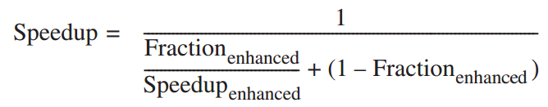
Hurdles of Parallel Processing
Limited parallelism affects speedup
Example
to achieve a speedup of 80 with 100 processors, what fraction of the original computation can be sequential?
Answer
by Amdahl’s law

Slide 22
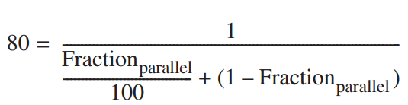
Hurdles of Parallel Processing
Limited parallelism affects speedup
Example
to achieve a speedup of 80 with 100 processors, what fraction of the original computation can be sequential?
Answer
by Amdahl’s law

Slide 23
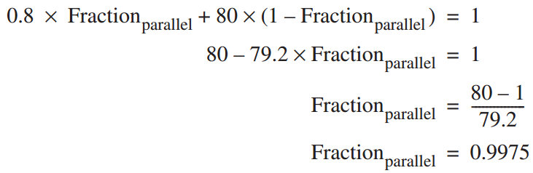
Hurdles of Parallel Processing
Limited parallelism affects speedup
Example
to achieve a speedup of 80 with 100 processors, what fraction of the original computation can be sequential?
Answer
by Amdahl’s law
Fraction_{seq} = 1 – Fraction_{parallel}
= 0.25%

Slide 24
Hurdles of Parallel Processing
Limited parallelism available in programs
makes it difficult to achieve good speedups in any parallel processor;
in practice, programs often use less than the full complement of the processors when running in parallel mode;
Relatively high cost of communications

Slide 25
Hurdles of Parallel Processing
Limited parallelism available in programs
Relatively high cost of communications
involves the large latency of remote access in a parallel processor

Slide 26
Hurdles of Parallel Processing
Relatively high cost of communications
involves the large latency of remote access in a parallel processor
Example
app running on a 32-processor MP;
200 ns for reference to a remote mem;
clock rate 2.0 GHz; base CPI 0.5;
Q: how much faster if no communication vs if 0.2% remote ref?

Slide 27

Hurdles of Parallel Processing
Example
app running on a 32-processor MP;
200 ns for reference to a remote mem;
clock rate 2.0 GHz; base CPI 0.5;
Q: how much faster if no communication vs if 0.2% remote ref?
Answer
if 0.2% remote reference

Slide 28

Hurdles of Parallel Processing
Example
app running on a 32-processor MP;
200 ns for reference to a remote mem;
clock rate 2.0 GHz; base CPI 0.5;
Q: how much faster if no communication vs if 0.2% remote ref?
Answer
if 0.2% remote ref, Remote req cost

Slide 29

Hurdles of Parallel Processing
Example
app running on a 32-processor MP;
200 ns for reference to a remote mem;
clock rate 2.0 GHz; base CPI 0.5;
Q: how much faster if no communication vs if 0.2% remote ref?
Answer
if 0.2% remote ref
no comm is 1.3/0.5 = 2.6 times faster

Slide 30
Hurdles of Parallel Processing
solutions
insufficient parallelism
new software algorithms that offer better parallel performance;
software systems that maximize the amount of time spent executing with the full complement of processors;
long-latency remote communication
by architecture: caching shared data…
by programmer: multithreading, prefetching…

Slide 31
Outline
Multiprocessor Architecture
Centralized Shared-Memory Arch
Distributed shared memory and directory-based coherence

Slide 32
Centralized Shared-Memory
Large, multilevel caches
reduce mem bandwidth demands

Slide 33
Centralized Shared-Memory
Cache private/shared data

Slide 34
Centralized Shared-Memory
private data
used by a single processor

Slide 35
Centralized Shared-Memory
shared data
used by multiple processors
may be replicated in multiple caches to reduce
access latency, required mem bw, contention

Slide 36
Centralized Shared-Memory
w/o additional precautions
different processors can have different values
for the same memory location
shared data
used by multiple processors
may be replicated in multiple caches to reduce
access latency, required mem bw, contention

Slide 37
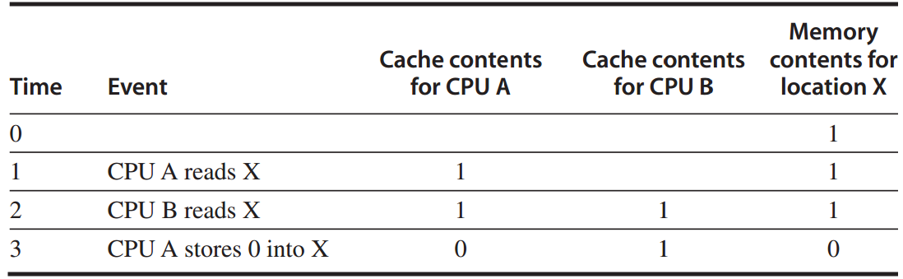
Cache Coherence Problem
write-through cache

Slide 38
Cache Coherence Problem
Global state defined by main memory
Local state defined by the individual caches

Slide 39
Cache Coherence Problem
A memory system is Coherent if any read of a data item returns the most recently written value of that data item
Two critical aspects
coherence: defines what values can be returned by a read
consistency: determines when a written value will be returned by a read

Slide 40
Coherence Property
A read by processor P to location X that follows a write by P to X, with writes of X by another processor occurring between the write and the read by P,
always returns the value written by P.
preserves program order

Slide 41
Coherence Property
A read by a processor to location X that follows a write by anther processor to X returns the written value if the read the write are sufficiently separated in time and no other writes to X occur between the two accesses.

Slide 42
Coherence Property
Write serialization
two writes to the same location by any two processors are seen in the same order by all processors

Slide 43
Consistency
When a written value will be seen is important
For example, a write of X on one processor precedes a read of X on another processor by a very small time, it may be impossible to ensure that the read returns the value of the data written,
since the written data may not even have left the processor at that point

Slide 44
Cache Coherence Protocols
Directory based
the sharing status of a particular block of physical memory is kept in one location, called directory
Snooping
every cache that has a copy of the data from a block of physical memory could track the sharing status of the block

Slide 45
Snooping Coherence Protocol
Write invalidation protocol
invalidates other copies on a write
exclusive access ensures that no other readable or writable copies of an item exist when the write occurs

Slide 46
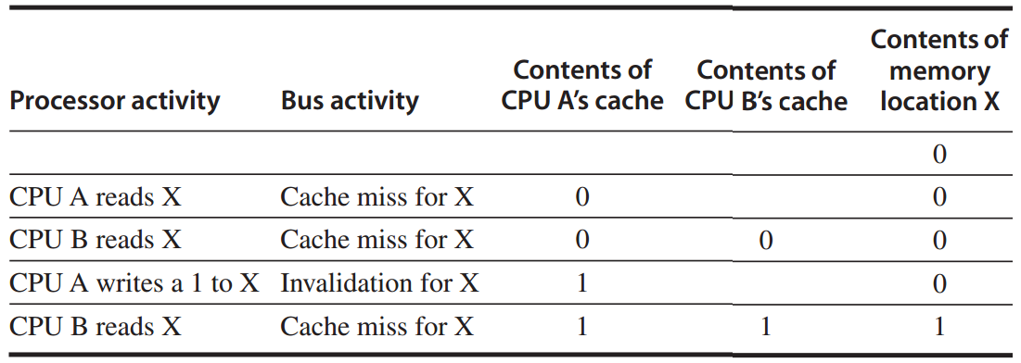
Snooping Coherence Protocol
Write invalidation protocol
invalidates other copies on a write
write-back cache

Slide 47
Snooping Coherence Protocol
Write update/broadcast protocol
update all cached copies of a data item when that item is written
consumes more bandwidth

Slide 48
Write Invalidation Protocol
To perform an invalidate, the processor simply acquires bus access and broadcasts the address to be invalidated on the bus
All processors continuously snoop on the bus, watching the addresses
The processors check whether the address on the bus is in their cache;
if so, the corresponding data in the cache is invalidated.

Slide 49
Write Invalidation Protocol
three block states (MSI protocol)
Invalid
Shared
indicates that the block in the private cache is potentially shared
Modified
indicates that the block has been updated in the private cache;
implies that the block is exclusive

Slide 50
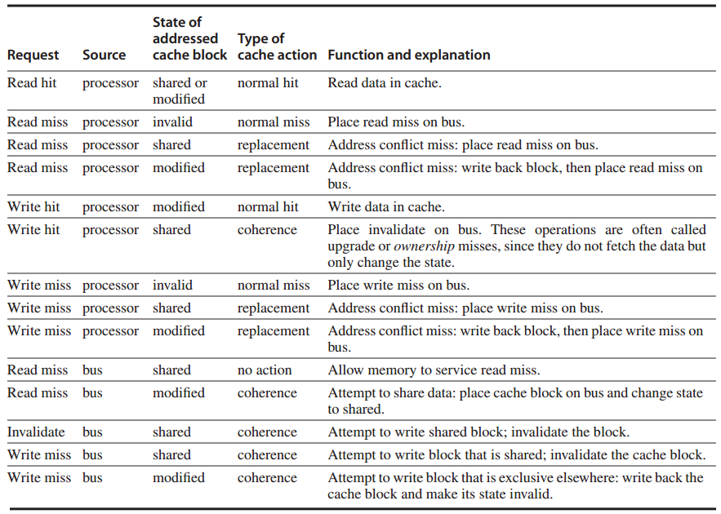
Write Invalidation Protocol

Slide 51
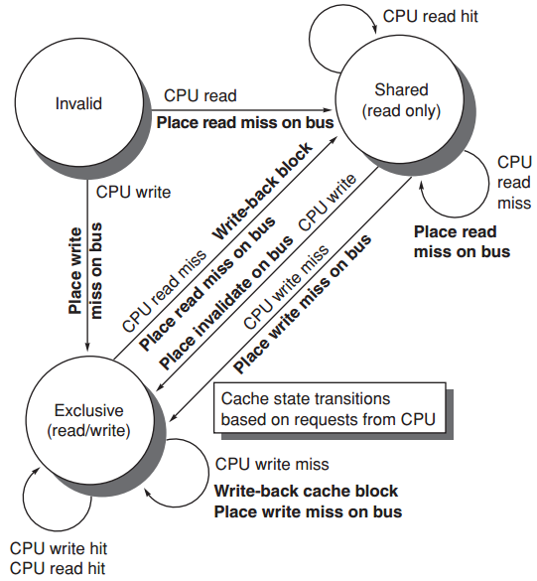
Write Invalidation Protocol

Slide 52
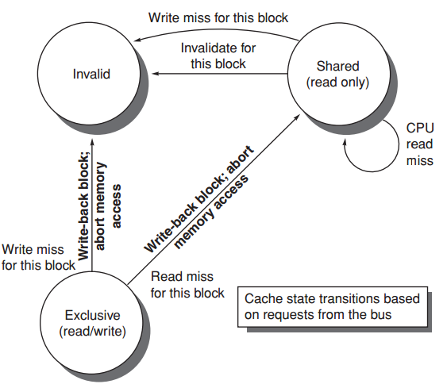
Write Invalidation Protocol

Slide 53
MSI Extensions
MESI
exclusive: indicates when a cache block is resident only in a single cache but is clean
exclusive->read by others->shared
exclusive->write->modified
MOESI

Slide 54
MSI Extensions
MOESI
owned: indicates that the associated block is owned by that cache and out-of-date in memory
Modified -> Owned without writing the shared block to memory

Slide 55
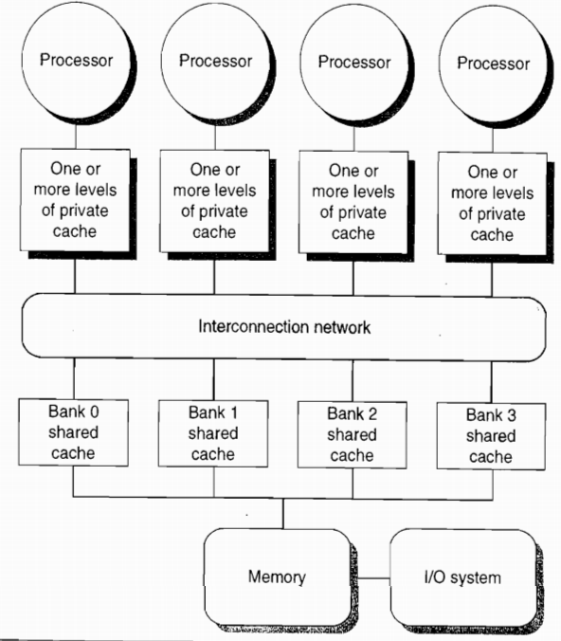
increase mem bandwidth
through multi-bus + interconnection network
and multi-bank cache

Slide 56
Coherence Miss
True sharing miss
first write by a processor to a shared cache block causes an invalidation to establish ownership of that block;
another processor reads a modified word in that cache block;
False sharing miss

Slide 57
Coherence Miss
True sharing miss
False sharing miss
a single valid bit per cache block;
occurs when a block is invalidated (and a subsequent reference causes a miss) because some word in the block, other than the one being read, is written into

Slide 58
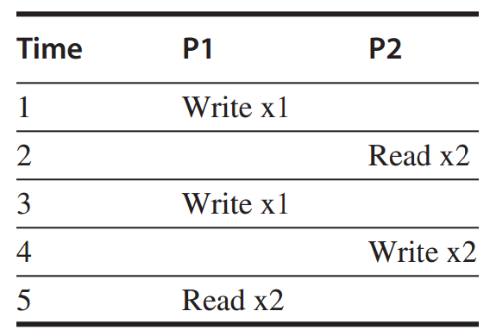
Coherence Miss
Example
assume words x1 and x2 are in the same cache block, which is in shared state in the caches of both P1 and P2.
identify each miss as a true sharing miss, a false sharing miss, or a hit?

Slide 59
Coherence Miss
Example
1. true sharing miss
since x1 was read by P2 and needs to be invalidated from P2

Slide 60
Coherence Miss
Example
2. false sharing miss
since x2 was invalidated by the write of x1 in P1,
but that value of x1 is not used in P2;

Slide 61
Coherence Miss
Example
3. false sharing miss
since the block is in shared state, need to invalidate it to write;
but P2 read x2 rather than x1;

Slide 62
Coherence Miss
Example
4. false sharing miss
need to invalidate the block;
P2 wrote x1 rather than x2;

Slide 63
Coherence Miss
Example
5. true sharing miss
since the value being read was written by P2 (invalid -> shared)

Slide 64
Outline
Multiprocessor Architecture
Centralized Shared-Memory Arch
Distributed shared memory and directory-based coherence

Slide 65
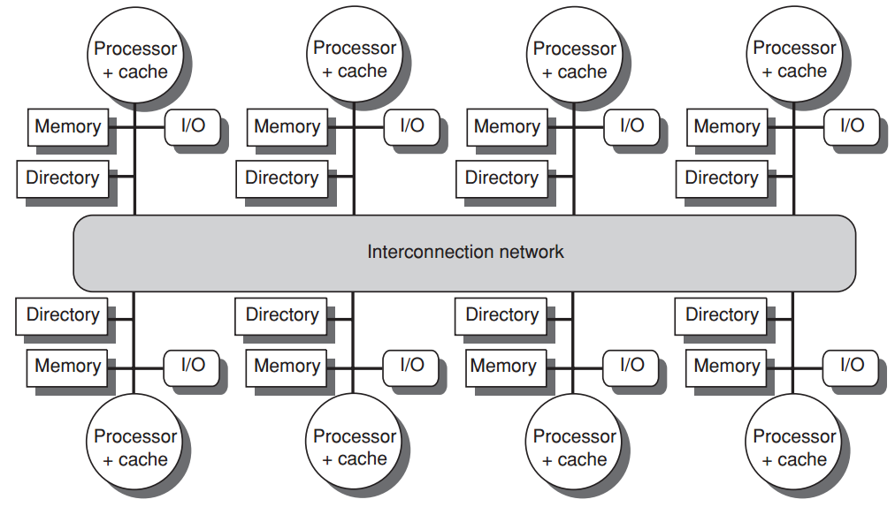
A directory is added to each node;
Each directory tracks the caches that share the memory addresses of the portion of memory in the node;
need not broadcast for on every cache miss

Slide 66
Directory-based
Cache Coherence Protocol
Common cache states
Shared
one or more nodes have the block cached, and the value in memory is up to date (as well as in all the caches)
Uncached
no node has a copy of the cache block
Modified
exactly one node has a copy of the cache block, and it has written the block, so the memory copy is out of date

Slide 67
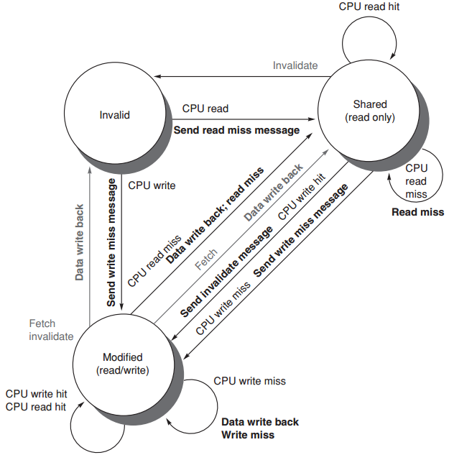
Directory Protocol
state transition diagram
for an individual cache block
requests from outside the node in gray

Slide 68
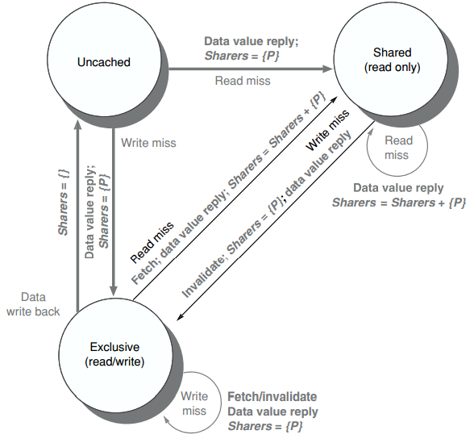
Directory Protocol
state transition diagram
for the directory
All actions in gray
because they’re all externally caused

Slide 69
?

