Slide 1
Lecture 01: Welcome
Computer Architecture!
Kai Bu
kaibu@zju.edu.cn
http://list.zju.edu.cn/kaibu/comparch2015

Slide 2
Instructor
Kai Bu 卜凯
Assistant Professor, College of CS, ZJU
Ph.D. from Hong Kong PolyU, 2013
Research Interests: wireless networking,
network security (e.g., RFID, software-
defined networking)
http://list.zju.edu.cn/kaibu

Slide 3

Textbook
Computer Architecture:
A Quantitative Approach
5th edition
John L. Hennessy
David A. Patterson

Slide 4
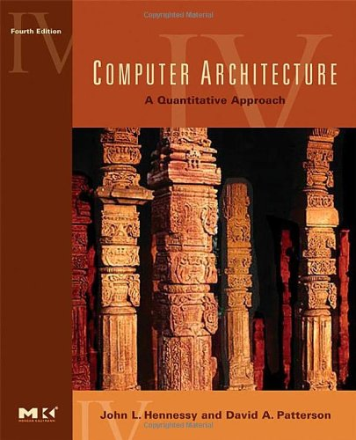
Textbook
Computer Architecture:
A Quantitative Approach
4th edition
John L. Hennessy
David A. Patterson
Some instructors may stick to the 4th ed
We’ll coordinate to keep the harmony
of the course content.

Slide 5
Why This Book?
Quantitative approach:
Performance driven
Know not only how but also why
As in this book
Operating Systems: Three Easy Pieces
http://pages.cs.wisc.edu/~remzi/OSTEP/

Slide 6
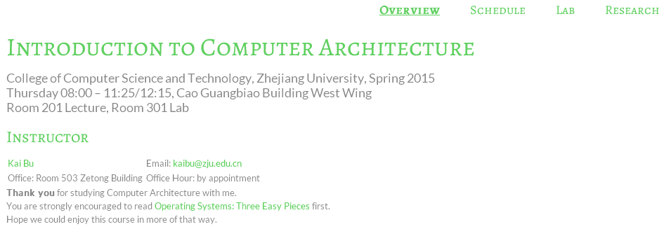
Course Website
http://list.zju.edu.cn/kaibu/comparch2015/

Slide 7
Syllabus
Reference syllabus by Prof. Jiang
http://list.zju.edu.cn/kaibu/comparch2015/Syllabus_2013spring.pdf
Reference schedule
http://list.zju.edu.cn/kaibu/comparch/schedule.html

Slide 8
Components
Lectures
Labs
Research Warm-up

Slide 9
Components
Lectures
Labs
Research Warm-up

Slide 10
Lectures
Chapter 1: Fundamentals of Computer Design
classes of computers
trends in technology, power, cost
dependability
dependability and performance quantitative principles of comp design
Notes:
The lecture sessions will feature the following contents

Slide 11
Lectures
Appendix A: Instruction Set Principles
classifying instruction set architecture
memory addressing
operations
instruction encoding
the role of compilers
example: MIPS architecture

Slide 12
Lectures
Appendix C: Pipelining
pipeline principles
pipeline hazards
implementation hurdles and solutions
example: MIPS R4000 pipeline
instruction level parallelism (Chapter 3)

Slide 13
Lectures
Chapter 2: Memory Hierarchy Design
cache performance (App B.2)
cache optimizations (App B.3)
memory tech and optimizations
virtual memory (App B.4)
protection of virtual memory (App B.5)
virtual memory and virtual machines
design of memory hierarchies

Slide 14
Lectures
Appendix D: Storage System Performance
I/O performance
queuing theory

Slide 15
Lectures
Chapter 5: Multiprocessors
symmetric shared-memory architecture
distributed shared-memory
directory-based coherence

Slide 16
Components
Lectures
Labs
Research Warm-up

Slide 17
Labs
5 lab sessions
Pipeline implementation

Slide 18
Labs
Lab 1
warmup Spartan 3E and ISE environment;
update verilog code of multi-cycle CPU to 3E board;
add one new branch instruction;
reference code:
Spartan 3E Display: http://list.zju.edu.cn/kaibu/comparch/lab1-Spartan3E-Display.rar
Spartan Simulation: http://list.zju.edu.cn/kaibu/comparch/spartansimulation.txt

Slide 19
Labs
Lab 2
implement 5-stage pipelined CPU with 15 MIPS instructions;
Lab 3
implement stall technique against pipelining hazards;
Lab 4
implement forwarding paths toward faster CPU;
Lab 5
implement a pipelined CPU with 31 MIPS instructions;
use predict-not-taken policy to solve control hazard;

Slide 20
Labs
Call for volunteer lab assistants
help tutor & check the demo during lab sessions;
get bonus credit via active class participation;

Slide 21
Components
Lectures
Labs
Research Warm-up

Slide 22
Why do you care?

Slide 23
Research Warm-up
Grading: Bonus 5%
75% Literature Review
25% Presentation

Slide 24
More than that?

Slide 25
Learn to
learn things differently

Slide 26
Know not only how
but also why

Slide 27
Read this book and you’ll see
Operating Systems: Three Easy Pieces
http://pages.cs.wisc.edu/~remzi/OSTEP/

Slide 28
Research Warm-up
Basic Requirements
Find a research topic you are interested in: e.g., computer architecture, computer network, network security;
Read 2-3 latest papers from recent CCF A conferences; http://www.ccf.org.cn/sites/ccf/paiming.jsp
Write a review and prepare a presentation.

Slide 29
Research Warm-up
Notes: The review should cover
What is the research problem?
Why is it important?
What are the solutions?
Any limitations?
What would you do?
More on http://list.zju.edu.cn/kaibu/comparch2015/research.html

Slide 30
Research Warm-up
Advanced Requirements
your research, your way
improve your review report into a research paper
prototype your idea

Slide 31
Call for Research Interns
and SRTP advisees
Networking, Security, Architecture:
RFID, SDN, Storage, etc.
more on http://list.zju.edu.cn/kaibu/publication.html
And, of course, what else you are interested in

Slide 32
Grade?
Notes:
Now we’ve talked about several components this course requires, then how will they be integrated into final grade?

Slide 33
Grading
4% | Class participation & performance
16% | Homework
8% | Pop quiz
32% | Lab assignments
40% | Final exam (closed-book)
Bonus 5% | Research Warm-up
Bonus 5% | Active class participation
Notes:
Grading policy

Slide 34
How will I teach?

Slide 35
What Students Expect from Teachers
Fun
Humor
Easy exam
High grades
…

Slide 36
I wish I knew someone like this, too…

Slide 37
Teaching Plan
Keep it Simple
Focus on the core concepts
Try to help you more easily understand

Slide 38
How will you contribute?

Slide 39
Thanks In Advance
Study group
Lab assistants
Research interns
…
Start a qq group for discussion?

Slide 40
?

Slide 41

Who’s Who

Slide 42
Ready?

