Slide 1
Lecture 03: Fundamentals of Computer Design
- Trends and Performance
Kai Bu
kaibu@zju.edu.cn
http://list.zju.edu.cn/kaibu/comparch2015
Notes:
In this class, we will continue with computer design basics.

Slide 2

Chapter 1.4-1.9
Notes:
The content corresponds to Chapter 1.4 – 1.9 in the textbook.

Slide 3
Preview
Trends in computer design
Performance-driven:
how to measure performance?
how to design computers toward better performance?
Notes:
We’ll feature two main parts in this class: trends and performance.
Quantitative approach: performance driven. How to measure? How to perform better?

Slide 4
How do trends evolve?
Notes:
Discuss about development trends now

Slide 5
Trends
Technology
Power and energy
Cost
Notes:
Trends in three aspects

Slide 6
Trends
Technology
Power and energy
Cost
Notes:
Trends in three aspects

Slide 7
Trends in Technology
5 critical implementation technologies:
Integrated circuit logic technology
Semiconductor DRAM
Semiconductor flash
Magnetic disk technology
Network technology
Notes:
Five rapidly changing implementation technologies that are critical to modern implementations;

Slide 8
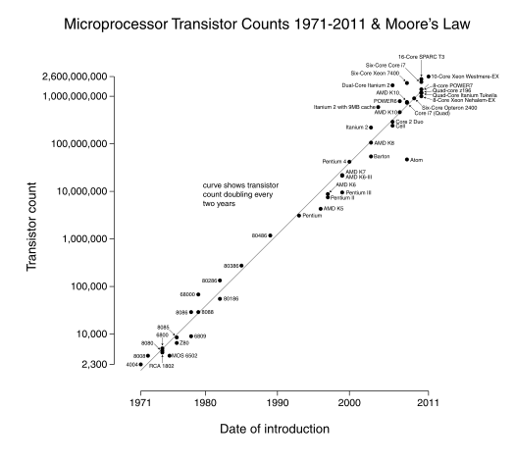
Integrated circuit logic technology
Moore’s Law: a growth rate in
transistor count
on a chip of about
40% to 55%
per year
doubles every
18 to 24 months
Notes:
Follows Moore’s law:

Slide 9
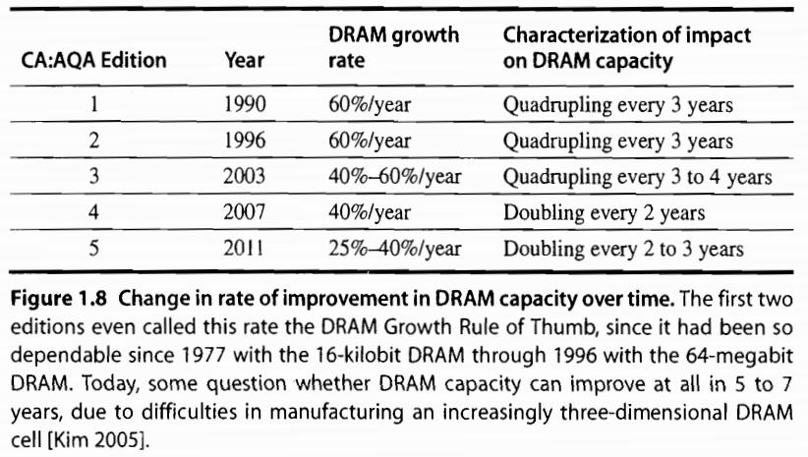
Semiconductor DRAM
Capacity per DRAM chip doubles roughly every 2 or 3 years

Slide 10
Semiconductor Flash
Electronically erasable programmable read-only memory
Standard storage devices in PMDs
Capacity per Flash chip doubles roughly every two years
In 2011, 15 to 20 times cheaper per bit than DRAM

Slide 11
Magnetic Disk Technology
Since 2004, density doubles every three years
15 to 20 times cheaper per bit than Flash
300 to 500 times cheaper per bit than DRAM
For server and warehouse scale storage

Slide 12
Network Technology
Switches
Transmission systems

Slide 13
Performance Trends
Bandwidth/Throughput
the total amount of work done in a given time;
Latency/Response Time
the time between the start and the completion of an event;

Slide 14
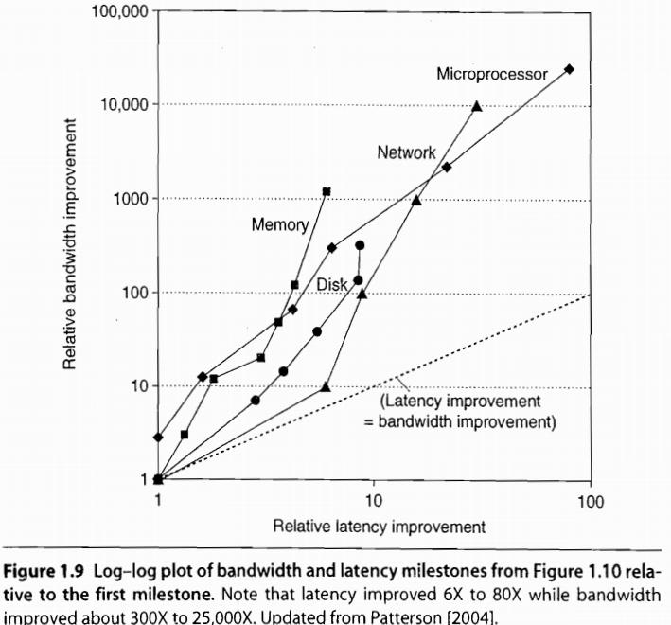
Bandwidth over Latency
For memory and disks
Capacity is generally more important than performance
So capacity improved more than latency
Notes:
Capacity is generally more important than performance for memory and disks
So capacity has improved most

Slide 15
Transistor Performance and Wires
Feature Size is decreasing
minimum size of a transistor or a wire in either the x or y dimension
Transistor performance improves linearly with decreasing feature size
feature size shrinks, wires gets shorter;
resistance and capacitance per unit length get worse.

Slide 16
Trends
Technology
Power and energy
Cost
Notes:
Trends in three aspects

Slide 17
Power vs Energy
How to measure power?
Power = Energy per unit time
1 watt = 1 joule per second
energy to execute a workload =
avg power x execution time
Notes:
Relation of power and energy;
The unit for measuring power is watt, while the unit for energy is joule

Slide 18
Power/Energy vs Efficiency
Example
processor A with 20% higher avg power consumption than processor B;
but A executes the task with 70% of the time by B;
A or B is more efficient?

Slide 19
Power/Energy vs Efficiency
Example
processor A with 20% higher avg power consumption than processor B;
but A executes the task with 70% of the time by B;
A or B is more efficient?
EnergyConsumptionA
= 1.2 x 0.7 x EnergyConsumptionB
=0.84 x EnergyConsumptionB

Slide 20

Primary Energy Consumption within a Microprocessor
Dynamic Energy:
switch transistors
energize pulse of the logic transition:
0->1->0 or 1->0->1
The energy of a single transition
0->1 or 1->0
Notes:
Dynamic energy is proportional to the product of the capacitive load and the square of voltage

Slide 21
Power Consumption of a Transistor
For a fixed task, slowing clock rate (frequency) reduces power,
but not energy.

Slide 22
Power Consumption of a Transistor
For a fixed task, slowing clock rate (frequency) reduces power,
but not energy.
Why?

Slide 23
Power Consumption of a Transistor
For a fixed task, slowing clock rate (frequency) reduces power,
but not energy.
Why?
energy = power x execution-time

Slide 24
Power Consumption of a Transistor
For a fixed task, slowing clock rate (frequency) reduces power,
but not energy.
Why?
energy = power x execution-time

Slide 25
Challenges
Distributing the power
Removing the heat
Preventing hot spots
Notes:
All have interesting research topics

Slide 26
Improve Energy-Efficiency
1. do nothing well
turn off the clock of inactive modules
2. DVFS: dynamic voltage-frequency scaling
scale down clock frequency and voltage during periods of low activity

Slide 27
Improve Energy-Efficiency
3. design for typical case
PMDs, laptops – often idle
memory and storage with low power modes to save energy
4. overclocking – Turbo mode
the chip runs at a higher clock rate for a short time until temperature rises
Notes:
3. Pmds and laptops are often iden, memory and storage offer low power modes to save energy
4.

Slide 28
Beyond Transistors
Processor is just a portion of the whole energy cost
Race-to-halt
a faster, less energy-efficient processor
to more quickly complete tasks,
for the rest of the system to go into sleep mode
Notes:
Use a faster processor to more quickly complete tasks, then less energy cost induced by other system components;

Slide 29
Trends
Technology
Power and energy
Cost
Notes:
Trends in three aspects

Slide 30
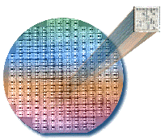
Integrated Circuit
wafer for test; chopped into dies for
packaging

Slide 31
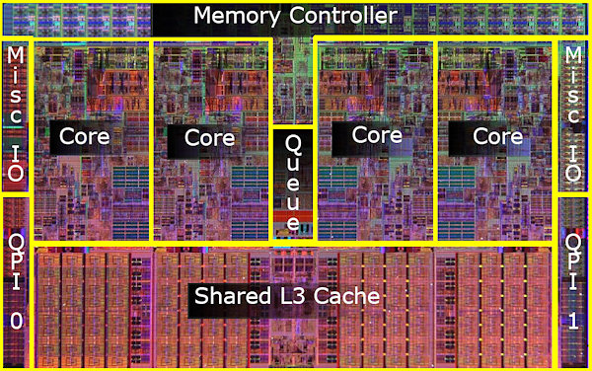
Example: Intel Core i7 Die

Slide 32

Dies per Wafer
Notes:
Need geometry knowledge to derive this equation

Slide 33

Cost per Die
percentage of manufactured devices that survives the testing procedure

Slide 34
Die Yield
process-complexity factor for measuring manufacturing difficulty

Slide 35
Cost of Integrated Circuit =

Slide 36
Feature size is shrinking
to 32 nm or smaller.

Slide 37
Transient/permanent faults
will be more commonplace.

Slide 38
How to build
dependable computers?

Slide 39
Dependability
Is a system operating properly?
Notes:
When we call a computer is dependable, the computer should operate properly (according to function requirements)

Slide 40
Dependability
SLA: service level agreements
System states: up or down
Service states
service accomplishment
service interruption
failure
restoration
Notes:
Infrastructure providers started offering service level agreements to guarantee that their networking or power service would be dependable.
Service accomplishment: the service is delivered as specified;
Service interruption: the delivered service is different from the SLA

Slide 41
How to measure dependability?

Slide 42
Measures of Dependability
Module reliability
Module availability
Notes:
Two main measures

Slide 43
Module Reliability
A measure of continuous service accomplishment (or of the time to failure) from a reference initial instant
MTTF: mean time to failure
MTTR: mean time to repair
MTBF: mean time between failures
MTBF = MTTF + MTTR

Slide 44
Module Reliability
FIT: failures in time: 1/MTTF
failures per billion hours
MTTF of 1,000,000 hours
= 1/10⁶ x 10⁹
= 1000 FIT

Slide 45

Module Availability
Notes:
System works properly till failure

Slide 46
Module Availability
Notes:
Then take some time to repair, during which system is not working, not available

Slide 47
Module Availability
Notes:
So the module availability can be quantified as the fraction of the working time over the whole time frame;

Slide 48
How to measure performance?

Slide 49
Measuring Performance
Execution/response time
the time between the start and
the completion of an event
Throughput
the total amount of work done in a given time

Slide 50

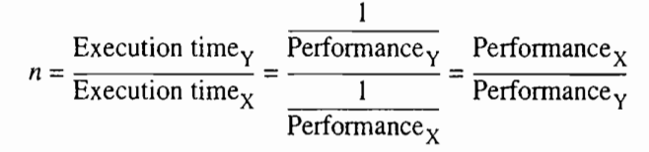
Measuring Performance
Computers: X and Y
X is n times faster than Y, if

Slide 51
Finally,
quantitative principles
of computer design
Notes:
Now we have seen how to define, measure, and summarize/report performance, cost, dependability, energy, and power,
We can explore guidelines and principals that are useful in the design and analysis of computers.

Slide 52
Quantitative Principles
Parallelism
Locality
temporal locality: recently accessed items are likely to be accessed in the near future;
spatial locality: items whose addresses are near one another tend to be referenced close together in time

Slide 53
Quantitative Principles
Focus on the Common Case
in making a design trade-off,
favor the frequent case over
the infrequent case

Slide 54
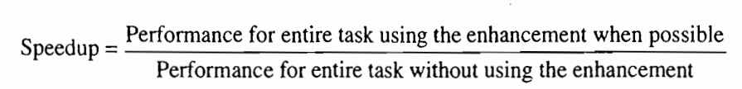
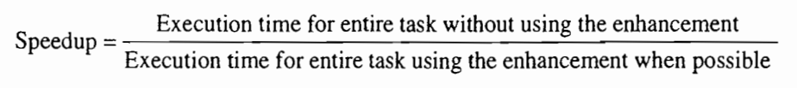
Quantitative Principles
Amdahl’s Law
Notes:
Amdahl’s law defines speedup

Slide 55
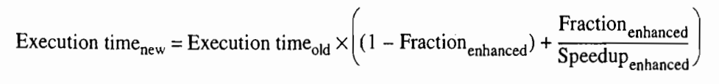
Amdahl’s Law: Two Factors
1. Fraction_{enhanced}:
e.g., 20/60 if 20 seconds out of a 60-second program to enhance
2. Speedup_{enhanced}:
e.g., 5/2 if enhanced to 2 seconds while originally 5 seconds
Notes:
Fraction-enhanced: the fraction of the computation time in the original computer that can be converted to take advantage of the enhancement;
Speedup-enhanced:

Slide 56
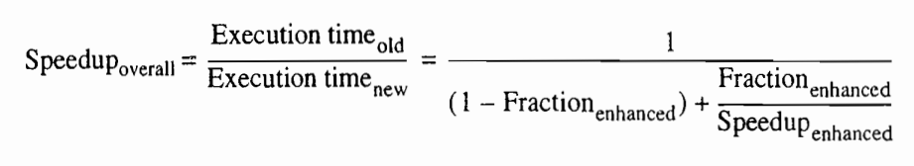
Amdahl’s Law: Overall Speedup
Notes:
Fraction-enhanced: the fraction of the computation time in the original computer that can be converted to take advantage of the enhancement;
Speedup-enhanced:

Slide 57
Processor Performance
Notes:
A series of processor performance equations ahead

Slide 58
CPU Time for Program
CPU time = CPU clock cycles for a program
x clock cycle time
CPU time = CPU clock cycles for a program
Clock rate

Slide 59
CPI: Clock Cycles per Instruction
CPI = CPU clock cycles for a program
Instruction count

Slide 60
CPI: Clock Cycles per Instruction
CPI = CPU clock cycles for a program
Instruction count
Clock cycles = IC x CPI
Instruction Count

Slide 61
CPI: Clock Cycles per Instruction
CPI = CPU clock cycles for a program
Instruction count
Clock cycles = IC x CPI
CPU time = Clock cycles x Clock cycle time
= IC x CPI x Clock cycle time
Notes:
Substitute clock cycles in the equation of cpu time with IC x CPI;

Slide 62
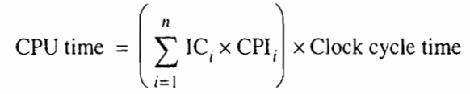
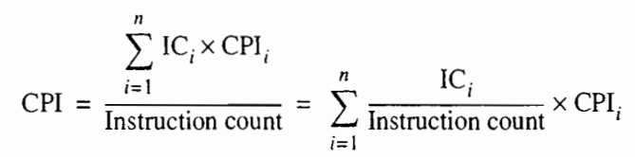
Multiple Instructions

Slide 63
Review
Trends in technology, power, energy, and cost
Dependability
Performance
Quantitative principles

Slide 64
?

