Slide 1
Lecture 06: Pipelining
Implementation
Kai Bu
kaibu@zju.edu.cn
http://list.zju.edu.cn/kaibu/comparch2015

Slide 2
Assignment 1 due
Lab 1 Report Submission: April 16
http://10.78.18.200:8080/Platform/
Register with zju email account
Demo 70% + Report 30%
report template: http://list.zju.edu.cn/kaibu/comparch/Lab_report_template.doc

Slide 4
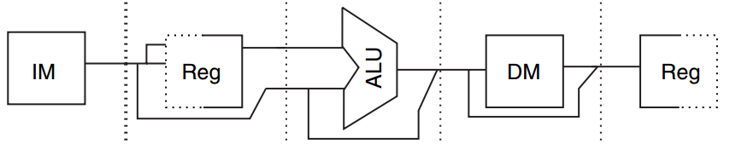
Data Path
Underneath Pipelining
MIPS
Five-Stage
IF ID EX MEM WB

Slide 5
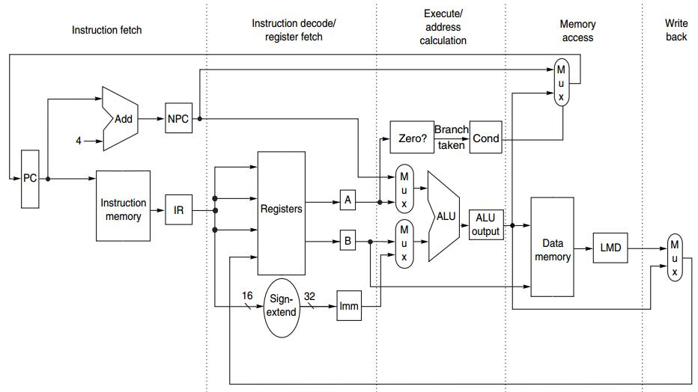
Data Path
Underneath Pipelining
IF ID EX MEM WB

Slide 6
Preview
under MIPS architecture
How an MIPS instruction works?
How MIPS instructions pipleline?

Slide 7

Appendix C.3-C.4

Slide 8
How an unpipelined
MIPS instruction works?

Slide 9
MIPS Instruction
at most 5 clock cycles per instruction
IF ID EX MEM WB

Slide 10
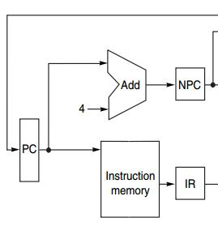
IF
IF ID EX MEM WB
Instruction Fetch cycle
IR ← Mem[PC];
NPC ← PC + 4;
IR: instruction register
NPC: next sequential PC

Slide 11
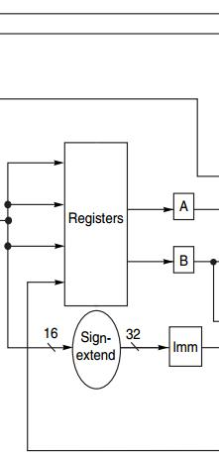
ID
IF ID EX MEM WB
Instruction Decode/register fetch
A ← Regs[rs];
B ← Regs[rt];
Imm ← sign-extended
immediate field
of IR
(lower 16 bits)

Slide 12
EX
IF ID EX MEM WB
Execution/effective address cycle
ALU operates on the operands from ID:
4 functions depending on the instr type -Memory reference
-Register-register ALU instruction
-Register-immediate ALU instruction
-Branch
Notes:
Note that different from the RISC implementation instance in previous lecture, MIPS’s EX stage has four types of functions; with one more function - branch

Slide 13
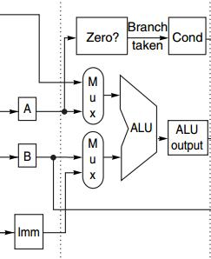
EX
IF ID EX MEM WB
Execution/effective address cycle
-Memory reference
ALUOutput ← A + Imm;
ALU adds the operands
to form effective address
Notes:
Base register + offset

Slide 14
EX
IF ID EX MEM WB
Execution/effective address cycle
-Register-register ALU instr
ALUOutput ← A func B;
ALU performs the operation
specified by function code
on the values in register A & register B

Slide 15
EX
IF ID EX MEM WB
Execution/effective address cycle
-Register-Immediate ALU Instr
ALUOutput ← A op Imm;
ALU performs the operation
specified by opcode
on the values in register A & reg IMM

Slide 16
EX
IF ID EX MEM WB
Execution/effective address cycle
-Branch
ALUOutput ← NPC + (Imm<<2);
Cond ← (A == 0);
ALUOutput -> branch target
BEQZ: comparison against 0
Notes:
Note that different from the RISC implementation instance in previous lecture, MIPS’s EX stage has four types of functions; with one more function - branch

Slide 17
EX
IF ID EX MEM WB
Execution/effective address cycle
-Branch
ALUOutput ← NPC + (Imm<<2);
Cond ← (A == 0);
ALUOutput -> branch target
BEQZ: comparison against 0
Why <<2?
http://www.cs.umd.edu/class/sum2003/cmsc311/Notes/Mips/addr.html
Notes:
Note that different from the RISC implementation instance in previous lecture, MIPS’s EX stage has four types of functions; with one more function - branch

Slide 18
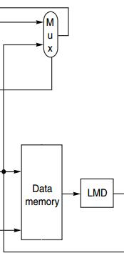
MEM
IF ID EX MEM WB
MEMory access/branch completion
update PC for all instr: PC ← NPC;
-Memory Access
LMD ← Mem[ALUOutput]; load
Mem[ALUOutput] ← B; store
-Branch
if (cond) PC ← ALUOutput;
Load Memory Data register

Slide 19
WB
IF ID EX MEM WB
Write-Back cycle
-Register-register ALU instruction
Regs[rd] ← ALUOutput;
-Register-immediate ALU instruction
Regs[rt] ← ALUOutput;
-Load instruction
Regs[rt] ← LMD;

Slide 20
Put It All Together

Slide 21
MIPS Instruction
IF ID EX MEM WB
IR ← Mem[PC];
NPC ← PC + 4;

Slide 22
MIPS Instruction
IF ID EX MEM WB
A ← Regs[rs];
B ← Regs[rt];
Imm ← sign-extended
immediate field
of IR (lower 16 bits)

Slide 23
MIPS Instruction
IF ID EX MEM WB
ALUOutput ← A + Imm;
ALUOutput ← A func B;
ALUOutput ← A op Imm;
ALUOutput ← NPC + (Imm<<2);
Cond ← (A == 0);

Slide 24
MIPS Instruction
IF ID EX MEM WB
LMD ← Mem[ALUOutput]; Mem[ALUOutput] ← B;
if (cond) PC ← ALUOutput;

Slide 25
MIPS Instruction
IF ID EX MEM WB
Regs[rd] ← ALUOutput;
Regs[rt] ← ALUOutput;
Regs[rt] ← LMD;

Slide 26
MIPS Instruction Demo
Prof. Gurpur Prabhu, Iowa State Univ http://www.cs.iastate.edu/~prabhu/Tutorial/PIPELINE/DLXimplem.html
Load, Store
Register-register ALU
Register-immediate ALU
Branch

Slide 27
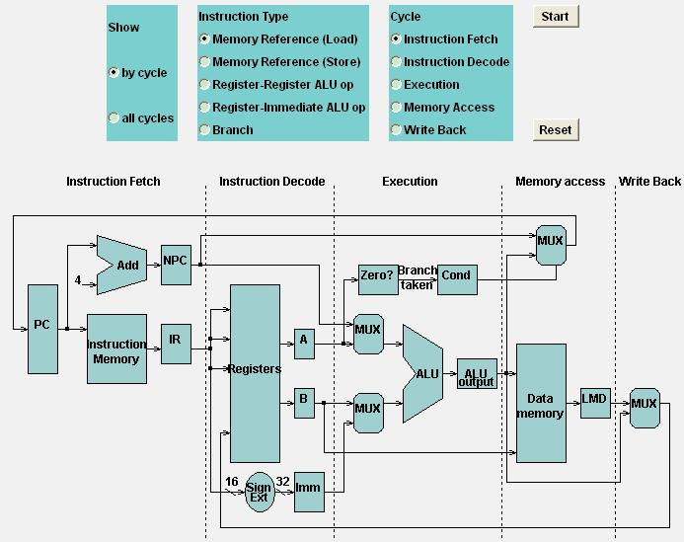
Load

Slide 28
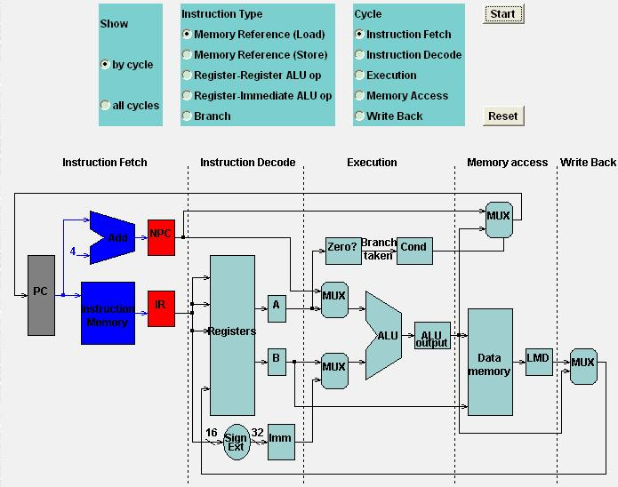
Load
Load: IF

Slide 29
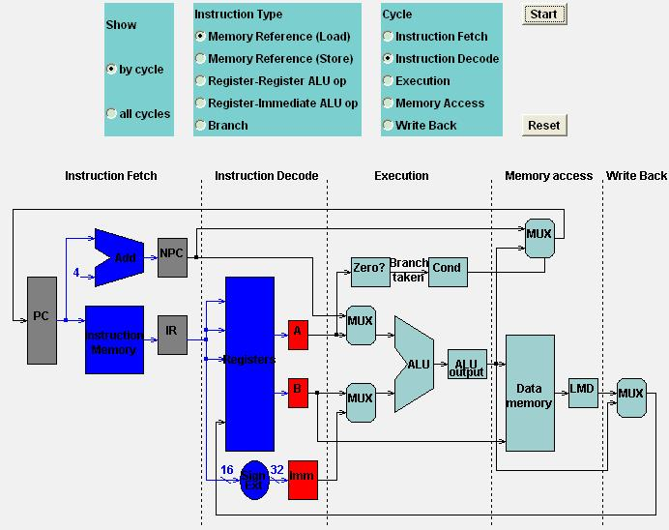
Load
Load: ID

Slide 30
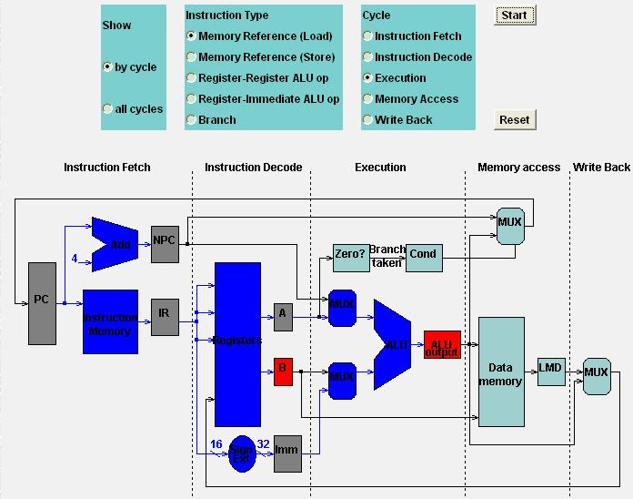
Load
Load: EX

Slide 31
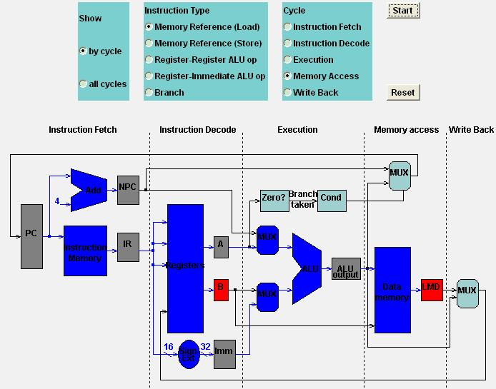
Load
Load: MEM

Slide 32
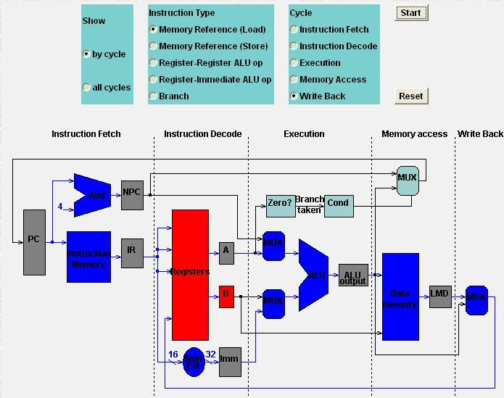
Load
Load: WB

Slide 33
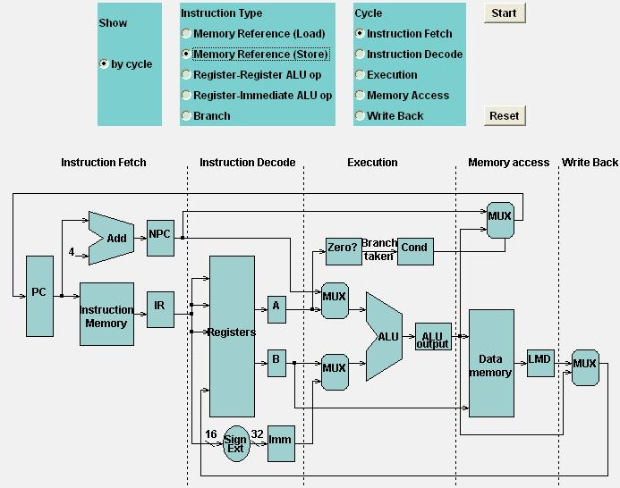
Store

Slide 34

Store
Store: IF

Slide 35
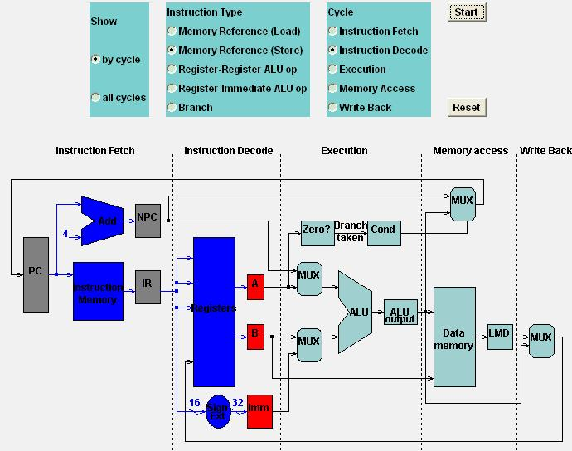
Store
Store: ID

Slide 36
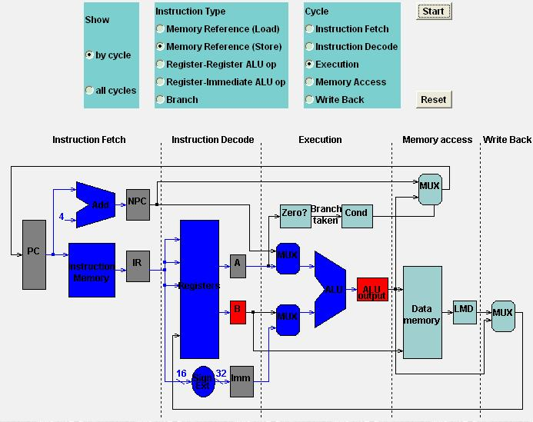
Store
Store: EX

Slide 37
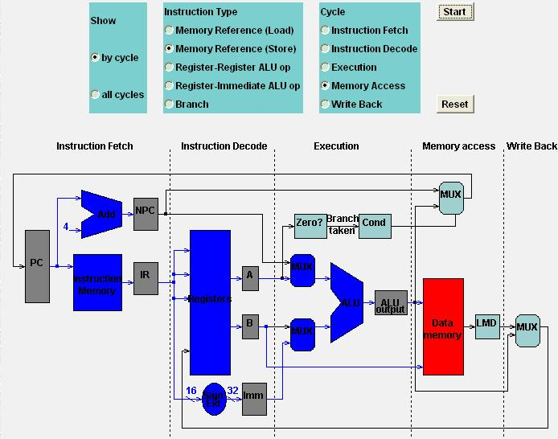
Store
Store: MEM

Slide 38

Store
Store: WB

Slide 39
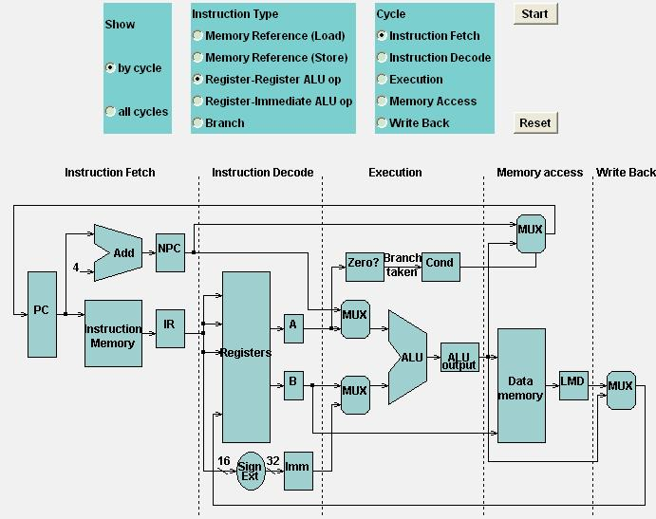
Register-Register ALU: MEM
IF

Slide 40
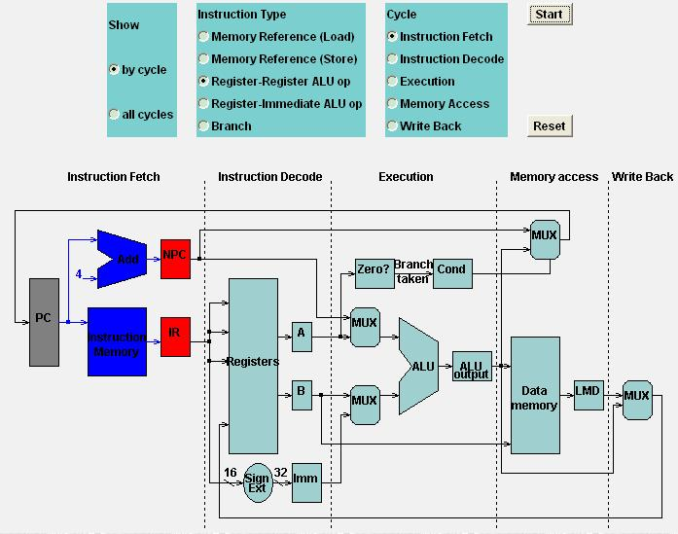
Register-Register ALU: MEM
IF

Slide 41

Register-Register ALU: MEM
ID

Slide 42
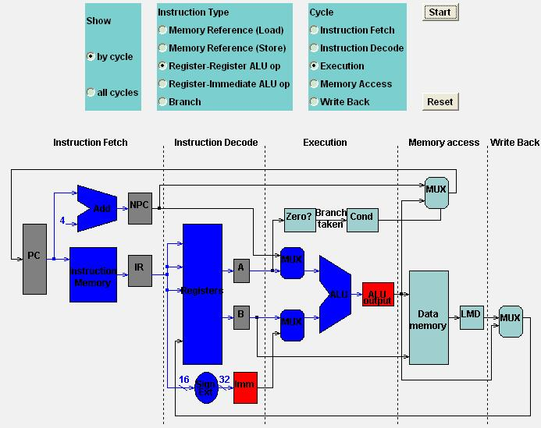
Register-Register ALU: MEM
EX

Slide 43
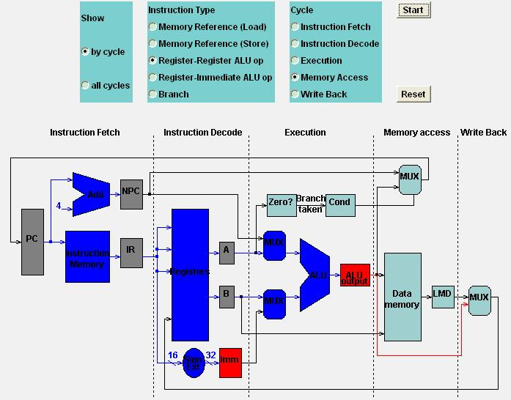
Register-Register ALU: MEM
MEM

Slide 44
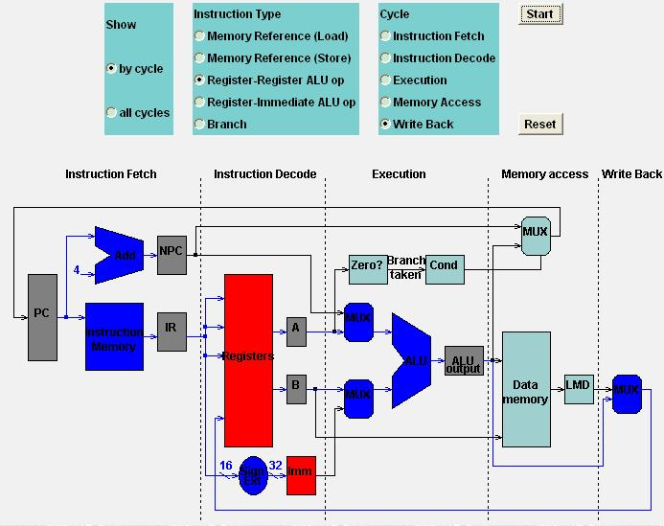
Register-Register ALU: MEM
WB

Slide 45
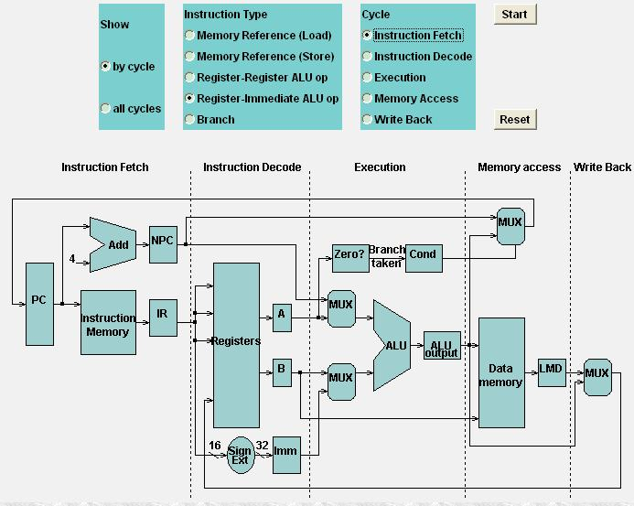
Register-Imm ALU: MEM
IFEM

Slide 46
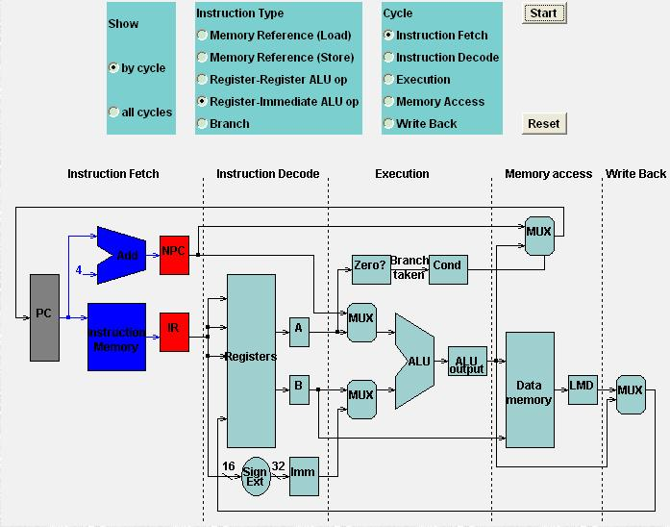
Register-Imm ALU: MEM
IFEM

Slide 47

Register-Imm ALU: MEM
IDEM

Slide 48
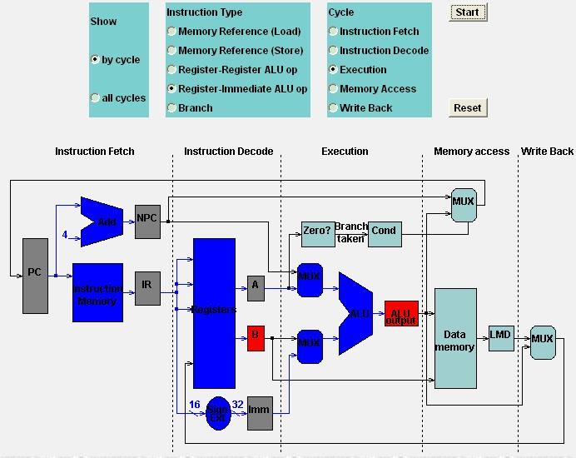
Register-Imm ALU: MEM
EXEM

Slide 49
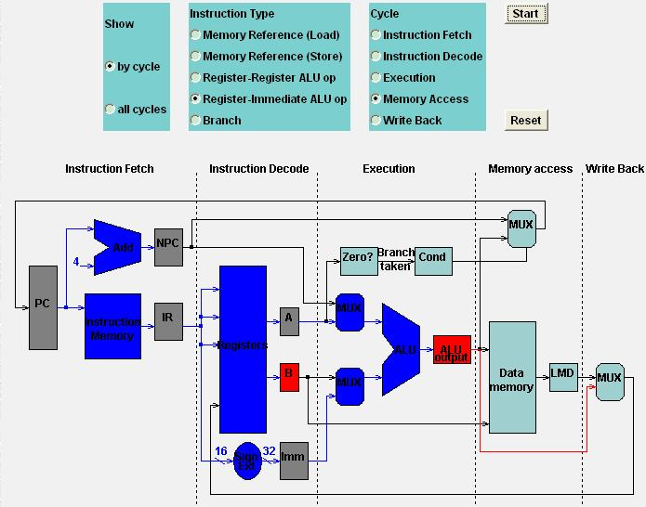
Register-Imm ALU: MEM
MEMEM

Slide 50
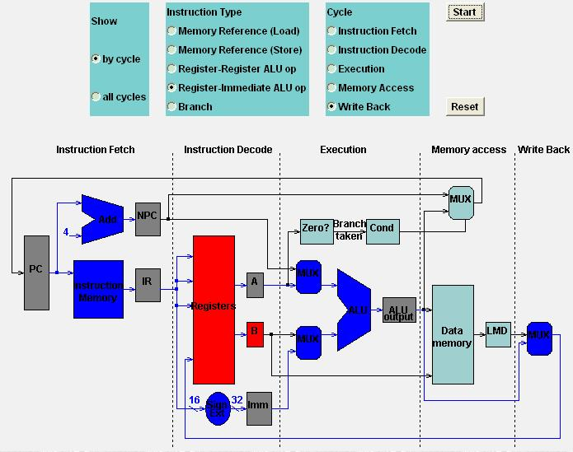
Register-Imm ALU: MEM
WBEM

Slide 51
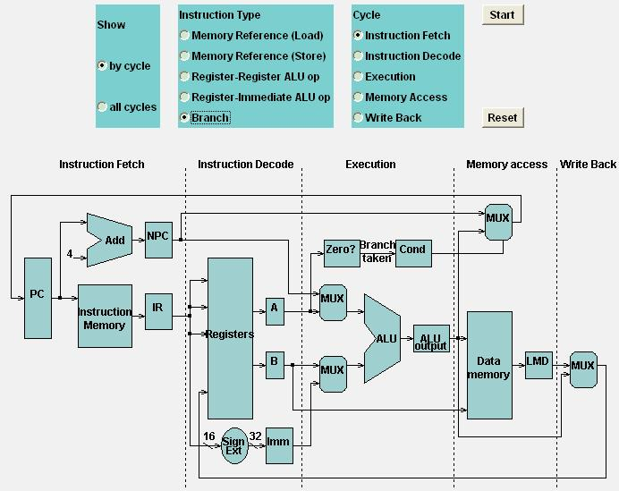
Branch: MEM
Branch: MEM

Slide 52

Branch: MEM
IFh: MEM

Slide 53
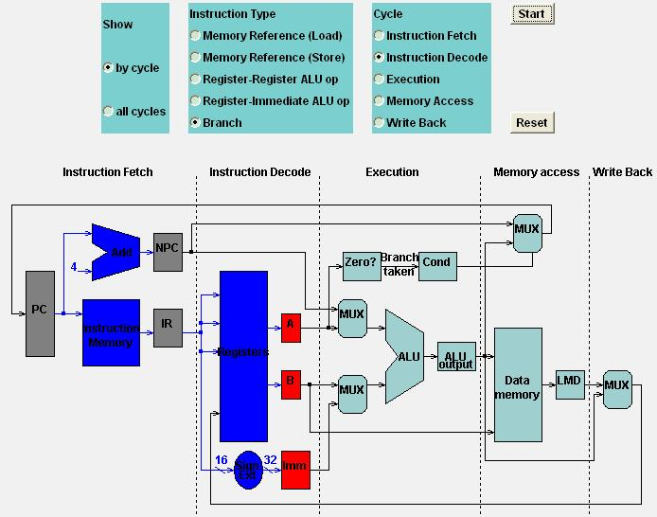
Branch: MEM
IDh: MEM

Slide 54
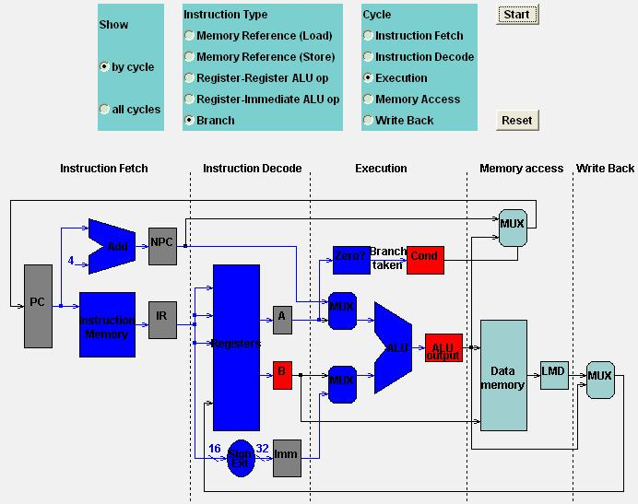
Branch: MEM
EXh: MEM

Slide 55
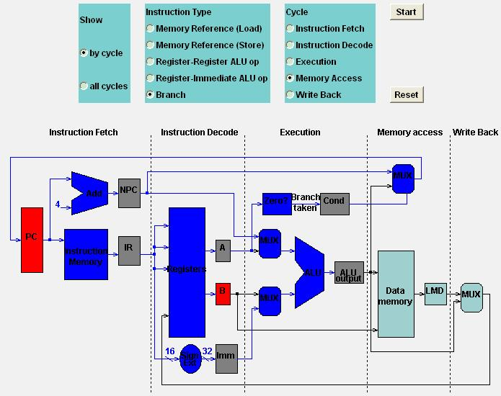
Branch: MEM
MEMh: MEM

Slide 56

Branch: MEM
WBh: MEM

Slide 57
This chapter is
about pipelining, right?

Slide 58
How MIPS instructions pipeline?

Slide 59
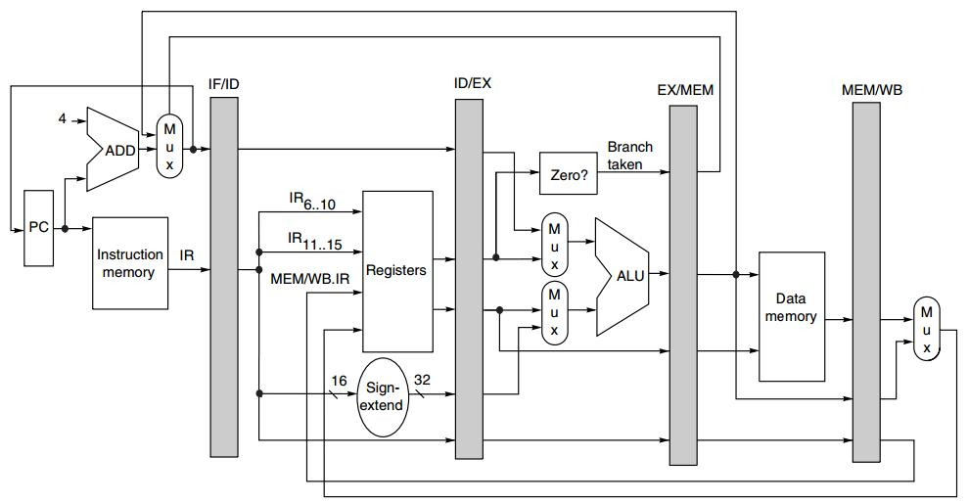
Pipelined MIPS
Pipeline
Registers/Latches
NPC
IR
A
B
IMM
Cond
ALUOutput
LMD

Slide 60
Instruction Type decides
actions on a pipeline stage

Slide 61
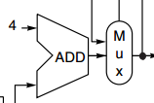
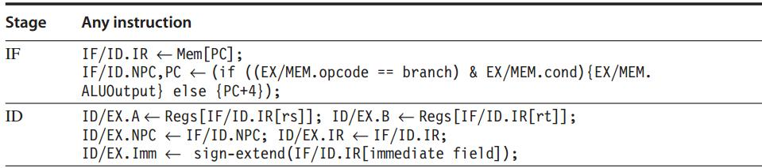
Pipelined MIPS: IF, ID
The first two stages are independent of instruction type because
the instruction is not decoded until the end of ID;
PC update

Slide 62
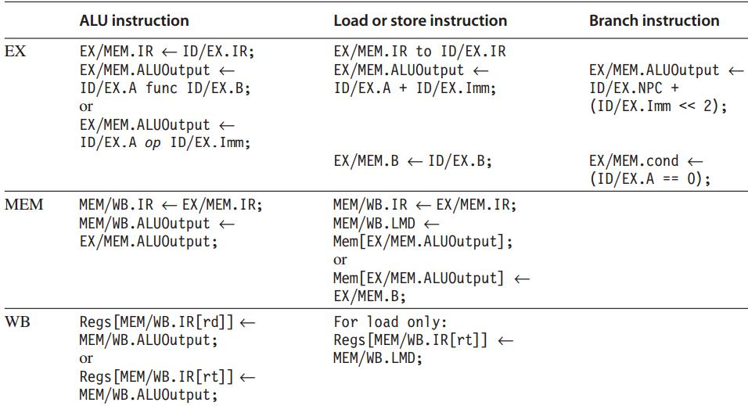
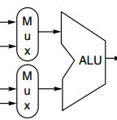

Pipelined MIPS: EX, MEM, WB
Any value needed on a later pipeline stage must be placed in a pipeline register,
and copied from one pipeline register to the next,
until it is no longer needed.

Slide 63
Data Hazard
Instruction Issue: ID -> EX
If a data hazard exists, the instruction is stalled before it is issued.
For integer pipeline, data hazards and forwarding can be checked during ID
Detect hazards by comparing the destination and sources of adjacent instruction

Slide 64
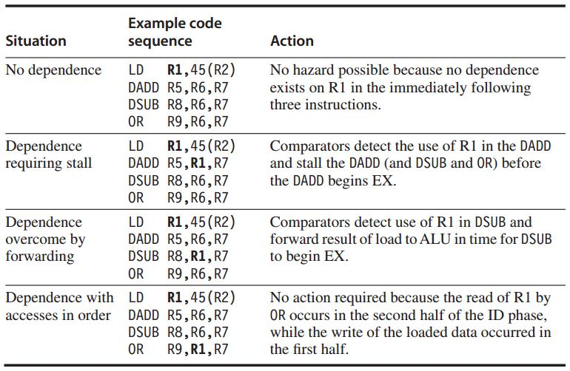
Data Hazard Example
Data hazards from Load
Comparison between the destination of Load
and the sources on the following two instr

Slide 65
Stall
Prevent instructions in IF and ID from advancing
Change the control portion of ID/EX to be a no-op
Recirculate the contents of IF/ID registers to hold the stalled instr

Slide 66
Forwarding
Data path: from the ALU or data memory output to the ALU input, the data memory input, or the zero detection unit.
Compare the destination registers of EX/MEM.IR and MEM/WB.IR against the source registers of ID/EX.IR and EX/MEM.IR

Slide 67
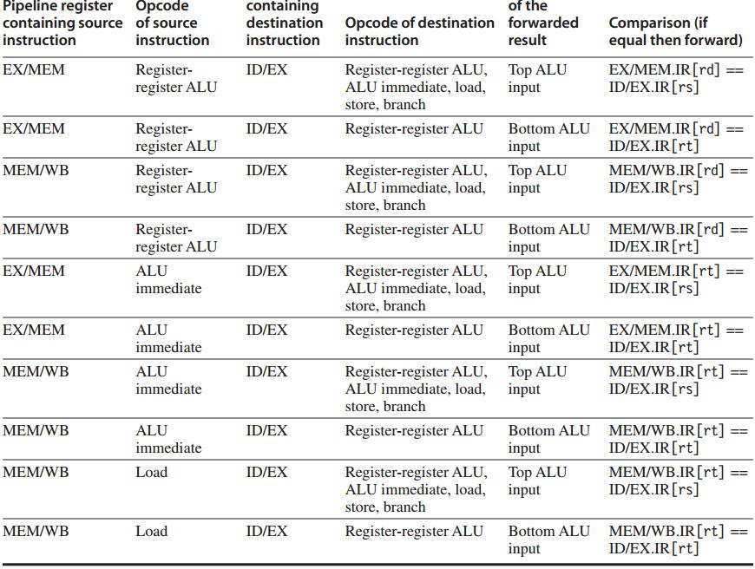
Example:
forwarding result is an ALU input

Slide 68
Forwarding: hw change
NextPC
ID/EX
EX/MEM
MEM/WR
Registers
mux
ALU
Data
Memory
mux
mux
Immediate
Source → sink
EX/Mem.ALUoutput → ALU input
MEM/WB.ALUoutput → ALU input
MEM/WB.LMD → ALU input

Slide 69
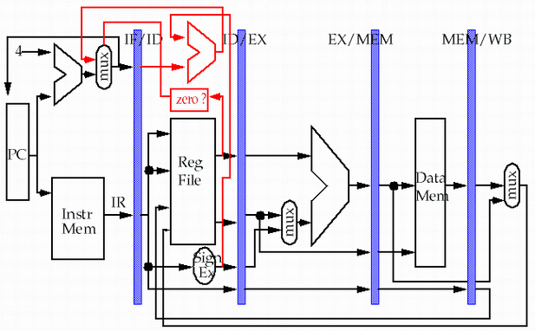
Forwarding: hw change
store
load
MEM/WB.LMD → DM input

Slide 70
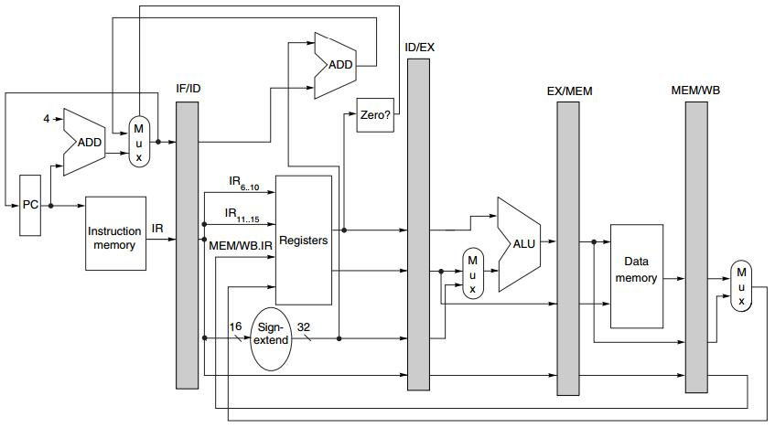
Branch
Move zero test to the ID stage
with an additional ADDer computing target address

Slide 71
… You know there’re exceptions.

Slide 72
Exceptions: Instruction Execution Order
aka interrupt/fault
When the normal execution order of instruction is changed
May force CPU to abort the instructions in the pipeline before they complete

Slide 73
Exceptions
Type
I/O device request
invoking os service from user program
tracing instruction execution
breakpoint
integer arithmetic overflow
FP arithmetic anomaly
page fault
misaligned memory address
memory protection violation
using undefined/unimplemented instruction
hardware malfunctions
power failure

Slide 74
Exceptions: Requirements
Synchronous vs asynchronous
User requested vs coerced
User maskable vs user nonmaskable
Within vs between instructions
Resume vs terminate

Slide 75
Sync vs Asynch
Synchronous
event occurs at the same place every time the program is executed with the same data and memory allocation
Asynchronous
caused by devices external to the CPU and memory

Slide 76
User requested vs Coerced
User requested
the user task directly asks for it
Coerced
caused by some hardware event that is not under the control of the user program

Slide 77
User non/maskable
User maskable
an event can be amsked or disabled by a user task

Slide 78
Within vs Between instr
Whether the event prevents intruction completion by occurring in the middle of execution (within) or is recognized between instructions

Slide 79
Resume vs Terminate
Resume
the program’s execution continues after the interrupt
Terminate
the program’s execution always stops after the interrupt

Slide 80
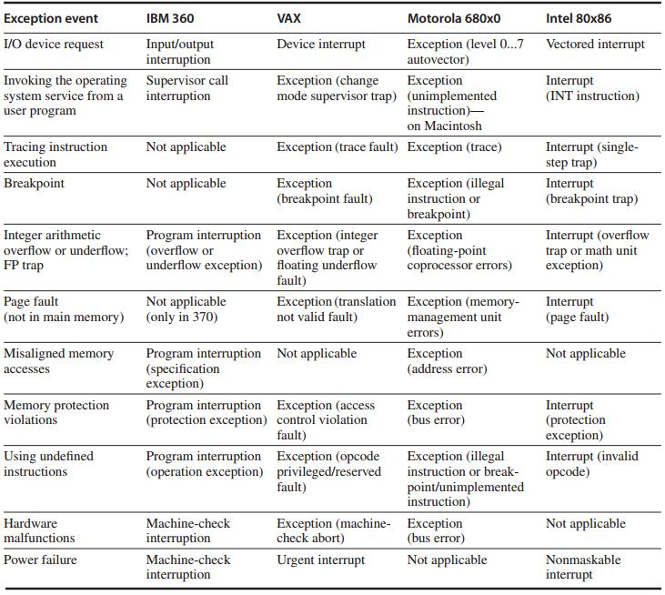
names of common exceptions
across four different architectures

Slide 81
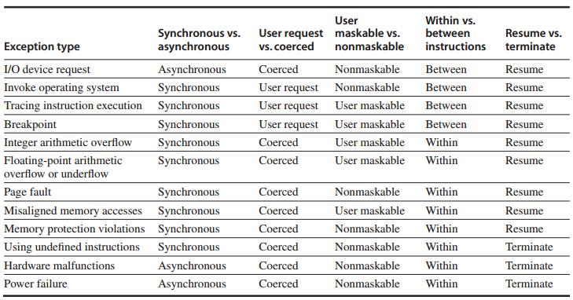
Exception Category

Slide 82
Instruction Set Complications
Instruction set specific factors that make pipelining harder to implement
PP. C-49 – C.51

Slide 83
?

