Slide 1
Lecture 08: Memory Hierarchy
Cache Performance
Kai Bu
kaibu@zju.edu.cn
http://list.zju.edu.cn/kaibu/comparch2015

Slide 2
Lab 2 Report
due May 07
PhD Positions at Hong Kong PolyU
http://www.cc98.org/dispbbs.asp?boardID=248&ID=4509074
http://cspo.zju.edu.cn/attachments/2015-04/01-1430104631-143723.pdf

Slide 4
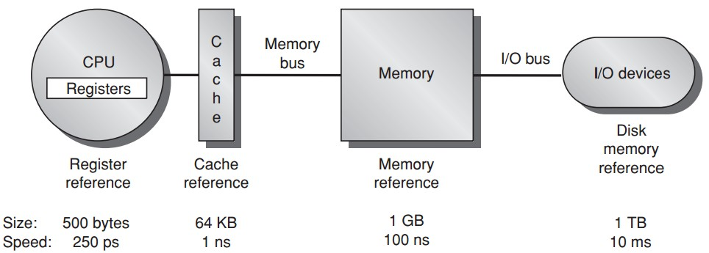
data process & temporary storage

Slide 5
temporary storage

Slide 6
permanent storage

Slide 7
faster temporary storage

Slide 8
Memory Hierarchy

Slide 9
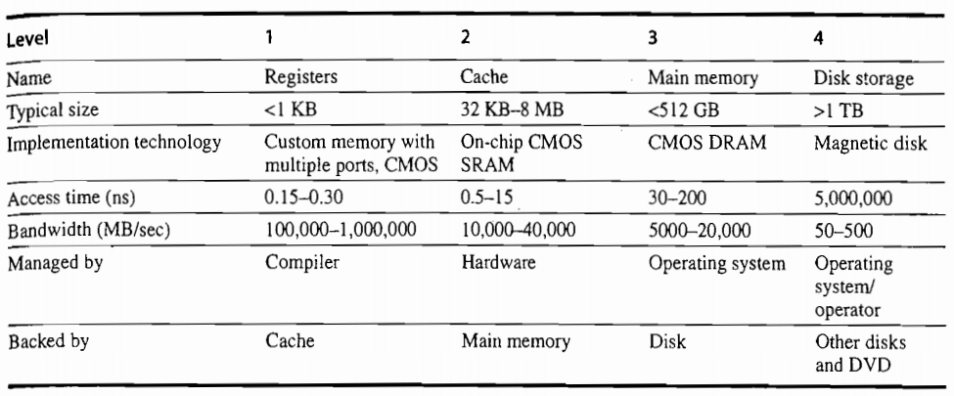

Slide 10
Wait, but what’s cache?

Slide 11
Preview
What’s cache?
How data in/out of cache matters?
How to benefit more from cache?

Slide 12

Appendix B.1-B.3

Slide 13
Again, what’s cache?

Slide 14
Cache
The highest or first level of the memory hierarchy encountered once the addr leaves the processor
Employ buffering to reuse commonly occurring items

Slide 15
Cache Hit/Miss
When the processor can/cannot find
a requested data item in the cache

Slide 16
Cache Locality
Block/line run: a fixed-size collection of data containing the requested word, retrieved from the main memory and placed into the cache
Temporal locality: need the requested word again soon
Spatial locality: likely need other data in the block soon

Slide 17
Cache Miss
Time required for cache miss depends on:
Latency: the time to retrieve the first word of the block
Bandwidth: the time to retrieve the rest of this block

Slide 18
How cache performance matters?

Slide 19
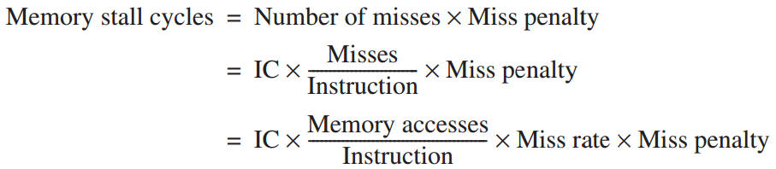
Cache Performance: Equations
Assumption:
Includes the time
to handle
a cache hit/miss

Slide 20
Cache Miss Metrics
Memory stall cycles
the number of cycles during processor is stalled waiting for a mem access
Miss rate
number of misses over number of accesses
Miss penalty
the cost per miss (number of extra clock cycles to wait)

Slide 21
Cache Performance: Example
Example
a computer with CPI=1 when cache hit;
50% instructions are loads and stores;
2 cc per memory access;
2% miss rate, 25 cc miss penalty;
Q: how much faster would the computer be if all instructions were cache hits?

Slide 22
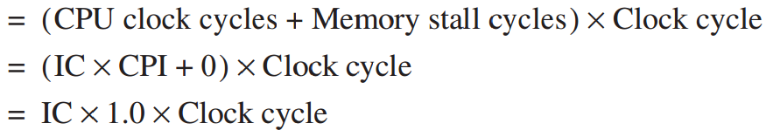
Cache Performance: Example
Answer
always hit:
CPU execution time

Slide 23
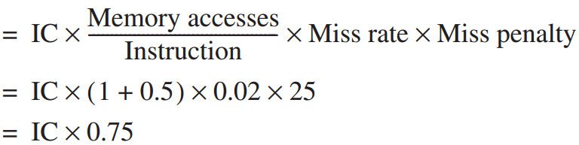
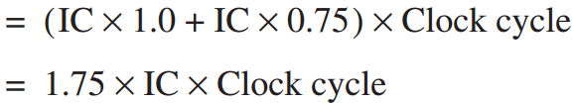
Cache Performance: Example
Answer
with misses:
Memory stall cycles
CPU execution time_{cache}

Slide 24
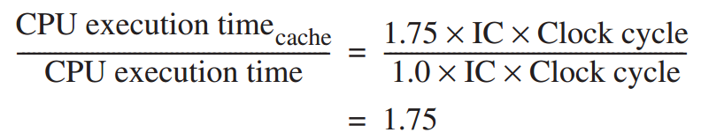
Cache Performance: Example
Answer

Slide 25
Hit or Miss:
Where to find a block?

Slide 26
Block Placement
Direct Mapped
only one place
Fully Associative
anywhere
Set Associative
anywhere within only one set
Notes:
Before we know where to find a block, we first need to know how it is placed

Slide 27
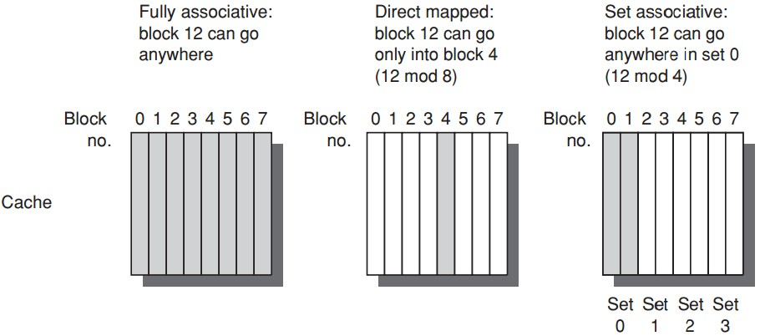
Block Placement

Slide 28
Block Placement: Generalized
n-way set associative:
n blocks in a set
Direct mapped = one-way set associative
i.e., one block in a set
Fully associative = m-way set associative
i.e., entire cache as one set with m blocks

Slide 29

Block Identification
Block address: tag + index
Index: select the set
Tag: = valid bit+ block address
check all blocks in the set
Block offset: the address of the desired data within the block
Fully associative caches have no index field

Slide 30
Block Read
Block can be read from the cache while the tag is read and compared,
so block read begins as soon as the block address is available.
Hit: the requested part of the block is passed on to the processor immediately;
Miss: no benefit yet no time overhead

Slide 31
Block Replacement
upon cache miss, to load the data to a cache block, which block to replace?
Random
simple to build
LRU: Least Recently Used
the block that has been unused for the longest time;
use spatial locality;
complicated/expensive;
FIFO: first in, first out

Slide 32
Write Strategy
Must read after tag checking
Write-through
info is written to both the block in the cache and to the block in the lower-level memory
Write-back
info is written only to the block in the cache;
to the main memory only when the modified cache block is replaced;

Slide 33
Write Strategy
Options on a write miss
Write allocate
the block is allocated on a write miss
No-write allocate
write miss not affect the cache;
the block is modified in the lower-level memory;
until the program tries to read the block;

Slide 34
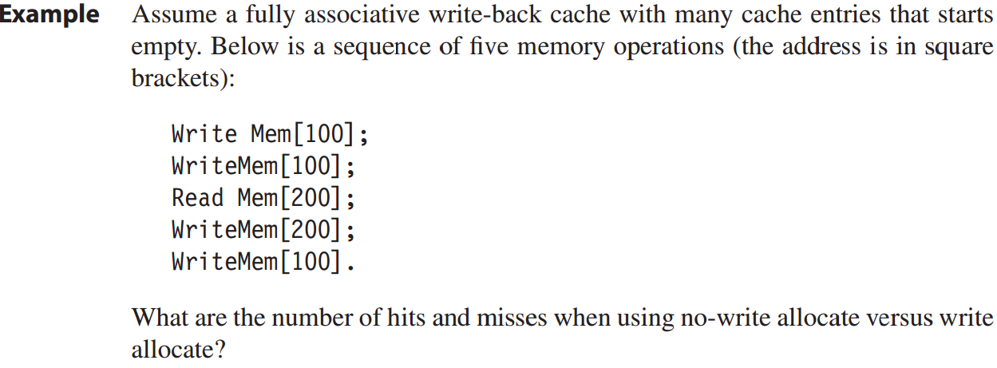
Write Strategy: Example

Slide 35
Write Strategy: Example
No-write allocate: 4 misses + 1 hit
cache not affected- address 100 not in the cache;
read [200] miss, block replaced, then write [200] hits;
Write allocate: 2 misses + 3 hits

Slide 36
Hit or Miss:
How long will it take?

Slide 37
Avg Mem Access Time
Average memory access time
=Hit time + Miss rate x Miss penalty

Slide 38
Avg Mem Access Time
Example
16KB instr cache + 16KB data cache;
32KB unified cache;
36% data transfer instructions;
(load/store takes 1 extra cc on unified cache)
1 CC hit; 200 CC miss penalty;
Q1: split cache or unified cache has lower miss rate?
Q2: average memory access time?

Slide 39
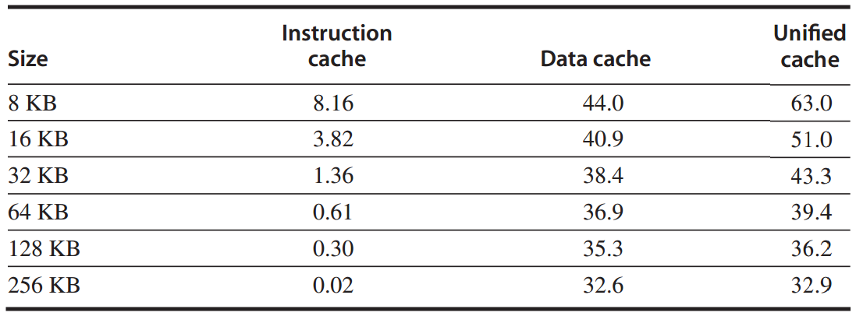
Example: miss per 1000 instructions

Slide 40
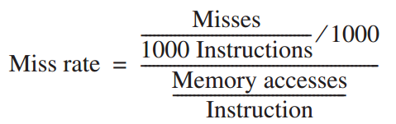



Avg Mem Access Time
Q1

Slide 41
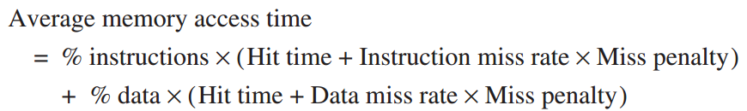
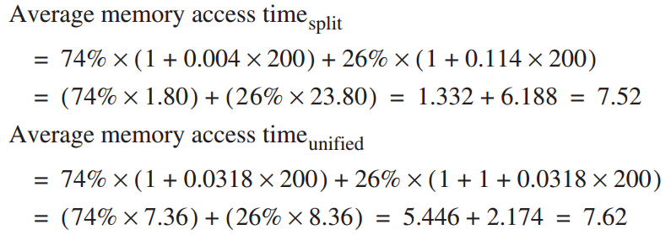
Avg Mem Access Time
Q2

Slide 42
Cache vs Processor
Processor Performance
Lower avg memory access time may correspond to higher CPU time (Example on Page B.19)

Slide 43
Out-of-Order Execution
in out-of-order execution, stalls happen to only instructions that depend on incomplete result;
other instructions can continue;
so less avg miss penalty

Slide 44
How to optimize
cache performance?

Slide 45
Average Memory Access Time =
Hit Time + Miss Rate x Miss Penalty

Slide 46
Average Memory Access Time =
Hit Time + Miss Rate x Miss Penalty

Slide 47
Average Memory Access Time =
Hit Time + Miss Rate x Miss Penalty
Larger block size;
Larger cache size;
Higher associativity;

Slide 48
Reducing Miss Rate
3 categories of miss rates / root causes
Compulsory:
cold-start/first-reference misses;
Capacity
cache size limit;
blocks discarded and later retrieved;
Conflict
collision misses: associativity
a block discarded and later retrieved in a set;

Slide 49
Opt #1: Larger Block Size
Reduce compulsory misses
Leverage spatial locality
Increase conflict/capacity misses
Fewer block in the cache

Slide 50
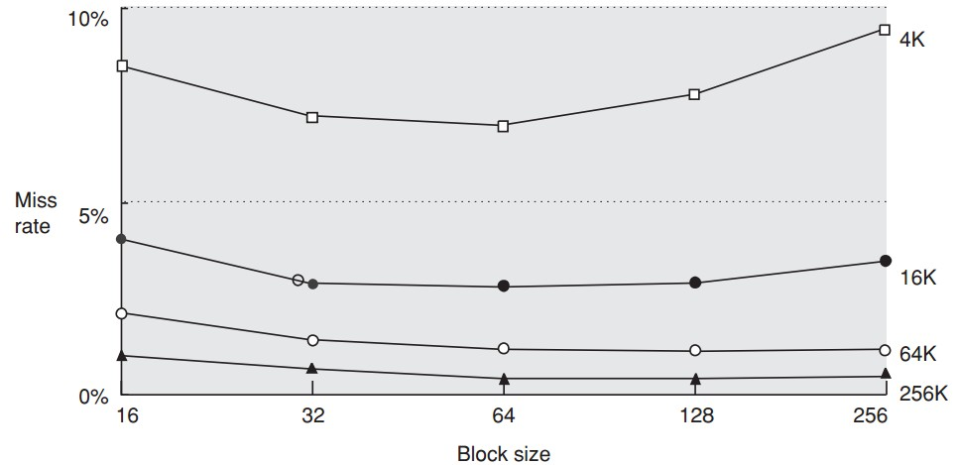

Slide 51
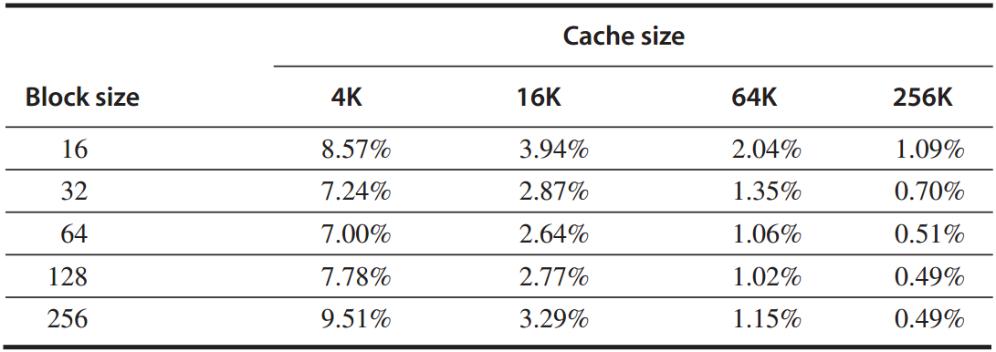
Example
given the above miss rates;
assume memory takes 80 CC overhead,
delivers 16 bytes in 2 CC;
Q: which block size has the smallest average memory access time for each cache size?

Slide 52
Answer
avg mem access time
=hit time + miss rate x miss penalty
*assume 1-CC hit time
for a 256-byte block in a 256 KB cache:
avg mem access time
= 1 + 0.49% x (80 + 2x256/16) = 1.5 cc

Slide 53
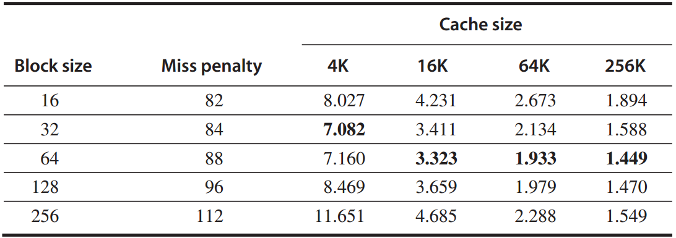
Answer
average memory access time

Slide 54
Opt #2: Larger Cache
Reduce capacity misses
Increase hit time, cost, and power

Slide 55
Opt #3: Higher Associativity
Reduce conflict misses
Increase hit time

Slide 56
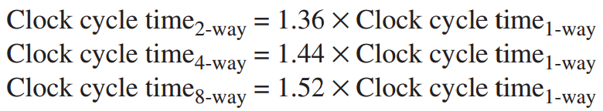
Example
assume higher associativity -> higher clock cycle time:
assume 1-cc hit time, 25-cc miss penalty, and miss rates in the following table;

Slide 57
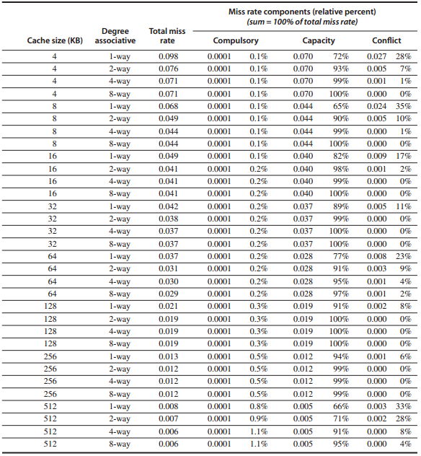
Miss rates

Slide 58
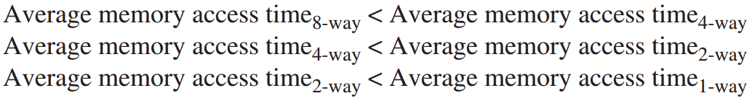
Question:
for which cache sizes
are each of the statements true?

Slide 59
Answer
for a 512 KB, 8-way set associative cache:
avg mem access time
=hit time + miss rate x miss penalty
=1.52x1 + 0.006 x 25
=1.66

Slide 60
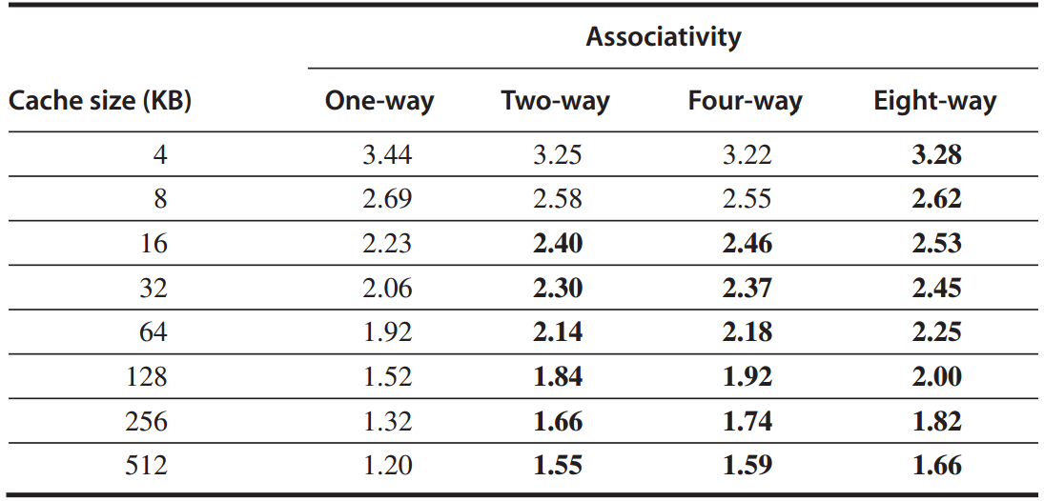
Answer
average memory access time

Slide 61
Average Memory Access Time =
Hit Time + Miss Rate x Miss Penalty
Multilevel caches;
Reads > Writes;

Slide 62
Opt #4: Multilevel Cache
Reduce miss penalty
Motivation
faster/smaller cache to keep pace with the speed of processors?
larger cache to overcome the widening gap between processor and main mem?

Slide 63
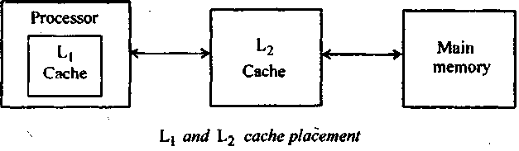
Opt #4: Multilevel Cache
Two-level cache
Add another level of cache between the original cache and memory
L1: small enough to match the clock cycle time of the fast processor;
L2: large enough to capture many accesses that would go to main memory, lessening miss penalty

Slide 64
Opt #4: Multilevel Cache
Average memory access time
=Hit time_{L1} + Miss rate_{L1} x Miss penalty_{L1}
=Hit time_{L1} + Miss rate_{L1}
x(Hit time_{L2}+Miss rate_{L2}xMiss penalty_{L2})
Average mem stalls per instruction
=Misses per instruction_{L1} x Hit time_{L2}
+ Misses per instr_{L2} x Miss penalty_{L2}

Slide 65
Opt #4: Multilevel Cache
Local miss rate
the number of misses in a cache
divided by the total number of mem accesses to this cache;
Miss rate_{L1}, Miss rate_{L2}
Global miss rate
the number of misses in the cache
divided by the number of mem accesses generated by the processor;
Miss rate_{L1}, Miss rate_{L1} x Miss rate_{L2}

Slide 66
Example
1000 mem references -> 40 misses in L1 and 20 misses in L2;
miss penalty from L2 is 200 cc;
hit time of L2 is 10 cc;
hit time of L1 is 1 cc;
1.5 mem references per instruction;
Q: 1. various miss rates?
2. avg mem access time?
3. avg stall cycles per instruction?

Slide 67
Answer
1. various miss rates?
L1: local = global
40/1000 = 4%
L2:
local: 20/40 = 50%
global: 20/1000 = 2%

Slide 68
Answer
2. avg mem access time?
average memory access time
=Hit time_{L1} + Miss rate_{L1}
x(Hit time_{L2}+Miss rate_{L2}xMiss penalty_{L2})
=1 + 4% x (10 + 50% x 200)
=5.4

Slide 69
Answer
3. avg stall cycles per instruction?
average stall cycles per instruction
=Misses per instruction_{L1} x Hit time_{L2}
+ Misses per instr_{L2} x Miss penalty_{L2}
=(1.5x40/1000)x10+(1.5x20/1000)x200
=6.6

Slide 70
Opt #5: Prioritize read misses over writes
Reduce miss penalty
instead of simply stall read miss until write buffer empties,
check the contents of write buffer,
let the read miss continue
if no conflicts with write buffer & memory system is available

Slide 71
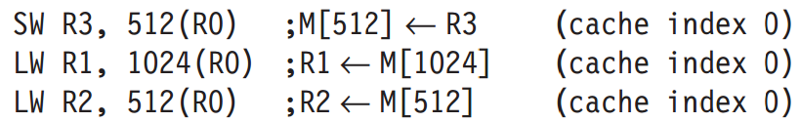
Opt #5: Prioritize read misses over writes
Why
for the code sequence, assume a direct-mapped, write-through cache that maps 512 and 1024 to the same block;
a four-word write buffer is not checked on a read miss.
R2.value ≡ R3.value ?

Slide 72
Average Memory Access Time =
Hit Time + Miss Rate x Miss Penalty
Avoid address translation
during indexing of the cache

Slide 73
Opt #6: Avoid address translation during indexing cache
Cache addressing
virtual address – virtual cache
physical address – physical cache
Processor/program – virtual address
Processor -> address translation -> Cache
virtual cache or physical cache?

Slide 74
Opt #6: Avoid address translation during indexing cache
Virtually indexed, physically tagged
page offset to index the cache;
physical address for tag match;
For direct-mapped cache,
it cannot be bigger than the page size.
Reference: CPU Cache
http://zh.wikipedia.org/wiki/CPU%E9%AB%98%E9%80%9F%E7%BC%93%E5%AD%98

Slide 75
?

Slide 76
Happy Holidays!

