Slide 1
Lecture 09: Memory Hierarchy
Virtual Memory
Kai Bu
kaibu@zju.edu.cn
http://list.zju.edu.cn/kaibu/comparch

Slide 2
Assignment 2 due May 14
Lab 3 Demo due May 21
Report due May 28
Lab 4 Demo due May 28
Report due Jun 04

Slide 3


Slide 4
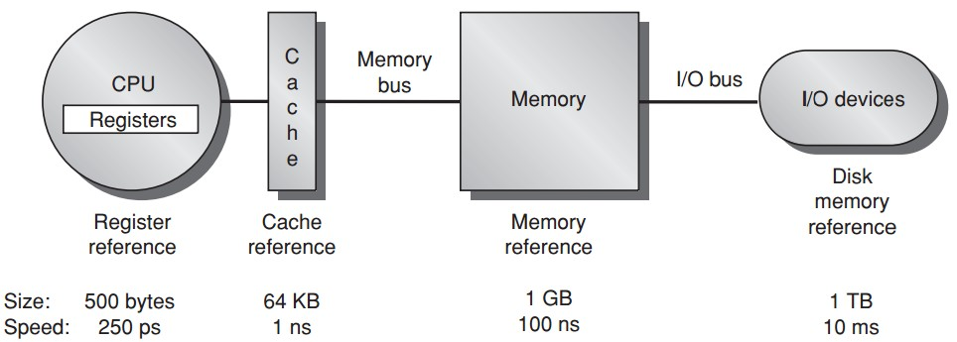
Memory Hierarchy
Larger memory for more processes?
Notes:
From cache to memory; whose size is still limited. What if larger memory is desired?

Slide 5
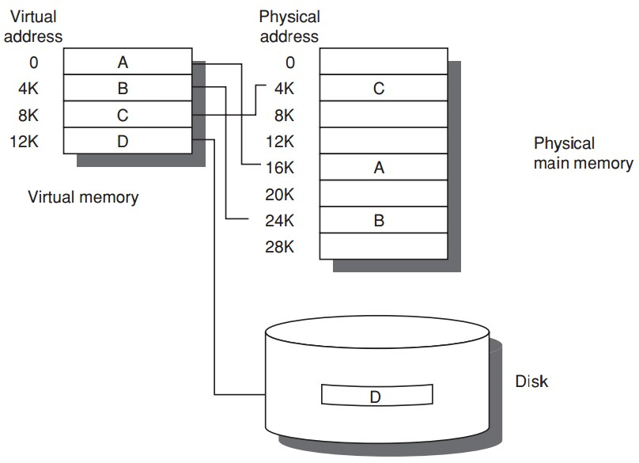
Virtual Memory
+

Slide 6
Virtual Memory
Program uses
discontiguous memory locations
+ secondary/non-memory storage

Slide 7
Virtual Memory
Program thinks
contiguous memory locations
larger physical memory

Slide 8
Virtual Memory
relocation
allows the same program to run in any location in physical memory

Slide 9
Preview
Why virtual memory (besides larger)?
Virtual-physical address translation?
Memory protection/sharing among multi-program?

Slide 10

Appendix B.4-B.5

Slide 11
More behind the scenes:
Why virtual memory?

Slide 12
Prior Virtual Memory
Main/Physical Memory
Contiguous allocation
Direct memory access
allocated
Process A
Process B
allocated

Slide 13
Prior Virtual Memory
Main/Physical Memory
Direct memory access – protection?
used
Process A
Process B
used

Slide 14
Prior Virtual Memory
Main/Physical Memory
Easier/flexible memory management
Virtual memory
used
used
Process A
Process B
used
used

Slide 15
Prior Virtual Memory
Main/Physical Memory
Share a smaller amount of physical memory among many processes
Virtual memory
used
used
Process A
Process B
used
used

Slide 16
Prior Virtual Memory
Main/Physical Memory
Physical memory allocations
need not be contiguous
Virtual memory
used
used
used
Process A
used
Process B
used
used
used
used

Slide 17
Prior Virtual Memory
Main/Physical Memory
memory protection;
process isolation
Virtual memory
used
used
used
Process A
used
Process B
used
used
used
used

Slide 18
Prior Virtual Memory
Main/Physical Memory
Introduces another level of
secondary storage
Virtual memory
used
used
used
Process A
used
Process B
used
used
used
used

Slide 19
Virtual Memory =
Main Memory + Secondary Storage

Slide 20
Memory Hierarchy
Virtual memory
Notes:
From cache to memory; whose size is still limited. What if larger memory is desired?

Slide 21
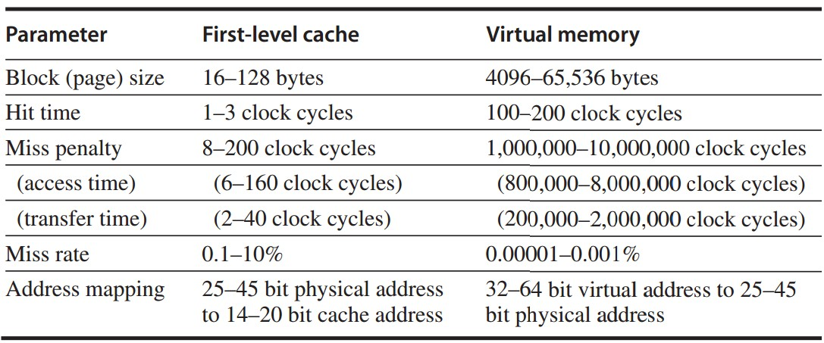
Cache vs Virtual Memory

Slide 22
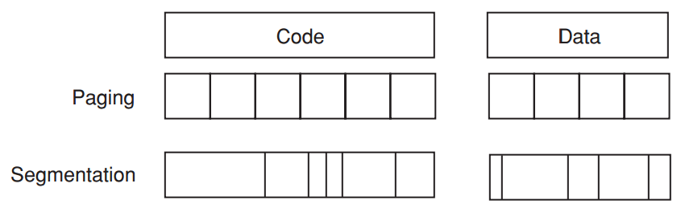
Virtual Memory Allocation
Paged virtual memory
page: fixed-size block
Segmented virtual memory
segment: variable-size block

Slide 23
Virtual Memory Address
Paged virtual memory
page address: page # || offset
Segmented virtual memory
segment address: seg # + offset
concatenate

Slide 24
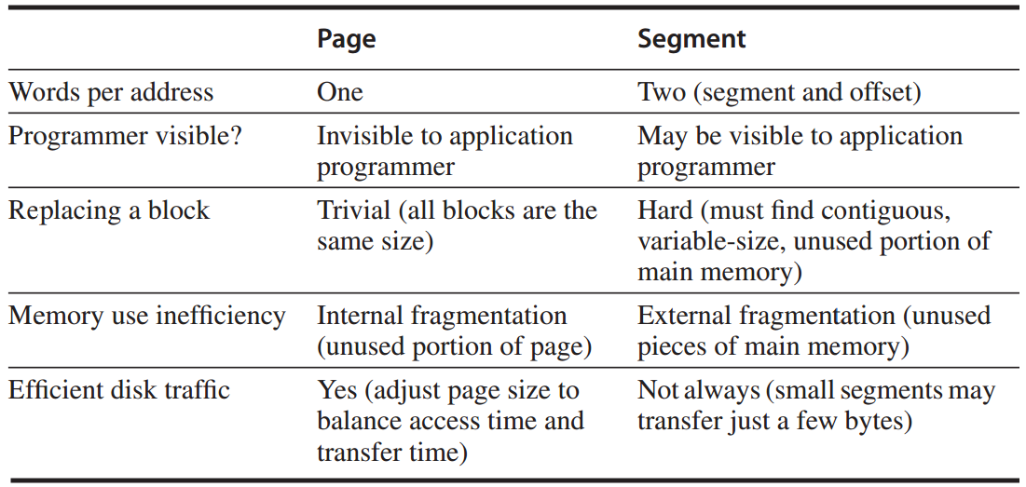
Paging vs Segmentation
http://www.cnblogs.com/felixfang/p/3420462.html

Slide 25
How virtual memory works?
Four Questions

Slide 26
How virtual memory works?
Four Questions

Slide 27
Four Mem Hierarchy Q’s
Q1. Where can a block be placed in main memory?
Fully associative strategy:
OS allows blocks to be placed anywhere in main memory
Because of high miss penalty by
access to a rotating magnetic storage device upon page/address fault

Slide 28
Four Mem Hierarchy Q’s
Q2. How is a block found if it is in main memory? [cont’d]
use a data structure
--contains phy addr of a block;
--indexed by page/segment number;
in the form of page table
--indexed by virtual page number;
--table size = the # of pages in the virtual address space

Slide 29
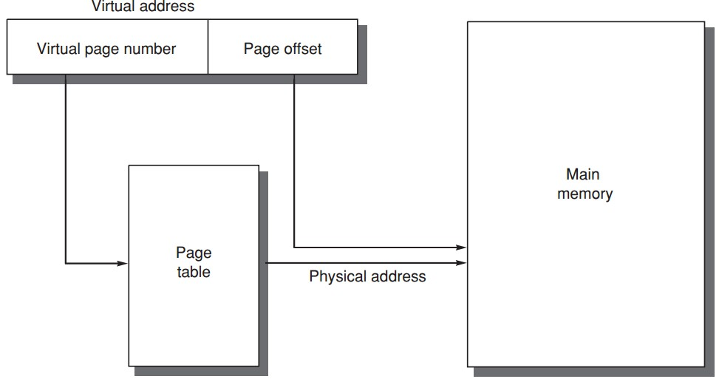
Four Mem Hierarchy Q’s
Q2. How is a block found if it is in main memory?
Segment addressing
add offset to seg’s phy addr;
Page addressing
concatenate offset to page’s phy addr;

Slide 30
Four Memory Hierarchy Q’s
Q3. Which block should be replaced on a virtual memory miss?
Least recently used (LRU) block
use/reference bit
--logically set whenever a page is accessed;
--OS periodically clears use bits and later records them to track the least recently referenced pages;

Slide 31
Four Mem Hierarchy Q’s
Q4. What happens on a write?
Write-back strategy
as accessing rotating magnetic disk takes millions of clock cycles;
Dirty bit
write a block to disk only if it has been altered since being read from the disk;

Slide 32
Can you tell me more?
Address Translation

Slide 33
Can you tell me more?
Address Translation

Slide 34
Page Table ?
physical page number || page offset = physical address
page
table

Slide 35
Page Table ?
Page tables are often large and stored in main memory
Logically two mem accesses for data access:
one to obtain the physical address;
one to get the data;
Access time doubled
How to be faster?

Slide 36
Learn from History
Translation lookaside buffer (TLB)
/translation buffer (TB)
a special cache
that keeps (prev) address translations
TLB entry
--tag: portions of the virtual address;
--data: a physical page frame number, protection field, valid bit, use bit, dirty bit;

Slide 37
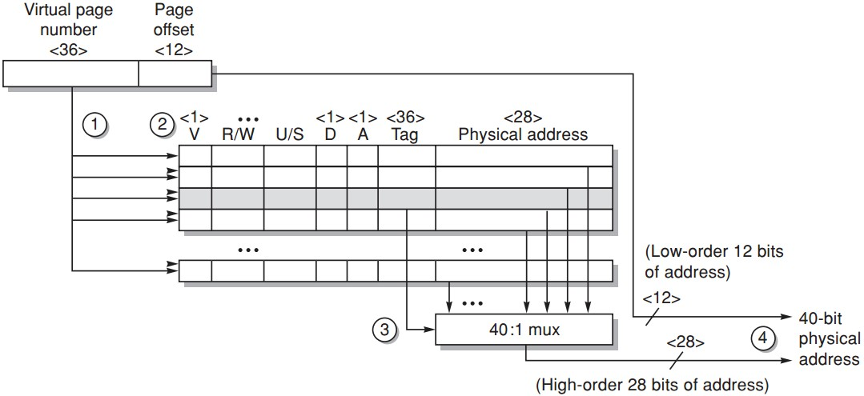
TLB Example
Opteron data TLB
Steps 1&2: send the virtual address to all tags
Step 2: check the type of mem access against protection info in TLB

Slide 38
TLB Example
Opteron data TLB
Steps 3: the matching tag sends phy addr through multiplexor

Slide 39
TLB Example
Opteron data TLB
Steps 4: concatenate page offset to phy page frame to form final phy addr

Slide 40
Page Size Selection
Pros of larger page size
Smaller page table, less memory (or other resources used for the memory map);
Larger cache with fast cache hit;
Transferring larger pages to or from secondary storage is more efficient than transferring smaller pages;
Map more memory, reduce the number of TLB misses;

Slide 41
Page Size Selection
Pros of smaller page size
Conserve storage
When a contiguous region of virtual memory is not equal in size to a multiple of the page size,
a small page size results in less wasted storage.
Very large page size may waste more storage, I/O bandwidth and lengthen the time to invoke a process.

Slide 42
Page Size Selection
Use both: multiple page sizes
Recent microprocessors have decided to support multiple page sizes, mainly because of larger page size reduces the # of TLB entries and thus the # of TLB misses;
for some programs, TLB misses can be as significant on CPI as the cache misses;

Slide 43
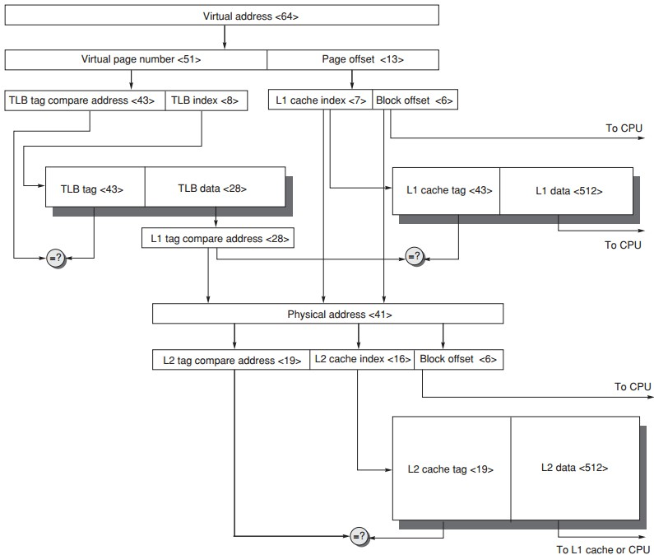
Address Translation
Page size: 8KB
Direct-mapped caches
L1: 8KB
L4: 4MB
TLB 256 entries

Slide 44
Address Translation

Slide 45
Address Translation

Slide 46
Address Translation

Slide 47
You said virtual memory promised safety?
Mem protection & sharing among programs

Slide 48
You said virtual memory promised safety?
Mem protection & sharing among programs

Slide 49
Multiprogramming
Enable a computer to be shared by several programs running concurrently
Need protection and sharing among programs

Slide 50
Process
A running program plus any state needed to continue running it
Time-sharing
shares processor and memory with interactive users simultaneously;
gives the illusion that all users have their own computers;
Process/context switch
from one process to another

Slide 51
Process
Maintain correct process behavior
--computer designer must ensure that the processor portion of the process state can be saved and restored;
--OS designer must guarantee that processes do not interfere with each others’ computations;
Partition main memory so that several different processes have their state in memory at the same time

Slide 52
Process Protection
Proprietary page tables
processes can be protected from one another by having their own page tables,
each pointing to distinct pages of memory;
user programs must be prevented from modifying their page tables

Slide 53
Process Protection
Rings
added to the processor protection structure,
expands memory access protection to multiple levels.
The most trusted accesses anything
The second most trusted accesses everything except the innermost level
…
The civilian programs are the least trusted, have the most limited range of accesses.

Slide 54
Process Protection
Keys and Locks
a program cannot unlock access to the data unless it has the key
For keys/capabilities to be useful, hardware and OS must be able to explicitly pass them from one program to another
without allowing a program itself to forge them

Slide 55
Example 1: Intel Pentium
Segmented virtual memory
IA-32: four levels of protection
(0) innermost level, kernel mode;
(3) outermost level, least privileged mode;
separate stacks for each level to avoid security breaches between the levels

Slide 56
Example 1: Intel Pentium
Add bounds checking and memory mapping
base + limit fields
Add sharing and protection
global/local address space;
a field giving a seg’s legal access level;
Add safe calls from user to OS gates and inheriting protection level for parameters
call gate

Slide 57
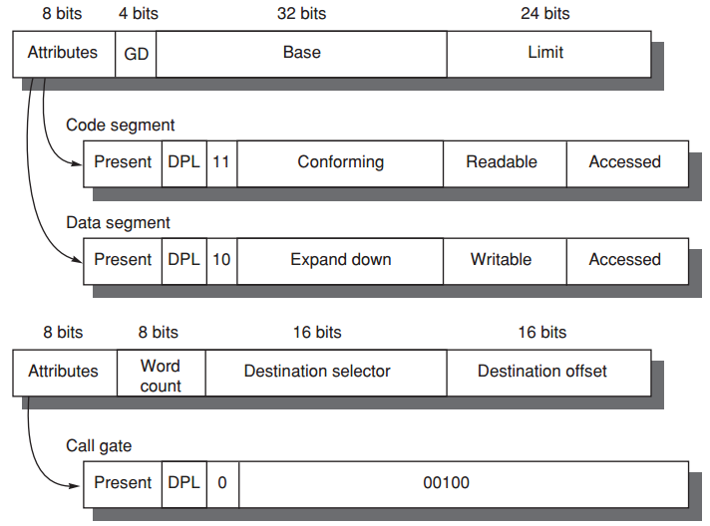
Example 1: Intel Pentium
Segment Descriptors
Page B-53

Slide 58
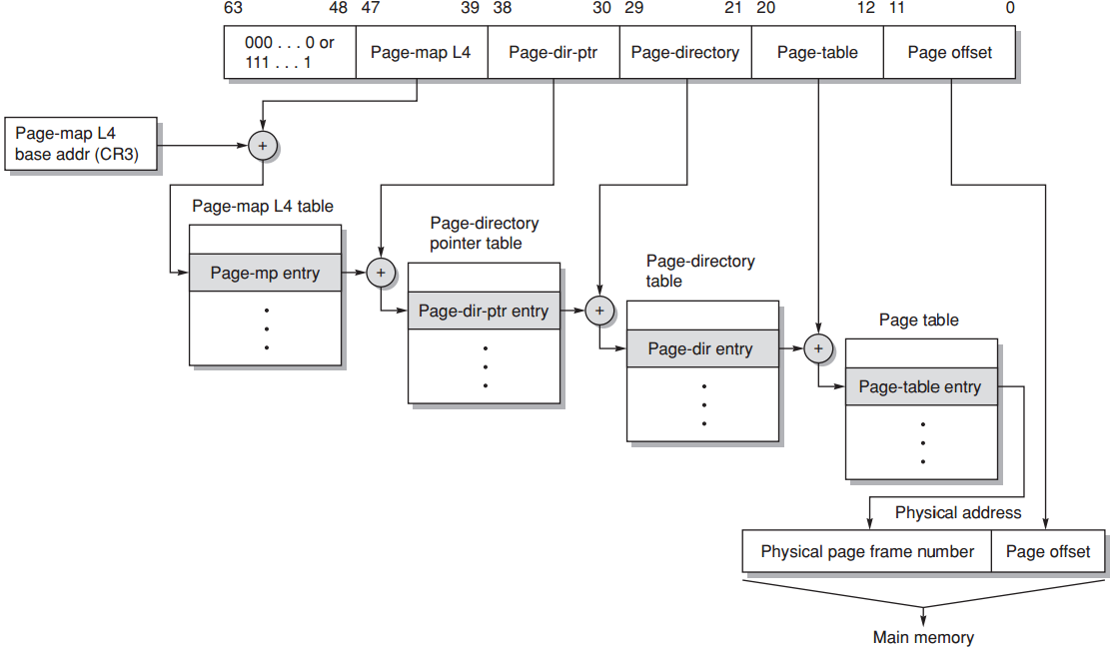
Example 2: 64-bit Opteron
Paged virtual memory
Multilevel hierarchical page table;
Page tables are protected from being written by user programs;
Sharing of memory between processes is accomplished by having a page table entry in each address space point to the same physical memory page;
Page B-55

Slide 59
?

