Slide 1
Lecture 11: Storage Systems
Disk, RAID, Dependability
Kai Bu
kaibu@zju.edu.cn
http://list.zju.edu.cn/kaibu/comparch2015

Slide 2
Lab 3 Report due May 28
Lab 4 Demo due May 28
Report due June 04
Exam requirement:
in English
one written A4 note allowed

Slide 4
1960s – 1980s
Computing Revolution

Slide 5
1990 –
Information Age
Notes:
Information technology instead of computational power;

Slide 6

Communication
Computation
Storage
Notes:
Internet services depend on massive storage;

Slide 7
Communication
Computation
Storage
Notes:
Storage is the focus of today’s lecture;

Slide 8
Communication
Computation
Storage
requires higher standard of dependability than the rest of the computer
Notes:
Storage requires higher …;

Slide 9
Communication
Computation
Storage ?
requires higher standard of dependability than the rest of the computer
Notes:
Why such requirement?

Slide 10

program crash
Communication
Computation
Storage
requires higher standard of dependability than the rest of the computer
Notes:
Processor not that depedant, e.g., program crash; but usually tolerable

Slide 11

Communication
Computation
Storage
data loss
requires higher standard of dependability than the rest of the computer
Notes:
However, if disk not dependant enough, data loss, drive most users crazy;

Slide 12
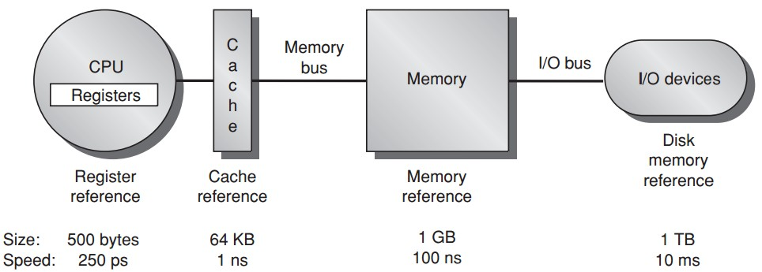
Memory Hierarchy
Notes:
The position of disk/storage in the entire memory hierarchy; major properties: large but slow;

Slide 13
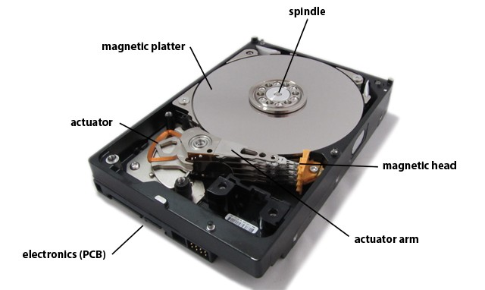
Communication
Storage
magnetic disks dominate

Slide 14
Preview
Disk
Disk Array: RAID
Dependability: Fault, Error, Failure

Slide 15

Appendix D.1–D.3 http://booksite.mkp.com/9780123838728/references/appendix_d.pdf

Slide 16

let’s start from a single disk

Slide 17
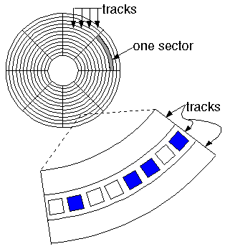
Disk
http://cf.ydcdn.net/1.0.1.19/images/computer/MAGDISK.GIF

Slide 18
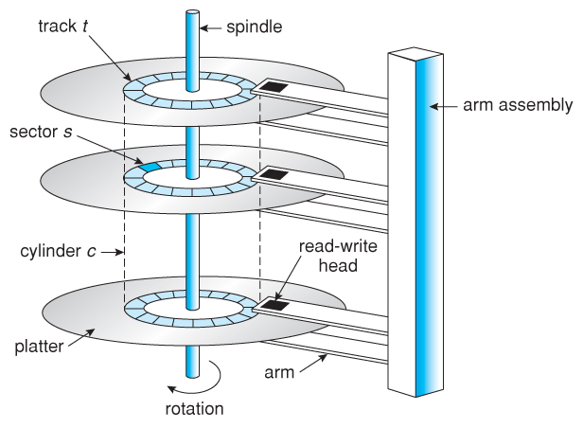
Disk
http://www.cs.uic.edu/~jbell/CourseNotes/OperatingSystems/images/Chapter10/10_01_DiskMechanism.jpg

Slide 19
Disk Capacity
Areal Density
=bits/inch²
=(tracks/inch) x (bits-per-track/inch)

Slide 20
Disk Capacity
Areal Density
in 2011, the highest density
400 billion bits per square inch
Costs per gigabyte
between 1983 and 2011,
improved by almost
a factor of 1,000,000
Notes:
One million times of cost reduction

Slide 21
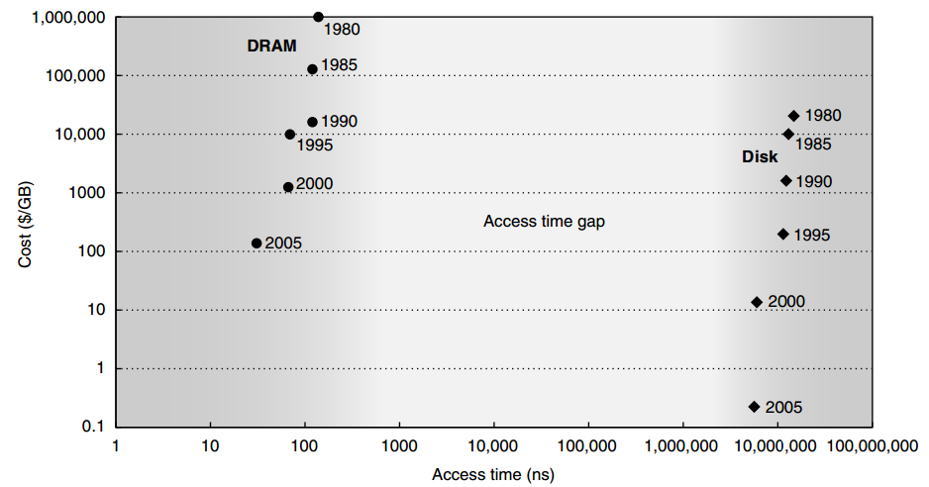
Disk vs DRAM
Cost DRAM >> DISK
Access time DRAM << DISK

Slide 22
Disk’s Competitor
Flash Memory
non-volatile semiconductor memory;
same bandwidth as disks;
100 to 1000 times faster;
15 to 25 times higher cost/gigabyte;
Wear out
limited to 1 million writes
Popular in cell phones,
but not in desktop and server

Slide 23
Disk Power
Power by disk motor
≈Diameter^{4.6} x RPM^{2.8} x No. of platters
RPM: Revolutions Per Minute rotation speed

Slide 24
Disk Power
Power by disk motor
≈Diameter^{4.6} x RPM^{2.8} x No. of platters
RPM: Revolutions Per Minute rotation speed
Smaller patters, slower rotation, and fewer platters reduce disk motor power

Slide 25
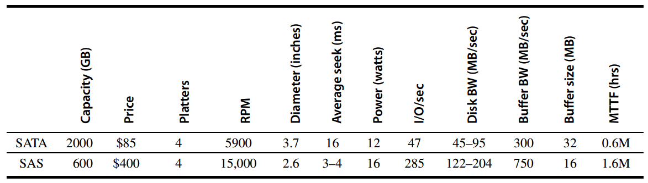
Disk Power

Slide 26
what if one is not enough…
disk failure
all or nothing

Slide 27
what if one is not enough…
disk failure
all or nothing

Slide 28
what if one is not enough…
disk failure
all or nothing

Slide 29
Disk Arrays
Disk arrays with redundant disks to tolerate faults
If a single disk fails, the lost information is reconstructed from redundant information
Striping: simply spreading data over multiple disks
RAID: redundant array of inexpensive/independent disks

Slide 30
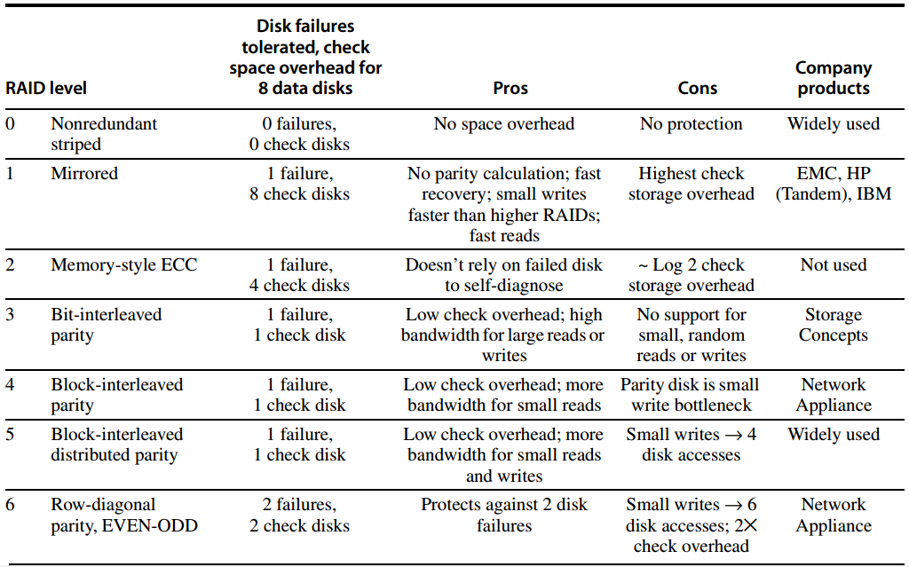
RAID

Slide 31
RAID 0
JBOD: just a bunch of disks
No redundancy
No failure tolerated
Measuring stick for other RAID levels in terms of cost, performance, and dependability

Slide 32
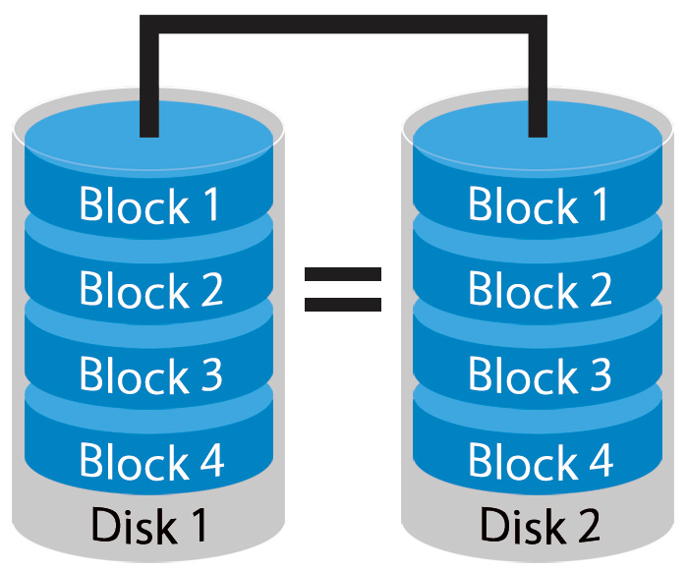
RAID 1
Mirroring or Shadowing
Two copies for every piece of data
one logical write = two physical writes
100% capacity/space
overhead
http://www.petemarovichimages.com/wp-content/uploads/2013/11/RAID1.jpg

Slide 33
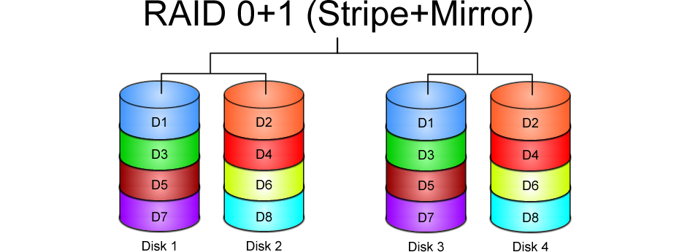
https://www.icc-usa.com/content/raid-calculator/raid-0-1.png

Slide 34
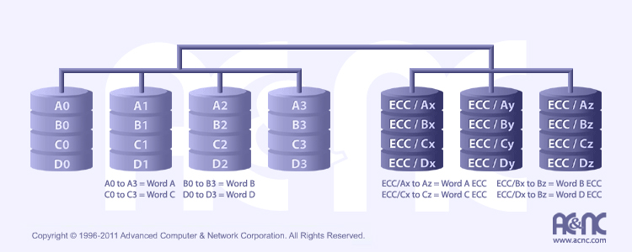
RAID 2
http://www.acnc.com/raidedu/2
Each bit of data word is written to a data disk drive
Each data word has its (Hamming Code) ECC word recorded on the ECC disks
On read, the ECC code verifies correct data or corrects single disks errors

Slide 35
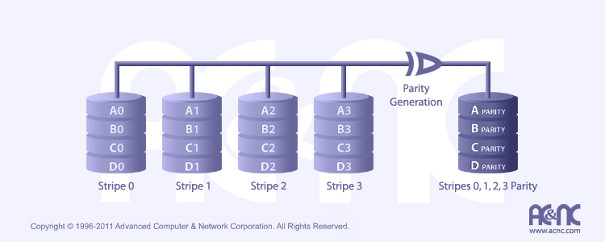
RAID 3
http://www.acnc.com/raidedu/3
Data striped over all data disks
Parity of a stripe to parity disk
Require at least 3 disks to implement

Slide 36
RAID 3
Even Parity
parity bit makes
the # of 1 even
p = sum(data1) mod 2
Recovery
if a disk fails,
“subtract” good data
from good blocks;
what remains is missing data;
P
1
0
1
0
0
0
1
1
1
1
0
0
1
1
0
1
1
0
1
0
0
0
1
1
1
1
0
0
1
1
0
1

Slide 37

RAID 4
http://www.acnc.com/raidedu/4
Favor small accesses
Allows each disk to perform independent reads, using sectors’ own error checking

Slide 38
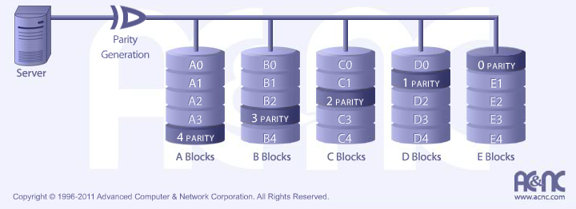
RAID 5
http://www.acnc.com/raidedu/5
Distributes the parity info across all disks in the array
Removes the bottleneck of a single parity disk as RAID 3 and RAID 4

Slide 39
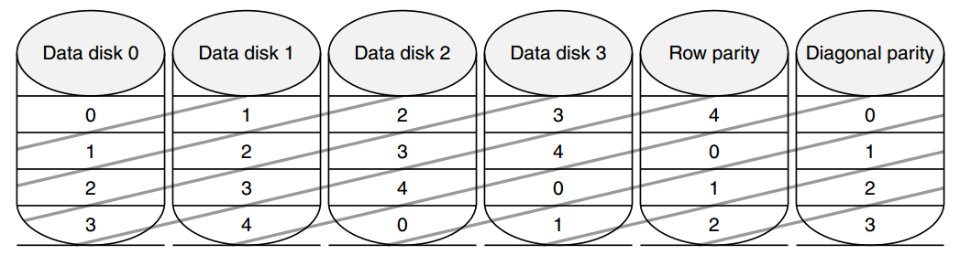
RAID 6: Row-diagonal Parity
RAID-DP
Recover from two failures
xor
row: 00+11+22+33=r4
diagonal: 01+11+31+r1=d1

Slide 40
Double-Failure Recovery

Slide 41
Double-Failure Recovery

Slide 42
Double-Failure Recovery

Slide 43
Double-Failure Recovery

Slide 44
Double-Failure Recovery

Slide 45
Double-Failure Recovery

Slide 46
Double-Failure Recovery

Slide 47
Double-Failure Recovery

Slide 48
Double-Failure Recovery

Slide 49
RAID: Further Readings
Raid Types – Classifications
BytePile.com
https://www.icc-usa.com/content/raid-calculator/raid-0-1.png
RAID
JetStor
http://www.acnc.com/raidedu/0

Slide 50
When are disks dependable and when are they not?

Slide 51
Dependability
Computer system dependability is the quality of delivered service such that reliance can justifiably be placed on this service.

Slide 52
The service delivered by a system is its observed actual behavior as perceived by other system(s) interacting with this system’s users.

Slide 53
Each module also has an ideal specified behavior, where a service specification is an agreed description of the expected behavior.

Slide 54
Failure
A system failure occurs when the actual behavior deviates from the specified behavior.

Slide 55
Error, Fault
The failure occurred because of an error, a defect in that module.
The cause of an error is a fault.
When a fault occurs, it creates a latent error, which becomes effective when it is activated;
When the error actually affects the delivered service, a failure occurs.

Slide 56
Fault, Error, Failure
A fault creates one or more latent errors
Either an effective error is a formerly latent error in that component or it has propagated from another error in that component or from else where
A component failure occurs when the error affects the delivered service

Slide 57
Failure
Error
Fault
affect the delivered service
activated to be effective
one or more latent errors

Slide 58
Categories of Faults by Cause
Hardware faults
failed devices
Design faults
usually in software design;
occasionally in hardware design;
Operation faults
mistakes by operations and maintenance personnel;
Environmental faults
fire, flood, earthquake, power failure, sabotage;

Slide 59
Categories of Faults by Duration
Transient faults
exist for a limited time and are not recurring;
Intermittent faults
cause a system to oscillate between faulty and fault-free operation
Permanent faults
do not correct themselves with the passing of time;

Slide 60
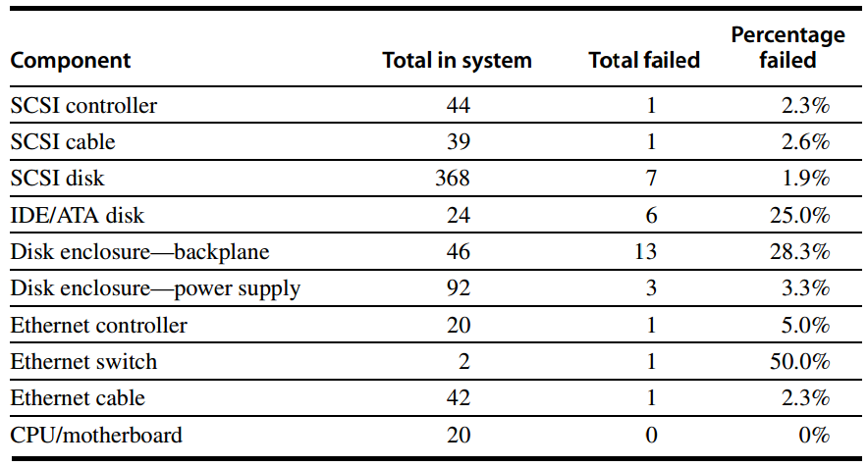
Example: Berkeley’s
Tertiary Disk

Slide 61
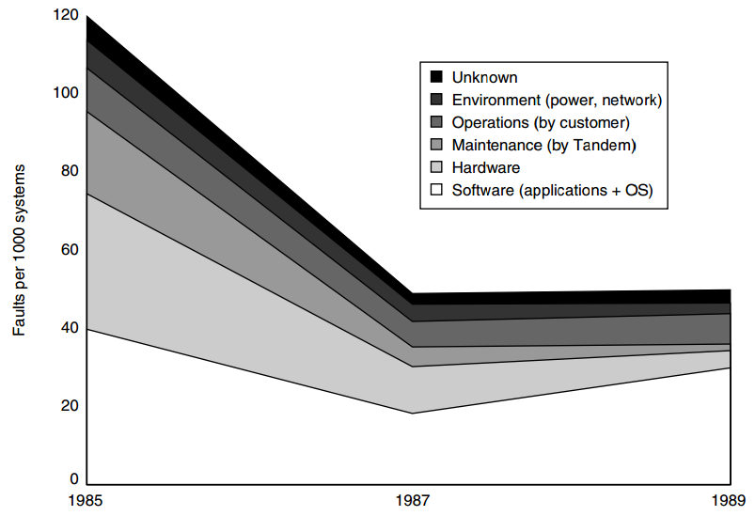
Example: Tandem

Slide 62
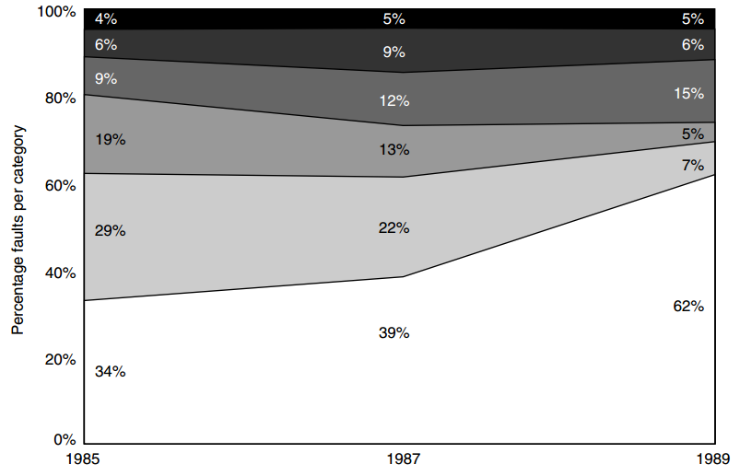
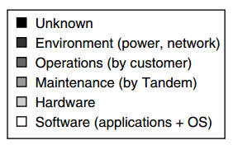
Example: Tandem

Slide 63
?

