Slide 1
Lecture 12: Storage Systems
Performance
Kai Bu
kaibu@zju.edu.cn
http://list.zju.edu.cn/kaibu/comparch2015

Slide 2
Lab 4 Report due
Quiz 2 June 18
storage, multiprocessor

Slide 4
Outline
I/O Performance
Queuing Theory

Slide 5

Appendix D.4–D.5

Slide 6
Outline
I/O Performance
Queuing Theory

Slide 7
Unique Measures
Diversity
which I/O devices can connect to the computer system?
Capacity
how many I/O devices can connect to a computer system?

Slide 8
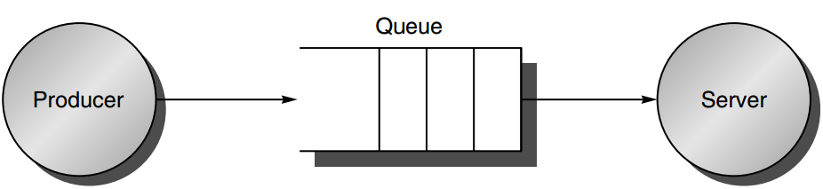
Producer-Server Model
producer creates tasks to be performed and places them in a buffer;
server takes tasks from the FIFO buffer and performs them;
Notes:
To measure a system’s performance, first to model the system, ease analysis;
Tasks here -> I/O requests;

Slide 9
Metrics
Response time / Latency
the time a task from the moment it is placed in the buffer until the server finishes the task
Throughput / Bandwidth
the average number of tasks completed by the server over a time period

Slide 10
Throughput vs Response Time
Competing demands
Highest possible throughput requires server never be idle, thus the buffer should never be empty
Response time counts time spent in the buffer, so an empty buffer shrinks it

Slide 11
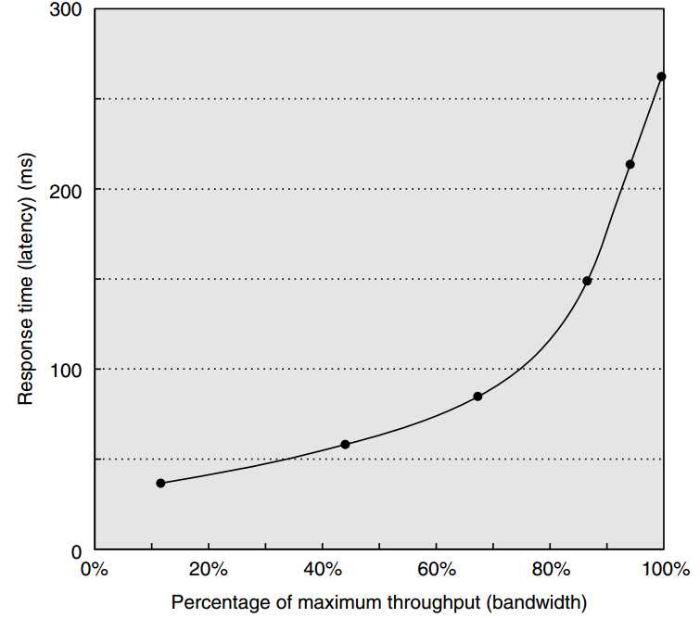
Throughput vs Response Time

Slide 12
Choosing Response Time
Transaction
an interaction between user and comp
Transaction Time consists of
Entry time: the time for the user to enter the command
System response time: the time between command entered and complete response displayed
Think time: the time from response reception to user entering next cmd

Slide 13
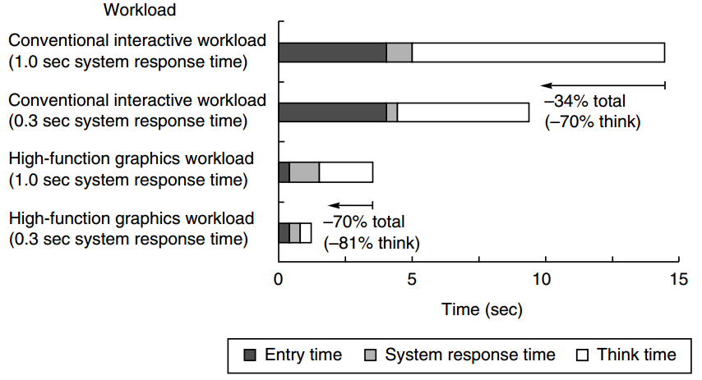
Choosing Response Time
reduce response time from 1 s to 0.3 s

Slide 14
Choosing Response Time
More transaction time reduction than just the response time reduction

Slide 15
Choosing Response Time
People need less time to think when given a faster response

Slide 16
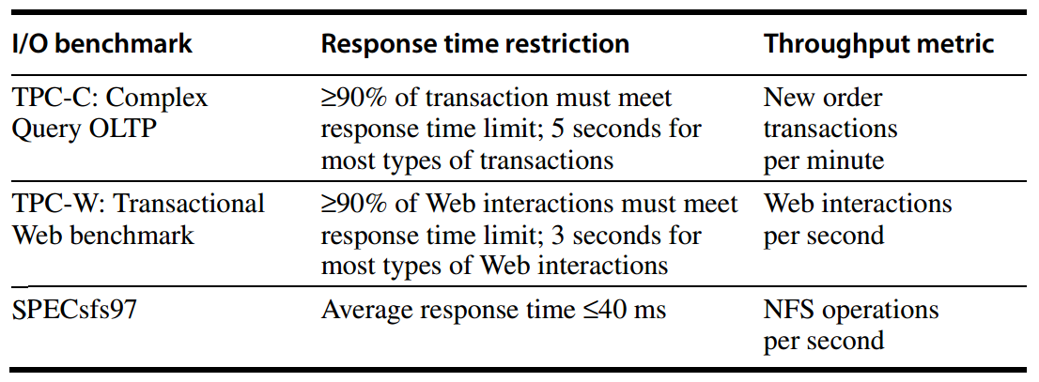
I/O Benchmarks
Response time restrictions for I/O benchmarks

Slide 17
TPC
Conducted by
Transaction-Processing Council
OLTP for online transaction processing
I/O rate: the number of disk accesses per second;
instead of data rate (bytes of data per second)

Slide 18
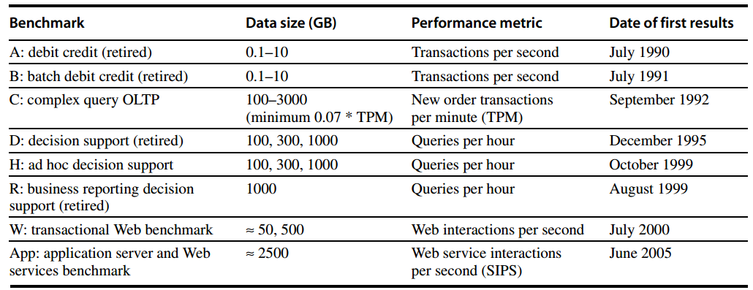
TPC

Slide 19
TPC-C
Configuration
use a database to simulate an order-entry environment of a wholesale supplier
Include entering and delivering orders, recording payments, checking the status of orders, and monitoring the level of stock at the warehouses
Run five concurrent transactions of varying complexity
Includes nine tables with a scalable range of records and customers

Slide 20
TPC-C
Metrics
tmpC
transactions per minute
System price
hardware
software
three years of maintenance support

Slide 21
TPC: Initiative/Unique Characteristics
Price is included with the benchmark results
The dataset generally must scale in size as the throughput increases
The benchmark results are audited
Throughput is performance metric, but response times are limited
An independent organization maintains the benchmarks

Slide 22
SPEC Benchmarks
Best known for its characterization of processor performances
Has created benchmarks for also file servers, mail servers, and Web servers
SFS, SPECMail, SPECWeb

Slide 23
SPEC File Server Benchmark
SFS
a synthetic benchmark agreed by seven companies;
evaluate systems running the Sun Microsystems network file sys (NFS);
SFS 3.0 / SPEC SFS97_R1
to include support for NFS version 3

Slide 24
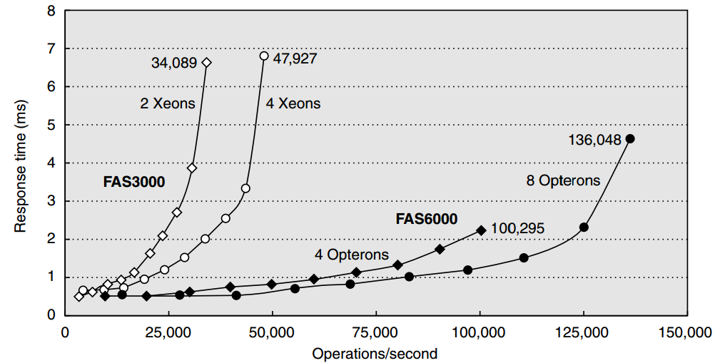
SFS
Scale the amount of data stored according to the reported throughput
Also limits the average response time

Slide 25
SPECMail
Evaluate performance of mail servers at an Internet service provider
SPECMail 2001
based on standard Internet protocols SMTP and POP3;
measures throughput and user response time while scaling the number of users from 10,000 to 1,000,000

Slide 26
SPECWeb
Evaluate the performance of World Wide Web servers
Measure number of simultaneous user sessions
SPECWeb2005
simulates accesses to a Web service provider;
server supports home pages for several organizations;
three workloads: Banking (HTTPs), E-commerce (HTTP and HTTPs), and Support (HTTP)

Slide 27
Dependability Benchmark
Examples
TPC-C
The benchmarked system must be able to handle a single disk failure
Measures submitters run some RAID organization in their storage system

Slide 28
Dependability Benchmark
Examples
Effectiveness of fault tolerance
Availability: measured by examining the variations in system quality-of-service metrics over time as faults are injected into the system
For a Web server
performance: requests satisfied per second
degree of fault tolerance: the number of faults tolerated by the storage system, network connection topology, and so forth

Slide 29
Dependability Benchmark
Examples
Effectiveness of fault tolerance
SPECWeb99
Single fault injection
e.g., write error in disk sector
Compares software RAID implementations provided by Linux, Solaris, and Windows 2000 Server

Slide 30
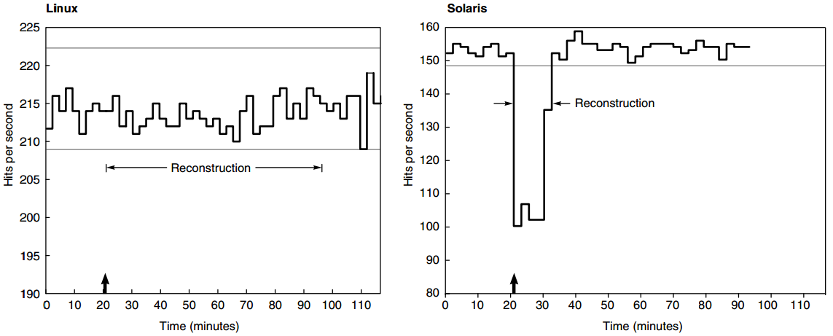
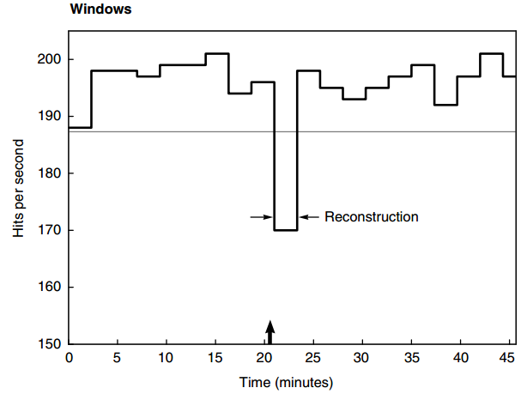
SPECWeb99
fast reconstruction
decreases app performance
reconstruction steals I/O resources from running apps

Slide 31
SPECWeb99
Linux and Solaris initiate automatic reconstruction of the RAID volume onto a hot spare when an active disk is taken out of service due to a failure
Windows’s RAID reconstruction must be initiated manually

Slide 32
SPECWeb99
Managing transient faults
Linux: paranoid
shut down a disk in controlled manner at the first error,
rather than wait to see if the error is transient;
Windows and Solaris: forgiving
ignore most transient faults with the expectation that they will not recur

Slide 33


Slide 34
Outline
I/O Performance
Queuing Theory

Slide 35
Queuing Theory
Give a set of simple theorems that will help calculate response time and throughput of an entire I/O system
Because of the probabilistic nature of I/O events and because of sharing of I/O devices
A little more work and much more accurate than best-case analysis,
but much less work than full-scale simulation

Slide 36
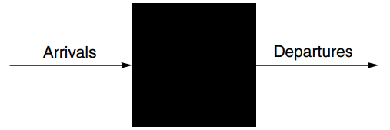
Black Box Model
I/O Device
Processor makes I/O requests that arrive at the I/O device,
requests depart when the I/O device fulfills them

Slide 37
Flow-balanced State
I/O Device
If the system is in steady state,
then the number of tasks entering the system must equal the number of tasks leaving the system
This flow-balanced state is necessary but not sufficient for steady state

Slide 38
Steady State
I/O Device
The system has reached steady state
if the system has been observed for a sufficiently long time and
mean waiting times stabilize

Slide 39
Little’s Law
Assumptions
multiple independent I/O requests in equilibrium:
input rate = output rate;
a steady supply of tasks independent for how long they wait for service;

Slide 40
Little’s Law
Mean number of tasks in system
= Arrival rate x Mean response time

Slide 41
Little’s Law
Mean number of tasks in system
= Arrival rate x Mean response time
applies to any system in equilibrium
nothing inside the black box creating new tasks or destroying them

Slide 42
Little’s Law
Observe a sys for Time_{observe} mins
Sum the times for each task to be serviced Time_{accumulated}
Number_{task} completed during Time_{observe}
Time_{accumulated}≥Time_{observe}
because tasks can overlap in time

Slide 43
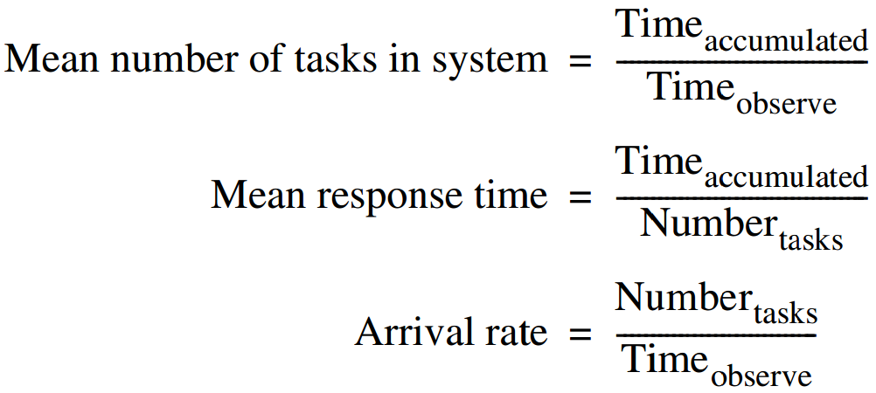
Little’s Law

Slide 44
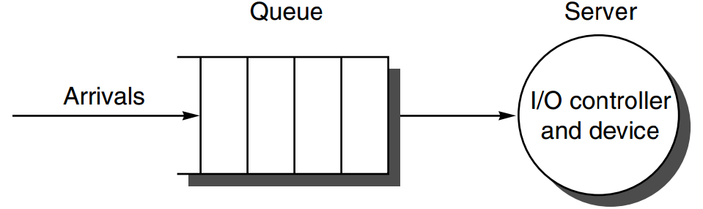
Single-Server Model
Queue / Waiting line
the area where the tasks accumulate, waiting to be serviced
Server
the device performing the requested service is called the server

Slide 45
Single-Server Model
Time_{server}
average time to service a task
average service rate: 1/Time_{server}
Time_{queue}
average time per task in the queue
Time_{system}
average time/task in the system, or the response time;
the sum of Time_{queue} and Time_{server}

Slide 46
Single-Server Model
Arrival rate
average # of arriving tasks per second
Length_{server}
average # of tasks in service
Length_{queue}
average length of queue
Length_{system}
average # of tasks in system,
the sum of Length_{server} and Length_{queue}

Slide 47
Server Utilization / traffic intensity
Server utilization
the mean number of tasks being serviced divided by the service rate
Service rate = 1/Time_{server}
Server utilization
=Arrival rate x Time_{server}
(little’s law again)

Slide 48
Server Utilization
Example
an I/O sys with a single disk gets on average 50 I/O requests per sec;
10 ms on avg to service an I/O request;
server utilization
=arrival rate x time_{server}
=50 x 0.01 = 0.5 = 1/2
Could handle 100 tasks/sec, but only 50

Slide 49
Queue Discipline
How the queue delivers tasks to server
FIFO: first in, first out
Time_{queue}
=Length_{queue} x Time_{server}
+ Mean time to complete the task being serviced when new task arrives if server is busy

Slide 50
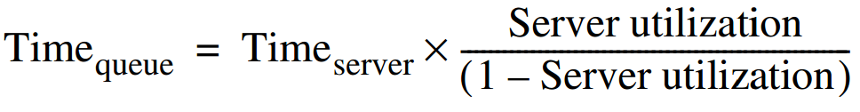
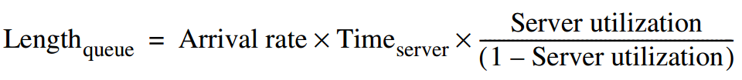
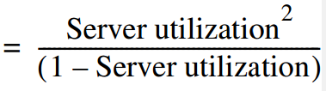
Queue
with exponential/Poisson distribution of events/requests

Slide 51

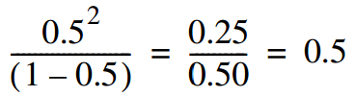
Length_{queue}
Example
an I/O sys with a single disk gets on average 50 I/O requests per sec;
10 ms on avg to service an I/O request;
Length_{queue}
=
=

Slide 52
M/M/1 Queue
assumptions
The system is in equilibrium
Interarrival times (times between two successive requests arriving) are exponentionally distributed
Infinite population model: unlimited number of sources of requests
Server starts on the next job immediately after finishing prior one
FIFO queue with unlimited length
One server only

Slide 53
M/M/1 Queue
M: Markov
exponentially random request arrival;
M: Markov
exponentially random service time
1
single server

Slide 54
M/M/1 Queue
Example
a processor sends 40 disk I/Os per sec;
exponentially distributed requests;
avg service time of an older disk is 20ms;
Q:
1. avg server utilization?
2. avg time spent in the queue?
3. avg response time (queuing+serv)?

Slide 55
M/M/1 Queue
Example
a processor sends 40 disk I/Os per sec;
exponentially distributed requests;
avg service time of an older disk is 20ms;
Q: 1. avg dis utilization?
server utilization
=Arrival rate x Time_{server}
=40 x 0.02 = 0.8

Slide 56
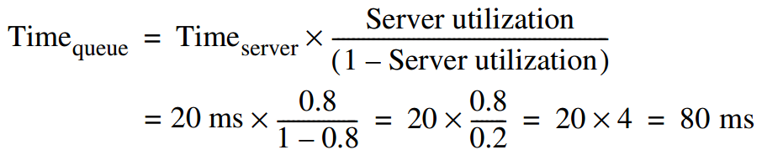
M/M/1 Queue
Example
a processor sends 40 disk I/Os per sec;
exponentially distributed requests;
avg service time of an older disk is 20ms;
Q: 2. avg time spent in the queue?

Slide 57
M/M/1 Queue
Example
a processor sends 40 disk I/Os per sec;
exponentially distributed requests;
avg service time of an older disk is 20ms;
Q:3. avg response time (queuing+serv)?
Time_{system}
=Time_{queue} + Time_{server}
=80 + 20 = 100 ms

Slide 58
M/M/1 Queue
Example
a processor sends 40 disk I/Os per sec;
exponentially distributed requests;
avg service time of an older disk is down to 10ms;
Q: 1. avg dis utilization?
server utilization
=Arrival rate x Time_{server}
=40 x 0.01 = 0.4

Slide 59
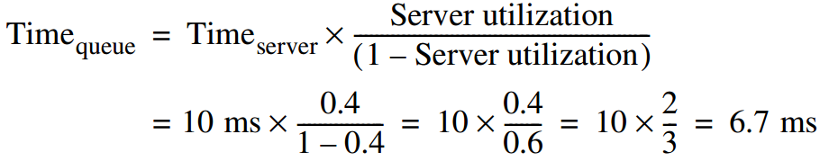
M/M/1 Queue
Example
a processor sends 40 disk I/Os per sec;
exponentially distributed requests;
avg service time of an older disk is down to 10ms;
Q: 2. avg time spent in the queue?

Slide 60
M/M/1 Queue
Example
a processor sends 40 disk I/Os per sec;
exponentially distributed requests;
avg service time of an older disk is down to 10ms;
Q:3. avg response time (queuing+serv)?
Time_{system}
=Time_{queue} + Time_{server}
=10 + 6.7 = 16.7 ms

Slide 61
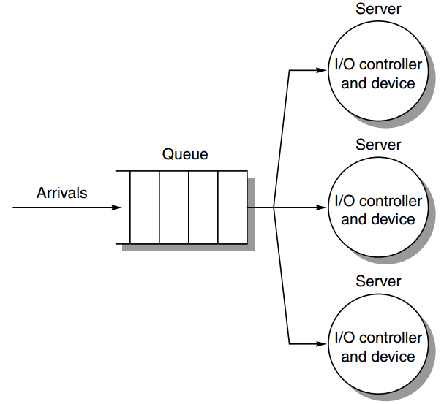
M/M/m Queue
multiple servers

Slide 62
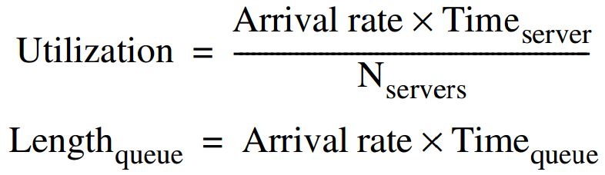
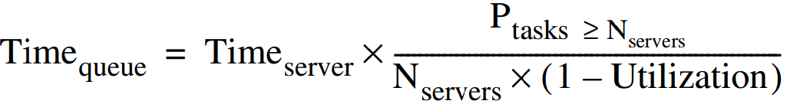
M/M/m Queue

Slide 63
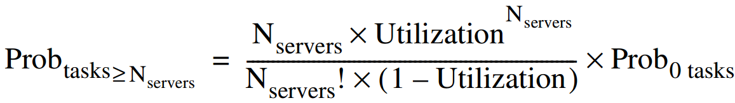
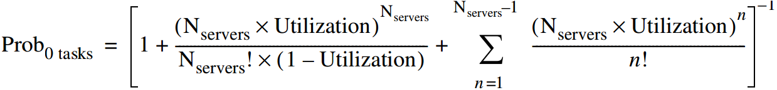
M/M/m Queue

Slide 64
M/M/m Queue
Example
a processor sends 40 disk I/Os per sec;
exponentially distributed requests;
avg service time for read is 20ms;
two disks duplicate the data;
all requests are reads;

Slide 65
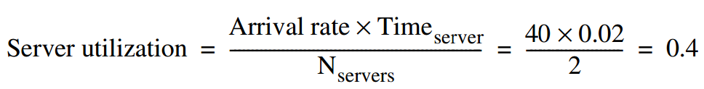
M/M/m Queue
Example

Slide 66
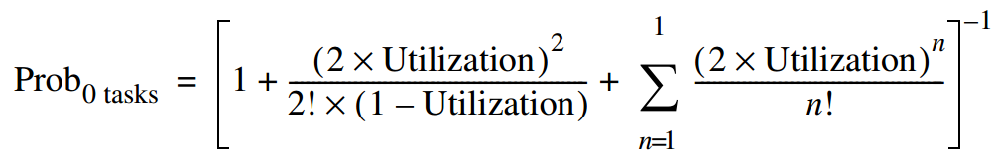

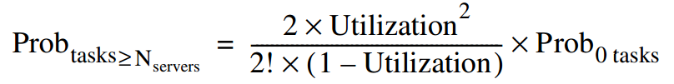

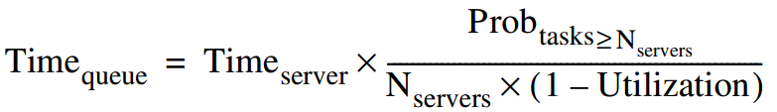

M/M/m Queue
Example

Slide 67
M/M/m Queue
Example
avg response time
=20 + 3.8
=23.8 ms

Slide 68
?

