Slide 1
Lecture 02: Fundamentals of Computer Design
- Basics
Kai Bu
kaibu@zju.edu.cn
http://list.zju.edu.cn/kaibu/comparch2016
Notes:
In this class, we will warm up with computer design basics, such as classification and performance.

Slide 2

Chapter 1.1-1.3
Notes:
These contents correspond to the first part of Chapter 1.

Slide 3
Preview
What types of computers?
Why are computers so fast?
What is computer architecture?
Notes:
Specifically, we’ll walk through computer classes, major techniques for speedy computation, and the definition of computer architecture.

Slide 4
What types of computers?
Notes:
Since all our discussions will relate to computers, then what kinds of computers do you know or have? Any examples?

Slide 5
5 Classes of Computers
PMD: Personal Mobile Device
Desktop
Server
Cluster/WSC (warehouse-scale computer)
Embedded computer
Notes:
Good examples; All those computers you’ve just mentioned fall into these five classes: they’re…
Next, Let’s briefly walk through the basics of each class.

Slide 6
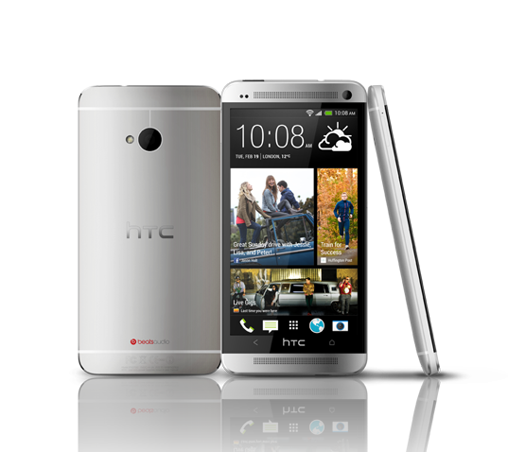
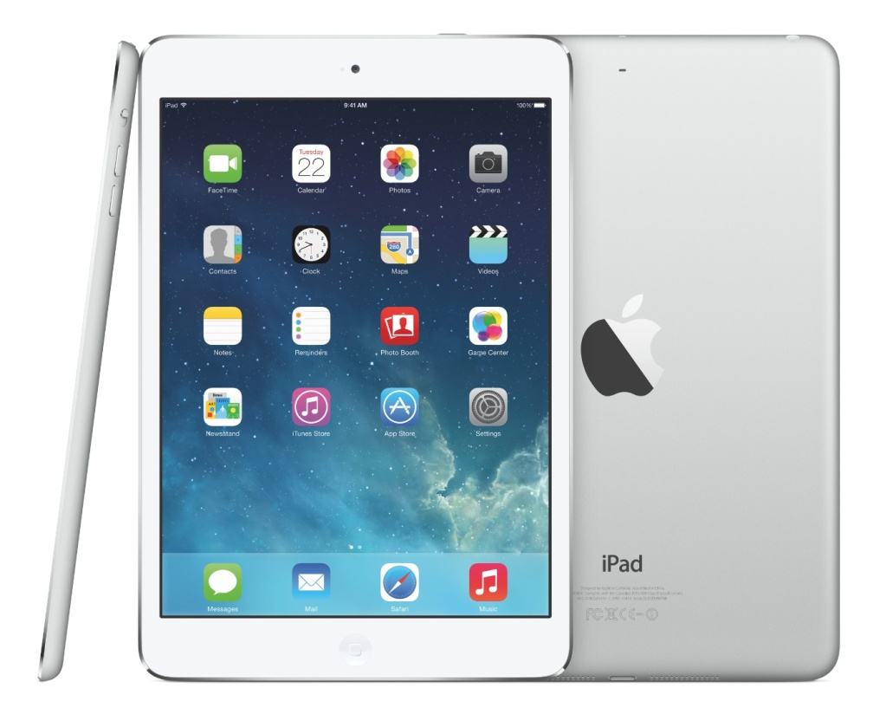
PMD: Personal Mobile Device
Wireless devices with multimedia user interfaces
cell phones, tablet computers, etc.
a few hundred dollars
Notes:
Personal mobile devices, such as smartphones and tablets, are the most pervasive computers nowadays. They have small size, high portability, yet low cost.
Extensive applications make them function far beyond traditional calling service.

Slide 7
PMD Characteristics
Cost effectiveness
less expensive packaging
absence of fan for cooling
Notes:
In comparison with larger computers like pcs or laptops, PMD’s low cost owes to their less expensive packaging and absence of fan for cooling.

Slide 8
PMD Characteristics
Responsiveness & Predictability
real-time performance:
a maximum execution time for each app segment
soft real-time:
trade time of a certain event for others’;
tolerate occasionally missed time constraint on an event,
as long as not too many are missed;
Notes:
The expectation for PMD’s responsiveness is that it should satisfy real-time performance constraint.
For this, a segment of the application has an absolute maximum execution time.
For example, in plying a video on a PMD, the time to process each video frame should be limited, since the processor must accept and process the next frame shortly.
However, real-time performance is a very strict requirement; it’s hard to satisfy.
As an alternative, some applications choose soft real-time performance, which tolerates occasionally missed time constraint on an event, as long as not too many are missed.

Slide 9
PMD Characteristics
Memory efficiency
optimize code size
Energy efficiency
battery power
heat dissipation
Notes:
For PMD, Memory can be a substantial portion of the system cost; We need to economize memory usage. PMD hosts various applications and thus large volume of code; so we can optimize code size towared memory efficiency;
Besides, PMD also has limited power and has no fan for cooling; so economize battery usage and heat dissipation technique are key to save energy;

Slide 10
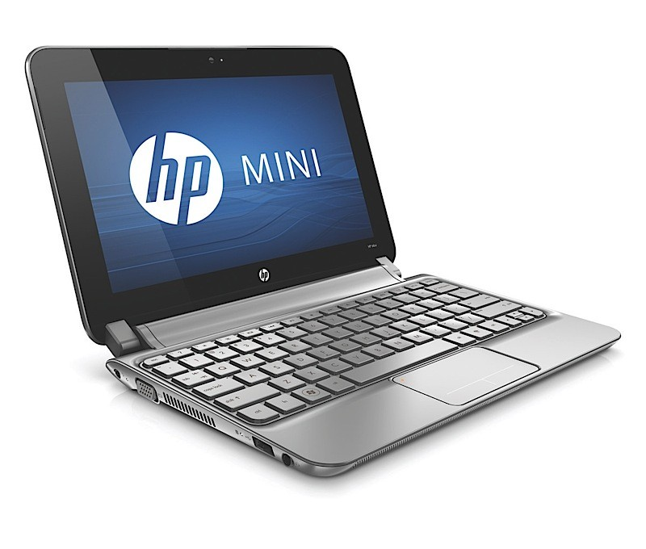
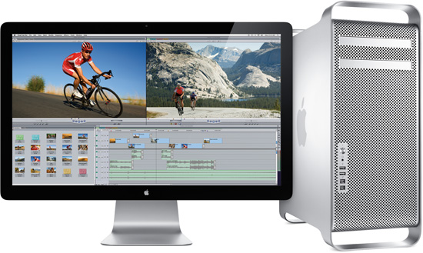
Desktop Computing
Largest market share
low-end netbooks: $x00
…
high-end workstations: $x000
Notes:
Desktops and laptops take largest market share and are most familiar to us.
They range from low-end netbooks to high-end workstations.
They usually cost hundreds to thousands of dollars

Slide 11
Desktop Characteristics
Price-Performance
combination of performance and price;
compute performance
graphics performance
The most important to customers,
and hence to computer designers
Notes:
Desktops deliver high performance but cost affordable prices.
So they are the most important to customers and hence to computer designers.

Slide 12
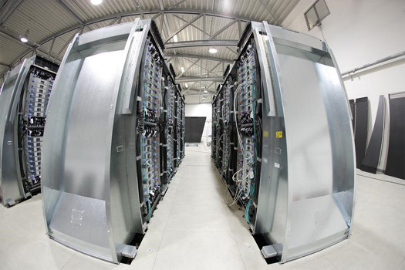
Servers
Provide large-scale and reliable file and computing services (to desktops)
Constitute the backbone of large-scale enterprise computing
Notes:
Servers aim to provide large-scale and reliable file and computing services to desktops connected to them.
They constitute the backbone of large-scale enterprise computing.

Slide 13
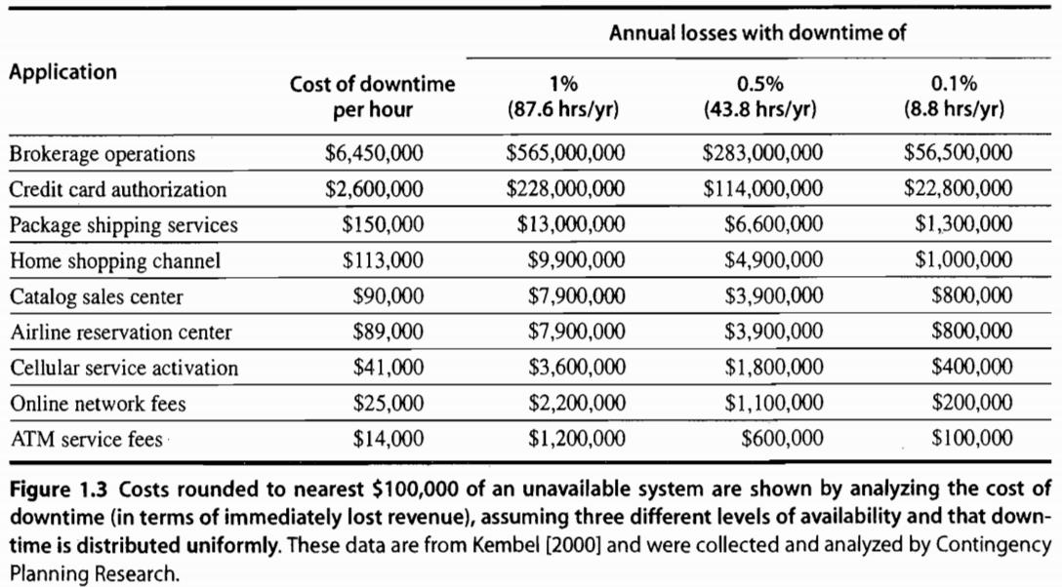
Servers Characteristics
Availability
against high-cost server failure
Notes:
The major character of servers should be high availability, as server down usually costs a lot to hosting services.
For some critical network services like credit card authentication and ATM operations, server failure comes at too high a cost.

Slide 14
Servers Characteristics
Scalability
in response to increasing demand with scaling up computing capacity, memory, storage, and I/O bandwidth
Efficient throughput
toward handling more requests in a unit time
Notes:
Servers should also be scalable, that is, they should be capable of handling a large volume of service requests. Toward this, it might need to enhance computing and storage capacity.
We also expect that servers have high throughput, that is, handling more requests in a unit time.

Slide 15

Clusters/WSCs
Warehouse-Scale Computers
collections of desktop computers or servers
connected by local area networks (LANs)
to act as a single larger computer
Characteristics
price-performance, availability, power
Notes:
Clusters are also known as werehouse-scale computers; they are collections of ...;
Then the connected computers can act as a single larger computer.
Its Characteristics are similar to its components, that is, desktop and server: which are, for example, price-performance and availability
Besides, since it consists of a bunch of computers altogether, we need to economize its power consumption;

Slide 16
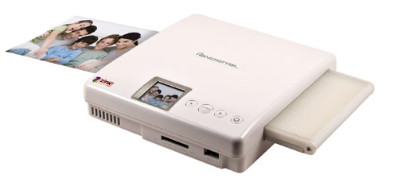
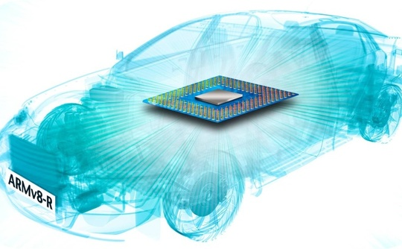
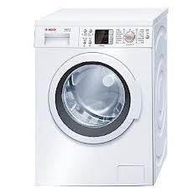
Embedded Computers
hide everywhere
Notes:
Embedded computers just hide everywhere. They are in cameras, watching machines, and even our cars.

Slide 17
Embedded vs Non-embedded
Dividing line
the ability to run third-party software
Embedded computers’ primary goal
meet the performance need at a minimum price;
rather than achieve higher performance at a higher price
Notes:
How can we differ embedded computers from non-embedded ones?
The key clue is whether a computer got the ability to run third-party software.
After all, embedded computers are made to meet the performance need at a minimum price rather than achieve higher performance at a higher price.

Slide 18
What makes computers fast?
Notes:
What makes these types of computers so fast?

Slide 19
Parallelism
Multi-task simultaneously takes effect
Application parallelism
Hardware parallelism
Notes:
The answer is parallelism, it makes multiple tasks to simultaneously take effect;
We can explore parallelism in both application layer and hardware layer.

Slide 20
Application Parallelism
DLP: Data-Level Parallelism
many data items being operated on
at the same time
TLP: Task-Level Parallelism
tasks of work created to operate independently and largely in parallel
Notes:
For application parallelism, we have data-level parallelism and task-level parallelism.
DLP operates many data items at the same time;
TLP creates tasks of work such that they operate independently and largely in parallel.

Slide 21
Hardware Parallelism
Hardware exploits application parallelism in four ways:
Instruction-Level Parallelism
Vector Architectures and GPUs
Thread-Level Parallelism
Request-Level Parallelism
Notes:
For hardware parallelism, we have four possible ways.
They are…;
Next let’s briefly introduce each type.

Slide 22
Hardware Parallelism
Instruction-Level Parallelism
exploits data-level parallelism
at modest levels – pipelining
divide a task to steps;
simultaneously run different steps
of different tasks.
at medium levels – speculative execution
do some work in advance;
prevent delay when the work is needed.
Notes:
Instruction-level parallelism exploits data-level parallelism;
At modest levels, it works through pipelining. Pipelining is the most important topic of our lecture and lab sessions.
It divides a task to steps, and then simultaneously runs different steps of different tasks.
At medium levels, instruction-level parallelism works through speculative execution. It runs some task in advance in order to prevent delay when the task’s result is needed.

Slide 23
Hardware Parallelism
Vector Architectures & GPUs
(Graphic Process Units)
exploit data-level parallelism
apply a single instruction to a collection of data in parallel
Notes:
Vector architectures and GPUs also exploit data-level parallelism; it applies a single instruction to a collection of data in parallel.

Slide 24
Hardware Parallelism
Thread-Level Parallelism
exploits either DLP or TLP
in a tightly coupled hardware model
that allows for interaction among parallel threads
Notes:
On the other hand, thread-level parallelism exploits either data-level parallelism or task-level parallelism.
It aims for tightly coupled hardware model that allows for interaction among parallel threads.

Slide 25
Hardware Parallelism
Request-Level Parallelism
exploits parallelism among largely decoupled tasks specified by the programmer or the OS
Notes:
Finally, request-level parallelism exploits parallelism among largely decoupled tasks specified by the programmer or the operating system.

Slide 26
Classes of Parallel Architectures
by Michael Flynn
Single/Multiple Instruction/Data stream
SISD
SIMD
MISD
MIMD
Notes:
According to the number of instruction stream and data stream under use, parallel architectures can be classified to four types. Each may work on single or multiple instruction stream and single or multiple data stream.

Slide 27
SISD
Single instruction stream, single data stream – uniprocessor
Can exploit instruction-level parallelism
Notes:
SISD works on single instruction stream and single data stream.
It can exploit only instruction-level parallelism.

Slide 28
SIMD
Single instruction stream, multiple data stream
The same instruction is executed by multiple processors using different data streams.
Exploits data-level parallelism
Data memory for each processor;
whereas a single instruction memory and control processor.
Notes:
SIMD works on single instruction stream and multiple data stream.
Specifically, the same instruction is executed by multiple processors using different data streams. it thus exploits data-level parallelism.
Each processor has a data memory of its own, while all processors share a single instruction memory.

Slide 29
MISD
Multiple instruction streams, single data stream
No commercial multiprocessor of this type yet
Notes:
MISD works on Multiple instruction streams and a single data stream
As you may notice, it’s hard to exploit data-level parallelism for misd, so there’s no such type of commercial multiprocessor yet;

Slide 30
MIMD
Multiple instruction streams, multiple data streams
Each processor fetches its own instructions and operates on its own data.
Exploits task-level parallelism
Notes:
MIMD works on multiple instruction streams and multiple data streams.
Each processor fetches its own instructions and operates on its own data.
It exploits task-level parallelism.

Slide 31
What’s computer architecture?
Notes:
We’ve discussed about computer basics and parallelism it can leverage for fast task execution;
Then what exactly is computer architecture?

Slide 32
Computer Architecture
Used to refer only to instruction set design
Notes:
The term computer architecture is used to refer to instruction set design.

Slide 33
What’s
instruction set architecture?
Notes:
So first, we need to understand what is instruction set architecture.

Slide 34
Instruction Set Architecture
ISA
actual programmer-visible instruction set
the boundary between software and hardware
Notes:
Instruction set architecture is called ISA for short.
It’s visible to programmers and serves as the boundary between software and hardware.

Slide 35
ISA: Class
Most are general-purpose register architectures with operands of either registers or memory locations
Two popular versions
register-memory ISA: e.g., 80x86
many instructions can access memory
load-store ISA: e.g., ARM, MIPS
only load or store instructions can access memory
Notes:
Most instruction set architectures are general-purpose register architectures.
Their operands are either registers or memory locations.
Tow popular versions of general-purpose register architectures are register-memory ISA and load-store ISA.
80 ex 86 belongs to register-memory ISA. It allows many instructions to access memory.
ARM and MIPS belong to load-store ISA. It allows only load and store instructions to access memory.

Slide 36
ISA: Memory Addressing
Byte addressing
Aligned address
object width: s bytes
address: A
aligned if A mod s = 0
Notes:
Memory addressing is the procedure when an instruction finds its interested data at a certain location in memory.
The smallest unit for how much volume of data can be accessed at one time is one byte.
When storing data in memory, we require that their addresses be aligned.
Given object width s and address A, for its address to b e aligned, we should have that A modulo s equals to zero.

Slide 37
Why alignment?
Notes:
Then why need we follow address alignment?

Slide 38
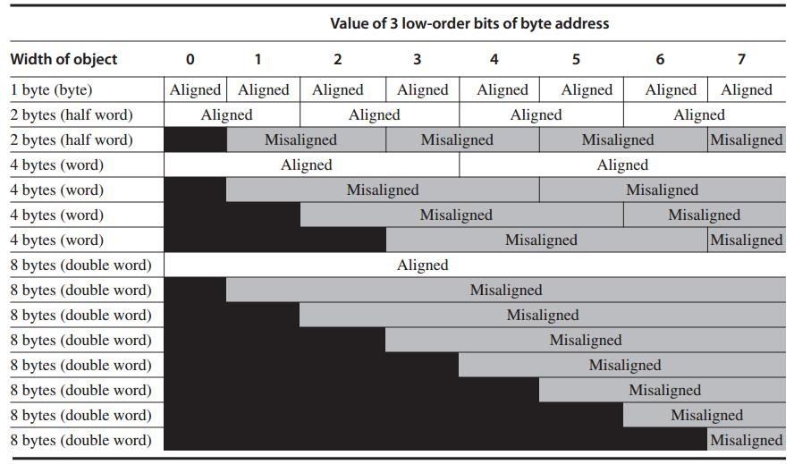
Each misaligned object requires two memory accesses
Notes:
This picture clearly demonstrates that address alignment helps limit memory access timess.
When well aligned, requires only on memory access to read one object;
If address is not well aligned, each misaligned object requires two memory accesses to fetch.

Slide 39
ISA: Addressing Modes
Specify the address of a memory object (as operands of instructions):
Register, Immediate, Displacement
constant
register + constant
Notes:
An instruction has three addressing modes for it to specify the address of a memory object as one of its operands.
The operand could a register, an immediate, or a displacement.
For register, the operand is just the name/alias of the register.
for immediate, it’s a constant which directly points to the memory address/location.
For displacement, it specifies a register in addition to a constant, then we need to add the constant to the value stored in the register, the result is the corresponding memory address.

Slide 40
ISA: Types and Sizes of OPerands
Type | Size in bits
ASCII character | 8
Unicode character Half word | 16
Integer word | 32
Double word Long integer | 64
IEEE 754 floating point – single precision | 32
IEEE 754 floating point – double precision | 64
Floating point – extended double precision | 80
Notes:
Here’s an overview of types and sizes of instruction perands.

Slide 41
ISA: Operations
Four general categories
data transfer
arithmetic logical
control
floating point
Notes:
With an instruction, we could achieve one of the following four categories of operations:
They are data transfer operation, arithmetic logical operation, control operation, floating point operation;

Slide 42
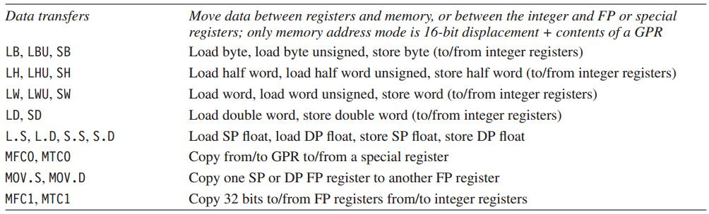
MIPS64 Operations
Data transfer
Notes:
The tables list example instructions of each operation type.

Slide 43
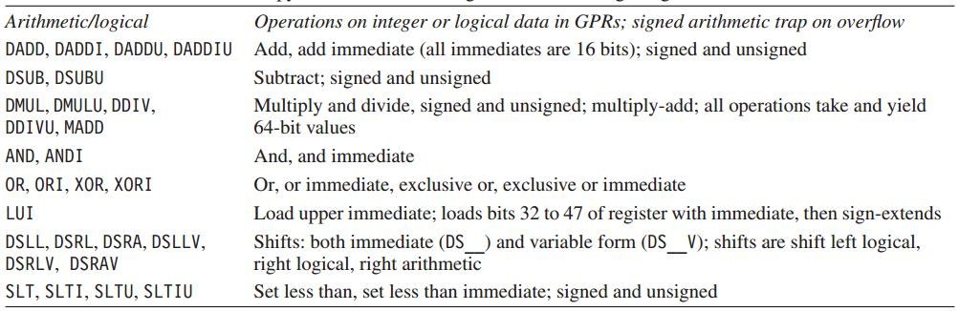
MIPS64 Operations
Arithmetic Logical

Slide 44
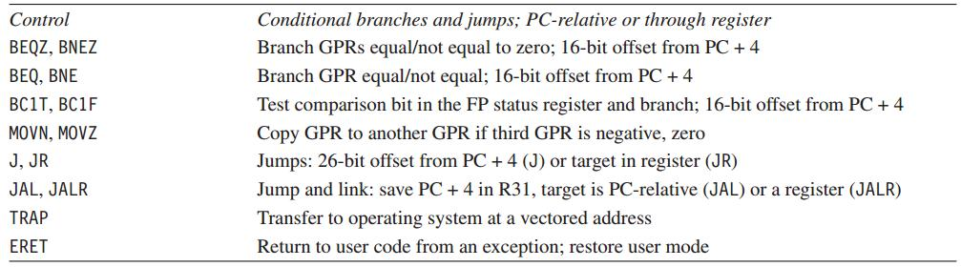
MIPS64 Operations
Control

Slide 45
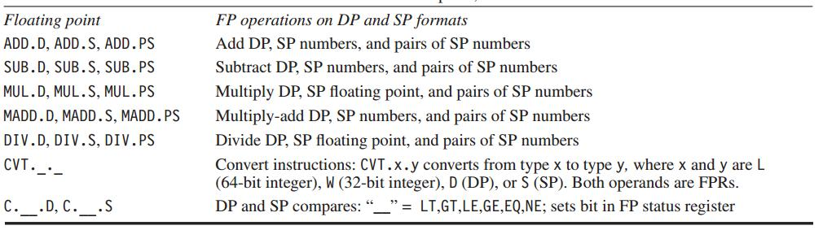
MIPS64 Operations
Floating point

Slide 46
ISA: Control Flow Instructions
Types:
conditional branches
unconditional jumps
procedure calls
returns
Branch address: add an address field to PC (program counter)
Notes:
Control instructions also have various types; and each type has its own way to specify the next instruction to run;
We’ll discuss more about them in later lecture sessions.

Slide 47
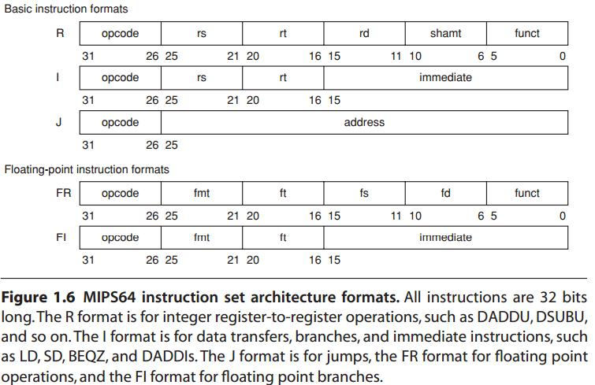
ISA: Encoding an ISA
Fixed length: ARM, MIPS – 32 bits
Variable length: 80x86 – 1~18 bytes
http://en.wikipedia.org/wiki/MIPS_architecture
Start with a 6-bit opcode.
R-type: register
three registers,
a shift amount field,
and a function field;
I-type: immediate
two registers,
a 16-bit immediate value;
J-type: jump
a 26-bit jump target.
Notes:
As we mentioned, instructions should be encoded in a format understandable to computer hardware, right?
Here are various possible types of instruction formats.
Again, we’ll detail them in later chapters.

Slide 48
Again,
what’s computer architecture?
Notes:
Now, putting all together, let’s again more comprehensively define computer architecture.

Slide 49
Computer Architecture
ISA Organization Hardware
actual programmer
visible instruction set;
boundary between sw
and hw;
high-level aspects
of computer design:
memory system,
memory interconnect,
design of internal processor or CPU;
computer specifics:
logic design,
packaging tech;
Computer architects must design
the organization and hardware
to meet functional requirements
as well as price, power, performance, and availability goals.
Notes:
it actually Covers all three aspects of computer design: instruction set architecture, organization (or microarchitecture), and hardware;
In summary, computer architectures must design the organization and hardware to meet functional requirements as well as price, power, performance, and availability goals.

Slide 50
Review
5 classes of computers
Parallelism
Instruction set architecture
Computer architecture

Slide 51
?

Slide 52
#What’s More
If you can dream it, you can accomplish it.
What's Your Dream by LinkedIn
If not now, when?
The 3 Secrets of Highly Successful Graduates by Reid Hoffman

