Slide 1
Lecture 04: Instruction Set
Principles
Kai Bu
kaibu@zju.edu.cn
http://list.zju.edu.cn/kaibu/comparch2016
Notes:
Students registered; Thank you all.
In today’s lecture session, we’ll walk through instruction principles, it’s our final preparation for next week’s pipelining, which enables faster computer by running multiple instructions in parallel.

Slide 2

Appendix A.1-A.9
Notes:
The content corresponds to Appendix A in the textbook.

Slide 3
Preview
What’s instruction set architecture?
How do instructions operate?
How do instructions find operands?
How do programs turn to instructions?
How do hardware understand instructions?
Notes:
Before we discuss how to more quickly run a series of instructions, we need to understand what an instruction looks like and how it works.
In particular, how do instructions operate?
How do they find operands in memory?
How do our coded programs turn to instructions?
How do computer hardware understand these instructions?
Seems quite a lot to deal with, right?

Slide 4
What’s ISA?
(Instruction Set Architecture)
Notes:
let’s first start with instruction set architecture.

Slide 5
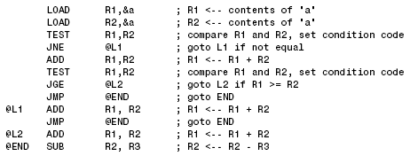
ISA: Instruction Set Architecture
Programmer-visible instruction set
Notes:
Instruction set architecture is the lowest level programmer-visible instruction set.
We usually work with higher level programming languages. Then instruction set serves as the boundary between these programs and underlying hardware.
If you already start implementing branch instructions for lab 1, you might get very familiar with these instructions.

Slide 6
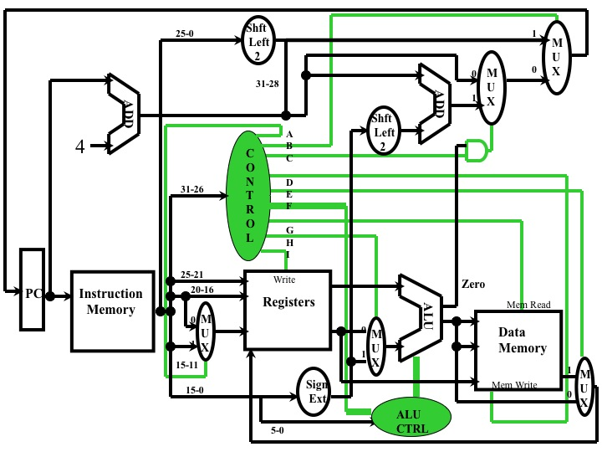
ISA: Instruction Set Architecture
Programmer-visible instruction set
not what’s underneath
Notes:
But note that how underlying hardware processes these instructions is not the focus of this course.

Slide 7
What types of ISA?
Notes:
So how many types of instruction set architecture out there?

Slide 8
ISA Classification Basis
the type of internal storage:
stack
accumulator
register
Notes:
A computer could use stack, accumulator, or register as internal storage,
According to which of these types of internal storage is in use,

Slide 9
ISA Classes
stack architecture
accumulator architecture
general-purpose register architecture (GPR)
Notes:
Instruction set architecture can be classified into three classes:
They are stack architecture, accumulator architecture, and general-purpose register architecture, also called gpr.

Slide 10
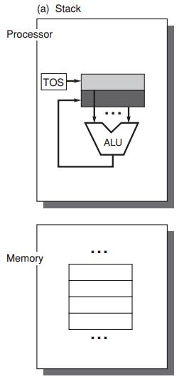
ISA Classes:
Stack Architecture
implicit operands
on the Top Of the Stack (TOS)
C = A + B
Push A
Push B
Add
Pop C
First operand removed from stack
Second op replaced by the result
memory
Notes:
When we are using stack architecture, the operands are the data stored on the top of the stack by default.
Now let’s use the computation process of C=A+B to illustrate how stack architecture works.
To add A and B, we should need push them into ALU;
The first instruction Push A moves the data stored on the TOS to ALU;
Now the TOS moves down to lower address location;
Then the second instruction Push B moves the data stored on the new TOS to ALU;
Now we have both operands in ALU and use ADD instruction to add the two values. Then ALU pushes back the result C to the TOS.
In summary, by the end of this computation, first operand is removed from stack, while the second operand is replaced by the result.

Slide 11
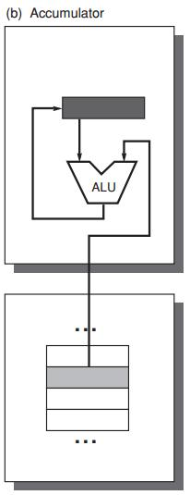
ISA Classes:
Accumulator Architecture
one implicit operand: the accumulator
one explicit operand: mem location
C = A + B
Load A
Add B
Store C
accumulator is both
an implicit input operand
and a result
memory
Notes:
Now let’s use C=A+B again as an example to see how accumulator architecture works.
For the two operands A and B, one is implicit, which refers to the accumulator; one is explicit, which refers to an exact memory location.
For example, we use Load A to move the data in the accumulator to the ALU;
Then we Add B, where B fetches the value of a certain memory location; and then add the value A already in ALU;
The alu then stores the result, say C, back to the accumulator.

Slide 12
ISA Classes:
General-Purpose Register Arch
Only explicit operands
registers
memory locations
Operand access:
direct memory access
loaded into temporary storage first
Notes:
General-purpose register architecture uses only explicit operands: they could be either registers or memory locations;
To fetch operands, GPR may directly access memory or load the data into temporary storage first.

Slide 13
ISA Classes:
General-Purpose Register Arch
Two Classes:
register-memory architecture
any instruction can access memory
load-store architecture
only load and store instructions can access memory
Notes:
According to which instruction can access memory, GPR falls into two classes:
One is register-memory architecture, any instruction of it can access memory;
The other is load-store architecture, it allows only load and store instructions to access memory.

Slide 14
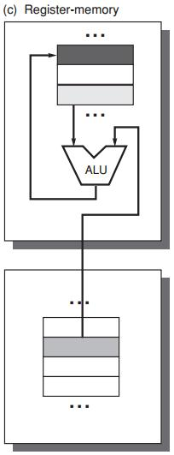
GPR: Register-Memory Arch
register-memory architecture
any instruction can access mem
C = A + B
Load R1, A
Add R3, R1, B
Store R3, C
R3
A
R1
B
memory
Notes:
Here’s how register-memory architecture processes A+B;
First, preload A to register R1;
Then B uses direct memory access;
Store the result in register R3;
In this example, both load and add instruction accessed memory;

Slide 15
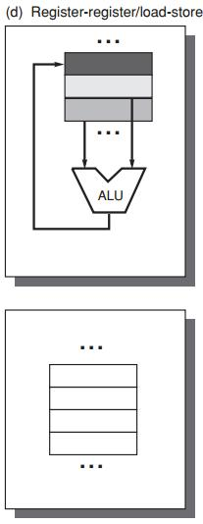
GPR: Load-Store Architecture
load-store architecture
only load and store instructions
can access memory
C = A + B
Load R1, A
Load R2, B
Add R3, R1, R2
Store R3, C
A+B
R3
B
R2
A
R1
memory
Notes:
If we use load-store architecture, only load and store instructions can access memory.
Then to compute A +B, we must first use two load instructions to preload A and B to registers;
Then use corresponding registers as operands of add instruction;

Slide 16
GPR Classification
ALU instruction has 2 or 3 operands?
2 = 1 result&source op + 1 source op
3 = 1 result op + 2 source op
ALU instruction has 0, 1, 2, or 3 operands of memory address?
Notes:
As we can observe from previous examples, ALU instruction in GPR can have 2 or three operands, of which 0 to 3 could be memory address;

Slide 17
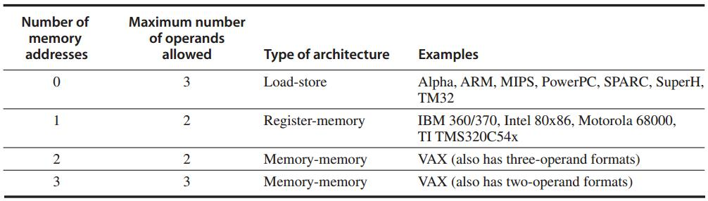
GPR Classification
Three major classes
Register-register
Notes:
This table exemplifies product types and operand types of each GPR class.
For example, ARM and MIPS belong to load-store architecture, they support 3 operands at maximum with 0 memory address allowed.

Slide 18
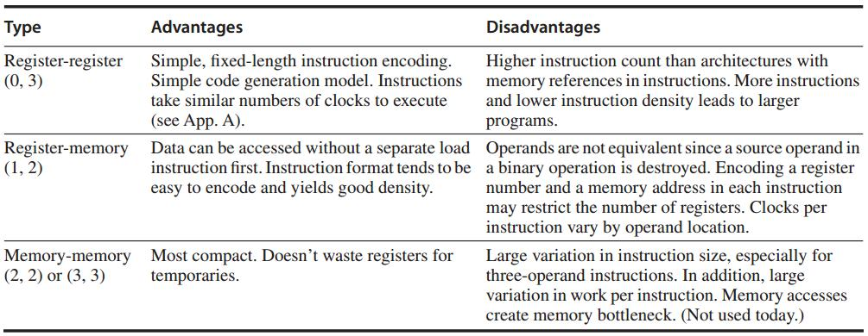
GPR Classification
Notes:
Each GPR class has its own pros and cons. You could refer to these descriptions after class.

Slide 19
Where to find operands?
Notes:
Now we know what instructions of each instruction set architecture look like,
Then how do they find operands for computation?
This process is called Memory addressing
It is the procedure when an instruction finds its interested data at a certain location in memory.

Slide 20
Interpret Memory Address
Byte addressing
byte – 8 bits
half word – 16 bits
words – 32 bits
double word – 64 bits
Notes:
The smallest unit for how much volume of data can be accessed at one time is one byte.

Slide 21
Operand Type and Size
Type | Size in bits
ASCII character | 8
Unicode character Half word | 16
Integer word | 32
Double word Long integer | 64
IEEE 754 floating point – single precision | 32
IEEE 754 floating point – double precision | 64
Floating point – extended double precision | 80
Notes:
Various types of operand and corresponding size are summarized in this table.

Slide 22
Interpret Memory Address
Byte ordering in memory: 0x12345678
Little Endian: store least significant byte in the smallest address
78 | 56 | 34 | 12
Big Endian: store most significant byte in the smallest address
12 | 34 | 56 | 78
Notes:
Now we know that the smallest storage unit is one byte.
When we store multi-byte operands in memory, we have two ways to order each byte of it.
The first way is little endian, it stores the least significant byte in the smallest address;
Take the example hexadecimal number for instance, it has 4 bytes, when we use little endian, we should store it as 78, 56, 34, 12 from low mem address to high ones;
The second way is big endian, in contrast, it stores the most significant byte in the smallest address.

Slide 23
Interpret Memory Address
Address alignment
object width: s bytes
address: A
aligned if A mod s = 0
Notes:
When storing data in memory, we require that their addresses be aligned.
Given object width s and address A, for its address to be aligned, we should have that A modulo s equals to zero.

Slide 24
Interpret Memory Address
Address alignment
object width: s bytes
address: A
aligned if A mod s = 0
Why to align addresses?
Notes:
Then why need we follow address alignment?

Slide 25
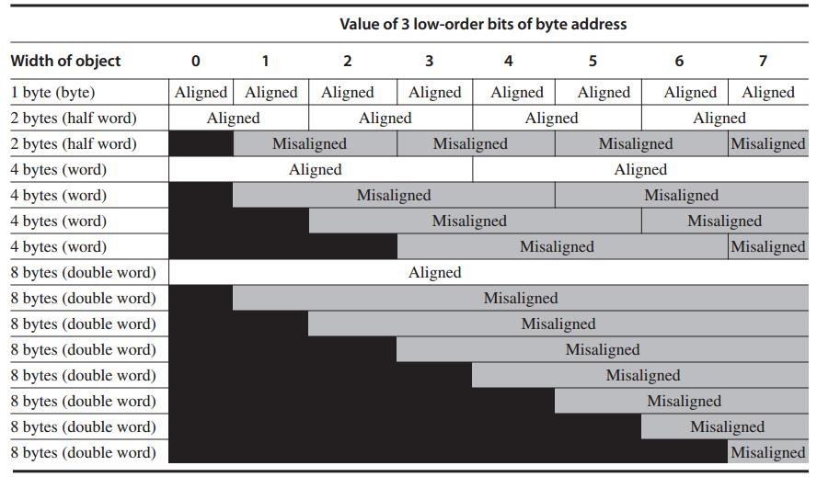
Each misaligned object requires two memory accesses
Notes:
This picture clearly demonstrates that address alignment helps limit memory access times.
When well aligned, requires only one memory access to read one object;
If address is not well aligned, each misaligned object requires two memory accesses to fetch.

Slide 26
Addressing Modes
How instructions specify addresses
of objects to access
Types
constant
register
memory location – effective address
Notes:
We have different addressing modes for instructions to specify operand address;
For example, we could use constant, register, or memory location; memory location is also called effective address;

Slide 27
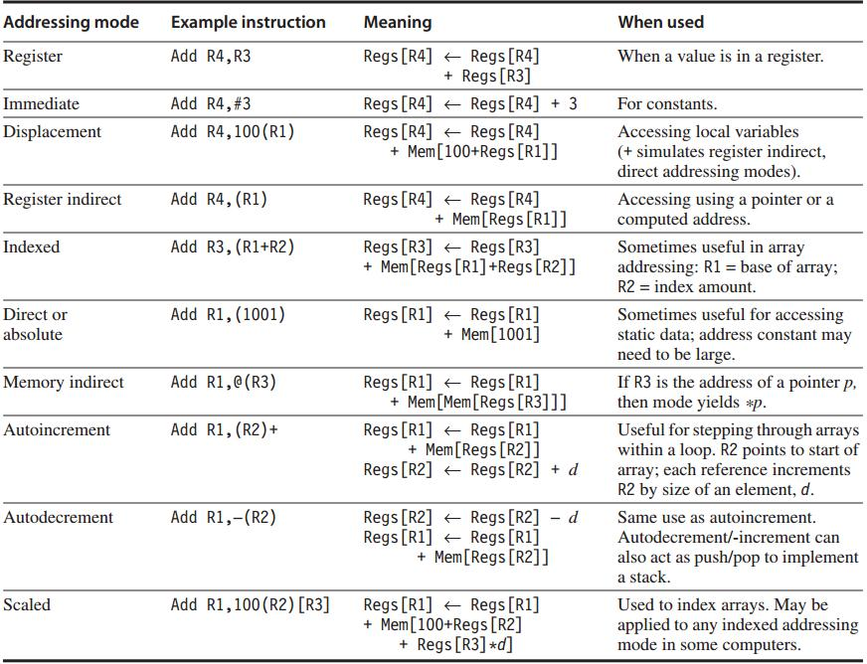
frequently used
tricky one
Addressing Modes
Notes:
This table summarizes different addressing modes and their meanings.
For example,

Slide 28
How to operate operands?
Notes:
After we get operands, how instructions do with them?

Slide 29
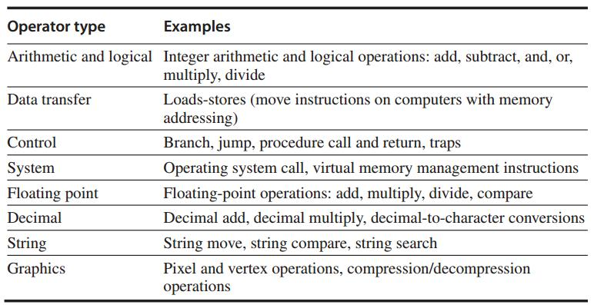
Operations

Slide 30
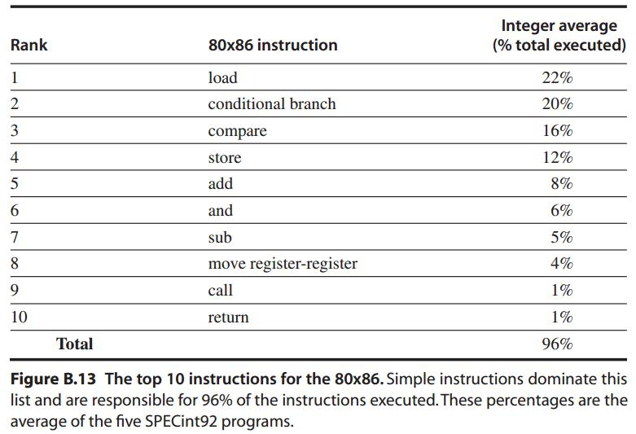
Simple Operations are the most widely executed

Slide 31
Control Flow Instructions
Four types of control flow change:
Conditional branches – most frequent
Jumps
Procedure calls
Procedure returns

Slide 32
Control Flow: Addressing
Explicitly specified destination address
(exception: procedure return as target is not known at compile time)
PC-relative
destination addr = PC + displacement
Dynamic address: for returns and indirect jumps with unknown target at compile time
e.g., name a register that contains the target address

Slide 33
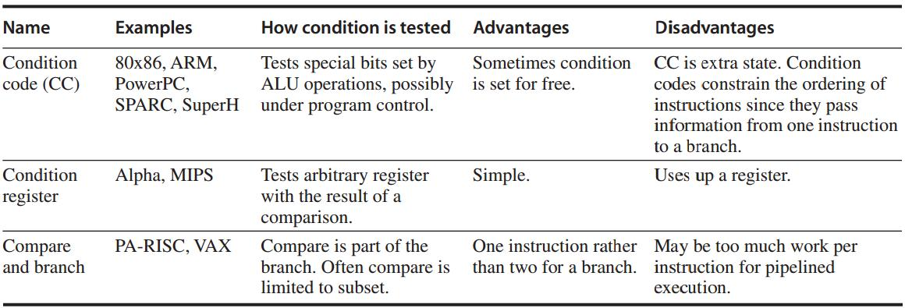
Conditional Branch Options
http://www.ece.mtu.edu/ee/faculty/cchigan/EE3170/EE%203170%20Lecture%207-Branches.pdf

Slide 34
Procedure Invocation Options
Control transfer + State saving
Return address must be saved
in a special link register or just a GPR
How to save registers?

Slide 35
Procedure Invocation Options:
Save Registers
Caller Saving
the calling procedure saves the registers that it wants preserved for access after the call
Callee Saving
the called procedure saves the registers it wants to use

Slide 36
How do hardware understand instructions?
Notes:
Now given an instruction, you probably are very clear about how it works, right;
But how do hardware understand it?

Slide 37
Encoding an ISA
Opcode for specifying operations
Address Specifier for specifying the addressing mode to access operands

Slide 38
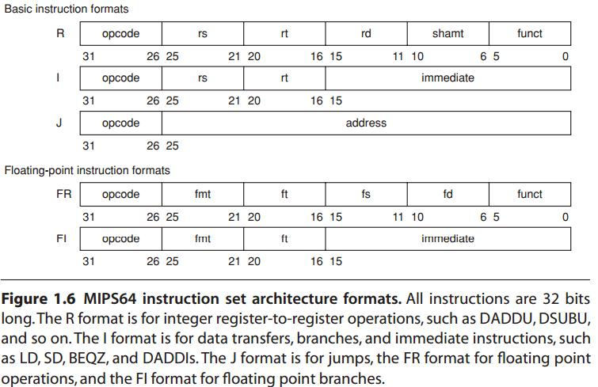
Encoding an ISA
Fixed length: ARM, MIPS – 32 bits
Variable length: 80x86 – 1~18 bytes
http://en.wikipedia.org/wiki/MIPS_architecture
Start with a 6-bit opcode
that specifies the operation.
R-type:
three registers,
a shift amount field,
and a function field;
I-type:
two registers,
a 16-bit immediate value;
J-type:
a 26-bit jump target.
Notes:
How to represent ISA in a form that makes it easy for the hardware to execute?

Slide 39
Encoding an ISA
Balance several competing forces for encoding:
1. desire to have more registers and addressing modes;
2. impact of the size of register and addressing mode fields on the average instruction/program size
3. desire to encode instructions into lengths easy for pipelining

Slide 40
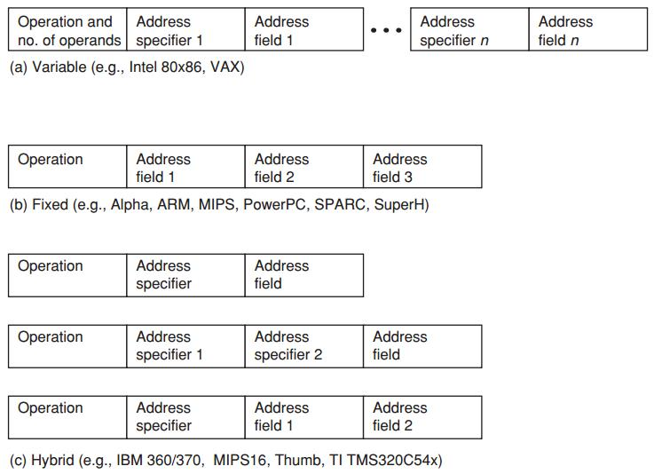
Encoding an ISA
Variable allows all addressing modes to be with all operations
Fixed combines the operation and addressing mode into the opcode
Hybrid reduces the variability in size and work of the variable arch
but provides multiple instruction lengths to reduce code size

Slide 41
How do programs
turn to instructions?
Notes:
Most often, we only face the programs;
Then how our programs become the aforementioned instructions that can be executed by computer?

Slide 42
Program
Compiler
Instructions
Notes:
It’s the compiler that does this job for us.

Slide 43
The Role of Compilers
compile desktop and server apps programmed in high-level languages;
Output instructions that can be executed by hardware;
significantly affect the performance of a computer;

Slide 44
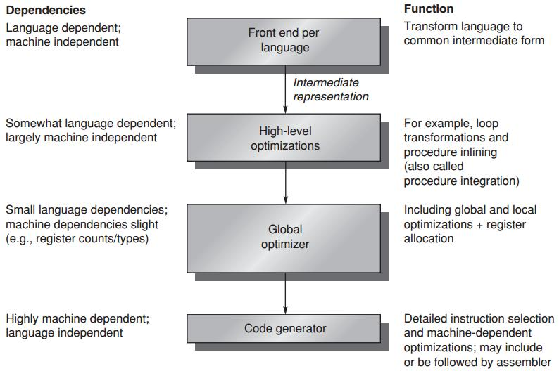
Compiler Structure

Slide 45
Compiler Goals
Correctness
all valid programs must be compiled correctly
Speed of the compiled code
Others
fast compilation
debugging support
interoperability among languages

Slide 46
Compiler Optimizations
High-level optimizations
are done on the source with output fed to later optimization passes
Local optimizations
optimize code only within a straight-line code fragment (basic block)
Global optimizations
optimize across branches and transform for optimizing loops
Register allocation
associates registers with operands
Processor-dependent optimizations
leverage specific architectural knowledge

Slide 47
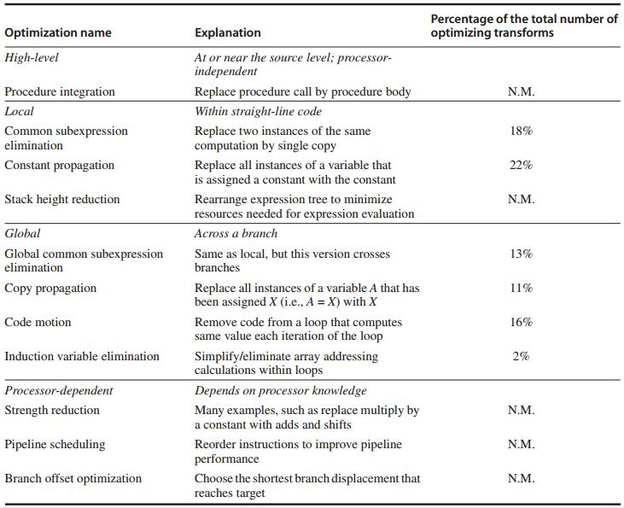
Compiler Optimizations: Examples

Slide 48
Data/Register Allocation
Where high-level languages allocate data
Stack: for local variable
Global data area: statically declared objects, e.g., global variable, constant
Heap: for dynamic objects
Register allocation is much more effective for stack-allocated objects for global variables;
Register allocation is essentially impossible for heap-allocated objects because they are accessed with pointers;

Slide 49
Compiler Writer’s Principles
Make the frequent cases fast
and the rare case correct
Driven by instruction set properties
Notes:
Some instruction set properties serve as compiler design guidelines

Slide 50
Compiler Writer’s Principles
Provide regularity
keep primary components of an instruction set (operations, data types, addressing modes) orthogonal/independent
Provide primitives, not solutions
Simplify trade-offs among alternatives
instruction size, total code size, register allocation (in register-memory arch, how many times a variable should be referenced before it is cheaper to load it into a register)
Provide instructions that bind the quantities known at compile time as constants
instead of processor interpreting at runtime a value that was known at compile time
Notes:
Provide primitives, not solutions: the compiler should not be too specific toward certain high-level language;

Slide 51
Finally,
all in MIPS
Notes:
In last part/lecture, computer architecture basics
Discuss about development trends now

Slide 52
MIPS
Microprocessor without Interlocked Pipeline Stages
64-bit load-store architecture
Design for pipelining efficiency, including a fixed instruction set encoding
Efficiency as a compiler target

Slide 53
MIPS: Registers
32 64-bit general-purpose regs (GPRs)
R0 … R31 – for holding integers
32 floating-point regs (FPRs)
F0 … F31 – for holding up to 32 single-precision (32-bit) values or 32 double-precision (64-bit) values
The value of R0 is always 0

Slide 54
MIPS: Data Types
64-bit integers
32- or 64-bit floating point
For 8-bit bytes, 16-bit half words, 32-bit words:
loaded into the general-purpose registers (GPRs)
with either zeros or the sign bit replicated
to fill the 64 bits of GPRs

Slide 55
MIPS: Addressing Modes
Directly support immediate and displacement, with 16-bit fields
Others:
register indirect: placing 0 in the 16-bit displacement field
absolute addressing: using register 0 (with value 0) as the base register
Aligned byte addresses of 64-bits

Slide 56
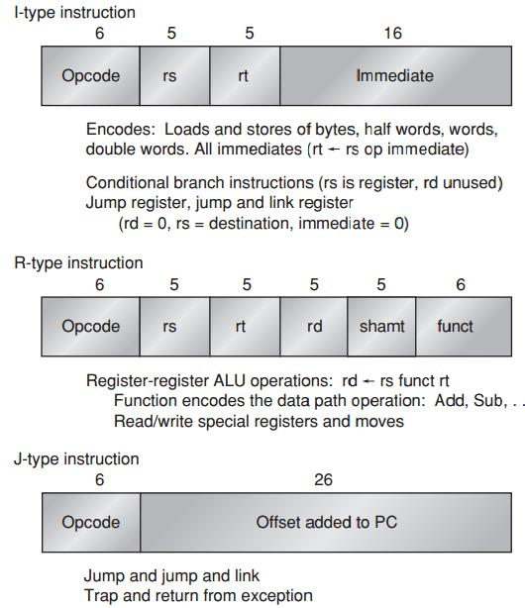
MIPS: Instruction Format

Slide 57
MIPS Operations
Four classes
loads and stores
ALU operations
branches and jumps
floating-point operations

Slide 58
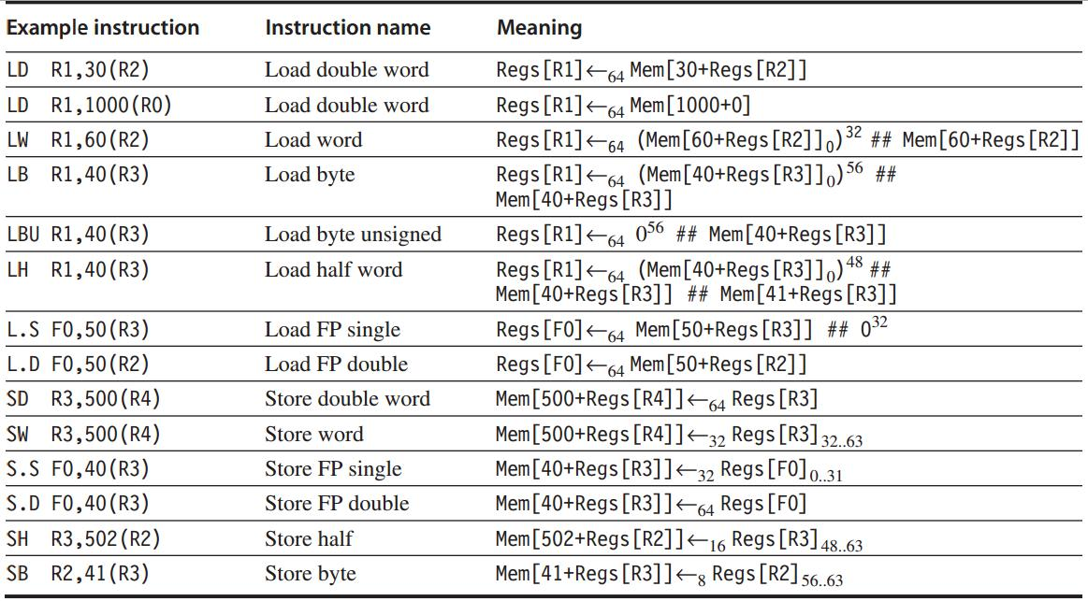
MIPS: Loads and Stores

Slide 59
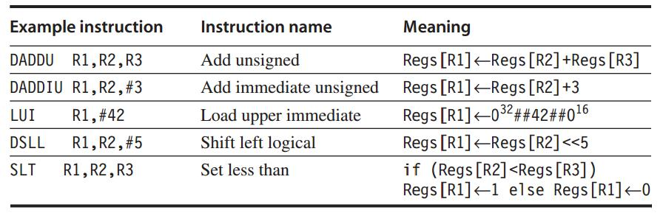
MIPS: ALU Operations

Slide 60
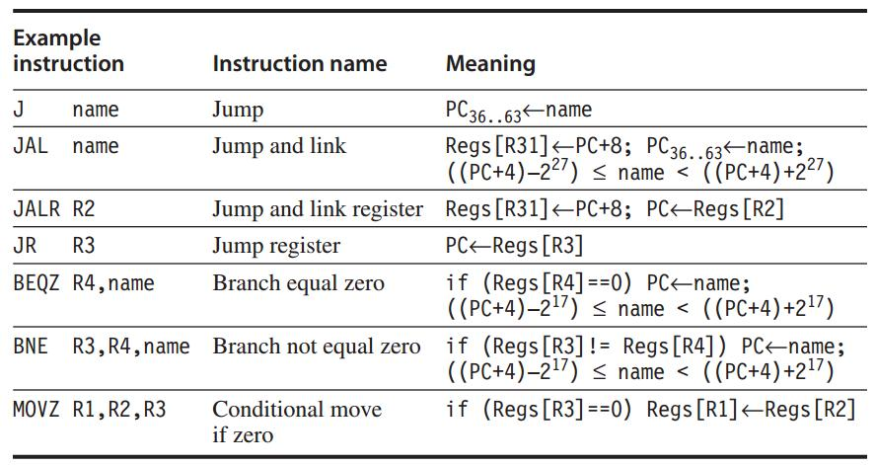
MIPS: Control Flow Instructions
Jumps and Branches
http://www.cs.umd.edu/class/sum2003/cmsc311/Notes/Mips/jump.html

Slide 61
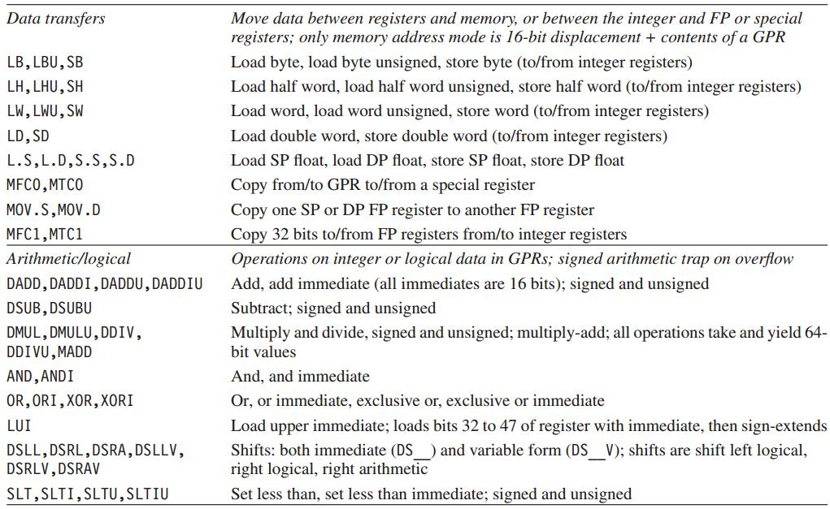
MIPS: Floating-Point Operations

Slide 62
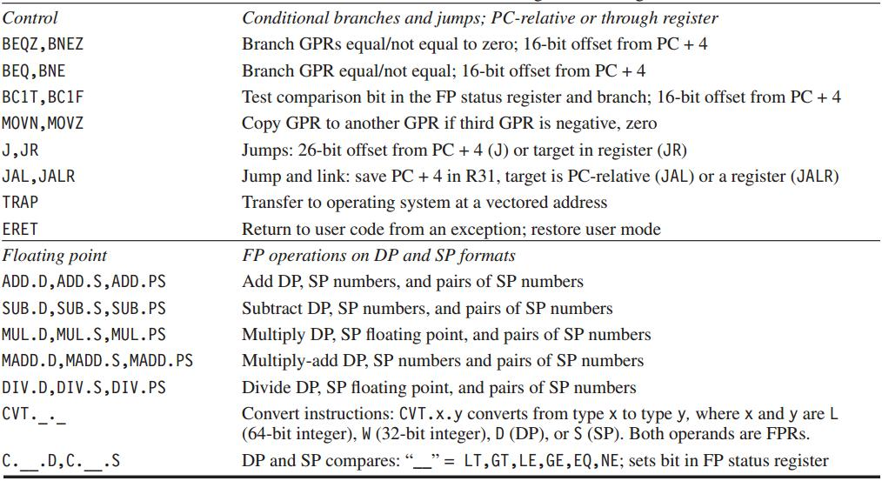
MIPS: Floating-Point Operations

Slide 63
Review
ISA classification and operation
Memory addressing
ISA Encoding
Compiler
MIPS example

Slide 64
?

Slide 65
#What’s More
The Lesson of Grace in Teaching [video]
by Francis Su
“You learn this lesson by receiving GRACE: good things you didn’t earn or deserve, but you’re getting them anyway.”

