Slide 1


Slide 2
Lecture 13: Multiprocessors
Kai Bu
kaibu@zju.edu.cn
http://list.zju.edu.cn/kaibu/comparch2016

Slide 3
Quiz 2 June 15
storage, multiprocessors
Lab 5 demo due June 15 & June 22
report due June 26
Final Exam June 28
Start preparing!
But enjoy holidays first☺

Slide 5
ILP -> TLP
instruction-level
parallelism
thread-level
parallelism
Notes:
So the focus of today’s lecture is multiprocessor architecture.
All our previous discussions are based on a single processor, where when we consider about exploring parallelism to speed up computer execution, we pipeline a series of instructions.
But by multiprocessor, we can propel parallelism from instruction level to thread level.

Slide 6
MIMD multiple instruction streams multiple data streams
Each processor fetches its own instructions and operates on its own data
Notes:
Using a multiprocessor architecture, a computer can simultaneously work on multiple instruction streams as well as multiple data streams.
Each processor can fetch its own instructions and operate on its own data.

Slide 7
multiprocessors multiple instruction streams multiple data streams
computers consisting of tightly coupled processors
Coordination and usage are typically controlled by a single OS
Share memory through a shared address space
Notes:
All the processors share the same memory and their coordination are typically controlled by a single operating system.

Slide 8
multiprocessors multiple instruction streams multiple data streams
computers consisting of tightly coupled processors
Muticore Single-chip systems with multiple cores
Multi-chip computers each chip may be a multicore sys
Notes:
According to how processors are integrated, there are two types of multiprocessor architectures.
The first one is multicore computers, they use a single chip integrated with multiple cores.
While the second type, multi-chip computers have multiple chips, each might be a multicore system.

Slide 9
Exploiting TLP
two software models
Parallel processing
the execution of a tightly coupled set of threads collaborating on a single task
Request-level parallelism
the execution of multiple, relatively independent processes that may originate from one or more users
Notes:
Such systems exploit thread-level parallelism through two different software models.
The first is the execution of a tightly coupled set of threads collaborating on a single task, which is called parallel processing;
The second is the execution of multiple, relatively independent processes that may originate from one or more users, which is called request-level parallelism.

Slide 10
Outline
Multiprocessor Architecture
Centralized Shared-Memory Arch
Distributed Shared memory and directory-based coherence
Notes:
Next, we’ll first introduce the multiprocessor architecture;
After that, we’ll discuss how different processors manage memory in centralized and distributed fashion.
For distributed shared memory, we also introduce how data coherence across different processors is maintained.

Slide 11

Chapter 5.1–5.4
Notes:
All these contents can be found in Chapter 5.

Slide 12
Outline
Multiprocessor Architecture
Centralized Shared-Memory Arch
Distributed shared memory and directory-based coherence

Slide 13
Multiprocessor Architecture
According to memory organization and interconnect strategy
Two classes
symmetric/centralized shared-memory multiprocessors (SMP)
+
distributed shared memory multiprocessors (DMP)
Notes:
According to how the memory is shared and how processors interconnect with each other, multiprocessor architecture can be classified into two classes.
Centralized shared-memory multiprocessors and distributed shared memory multiprocessors.

Slide 14
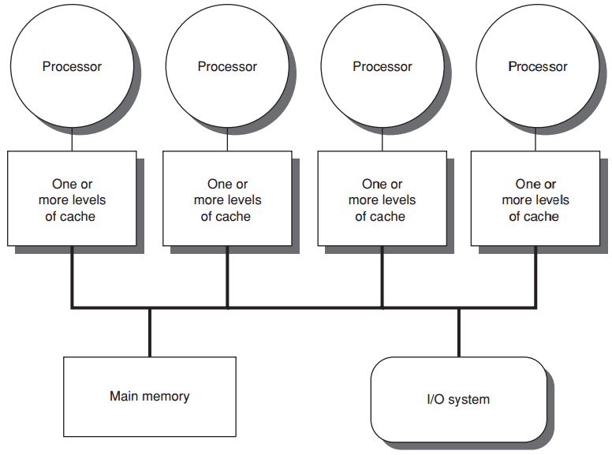
centralized shared-memory
eight or fewer cores
Notes:
Centralized shared-memory multiprocessors usually feature either or fewer cores.

Slide 15
centralized shared-memory
Share a single centralized memory
All processors have equal access
Notes:
They share a single centralized memory, to which all processors have equal access

Slide 16
centralized shared-memory
All processors have uniform latency from memory
Uniform memory access (UMA) multiprocessors
Notes:
All processors have uniform latency from memory
So centralized shared-memory multiprocessors are also called uniform memory access multiprocessors.

Slide 17
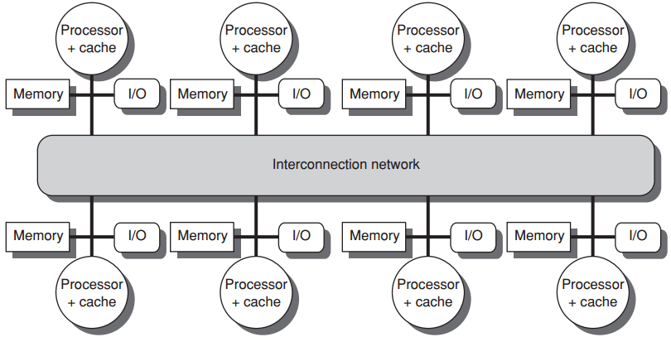
distributed shared memory
more processors
physically distributed memory
Notes:
In contrast, distributed shared memory multiprocessors support more processors and each is attached with a physically distributed memory.

Slide 18
distributed shared memory
more processors
physically distributed memory
Distributing mem among the nodes
increases bandwidth & reduces local-mem latency
Notes:
Distributing memory among multiple cores increases bandwidth and reduces local-memory latency.

Slide 19
distributed shared memory
more processors
physically distributed memory
NUMA: nonuniform memory access
access time depends on data word loc in mem
Notes:
Clearly, access time varies with data location; fetching data from local memory should be faster than fetching data from distant memory.
So distributed shared-memory multiprocessors are also called Nnnuniform memory access multiprocessors

Slide 20
distributed shared memory
more processors
physically distributed memory
Disadvantages:
more complex inter-processor communication
more complex software to handle distributed mem
Notes:
But in comparison with centralized shared memory multiprocessors, distributed version requires more complex designs to handle inter-processor communication and distributed memory.

Slide 21
Hurdles of Parallel Processing
Limited parallelism available in programs
Relatively high cost of communications
Notes:
Given these muti-processor architectures, what are the challenges for making the most parallelism out of them?
In particular, limited parallelism within programs and relatively high communication cost of remote access would be the key challenges.

Slide 22
Limited Program Parallelism
Limited parallelism available in programs
makes it difficult to achieve good speedups in any parallel processor
Load A
Load B
Add C, A, B
Add D, C, 2
Load A
Load B
Add C, A, 1
Add D, B, 1
Add E, C, D
Notes:
Limited parallelism within programs will limit the extent of any parallel processor.
Two example code snippets.

Slide 23
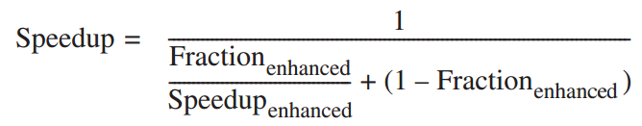
Limited Program Parallelism
Limited parallelism affects speedup
Example
to achieve a speedup of 80 with 100 processors, what fraction of the original computation can be sequential?
Answer
by Amdahl’s law

Slide 24
Limited Program Parallelism
Limited parallelism affects speedup
Example
to achieve a speedup of 80 with 100 processors, what fraction of the original computation can be sequential?
Answer
assumption: two modes
enhanced mode: 100 processors
serial mode: only 1 processor

Slide 25
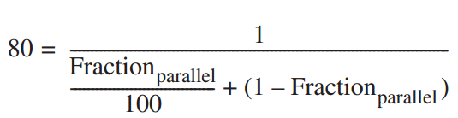
Limited Program Parallelism
Limited parallelism affects speedup
Example
to achieve a speedup of 80 with 100 processors, what fraction of the original computation can be sequential?
Answer
by Amdahl’s law

Slide 26
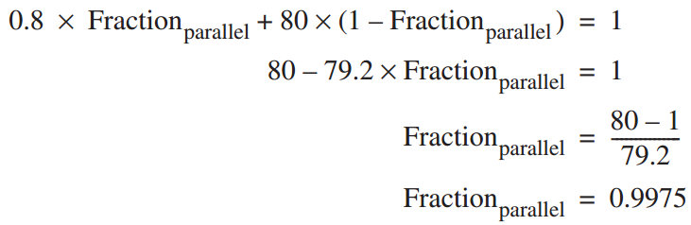
Limited Program Parallelism
Limited parallelism affects speedup
Example
to achieve a speedup of 80 with 100 processors, what fraction of the original computation can be sequential?
Answer
by Amdahl’s law
Fraction_{seq} = 1 – Fraction_{parallel}
= 0.25%

Slide 27
Limited Program Parallelism
Limited parallelism available in programs
makes it difficult to achieve good speedups in any parallel processor;
in practice, programs often use
less than the full complement
of the processors
when running in parallel mode;

Slide 28
High Communication Cost
Relatively high cost of communications
involves the large latency of remote access in a parallel processor

Slide 29
High Communication Cost
Relatively high cost of communications
involves the large latency of remote access in a parallel processor
Example
app running on a 32-processor MP;
200 ns for reference to a remote mem;
clock rate 2.0 GHz; base CPI 0.5;
Q: how much faster if no communication vs if 0.2% remote ref?

Slide 30

High Communication Cost
Example
app running on a 32-processor MP;
200 ns for reference to a remote mem;
clock rate 2.0 GHz; base CPI 0.5;
Q: how much faster if no communication vs if 0.2% remote ref?
Answer
if 0.2% remote reference

Slide 31

High Communication Cost
Example
app running on a 32-processor MP;
200 ns for reference to a remote mem;
clock rate 2.0 GHz; base CPI 0.5;
Q: how much faster if no communication vs if 0.2% remote ref?
Answer
if 0.2% remote ref, Remote req cost

Slide 32

High Communication Cost
Example
app running on a 32-processor MP;
200 ns for reference to a remote mem;
clock rate 2.0 GHz; base CPI 0.5;
Q: how much faster if no communication vs if 0.2% remote ref?
Answer
if 0.2% remote ref
no comm is 1.3/0.5 = 2.6 times faster

Slide 33
Improve Parallel Processing
solutions
insufficient parallelism
new software algorithms that offer better parallel performance;
software systems that maximize the amount of time spent executing with the full complement of processors;
long-latency remote communication
by architecture: caching shared data…
by programmer: multithreading,
prefetching…

Slide 34
Outline
Multiprocessor Architecture
Centralized Shared-Memory Arch
Distributed shared memory and directory-based coherence
Notes:
Now, more details about centralized shared-memory architecture.

Slide 35
Centralized Shared-Memory
Large, multilevel caches
reduce mem bandwidth demands
Notes:
Between processors and the centralized shared main memory, there are large, multilevel caches to reduce memory bandwidth demands.

Slide 36
Centralized Shared-Memory
Cache private/shared data
Notes:
Cached data is either private or shared.

Slide 37
Centralized Shared-Memory
private data
used by a single processor
Notes:
Private data can be used by only a single processor.

Slide 38
Centralized Shared-Memory
shared data
used by multiple processors
may be replicated in multiple caches to reduce
access latency, required mem bw, contention
Notes:
While shared data can be used by multiple processors,
Shared data may be replicated in multiple caches to reduce access latency

Slide 39
Centralized Shared-Memory
w/o additional precautions
different processors can have different values
for the same memory location
shared data
used by multiple processors
may be replicated in multiple caches to reduce
access latency, required mem bw, contention
Notes:
For replicated data across different caches, additional precautions are needed to guarantee their coherence.
Otherwise, different processors may have different values of the same memory location.

Slide 40
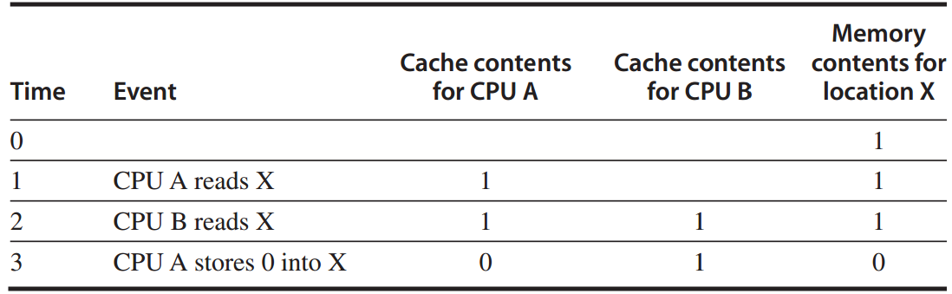
Cache Coherence Problem
w/o precautions
write-through cache
Notes:
The problem concerning whether the value of shared data is identical in different caches is called cache coherence problem.

Slide 41
Cache Coherence Problem
Global state defined by main memory
Local state defined by the individual caches
Notes:
The cache coherence problem is interested in two states of cached data.
Global state is defined by main memory;
Local state is defined by individual caches.

Slide 42
Cache Coherence Problem
A memory system is Coherent if any read of a data item returns the most recently written value of that data item
Two critical aspects
coherence: defines what values can be returned by a read
consistency: determines when a written value will be returned by a read

Slide 43
Coherence Property: 1/3
A memory is coherent if: 3-1
A read by processor P to location X that follows a write by P to X, with no writes of X by another processor occurring between the write and the read by P,
always returns the value written by P.
preserves program order

Slide 44
Coherence Property: 2/3
A memory is coherent if: 3-2
A read by a processor to location X that follows a write by another processor to X returns the written value if the read and the write are sufficiently separated in time and no other writes to X occur between the two accesses.

Slide 45
Coherence Property: 3/3
A memory is coherent if: 3-3
Write serialization
two writes to the same location by any two processors are seen in the same order by all processors

Slide 46
Consistency
When a written value will be seen is important
For example, a write of X on one processor precedes a read of X on another processor by a very small time, it may be impossible to ensure that the read returns the value of the data written,
since the written data may not even have left the processor at that point

Slide 47
Cache Coherence Protocols
Directory based
the sharing status of a particular block of physical memory is kept in one location, called directory
Snooping
every cache that has a copy of the data from a block of physical memory could track the sharing status of the block

Slide 48
Snooping Coherence Protocol
Write invalidation protocol
invalidates other copies on a write
exclusive access ensures that no other readable or writable copies of an item exist when the write occurs

Slide 49
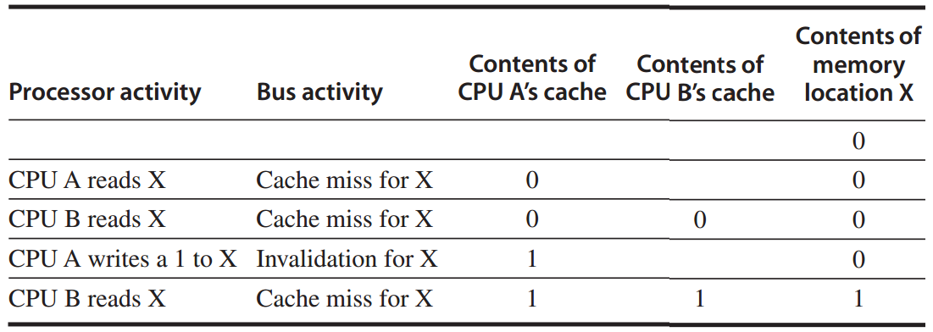
Snooping Coherence Protocol
Write invalidation protocol
invalidates other copies on a write
write-back cache

Slide 50
Snooping Coherence Protocol
Write update/broadcast protocol
update all cached copies of a data item when that item is written
consumes more bandwidth

Slide 51
Write Invalidation Protocol
To perform an invalidate, the processor simply acquires bus access and broadcasts the address to be invalidated on the bus
All processors continuously snoop on the bus, watching the addresses
The processors check whether the address on the bus is in their cache;
if so, the corresponding data in the cache is invalidated.

Slide 52
Write Invalidation Protocol
three block states (MSI protocol)
Invalid
Shared
indicates that the block in the private cache is potentially shared
Modified
indicates that the block has been updated in the private cache;
implies that the block is exclusive

Slide 53
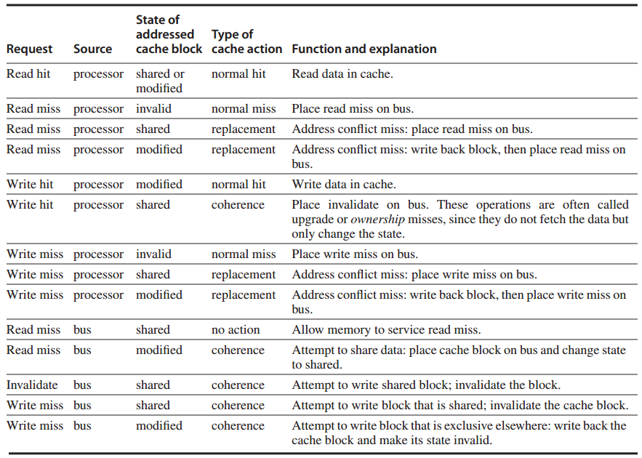
Write Invalidation Protocol

Slide 54
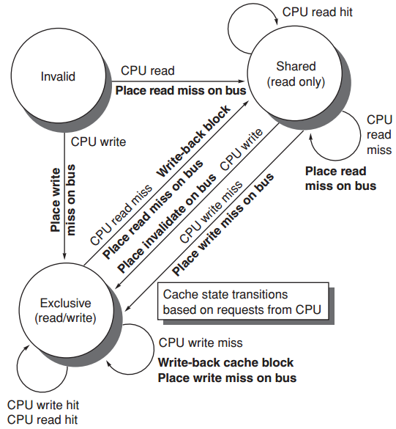
Write Invalidation Protocol
https://www.youtube.com/watch?v=gAUVAel-2Fg

Slide 55
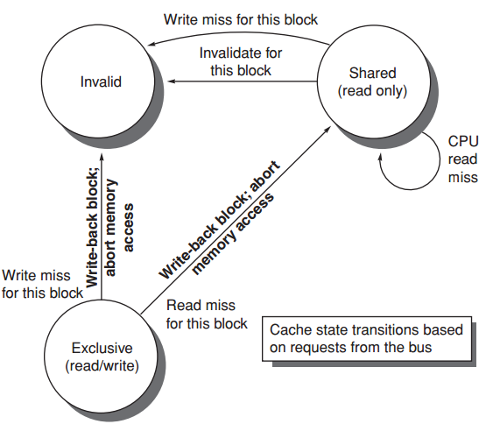
Write Invalidation Protocol

Slide 56
MSI Extensions
MESI
exclusive: indicates when a cache block is resident only in a single cache but is clean
exclusive->read by others->shared
exclusive->write->modified

Slide 57
MSI Extensions
MOESI
owned: indicates that the associated block is owned by that cache and out-of-date in memory
Modified -> Owned without writing the shared block to memory

Slide 58
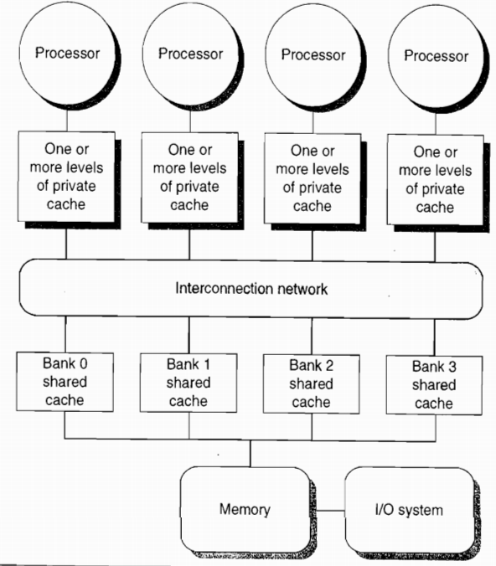
increase mem bandwidth
through multi-bus + interconnection network
and multi-bank cache

Slide 59
Coherence Miss
True sharing miss
first write by a processor to a shared cache block causes an invalidation to establish ownership of that block;
another processor reads a modified word in that cache block;
False sharing miss

Slide 60
Coherence Miss
True sharing miss
False sharing miss
a single valid bit per cache block;
occurs when a block is invalidated (and a subsequent reference causes a miss) because some word in the block, other than the one being read, is written into

Slide 61
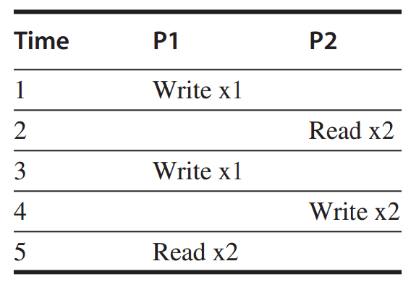
Coherence Miss
Example
assume words x1 and x2 are in the same cache block, which is in shared state in the caches of both P1 and P2.
identify each miss as a true sharing miss, a false sharing miss, or a hit?

Slide 62
Coherence Miss
Example
1. true sharing miss
since x1 was read by P2 and needs to be invalidated from P2

Slide 63
Coherence Miss
Example
2. false sharing miss
since x2 was invalidated by the write of x1 in P1,
but that value of x1 is not used in P2;

Slide 64
Coherence Miss
Example
3. false sharing miss
since the block is in shared state, need to invalidate it to write;
but P2 read x2 rather than x1;

Slide 65
Coherence Miss
Example
4. false sharing miss
need to invalidate the block;
P2 wrote x1 rather than x2;

Slide 66
Coherence Miss
Example
5. true sharing miss
since the value being read was written by P2 (invalid -> shared)

Slide 67
Outline
Multiprocessor Architecture
Centralized Shared-Memory Arch
Distributed shared memory and directory-based coherence

Slide 68
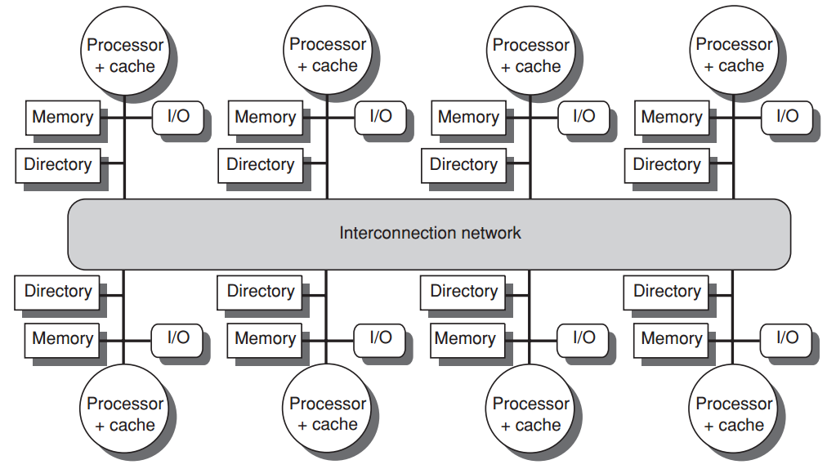
A directory is added to each node;
Each directory tracks the caches that share the memory addresses of the portion of memory in the node;
need not broadcast on every cache miss

Slide 69
Directory-based
Cache Coherence Protocol
Common cache states
Shared
one or more nodes have the block cached, and the value in memory is up to date (as well as in all the caches)
Uncached
no node has a copy of the cache block
Modified
exactly one node has a copy of the cache block, and it has written the block, so the memory copy is out of date

Slide 70
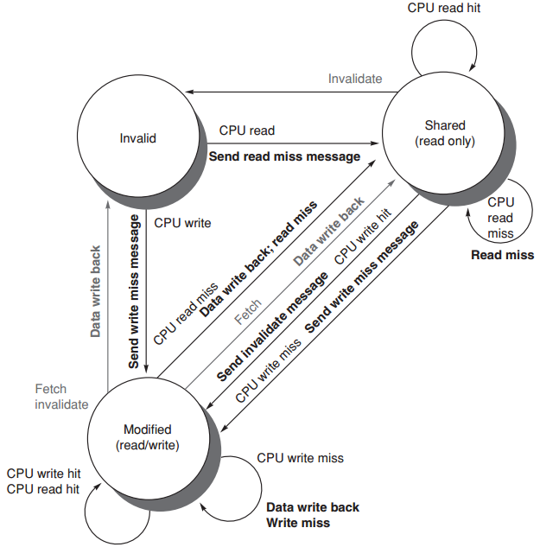
Directory Protocol
state transition diagram
for an individual cache block
requests from outside the node in gray

Slide 71
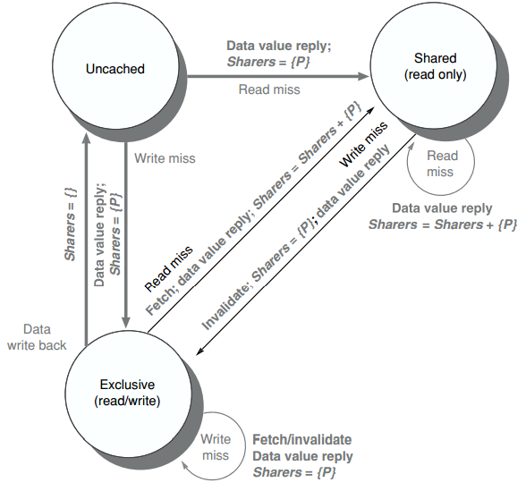
Directory Protocol
state transition diagram
for the directory
All actions in gray
because they’re all externally caused

Slide 72
?

Slide 73

#What’s More
The Story of Xiaoyan
When was the last time
you tried really hard
to chase?

