Slide 1
Lecture 01: Welcome
Computer Architecture!
Kai Bu
kaibu@zju.edu.cn
http://list.zju.edu.cn/kaibu/comparch2016fall
Notes:
Good afternoon, class! Welcome on board. I hope you just had a wonderful vacation.
At the very beginning of this semester, let me sincerely thank you for choosing me as your computer architecture instructor.

Slide 2
Instructor
Kai Bu 卜凯
Assistant Professor, College of CS, ZJU
Ph.D. from Hong Kong PolyU, 2013
Research Interests: wireless networking,
network security (e.g., RFID, software-
defined networking)
research interns wanted
http://list.zju.edu.cn/kaibu
Notes:
My name is Kai Bu. Right after I graduated from Hong Kong PolyU in 2013, I joined cs college as an assistant professor.
As a junior faculty member, I always cherish opportunities to work with undergraduate students on various research projects.
If you happen to be interested in networking and security research, I’ll be more than happy to work with you.
Before that, you might also like to know more about me via my webpage.

Slide 3

Textbook
Computer Architecture:
A Quantitative Approach
5th edition
John L. Hennessy
David A. Patterson
Notes:
The textbook we are using is Computer Architecture: A quantitative approach 5th edition by Professor Hennessy and Professor Patterson.

Slide 4
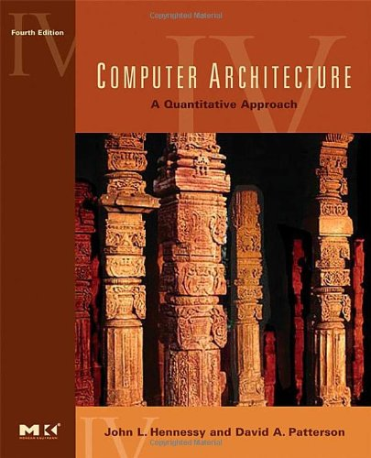
Textbook
Computer Architecture:
A Quantitative Approach
4th edition
John L. Hennessy
David A. Patterson
Some instructors may stick to the 4th ed
We’ll coordinate to keep the harmony
of the course content.
Notes:
Other instructors might use the 4th edition as well.
We’ll coordinate to keep the teaching content consistent across different classes.

Slide 5
Why This Book?
Quantitative approach:
Performance driven
Know not only how but also why
As in this book
Operating Systems: Three Easy Pieces
http://pages.cs.wisc.edu/~remzi/OSTEP/
Notes:
So why this book?
It presents computer architecture design in a quantitative approach, which adopts a performance-driven perspective. In other words, whenever it delivers a design technique, it clearly motivates how this technique makes our computers faster or better in terms of other measurement methodology.
So it tells us not only how computer architecture works but also why it works in the way it is designed.
You are also strongly encouraged to read the book Operating Systems: three easy pieces as well, as os is a prerequisite for computer architecture.

Slide 6
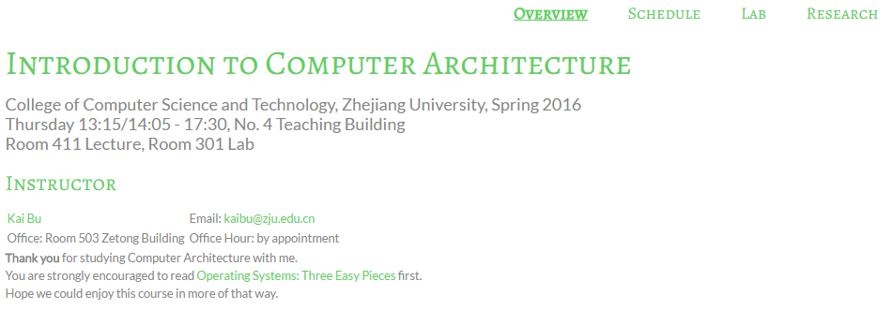
Course Website
http://list.zju.edu.cn/kaibu/comparch2016fall/
Notes:
all announcements and materials like slides and assignments will be posted on this website.

Slide 7
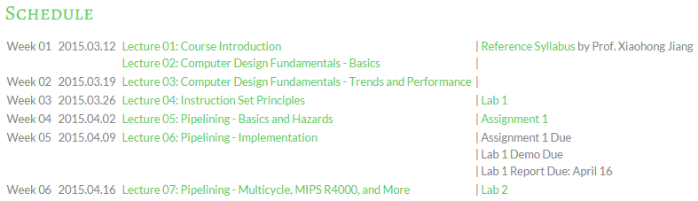
Syllabus
Reference syllabus by Prof. Jiang
http://list.zju.edu.cn/kaibu/comparch2015/Syllabus_2013spring.pdf
Reference schedule
http://list.zju.edu.cn/kaibu/comparch2016/schedule.html
Notes:
Here’re the links for reference syllabus and schedule

Slide 8
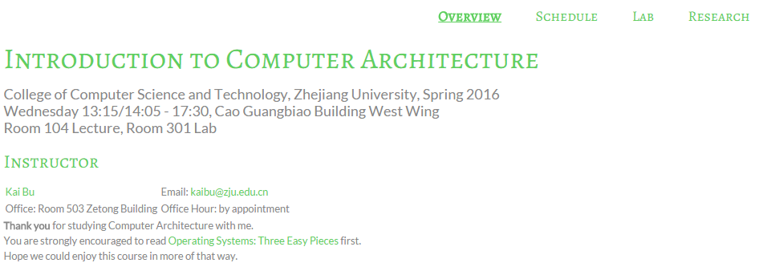
Components
Lectures
Labs
Research Warm-up
Notes:
The course contains three major components; they are lectures, labs, and research practice;

Slide 9
Components
Lectures
Labs
Research Warm-up
Notes:
Lecture sessions will feature the following cotents

Slide 10
Lectures
Chapter 1: Fundamentals of Computer Design
classes of computers
trends in technology, power, cost
dependability and performance quantitative principles of comp design
Notes:
Before detailing computer architecture, we first preview key fundamentals of computer design.
Like classes of computers, evolving trends in technology, power, and cost, computer dependability and performance, and foremost, the quantitative principles of computer design.

Slide 11
Lectures
Appendix A: Instruction Set Principles
classifying instruction set architecture
memory addressing
operations
instruction encoding
the role of compilers
example: MIPS architecture
Notes:
Then we’ll start from instructions.
As we know, we develop applications using various programming languages to make computers work for us.
But the code we type cannot be directly understood by our computers. Instead, the code should be compiled into instructions by compilers.
In this part, we’ll discuss basic types of instruction set architecture, how instructions address data in memory, how they compute with addressed data.
Besides, we’ll also discuss instruction encoding formats and how compiler affects computer performance.
Finally, we’ll use MIPS architecture as an example to better understand instructions.

Slide 12
Lectures
Appendix C: Pipelining
pipeline principles
pipeline hazards
implementation hurdles and solutions
example: MIPS R4000 pipeline
instruction level parallelism (Chapter 3)
Notes:
Facing with a bunch of instructions, how CPU processes them to fulfill our commands?
This is where pipelining technique shines. Using pipelining, the CPU can start processing the next instruction before it completes the previous one.
This significantly accelerates our computers. In this part, we’ll take several lecture sessions to explore pipeline’s principles and implementation. Meanwhile, we’ll see what challenges we face for implementing pipelining and how we solve them. Again, we use MIPS as an example to better understand pipelining.

Slide 13
Lectures
Chapter 2: Memory Hierarchy Design
cache performance (App B.2)
cache optimizations (App B.3)
memory tech and optimizations
virtual memory (App B.4)
protection of virtual memory (App B.5)
virtual memory and virtual machines
design of memory hierarchies
Notes:
Now we know what instruction looks like and how cpu processes them;
Then let’s move to a bigger picture, where comes the memory hierarchy.
As we mentioned, instructions work on various data. CPU directly fetches data from registers. However, registers are usually tiny in size. Then we introduce cache and main memory between CPU and disk storage for temporary data storage. From register to main memory, storage size increases but read and write speed decreases.
For larger addressing space, we might integrate disk storage into the memory hierarchy and we call this virtual memory.

Slide 14
Lectures
Appendix D: Storage System Performance
I/O performance
queuing theory
Notes:
After memory hierarchy, we’ll move our focus to disk storage.
Two major components we’ll discuss there are I/O performance and queuing theory.

Slide 15
Lectures
Chapter 5: Multiprocessors
symmetric shared-memory architecture
distributed shared-memory
directory-based coherence
Notes:
Finally, we’ll study the most current multiprocessor architecture. We mainly focus on how processors share memory and guarantee data coherence.

Slide 16
Components
Lectures
Labs
Research Warm-up
Notes:
Together with lecture sessions, we also have tight lab schedules to practice what we learn.

Slide 17
Labs
6 lab sessions
Pipeline implementation
Cache implementation
Notes:
In particular, through 6 lab assignments, we aim to implement pipeline and cache.

Slide 18
Labs
Lab 1
warmup Spartan 3E and ISE environment;
update verilog code of multi-cycle CPU to 3E board;
add one new branch instruction;
reference code:
Spartan 3E Display: http://list.zju.edu.cn/kaibu/comparch/lab1-Spartan3E-Display.rar
Spartan Simulation: http://list.zju.edu.cn/kaibu/comparch/spartansimulation.txt
Notes:
In the first lab session, we start from warming up the experiment environment.
Here are some reference codes you might use to get experiment tools work.

Slide 19
Labs
Lab 2
implement 5-stage pipelined CPU with 15 MIPS instructions;
Lab 3
implement stall technique against pipelining hazards;
Lab 4
implement forwarding paths toward faster CPU;
Lab 5
implement a pipelined CPU with 31 MIPS instructions;
use predict-not-taken policy to solve control hazard;
Lab 6
cache (tbd)
Notes:
Labs 2 through 5 are dedicated to pipeline implementation while lab 6 is for cache implementation.

Slide 20
Labs
Call for volunteer lab assistants
help tutor & check the demo during lab sessions;
get bonus credit via active class participation;
Notes:
For students who are familiar with lab experiments, you are strongly encouraged to join me as lab assistants.
As a lab assistant, you are expected to help tutor students and check demos.
Then, of course, you can get bonus credit as reward.

Slide 21
Components
Lectures
Labs
Research Warm-up
Notes:
Besides lectures and labs, we also advocate research practice.

Slide 22
Why do you care?
Notes:
So why do u care about the research part?

Slide 23
Research Warm-up
Grading: Bonus 5%
75% Literature Review
25% Presentation
Notes:
First, of course, you can get bonus credit.

Slide 24
More than that?
Notes:
But what’s more than that is if you really go deep into the research practice,

Slide 25
Learn to
learn things differently
Notes:
You’ll learn to learn things differently

Slide 26
Know not only how
but also why
Notes:
You’ll start paying attention to not only how something works but also why it works in that way.
You may also start wondering why it doesn’t work in some other ways.

Slide 27
Read this book and you’ll see
Operating Systems: Three Easy Pieces
http://pages.cs.wisc.edu/~remzi/OSTEP/
Notes:
Again, I’m recommending the book Operating Systems: three easy pieces;
It’ll help to shape your research mind as well as build background knowledge for computer architecture.

Slide 28
Research Warm-up
Basic Requirements
Find a research topic you are interested in: e.g., computer architecture, computer network, network security;
Read 2-3 latest papers from recent CCF A conferences; http://www.ccf.org.cn/sites/ccf/paiming.jsp
Write a review and prepare a presentation.
Notes:
Basically, to take on the challenge of research practice, you need to submit a review report and deliver a presentation.
You can browse recent papers in top conferences and find your interested topic.

Slide 29
Research Warm-up
Notes: The review should cover
What is the research problem?
Why is it important?
What are the solutions?
Any limitations?
What would you do?
More on http://list.zju.edu.cn/kaibu/comparch2016/research.html
Notes:
Here’s what a good review report should cover:
First, you need to clearly specify the research problem you’re working on. Also, you need to convince readers why your research problem is important so that they should pay attention to ur research. Then you need to review existing solutions, that is, how other researchers solve the problem.
What are their pros and cons? How would you solve the problem in a better way?

Slide 30
Research Warm-up
Advanced Requirements
your research, your way
improve your review report into a research paper
prototype your idea
Notes:
If you come up with some interesting ideas, we could collaborate to improve your report into a research paper;

Slide 31
Call for Research Interns
and SRTP/FYP advisees
Networking, Security:
RFID, SDN, etc.
more on http://list.zju.edu.cn/kaibu/publication.html
And, of course, what else you are interested in
Notes:
Moreover, if you are interested in what I’m working on, you are welcome to join our lab or choose me as your SRTP/graduation thesis mentor.

Slide 32
Grade?
Notes:
Finally, the part you care the most,

Slide 33
Grading
4% | Class participation & performance
16% | Homework
8% | Pop quiz
32% | Lab assignments
40% | Final exam (closed-book + memo)
Bonus 5% | Research Warm-up
Bonus 5% | Active class participation
Notes:
Grading policy
Now we’ve talked about several components this course requires, here’s how they contribute to the final grade.

Slide 34
How will I teach?
Notes:
Then, how will I teach?

Slide 35
What Students Expect from Teachers
Fun
Humor
Expertise
Easy exam
High grades
…
Notes:
For most of us, an ideal teacher should be fun and humorous, meanwhile, he or she should be an expert for what is taught.
More important, exams should be easy and grades should be high.

Slide 36
I wish I knew someone like this, too…
Notes:
Well, you can’t always get what u want, right?

Slide 37
Teaching Plan
Keep it Simple
Focus on the core concepts
Try to help you more easily understand
Notes:
So here’s how I teach.
As a junior faculty member, I’m gradually getting familiar with what I teach as well.
For every teaching component, I’ll try to keep it simple and focus on the core concepts. The ultimate goal of my teaching is to help you more easily understand what the textbook delivers.

Slide 38
#What’s More to Share
helpful/inspiring resources
#The 3 Secrets of Highly Successful Graduates by Reid Hoffman
Notes:
I’ll also share with you some helpful or inspiring videos and articles.

Slide 39
How will you contribute?
Notes:
Besides my efforts, your contributions are also indispensible.

Slide 40
Thanks In Advance
Study group
Lab assistants
Research interns
…
AT LEAST
submit assignments & lab reports
show up to final exam
Notes:
For example, you can start study groups for peer discussion, you can help me as lab assistants or research interns.
At least, please submit assignments in time and show up to final exam.
Believe it or not, some students just don’t.

Slide 41
QQ Group: 533944879
Notes:
One more request, join this qq group for ease of off-line discussion.

Slide 42
?
Notes:
So far, we have introduced course logistics and contents.
Any questions?

Slide 43

Who’s Who
Notes:
Roster;
Now it’s time for the class to get the first impression of each of you.
Briefly introduce yourself if you like when I call ur name; you could use either English or Chinese.

Slide 44
Ready?
Notes:
Great to know u all,
Now, Ready for an adventure to computer architecture?

Slide 45

#The 3 Secrets of Highly Successful Graduates

