Slide 1
Lecture 04: Instruction Set
Principles
Kai Bu
kaibu@zju.edu.cn
http://list.zju.edu.cn/kaibu/comparch2016fall
Notes:
Students registered; Thank you all.
In today’s lecture session, we’ll walk through instruction principles, it’s our final preparation for next week’s pipelining, which enables faster computer by running multiple instructions in parallel.

Slide 2
Lab 1 Demo: October 13
Lab 1 Report: October 20
http://10.78.18.200:8080/Platform/
Register with zju email account
Demo 70% + Report 30%
report template: http://list.zju.edu.cn/kaibu/comparch/Lab_report_template.doc
Notes:
Before that, Here’s a reminder of the requirement for lab 1.
We’ll check its demo next week and its report is expected one week after that.
To submit the report, you need to register on this website with your zju email account.
You can find report template via this link.

Slide 3

Appendix A.1-A.9
Notes:
Now let’s proceed to the content of today’s lecture.
The content corresponds to Appendix A in the textbook.

Slide 4
Preview
What’s instruction set architecture?
How do instructions operate?
How do instructions find operands?
How do programs turn to instructions?
How do hardware understand instructions?
Notes:
As we mentioned times, one major component of this course is pipelining.
It’s a technique to enable parallel execution of multiple instructions at the same time.
Before we discuss how to more quickly run a series of instructions, we need to understand what an instruction looks like and how it works.
In particular, in what formats do we construct instructions?
how do instructions operate?
How do they find operands in memory?
How do our coded programs turn to instructions?
How do computer hardware understand these instructions?
Seems quite a lot to deal with, right?

Slide 5
What’s ISA?
(Instruction Set Architecture)
Notes:
let’s first start with instruction set architecture.
It regulates various features of instructions, like how to encode an instruction, what kind of operation delivered by which instructions.

Slide 6
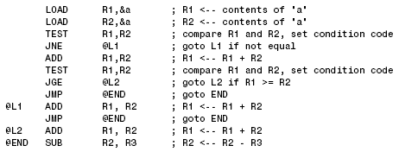
ISA: Instruction Set Architecture
Programmer-visible instruction set
Notes:
Instruction set architecture, usually called ISA for short, is the lowest level programmer-visible instruction set.
It serves as the boundary between programs coded with higher level programming languages and underlying hardware.
If you already dig up instruction implementation for lab 1, you might get very familiar with these instructions.

Slide 7
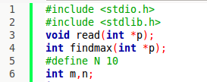
ISA: Instruction Set Architecture
Programmer-visible instruction set
Notes:
Instruction set architecture, usually called ISA for short, is the lowest level programmer-visible instruction set.
It serves as the boundary between programs coded with higher level programming languages and underlying hardware.
If you already dig up instruction implementation for lab 1, you might get very familiar with these instructions.

Slide 8
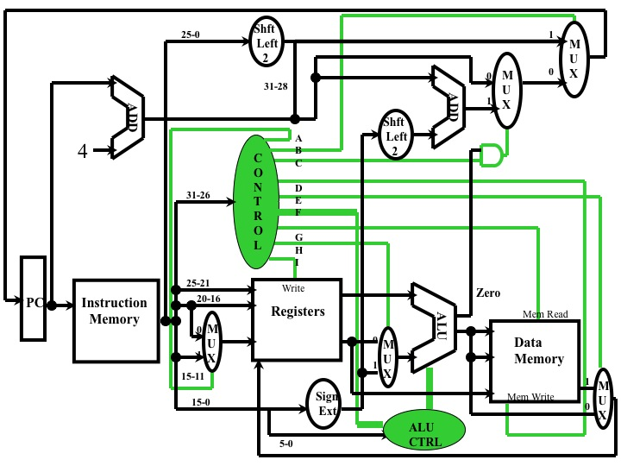
ISA: Instruction Set Architecture
Programmer-visible instruction set
Notes:
Instruction set architecture, usually called ISA for short, is the lowest level programmer-visible instruction set.
It serves as the boundary between programs coded with higher level programming languages and underlying hardware.
If you already dig up instruction implementation for lab 1, you might get very familiar with these instructions.
But note that how underlying hardware processes these instructions is not the focus of this course.

Slide 9
What types of ISA?
Notes:
So how many types of instruction set architecture out there?

Slide 10
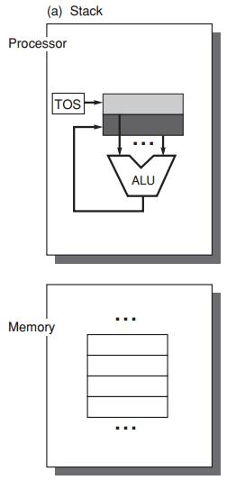
ISA Classification Basis
the type of internal storage:
stack
accumulator
register
in processor,
stores data fetched from memory/cache
Notes:
We should design ISA according to which type of internal storage is in use.
By internal storage, we refer to storage component/device residing inside processor.
Data loaded into memory should be first transferred to internal storage. Then CPU fetches needed data from internal storage to finish the operation specified by an instruction.
A computer could use stack, accumulator, and register as internal storage.
Therefore we accordingly have three classes of ISA,

Slide 11
ISA Classes
stack architecture
accumulator architecture
general-purpose register architecture (GPR)
Notes:
They are stack architecture, accumulator architecture, and general-purpose register architecture, also called gpr.

Slide 12
ISA Classes:
Stack Architecture
implicit operands
on the Top Of the Stack (TOS)
first operand removed from
second op replaced by the
C = A + B
Push A
Push B
Add
Pop C
A
B
C
Notes:
When we are using stack architecture, the operands are the data stored on the top of the stack by default.
Now let’s use the computation process of C=A+B to illustrate how stack architecture works. (A, B, C are memory locations.)
Using stack architecture, we have two instructions to transfer data between memory and stack.
One is Push, it reads data from memory and moves it to new TOS.
The other is Pop, it reads data from TOS and writes it to memory.

Slide 13
ISA Classes:
Stack Architecture
implicit operands
on the Top Of the Stack (TOS)
first operand removed from
second op replaced by the res
C = A + B
Push A
Push B
Add
Pop C
A
B
C
Notes:
To add A and B using ALU, we have to fetch data from memory and store them in the stack.
The first instruction Push A reads the data located at memory location A and stores it to the stack.
As shown in this figure, the fetched data becomes the new TOS.

Slide 14
ISA Classes:
Stack Architecture
implicit operands
on the Top Of the Stack (TOS)
first operand removed from
second op replaced by the
C = A + B
Push A
Push B
Add
Pop C
A
B
C
Notes:
Similarly, the second instruction Push B reads data located at memory location B and stores it to the stack.
The TOS updates again.

Slide 15
ISA Classes:
Stack Architecture
implicit operands
on the Top Of the Stack (TOS)
first operand removed from stack
second op replaced by the result
C = A + B
Push A
Push B
Add
Pop C
A
B
C
Notes:
Now we have both operands ready in the stack.
The third instruction Add takes data on the TOS as operands.
After the computation, the first operand will be removed from stack and the second operand will be replaced by the result.
Obviously, the result becomes the new TOS.

Slide 16
ISA Classes:
Stack Architecture
implicit operands
on the Top Of the Stack (TOS)
first operand removed from stack
second op replaced by the result
C = A + B
Push A
Push B
Add
Pop C
A
B
C
Notes:
Finally, we use instruction Pop C to move the data on the TOS to memory location C.

Slide 17
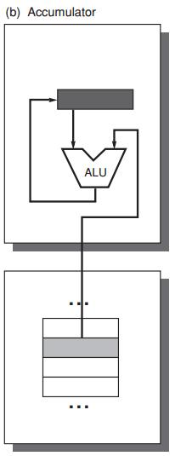
ISA Classes:
Accumulator Architecture
one implicit operand: the accumulator
one explicit operand: mem location
C = A + B
Load A
Add B
Store C
accumulator is both
an implicit input operand
and a result
A
B
C
memory
Notes:
Now let’s use C=A+B again as an example to see how accumulator architecture works.
For the two operands A and B, one is implicit, which refers to the accumulator; one is explicit, which refers to an exact memory location.

Slide 18
ISA Classes:
Accumulator Architecture
one implicit operand: the accumulator
one explicit operand: mem location
C = A + B
Load A
Add B
Store C
accumulator is both
an implicit input operand
and a result
A
B
C
memory
Notes:
We use the first instruction Load A to move the data at memory location A to the accumulator;

Slide 19
ISA Classes:
Accumulator Architecture
one implicit operand: the accumulator
one explicit operand: mem location
C = A + B
Load A
Add B
Store C
accumulator is both
an implicit input operand
and a result
A
B
C
memory
Notes:
Now let’s use C=A+B again as an example to see how accumulator architecture works.
For the two operands A and B, one is implicit, which refers to the accumulator; one is explicit, which refers to an exact memory location.
For example, we use Load A to move the data in the accumulator to the ALU;
Then we use the second instruction Add B to complete the addition.
B here is an explicit operand corresponding to a memory location.
For the Add instruction, we do have another implicit operand, which is the accumulator. It holds the data we just reads from memory location A.
Meantime, the accumulator will also hold the result.

Slide 20
ISA Classes:
Accumulator Architecture
one implicit operand: the accumulator
one explicit operand: mem location
C = A + B
Load A
Add B
Store C
accumulator is both
an implicit input operand
and a result
A
B
C
memory
Notes:
Finally, we use instruction Store C to store the result to memory location C.

Slide 21
ISA Classes:
General-Purpose Register Arch
Only explicit operands
registers
memory locations
Operand access:
direct memory access
loaded into temporary storage first
Notes:
General-purpose register architecture uses only explicit operands: they could be either registers or memory locations;
To fetch operands, GPR may directly access memory or load the data into temporary storage first.

Slide 22
ISA Classes:
General-Purpose Register Arch
Two Classes:
register-memory architecture
any instruction can access memory
load-store architecture
only load and store instructions can access memory
Notes:
According to which instruction can access memory, GPR falls into two classes:
One is register-memory architecture, any instruction of it can access memory;
The other is load-store architecture, it allows only load and store instructions to access memory.

Slide 23
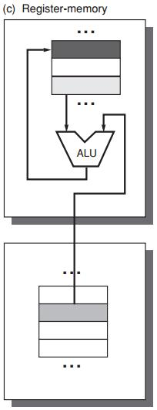
GPR: Register-Memory Arch
register-memory architecture
any instruction can access mem
C = A + B
Load R1, A
Add R3, R1, B
Store R3, C
R3
A
R1
B
A
B
C
memory

Slide 24
GPR: Register-Memory Arch
register-memory architecture
any instruction can access mem
C = A + B
Load R1, A
Add R3, R1, B
Store R3, C
R3
A
R1
B
A
B
C
memory
Notes:
First, preload A to register R1;

Slide 25
GPR: Register-Memory Arch
register-memory architecture
any instruction can access mem
C = A + B
Load R1, A
Add R3, R1, B
Store R3, C
R3
A
R1
B
A
B
C
memory
Notes:
Then B uses direct memory access;
Add data in R1 and at memory location B, store the result in R3.

Slide 26
GPR: Register-Memory Arch
register-memory architecture
any instruction can access mem
C = A + B
Load R1, A
Add R3, R1, B
Store R3, C
R3
A
R1
B
A
B
C
memory
Notes:
Store the result in register R3 to memory location C;
In this example, both load and add instruction accessed memory;

Slide 27
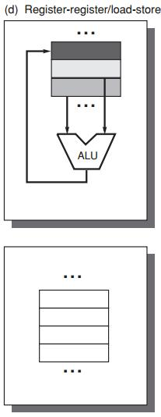
GPR: Load-Store Architecture
load-store architecture
only load and store instructions
can access memory
C = A + B
Load R1, A
Load R2, B
Add R3, R1, R2
Store R3, C
A+B
R3
B
R2
A
R1
A
B
C
memory
Notes:
If we use load-store architecture, only load and store instructions can access memory.
Then to compute A+B, we must first use two load instructions to preload A and B to registers;

Slide 28
GPR: Load-Store Architecture
load-store architecture
only load and store instructions
can access memory
C = A + B
Load R1, A
Load R2, B
Add R3, R1, R2
Store R3, C
A+B
R3
B
R2
A
R1
A
B
C
memory

Slide 29
GPR: Load-Store Architecture
load-store architecture
only load and store instructions
can access memory
C = A + B
Load R1, A
Load R2, B
Add R3, R1, R2
Store R3, C
A+B
R3
B
R2
A
R1
A
B
C
memory

Slide 30
GPR: Load-Store Architecture
load-store architecture
only load and store instructions
can access memory
C = A + B
Load R1, A
Load R2, B
Add R3, R1, R2
Store R3, C
A+B
R3
B
R2
A
R1
A
B
C
memory
Notes:
Then use corresponding registers as operands of add instruction;
In the Add instruction, we add the values in registers R1 and R2, and store the result in register R3.

Slide 31
GPR: Load-Store Architecture
load-store architecture
only load and store instructions
can access memory
C = A + B
Load R1, A
Load R2, B
Add R3, R1, R2
Store R3, C
A+B
R3
B
R2
A
R1
A
B
C
memory
Notes:
Finally, we use the Store instruction to store the result in resiter R

Slide 32
GPR Classification
ALU instruction has 2 or 3 operands?
2 = 1 result&source op + 1 source op
3 = 1 result op + 2 source op
ALU instruction has 0, 1, 2, or 3 operands of memory address?
Notes:
As we can observe from previous examples, ALU instruction in GPR can have 2 or three operands, of which 0 to 3 could be memory address;

Slide 33
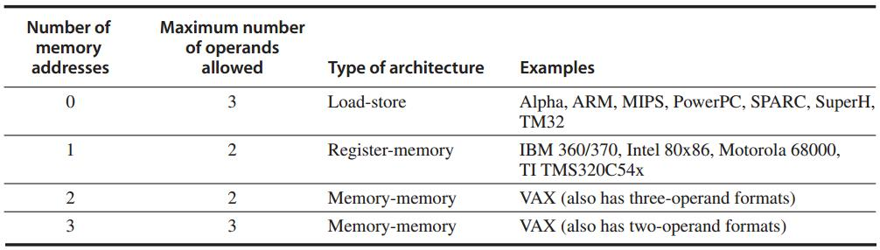
GPR Classification
Three major classes
Register-register
Notes:
This table exemplifies product types and operand types of each GPR class.
For example, ARM and MIPS belong to load-store architecture, they support 3 operands at maximum with 0 memory address allowed.

Slide 34
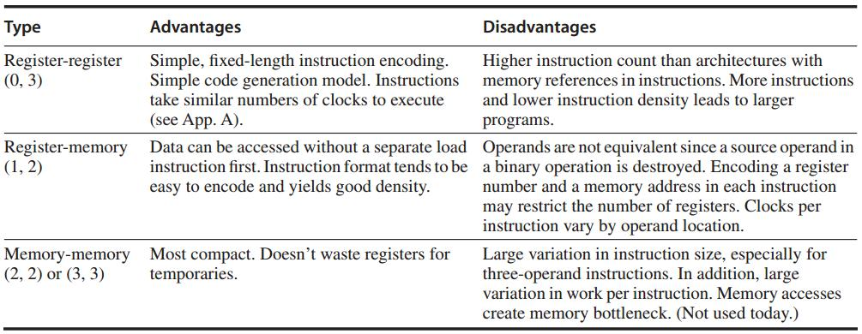
GPR Classification
Notes:
Each GPR class has its own pros and cons. You could refer to these descriptions after class.

Slide 35
Where to find operands?
Notes:
Now we know what instructions of each instruction set architecture look like,
Then how do they find operands for computation?
This process is called Memory addressing
It is the procedure when an instruction finds its interested data at a certain location in memory.

Slide 36
Interpret Memory Address
Byte addressing
byte – 8 bits
half word – 16 bits
words – 32 bits
double word – 64 bits
Notes:
The smallest unit for how much volume of data can be accessed at one time is one byte.

Slide 37
Operand Type and Size
Type | Size in bits
ASCII character | 8
Unicode character Half word | 16
Integer word | 32
Double word Long integer | 64
IEEE 754 floating point – single precision | 32
IEEE 754 floating point – double precision | 64
Floating point – extended double precision | 80
Notes:
Various types of operand and corresponding size are summarized in this table.

Slide 38
Interpret Memory Address
Byte ordering in memory: 0x12345678
Little Endian: store least significant byte in the smallest address
78 | 56 | 34 | 12
Big Endian: store most significant byte in the smallest address
12 | 34 | 56 | 78
Notes:
Now we know that the smallest storage unit is one byte.
When we store multi-byte operands in memory, we have two ways to order each byte of it.
The first way is little endian, it stores the least significant byte in the smallest address;
Take the example hexadecimal number for instance, it has 4 bytes, when we use little endian, we should store it as 78, 56, 34, 12 from low mem address to high ones;
The second way is big endian, in contrast, it stores the most significant byte in the smallest address.

Slide 39
Interpret Memory Address
Address alignment
object width: s bytes
address: A
aligned if A mod s = 0
Notes:
When storing data in memory, we require that their addresses be aligned.
Given object width s and address A, for the address to be aligned, we should have that A modulo s equals to zero.

Slide 40
Interpret Memory Address
Address alignment
object width: s bytes
address: A
aligned if A mod s = 0
Why to align addresses?
Notes:
Then why need we follow address alignment?

Slide 41
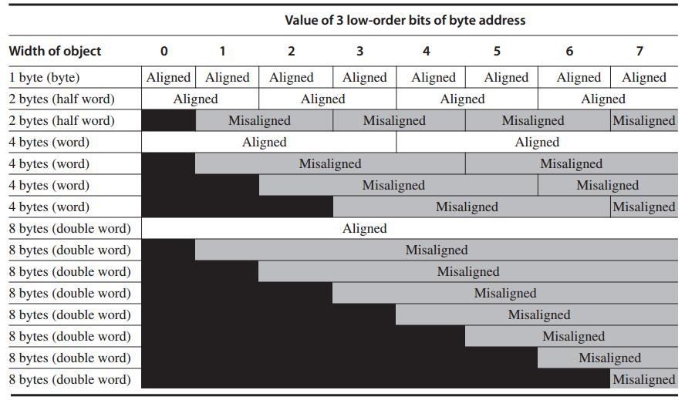
Each misaligned object requires two memory accesses
Notes:
(Accessing memory address should be the multiple of object width.)
This picture clearly demonstrates that address alignment helps limit memory access times.
When well aligned, requires only one memory access to read one object;
If address is not well aligned, each misaligned object requires two memory accesses to fetch.

Slide 42
Addressing Modes
How instructions specify addresses
of objects to access
Types
constant
register
memory location – effective address
Notes:
We have different addressing modes for instructions to specify operand address;
For example, we could use constant, register, or memory location; memory location is also called effective address;

Slide 43
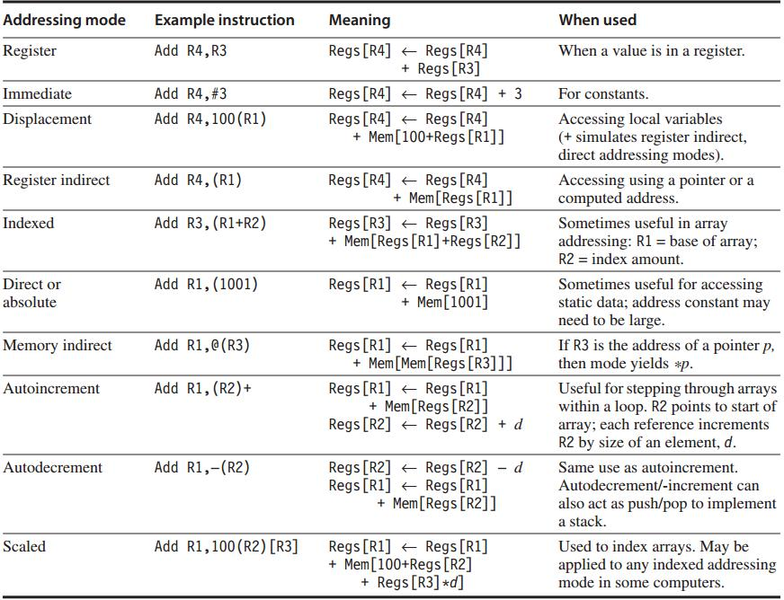
frequently used
tricky one
Addressing Modes
Notes:
This table summarizes different addressing modes and their meanings.
For example,

Slide 44
How to operate operands?
Notes:
After we get operands, how instructions do with them?

Slide 45
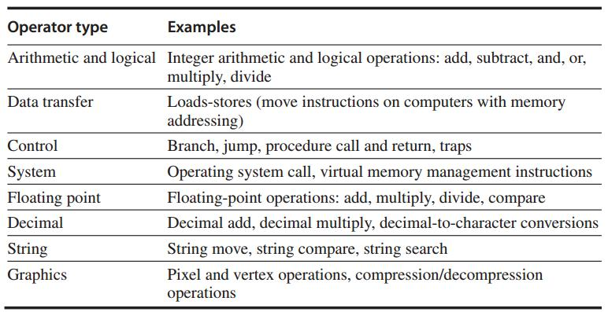
Operations

Slide 46
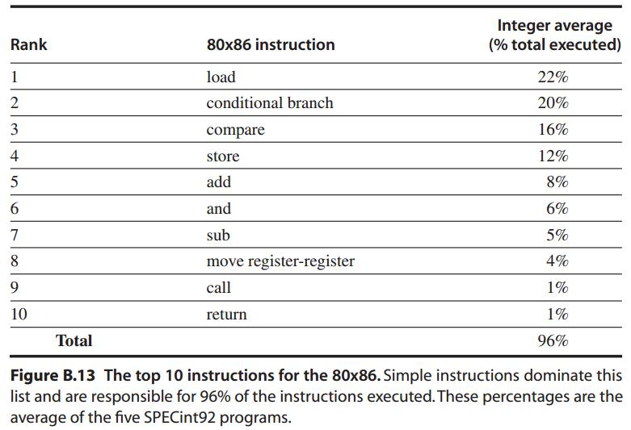
Simple Operations are the most widely executed

Slide 47
Control Flow Instructions
Four types of control flow change:
Conditional branches – most frequent
Jumps
Procedure calls
Procedure returns

Slide 48
Control Flow: Addressing
Explicitly specified destination address
(exception: procedure return as target is not known at compile time)
PC-relative
destination addr = PC + displacement
Dynamic address: for returns and indirect jumps with unknown target at compile time
e.g., name a register that contains the target address

Slide 49
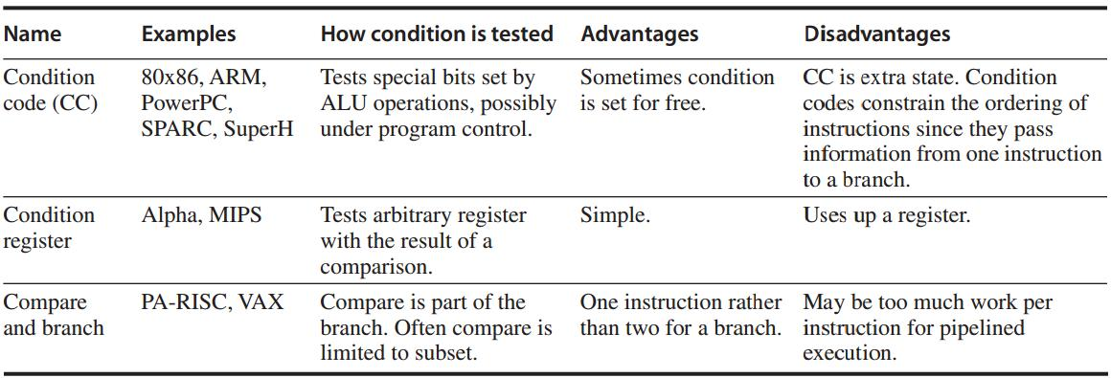
Conditional Branch Options
http://www.ece.mtu.edu/ee/faculty/cchigan/EE3170/EE%203170%20Lecture%207-Branches.pdf

Slide 50
Procedure Invocation Options
Control transfer + State saving
Return address must be saved
in a special link register or just a GPR
How to save registers?

Slide 51
Procedure Invocation Options:
Save Registers
Caller Saving
the calling procedure saves the registers that it wants preserved for access after the call
Callee Saving
the called procedure saves the registers it wants to use

Slide 52
How do hardware understand instructions?
Notes:
Now given an instruction, you probably are very clear about how it works, right;
But how do hardware understand it?

Slide 53
Encoding an ISA
Opcode for specifying operations
Address Specifier for specifying the addressing mode to access operands
Notes:
To let the hardware execute an instruction in the way we expect the instruction to operate,
We need first encode the instruction with an opcode, which specifies what operations this instruction will do.
As most operations are conducted over some data, that is, operands, we also need to specify the addressing mode to let the hardware know where to find operand.
The parameter for specifying the addressing mode is called address specifier.

Slide 54
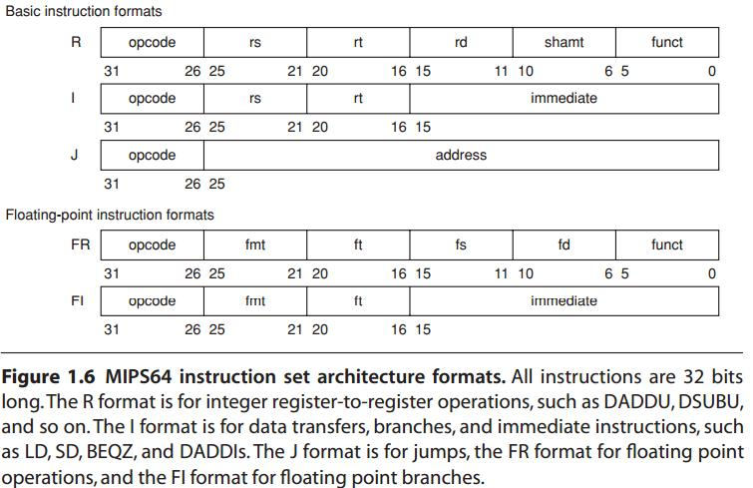
Encoding an ISA
Fixed length: ARM, MIPS – 32 bits
Variable length: 80x86 – 1~18 bytes
http://en.wikipedia.org/wiki/MIPS_architecture
Start with a 6-bit opcode
that specifies the operation.
Register-type:
three registers,
a shift amount field,
and a function field;
Immediate-type:
two registers,
a 16-bit immediate value;
Jump-type:
a 26-bit jump target.
Notes:
How to represent ISA in a form that makes it easy for the hardware to execute?

Slide 55
Encoding an ISA
Balance several competing forces for encoding:
1. desire to have more registers and addressing modes;
2. impact of the size of register and addressing mode fields on the average instruction/program size
3. desire to encode instructions into lengths easy for pipelining

Slide 56
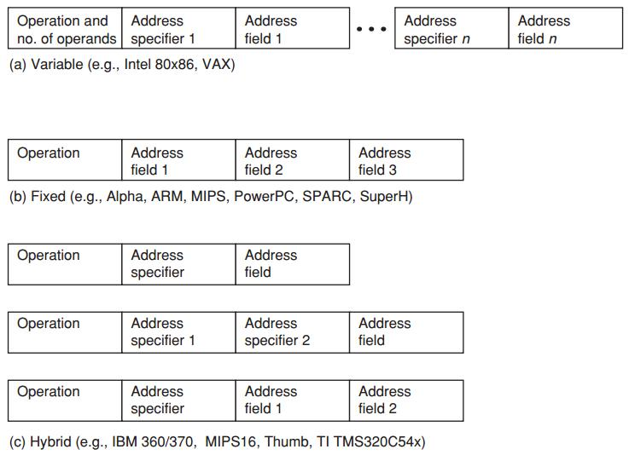
Encoding an ISA
Variable allows all addressing modes to be with all operations
Fixed combines the operation and addressing mode into the opcode
Hybrid reduces the variability in size and work of the variable arch
but provides multiple instruction lengths to reduce code size
Notes:
So besides fixed and variable length encoding,
Introduce a hybrid encoding.

Slide 57
How do programs
turn to instructions?
Notes:
Most often, we only face the programs;
Then how our programs become the aforementioned instructions that can be executed by computer?

Slide 58
Program
Compiler
Instructions
Notes:
It’s the compiler that does this job for us.

Slide 59
The Role of Compilers
compile desktop and server apps programmed in high-level languages;
Output instructions that can be executed by hardware;
significantly affect the performance of a computer;

Slide 60
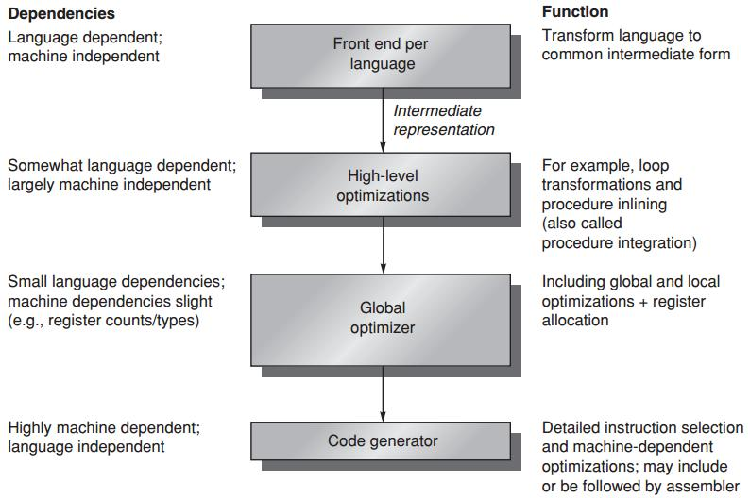
Compiler Structure

Slide 61
Compiler Goals
Correctness
all valid programs must be compiled correctly
Speed of the compiled code
Others
fast compilation
debugging support
interoperability among languages

Slide 62
Compiler Optimizations
High-level optimizations
are done on the source with output fed to later optimization passes
Local optimizations
optimize code only within a straight-line code fragment (basic block)
Global optimizations
optimize across branches and transform for optimizing loops
Register allocation
associates registers with operands
Processor-dependent optimizations
leverage specific architectural knowledge

Slide 63
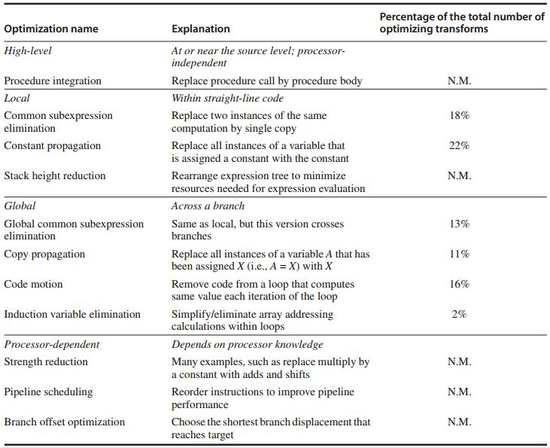
Compiler Optimizations: Examples

Slide 64
Data/Register Allocation
Where high-level languages allocate data
Stack: for local variable
Global data area: statically declared objects, e.g., global variable, constant
Heap: for dynamic objects
Register allocation is much more effective for stack-allocated objects for global variables;
Register allocation is essentially impossible for heap-allocated objects because they are accessed with pointers;

Slide 65
Compiler Writer’s Principles
Make the frequent cases fast
and the rare case correct
Driven by instruction set properties
Notes:
Some instruction set properties serve as compiler design guidelines

Slide 66
Compiler Writer’s Principles
Provide regularity
keep primary components of an instruction set (operations, data types, addressing modes) orthogonal/independent
Provide primitives, not solutions
Simplify trade-offs among alternatives
instruction size, total code size, register allocation (in register-memory arch, how many times a variable should be referenced before it is cheaper to load it into a register)
Provide instructions that bind the quantities known at compile time as constants
instead of processor interpreting at runtime a value that was known at compile time
Notes:
Provide primitives, not solutions: the compiler should not be too specific toward certain high-level language;

Slide 67
Finally,
all in MIPS

Slide 68
MIPS
Microprocessor without Interlocked Pipeline Stages
64-bit load-store architecture
Design for pipelining efficiency, including a fixed instruction set encoding
Efficiency as a compiler target

Slide 69
MIPS: Registers
32 64-bit general-purpose regs (GPRs)
R0 … R31 – for holding integers
32 floating-point regs (FPRs)
F0 … F31 – for holding up to 32 single-precision (32-bit) values or 32 double-precision (64-bit) values
The value of R0 is always 0

Slide 70
MIPS: Data Types
64-bit integers
32- or 64-bit floating point
For 8-bit bytes, 16-bit half words, 32-bit words:
loaded into the general-purpose registers (GPRs)
with either zeros or the sign bit replicated
to fill the 64 bits of GPRs

Slide 71
MIPS: Addressing Modes
Directly support immediate and displacement, with 16-bit fields
Others:
register indirect: placing 0 in the 16-bit displacement field
absolute addressing: using register 0 (with value 0) as the base register
Aligned byte addresses of 64-bits

Slide 72
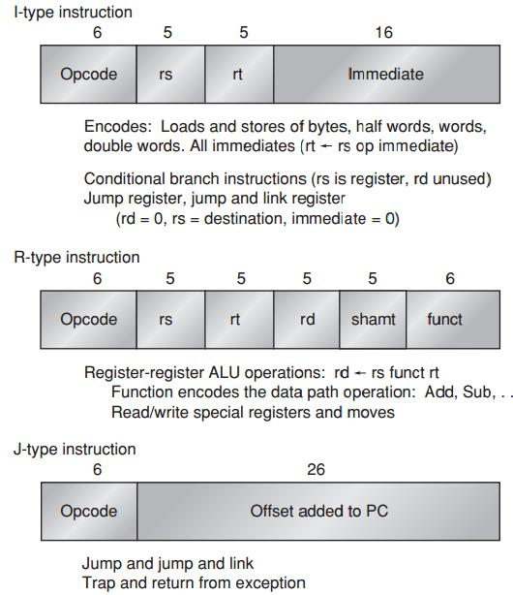
MIPS: Instruction Format

Slide 73
MIPS Operations
Four classes
loads and stores
ALU operations
branches and jumps
floating-point operations

Slide 74
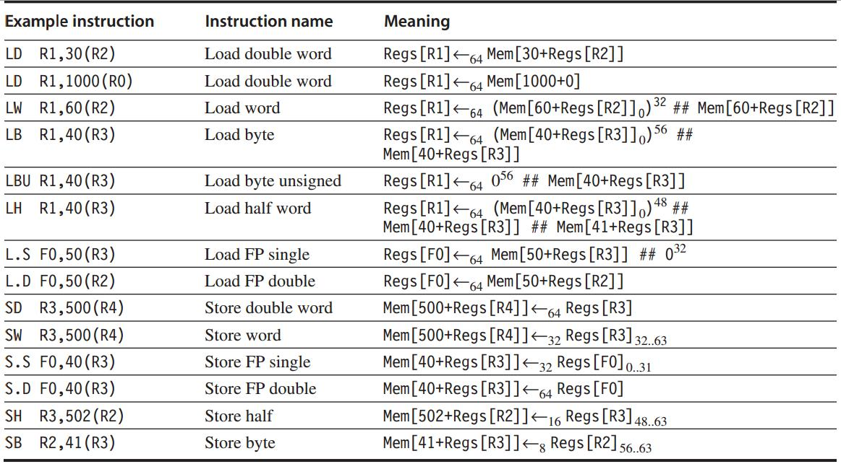
MIPS: Loads and Stores

Slide 75
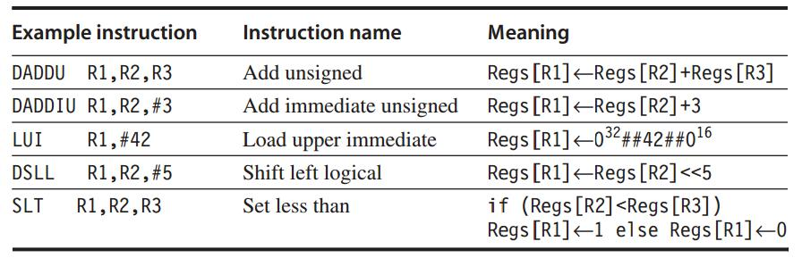
MIPS: ALU Operations

Slide 76
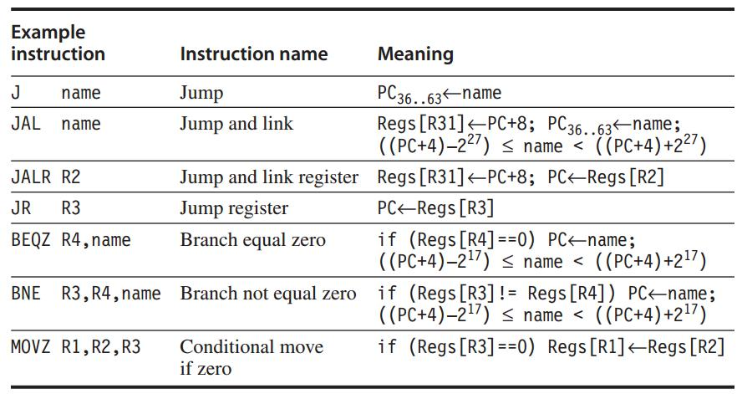
MIPS: Control Flow Instructions
Jumps and Branches
http://www.cs.umd.edu/class/sum2003/cmsc311/Notes/Mips/jump.html

Slide 77
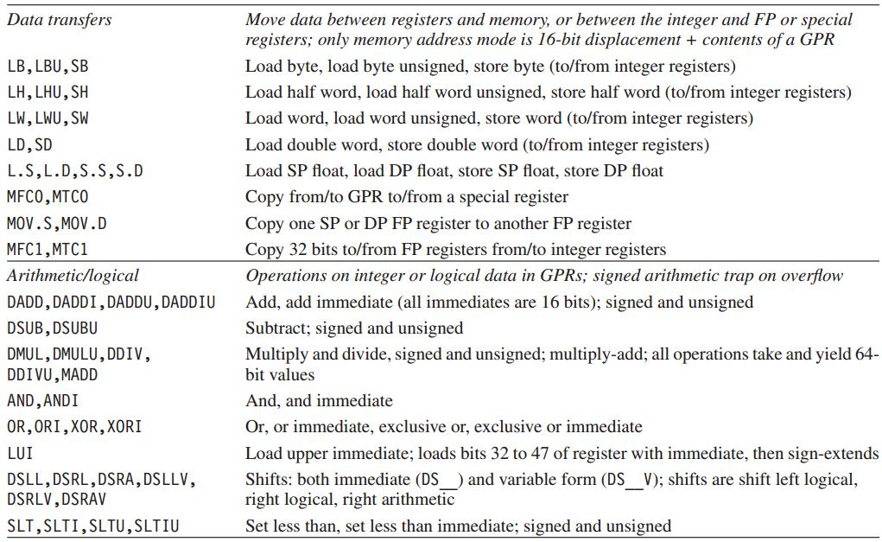
MIPS: Floating-Point Operations

Slide 78
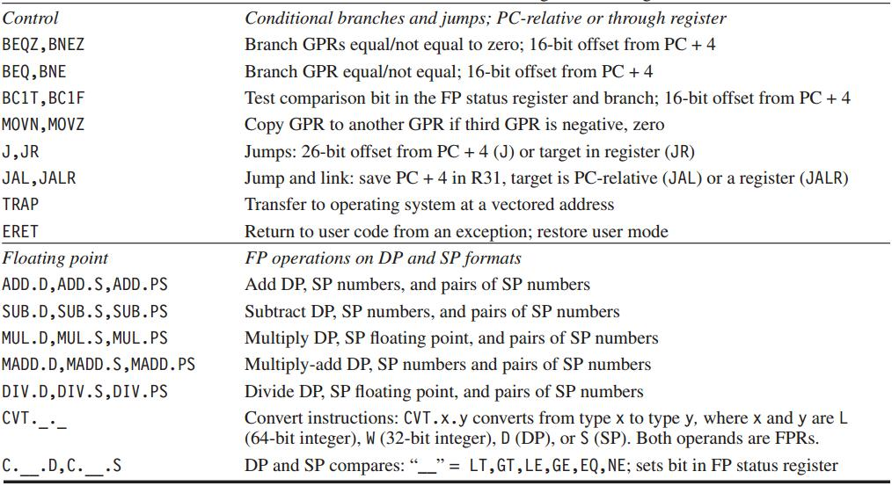
MIPS: Floating-Point Operations

Slide 79
Review
ISA classification and operation
Memory addressing
ISA Encoding
Compiler
MIPS example

Slide 80
?

Slide 81
#What’s More
The Impossible Decision by Joshua Rothman
A Guide for Potential Grad Students: Should You Go To Graduate School?
The Most Important Qualities for Success in Grad School by Bill Freeman

