Slide 1
Lecture 06: Pipelining
Implementation
Kai Bu
kaibu@zju.edu.cn
http://list.zju.edu.cn/kaibu/comparch2016fall

Slide 2
Assignment 1 due
Lab 1 Report due
Lab 2 Demo due November 06
Report due November 17
Final Exam: 2017.01.19
18:30-20:30

Slide 4
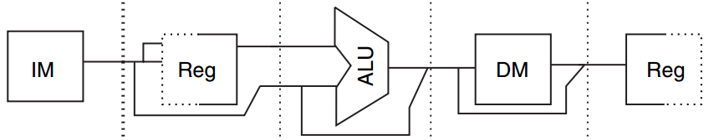
Data Path
Underneath Pipelining
MIPS
Five-Stage
IF ID EX MEM WB
Notes:
We just finished exploring high level principles of pipelining.
We used MIPS five-stage pipeline as an example. The execution of an instruction is divided into five stages, which are IF, ID, EX, MEM, and WB.
Connecting adjacent pipe stages are pipe registers. They store temporary result from the previous stage and feed it to the next stage.

Slide 5
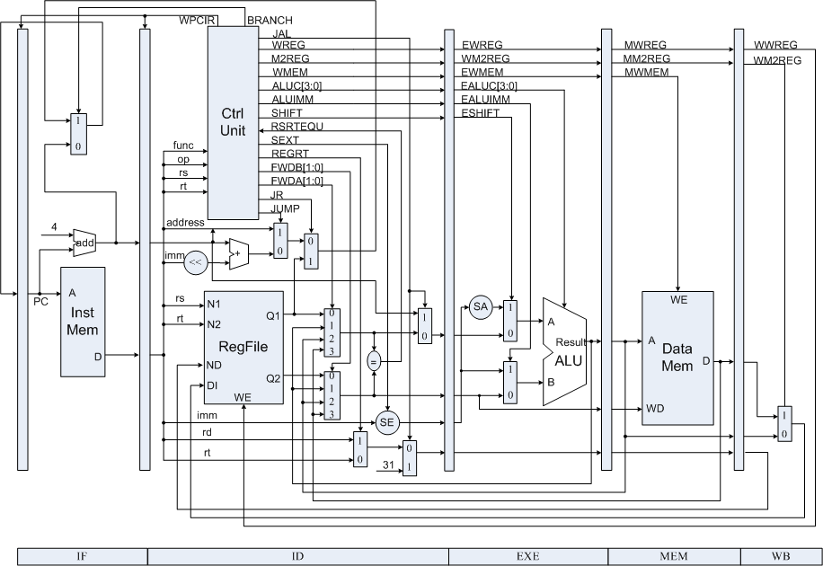
Data Path
Underneath Pipelining
lab & exam
Notes:
And this is what underlying data path looks like.
It’s more complex when taking other corresponding components into account.
[key framework for lab and exam]

Slide 6
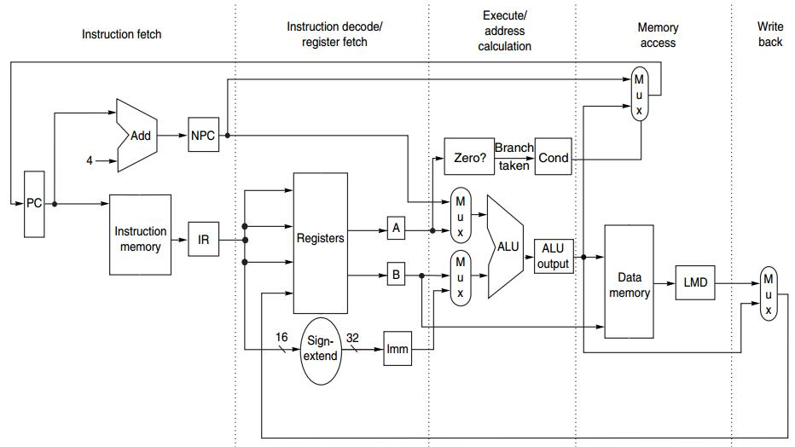
Data Path
Underneath Pipelining
IF ID EX MEM WB
Notes:
In this course, we focus mainly on the parts that highly relate to the five stages of pipeline.

Slide 7
Preview
under MIPS architecture
How an MIPS instruction works?
How MIPS instructions pipleline?
Notes:
In particular, we’ll discuss how an MIPS instruction works atop such data paths, and how such data paths support MIPS pipeline.

Slide 8

Appendix C.3-C.4
Notes:
These contents correspond to the second part of Appendix C.

Slide 9
How an unpipelined
MIPS instruction works?
Notes:
So first, how an instruction works when unpipelined?

Slide 10
MIPS Instruction
at most 5 clock cycles per instruction
IF ID EX MEM WB
Notes:
It runs in at most 5 clock cycles, which we’ve already known.
Next, let’s dig deeper into each stage, see what exactly happens on the data path.

Slide 11
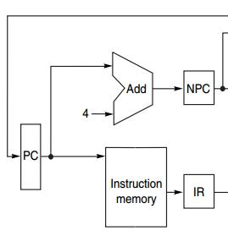
IF
IF ID EX MEM WB
Instruction Fetch cycle
IR ← Mem[PC];
NPC ← PC + 4;
IR: instruction register
NPC: next sequential PC
Notes:
In the first cycle, we fetch the instruction to process from instruction memory and store it in instruction register.
We use program counter (PC) as the pointer to find the instruction in memory. After fetching the instruction, we need update PC so that it points to the next instruction. Since an instruction is 4 bytes long, we increment PC by four. The value of PC is stored in a register called NPC.

Slide 12
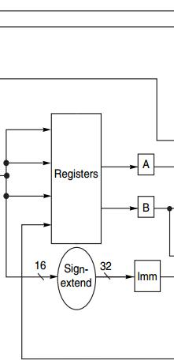
ID
IF ID EX MEM WB
Instruction Decode/register fetch
A ← Regs[rs];
B ← Regs[rt];
Imm ← sign-extended
immediate field
of IR
(lower 16 bits)
Notes:
To make the fetched instruction understandable to subsequent components, the second stage decodes it.
Meanwhile, operands will be read from registers and stored into temporary registers A, B, and IMM. All these operands are key inputs for the next cycle, EX.

Slide 13
EX
IF ID EX MEM WB
Execution/effective address cycle
ALU operates on the operands from ID:
4 functions depending on the instr type -Memory reference
-Register-register ALU instruction
-Register-immediate ALU instruction
-Branch
Notes:
(Note that different from the RISC implementation instance in previous lecture, with one more function - branch)
MIPS’s EX stage has four types of functions;

Slide 14
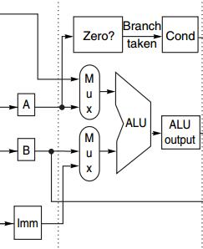
EX
IF ID EX MEM WB
Execution/effective address cycle
-Memory reference
ALUOutput ← A + Imm;
ALU adds the operands
to form effective address
Notes:
(Base register + offset)
The first function is memory reference. For memory reference, we need to access memory for reading data from it or storing data into it. Where should we conduct such operations in memory space? It is effective address that specifies the location. Effective address is formed in EX stage, specifically, it is the sum of values from register A and Imm.

Slide 15
EX
IF ID EX MEM WB
Execution/effective address cycle
-Register-register ALU instr
ALUOutput ← A func B;
ALU performs the operation
specified by function code
on the values in register A & register B
Notes:
When it’s a register-register ALU instruction, the ALU performs corresponding function/operation on the values in Registers A and B. and the results is stored in register ALUOutput

Slide 16
EX
IF ID EX MEM WB
Execution/effective address cycle
-Register-Immediate ALU Instr
ALUOutput ← A op Imm;
ALU performs the operation
specified by opcode
on the values in register A & reg IMM
Notes:
For ALU instruction, one operand could be defined as an immediate, which locates in register IMM. In this case, the ALU just simply performs corresponding operation on the values in register A and IMM.

Slide 17
EX
IF ID EX MEM WB
Execution/effective address cycle
-Branch
ALUOutput ← NPC + (Imm<<2);
Cond ← (A == 0);
ALUOutput -> branch target
BEQZ: comparison against 0
Notes:
Note that different from the RISC implementation instance in previous lecture, MIPS’s EX stage has four types of functions; with one more function - branch

Slide 18
EX
IF ID EX MEM WB
Execution/effective address cycle
-Branch
ALUOutput ← NPC + (Imm<<2);
Cond ← (A == 0);
ALUOutput -> branch target
BEQZ: comparison against 0
Why <<2?
http://www.cs.umd.edu/class/sum2003/cmsc311/Notes/Mips/addr.html
Notes:
Note that different from the RISC implementation instance in previous lecture, MIPS’s EX stage has four types of functions; with one more function - branch

Slide 19
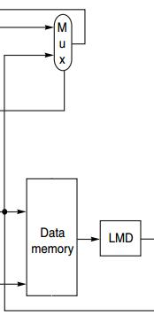
MEM
IF ID EX MEM WB
MEMory access/branch completion
update PC for all instr: PC ← NPC;
-Memory Access
LMD ← Mem[ALUOutput]; load
Mem[ALUOutput] ← B; store
-Branch
if (cond) PC ← ALUOutput;
Load Memory Data register
Notes:
For memory reference instructions and branch instruction, they’ll proceed to the MEM stage.
In this stage, it uses the effective address for memory access or update branch target for taken branch.
For example, for load instruction, fetch data from location specified by the value in ALUOutput, and stores it in register LMD.

Slide 20
WB
IF ID EX MEM WB
Write-Back cycle
-Register-register ALU instruction
Regs[rd] ← ALUOutput;
-Register-immediate ALU instruction
Regs[rt] ← ALUOutput;
-Load instruction
Regs[rt] ← LMD;
Notes:
Finally, the write-back cycle writes the resulting data into corresponding registers for later use.

Slide 21
Put It All Together

Slide 22
MIPS Instruction
IF ID EX MEM WB
IR ← Mem[PC];
NPC ← PC + 4;

Slide 23
MIPS Instruction
IF ID EX MEM WB
A ← Regs[rs];
B ← Regs[rt];
Imm ← sign-extended
immediate field
of IR (lower 16 bits)

Slide 24
MIPS Instruction
IF ID EX MEM WB
ALUOutput ← A + Imm;
ALUOutput ← A func B;
ALUOutput ← A op Imm;
ALUOutput ← NPC + (Imm<<2);
Cond ← (A == 0);

Slide 25
MIPS Instruction
IF ID EX MEM WB
PC ← NPC
LMD ← Mem[ALUOutput]; Mem[ALUOutput] ← B;
if (cond) PC ← ALUOutput;

Slide 26
MIPS Instruction
IF ID EX MEM WB
Regs[rd] ← ALUOutput;
Regs[rt] ← ALUOutput;
Regs[rt] ← LMD;

Slide 27
MIPS Instruction Demo
Prof. Gurpur Prabhu, Iowa State Univ http://www.cs.iastate.edu/~prabhu/Tutorial/PIPELINE/DLXimplem.html
Load, Store
Register-register ALU
Register-immediate ALU
Branch

Slide 28
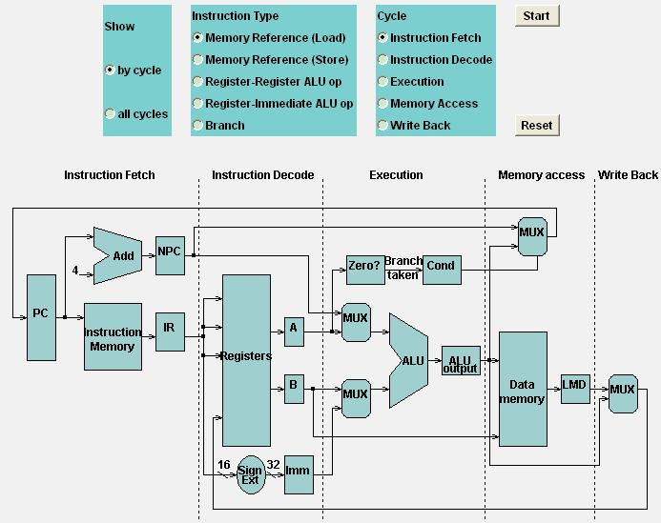
Load

Slide 29
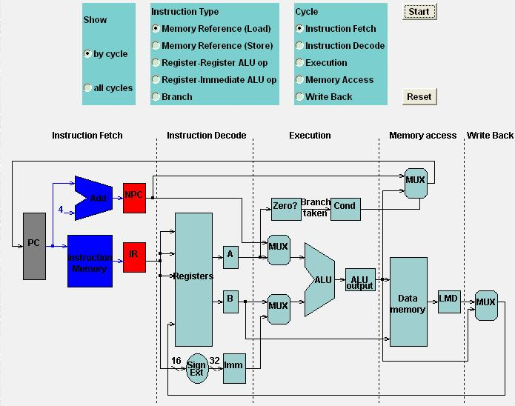
Load
Load: IF

Slide 30
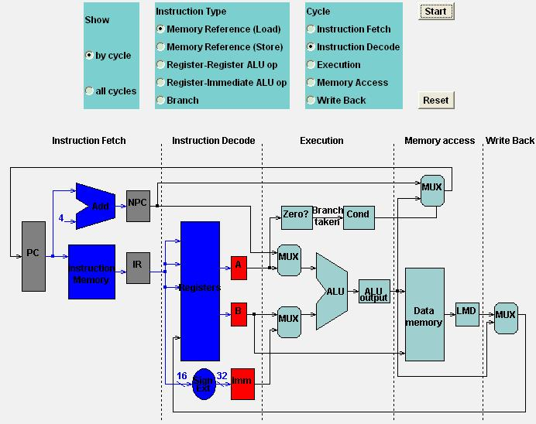
Load
Load: ID

Slide 31
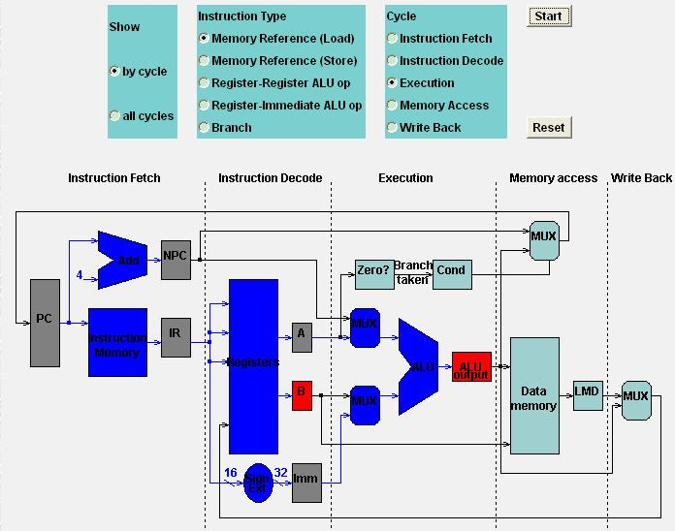
Load
Load: EX

Slide 32
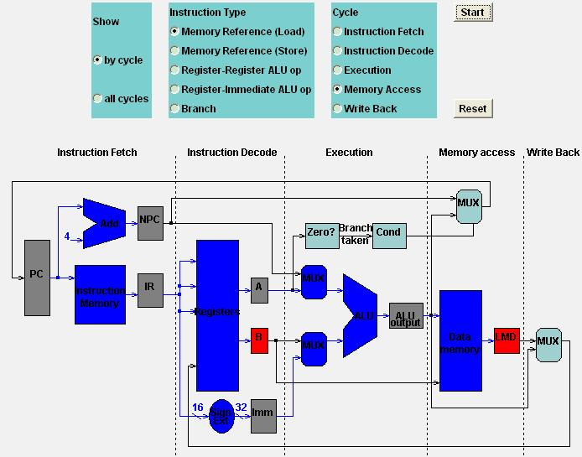
Load
Load: MEM

Slide 33
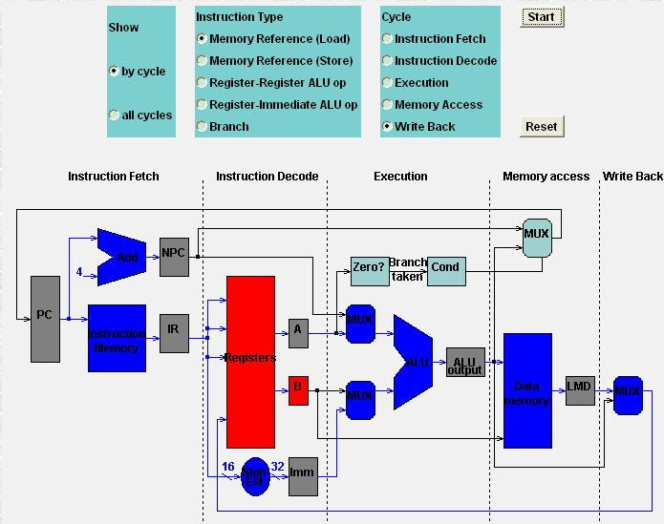
Load
Load: WB

Slide 34
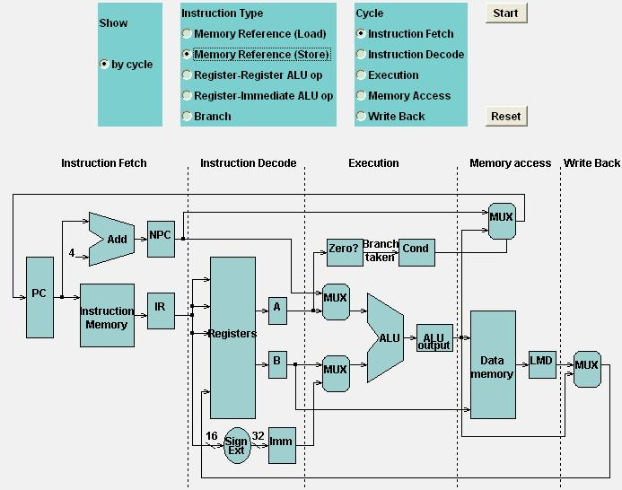
Store

Slide 35

Store
Store: IF

Slide 36
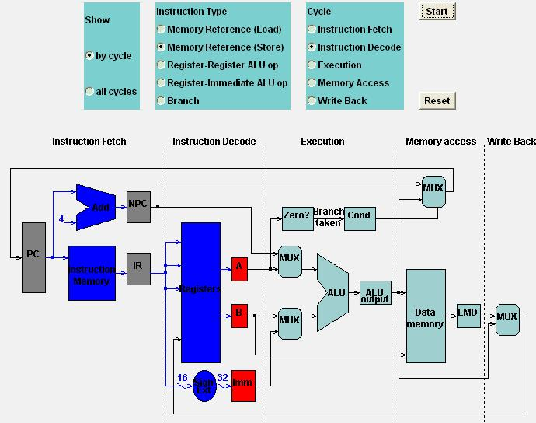
Store
Store: ID

Slide 37
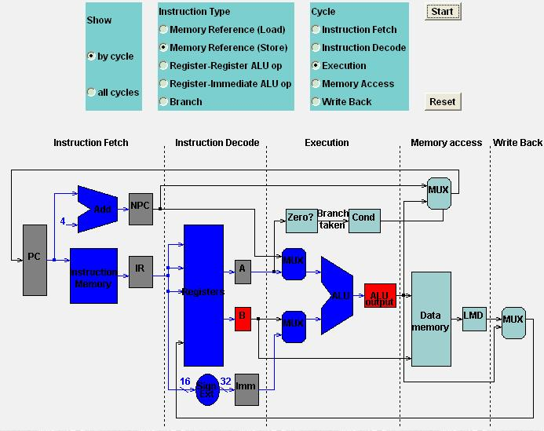
Store
Store: EX

Slide 38
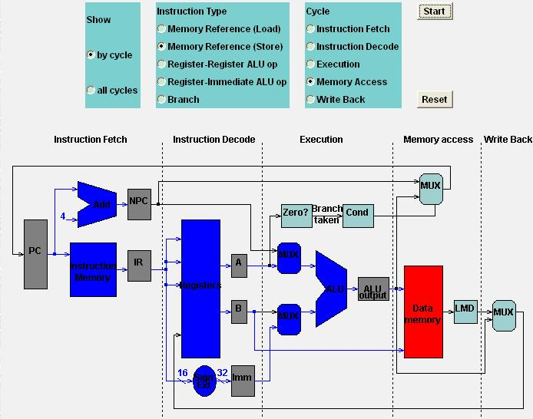
Store
Store: MEM

Slide 39

Store
Store: WB

Slide 40
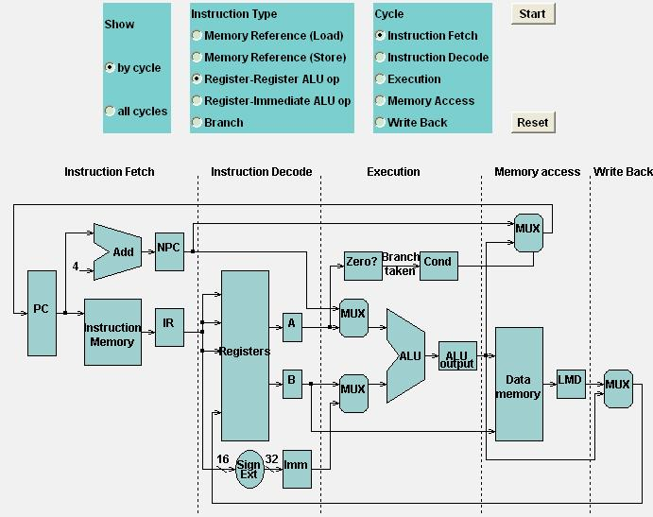
Register-Register ALU: MEM
IF

Slide 41
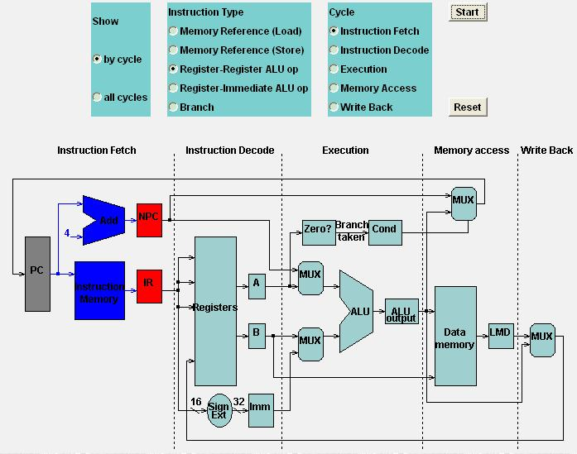
Register-Register ALU: MEM
IF

Slide 42

Register-Register ALU: MEM
ID

Slide 43
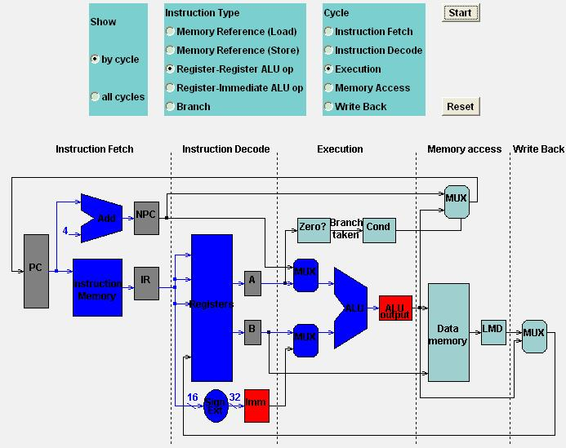
Register-Register ALU: MEM
EX

Slide 44
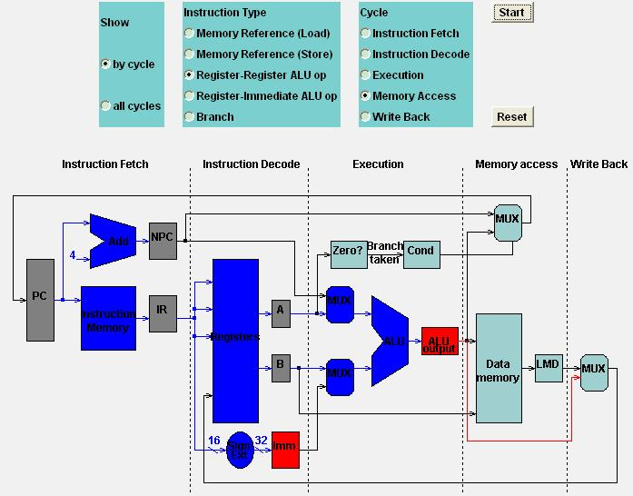
Register-Register ALU: MEM
MEM

Slide 45
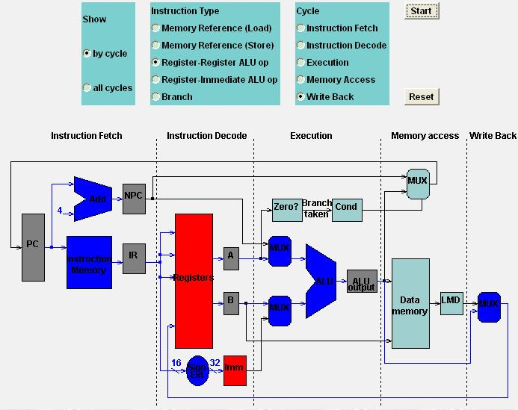
Register-Register ALU: MEM
WB

Slide 46
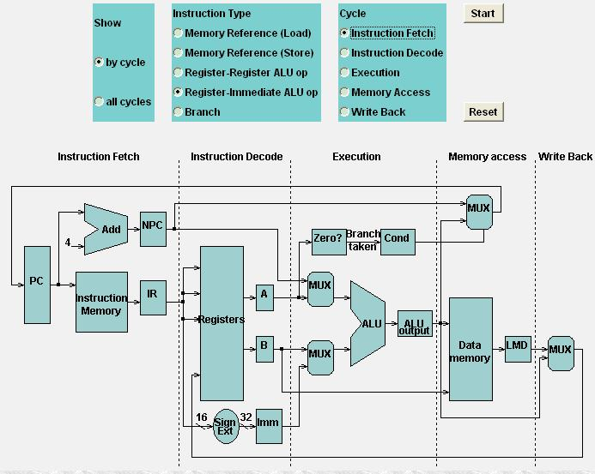
Register-Imm ALU: MEM
IFEM

Slide 47
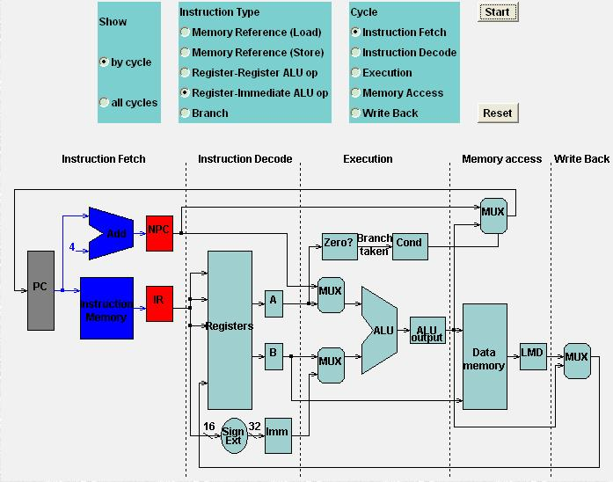
Register-Imm ALU: MEM
IFEM

Slide 48

Register-Imm ALU: MEM
IDEM

Slide 49
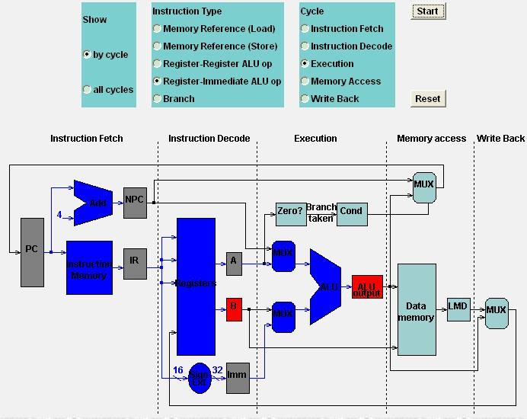
Register-Imm ALU: MEM
EXEM

Slide 50
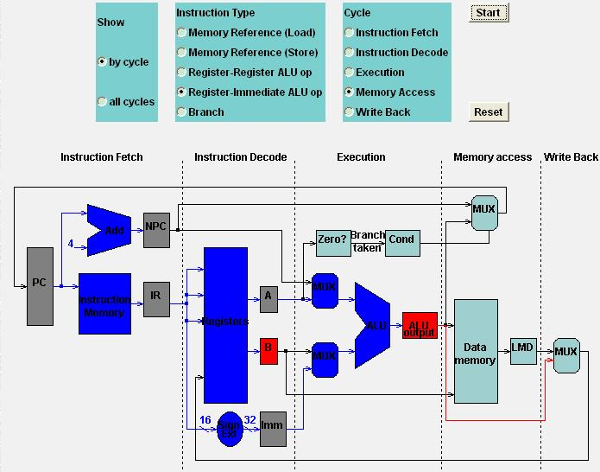
Register-Imm ALU: MEM
MEMEM

Slide 51
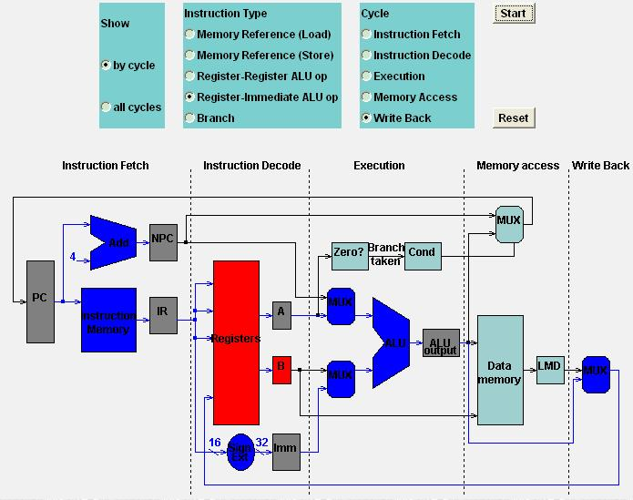
Register-Imm ALU: MEM
WBEM

Slide 52
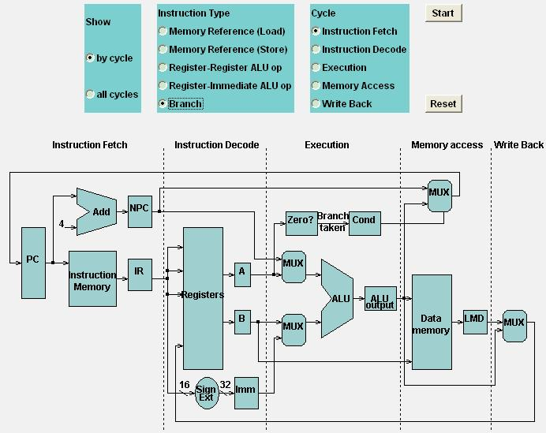
Branch: MEM
Branch: MEM

Slide 53

Branch: MEM
IFh: MEM

Slide 54
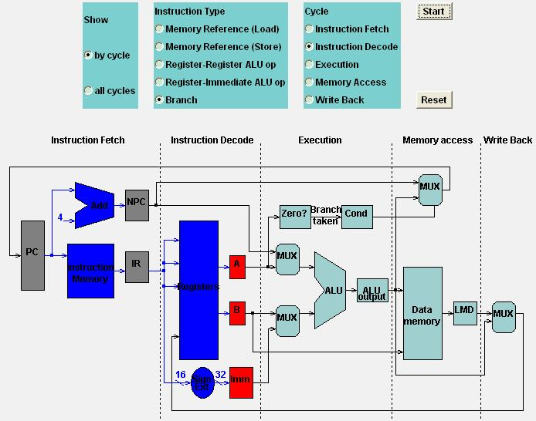
Branch: MEM
IDh: MEM

Slide 55
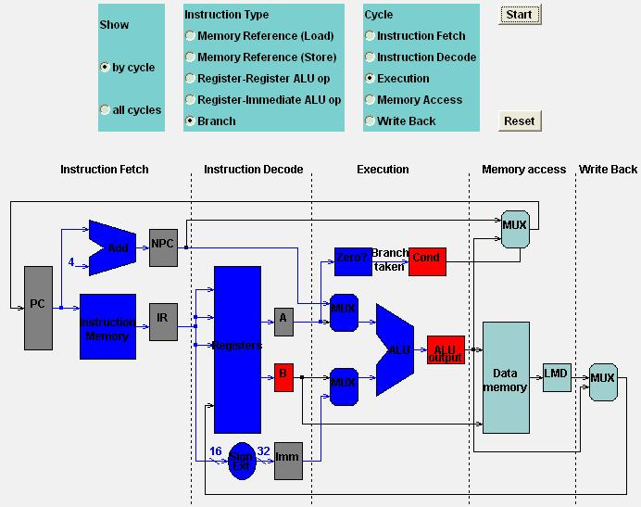
Branch: MEM
EXh: MEM

Slide 56
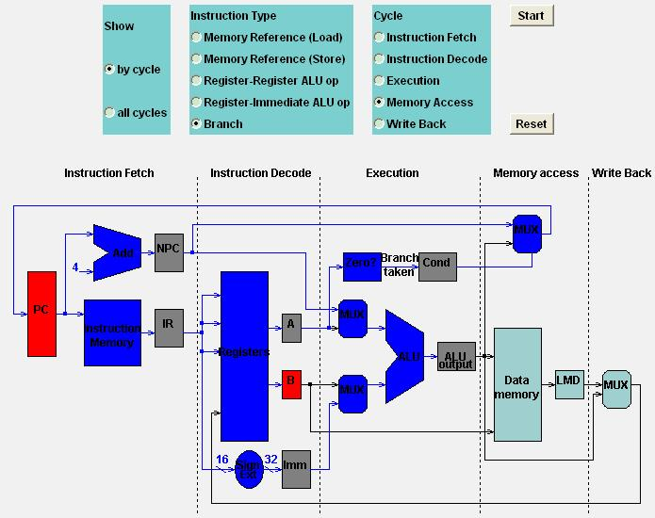
Branch: MEM
MEMh: MEM

Slide 57

Branch: MEM
WBh: MEM

Slide 58
This chapter is
about pipelining, right?
Notes:
But most of our discussions so far go to how an individual instruction works

Slide 59
How MIPS instructions pipeline?

Slide 60
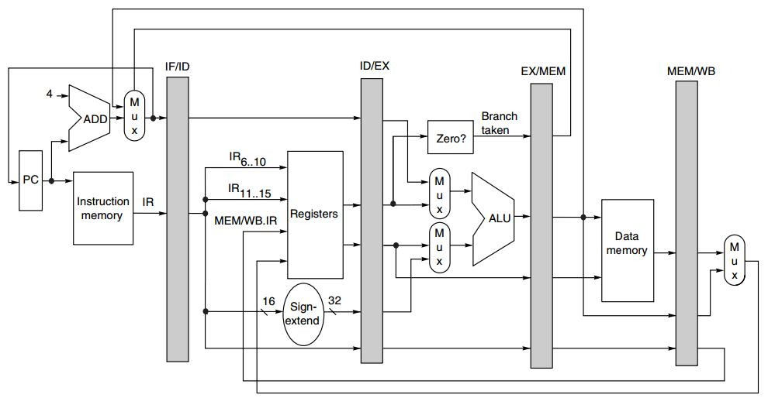
Pipelined MIPS
Pipeline
Registers/Latches
NPC
IR
A
B
IMM
Cond
ALUOutput
LMD
Notes:
One necessary modification to data path is introducing pipeline registers, connecting consecutive pipeline stages.
The actions on each pipeline stage is decided

Slide 61
Instruction Type decides
actions on a pipeline stage
Notes:
By the instruction type

Slide 62
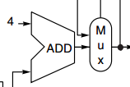
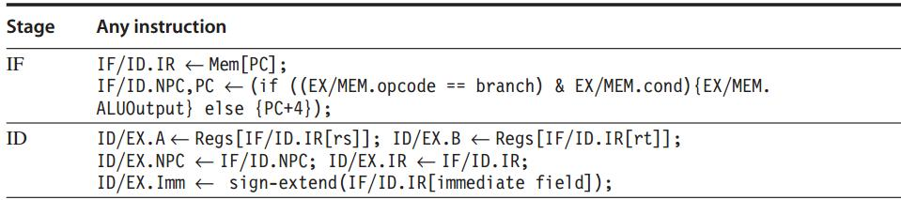
Pipelined MIPS: IF, ID
The first two stages are independent of instruction type because
the instruction is not decoded until the end of ID;
PC update

Slide 63
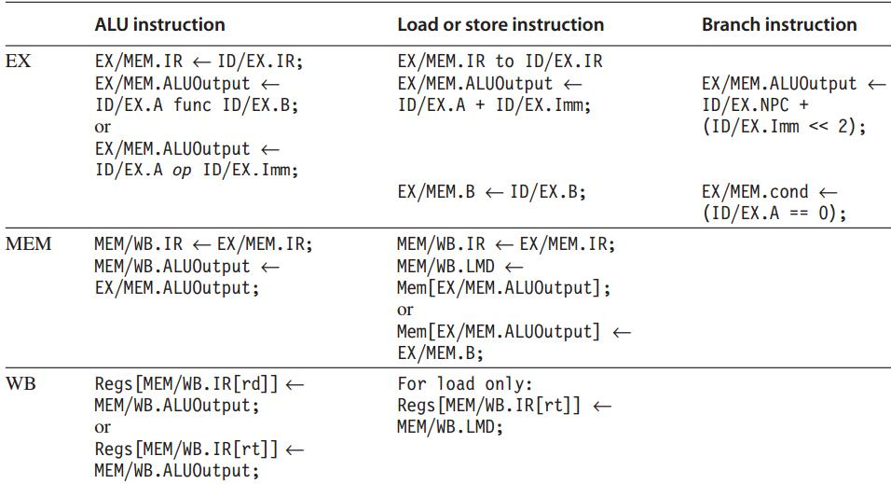
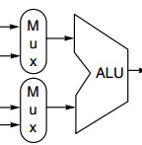

Pipelined MIPS: EX, MEM, WB
Any value needed on a later pipeline stage must be placed in a pipeline register,
and copied from one pipeline register to the next,
until it is no longer needed.

Slide 64
Data Hazard
Instruction Issue: ID -> EX
If a data hazard exists, the instruction is stalled before it is issued.
For integer pipeline, data hazards and forwarding can be checked during ID
Detect hazards by comparing the destination and sources of adjacent instructions

Slide 65
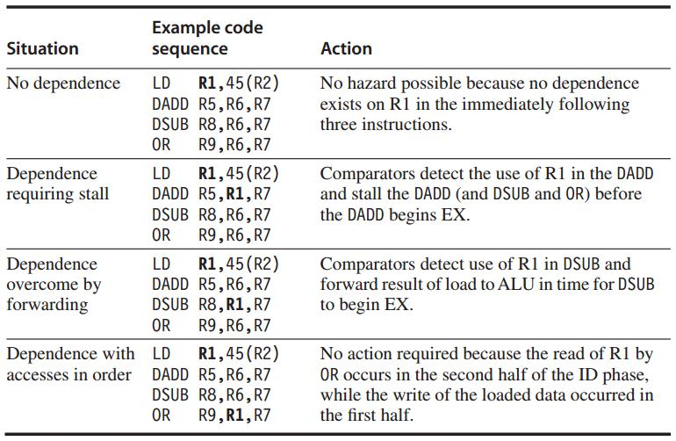
Data Hazard Example
Data hazards from Load
Comparison between the destination of Load
and the sources on the following two instr

Slide 66
Stall
Prevent instructions in IF and ID from advancing
Change the control portion of ID/EX to be a no-op
Recirculate the contents of IF/ID registers to hold the stalled instr

Slide 67
Forwarding
Data path: from the ALU or data memory output to the ALU input, the data memory input, or the zero detection unit.
Compare the destination registers of EX/MEM.IR and MEM/WB.IR against the source registers of ID/EX.IR and EX/MEM.IR

Slide 68
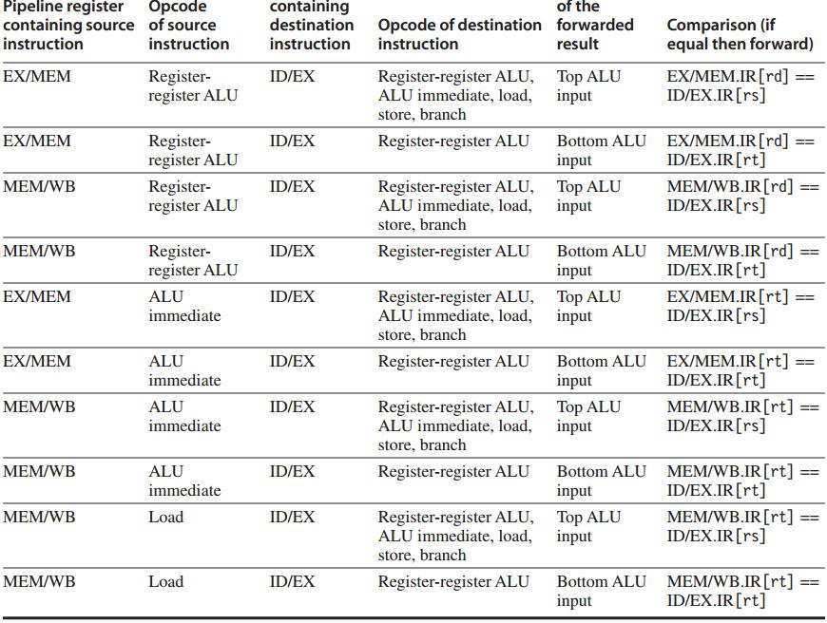
Example:
forwarding result is an ALU input

Slide 69
Forwarding: hw change
NextPC
ID/EX
EX/MEM
MEM/WR
Registers
mux
ALU
Data
Memory
mux
mux
Immediate
Source → sink
EX/Mem.ALUoutput → ALU input
MEM/WB.ALUoutput → ALU input
MEM/WB.LMD → ALU input

Slide 70
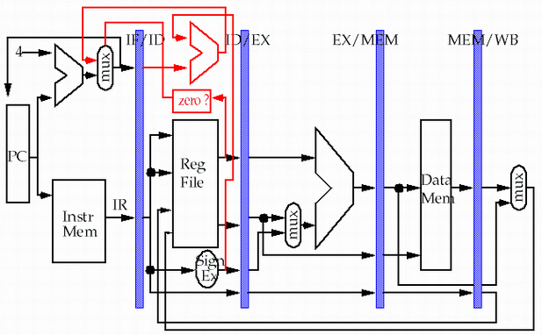
Forwarding: hw change
store
load
MEM/WB.LMD → DM input

Slide 71
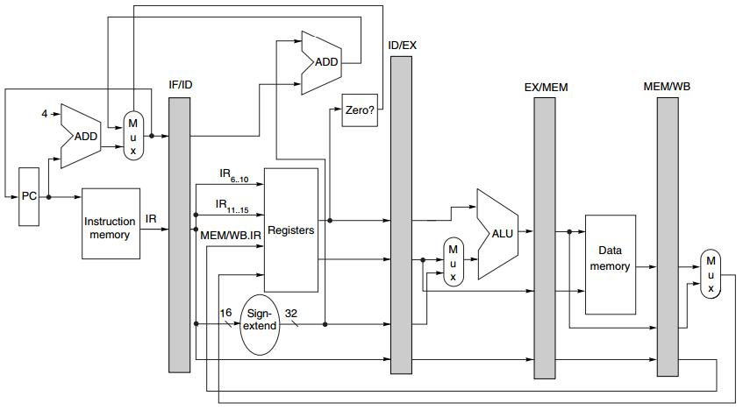
Branch
Move zero test to the ID stage
with an additional ADDer computing target address

Slide 72
… You know there’re exceptions.

Slide 73
Exceptions: Instruction Execution Order
aka interrupt/fault
When the normal execution order of instruction is changed
May force CPU to abort the instructions in the pipeline before they complete

Slide 74
Exceptions
Type
I/O device request
invoking os service from user program
tracing instruction execution
breakpoint
integer arithmetic overflow
FP arithmetic anomaly
page fault
misaligned memory address
memory protection violation
using undefined/unimplemented instruction
hardware malfunctions
power failure

Slide 75
Exceptions: Requirements
Synchronous vs Asynchronous
User requested vs Coerced
User maskable vs User nonmaskable
Within vs Between instructions
Resume vs Terminate

Slide 76
Sync vs Asynch
Synchronous
event occurs at the same place every time the program is executed with the same data and memory allocation
Asynchronous
caused by devices external to the CPU and memory

Slide 77
User requested vs Coerced
User requested
the user task directly asks for it
Coerced
caused by some hardware event that is not under the control of the user program

Slide 78
User non/maskable
User maskable
an event can be masked or disabled by a user task

Slide 79
Within vs Between instr
Whether the event prevents intruction completion by occurring in the middle of execution (within) or is recognized between instructions

Slide 80
Resume vs Terminate
Resume
the program’s execution continues after the interrupt
Terminate
the program’s execution always stops after the interrupt

Slide 81
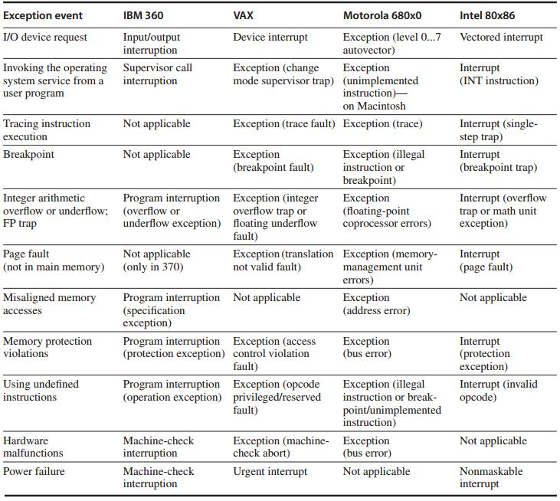
names of common exceptions
across four different architectures

Slide 82
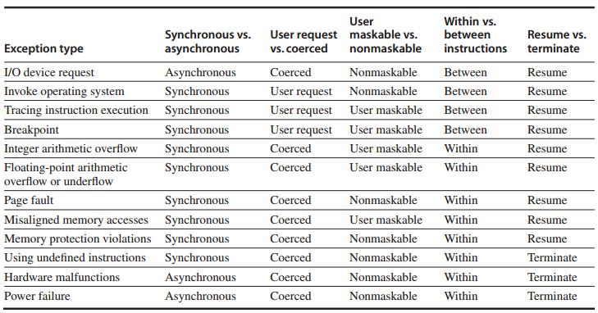
Exception Category

Slide 83
Instruction Set Complications
Instruction set specific factors that make pipelining harder to implement
PP. C-49 – C.51

Slide 84
?

Slide 85
#What’s More
How to Write a Great Research Paper
by Simon Peyton Jones
How to Give a Great Research Talk
by Simon Peyton Jones

