Slide 1
Lecture 07: Pipelining
Multicycle, MIPS R4000, and More
Kai Bu
kaibu@zju.edu.cn
http://list.zju.edu.cn/kaibu/comparch2016fall

Slide 2
Lab 2 Demo due November 06
Report due November 17
Final Exam: 2017.01.15
14:00 – 16:00

Slide 3
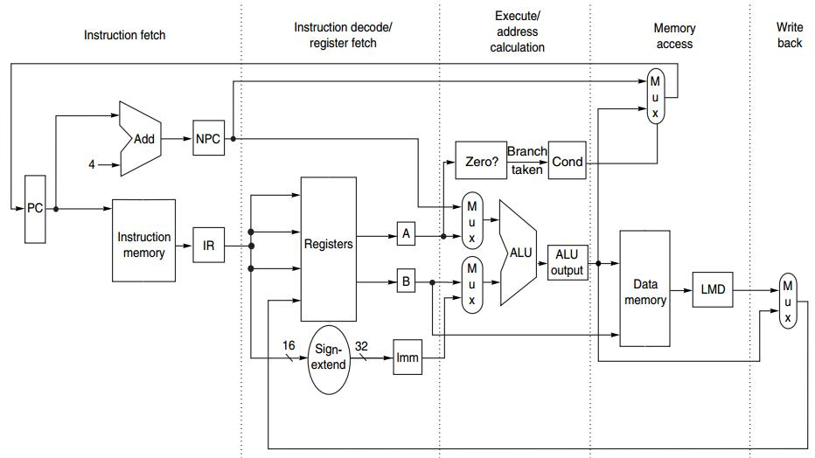
Integer Op in 1 CC
IF ID EX MEM WB

Slide 4
What about
floating-point operation?

Slide 5
FP Operation
Floating-point (FP) operations take more time than integer operations do
To complete an FP op in 1 cc:
a slow clock?
many logic in FP units?

Slide 6
Multicycle FP Operation
FP pipeline
allow for a longer latency for op;
two changes over integer pipeline:
repeat EX;
use multiple FP functional units;

Slide 7
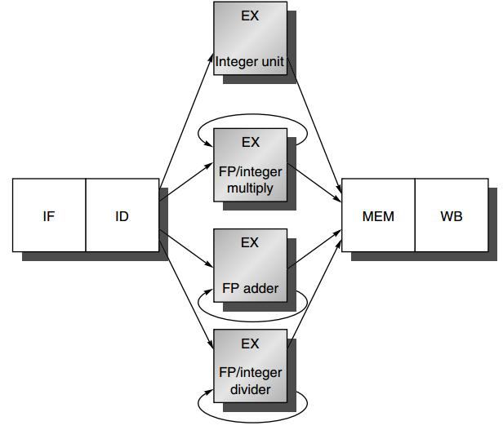
FP Pipeline

Slide 8
Preview
Multicycle FP Operations
Hazards and Forwarding
Example: MIPS R4000 Pipeline

Slide 9

Appendix C.5-C.7

Slide 10
How FP operations pipeline?

Slide 11
FP Pipeline
loads and stores
integer ALU operations
branches
use multiple FP units
FP and integer multiplier
repeat EX
FP add
FP subtract
FP conversion
FP and integer divider

Slide 12
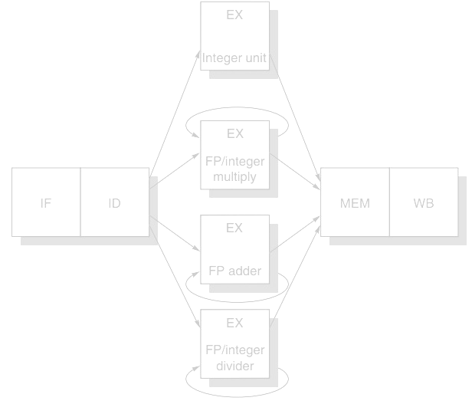
FP Pipeline
EX is not pipelined
Until the previous instruction leaves EX, no other instruction using that functional unit may issue
If an instruction cannot proceed to EX, the entire pipeline
behind that instruction will be stalled

Slide 13
Latency & Ini/Repeat Interval
Latency
the number of intervening cycles between an instruction that produces a result and an instruction that uses the result
Initiation/Repeat Interval
the number of cycles that must elapse between issuing two operations of a given type

Slide 14
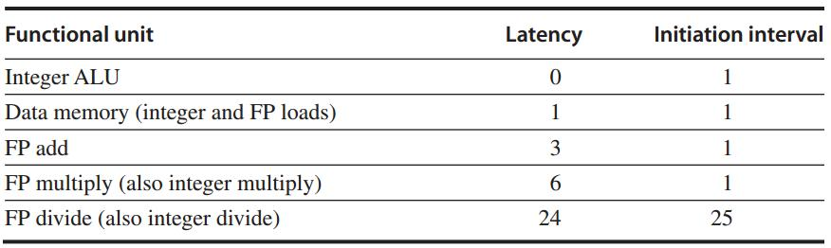
Latency & Ini/Repeat Interval
Essentially, pipeline latency is
1 cycle less than
the depth of the execution pipeline,
which is the number of stages from the
EX stage to the stage that produces the result

Slide 15
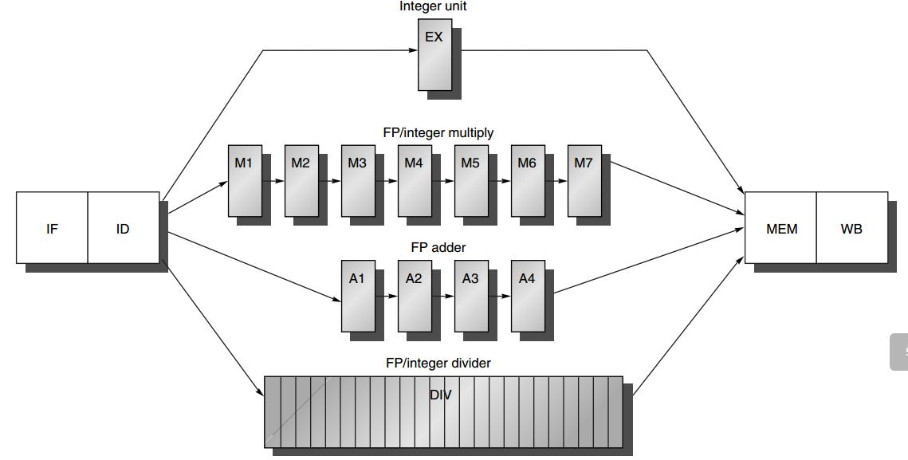
Generalized FP Pipeline
EX is pipelined (except for FP divider)
Additional pipeline registers
e.g., ID/A1
FP divider: 24 CCs

Slide 16
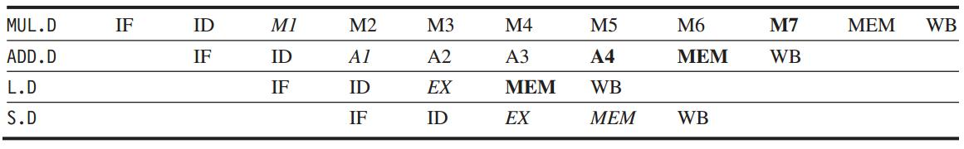
Generalized FP Pipeline
Example
italics: stage where data is needed
bold: stage where a result is available

Slide 17
Generalized FP Pipeline
Example
italics: stage where data is needed
bold: stage where a result is available
Intervening cycles

Slide 18
Any FP pipeline hazards?

Slide 19
Structural Hazard
Divider is not fully pipelined – structural hazard

Slide 20
Structural Hazard
Instructions have varying running times, maybe >1 register write in a cycle
- structural hazard

Slide 21
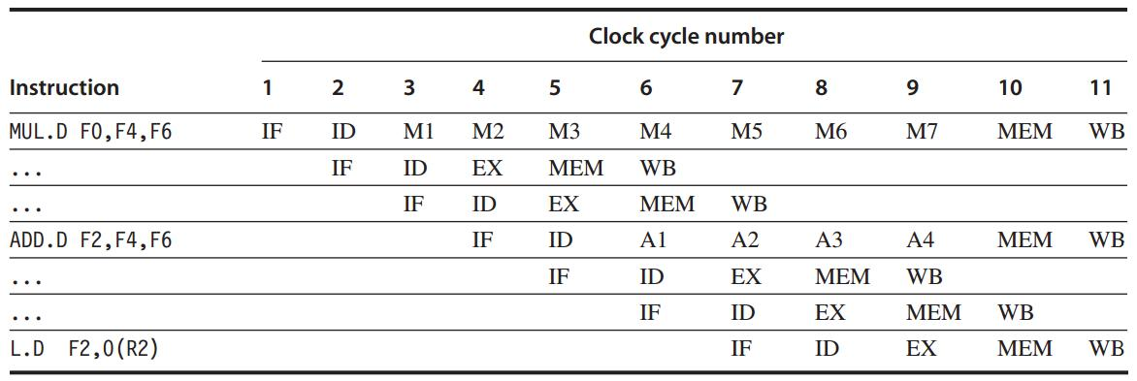
Structural Hazards

Slide 22
Structural Hazards
Interlock Detection
Method 1: track the use of the write port in the ID stage and stall an instruction before it issues
::a shift register tracks when already-issued instructions will use the register file;
if the instruction in ID needs to use the register file at the same time, stall

Slide 23
Structural Hazards
Interlock Detection
Method 2: stall a conflicting instruction when it tries to enter MEM/WB
::could stall either issuing or issued one;
give priority to the unit with the longest latency;
more complicated: stall arises from MEM/WB

Slide 24
WAW Hazard
Instructions no longer reach WB in order
– Write after write (WAW) hazard

Slide 25
WAW Hazards
If L.D were issued one cycle earlier
L.D would write F2 one cycle earlier than ADD.D – WAW hazard
what if another instruction using F2 between them? --- No WAW

Slide 26
RAW Hazard
Longer latency of operations
– more frequent stalls for
read after write (RAW) hazards

Slide 27
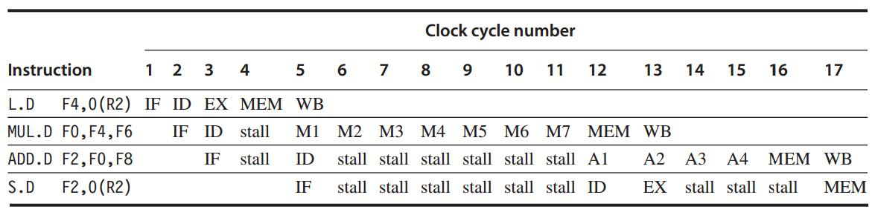
RAW Hazards

Slide 28
Hazard: Exceptions
Instructions may complete in a different order than they were issued – exceptions

Slide 29
How to detect and solve
pipeline hazards?

Slide 30
Hazard Detection in ID
1. Check for structural hazards
wait until the required functional unit is not busy (only for divides);
make sure the register write port is available when it will be needed;

Slide 31
Hazard Detection in ID
2. Check for RAW data hazards
wait until source registers are available when needed --- when they are not pending destinations of issued instructions

Slide 32
Hazard Detection in ID
3. Check for WAW data hazards
determine if any instruction in A1 – A4, D, M1-M7 has the same register destination as this instruction;
if so, stall the issue of the instr in ID

Slide 33
Forwarding
Generalized with more sources
EX/MEM, A4/MEM, M7/MEM, D/MEM, MEM/WB
-> source registers of an FP instruction

Slide 34

Out-of-order Completion
ADD and SUB complete before DIV
Out-of-order completion: instructions are completing in a different order than they were issued

Slide 35
Out-of-order Completion
How to deal with out-of-order?
1. ignore the problem
2. buffer the results of an operation until all the operations issued earlier complete
3. tracking what operations were in the pipeline and their PCs
4. issue an instruction only if it is certain that all previous instructions will complete without exception

Slide 36
All in MIPS R4000

Slide 37
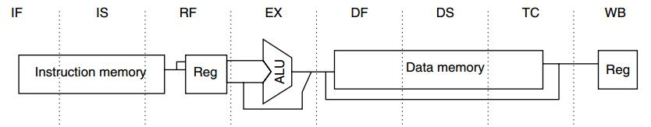
MIPS R4000:
5-stage -> 8-stage
Higher clock rate

Slide 38
MIPS R4000:
IF
IF: first half of instruction fetch;
PC selection;
initiation of instruction cache access;

Slide 39
MIPS R4000:
IS
IS: second half of instruction fetch;
completion of instruction cache access;

Slide 40
MIPS R4000:
RF
RF:
instruction decode and register fetch;
hazard checking;
instruction cache hit detection;

Slide 41
MIPS R4000:
EX
EX: execution
effective address calculation;
ALU operation;
branch-target computation and condition evaluation;

Slide 42
MIPS R4000:
DF
DF: data fetch
first half of data access;

Slide 43
MIPS R4000:
DS
DS: second half of data fetch
completion of data cache access;

Slide 44
MIPS R4000:
TC
TC: tag check
determine whether the data cache access hit;

Slide 45
MIPS R4000:
WB
WB: write back
for loads and register-register operations;

Slide 46
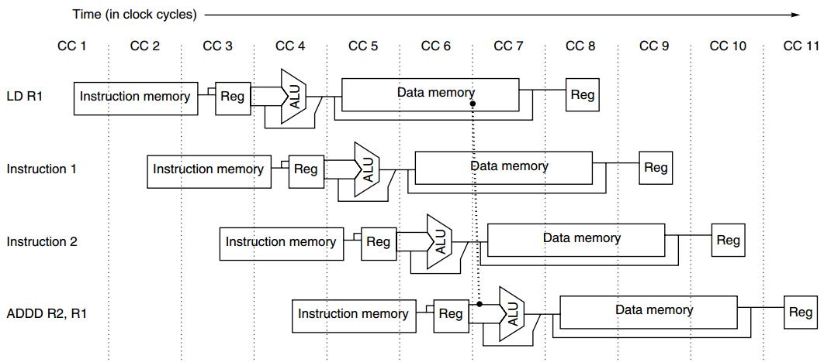
Load Delay
2-cycle load delay

Slide 47
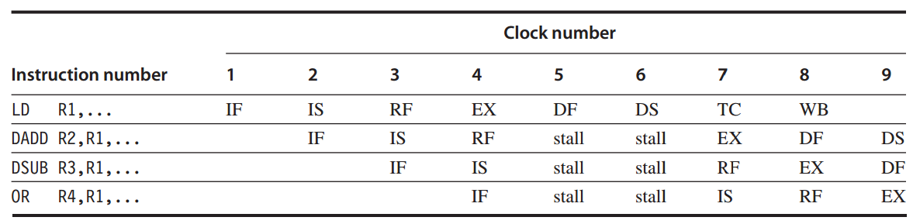
Load Delay
2-cycle load delay

Slide 48
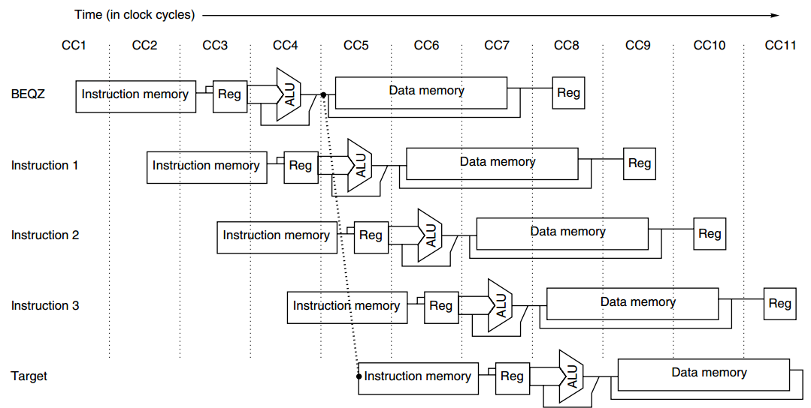
Branch Delay
3-cycle branch delay:
predicted-not-taken

Slide 49
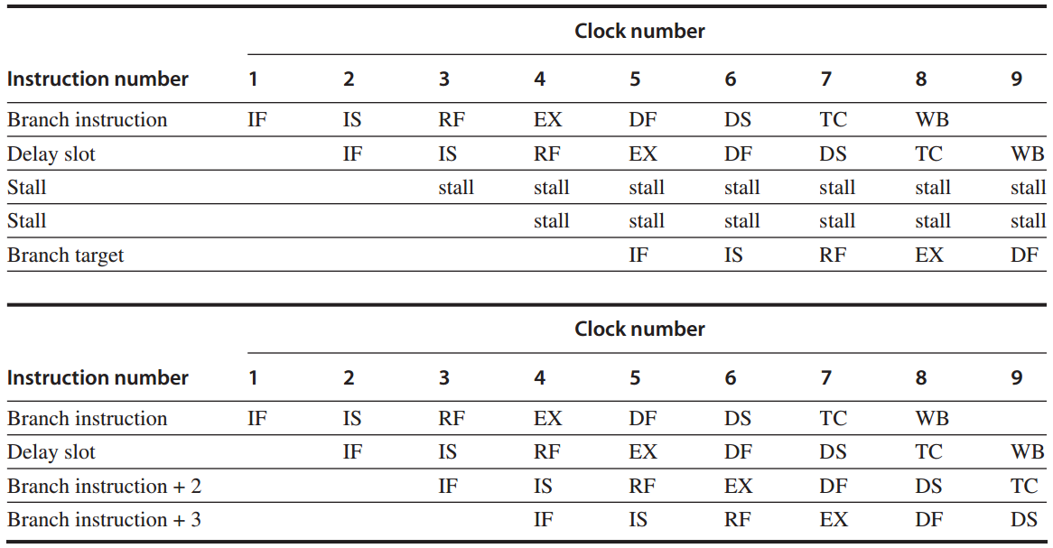
Branch Delay
3-cycle branch delay:
predicted-not-taken
taken branch
untaken branch

Slide 50
Forwarding
Forwarding
ALU/MEM or MEM/WB
-> EX/DF, DF/DS, DS/TC, TC/WB

Slide 51
FP Operations
FP Pipeline
FP unit with three functional units:
FP divider, FP multiplier, FP adder
2 cycles to 112 cycles

Slide 52
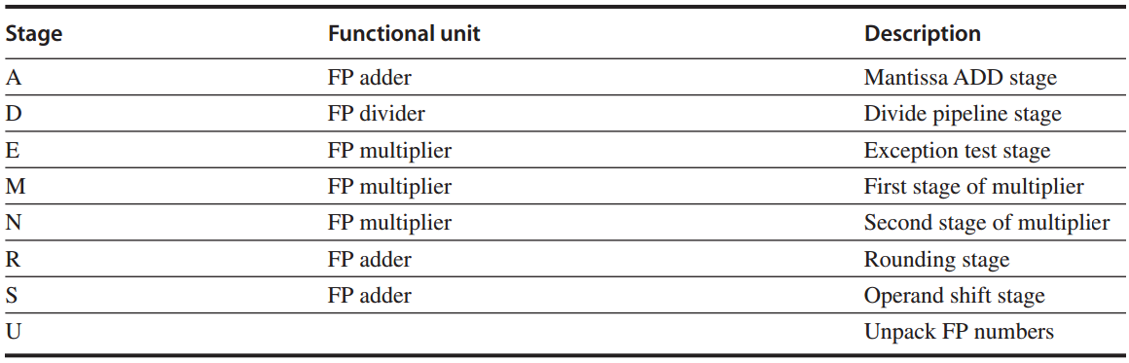
Stage vs FP Unit
FP unit with eight different stages

Slide 53
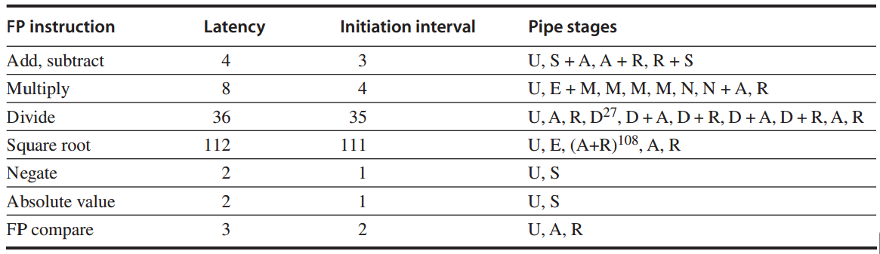
Latency & Ini Interval
FP operations: latency and initiation interval

Slide 54
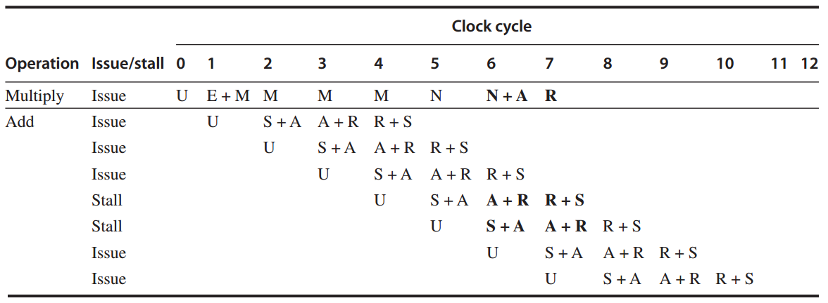
FP Ops: Example 1
FP multiply + FP add

Slide 55
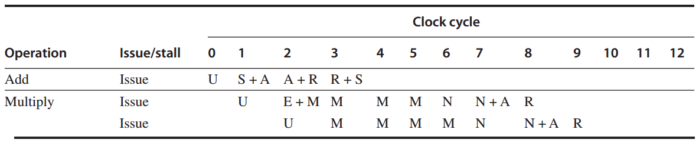
FP Ops: Example 2
FP add + FP multiply

Slide 56
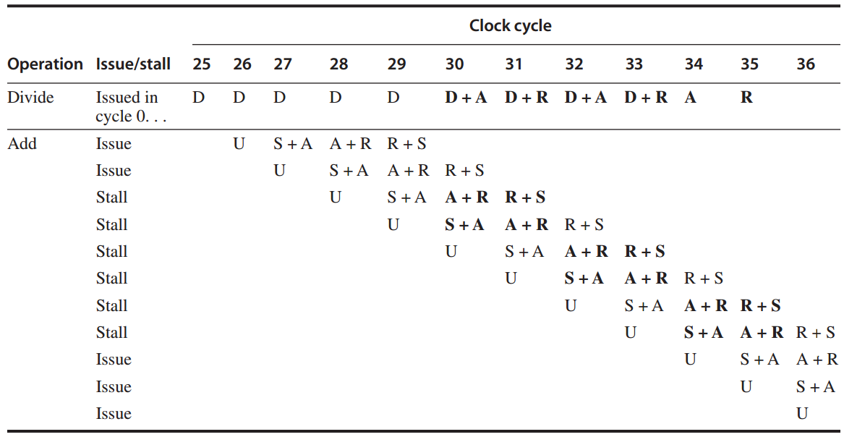
FP Ops: Example 3
divide + add

Slide 57
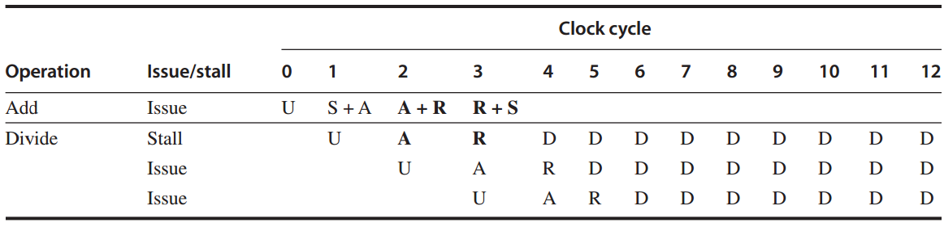
FP Ops: Example 4
FP add + FP divide

Slide 58
?

Slide 59
#What’s More
What Matters More than Your Talents? by Jeff Bezos
The Power of Vulnerability
by Brené Brown

