Slide 1
Pipelining:
Basics & Hazards
05
Kai Bu
kaibu@zju.edu.cn
http://list.zju.edu.cn/kaibu/comparch2017
Notes:
In today’s lecture, we’re going to discuss pipelining, which is a fundamental technique for supporting faster computers.
It’s also one of the major teaching components of this course, and there’ll be many questions regarding pipelining in final exam.

Slide 2
Pipelining?
Basics & Hazards
Notes:
So, what is pipelining?

Slide 3
Pipelining? you already knew!
Notes:
Although it might be the first time you’ve ever heard of this concept,
You’ve already known many of its examples in daily lives.

Slide 4
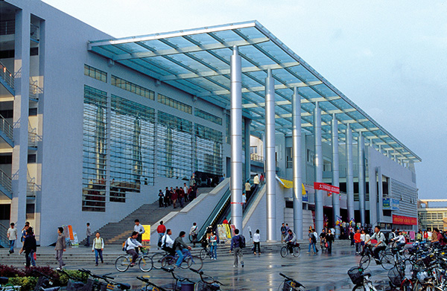
Cafeteria:
kinda miss zjg?
Notes:
Which cafeteria did you go for lunch today?
Did u wait until all other students before you finish?
Apparently not; after we enter the cafeteria,

Slide 5
Cafeteria:
Did you wait until all others finish?
kinda miss zjg?
Notes:
Did u wait until all other students before you finish?
Apparently not; after we enter the cafeteria,

Slide 6

Cafeteria:
Order
Notes:
Queue, to order first

Slide 7

Cafeteria:
Pay
Notes:
Pay for what u order

Slide 8

Cafeteria:
Enjoy
Notes:
Then find a table, start enjoying the meal with your classmates

Slide 9
Cafeteria:
Enjoy
while some others are
Ordering or Paying
Notes:
While some other students are still ordering and paying.

Slide 10
Cafeteria:
Observations?
Notes:
From this cafeteria example, what do you observe?

Slide 11
Cafeteria:
Observations?
besides eating…
Ordering or Paying

Slide 12
Cafeteria:
Observations?
co-use dependent function areas
speed up the dining process of all
Notes:
Divide the dining process (of each student) into sub-processes;
For each sub-process, allocate dependent function areas;
These function areas can be co-used – by different students;
Speed up the dining process of all students;

Slide 13
Cafeteria:
Observations?
individual perspective?
speed up the dining process of all
order
pay
enjoy
Notes:
Observations from individual perspective
That is, as a student, how this sharing fashion affects you, do you take shorter time or longer time to finish lunch?

Slide 14
Cafeteria:
Observations?
individual perspective?
speed up the dining process of all
fastest if only one to server
order
pay
enjoy
Notes:
Apparently, if you are the only one to serve
You can take the shortest time to finish, as at each step, you don’t need to wait for any one;

Slide 15

Cafeteria:
Observations?
individual perspective?
speed up the
fastest if only one to server
order
pay
enjoy
…… a potentially very, very long queue
Notes:
Apparently, if you are the only one to serve
You can take the shortest time to finish, as at each step, you don’t need to wait for any one;

Slide 16

Cafeteria:
Observations?
individual perspective?
fastest if only one to server
order
pay
enjoy
…… a potentially very, very long queue
Notes:
Apparently, if you are the only one to serve
You can take the shortest time to finish, as at each step, you don’t need to wait for any one;

Slide 17
Cafeteria:
Observations
Average - faster
Individual – slower (service time)
but much less time in queue
Individual – faster: queue + service

Slide 18
(classic) laundry example
Notes:
The laundry example is a classic one for us to kick off the discussion of pipelining,
although it’s more applicable to western universities,

Slide 19
Laundry Example
Ann, Brian, Cathy, Dave
Each has one load of clothes to
wash, dry, fold.
washer
30 mins
dryer
40 mins
folder
20 mins
Notes:
Say four students each with a load of clothes to wash, dry, and fold.
The washer takes 30 mins, dryer 40 mins, and folder 20 mins.

Slide 20
Sequential Laundry
6 Hours
Time
30 40 20
30 40 20
30 40 20
30 40 20
A
Task Order
B
C
D
What would you do?
Notes:
When they do the laundry in a sequential fashion, A does the laundry first, and only after A completes can B start. Similarly, C after B, and D after C.
Obviously, in this case, the sequential laundry will take up to 6 hours.
But the question is, would you do it like this in real life? Actually, after A uses the washer, B can immediately start washing without further waiting.

Slide 21
Sequential Laundry
6 Hours
Time
30 40 20
30 40 20
30 40 20
30 40 20
A
Task Order
B
C
D
What would you do?
Notes:
And then B can start drying after A finishes drying, and start folding after A finishes folding.

Slide 22
Pipelined Laundry
3.5 Hours
Time
30 40 40
40 40 20
A
Task Order
B
C
D
Notes:
Following this way, the laundry task execution will look like this. We call such laundry execution pipelined laundry, in which a laundry task can start before previous one completes.
The pipelined laundry takes only 3 and a half hours, which is much shorter than 6 hours taken by the sequential laundry.
Before we delve into the definition of pipelining in computer architecture, let’s see what observations we can get from this pipelined laundry example.
First, a task has a series of stages. For example, a laundry task here has three stages, washing, drying, and folding.
Second, connecting stages have dependency upon each other. For example, you need to wash clothes before you dry them.
When there are multiple tasks to run, simultaneously using different resources can accelerate the execution.
A deeper observation is that the slowest stage determines the finish time. In this example, the dryer takes the longest time of 40 mins. And it’s obvious that the dryer decides when the last task will finish.

Slide 23
Pipelined Laundry
3.5 Hours
Observations
A task has a series of stages;
Time
30 40 40
40 40 20
A
Task Order
B
C
D
Notes:
Following this way, the laundry task execution will look like this. We call such laundry execution pipelined laundry, in which a laundry task can start before previous one completes.
The pipelined laundry takes only 3 and a half hours, which is much shorter than 6 hours taken by the sequential laundry.
Before we delve into the definition of pipelining in computer architecture, let’s see what observations we can get from this pipelined laundry example.
First, a task has a series of stages. For example, a laundry task has three stages, washing, drying, and folding.
Second, connecting stages have dependency upon each other. For example, you need to wash clothes before you dry them.
When there are multiple tasks to run, simultaneously using different resources can accelerate the execution.
A deeper observation is that the slowest stage determines the finish time. In this example, the dryer takes the longest time of 40 mins. And it’s obvious that the dryer decides when the last task will finish.

Slide 24
Pipelined Laundry
3.5 Hours
Observations
A task has a series of stages;
Stage dependency:
e.g., wash before dry;
Time
30 40 40
40 40 20
A
Task Order
B
C
D
Notes:
Following this way, the laundry task execution will look like this. We call such laundry execution pipelined laundry, in which a laundry task can start before previous one completes.
The pipelined laundry takes only 3 and a half hours, which is much shorter than 6 hours taken by the sequential laundry.
Before we delve into the definition of pipelining in computer architecture, let’s see what observations we can get from this pipelined laundry example.
First, a task has a series of stages. For example, a laundry task has three stages, washing, drying, and folding.
Second, connecting stages have dependency upon each other. For example, you need to wash clothes before you dry them.
When there are multiple tasks to run, simultaneously using different resources can accelerate the execution.
A deeper observation is that the slowest stage determines the finish time. In this example, the dryer takes the longest time of 40 mins. And it’s obvious that the dryer decides when the last task will finish.

Slide 25
Pipelined Laundry
3.5 Hours
Observations
A task has a series of stages;
Stage dependency:
e.g., wash before dry;
Multi tasks with overlapping stages;
Time
30 40 40
40 40 20
A
Task Order
B
C
D
Notes:
When there are multiple tasks to run, simultaneously using different resources can accelerate the execution.
A deeper observation is that the slowest stage determines the finish time. In this example, the dryer takes the longest time of 40 mins. And it’s obvious that the dryer decides when the last task will finish.

Slide 26
Pipelined Laundry
3.5 Hours
Observations
A task has a series of stages;
Stage dependency:
e.g., wash before dry;
Multi tasks with overlapping stages;
Simultaneously use diff resources to speed up;
Time
30 40 40
40 40 20
A
Task Order
B
C
D
Notes:
Following this way, the laundry task execution will look like this. We call such laundry execution pipelined laundry, in which a laundry task can start before previous one completes.
The pipelined laundry takes only 3 and a half hours, which is much shorter than 6 hours taken by the sequential laundry.
Before we delve into the definition of pipelining in computer architecture, let’s see what observations we can get from this pipelined laundry example.
First, a task has a series of stages. For example, a laundry task has three stages, washing, drying, and folding.
Second, connecting stages have dependency upon each other. For example, you need to wash clothes before you dry them.
When there are multiple tasks to run, simultaneously using different resources can accelerate the execution.
A deeper observation is that the slowest stage determines the finish time. In this example, the dryer takes the longest time of 40 mins. And it’s obvious that the dryer decides when the last task will finish.

Slide 27
Pipelined Laundry
3.5 Hours
Observations
A task has a series of stages;
Stage dependency:
e.g., wash before dry;
Multi tasks with overlapping stages;
Simultaneously use diff resources to speed up;
Slowest stage determines the finish time;
Time
30 40 40
40 40 20
A
Task Order
B
C
D
Notes:
A deeper observation is that the slowest stage determines the finish time. In this example, the dryer takes the longest time of 40 mins. And it’s obvious that the dryer decides when the last task will finish.

Slide 28
Pipelined Laundry
3.5 Hours
Observations
No speed up for individual task;
e.g., A still takes 30+40+20=90
Time
30 40 40
40 40 20
A
Task Order
B
C
D
Notes:
Another important observation is that an individual task doesn’t become faster. For example. A still takes 90 mins for laundry.
On the contrary, it’s the average task execution time that becomes much shorter. In this case, four tasks take 3 and a half hours, with each taking about 52 mins, which is much shorter than the original 90 mins.

Slide 29
Pipelined Laundry
3.5 Hours
Observations
No speed up for individual task;
e.g., A still takes 30+40+20=90
But speed up for average task execution time;
e.g., 3.5*60/4=52.5 < 30+40+20=90
Time
30 40 40
40 40 20
A
Task Order
B
C
D
Notes:
Another important observation is that an individual task doesn’t become faster. For example. A still takes 90 mins for laundry.
On the contrary, it’s the average task execution time that becomes much shorter. In this case, four tasks take 3 and a half hours, with each taking about 52 mins, which is much shorter than the original 90 mins.

Slide 30
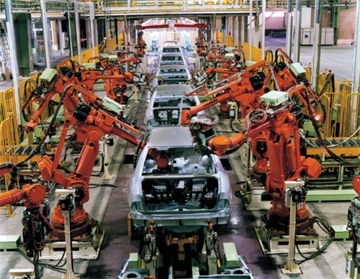
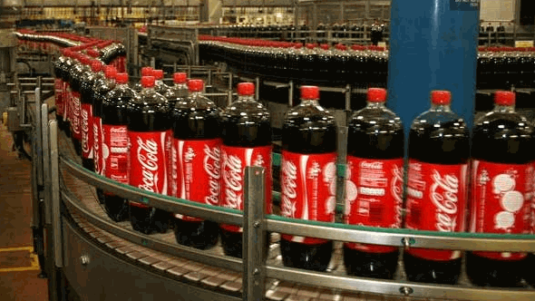
Pipeline Elsewhere:
Assembly Line
Cola
Auto
Notes:
Another example analogous to pipelining is assembly line where many products can be assembled at the same time.

Slide 31
What exactly is pipelining
in computer arch?
Notes:
Now, with these background, we can officially proceed to the principles of pipelining in computer world.

Slide 32
Pipelining
An implementation technique whereby multiple instructions are overlapped in execution.
e.g., B wash while A dry
Essence: Start executing one instruction before completing the previous one.
Significance: Make fast CPUs.
A
B
Notes:
Pipelining is an implementation technique whereby multiple instructions are overlapped in execution. Take the pipelined laundry for example. B uses the washer while A uses the dryer.
Its essence is to start executing one instruction before completing the previous one. And its significance is therefore to make fast CPUs.

Slide 33
(ideal) Balanced Pipeline
Equal-length pipe stages
e.g., Wash, dry, fold = 40 mins
per unpipelined laundry time = 40x3 mins
3 pipe stages – wash, dry, fold
40min
T1
A
T2
B
A
T3
C
B
A
T4
D
C
B
Notes:
The ideal case for pipelining is balanced pipeline. In a balanced pipeline, all pipe stages have equal duration.
Consider again the laundry example with each stage taking 40 mins. Then the unpipelined laundry will take 40 times 3 mins to finish one task.
Now let’s recap how pipelined laundry will perform the four tasks.
In the first time duration T1, A uses the washer; In T2, A uses the dryer while B uses the washer; In T3, A uses the folder, B uses the dryer, while C uses the washer. Starting from T3, all resources are fully used in the same duration. Then the pipelined laundry takes 40 mins on average to complete one task. Based on this observation, we have two performance properties of balanced pipeline. One is the time per instruction by pipeline is equal to time per instruction on unpipelined machine over the number of pipe stages. The other is speed up by pipeline is equal to the number of pipe stages.

Slide 34
Balanced Pipeline
Equal-length pipe stages
e.g., Wash, dry, fold = 40 mins
per unpipelined laundry time = 40x3 mins
3 pipe stages – wash, dry, fold
40min
T1
A
T2
B
A
T3
C
B
A
T4
D
C
B
Notes:
In the first time duration T1, A uses the washer;
In T2, A uses the dryer while B uses the washer; In T3, A uses the folder, B uses the dryer, while C uses the washer. Starting from T3, all resources are fully used in the same duration. Then the pipelined laundry takes 40 mins on average to complete one task. Based on this observation, we have two performance properties of balanced pipeline. One is the time per instruction by pipeline is equal to time per instruction on unpipelined machine over the number of pipe stages. The other is speed up by pipeline is equal to the number of pipe stages.

Slide 35
Balanced Pipeline
Equal-length pipe stages
e.g., Wash, dry, fold = 40 mins
per unpipelined laundry time = 40x3 mins
3 pipe stages – wash, dry, fold
40min
T1
A
T2
B
A
T3
C
B
A
T4
D
C
B
Notes:
In T2, A uses the dryer while B uses the washer;
In T3, A uses the folder, B uses the dryer, while C uses the washer. Starting from T3, all resources are fully used in the same duration. Then the pipelined laundry takes 40 mins on average to complete one task. Based on this observation, we have two performance properties of balanced pipeline. One is the time per instruction by pipeline is equal to time per instruction on unpipelined machine over the number of pipe stages. The other is speed up by pipeline is equal to the number of pipe stages.

Slide 36
Balanced Pipeline
One task/instruction
per 40 mins
Equal-length pipe stages
e.g., Wash, dry, fold = 40 mins
per unpipelined laundry time = 40x3 mins
3 pipe stages – wash, dry, fold
Performance
Time per instruction by pipeline =
Time per instr on unpipelined machine
Number of pipe stages
Speed up by pipeline =
Number of pipe stages
40min
T1
A
T2
B
A
T3
C
B
A
T4
D
C
B
Notes:
In T3, A uses the folder, B uses the dryer, while C uses the washer.
Starting from T3, all resources are fully used in the same duration. Then the pipelined laundry takes 40 mins on average to complete one task. Based on this observation, we have two performance properties of balanced pipeline. One is the time per instruction by pipeline is equal to time per instruction on unpipelined machine over the number of pipe stages. The other is speed up by pipeline is equal to the number of pipe stages.

Slide 37
Pipelining Terminology
Latency: the time for an instruction to complete.
Throughput of a CPU: the number of instructions completed per second.
Clock cycle: time duration of one lockstep
- everything in CPU moves in lockstep;
Processor Cycle: time required between moving an instruction one step down the pipeline;
= time required to complete a pipe stage;
= max(times for completing all stages);
= one or two clock cycles, but rarely more.
CPI: clock cycles per instruction
Notes:
Here are some frequently used definitions about pipelining.
Latency is measured by the time for an instruction to complete.
Throughput is measured by the number of instructions a CPU can complete per second.
Clock cycle is the time duration of one lockstep of CPU.
Processor cycle is the time required to complete a pipe stage. As we observed from the laundry example, the slowest stage determines the length of a processor cycle. It usually spans one or two clock cycles.
CPI represents the number of clock cycles an instruction takes.

Slide 38
How does pipelining work?
Notes:
Too much to digest, right?
Now let’s put all of these together, see how pipelining works using

Slide 39
Example:
RISC Architecture
Notes:
RISC as an example.

Slide 40
RISC: Reduced Instruction Set Computer
Properties:
All operations on data apply to data in registers and typically change the entire register (32 or 64 bits per reg);
Only load and store operations affect memory;
load: move data from mem to reg;
store: move data from reg to mem;
Only a few instruction formats;
fixed length.
Notes:
RISC stands for reduced instruction set computer.
A RISC processor has the following properties.
All operations on data apply to data in registers. Only load and store operations affect memory. The load operation moves data from memory to register. The store operation moves data from register to memory.
And RISC has only a few instruction formats with each being one size.

Slide 41
RISC: Reduced Instruction Set Computer
32 registers
3 classes of instructions
ALU (Arithmetic Logic Unit) instructions
Load (LD) and store (SD) instructions
Branches and jumps
Notes:
RISC has 32 registers and 3 classes of instructions.

Slide 42
ALU Instructions
ALU (Arithmetic Logic Unit) instructions
operate on two regs or
a reg + a sign-extended immediate;
store the result into a third reg;
e.g., add (DADD), subtract (DSUB)
logical operations AND, OR
Notes:
The first class is ALU instruction. It usually operates on two registers and stores the result into a third register.
Typical ALU instructions include add, subtract, and logical operations such as AND, OR.

Slide 43
Load and Store Instructions
Load (LD) and store (SD) instructions
operands: base register + offset;
the sum (called effective address) is used as a memory address;
Load: use a second reg operand as the destination for the data loaded from memory;
Store: use a second reg operand as the source of the data stored into memory.
Notes:
The second class is Load and Store instructions that affect memory.
They first get the memory address by adding the base register and an offset. The load instruction uses a second register operand as the data destination while the store instruction uses a second register as the data source.

Slide 44
Branch and Jumps
conditional transfers of control
Branch:
specify the branch condition with a set of condition bits or comparisons between two regs or between a reg and zero;
decide the branch destination by adding a sign-extended offset to the current PC (program counter);
Notes:
The third class is branches and jumps that make conditional transfers of control.
We temporarily focus only on branches.
A branch instruction consists of two phases. The first phase specifies the branch condition to decide whether the branch should take effect. It’s just like an if-else in programming language. The branch condition can be verified via a set of condition bits or comparison between two registers.
If the branch condition is satisfied, the second phase decides the branch destination. That is, where to fetch the next instruction.

Slide 45
Finally,
RISC’s 5-Stage Pipeline
Notes:
Then how are these RISC instructions executed in a pipelining fashion?

Slide 46
RISC’s 5-Stage Pipeline
at most 5 clock cycles per instruction
IF ID EX MEM WB
Notes:
For each instruction, RISC takes at most 5 clock cycles to process it.
Accordingly, we can divide instruction execution into five stages.

Slide 47
Stage 1: IF
at most 5 clock cycles per instruction – 1
IF ID EX MEM WB
Instruction Fetch cycle
send the PC to memory;
fetch the current instruction from mem;
PC = PC + 4; //each instr is 4 bytes
Notes:
The first cycle is IF for fetching the current instruction from memory.
To do so, the processor sends the program counter to memory, fetches the current instruction from there and then increments the program counter by 4.

Slide 48
Stage 2: ID
at most 5 clock cycles per instruction – 2
IF ID EX MEM WB
Instruction Decode/register fetch cycle
decode the instruction;
read the registers (corresponding to register source specifiers);
Notes:
The second cycle is ID for decoding the current instruction.
It also reads the registers for later operations.

Slide 49
Stage 3: EX
at most 5 clock cycles per instruction – 3
IF ID EX MEM WB
Execution/effective address cycle
ALU operates on the operands from ID:
3 functions depending on the instr type - 1
Memory reference: ALU adds base register and offset to form effective address;
Notes:
The third cycle is EX for calculating the effective memory address.
ALU operates on the operands fetched in the ID cycle.
There are 3 classes of functions according to the instruction type. The first class is memory reference, ALU adds base register and offset to form effective address.

Slide 50
Stage e: EX
at most 5 clock cycles per instruction – 3
IF ID EX MEM WB
Execution/effective address cycle
ALU operates on the operands from ID:
3 functions depending on the instr type - 2
Register-Register ALU instruction: ALU performs the operation specified by opcode on the values read from the register file;
Notes:
The second class is register-register ALU instruction: in this case, ALU performs the operation specified by opcode on the values in the register file.

Slide 51
Stage 3: EX
at most 5 clock cycles per instruction – 3
IF ID EX MEM WB
EXecution/effective address cycle
ALU operates on the operands from ID:
3 functions depending on the instr type - 3
Register-Immediate ALU instruction: ALU operates on the first value read from the register file and the sign-extended immediate.
Notes:
The third class is register-immediate ALU instruction. For this type, ALU operates on the first value read from the register file and the immediate.

Slide 52
Stage 4: MEM
at most 5 clock cycles per instruction – 4
IF ID EX MEM WB
MEMory access
for load instr: the memory does a read using the effective address;
for store instr: the memory writes the data from the second register using the effective address.
Notes:
The fourth cycle is MEM for memory access. As aforementioned, there are two types of instructions affecting the memory. For load instruction, the memory does a read using the effective address.
For store instruction, the memory writes some data using the effective address.

Slide 53
Stage 5: WB
at most 5 clock cycles per instruction – 5
IF ID EX MEM WB
Write-Back cycle
for Register-Register ALU or load instr;
write the result into the register file, whether it comes from the memory (for load) or from the ALU (for ALU instr).
Notes:
The fifth cycle is WB for writing the result into the register file.
The result may come from the memory if it’s a load instruction or from the ALU if it’s an ALU instruction.

Slide 54
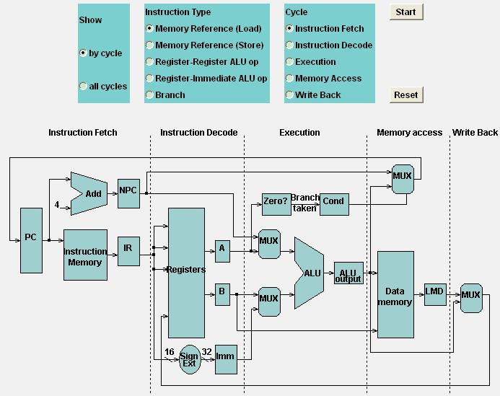
Load
http://www.cs.iastate.edu/~prabhu/Tutorial/PIPELINE/DLXimplem.html

Slide 55
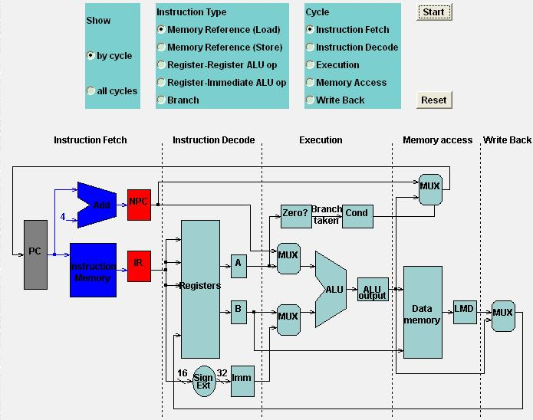
Load
Load: IF

Slide 56
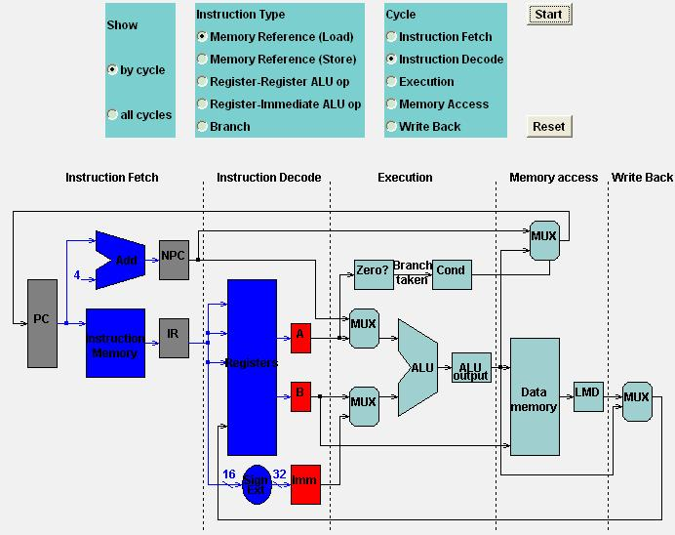
Load
Load: ID

Slide 57
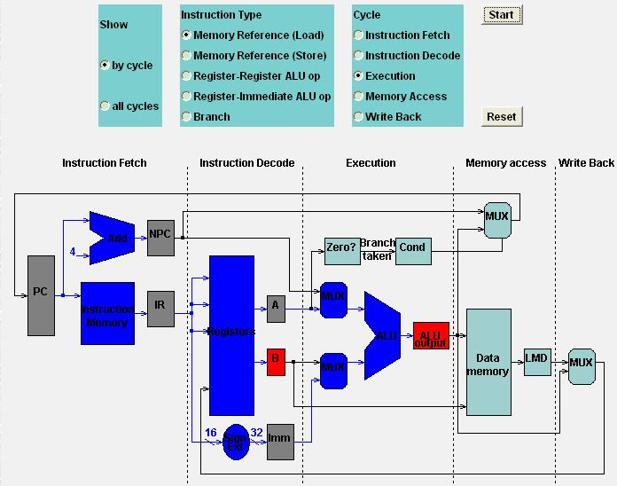
Load
Load: EX

Slide 58
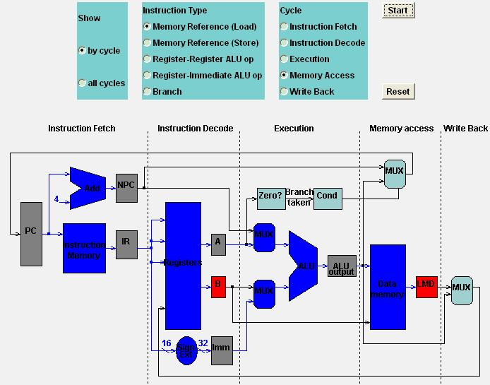
Load
Load: MEM

Slide 59
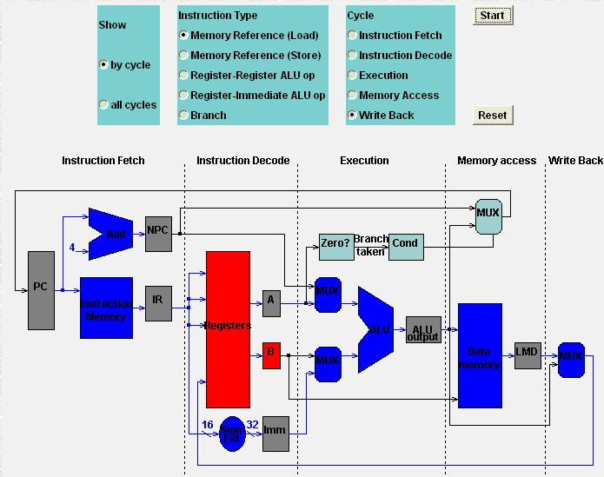
Load
Load: WB

Slide 60
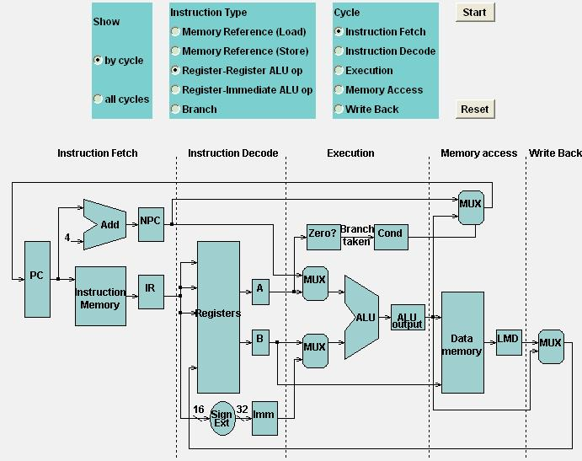
Register-Register ALU: MEM
IF

Slide 61
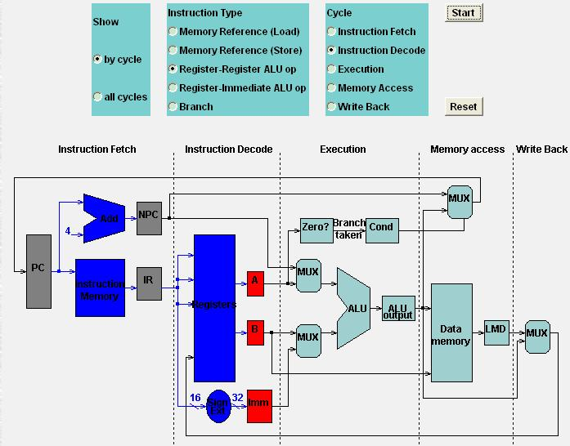
Register-Register ALU: MEM
ID

Slide 62
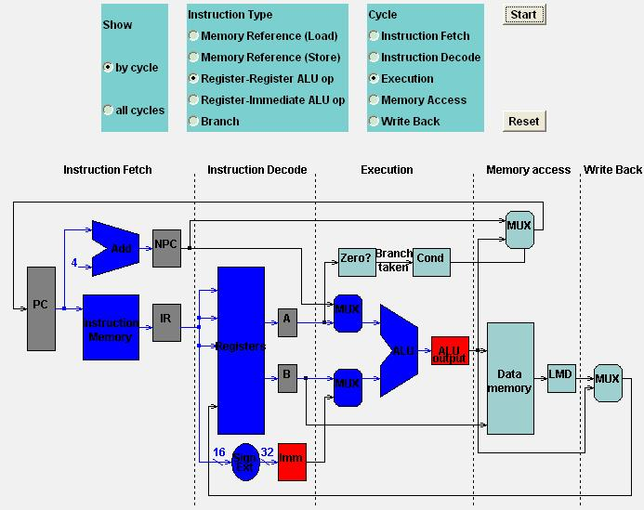
Register-Register ALU: MEM
EX

Slide 63
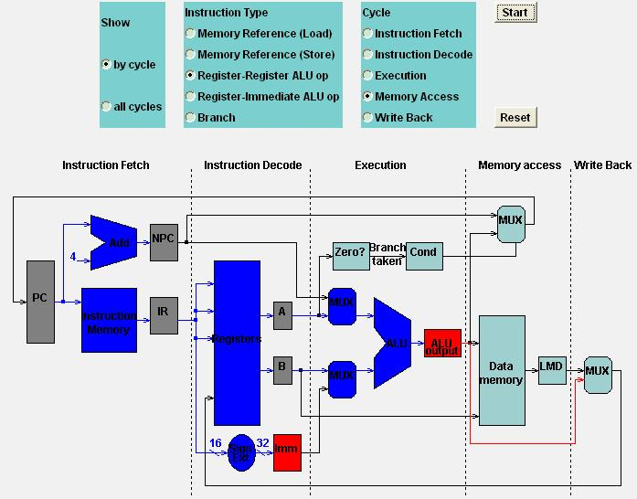
Register-Register ALU: MEM
MEM

Slide 64
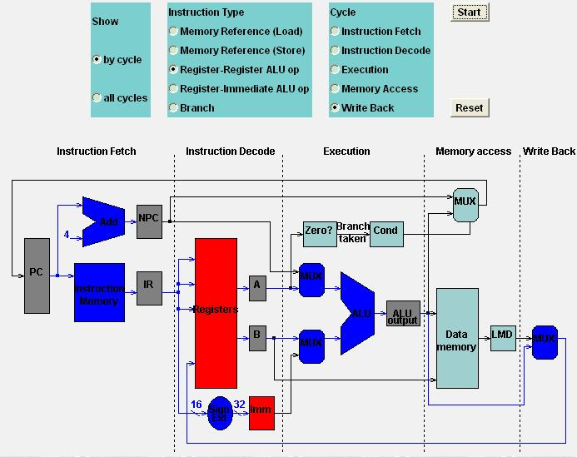
Register-Register ALU: MEM
WB

Slide 65
RISC’s 5-Stage Pipeline
at most 5 clock cycles per instruction
IF ID EX MEM WB
Notes:
So now we have walked through all these five clock cycles of RISC.

Slide 66
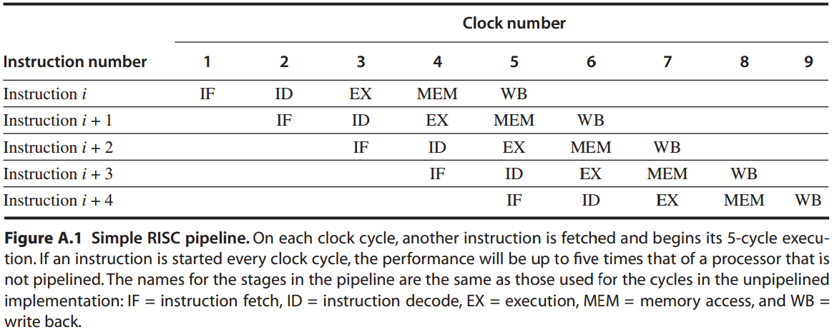
RISC’s 5-Stage Pipeline
Simply start a new instruction
on each clock cycle;
Speedup = 5.
Notes:
And this is how they could be pipelined.
We can simply start a new instruction on each clock cycle and make the execution 5 times faster.

Slide 67
Cool enough!
Notes:
How cool is that!

Slide 68
Anything else to know?
Notes:
There must be some key techniques behind the scenes, right

Slide 69

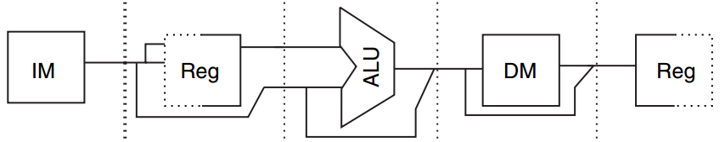
Memory
How it works
separate instruction and data mems to eliminate conflicts for a single memory between instruction fetch and data memory access.
Instr mem
Data mem
IF
MEM
Notes:
The first technique is separating instruction memory and data memory.
Because both IF and MEM require memory access, if there is only one single memory, IF and MEM will have memory conflicts during the pipelining process.

Slide 70

Register
How it works
use the register file in two stages;
either with half CC;
in one clock cycle, write before read
ID
WB
read
write
Notes:
Another technique for pipelining is to use the register file in two stages. One stage spans a half clock cycle.
To avoid data conflicts, the first stage performs write while the second stage performs read.
This way, the result from previous instruction’s WB cycle can be used by the current instruction’s ID cycle.

Slide 71
Pipeline Register
How it works
introduce pipeline registers between successive stages;
pipeline registers store the results of a stage and use them as the input of the next stage.
Notes:
Besides, for making a stage’s results as input of the next stage, RISC uses pipeline registers between successive stages.

Slide 72
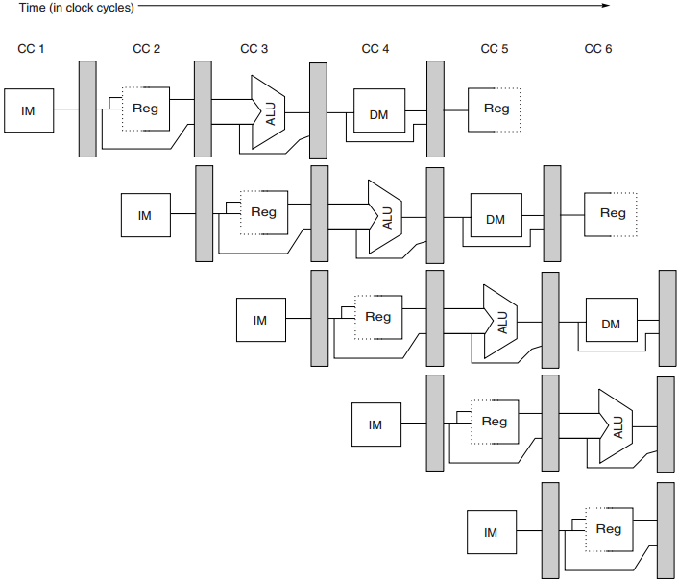
RISC’s Five-Stage Pipeline
How it works
Notes:
So finally, here is the high level paradigm of RISC pipelining.

Slide 73
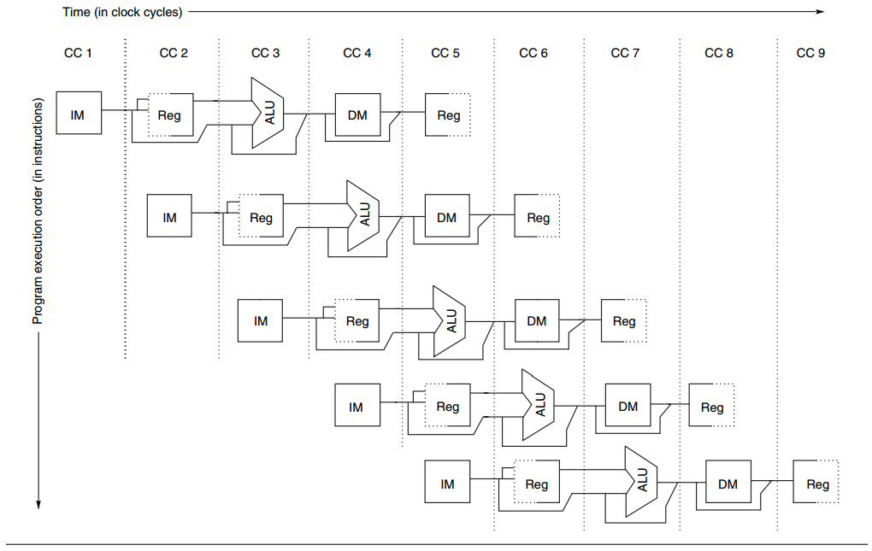
RISC’s Five-Stage Pipeline
How it works - omit pipeline regs
for ease of illustration
but required in implementation
Notes:
For simplicity, some illustrations will omit pipeline registers. But please remember that they are definitely required in implementation.

Slide 74
Performance: Example
Example
Consider an unpipelined instruction.
1 ns clock cycle;
4 cycles for ALU and branches;
5 cycles for memory operations;
relative frequencies 40%, 20%, 40%;
0.2 ns pipeline overhead (e.g., due to stage imbalance, pipeline register setup, clock skew)
Question: How much speedup by pipeline?
Notes:
So we have learned pipelining basics and how pipelining could be implemented.
Now let’s see how to calculate the speed up by pipelining via this example.
It sates that the unpipelined version has a 1 nanosecond clock cycle. It takes 4 cycles for ALU and branches and 5 for memory operations.
Their relative frequencies are these much. And then there’s 0.2 nanosecond overhead for pipelining. The question is how much is the speed up by pipeline?

Slide 75
Performance: Example
Answer
speedup by pipelining
= Avg instr time unpipelined
Avg instr time pipelined
= ?
Notes:
To find the speed up by pipeline, we need first find the average instruction time when unpipelined and when pipelined.

Slide 76
Performance: Example
Answer
Avg instr time unpipelined
= clock cycle x avg CPI
= 1 ns x [(0.4+0.2)x4 + 0.4x5]
= 4.4 ns
Avg instr time pipelined
= 1+0.2
= 1.2 ns
Notes:
Here are how we find these average instruction times.

Slide 77
Performance: Example
Answer
speedup by pipelining
= Avg instr time unpipelined
Avg instr time pipelined
= 4.4 ns
1.2 ns
= 3.7 times
Notes:
Now we have the values of average instruction time when unpipelined and average instruction time when pipelined, we can simply obtain the speed up through their quotient.

Slide 78
That’s it !
Notes:
You’re probably wondering that you’ve already knew all about pipelining.

Slide 79
That’s it?
Notes:
However, our computers would be much faster if pipelining could be implemented that easily.

Slide 80
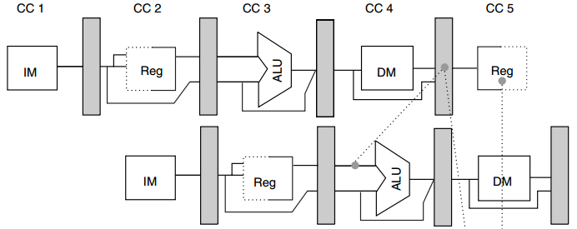
What if pipeline is stuck?
R1
LD R1, 0(R2)
R1
DSUB R4, R1, R5
Notes:
Actually, in many cases, instructions cannot be fully pipelined.
In this example, R1 is read by load instruction at the end of clock cycle 4;
But subtract instruction requires R1 at the beginning of clock cycle 4; in this case, the processor can not fully pipeline the two instructions as we expect.

Slide 81
Meet the Pipeline Hazards
Notes:
Such situations are known as pipeline hazards.

Slide 82
Pipeline Hazards
Hazards: situations that prevent the next instruction from executing in the designated clock cycle.
3 classes of hazards:
structural hazard – resource conflicts
data hazard – data dependency
control hazard – pc changes
(e.g., branches)
Notes:
Specifically, pipeline hazards are situations that prevent the next instruction from executing in the designated clock cycle.
There are 3 classes of hazards. Structural hazard due to resource conflicts, data hazard due to data dependency, and control hazard due to pc changes.

Slide 83
Pipeline Hazards
Structural hazard
Data Hazard
Control Hazard
Notes:
The first is structural hazard.

Slide 84
Structural Hazard
Root Cause: resource conflicts
e.g., a processor with 1 reg write port
but intends two writes in a CC
Solution
stall one of the instructions
until required unit is available
Notes:
It is caused by resource conflicts.
For example, a processor has only 1 register write port but intends two writes in the same clock cycle.
Solution to structural hazard is to stall one of the instructions, let one instruction use the write port first, and then activate the other instruction when the write port is available.

Slide 85
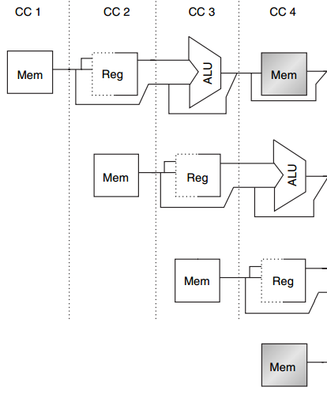
Structural Hazard
MEM
Example
1 mem port
mem conflict
data access
vs
instr fetch
Load
Instr i+1
Instr i+2
IF
Instr i+3
Notes:
Here’s an example of structural hazard due to memory conflict.
Assume the processor has only memory port.
A structural hazard will arise in clock cycle 4 when the load instruction reads data from memory and instruction i + 3 fetches instruction from memory.

Slide 86
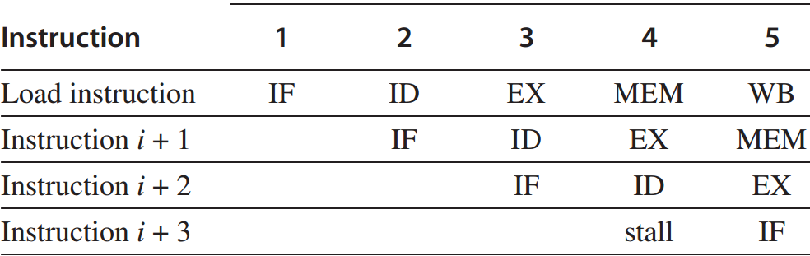
Solution: Stall Instruction
Stall Instr i+3
till CC 5
Notes:
The solution to this structural hazard is stall instruction i+3 for one clock cycle.

Slide 87
Performance Impact
memory access
Example
ideal CPI is 1;
40% data references;
structural hazard with 1.05 times higher clock rate than ideal;
Question:
is pipeline w/wo hazard faster?
by how much?
Notes:
Now let’s get an impression of how hazard lowers the pipelining speed through an example.

Slide 88
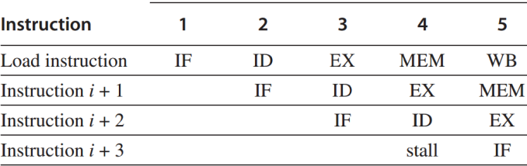
Performance Impact
Stall for
one clock cycle
Answer
avg instr time w/o hazard
=CPI x clock cycle time_{ideal}
=1 x clock cycle time_{ideal}
avg instr time w/ hazard
=(1 + 0.4x1) x clock cycle time_{ideal}
1.05
=1.3 x clock cycle time_{ideal}
So, w/o hazard is 1.3 times faster.

Slide 89
Pipeline Hazards
Structural hazard
Data Hazard
Control Hazard
Notes:
The second class of hazard is data hazard.

Slide 90
Data Hazard
Root Cause: data dependency
when the pipeline changes the order of read/write accesses to operands;
so that the order differs from the order seen by sequentially executing instructions on an unpipelined processor.
Notes:
Data hazard is due to data dependency. It usually happens when the pipeline changes the order of read/write accesses to operands.

Slide 91
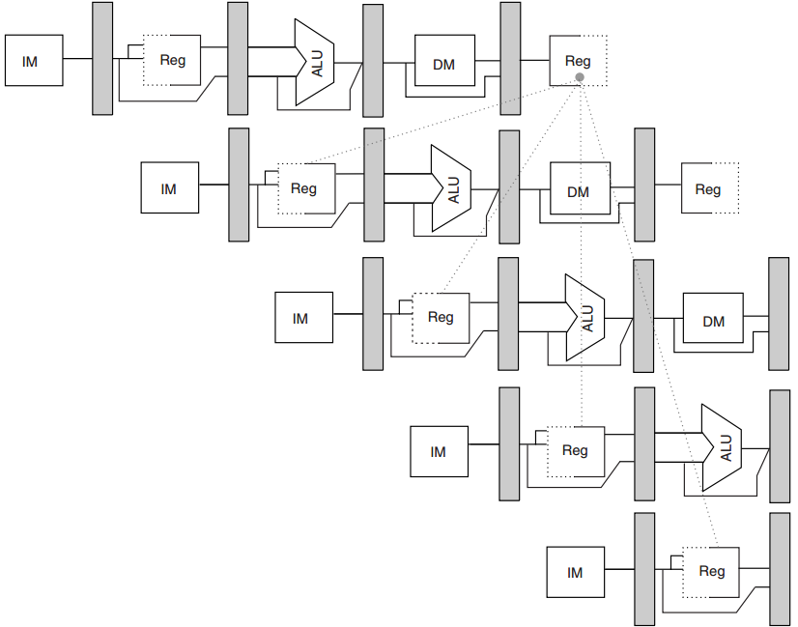
Data Hazard
R1
DADD
R1, R2, R3
DSUB
R4, R1, R5
AND
R6, R1, R7
No hazard
1st half cycle: w
2nd half cycle: r
OR
R8, R1, R9
XOR
R10, R1, R11
Notes:
In this example, the subtract and AND instructions need R1 before the ADD instruction prepares it. So R1 causes a data hazard that prevents normal pipelining of the subtract and AND instructions.
Note that the OR instruction has no hazard because the add instruction prepares R1 in the first half of the clock cycle while the OR instruction needs R1 till the second half.

Slide 92
Solution: Forwarding
Solution: forwarding
directly feed back EX/MEM&MEM/WB
pipeline regs’ results to the ALU inputs;
if forwarding hw detects that previous ALU has written the reg corresponding to a source for the current ALU,
control logic selects the forwarded result as the ALU input.
Notes:
The solution to data hazard is forwarding.
It directly feeds back the results in pipeline registers connecting EX and MEM or MEM and WB to the ALU inputs.

Slide 93
Solution: Forwarding
R1
DADD
R1, R2, R3
DSUB
R4, R1, R5
AND
R6, R1, R7
OR
R8, R1, R9
XOR
R10, R1, R11
Notes:
Back to the previous example,

Slide 94
Solution: Forwarding
R1
EX/MEM
DADD
R1, R2, R3
DSUB
R4, R1, R5
AND
R6, R1, R7
OR
R8, R1, R9
XOR
R10, R1, R11
Notes:
The add instruction can directly provide the subtract instruction with R1 via its EX/MEM pipeline register.

Slide 95
Solution: Forwarding
R1
MEM/WB
DADD
R1, R2, R3
DSUB
R4, R1, R5
AND
R6, R1, R7
OR
R8, R1, R9
XOR
R10, R1, R11
Notes:
Similarly, the add instruction can provide the AND instruction with R1 via its MEM/WB pipeline register.

Slide 96
Solution:
Generalized Forwarding
pass a result directly to the functional unit that requires it;
forward results to not only ALU inputs but also other types of functional units;
Notes:
More generally, a processor can forward results to not only ALU inputs but also any other functional unit that requires it.

Slide 97
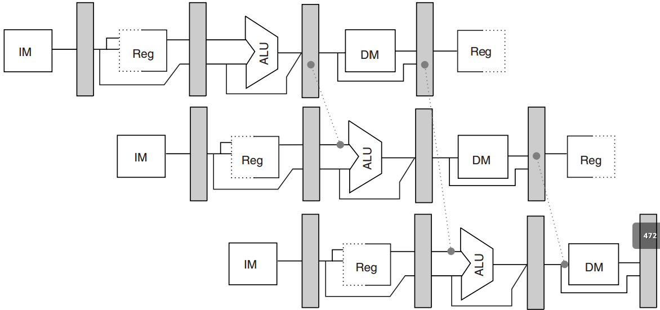
Solution:
Generalized Forwarding
DADD
R1, R2, R3
R1
R1
R4
LD
R4, 0(R1)
R1
SD
R4, 12(R1)
R1
R4
Notes:
(LD R4, 0(R1): R4=mem(R1+0); from mem to reg)
(SD R4, 12(R1): mem(R1+12)=R4; from reg to mem)
In this example, R1 is forwarded to the ALU inputs while R4 is to memory input.

Slide 98
Solution: Stall Instruction
Sometimes stall is necessary
MEM/WB
R1
LD
R1, 0(R2)
DSUB
R4, R1, R5
R1
Forwarding cannot be backward.
Has to stall.
Notes:
But a stall is still necessary sometimes.
In this example, the load instruction prepares R1 till it reaches the MEM/WB pipeline register at the end of clock cycle 4.
The subtract instruction, however, requires R1 at the beginning of clock cycle 4.
So in this case, no forwarding can be backward and thus the subtract instruction has to stall for one clock cycle.

Slide 99
Pipeline Hazards
Structural hazard
Data Hazard
Control Hazard
Notes:
The third type of hazard is control hazard.

Slide 100
Control Hazard
branches and jumps
Branch hazard
a branch may or may mot change PC to other values other than PC+4;
taken branch: changes PC to its target address;
untaken branch: falls through;
PC is not changed till the end of ID;
Notes:
A control hazard happens to branches and jumps. In this lecture, we focus only on branches.
Its main reason is that a branch may or may not change program counter to other values other than PC+4 but the change is available till the end of ID clock cycle.
If a branch instruction changes PC to its target address, it’s called a taken branch. Otherwise, it’s called untaken and falls through directly to the next instruction.

Slide 101
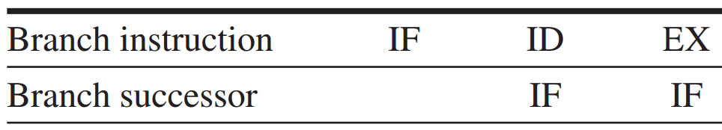
Branch Hazard
Redo IF
If the branch is untaken,
the stall is unnecessary.
essentially a stall
Notes:
Therefore, the IF running in parallel with the branch’s ID clock cycle may fetch a wrong instruction.
A simple solution is to redo IF, which is essentially a stall. However, if the branch is untaken, the stall is absolutely unnecessary.

Slide 102
Branch Hazard: Solutions
4 simple compile time schemes – 1
Freeze or flush the pipeline
hold or delete any instructions after the branch till the branch dst is known;
Notes:
There are four more solutions to branch hazard.
The first one is freeze or flush the pipeline. It simply holds or deletes any instruction after the branch till the branch destination is known.

Slide 103
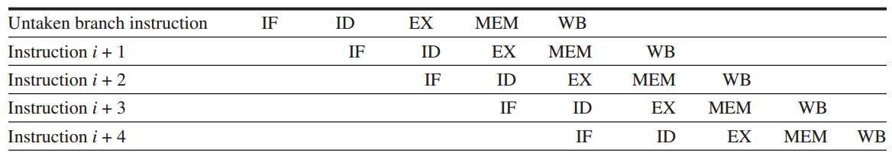
Branch Hazard: Solutions
4 simple compile time schemes – 2
Predicted-untaken
simply treat every branch as untaken;
when the branch is untaken,
pipelining as if no hazard.
Notes:
The second scheme is predicated-untaken. It simply treats every branch as untaken.
When the branch is really untaken, the pipelining proceeds as if no hazard exists.

Slide 104
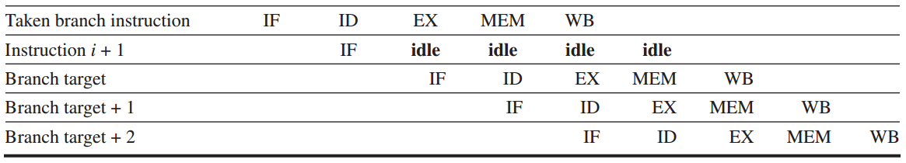
Branch Hazard: Solutions
4 simple compile time schemes – 2
Predicted-untaken
but if the branch is taken:
turn fetched instr into a no-op (idle);
restart the IF at the branch target addr
Notes:
But if the branch is taken, the processor will idle the fetched instruction and continue to process the instruction at the branch target address.

Slide 105
Branch Hazard: Solutions
4 simple compile time schemes – 3
Predicted-taken
simply treat every branch as taken;
not apply to the five-stage pipeline;
apply to scenarios when branch target addr is known before branch outcome.
Notes:
Opposite to predicted-untaken, another scheme is predicted-taken. It simply treats every branch as taken.
It doesn’t apply to the five-stage pipeline, so we don’t cover its details in this lecture.

Slide 106
Branch Hazard: Solutions
4 simple compile time schemes – 4
Delayed branch
delay the branch execution after the next instruction;
pipelining sequence:
branch instruction
sequential successor
branch target if taken
Branch delay slot
the next instruction
Notes:
The fourth scheme is delayed branch.
It directly delays the branch execution after the next instruction. In other words, it executes the next instruction first whether or not the branch is taken.

Slide 107
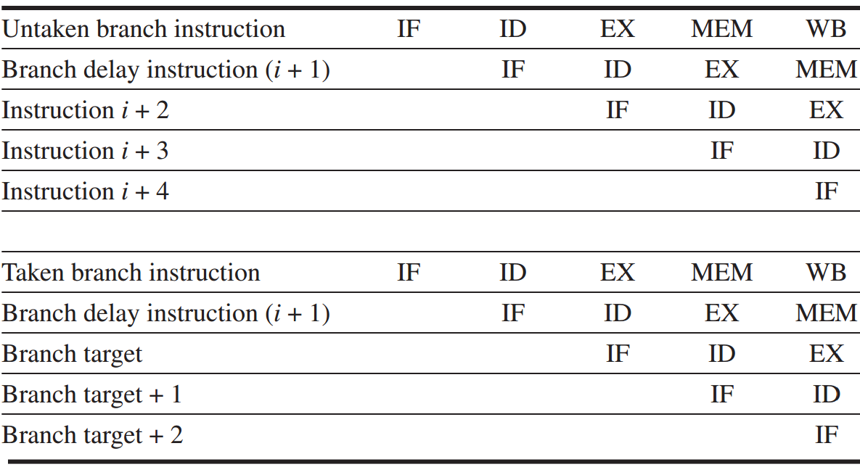
Branch Hazard: Solutions
Delayed branch
Notes:
Here are examples of delaying an untaken branch and a taken branch.
We can see that they have the same pipelining efficiency.

Slide 108
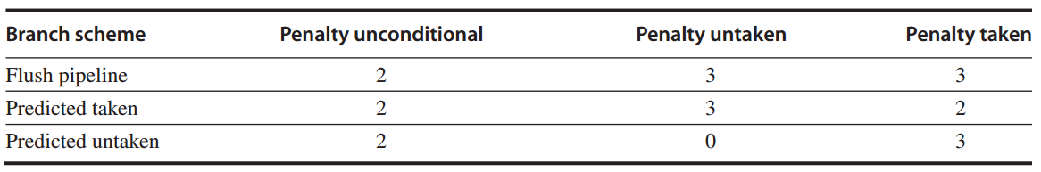
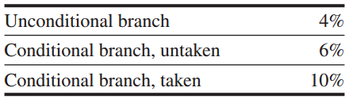
Branch Hazard: Performance
Example
a deeper pipeline (e.g., in MIPS R4000) with the following branch penalties:
and the following branch frequencies:
Question: find the effective addition to the CPI arising from branches.

Slide 109
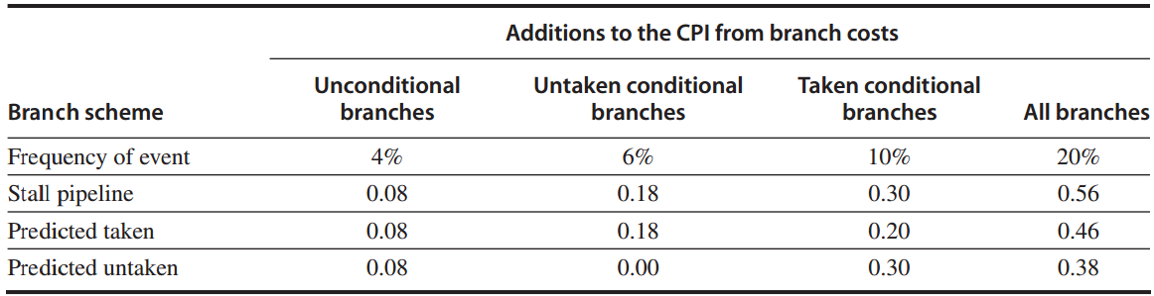
Branch Hazard: Performance
Answer
find the CPIs by
relative frequency x respective penalty.
0.04x2
0.10x3
0.08+0.00+0.30

Slide 110
Review
Pipelining promises fast CPU by starting the execution of one instruction before completing the previous one.
Classic five-stage pipeline for RISC
IF – ID – EX –MEM - WB
Pipeline hazards limit ideal pipelining
structural/data/control hazard
Notes:
In this lecture, we have learned pipelining. It makes faster CPU by starting the execution of one instruction before completing the previous one.
We learn pipelining principles and implementation through five-stage pipelined RISC.
We also discuss pipeline hazards that limit ideal pipelining and corresponding solutions.

Slide 111

Appendix C.1-C.2
Notes:
The content corresponds to the first two sections of Appendix C.

Slide 112
?

Slide 113
Assignment 1
October 25, lecture session
5 min presentation, per lab group
2016/7: MICRO, ISCA, HPCA, ASPLOS
Paper Topic:
Instruction, Compilation, Energy, Power, etc. (in lec 02-04)
Bonus: English Presentation

Slide 114
Lab 1
Lab Opening Hours
Tues, Thur, Sat: 10:00-15:30
Lab 1 Demo
Lab 1 Report: October 25
http://10.78.18.200:8080/Platform/
Register with zju email account
report template: in English http://list.zju.edu.cn/kaibu/comparch/Lab_report_template.doc

Slide 115
#What’s More
Failure is an option, but fear is not.
Before Avatar … a curious boy
by James Cameron @TED
What’s Stopping You from Achieving Your Goals?

