Slide 1
Pipelining:
Implementation
06
Kai Bu
kaibu@zju.edu.cn
http://list.zju.edu.cn/kaibu/comparch2017

Slide 2
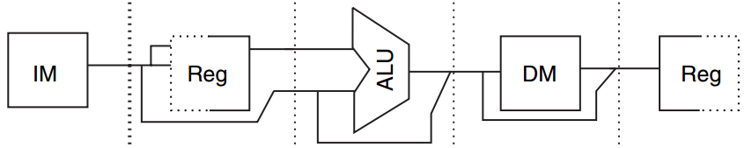
Data Path
Underneath Pipelining
MIPS
Five-Stage
IF ID EX MEM WB
Pipeline Register
Store temporary result from the previous stage;
Feed it to the next stage
Notes:
We just finished exploring high level principles of pipelining.
We used MIPS five-stage pipeline as an example. The execution of an instruction is divided into five stages, which are IF, ID, EX, MEM, and WB.
Connecting adjacent pipe stages are pipe registers. They store temporary result from the previous stage and feed it to the next stage.

Slide 3
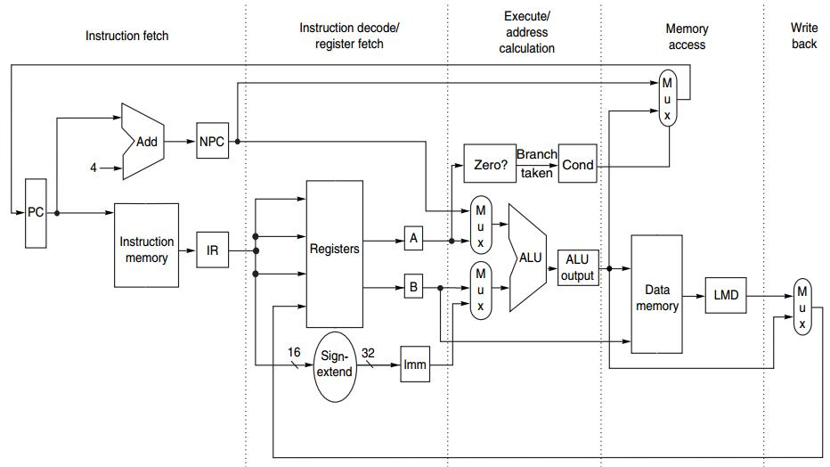
Data Path
Underneath Pipelining
IF ID EX MEM WB
Notes:
In this course, we focus mainly on the parts that highly relate to the five stages of pipeline.
Simplified version

Slide 4
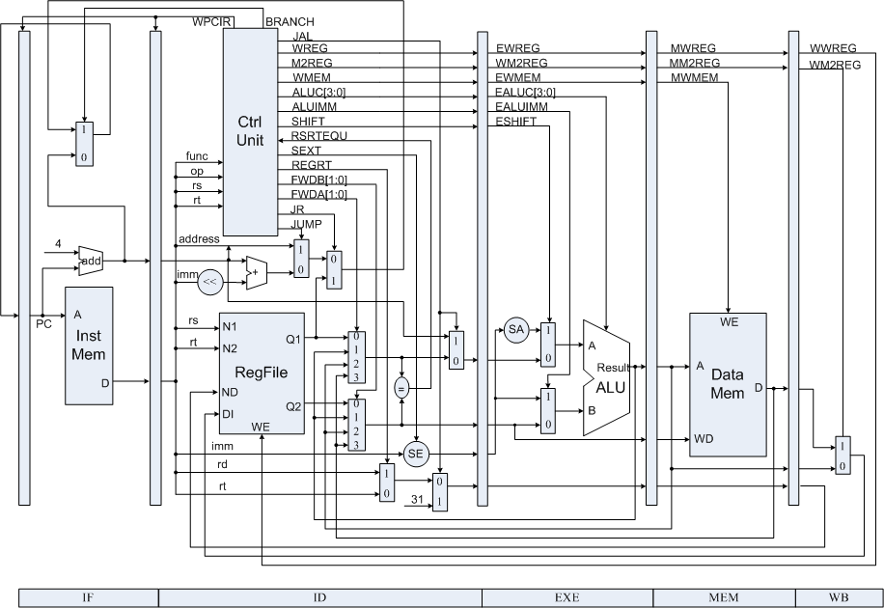
Data Path
Underneath Pipelining
lab & exam
Notes:
But for lab and exam
this is what underlying data path looks like.
It’s more complex when taking other corresponding components into account.
[key framework for lab and exam]

Slide 5
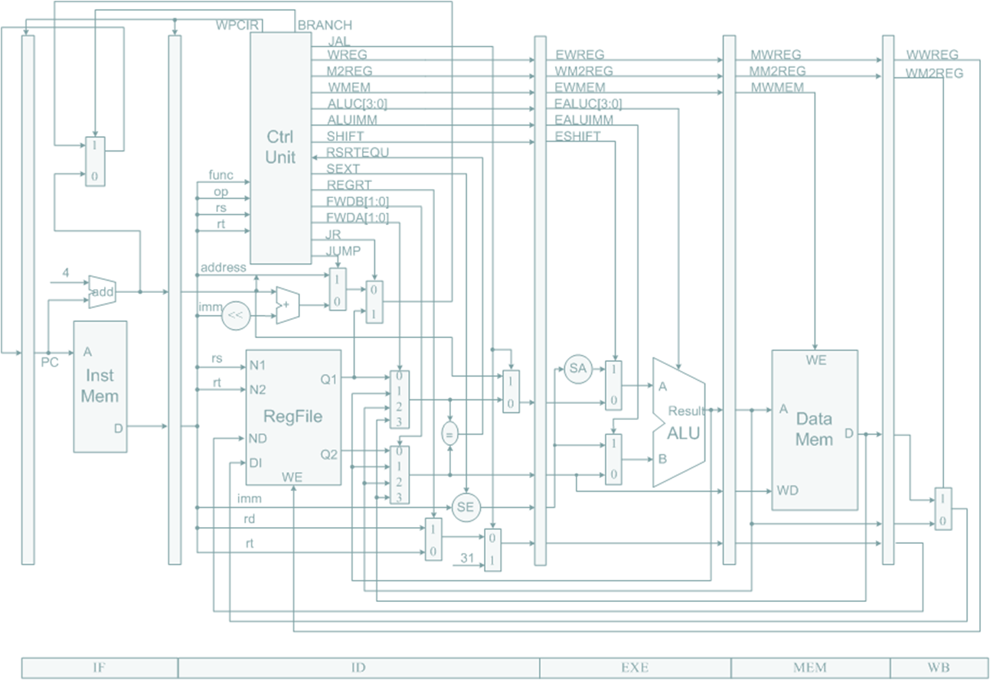
Preview
under MIPS architecture
How a MIPS instruction works?
How MIPS instructions pipleline?
Notes:
In particular, we’ll discuss how an MIPS instruction works atop such data paths, and how such data paths support MIPS pipeline.

Slide 6
How an un-pipelined
MIPS instruction works?
Notes:
So first, how an instruction works when unpipelined?

Slide 7
MIPS Instruction
at most 5 clock cycles per instruction
IF ID EX MEM WB
Notes:
It runs in at most 5 clock cycles, which we’ve already known.
Next, let’s dig deeper into each stage, see what exactly happens on the data path.

Slide 8
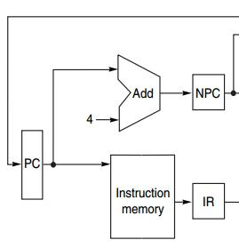
IF
IF ID EX MEM WB
Instruction Fetch cycle
IR ← Mem[PC];
NPC ← PC + 4;
IR: instruction register
NPC: next sequential PC
(32-bit instruction)
Notes:
In the first cycle, we fetch the instruction to process from instruction memory and store it in instruction register.
We use program counter (PC) as the pointer to find the instruction in memory. After fetching the instruction, we need update PC so that it points to the next instruction. Since an instruction is 4 bytes long, we increment PC by four. The value of PC is stored in a register called NPC.

Slide 9
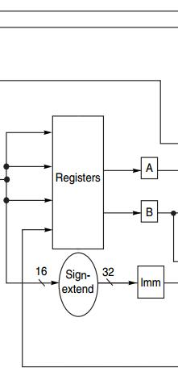
ID
IF ID EX MEM WB
Instruction Decode/register fetch
A ← Regs[rs];
B ← Regs[rt];
Imm ← sign-extended
immediate field
of IR
(lower 16 bits of Imm)
Notes:
To make the fetched instruction understandable to subsequent components, the second stage decodes it.
Meanwhile, operands will be read from registers and stored into temporary registers A, B, and IMM.
All these operands are key inputs for the next cycle, EX.

Slide 10
EX
IF ID EX MEM WB
Execution/effective address cycle
ALU operates on the operands from ID:
4 functions depending on the instr type -Memory reference
-Register-register ALU instruction
-Register-immediate ALU instruction
-Branch
Notes:
(Note that different from the RISC implementation instance in previous lecture, with one more function - branch)
MIPS’s EX stage has four types of functions;

Slide 11
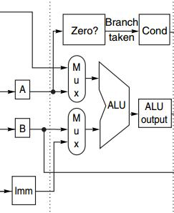
EX
IF ID EX MEM WB
Execution/effective address cycle
-Memory reference
ALUOutput ← A + Imm;
ALU adds the operands
to form effective address
Notes:
(Base register + offset)
The first function is memory reference. For memory reference, we need to access memory for reading data from it or storing data into it. Where should we conduct such operations in memory space? It is effective address that specifies the location. Effective address is formed in EX stage, specifically, it is the sum of values from register A and Imm.

Slide 12
EX
IF ID EX MEM WB
Execution/effective address cycle
-Register-register ALU instr
ALUOutput ← A func B;
ALU performs the operation
specified by function code
on the values in register A & register B
Notes:
When it’s a register-register ALU instruction, the ALU performs corresponding function/operation on the values in Registers A and B. and the results is stored in register ALUOutput

Slide 13
EX
IF ID EX MEM WB
Execution/effective address cycle
-Register-Immediate ALU Instr
ALUOutput ← A op Imm;
ALU performs the operation
specified by opcode
on the values in register A & reg IMM
Notes:
For ALU instruction, one operand could be defined as an immediate, which locates in register IMM. In this case, the ALU just simply performs corresponding operation on the values in register A and IMM.

Slide 14
function code vs opcode?

Slide 15
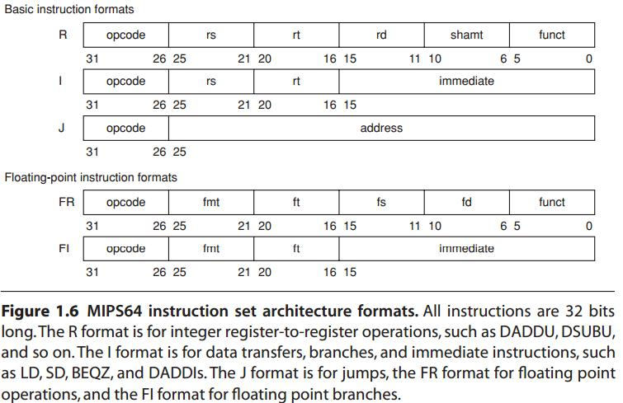
function code vs opcode?
1st src 2nd src dst shift w/ opcode to select instr
reg-reg
1st src src for branch 16-bit address
reg-imm
dst for I-type why sign-extended

Slide 16
EX
IF ID EX MEM WB
Execution/effective address cycle
-Branch
ALUOutput ← NPC + (Imm<<2);
Cond ← (A == 0);
ALUOutput -> branch target
BEQZ: comparison against 0
Notes:
Note that different from the RISC implementation instance in previous lecture, MIPS’s EX stage has four types of functions; with one more function - branch

Slide 17
EX
IF ID EX MEM WB
Execution/effective address cycle
-Branch
ALUOutput ← NPC + (Imm<<2);
Cond ← (A == 0);
ALUOutput -> branch target
BEQZ: comparison against 0
Why <<2?
http://www.cs.umd.edu/class/sum2003/cmsc311/Notes/Mips/addr.html
Notes:
Note that different from the RISC implementation instance in previous lecture, MIPS’s EX stage has four types of functions; with one more function - branch

Slide 18
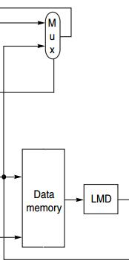
MEM
IF ID EX MEM WB
MEMory access/branch completion
update PC for all instr: PC ← NPC;
-Memory Access
LMD ← Mem[ALUOutput]; load
Mem[ALUOutput] ← B; store
-Branch
if (cond) PC ← ALUOutput;
Load Memory Data register
Notes:
For memory reference instructions and branch instruction, they’ll proceed to the MEM stage.
In this stage, it uses the effective address for memory access or update branch target for taken branch.
For example, for load instruction, fetch data from location specified by the value in ALUOutput, and stores it in register LMD.

Slide 19
WB
IF ID EX MEM WB
Write-Back cycle
-Register-register ALU instruction
Regs[rd] ← ALUOutput;
-Register-immediate ALU instruction
Regs[rt] ← ALUOutput;
-Load instruction
Regs[rt] ← LMD;
Notes:
Finally, the write-back cycle writes the resulting data into corresponding registers for later use.

Slide 20
Put It All Together

Slide 21
MIPS Instruction
IF ID EX MEM WB
IR ← Mem[PC];
NPC ← PC + 4;

Slide 22
MIPS Instruction
IF ID EX MEM WB
A ← Regs[rs];
B ← Regs[rt];
Imm ← sign-extended
immediate field
of IR (lower 16 bits)

Slide 23
MIPS Instruction
IF ID EX MEM WB
ALUOutput ← A + Imm;
ALUOutput ← A func B;
ALUOutput ← A op Imm;
ALUOutput ← NPC + (Imm<<2);
Cond ← (A == 0);

Slide 24
MIPS Instruction
IF ID EX MEM WB
PC ← NPC
LMD ← Mem[ALUOutput]; Mem[ALUOutput] ← B;
if (cond) PC ← ALUOutput;

Slide 25
MIPS Instruction
IF ID EX MEM WB
Regs[rd] ← ALUOutput;
Regs[rt] ← ALUOutput;
Regs[rt] ← LMD;

Slide 26
MIPS Instruction Demo
Prof. Gurpur Prabhu, Iowa State Univ http://www.cs.iastate.edu/~prabhu/Tutorial/PIPELINE/DLXimplem.html
Load, Store
Register-register ALU
Register-immediate ALU
Branch

Slide 27
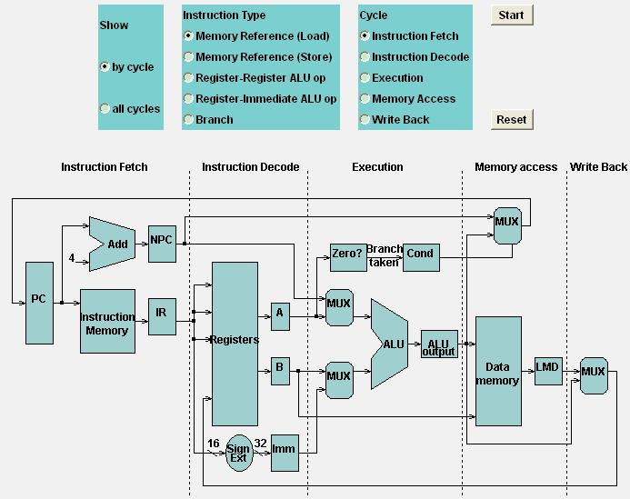
Load

Slide 28
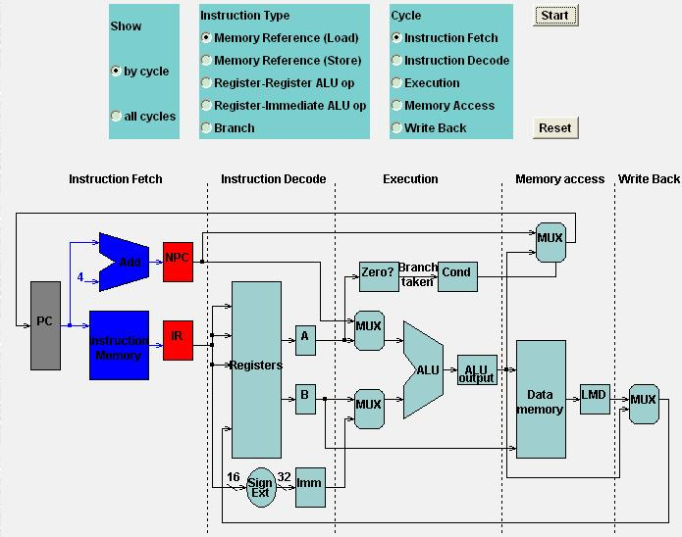
Load
Load: IF

Slide 29
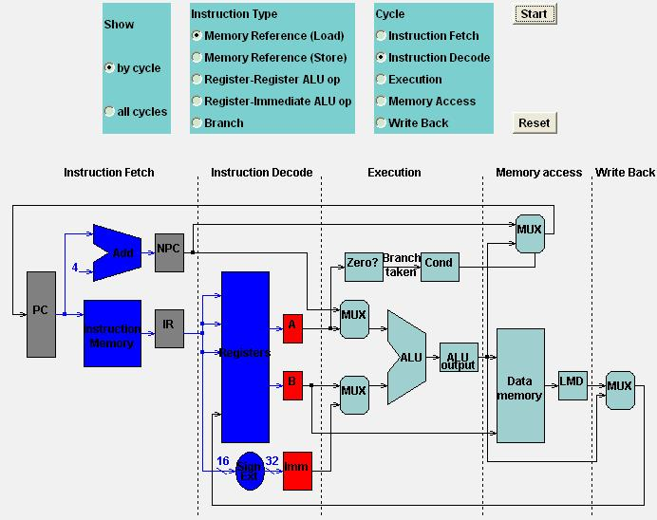
Load
Load: ID

Slide 30
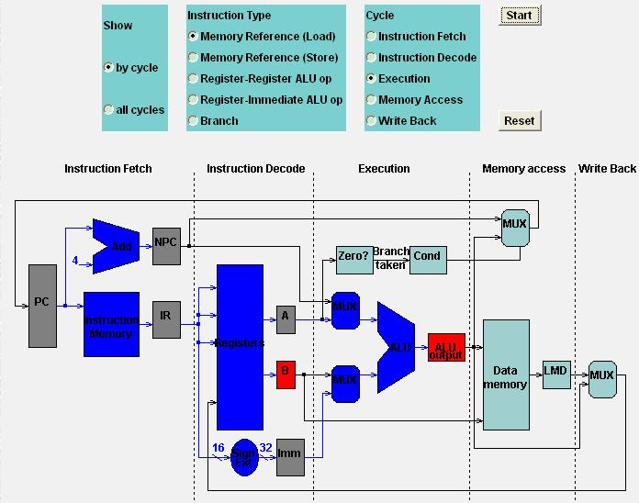
Load
Load: EX

Slide 31
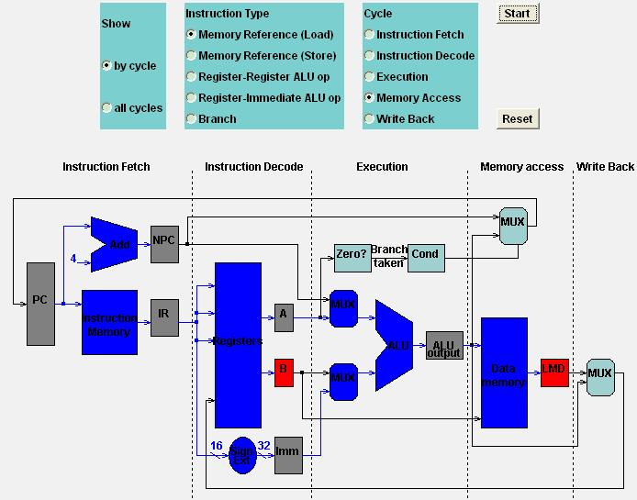
Load
Load: MEM

Slide 32
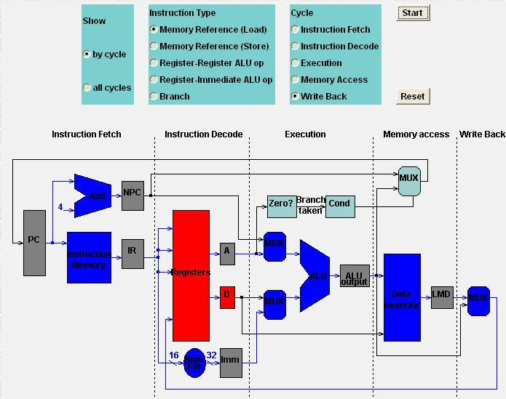
Load
Load: WB

Slide 33
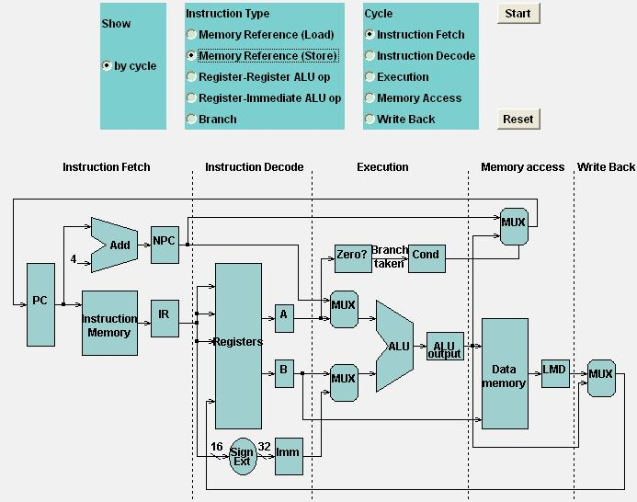
Store

Slide 34

Store
Store: IF

Slide 35
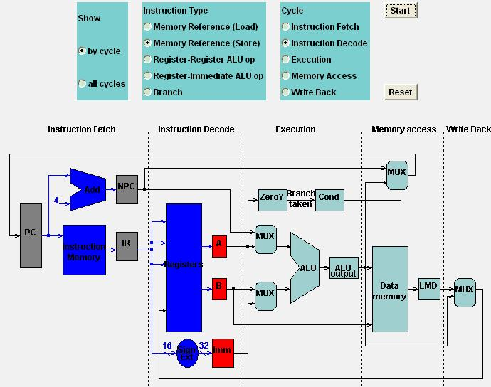
Store
Store: ID

Slide 36
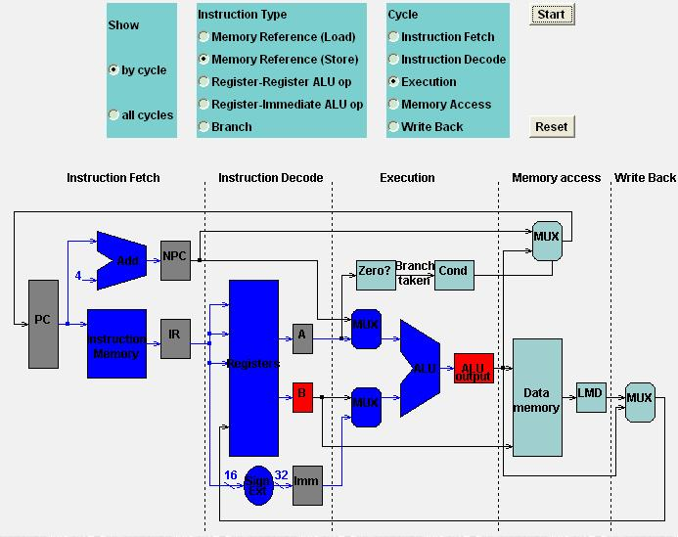
Store
Store: EX

Slide 37
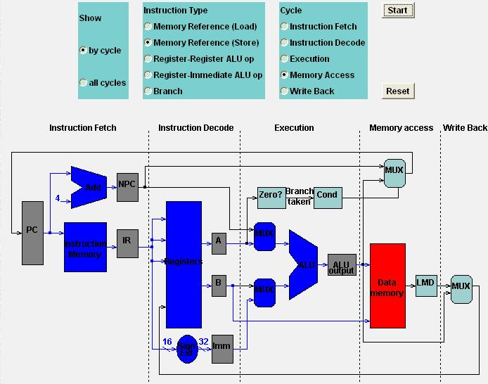
Store
Store: MEM

Slide 38

Store
Store: WB

Slide 39
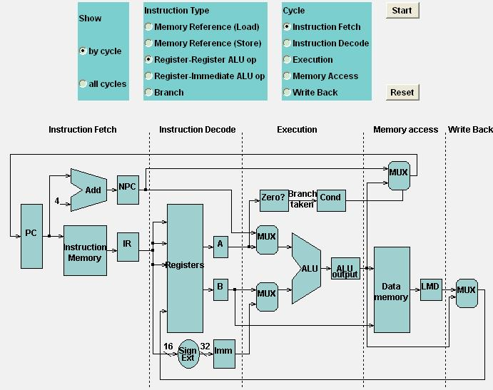
Register-Register ALU: MEM
IF

Slide 40
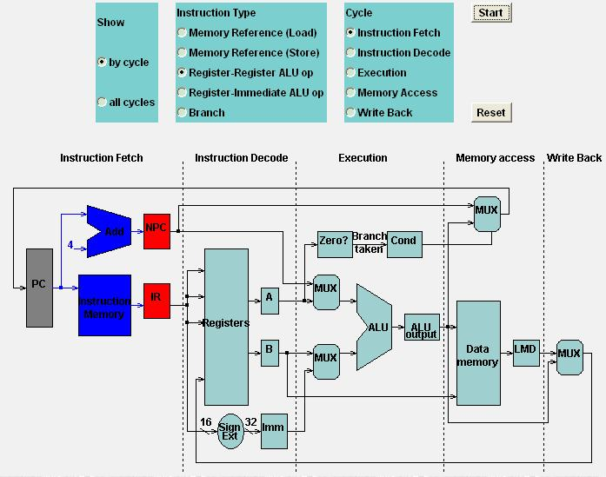
Register-Register ALU: MEM
IF

Slide 41

Register-Register ALU: MEM
ID

Slide 42
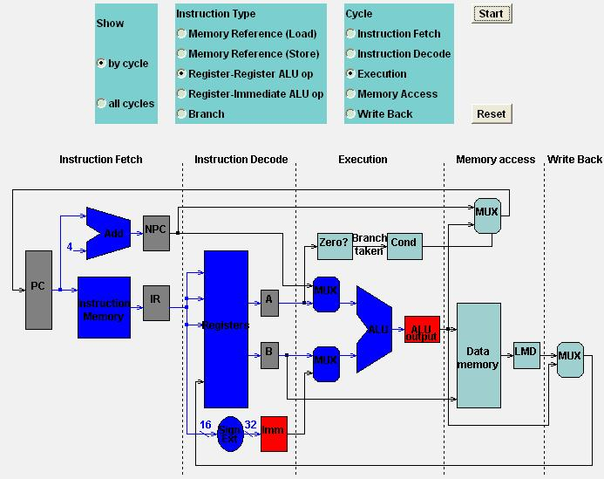
Register-Register ALU: MEM
EX

Slide 43
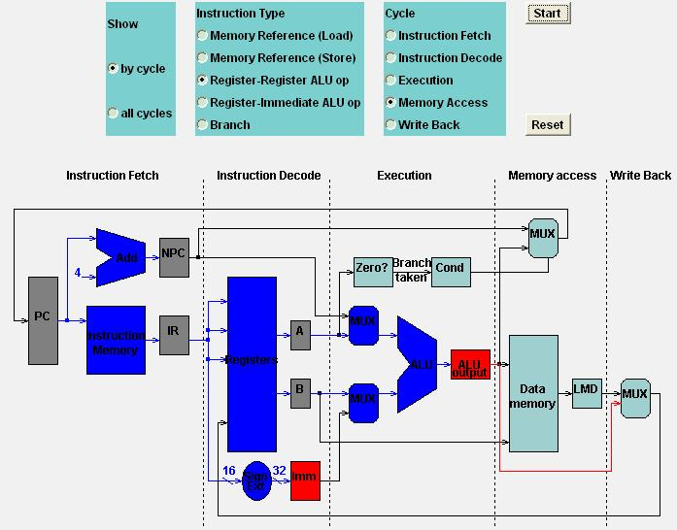
Register-Register ALU: MEM
MEM

Slide 44
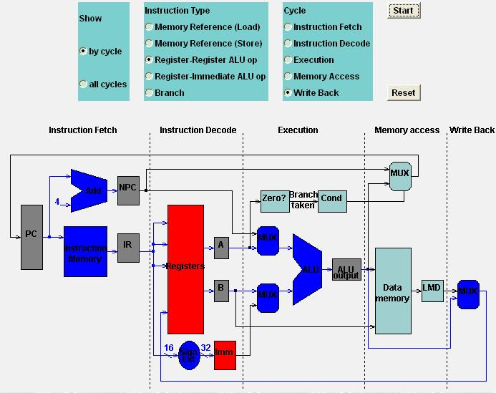
Register-Register ALU: MEM
WB

Slide 45
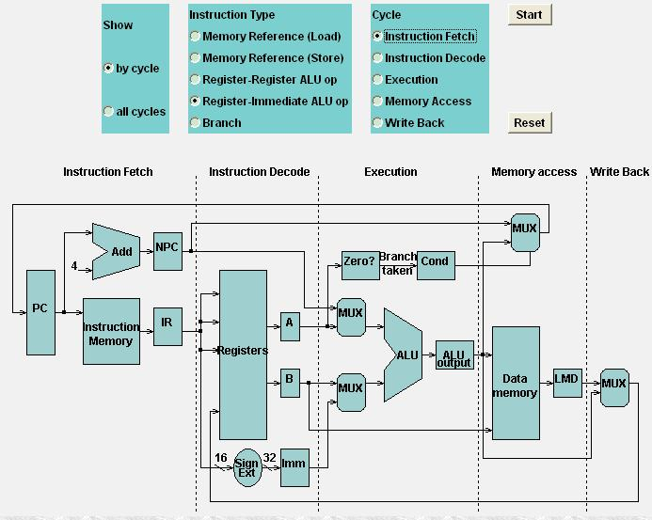
Register-Imm ALU: MEM
IFEM

Slide 46
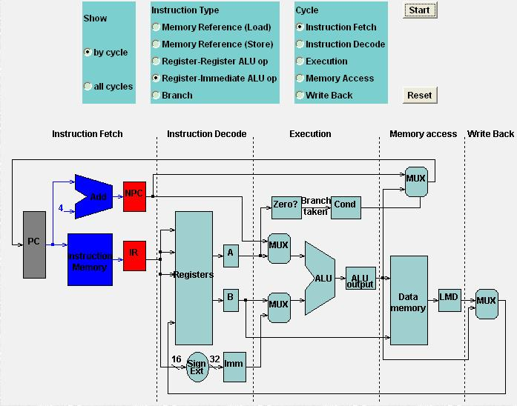
Register-Imm ALU: MEM
IFEM

Slide 47

Register-Imm ALU: MEM
IDEM

Slide 48
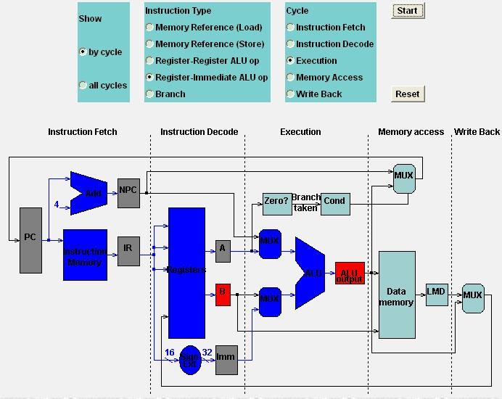
Register-Imm ALU: MEM
EXEM

Slide 49
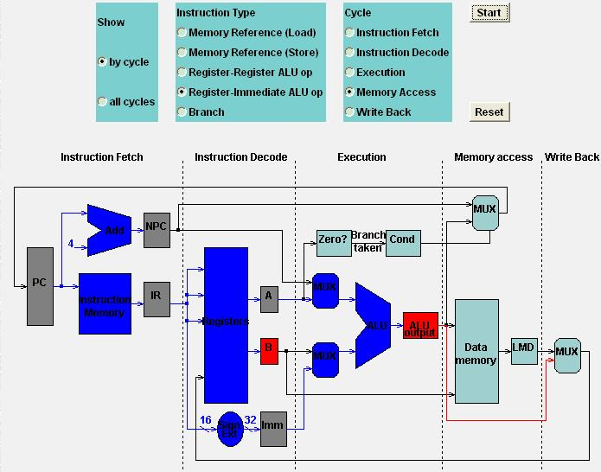
Register-Imm ALU: MEM
MEMEM

Slide 50
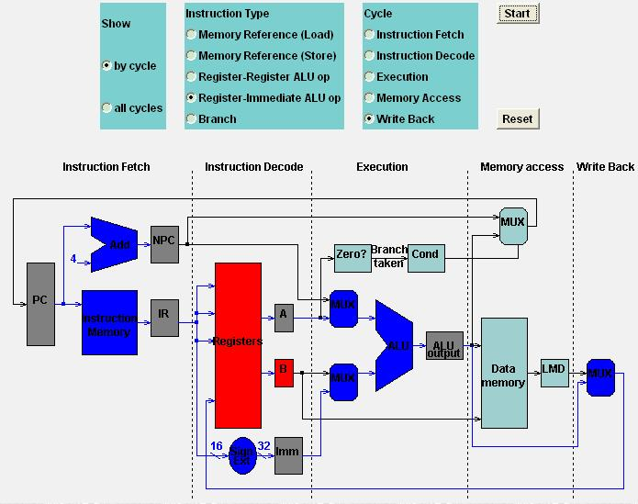
Register-Imm ALU: MEM
WBEM

Slide 51
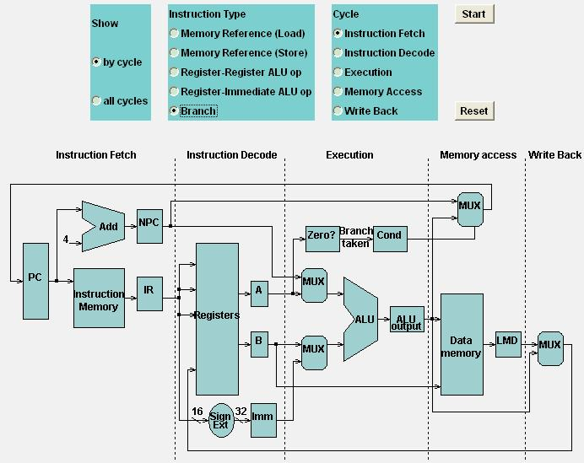
Branch: MEM
Branch: MEM

Slide 52

Branch: MEM
IFh: MEM

Slide 53
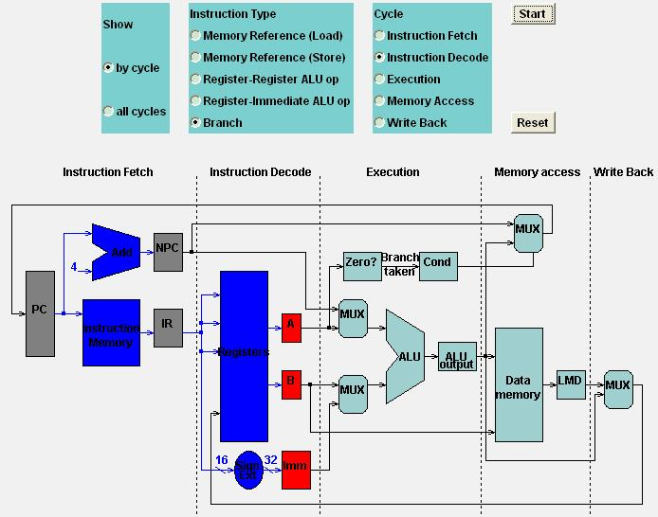
Branch: MEM
IDh: MEM

Slide 54
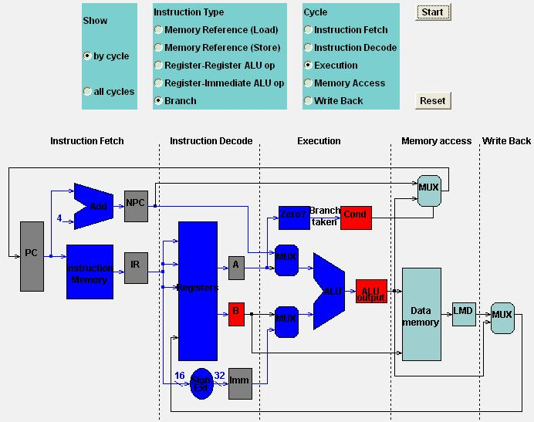
Branch: MEM
EXh: MEM

Slide 55
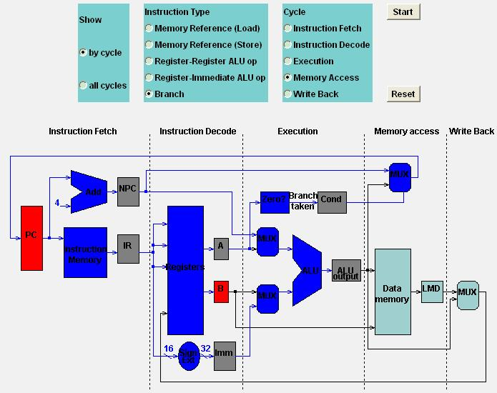
Branch: MEM
MEMh: MEM

Slide 56

Branch: MEM
WBh: MEM

Slide 57
This chapter is
about pipelining, right?
Notes:
But most of our discussions so far go to how an individual instruction works

Slide 58
How MIPS instructions pipeline?

Slide 59
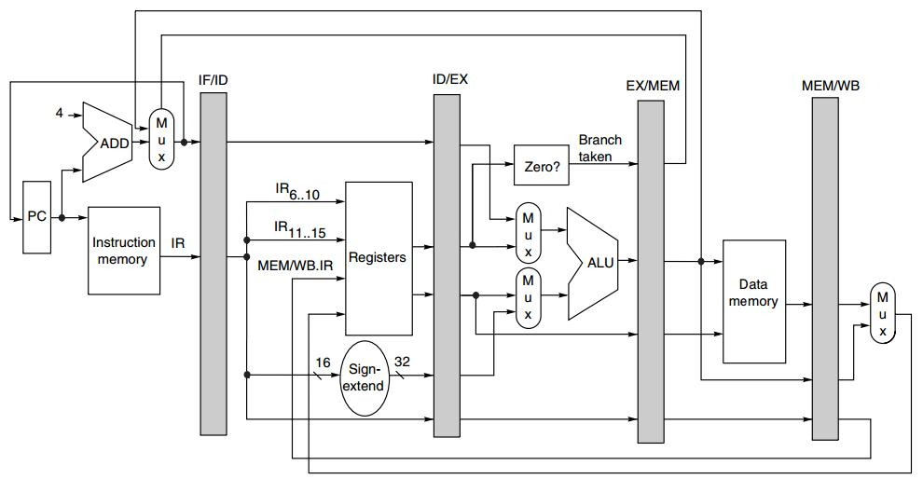
Pipelined MIPS
Pipeline
Registers/Latches
IF/ID.NPC
IF/ID.IR
ID/EX.A
ID/EX.B
ID/EX.IMM
MEM/WB.LMD
EX/MEM.Cond
EX/MEM.ALUOutput
Notes:
One necessary modification to data path is introducing pipeline registers, connecting consecutive pipeline stages.
The actions on each pipeline stage is decided

Slide 60
Instruction Type decides
actions on a pipeline stage
Notes:
By the instruction type

Slide 61
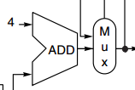
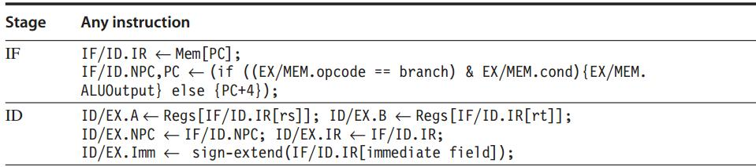
Pipelined MIPS: IF, ID
The first two stages are independent of instruction type because
the instruction is not decoded until the end of ID;
PC update

Slide 62
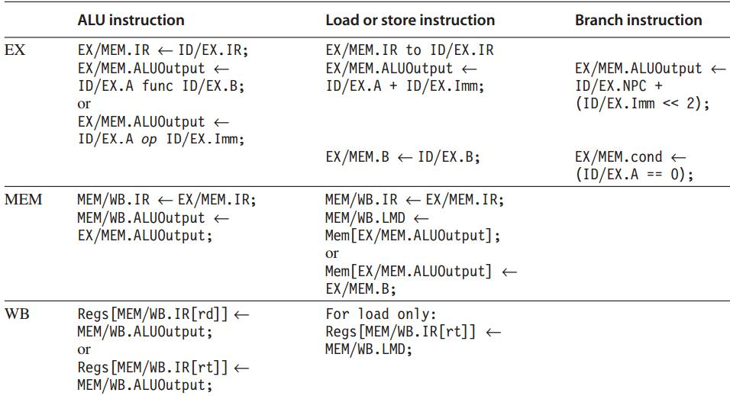
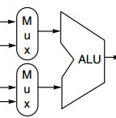

Pipelined MIPS: EX, MEM, WB
Any value needed on a later pipeline stage must be placed in a pipeline register,
and copied from one pipeline register to the next,
until it is no longer needed.

Slide 63
Data Hazard
Instruction Issue: ID -> EX
If a data hazard exists, the instruction is stalled before it is issued.
For integer pipeline, data hazards and forwarding can be checked during ID
Detect hazards by comparing the destination and sources of adjacent instructions
Notes:
ID -> EX, where it gets operated using necessary operands;
But when data hazard happens, operands are not available, so not issue the instruction to ex stage;

Slide 64
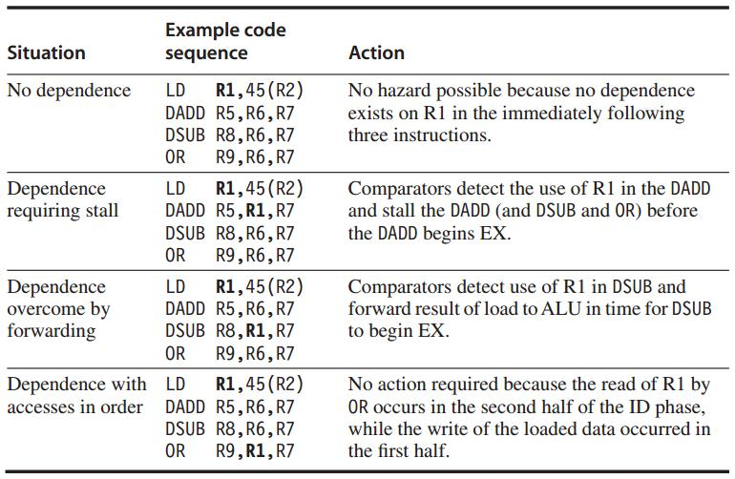
Data Hazard Example
Data hazards from Load
Comparison between the destination of Load
and the sources on the following two instructions

Slide 65
Stall
Prevent instructions in IF and ID from advancing
Change the control portion of ID/EX to be a no-op
Recirculate the contents of IF/ID registers to hold the stalled instr

Slide 66
Forwarding
Data path: from the ALU or data memory output to the ALU input, the data memory input, or the zero detection unit.
Compare the destination registers of EX/MEM.IR and MEM/WB.IR against the source registers of ID/EX.IR and EX/MEM.IR

Slide 67
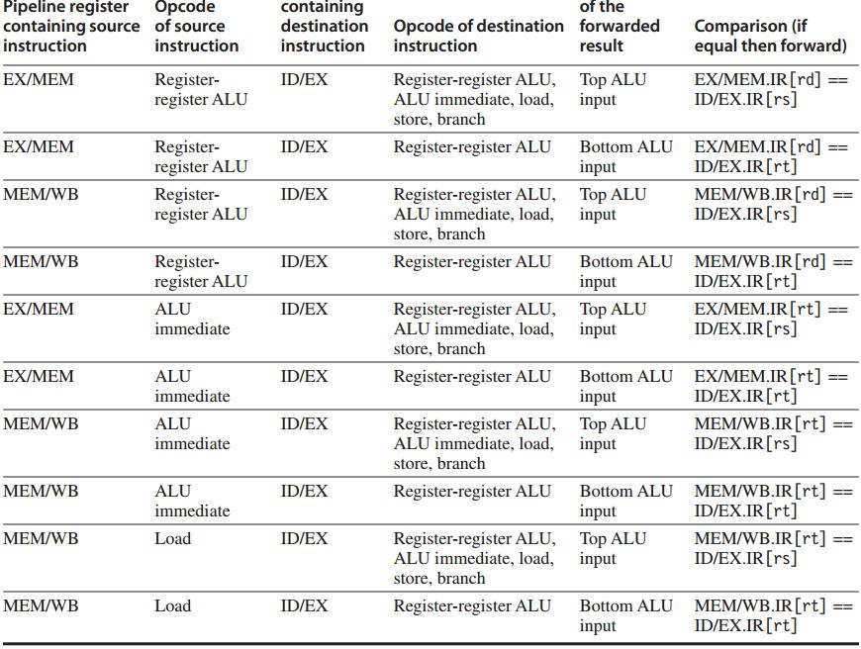
Example:
forwarding result is an ALU input

Slide 68
Forwarding: hw change
NextPC
ID/EX
EX/MEM
MEM/WR
Registers
mux
ALU
Data
Memory
mux
mux
Immediate
Source → sink
EX/Mem.ALUoutput → ALU input
MEM/WB.ALUoutput → ALU input
MEM/WB.LMD → ALU input

Slide 69
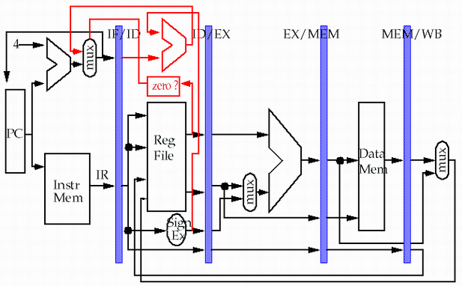
Forwarding: hw change
store
load
MEM/WB.LMD → DM input

Slide 70
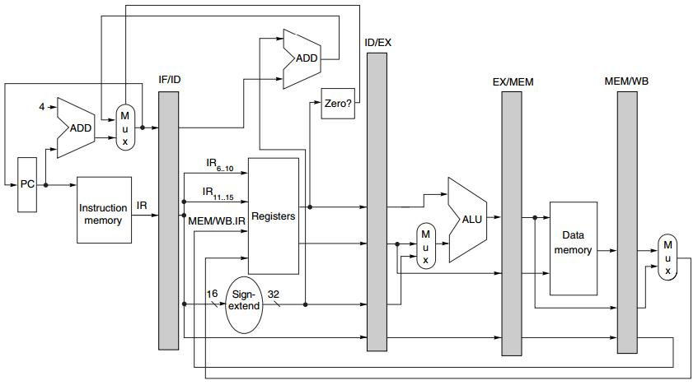
Branch
Move zero test to the ID stage
with an additional ADDer computing target address

Slide 71
… You know there’re exceptions.

Slide 72
Exceptions: Instruction Execution Order
aka interrupt/fault
When the normal execution order of instruction is changed
May force CPU to abort the instructions in the pipeline before they complete

Slide 73
Exceptions
Type
I/O device request
invoking os service from user program
tracing instruction execution
breakpoint
integer arithmetic overflow
FP arithmetic anomaly
page fault
misaligned memory address
memory protection violation
using undefined/unimplemented instruction
hardware malfunctions
power failure

Slide 74
Exceptions: Requirements
Synchronous vs Asynchronous
User requested vs Coerced
User maskable vs User nonmaskable
Within vs Between instructions
Resume vs Terminate

Slide 75
Sync vs Asynch
Synchronous
event occurs at the same place every time the program is executed with the same data and memory allocation
Asynchronous
caused by devices external to the CPU and memory

Slide 76
User requested vs Coerced
User requested
the user task directly asks for it
Coerced
caused by some hardware event that is not under the control of the user program

Slide 77
User non/maskable
User maskable
an event can / cannot be be masked or disabled by a user task

Slide 78
Within vs Between instr
Whether the event prevents intruction completion by occurring in the middle of execution (within) or is recognized between instructions

Slide 79
Resume vs Terminate
Resume
the program’s execution continues after the interrupt
Terminate
the program’s execution always stops after the interrupt

Slide 80
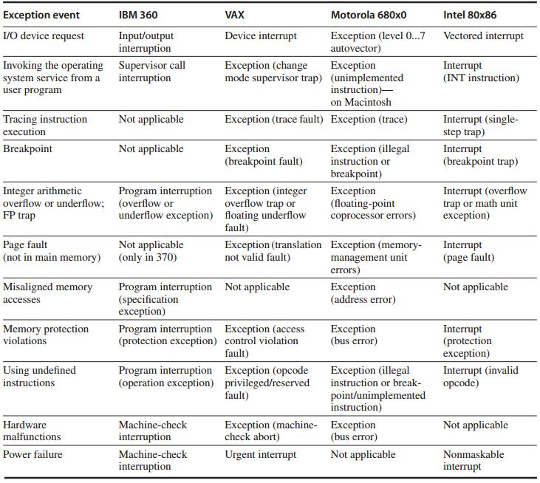
names of common exceptions
across four different architectures

Slide 81
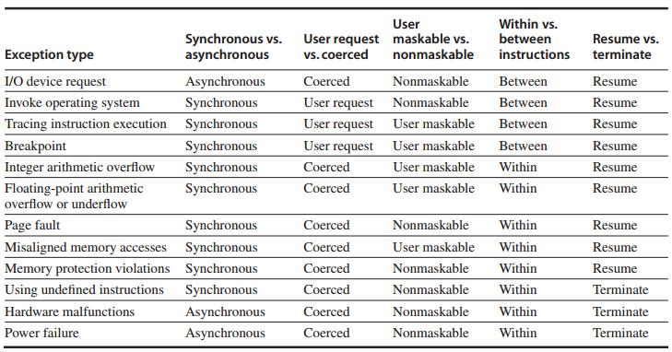
Exception Category

Slide 82
Instruction Set Complications
Instruction set specific factors that make pipelining harder to implement
PP. C-49 – C.51

Slide 83
Review
under MIPS architecture
How an MIPS instruction works?
How MIPS instructions pipleline?
Notes:
In particular, we’ll discuss how an MIPS instruction works atop such data paths, and how such data paths support MIPS pipeline.

Slide 84

Appendix C.3-C.4
Notes:
These contents correspond to the second part of Appendix C.

Slide 85
?

Slide 86
Quiz 1 & Lab 2
Quiz 1 November 08: Lectures 01-07
instruction, pipeline
basics in Chapter 1
Lab 2: 5-stage pipeline with 15 MIPS ins
Demo due November 22
Report due November 30
Final Exam: 2018.01.20
08:00-10:00

Slide 87
#What’s More
What Matters More than Your Talents? by Jeff Bezos

