Slide 1
Memory Hierarchy
Virtual Memory
09
Kai Bu
kaibu@zju.edu.cn
http://list.zju.edu.cn/kaibu/comparch2017

Slide 2
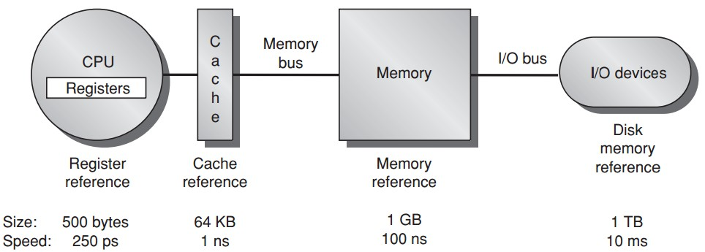
Memory Hierarchy
Notes:
In last lecture, we discussed the major framework of memory hierarchy.
After a data reference leaves CPU, it’ll first access cache. If the desired data is not found therein, the searching proceeds to main memory.
If the searching still fails, corresponding data will be loaded to memory from disk, and then further fed back to CPU register.

Slide 3
Memory Hierarchy
addr
Notes:
Computers are constantly running multiple processes, each with its own address space.
If we directly use memory address as process address space,

Slide 4
Memory Hierarchy
addr
Larger memory for more processes?
Notes:
we definitely need a huge memory.
But as we previously discussed, memory should be limited in size to preserve high processing speed and low system cost.

Slide 5
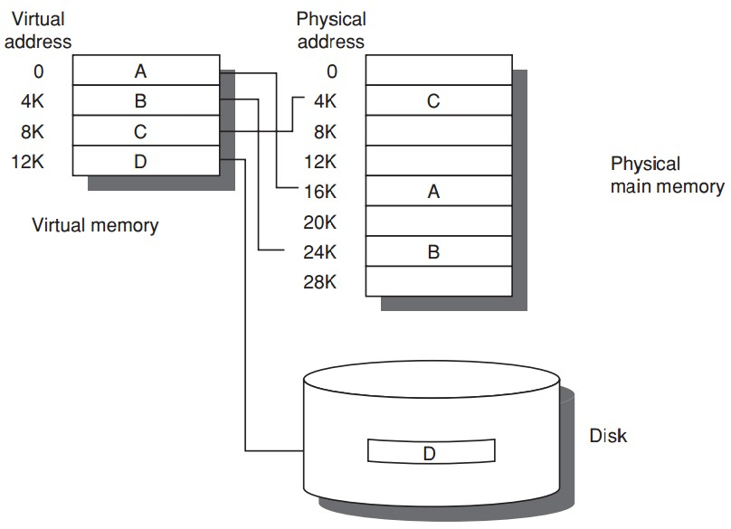
Virtual Memory
+
Notes:
To solve this dilemma, virtual memory is introduced.

Slide 6
Virtual Memory
Program uses
discontiguous memory locations
+ secondary/non-memory storage
Notes:
It enables a process to use discontiguous memory locations while integrating disk into the larger physical memory.

Slide 7
Virtual Memory
Program thinks
contiguous memory locations
larger physical memory
Notes:
But from the process’s point of view, it’s as if a larger physical memory were in use and contiguous memory locations were allocated.

Slide 8
Preview
Why virtual memory (besides larger)?
Virtual-physical address translation?
Memory protection/sharing among multi-program?
Notes:
Besides giving process an illusion of larger physical memory, any other benefits from virtual memory?
How can we translate virtual address to physical address?
How can we isolate memory access among different processes?
All these questions will be answered in today’s lecture.

Slide 9
more behind the scenes:
why virtual memory?
Notes:
So first, the motivation of virtual memory.

Slide 10
Prior Virtual Memory
Main/Physical Memory
Contiguous allocation
Direct memory access
Direct memory access
allocated
Process A
Process B
allocated
Notes:
If we directly map process address space to physical memory address, we need to follow contiguous allocation like this.
Then each process can use direct memory access using physical memory address.

Slide 11
Prior Virtual Memory
Main/Physical Memory
efficiency?
used
Process A
Process B
used
Notes:
One possible limitation of such direct memory access is low memory efficiency.
As we can see, at certain time instants, a process uses way less memory than it is allocated for.

Slide 12
Prior Virtual Memory
Main/Physical Memory
protection?
used
Process A
Process B
used
Notes:
Another limitation is lack of memory protection to prevent a process from accessing memory allocated for other processes.

Slide 13
Prior Virtual Memory
Main/Physical Memory
Easier/flexible memory management
Virtual memory
used
used
Process A
Process B
used
used
Notes:
To address the above limitations, virtual memory introduces an indirect mapping from the memory address processes use to the physical memory address where data actually locates.

Slide 14
Prior Virtual Memory
Main/Physical Memory
Share a smaller amount of physical memory among many processes
Virtual memory
used
used
Process A
Process B
used
used
Notes:
Each process still thinks that the same amount of memory space is allocated for it;
But in practical, not all data needs to be pre-loaded into memory and processed data could be evicted from memory.
This way, a smaller physical memory can support more processes.

Slide 15
Prior Virtual Memory
Main/Physical Memory
Physical memory allocations
need not be contiguous
Virtual memory
used
used
used
Process A
used
Process B
used
used
used
used
Notes:
Besides, memory allocations no longer need to be contiguous,
Virtual address can point to any physical address.

Slide 16
Prior Virtual Memory
Main/Physical Memory
memory protection;
process isolation
Virtual memory
used
used
used
Process A
used
Process B
used
used
used
used
Notes:
As now processes access memory through virtual address instead of physical address,
with well designed address mapping,
we can make sure that a process cannot access memory allocated for other processes.

Slide 17
Prior Virtual Memory
Main/Physical Memory
Introduces another level of
secondary storage
Virtual memory
used
used
used
Process A
used
Process B
used
used
used
used
Notes:
To support larger virtual memory space, data blocks corresponding to virtual addresses can also be temporarily stored in secondary storage like disk and swapped to memory when needed.

Slide 18
Virtual Memory =
Main Memory + Secondary Storage
Notes:
So in summary, virtual memory architecture integrates both main memory and secondary storage like disk.

Slide 19
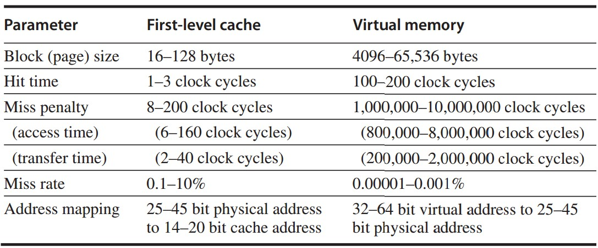
Cache vs Virtual Memory
Notes:
Here’s a quantitative comparison of cache and virtual memory.
The major difference is that virtual memory has larger address space but slower processing speed than cache.

Slide 20
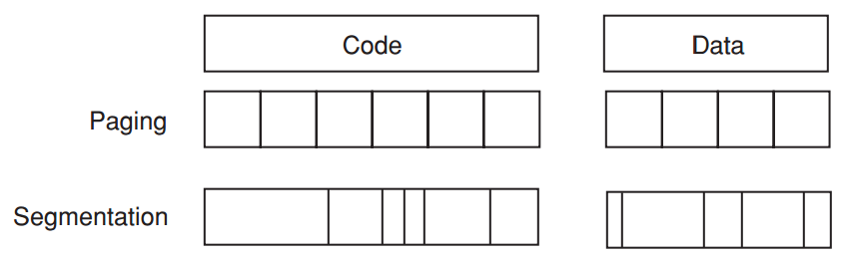
Virtual Memory Allocation
Paged virtual memory
page: fixed-size block
Segmented virtual memory
segment: variable-size block
Notes:
There are two ways to allocate virtual memory according to whether data block has fixed size.
When using fixed-size block, we call it paged virtual memory.
Otherwise, we call it segmented virtual memory.

Slide 21
Virtual Memory Allocation
Address
Paged virtual memory
page address: page # || offset
Segmented virtual memory
segment address: seg # offset
one word
concatenate
two words
Notes:
Page address is one word long, containing page number and offset within the page;
While segment address is two words long, containing segment number and offset within the segment.

Slide 22
Pros & Cons?
Notes:
Now given the two types of memory allocation schemes, which one should we choose?

Slide 23
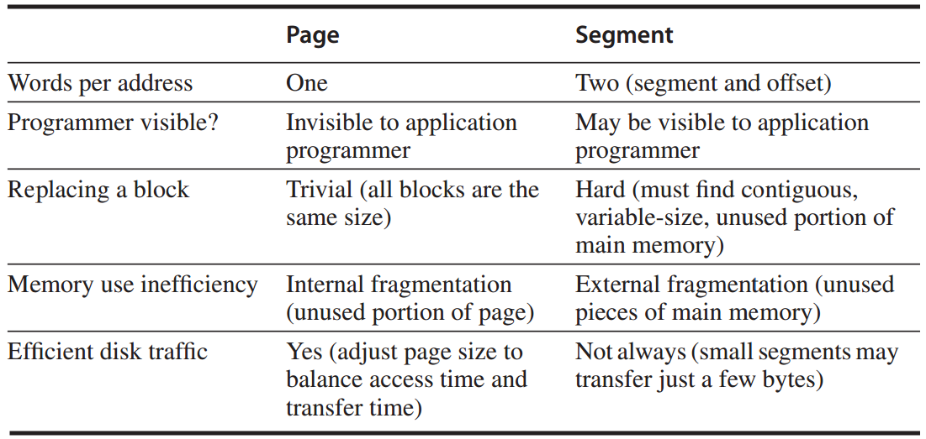
Paging vs Segmentation
http://www.cnblogs.com/felixfang/p/3420462.html
Notes:
This table compares properties of the two schemes.
Again, every scheme has its own pros and cons.
We need to base our choice on specific conditions; and sometimes we may use a hybrid design.
Block replacement and Memory use inefficiency;

Slide 24
How virtual memory works?
Four Questions
Notes:
Based on these basics of virtual memory,
Now let’s discuss how exactly virtual memory works.

Slide 25
How virtual memory works?
Four Questions
Notes:
In particular, we’ll walk through its working principles via investigating four questions.

Slide 26
Four Mem Hierarchy Q’s
Q1. Where can a block be placed in main memory?
Fully associative strategy:
OS allows blocks to be placed anywhere in main memory
Because of high miss penalty by
access to a rotating magnetic storage device upon page/address fault
Notes:
The first question, block placement in memory.
Still remember block placement strategies when we discussed about cache?
For memory, block placement is fully associative, that is, the OS allows blocks to be placed anywhere in the memory.
The main reason is to load as more blocks as possible to memory, as access to a rotating disk upon memory miss causes high miss penalty.

Slide 27
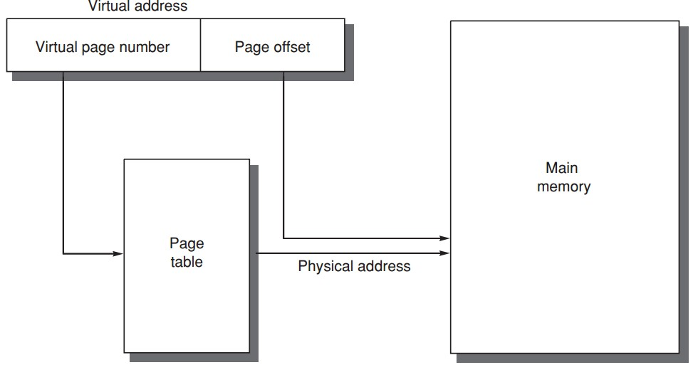
Four Mem Hierarchy Q’s
Q2. How is a block found if it is in main memory?
table
entry
VPN PPN
PPN
offset
Notes:
So now a block could be placed anywhere in the memory, given a virtual address, how can we find the exact corresponding physical address?
The solution is using page table to track the mapping between virtual address and physical address.
Specifically, each entry of the page table records which physical page a virtual page maps to.
Then using the offset contained in virtual address, we can locate the exact data within the physical page.

Slide 28
Four Memory Hierarchy Q’s
Q3. Which block should be replaced on a virtual memory miss?
Least recently used (LRU) block
use/reference bit
--logically set whenever a page is accessed;
--OS periodically clears use bits and later records them to track the least recently referenced pages;
Notes:
But there should be cases when certain block cannot be found in memory, right?
In this case, we face with the third question, which block to replace upon memory miss.
The replacement strategy is to replace the least recently used block.
The idea is using a use bit to mark a block when it’s accessed. This way, blocks with use bits unset could be selected as targets for replacement.

Slide 29
Four Mem Hierarchy Q’s
Q4. What happens on a write?
Write-back strategy
as accessing rotating magnetic disk takes millions of clock cycles;
Dirty bit
write a block to disk only if it has been altered since being read from the disk;
Notes:
The fourth question, write strategy.
Virtual memory adopts write-back strategy, that is, data is first updated to memory, and then to disk upon replacing the data in memory.
The reason is the slow speed for accessing rotating disk; write-back strategy requires accessing disk for write only when necessary.
Virtual memory also uses a dirty bit to track their integrity. For a block read from disk to memory, they will be written back to disk only if it has been modified.

Slide 30
well…tell me more
Address Translation
Notes:
Certainly we need more details to understand virtual memory, right?

Slide 31
well…tell me more
Address Translation
Notes:
Now let’s proceed to detail the entire process of translating virtual address to physical address.

Slide 32
Page Table ?
physical page number || page offset = physical address
page
table
Notes:
As we mentioned, address translation relies heavily on page table, which records the mapping from virtual page number to physical page number.
Given a virtual address, we first use its virtual page number as index to query the page table and find its corresponding physical page number.
Then concatenating the physical page number with the page offset in virtual address, we get the physical address.

Slide 33
Page Table ?
Page tables are often large
32-bit virtual address, 4KB pages,
4 bytes per page table entry.
page table size:
(2³²/2¹²) x 2² = 2²² bytes = 4 MB
Notes:
Page tables are often large in size,
For example, given a 32-bit virtual address, 4-kilobyte page, and 4-byte page table entry,
The size of corresponding page table would be as large as 4 megabyte.

Slide 34
Page Table ?
Page tables are stored in main memory
Logically two memory accesses for
data access:
one to obtain the physical address from page table;
one to get the data from the physical address;
Access time doubled
How to be faster?
Notes:
Page tables are stored in main memory;
This costs each data access two memory accesses:
One to obtain the physical address from the page table, and one to get the data from the physical address;
Obviously, this doubles access time; so how to be faster?

Slide 35
Translation lookaside buffer (TLB)
/translation buffer (TB)
a special cache!
that keeps (prev) address translations
TLB entry
--tag: portions of the virtual address;
--data: a physical page frame number, protection field, valid bit, use bit, dirty bit;
Notes:
Use cache, right?

Slide 36
Learn from History
Translation lookaside buffer (TLB)
/translation buffer (TB)
a special cache!
that keeps (prev) address translations
TLB entry
--tag: portions of the virtual address;
--data: a physical page frame number, protection field, valid bit, use bit, dirty bit;
Notes:
We introduce a special cache called TLB to cache previous address translations;
Each entry in TLB records a previous mapping from a virtual page number to a physical page number.
Specifically, two major parts of each entry work for this:
The tag part records virtual page number while the virtual address part records the physical page number.

Slide 37
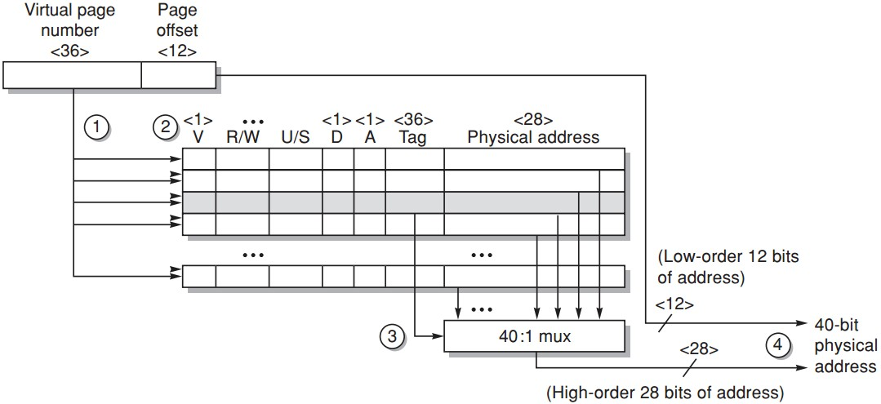
TLB Example
Opteron data TLB
Steps 1&2: send the virtual address to all tags
Step 2: check the type of mem access against protection info in TLB
https://www.youtube.com/watch?v=95QpHJX55bM
Notes:
Here’s an example of how TLB works for address translation.
First, the virtual page number is sent to compare with all tags;

Slide 38
TLB Example
Opteron data TLB
Steps 3: the matching tag sends phy addr through multiplexor
Notes:
The matching tag returns its physical page number through multiplexor;

Slide 39
TLB Example
Opteron data TLB
Steps 4: concatenate page offset to phy page frame to form final phy addr
Notes:
Then the physical page number is combined with page offset to form the physical address.

Slide 40
Does page size matter?
Notes:
When we studied cache, we knew that block size matters to cache performance.
Now TLB is also a cache and we use page as the basic transfer unit, does page size also affect system performance?

Slide 41
Page Size Selection
Pros of larger page size
Smaller page table, less memory (or other resources used for the memory map);
Larger cache with fast cache hit;
Transferring larger pages to or from secondary storage is more efficient than transferring smaller pages;
Map more memory, reduce the number of TLB misses;
Notes:
Let’s first see what advances can larger page size promise.

Slide 42
Page Size Selection
Pros of smaller page size
Conserve storage
When a contiguous region of virtual memory is not equal in size to a multiple of the page size,
a small page size results in less wasted storage.
Notes:
On the other hand, smaller page size has also some advances of its own.
Main advance is conserving storage.
Reason: less internal fragmentation

Slide 43
Page Size Selection
Use both: multiple page sizes
Recent microprocessors have decided to support multiple page sizes, mainly because of larger page size reduces the # of TLB entries and thus the # of TLB misses;
for some programs, TLB misses can be as significant on CPI as the cache misses;
Notes:
For real deployment, page size is not strictly confined with a certain size.
Instead, recent microprocessors support multiple page sizes, reaping the benefits of both larger and smaller page sizes.

Slide 44
Virtual Memory =
Main Memory + Secondary Storage
Notes:
Now we discussed various key principles of virtual memory

Slide 45
Virtual Memory =
Main Memory + Secondary Storage
Notes:
But between cpu and virtual memory, there’s still cache, right?

Slide 46
Address Translation:
one more time, with cache
Notes:
So let’s review address translation once again, but with cache jumping in this time

Slide 47
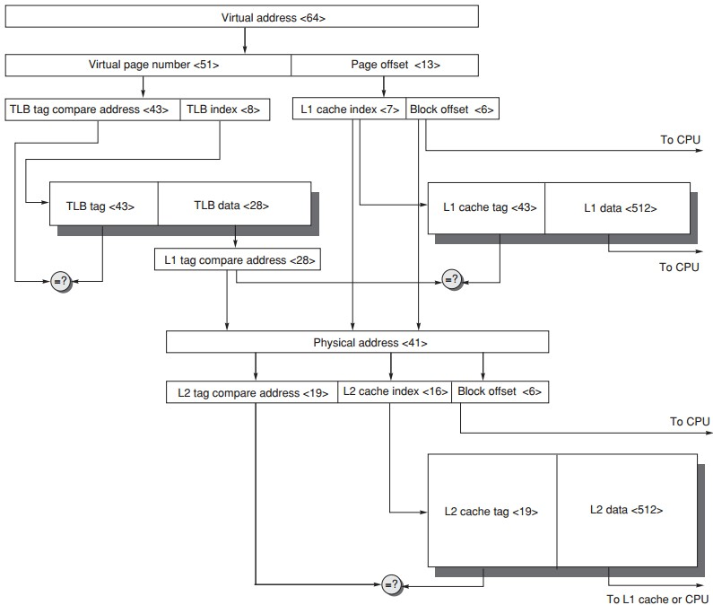
Address Translation
64-bit virtual address
41-bit physical address
page size: 8KB
two-level direct-mapped caches
64-byte blocks
L1: 8KB
L2: 4MB
TLB 256 entries

Slide 48
Address Translation
2¹³ = 8KB page
64-bit virtual address
41-bit physical address
page size: 8KB
two-level direct-mapped caches
64-byte blocks
L1: 8KB
L2: 4MB
TLB 256 entries

Slide 49
Address Translation
2⁸ = 256 entries
64-bit virtual address
41-bit physical address
page size: 8KB
two-level direct-mapped caches
64-byte blocks
L1: 8KB
L2: 4MB
TLB 256 entries

Slide 50
Address Translation
2⁶ = 64byte block
= 41 - 13
64-bit virtual address
41-bit physical address
page size: 8KB
two-level direct-mapped caches
64-byte blocks
L1: 8KB
L2: 4MB
TLB 256 entries

Slide 51
Address Translation
2⁶ = 64byte block
2¹³ = 8KB L1 cache
2⁶ = 64byte block
2⁷ = 2¹³/2⁶
64-bit virtual address
41-bit physical address
page size: 8KB
two-level direct-mapped caches
64-byte blocks
L1: 8KB
L2: 4MB
TLB 256 entries

Slide 52
Address Translation
64-bit virtual address
41-bit physical address
page size: 8KB
two-level direct-mapped caches
64-byte blocks
L1: 8KB
L2: 4MB
TLB 256 entries
2⁶ = 64byte block
2²² = 4MB L2 cache
2⁶ = 64byte block
2¹⁶ = 2²²/2⁶

Slide 53
ready?

Slide 54
Address Translation
64-bit virtual address
41-bit physical address
page size: 8KB
two-level direct-mapped caches
64-byte blocks
L1: 8KB
L2: 4MB
TLB 256 entries

Slide 55
Address Translation
64-bit virtual address
41-bit physical address
page size: 8KB
two-level direct-mapped caches
64-byte blocks
L1: 8KB
L2: 4MB
TLB 256 entries

Slide 56
Address Translation
64-bit virtual address
41-bit physical address
page size: 8KB
two-level direct-mapped caches
64-byte blocks
L1: 8KB
L2: 4MB
TLB 256 entries

Slide 57
You said virtual memory promised safety?
Mem protection & sharing among programs

Slide 58
You said virtual memory promised safety?
mem protection & sharing among programs

Slide 59
Multiprogramming
Enable a computer to be shared by several programs running concurrently
Need protection and sharing among programs

Slide 60
Process
A running program plus any state needed to continue running it
Time-sharing
shares processor and memory with interactive users simultaneously;
gives the illusion that all users have their own computers;
Process/context switch
from one process to another
Notes:
gives the illusion that all users have their own computers;
But, actually, process switch from one to another

Slide 61
Process
Maintain correct process behavior
--computer designer must ensure that the processor portion of the process state can be saved and restored;
--OS designer must guarantee that processes do not interfere with each others’ computations;
Partition main memory so that several different processes have their state in memory at the same time

Slide 62
Process Protection
Proprietary page tables
processes can be protected from one another by having their own page tables,
each pointing to distinct pages of memory;
user programs must be prevented from modifying their page tables

Slide 63
Process Protection
Rings
added to the processor protection structure,
expands memory access protection to multiple levels.
The most trusted accesses anything
The second most trusted accesses everything except the innermost level
…
The civilian programs are the least trusted, have the most limited range of accesses.

Slide 64
Process Protection
Keys and Locks
a program cannot unlock access to the data unless it has the key
For keys/capabilities to be useful, hardware and OS must be able to explicitly pass them from one program to another
without allowing a program itself to forge them

Slide 65
Example 1: Intel Pentium
Segmented virtual memory
IA-32: four levels of protection
(0) innermost level, kernel mode;
(3) outermost level, least privileged mode;
separate stacks for each level to avoid security breaches between the levels

Slide 66
Example 1: Intel Pentium
Add bounds checking and memory mapping
base + limit fields
Add sharing and protection
global/local address space;
a field giving a seg’s legal access level;
Add safe calls from user to OS gates and inheriting protection level for parameters
call gate

Slide 67
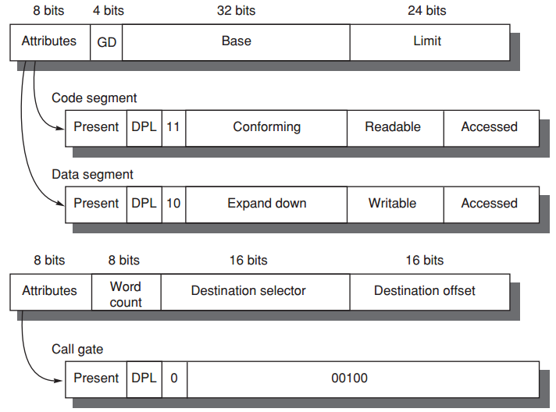
Example 1: Intel Pentium
Segment Descriptors
Page B-53

Slide 68
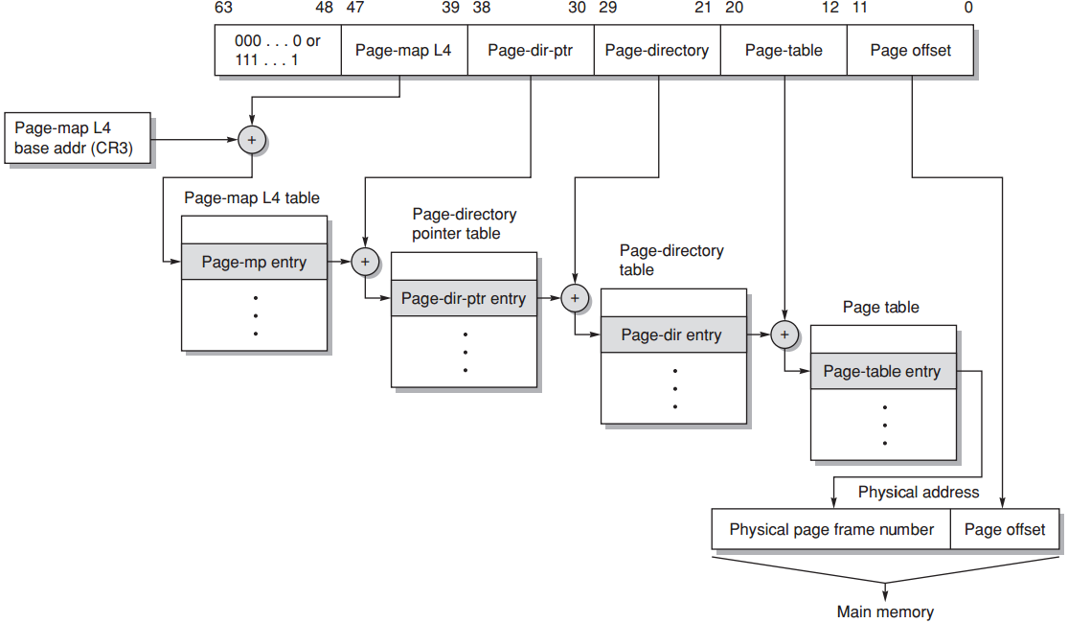
Example 2: 64-bit Opteron
Paged virtual memory
Multilevel hierarchical page table;
Page tables are protected from being written by user programs;
Sharing of memory between processes is accomplished by having a page table entry in each address space point to the same physical memory page;
Page B-55

Slide 69
Review
Why virtual memory (besides larger)?
Virtual-physical address translation?
Memory protection/sharing among multi-program?
Notes:
Besides giving process an illusion of larger physical memory, any other benefits from virtual memory?
How can we translate virtual address to physical address?
How can we isolate memory access among different processes?
All these questions will be answered in today’s lecture.

Slide 70

Appendix B.4-B.5
Notes:
And the content about to discuss can be found in Appendix B in the textbook.

Slide 71
?

Slide 72
#What’s More
Peaceful Warrior by Dan Millman
Focus all your energy not on struggling with the old, but on building the new.
Old urges continue to arise, but urges do not matter; only actions do. A warrior is as a warrior does.

