Slide 1
Storage Systems
Disk, RAID, Dependability
11
Kai Bu
kaibu@zju.edu.cn
http://list.zju.edu.cn/kaibu/comparch2017
Notes:
Today we’ll proceed with the second last chapter, Storage Systems. It consists of two lecture sessions.
In the first session, we discuss the basics of disks, and how a bunch of them work in RAID fashion;
RAID stands for Redundant Array of Inexpensive/Independent Disks, 冗余磁盘阵列 in Chinese.
Its main goal is to enhance disk dependability, that is, when a disk fails, redundant data stored on other disks can help recover lost data on the failed one.
Before delving into these details,

Slide 2
1960s – 1980s
Computing Revolution
Notes:
Ok, so, after the first computer was built, much effort was dedicated to enhancing the computation capability of computers,
so that computers could deliver various functions more and more quickly.

Slide 3
1990 –
Information Age
Notes:
When computation power rose to a certain level, the focus shifted more to information technology.

Slide 4

Communication
Computation
Storage
Notes:
Internet is definitely the main stimulus for information age.
For Internet to function well,
Communication protocols transmit and exchange data among connected computers while storage devices hold the data to be exchanged and operated on.
Between the two building blocks, communication and storage

Slide 5
Communication
Computation
Storage
Notes:
Between the two building blocks, communication and storage

Slide 6
Communication
Computation
Storage
Notes:
storage is our focus of today’s lecture;

Slide 7
Communication
Computation
Storage
requires higher standard of dependability than the rest of the computer
Notes:
Storage requires higher dependability than other computer components.

Slide 8
Communication
Computation
Storage ?
requires higher standard of dependability than the rest of the computer
Notes:
But why is that?
Now let’s consider about this based on how users react to failures of different components.

Slide 9

program crash
Communication
Computation
Storage
requires higher standard of dependability than the rest of the computer
Notes:
For example, users got frustrated upon program crash. But usually it’s tolerable.

Slide 10

Communication
Computation
Storage
data loss
requires higher standard of dependability than the rest of the computer
Notes:
However, if the disk is not dependant enough and fails, data loss might drive most users crazy.

Slide 11
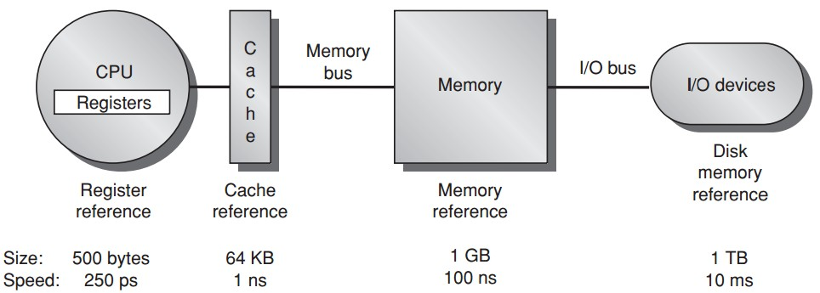
Memory Hierarchy
t e m p o r a r y s t o r a g e
permanent
storage
Notes:
As disk is the only part for permanent storage in our computers.

Slide 12
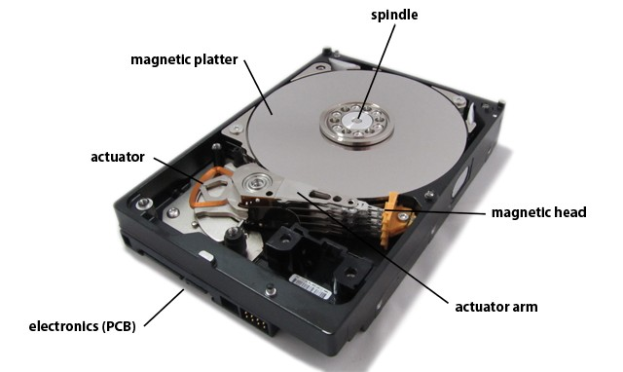
Communication
Storage
magnetic disks dominate
Notes:
Here’s the working environment of disks.

Slide 13
Preview
Disk
Disk Array: RAID
Dependability: Fault, Error, Failure
Notes:
After discussing the basics of a single disk,
We’ll explore how to spread redundant data across multiple disks toward higher dependability. This technique is called RAID.
Regarding dependability, we’ll introduce several performance measures, like fault, error, and failure.

Slide 14
let’s start from a single disk
Notes:
So now, let’s start from understanding how a single disk works.

Slide 15
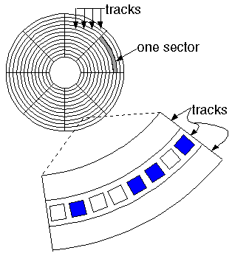
Disk
http://cf.ydcdn.net/1.0.1.19/images/computer/MAGDISK.GIF
Notes:
A disk consists of many circles of tracks;
Each track can be further divided into some sectors.

Slide 16
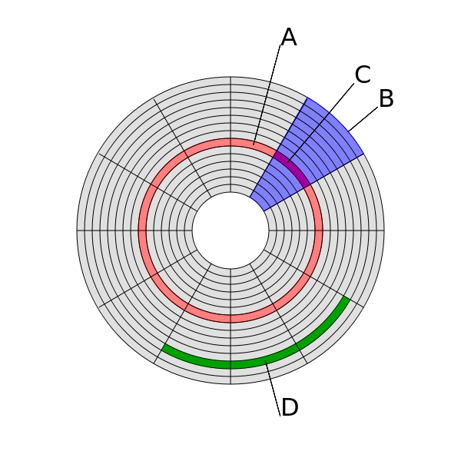
Disk
: wiki
track
(track) sector
geometrical
sector
cluster
https://en.wikipedia.org/wiki/Data_cluster
Notes:
This is a more detailed view of disk structure.

Slide 17
Disk
: wiki
track
Sector
minimum storage unit
a block may span multiple sectors
sector
geometrical
sector
cluster
https://en.wikipedia.org/wiki/Data_cluster
Notes:
Sector is the minimum storage unit,
All files must occupy at least one sector, regardless of the actual file size.
When we discuss about instructions and memory, block is the minimum data transfer unit, right? A block may span multiple sectors;

Slide 18
Disk
: wiki
track
Sector
minimum storage unit
a block may span multiple sectors
Cluster
(dis)contiguous groups of sectors
to reduce the overhead of managing on-disk data structures;
may span more than one track
sector
geometrical
sector
cluster
https://en.wikipedia.org/wiki/Data_cluster
Notes:
A cluster need not be physically contiguous on the disk; it may span more than one track or, if sector interleaving is used, may even be discontiguous within a track.

Slide 19
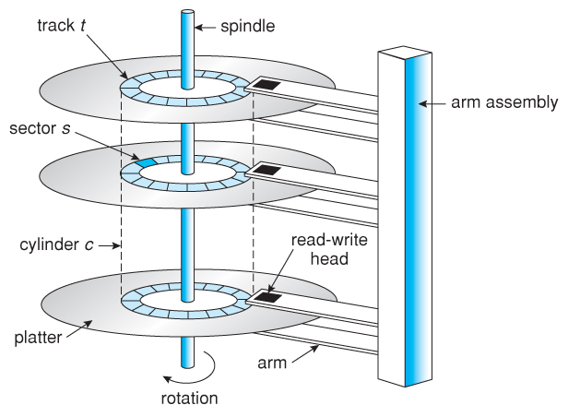
Disk
http://www.cs.uic.edu/~jbell/CourseNotes/OperatingSystems/images/Chapter10/10_01_DiskMechanism.jpg
Notes:
Disk architebure:
Multiple platters mounted to a rotating spindle;

Slide 20
Disk
: locate data
http://www.cs.uic.edu/~jbell/CourseNotes/OperatingSystems/images/Chapter10/10_01_DiskMechanism.jpg
CHS index
Notes:
Disk architebure:
Multiple platters mounted to a rotating spindle;

Slide 21
Disk Capacity
Areal Density
=bits/inch²
=(tracks/inch) x (bits-per-track/inch)
Notes:
bits per square inch

Slide 22
Disk Capacity
Areal Density
in 2011, the highest density
400 billion bits/inch²
Costs per gigabyte
between 1983 and 2011,
improved by almost
a factor of 1,000,000
Notes:
One million times of cost reduction

Slide 23
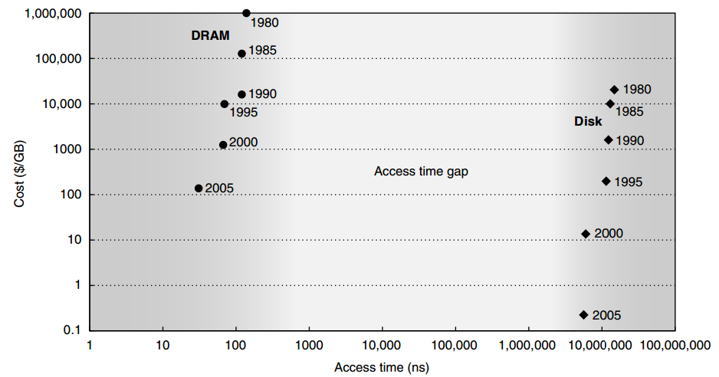
Disk vs DRAM
Cost DRAM >> DISK
Access time DRAM << DISK

Slide 24
Disk’s Competitor
Flash Memory
non-volatile semiconductor memory;
same bandwidth as disks;
100 to 1000 times faster;
15 to 25 times higher cost/gigabyte;
Wear out
limited to 1 million writes
Popular in cell phones,
but not in desktop and server

Slide 25
Disk Power
Power by disk motor
≈Diameter^{4.6} x RPM^{2.8} x No. of platters
RPM: Revolutions Per Minute rotation speed

Slide 26
Disk Power
Power by disk motor
≈Diameter^{4.6} x RPM^{2.8} x No. of platters
RPM: Revolutions Per Minute rotation speed
Smaller patters, slower rotation, and fewer platters reduce disk motor power

Slide 27
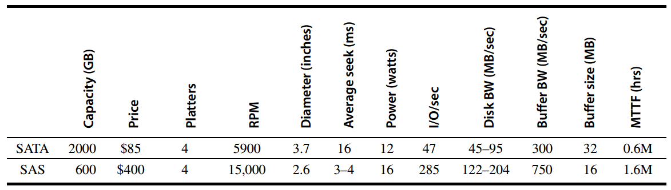
Disk Power
disk
Notes:
How different parameters impact disk power

Slide 28
what if one is not enough…
disk failure
all or nothing

Slide 29
what if one is not enough…
disk failure
all or nothing

Slide 30

what if one is not enough…
disk failure
all or nothing

Slide 31
Disk Arrays
Disk arrays with redundant disks to tolerate faults
If a single disk fails, the lost information is reconstructed from redundant information
Striping: simply spreading data over multiple disks
RAID: redundant array of inexpensive/independent disks

Slide 32
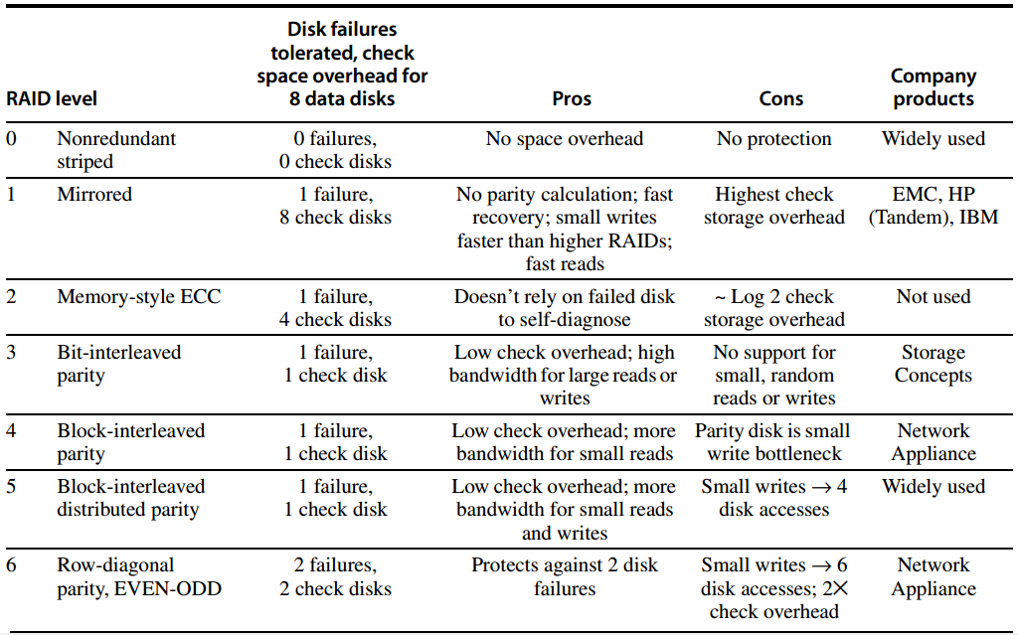
RAID

Slide 33
RAID 0
JBOD: just a bunch of disks
No redundancy
No failure tolerated
Measuring stick for other RAID levels: cost, performance, and dependability

Slide 34
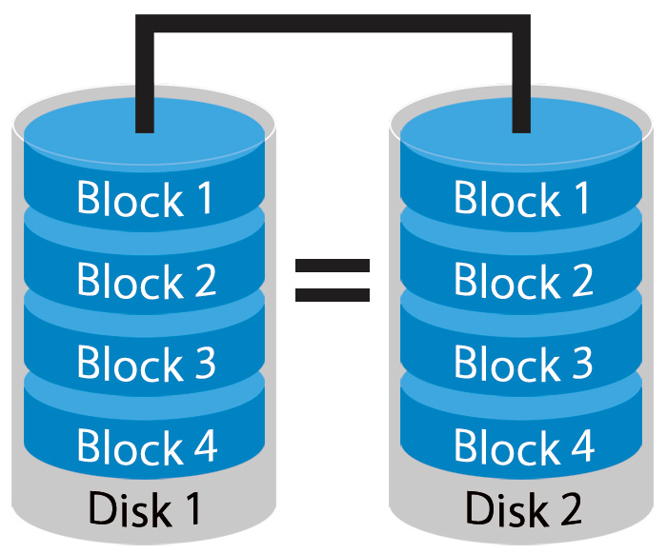
RAID 1
Mirroring or Shadowing
Two copies for every piece of data
one logical write = two physical writes
100% capacity/space
overhead
http://www.petemarovichimages.com/wp-content/uploads/2013/11/RAID1.jpg

Slide 35
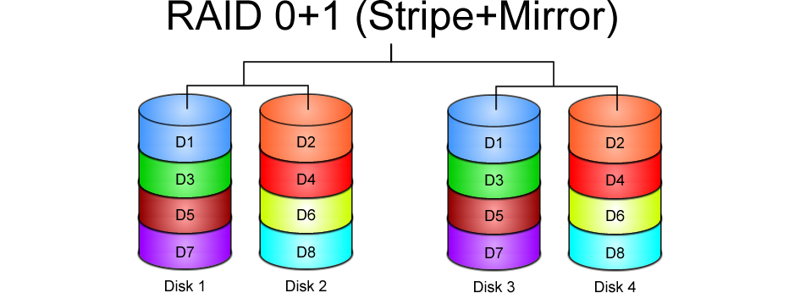
https://www.icc-usa.com/content/raid-calculator/raid-0-1.png

Slide 36
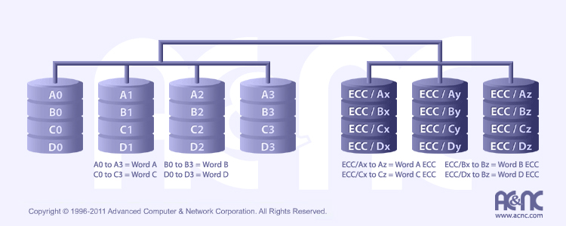
RAID 2
http://www.acnc.com/raidedu/2
Each bit of data word is written to a data disk drive
Each data word has its (Hamming Code) ECC word recorded on the ECC disks
On read, the ECC code verifies correct data or corrects single disks errors

Slide 37
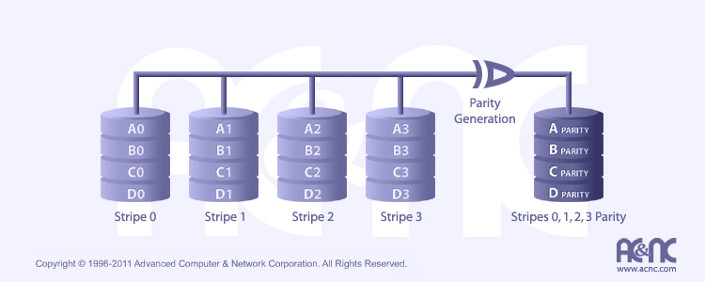
RAID 3
http://www.acnc.com/raidedu/3
Data striped over all data disks
Parity of a stripe to parity disk
Require at least 3 disks to implement

Slide 38
RAID 3
Even Parity
parity bit makes
the # of 1 even
p = sum(data1) mod 2
P
1
0
1
0
0
0
1
1
1
1
0
0
1
1
0
1
1
0
1
0
0
0
1
1
1
1
0
0
1
1
0
1

Slide 39
RAID 3
Even Parity
parity bit makes
the # of 1 even
p = sum(data1) mod 2
Recovery
if a disk fails,
“subtract” good data
from good blocks;
what remains is missing data;
P
1
0
1
0
0
0
1
1
1
0
1
0
0
0
1
1
1
1
0
0
1
1
0
1

Slide 40
RAID 3
“subtract”
1 – 1 = 0
1 – 0 = 1
0 – 1 = 1
0 – 0 = 0
Even Parity
parity bit makes
the # of 1 even
p = sum(data1) mod 2
Recovery
if a disk fails,
“subtract” good data
from p of good blocks;
what remains is missing data;
P
1
0
1
0
0
0
1
1
1
1
0
0
1
1
0
1
1
0
1
0
0
0
1
1
1
1
0
0
1
1
0
1

Slide 41

RAID 4
http://www.acnc.com/raidedu/4
Favor small accesses
Allows each disk to perform independent reads, using sectors’ own error checking
independent read - not read across multiple disks

Slide 42
RAID 3 & RAID 4
bottleneck:
single parity disk
access:
parallel vs independent

Slide 43
RAID 3 & RAID 4
? bottleneck:
single parity disk
access:
parallel vs independent

Slide 44
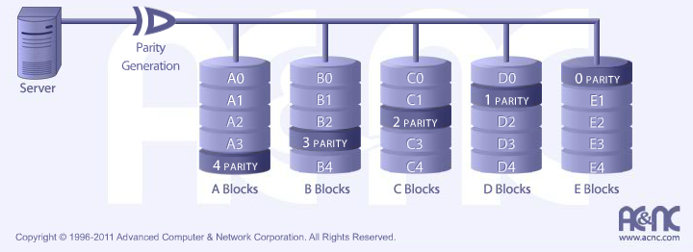
RAID 5
http://www.acnc.com/raidedu/5
Distributes the parity info across all disks in the array
Removes the bottleneck of a single parity disk as RAID 3 and RAID 4

Slide 45
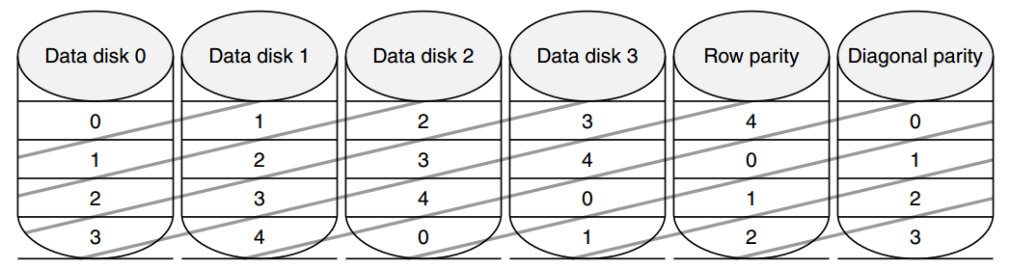
RAID 6: Row-diagonal Parity
RAID-DP
Recover from two failures
xor
row: 00+11+22+33=r4
diagonal: 01+11+31+r1=d1

Slide 46
RAID 6: Row-diagonal Parity
RAID-DP
Recover from two failures
xor
row: 00+11+22+33=r4
diagonal: 01+11+31+r1=d1

Slide 47
Double-Failure Recovery

Slide 48
Double-Failure Recovery

Slide 49
Double-Failure Recovery

Slide 50
Double-Failure Recovery

Slide 51
Double-Failure Recovery

Slide 52
Double-Failure Recovery

Slide 53
Double-Failure Recovery

Slide 54
Double-Failure Recovery

Slide 55
Double-Failure Recovery

Slide 56
Double-Failure Recovery

Slide 57
Double-Failure Recovery

Slide 58
Double-Failure Recovery

Slide 59
Double-Failure Recovery

Slide 60
RAID: Further Readings
Raid Types – Classifications
BytePile.com
https://www.icc-usa.com/content/raid-calculator/raid-0-1.png
RAID
JetStor
http://www.acnc.com/raidedu/0

Slide 61
More error detection and recovery schemes
Reed Solomon coding: https://www.youtube.com/watch?v=jgO09opx56o
Erasure coding, etc.

Slide 62
When are disks dependable and when are they not?

Slide 63
Dependability
Computer system dependability is the quality of delivered service such that reliance can justifiably be placed on this service.

Slide 64
The service delivered by a system is its observed actual behavior as perceived by other system(s) interacting with this system’s users.

Slide 65
Each module also has an ideal specified behavior, where a service specification is an agreed description of the expected behavior.

Slide 66
Failure
A system failure occurs when the actual behavior deviates from the specified behavior.

Slide 67
Error, Fault
The failure occurred because of an error, a defect in that module.
The cause of an error is a fault.
When a fault occurs, it creates a latent error, which becomes effective when it is activated;
When the error actually affects the delivered service, a failure occurs.

Slide 68
Fault, Error, Failure
A fault creates one or more latent errors
Either an effective error is a formerly latent error in that component or it has propagated from another error in that component or from else where
A component failure occurs when the error affects the delivered service

Slide 69
Failure
Error
Fault
affect the delivered service
activated to be effective
one or more latent errors

Slide 70
Categories of Faults by Cause
Hardware faults
failed devices
Design faults
usually in software design;
occasionally in hardware design;
Operation faults
mistakes by operations and maintenance personnel;
Environmental faults
fire, flood, earthquake, power failure, sabotage;

Slide 71
Categories of Faults by Duration
Transient faults
exist for a limited time and are not recurring;
Intermittent faults
cause a system to oscillate between faulty and fault-free operation
Permanent faults
do not correct themselves with the passing of time;

Slide 72
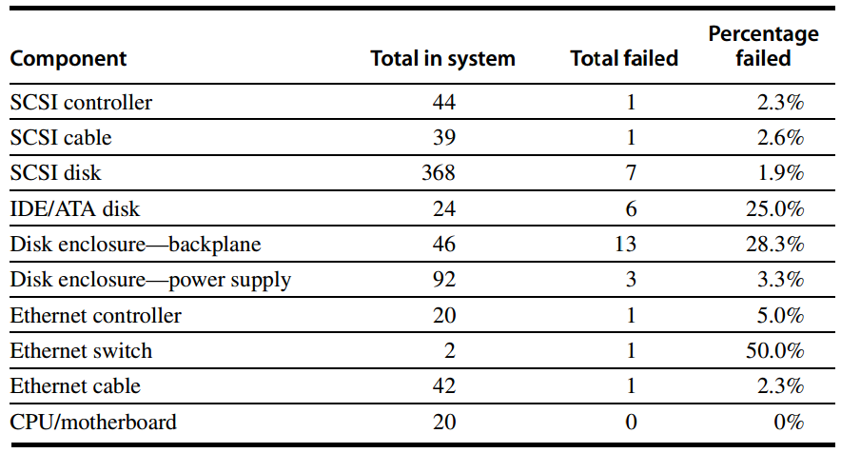
Example: Berkeley’s
Tertiary Disk

Slide 73
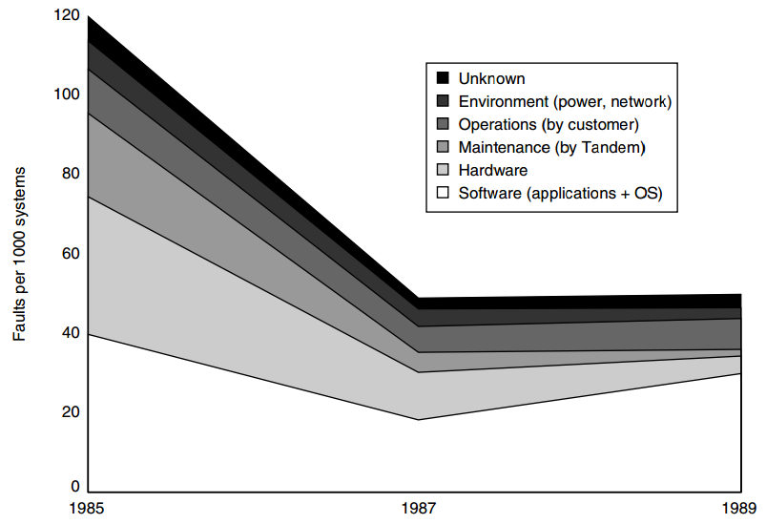
Example: Tandem

Slide 74
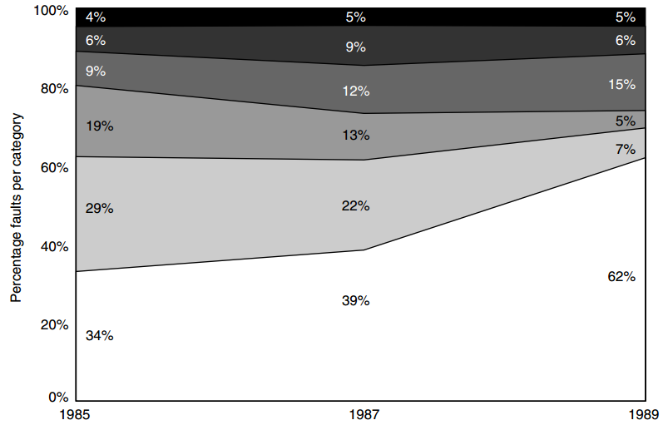
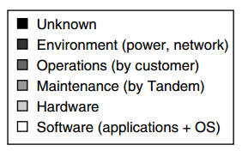
Example: Tandem

Slide 75

Appendix D.1–D.3 http://booksite.mkp.com/9780123838728/references/appendix_d.pdf
Notes:
All these contents can be found in Appendix D.

Slide 76
?

Slide 77
Lab 3 Report due December 21
Lab 4 Demo due
Report due December 27
Lab 5 Demo due January 10
Report due January 16
Assignment 2 due January 03
Assignment 3 due January 10
Notes:
Here’s a reminder of lab requirements.

Slide 78
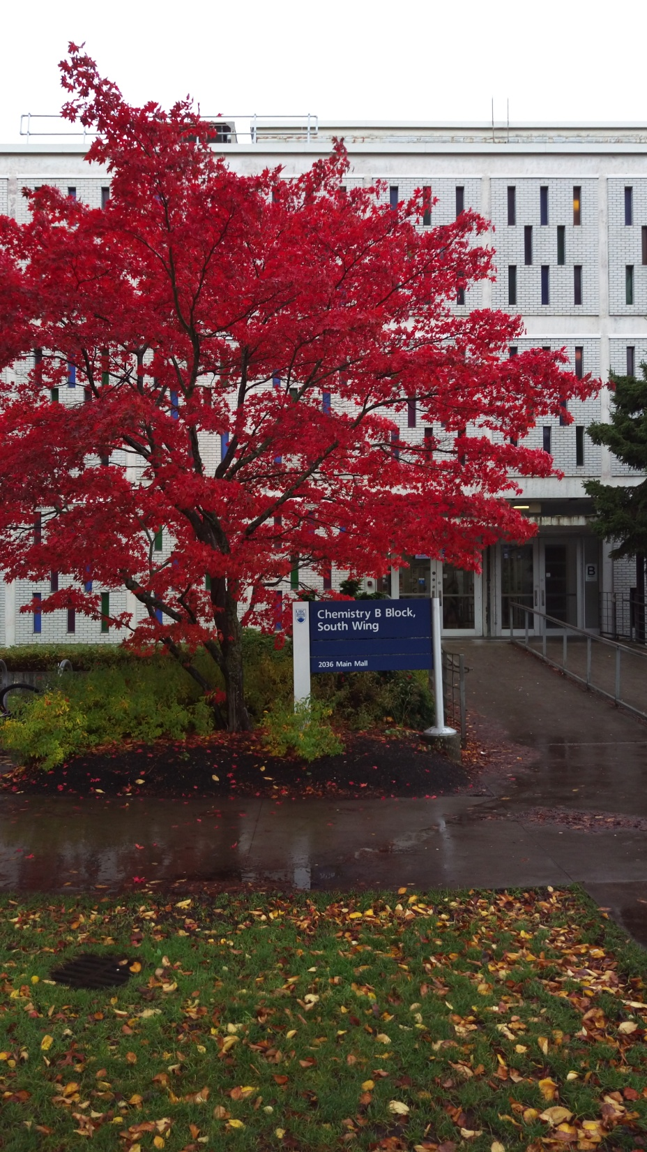
#What’s More
Teach to Learn:
A Privilege of Junior Faculty
by Kai Bu
Leaf,
like you will sparkle.

