Slide 1
Pipelining
Multicycle, MIPS R4000, and More
07
Kai Bu
kaibu@zju.edu.cn
http://list.zju.edu.cn/kaibu/comparch2018
Notes:
In this lecture, more pipeline principles: floating-point operation takes multiple clock cycles to complete, corresponding MIPS R4000 architecture to support that;

Slide 2
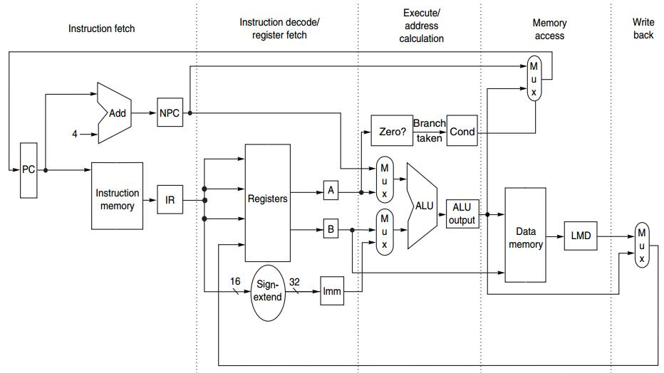
Integer Op in 1 CC
IF ID EX MEM WB
Notes:
In previous discussions, we consider only integer operations.
For each stage, operation completes in one clock cycle

Slide 3
What about
floating-point operation?

Slide 4
FP Operation
Floating-point (FP) operations take more time than integer operations do
To complete an FP op in 1 cc?
Notes:
Floating-point operations take more time than integer operations do;
Then if we still want the pipeline to complete an FP operation in one clock cycle? What should we do?

Slide 5
FP Operation
Floating-point (FP) operations take more time than integer operations do
To complete an FP op in 1 cc:
a slow clock?
Notes:
We could use a slow clock, right? Such that the time duration of a clock cycle will be longer, if it is long enough to finish any FP operation, then we can complete an FP in one clock cycle.
What else / any other solutions?

Slide 6
FP Operation
Floating-point (FP) operations take more time than integer operations do
To complete an FP op in 1 cc:
a slow clock?
many logic in FP units?
Notes:
With the time duration of a clock cycle being the same, we can enrich the computation power of FP units by mounting many more computation logic in them.
Using such complex design, we may complete an FP operation much faster such that it fits in one clock cycle that is short enough to finish an integer operation.
Now seems that we can easily extend our pipeline to support FP operations. What do u think? Do you consider it feasible if we simply adopt one of these two solutions?
For example, if we simply tune to a slow clock,

Slide 7
FP Operation
Floating-point (FP) operations take more time than integer operations do
To complete an FP op in 1 cc:
a slow clock?
many logic in FP units?
Notes:
what’s the downside?

Slide 8
FP Operation
Floating-point (FP) operations take more time than integer operations do
To complete an FP op in 1 cc:
a slow clock? slow down integer ops
many logic in FP units?
Notes:
It’ll slow down integer operations.
As an integer operation takes a shorter time to complete than an FP operation does, if we simply stretch the clock cycle to support slower FP operations, integer operations will waste some time in each clock cycle just waiting for the clock cycle to end.

Slide 9
FP Operation
Floating-point (FP) operations take more time than integer operations do
To complete an FP op in 1 cc:
a slow clock? slow down integer ops
many logic in FP units?
Notes:
What about putting more computation logic in FP units?

Slide 10
FP Operation
Floating-point (FP) operations take more time than integer operations do
To complete an FP op in 1 cc:
a slow clock? slow down integer ops
many logic in FP units? manufacturing
hardness
Notes:
This challenges the manufacturing process.

Slide 11
Then how?

Slide 12
Multicycle FP Operation
FP pipeline
allow for a longer latency for op;
i.e., take >1 cc for EXE;
two changes over integer pipeline:
repeat EX;
use multiple FP functional units;
e.g., FP adder, FP divider
Notes:
For manufacturing easiness, we need to compromise the speed requirement, that is, an FP operation does not necessarily have to be completed in one clock cycle.
In other words, we allow for a longer latency for FP operations, say, take more than one clock cycle for the execution stage;
Following this design principle, two changes over integer pipeline:
The first is repeat EX. Since EX stage takes more than one clock cycle, the component responsible for EX may be repeatedly used in each clock cycle.
The second is use multiple FP functional units, each of which is specialized for a certain type of operation such as addition and division.
It does not simply mix all types of computation logic into one component, easing the manufacturing process.

Slide 13
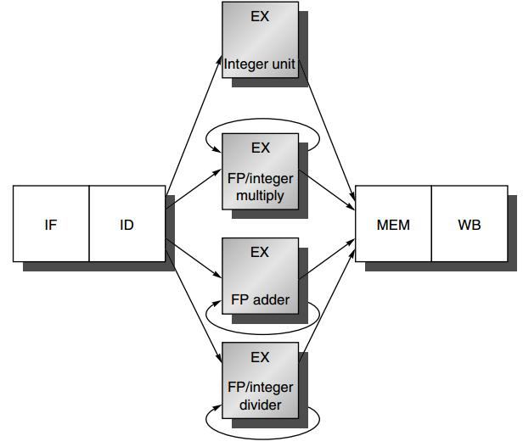
FP Pipeline
Notes:
The architecture supporting FP operations,
In comparison with integer pipeline, several more functional units are added.

Slide 14
FP Pipeline
how?
Notes:
How it works for supporting FP operations?

Slide 15
FP Pipeline
loads and stores
integer ALU operations
branches
use multiple FP units
FP and integer multiplier
repeat EX
FP add
FP subtract
FP conversion
FP and integer divider
Notes:
Each functional unit for certain types of operations;

Slide 16
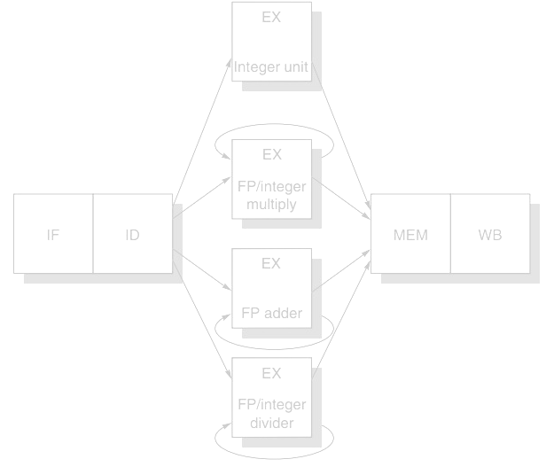
FP Pipeline
EX is not pipelined
Until the previous instruction leaves EX, no other instruction using that functional unit may issue
If an instruction cannot proceed to EX, the entire pipeline
behind that instruction will be stalled
ID → EX
Notes:
Apparently, now an FP operation may repeat EX several times to complete, it’s not feasible to allow a subsequent instruction to enter EX one clock cycle after another.
This requires that EX is not pipelined. Until the previous instruction leaves EX, no other instruction using that functional unit may issue.
(still remember the concept of Instruction Issue?)

Slide 17
Latency & Ini/Repeat Interval
Latency
the number of intervening cycles between an instruction that produces a result and an instruction that uses the result
Initiation/Repeat Interval
the number of cycles that must elapse between issuing two operations of a given type

Slide 18
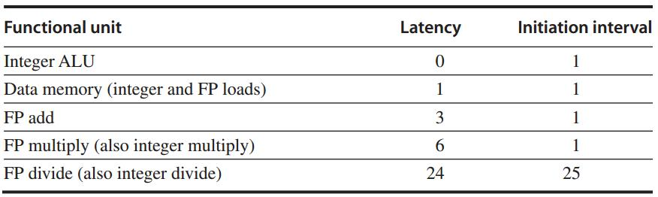
Latency & Ini/Repeat Interval
Essentially, pipeline latency is
1 cycle less than
the depth of the execution pipeline,
which is the number of stages from the
EX stage to the stage that produces the result

Slide 19
Latency & Ini/Repeat Interval
Two (dependent) integer ALU instructions:
ADD R3, R1, R2 pipeline diagram
ADD R5, R3, R4
EX
EX
Notes:
Latency
the number of intervening cycles between an instruction that produces a result and an instruction that uses the result
Initiation/Repeat Interval
the number of cycles that must elapse between issuing two operations of a given type

Slide 20
Latency & Ini/Repeat Interval
Two (dependent) integer ALU instructions:
ADD R3, R1, R2 pipeline diagram
ADD R5, R3, R4
Latency: 0
as no intervention to pipeline
EX
EX

Slide 21
Latency & Ini/Repeat Interval
Two (dependent) integer ALU instructions:
ADD R3, R1, R2 pipeline diagram
ADD R5, R3, R4
Initiation interval: 1
as 2nd ADD has to wait for 1 cc after 1st ADD
EX
EX

Slide 22
Latency & Ini/Repeat Interval
Two (dependent) instructions: Load + ADD
Load R2, 0(R1) pipeline diagram
ADD R3, R2, R1
M
EX
EX

Slide 23
Latency & Ini/Repeat Interval
Two (dependent) instructions: Load + ADD
Load R2, 0(R1) pipeline diagram
ADD R3, R2, R1
Latency: 1, pipeline is intervened at EX stage
as ADD.EX has to wait for 1 cc until Load.MEM
M
EX
EX
Notes:
Only one Intervening Cycle

Slide 24
Latency & Ini/Repeat Interval
Two (dependent) instructions: Load + ADD
Load R2, 0(R1) pipeline diagram
ADD R3, R2, R1
Initiation interval: ?
M
EX
EX

Slide 25
Latency & Ini/Repeat Interval
Two same-type instructions: Load + Load
Load R2, 0(R1) pipeline diagram
Load R3, 0(R1)
Initiation interval: 1
as 2nd Load has to wait for 1 cc after 1st Load
M
EX
M

Slide 26
Latency & Ini/Repeat Interval
Two same-type dependent instructions:
Load R2, 0(R1) pipeline diagram
Load R3, 0(R2)
M
EX
EX

Slide 27
Latency & Ini/Repeat Interval
Two same-type dependent instructions:
Load R2, 0(R1) pipeline diagram
Load R3, 0(R2)
Latency: 1
Initiation interval: 1
M
EX
EX

Slide 28
Latency & Ini/Repeat Interval
Essentially, pipeline latency is
1 cycle less than
the depth of the execution pipeline,
which is the number of stages from the
EX stage to the stage that produces the result

Slide 29
Latency & Ini/Repeat Interval
4 FP ADD
7 FP mul
25 FP div
Essentially, pipeline latency is
1 cycle less than
the depth of the execution pipeline,
which is the number of stages from the
EX stage to the stage that produces the result

Slide 30
Latency & Ini/Repeat Interval
4 FP ADD
7 FP mul
24 FP div? 25?
Essentially, pipeline latency is
1 cycle less than
the depth of the execution pipeline,
which is the number of stages from the
EX stage to the stage that produces the result
Notes:
It’s a bit confusing whether an FP divider takes 24 or 25 clock cycles.
A few slides and online discussion simply take it as 25 clock cycles, this can easily deduce the latency and interval values in the table.
So far, found no detailed explanation of how a 24-cc FP divider has 24-cc latency and 25-cc initiation interval… gg

Slide 31
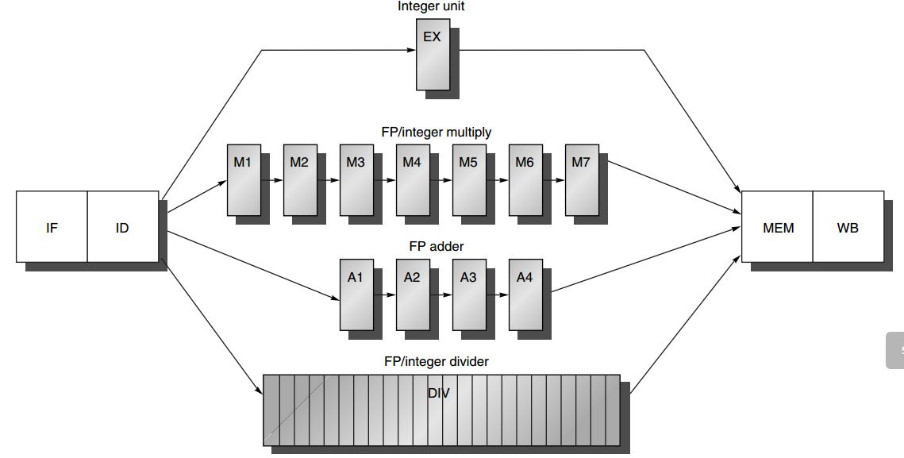
Generalized FP Pipeline
EX is pipelined (except for FP divider)
FP divider is not pipelined
Additional pipeline registers
e.g., ID/A1
FP divider: 24 CCs?

Slide 32
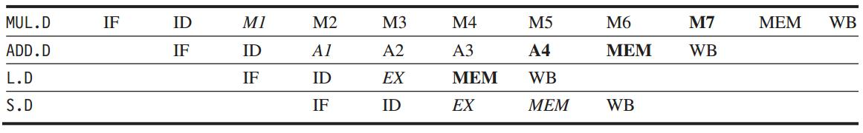
Generalized FP Pipeline
Example: independent FP instr
italics: stage where data is needed
bold: stage where a result is available

Slide 33
Generalized FP Pipeline
Example: independent FP instr
italics: stage where data is needed
bold: stage where a result is available
Intervening cycles

Slide 34
Any FP pipeline hazards?

Slide 35
Structural Hazard
Divider is not fully pipelined – structural hazard

Slide 36
Structural Hazard
Instructions have varying running times, maybe >1 register write in a cycle
- structural hazard

Slide 37
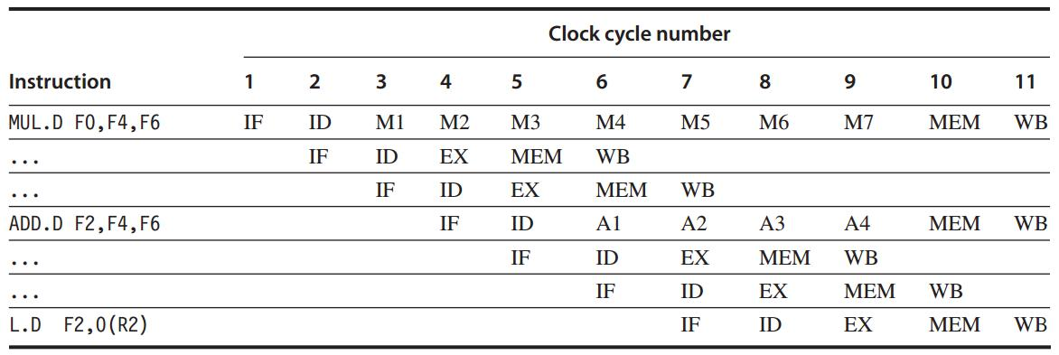
Structural Hazard
Notes:
Cases for competing accesses over memory and register

Slide 38
Structural Hazard
Interlock Detection
Method 1: track the use of the write port in the ID stage and stall an instruction before it issues
::a shift register tracks when already-issued instructions will use the register file;
if the instruction in ID needs to use the register file at the same time, stall

Slide 39
Structural Hazard
Interlock Detection
Method 2: stall a conflicting instruction when it tries to enter MEM/WB
::could stall either issuing or issued one;
give priority to the unit with the longest latency;
more complicated: stall arises from MEM/WB

Slide 40
WAW Hazard
Instructions no longer reach WB in order
– Write after write (WAW) hazard

Slide 41
WAW Hazard
If L.D were issued one cycle earlier
L.D would write F2 one cycle earlier than ADD.D – WAW hazard
what if another instruction using F2 between them? --- No WAW

Slide 42
RAW Hazard
Longer latency of operations
– more frequent stalls for
read after write (RAW) hazards

Slide 43
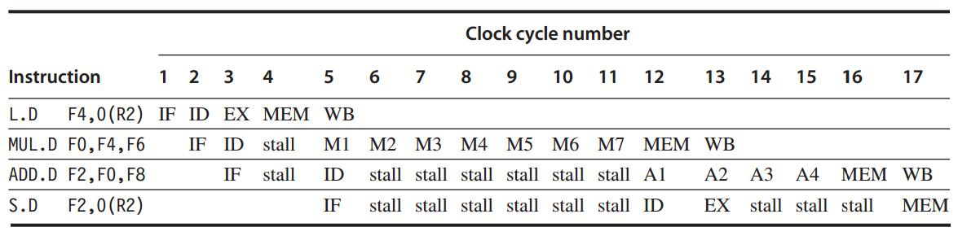
RAW Hazard

Slide 44
Hazard: Exceptions
Instructions may complete in a different order than they were issued – exceptions

Slide 45
How to detect and solve
pipeline hazards?

Slide 46
Hazard Detection in ID
1. Check for structural hazards
wait until the required functional unit is not busy (only for divides);
make sure the register write port is available when it will be needed;

Slide 47
Hazard Detection in ID
2. Check for RAW data hazards
wait until source registers are available when needed --- when they are not pending destinations of issued instructions

Slide 48
Hazard Detection in ID
3. Check for WAW data hazards
determine if any instruction in A1 – A4, D, M1-M7 has the same register destination as this instruction;
if so, stall the issue of the instr in ID

Slide 49
Forwarding
Generalized with more sources
EX/MEM, A4/MEM, M7/MEM, D/MEM, MEM/WB
-> source registers of an FP instruction

Slide 50

Out-of-order Completion
ADD and SUB complete before DIV
Out-of-order completion: instructions are completing in a different order than they were issued

Slide 51
Out-of-order Completion
How to deal with out-of-order?
1. ignore the problem
2. buffer the results of an operation until all the operations issued earlier complete
3. tracking what operations were in the pipeline and their PCs
4. issue an instruction only if it is certain that all previous instructions will complete without exception

Slide 52
All in MIPS R4000

Slide 53
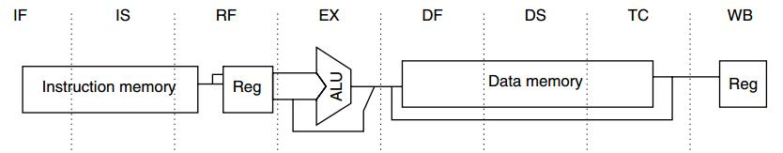
MIPS R4000:
5-stage -> 8-stage
Higher clock rate

Slide 54
MIPS R4000:
IF
IF: first half of instruction fetch;
PC selection;
initiation of instruction cache access;

Slide 55
MIPS R4000:
IS
IS: second half of instruction fetch;
completion of instruction cache access;

Slide 56
MIPS R4000:
RF
RF:
instruction decode and register fetch;
hazard checking;
instruction cache hit detection;

Slide 57
MIPS R4000:
EX
EX: execution
effective address calculation;
ALU operation;
branch-target computation and condition evaluation;

Slide 58
MIPS R4000:
DF
DF: data fetch
first half of data access;

Slide 59
MIPS R4000:
DS
DS: second half of data fetch
completion of data cache access;

Slide 60
MIPS R4000:
TC
TC: tag check
determine whether the data cache access hit;

Slide 61
MIPS R4000:
WB
WB: write back
for loads and register-register ops;

Slide 62
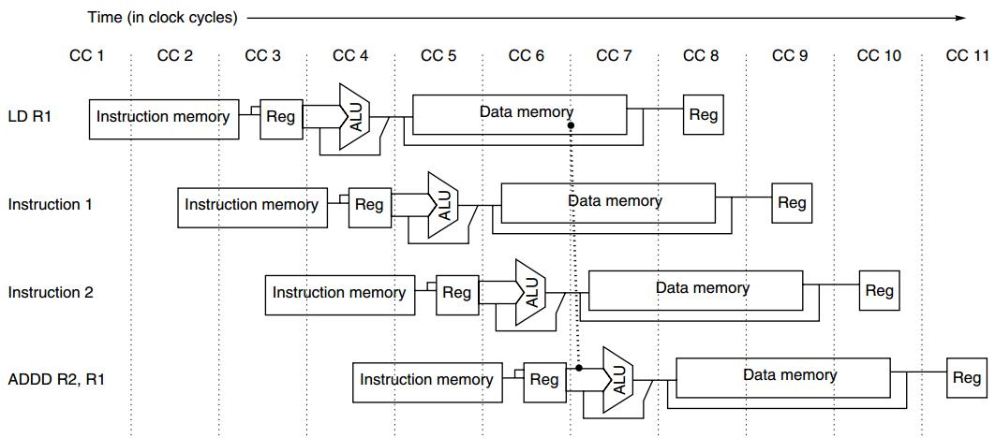
Load Delay
2-cycle load delay
(per the subsequent pipeline diagram)

Slide 63
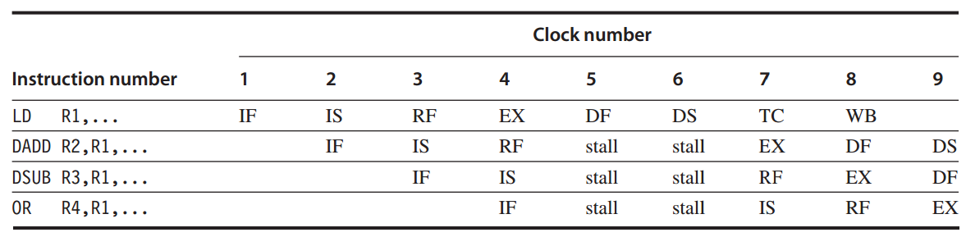
Load Delay
2-cycle load delay
DS: second half of data fetch
completion of data cache access;

Slide 64
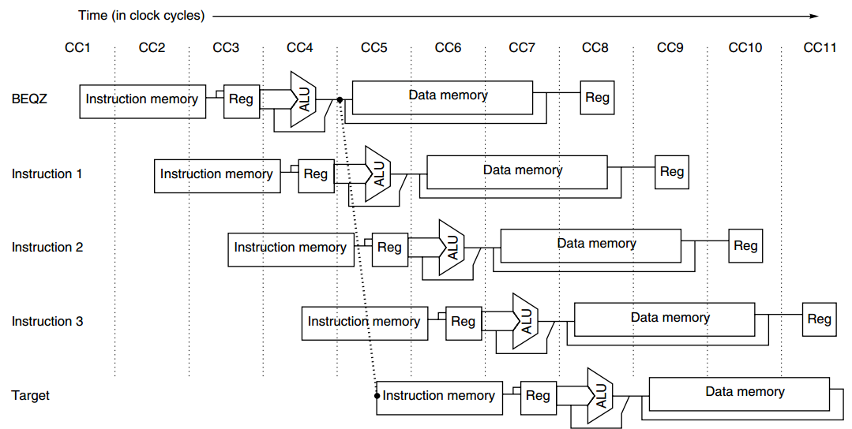
Branch Delay
3-cycle branch delay:
predicted-not-taken

Slide 65
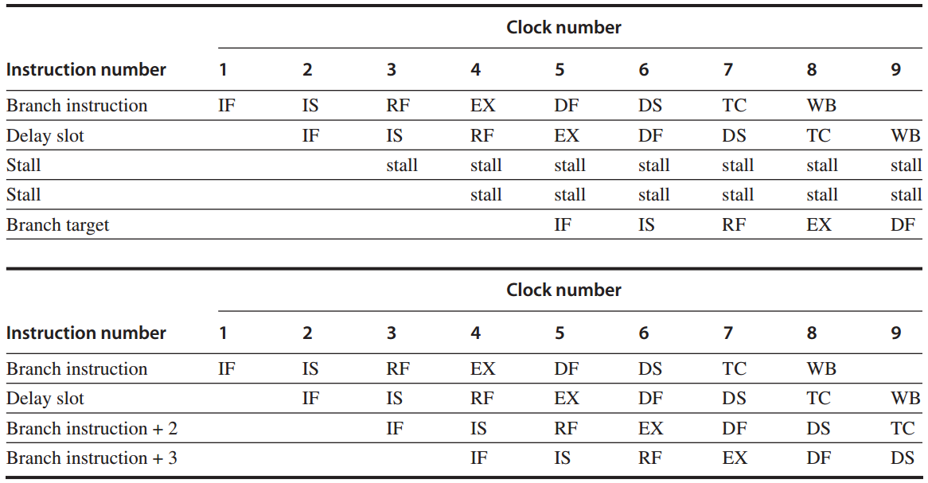
Branch Delay
3-cycle branch delay:
predicted-not-taken
taken branch
EX: branch-target computation & condition evaluation
untaken branch
Notes:
Delay slot: https://en.wikipedia.org/wiki/Delay_slot
In computer architecture, a delay slot is an instruction slot that gets executed without the effects of a preceding instruction. The most common form is a single arbitrary instruction located immediately after a branch instruction on a RISC or DSP architecture; this instruction will execute even if the preceding branch is taken. Thus, by design, the instructions appear to execute in an illogical or incorrect order. It is typical for assemblers to automatically reorder instructions by default, hiding the awkwardness from assembly developers and compilers.
Branch-likely instruction: https://www.microchip.com/forums/m317243.aspx
PIC32 also supports the so called 'branch likely' instructions. For this class of branches the instruction in the branch delay slot is only executed if the branch is taken. In case the branch is NOT taken, the instruction in the branch delay slot is NOT executed (ignored).
Confusion in table 1?
Given predicted-not-taken strategy, why in cc3 and cc4, the 3rd and 4th instructions are stalled (while they should proceed with IF-IS, and IF)?
Discussion: understand the two tables from the perspective that they demonstrate the contrast between the final-effects of whether the branch is taken or not.
This way, the two Stall instructions in table 1 correspond to Branch instruction+2 and Branch instruction+3 in table 2.
Since table 1 represents the case when the branch is taken, after cc4 where branch target is determined, in cc4 branch target will be fetched and previously fetched instructions may be stalled. In other words, the two Stall instructions will not take effect as if they were not procssed at all.

Slide 66
Forwarding
Forwarding
ALU/MEM or MEM/WB
-> EX/DF, DF/DS, DS/TC, TC/WB

Slide 67
FP Operations
FP Pipeline
FP unit with three functional units:
FP divider, FP multiplier, FP adder
2 cycles to 112 cycles

Slide 68
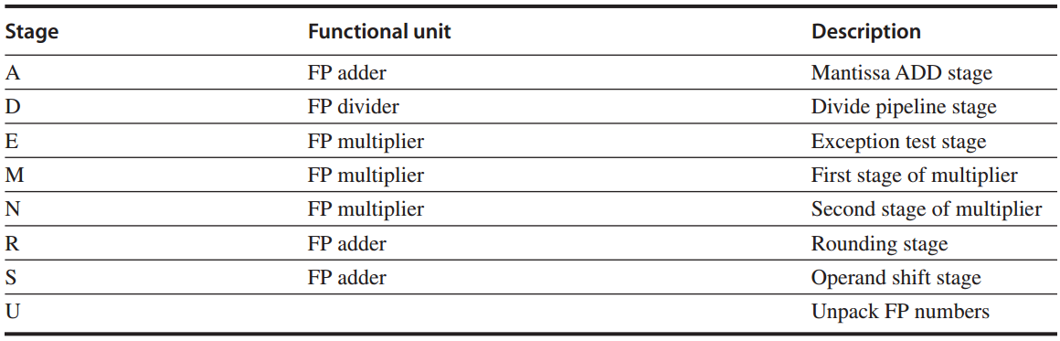
Stage vs FP Unit
FP unit with eight different stages

Slide 69
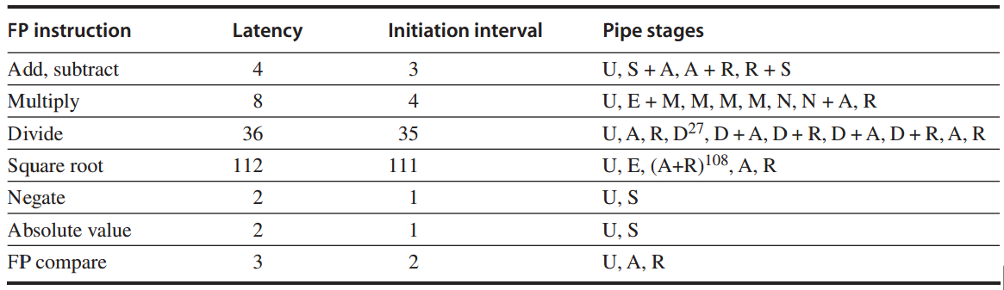
Latency & Ini Interval
FP operations: latency and initiation interval

Slide 70
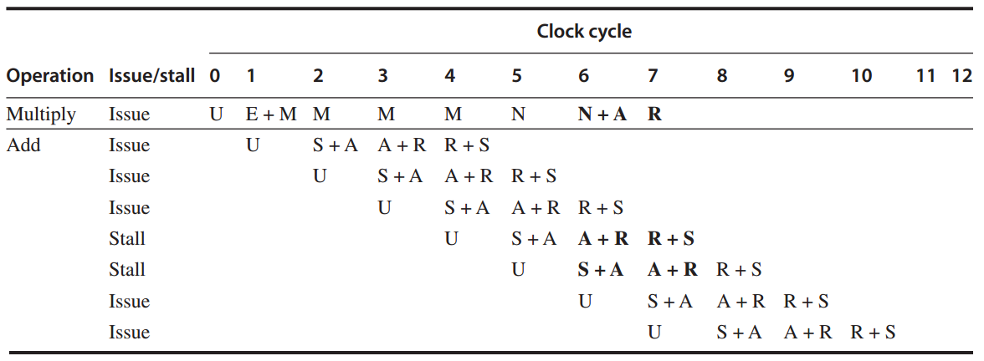
FP Ops: Example 1
FP multiply + FP add
Notes:
Two stalled instructions will use R as the same time when Multiply uses R;

Slide 71
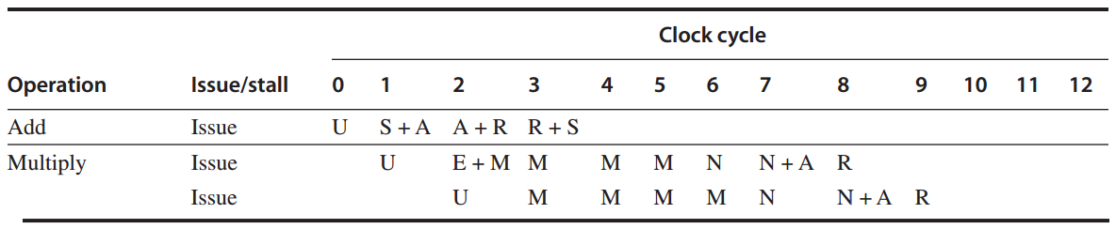
FP Ops: Example 2
FP add + FP multiply

Slide 72
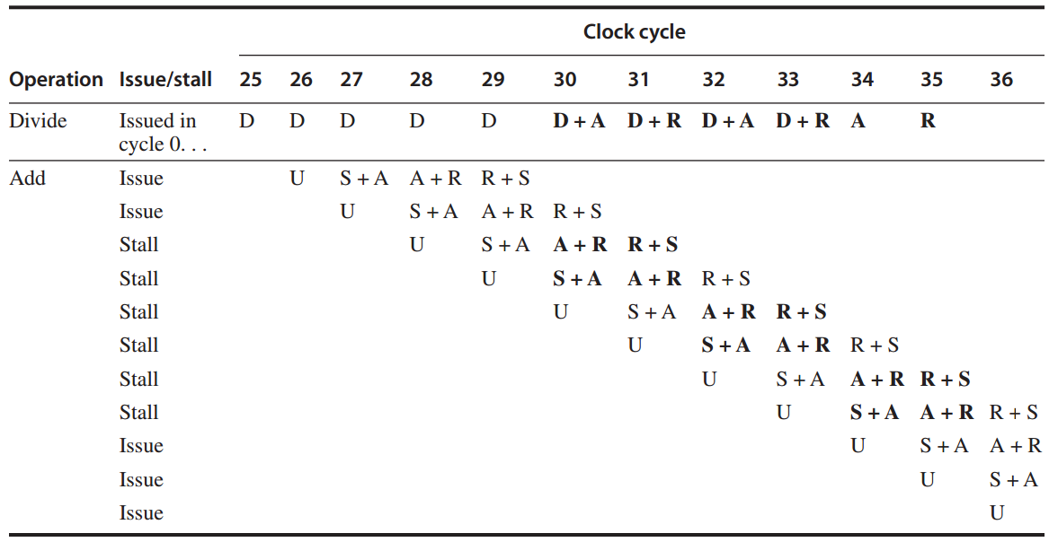
FP Ops: Example 3
divide + add

Slide 73
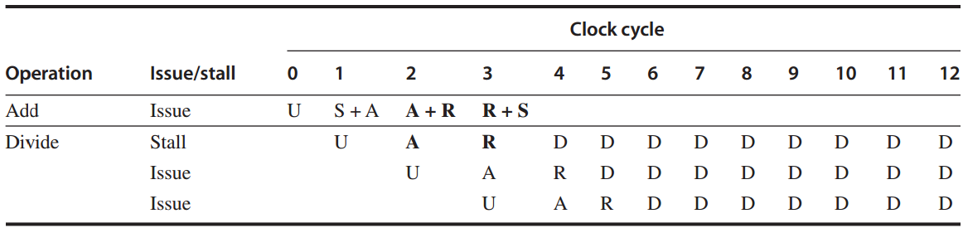
FP Ops: Example 4
FP add + FP divide

Slide 74
Review
Multicycle FP Operations
Hazards and Forwarding
Example: MIPS R4000 Pipeline

Slide 75

Appendix C.5-C.7

Slide 76
?

Slide 77

Thank You
be in the moment

Slide 78

be in the moment

Slide 79
#What’s More
Want to Be Happier? Stay in The Moment
by Matt Killingsworth
Avoid the Comparison Trap and Run Your Own Race
by Jeff Goins

