Slide 1
Happy Thanksgiving
appreciate the favor & spread the kindness
Notes:
Thanksgiving is coming in a few days.
In the light of being thankful and grateful, I usually share this video with the class this time around.
Sometimes, the best way to return the favor is to spread the kindness, offer help to others whenever you have the opportunity and power.
This message can be best echoed in this video.

Slide 2
Memory Hierarchy
Cache Performance
08
Kai Bu
kaibu@zju.edu.cn
http://list.zju.edu.cn/kaibu/comparch2018
Notes:
Good morning class, today we’re gonna proceed to the second major component of this course, memory hierarchy.

Slide 3
Memory?
Notes:
First question,
What’s your memory of ‘memory’?
I mean, what is memory used for in computer architecture?

Slide 4
Memory?
Load
Store
R2, 0(R1)
R2, 0(R1)
Notes:
We mentioned memory a lot for memory access instructions like load and store

Slide 5
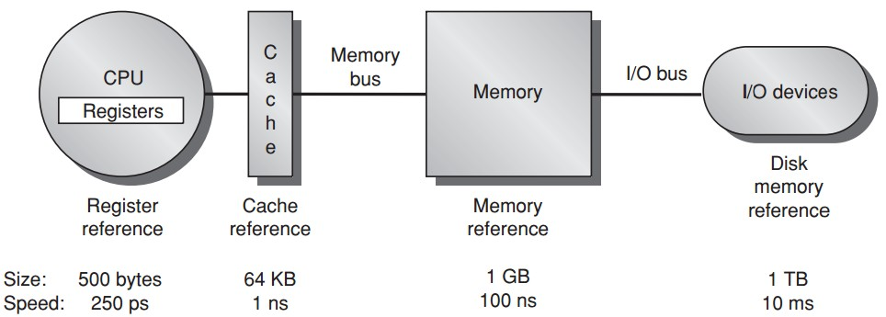
data processing
& temporary storage
Notes:
In previous lectures, we spent quite a bit of time on discussing how CPU executes instructions.
Instructions need to operate on data residing in registers.
But register volume is limited, 500 bytes; and architectures support only a limited number of them (32 registers). Thus we can’t put all required operands in registers,
ps: picosecond

Slide 6
temporary storage
Notes:
Instead, we store operands in a much larger memory, and transfer them from memory to registers when necessary.
Nowadays, memory for most pc is up to several gigabytes; sometimes it is still not large enough to hold all data for our programs.
And more importantly, both memory and registers are for temporary storage only. That is, data loaded to register/memory will get lost upon powering down the computer.
So obviously we need another storage medium that not only is much larger than memory but also supports permanent storage.

Slide 7
permanent storage
Notes:
this is where magnetic disk comes in.

Slide 8
permanent storage
Notes:
so far, it seems that we’ve got it all covered.
Cause now we have a large enough disk to permanently store all our data; when we want to run some programs, we preload some data to memory, and then some of which are further loaded to registers during instruction execution. Whenever we cannot find required data in registers, we look for them in memory; and if data absence is still the case, we can finally find them on disks.

Slide 9
permanent storage
*1000 picoseconds = 1 nanosecond = 10⁻⁶ millisecond
Notes:
But the problem is, the gap of processing speed on different storage medium is huge.
Although we can always find expected data in lower levels of the memory hierarchy, we have to slow down instruction execution.
To mitigate such a dilemma,

Slide 10
faster temporary storage
Notes:
We introduce another level of storage medium called cache,
It’s larger than registers but with comparative processing speed.

Slide 11
Memory Hierarchy
Notes:
Among these four major components, we are already familiar with registers, memory, and disk

Slide 12
Wait, but what’s cache?
Notes:
Then what’s cache?

Slide 13

program/instr
data request?
in/ out?
Wait, but what’s cache?
Notes:
How it affects performance when requested data are inside or outside the cache?

Slide 14
program/instr
data request?
in/ out?
Wait, but what’s cache?
Notes:
Apparently we expect as more cases when requested data are inside cache as possible,

Slide 15
program/instr
data request?
optimization?
in/ out?
Wait, but what’s cache?
Notes:
Then what kind of optimization strategies we can use to benefit more from cache?
All these questions will be addressed in today’s lecture

Slide 16
Wait, but what’s cache?
So,
Notes:
So first, what’s cache?

Slide 17
Cache
The highest or first level of the memory hierarchy encountered once the addr leaves the processor
Employ buffering to reuse commonly occurring items
Notes:
As we just mentioned, cache is the highest or first level of the memory hierarchy encountered once the address leaves the processor.
It buffers frequently used data to avoid accessing slower memory or disk.
But since cache volume is still limited,

Slide 18
Cache Hit/Miss
When the processor can/cannot find
a requested data item in the cache
Notes:
It is natural that the data we want can or cannot be found in it;
If we can find requested data in cache, we call it a cache hit;
Otherwise, we call it a cache miss.

Slide 19

Block/Line Run
a fixed-size collection of data containing the requested word, retrieved from the main memory and placed into the cache
cache
requested word
memory
Notes:
Upon cache miss, we need to transfer requested data from lower level storages like memory to cache;

Slide 20
Block/Line Run
a fixed-size collection of data containing the requested word, retrieved from the main memory and placed into the cache
cache
requested word
requested word
memory
Notes:
Note that the transmission does not serve solely the requested word

Slide 21
Block/Line Run
a fixed-size collection of data containing the requested word, retrieved from the main memory and placed into the cache
cache
requested word
in a block
requested word
in a block
memory
Notes:
Instead, the transmission volume should be a block, which is a fixed-size collection of data with the requested word included.

Slide 22
Cache Locality
Temporal locality
need the requested word again soon
Spatial locality
likely need other data in the block soon
Notes:
According to data usage frequency, cache has two locality properties:
one is temporal locality, it captures the case when the requested word will be needed again soon;
The other is spatial locality, it captures the case when other data within the same block of the requested data will be needed soon.
Obviously, we can gain more efficiency if we can design a cache update strategy that best suits data locality your program may offer.

Slide 23
Cache Miss
Time required for cache miss depends on:
Latency: the time to retrieve the first word of the block
Bandwidth: the time to retrieve the rest of this block
Notes:
When we encounter a cache miss, we have to access memory to fetch the requested word,
And we already know that some other data within the same block with the requested word will be fetched together.
The time to retrieve the first word of the block is called latency
The time to retrieve the rest of this block is called bandwidth
Difference between latency and bandwidth?

Slide 24
latency vs bandwidth
Notes:
Discussion:
Bandwidth decides latency?
Queueing, cpu scheduling…;

Slide 25
How cache performance matters?
Notes:
Now, based on these quantifiers,
Let’s see how cache performance matters

Slide 26
Cache Miss Metrics
Memory stall cycles
the number of cycles during processor is stalled waiting for a mem access
Miss rate
number of misses over
number of accesses
Miss penalty
the cost per miss
(number of extra clock cycles to wait)

Slide 27
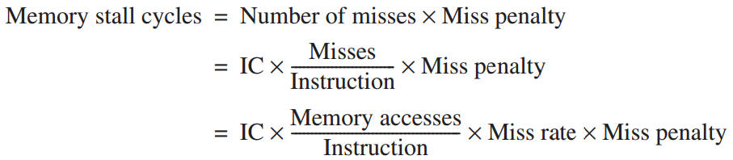
Cache Performance: Equations!!!
Assumption:
Includes the time
to handle
a cache hit/miss

Slide 28
Cache Performance: Example
Example
a computer with CPI=1 when cache hit;
50% instructions are loads and stores;
2 cc per memory access;
2% miss rate, 25 cc miss penalty;
Q: how much faster would the computer be if all instructions were cache hits?

Slide 29
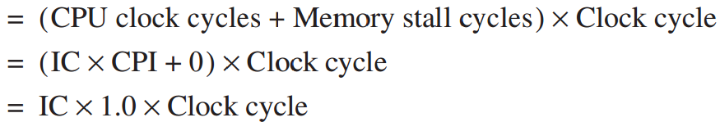
Cache Performance: Example
Answer
always hit:
CPU execution time

Slide 30
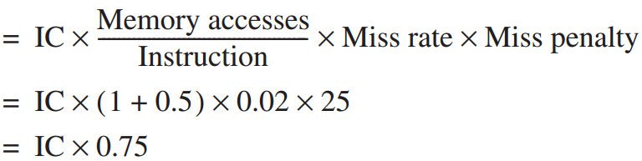
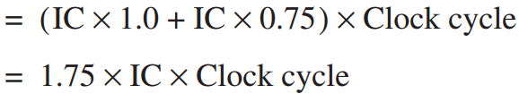
Cache Performance: Example
Answer
with misses:
Memory stall cycles
CPU execution time_{cache}

Slide 31
Cache Performance: Example
Answer
with misses:
Memory stall cycles
CPU execution time_{cache}

Slide 32
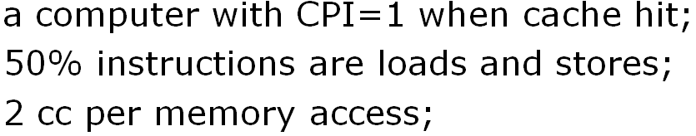
Cache Performance: Example
Answer
with misses:
Memory stall cycles
CPU execution time_{cache}
50%x1 + 50%x2

Slide 33
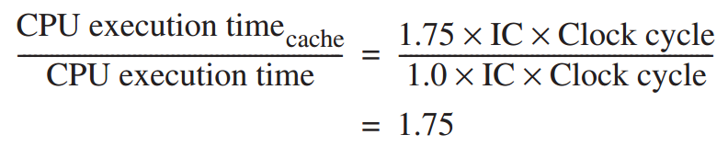
Cache Performance: Example
Answer

Slide 34
Hit or Miss:
Where to find a block?
Notes:
Whether it is a hit or miss, we need to know how to find a block, right?

Slide 35
Block Placement
Direct Mapped
only one place
Fully Associative
anywhere
Notes:
Before we know where to find a block, we first need to know how it is placed;
There are three block placement strategies:
The first one is direct mapped, which allows a block to be placed in only one place;
The second one is fully associative, it allows a block to be placed everywhere in cache as long as the place is empty.
Both direct mapped and fully associative are extreme cases with their own pros and cons:

Slide 36
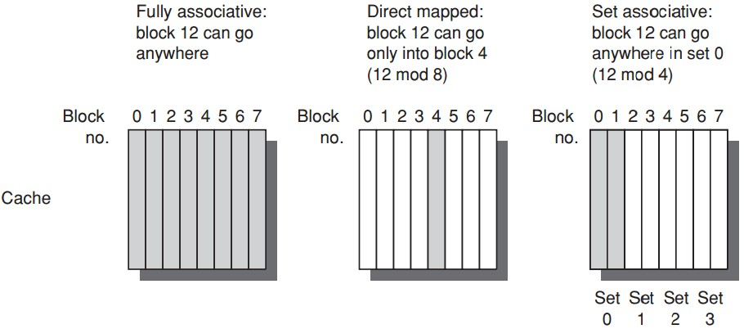
Block Placement
Notes:
for direct mapped, it’s easy to place and find a block, but low space usage efficiency;
for fully associative, it achieves the highest space efficiency, right, cause as long as there is an empty block, you can put your block there;
But, its down side is that you need to search over the entire cache to find a block.

Slide 37
Block Placement
Direct Mapped
only one place
Fully Associative
anywhere
Set Associative
anywhere within only one set
Notes:
A hybrid design: Set Associative
To reap the benefits of both

Slide 38
Block Placement
Notes:
for direct mapped, it’s easy to place and find a block, but low space usage efficiency;
for fully associative, it achieves the highest space efficiency, right, cause as long as there is an empty block, you can put your block there;
But, its down side is that you need to search over the entire cache to find a block.
A hybrid design, set associative.

Slide 39
Block Placement: generalized
n-way set associative:
n blocks in a set
Direct mapped = one-way set associative
i.e., one block in a set
Fully associative = m-way set associative
i.e., entire cache as one set with m blocks

Slide 40
Where to find a word?
Set
Block
Offset
Notes:
Based on set associative, the process of finding the requested word:
Which set?
In the specific set, which block?
Since a block contains more data than the requested word, in the block, which word?

Slide 41

Block Identification
Block address: tag + index
Index: select the set
Tag: = valid bit + block address
check all blocks in the set
Block offset: the address of the desired data/word within the block
Fully associative caches have no index field

Slide 42
What if the spot is occupied?
cache
requested word
in a block
requested word
in a block

Slide 43
Block Replacement
upon cache miss, to load the data to a cache block, which block to replace?
Direct-mapped placement
only one block can be replaced

Slide 44
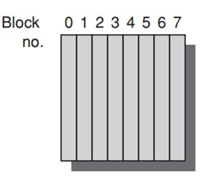
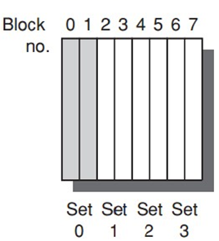
Block Replacement
Fully/set associative
Random
simple to build
LRU: Least Recently Used
the block that has been unused for the longest time;
use temporal locality;
complicated/expensive;
FIFO: first in, first out

Slide 45
write over cache: hit or miss

Slide 46
Write Strategy: write hit
Write-through
info is written to both the block in the cache and to the block in the lower-level memory
Write-back
info is written only to the block in the cache;
to the main memory only when the modified cache block is replaced;

Slide 47
Write Strategy: write miss
Write allocate
the block is allocated on a write miss
No-write allocate
write miss not affect the cache;
the block is modified in memory;
until the program tries to read the block;
Notes:
Write allocate (also called fetch on write): data at the missed-write location is loaded to cache, followed by a write-hit operation. ...
No-write allocate (also called write-no-allocate or write around): data at the missed-write location is not loaded to cache, and is written directly to the backing store.

Slide 48
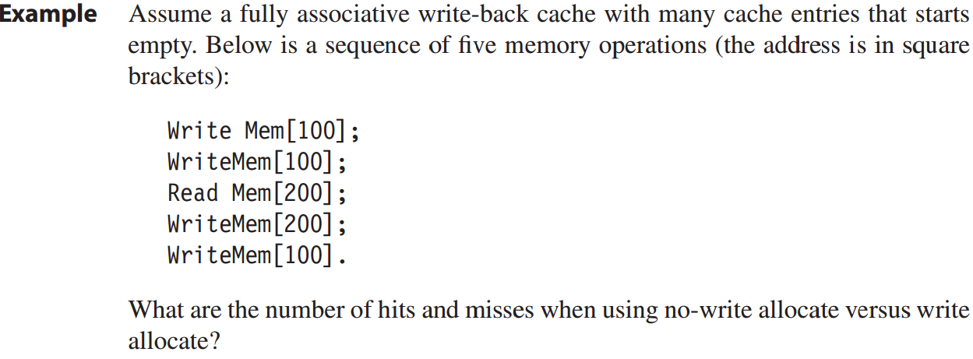
Write Strategy: Example

Slide 49
Write Strategy: Example
M
M
M
H
M
No-write allocate: 4 misses + 1 hit
cache not affected- address 100 not in the cache;
read [200] miss, block replaced, then write [200] hits;

Slide 50
Write Strategy: Example
M
H
M
H
H
Write allocate: 2 misses + 3 hits

Slide 51
Hit or Miss:
How long will it take?

Slide 52
Avg Mem Access Time
Average memory access time
=Hit time + Miss rate x Miss penalty

Slide 53
Avg Mem Access Time
Example
16KB instr cache + 16KB data cache;
or, 32KB unified cache;
36% data transfer instructions;
(load/store takes 1 extra cc on unified cache)
1 CC hit; 200 CC miss penalty;
Q1: split cache or unified cache has lower miss rate?
Q2: average memory access time?

Slide 54
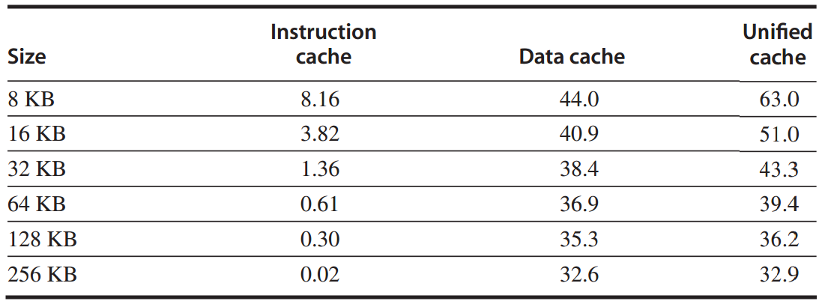
Example: miss per 1000 instructions

Slide 55
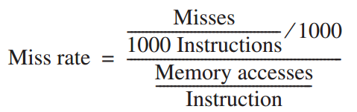



Avg Mem Access Time
Q1
Overall miss rate
assume 74% of memory accesses are instruction references
Notes:
36% data transfer / memory access in total:
Among that, assume 74% are instruction references, and the remaining 26% for data references;

Slide 56
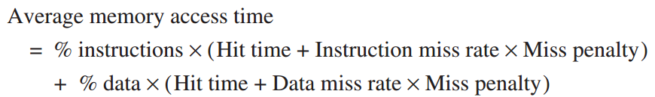
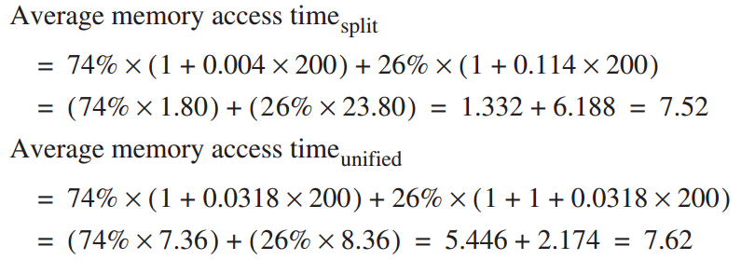
Avg Mem Access Time
Q2

Slide 57
Cache vs Processor
Processor Performance
Lower avg memory access time may correspond to higher CPU time (Example on Page B.19)

Slide 58
Out-of-Order Execution
in out-of-order execution, stalls happen to only instructions that depend on incomplete result;
other instructions can continue;
so less avg miss penalty

Slide 59
How to optimize
cache performance?

Slide 60
Average Memory Access Time =
Hit Time + Miss Rate x Miss Penalty

Slide 61
Average Memory Access Time =
Hit Time + Miss Rate x Miss Penalty

Slide 62
Average Memory Access Time =
Hit Time + Miss Rate x Miss Penalty
Larger block size;
Larger cache size;
Higher associativity;

Slide 63
Root Causes of Miss Rates
Compulsory:
cold-start/first-reference misses;
Capacity
cache size limit;
blocks discarded and later retrieved;
Conflict
collision misses: associativity
a block discarded and later retrieved in a set;

Slide 64
Opt #1: Larger Block Size
Reduce compulsory misses
Leverage spatial locality
Increase conflict/capacity misses
Fewer block in the cache

Slide 65
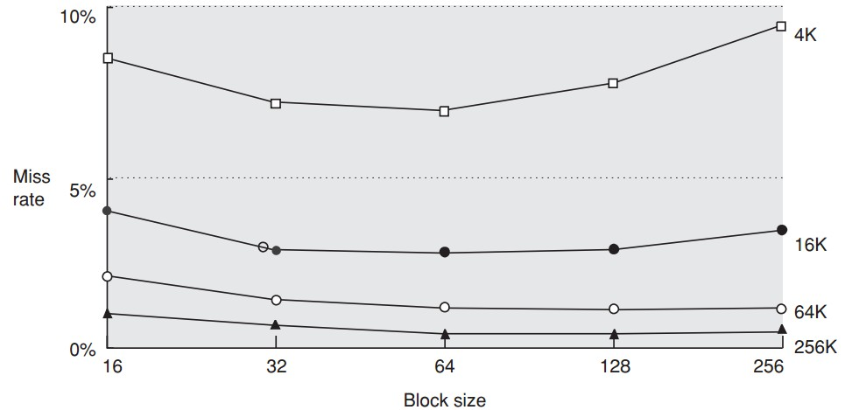

Slide 66
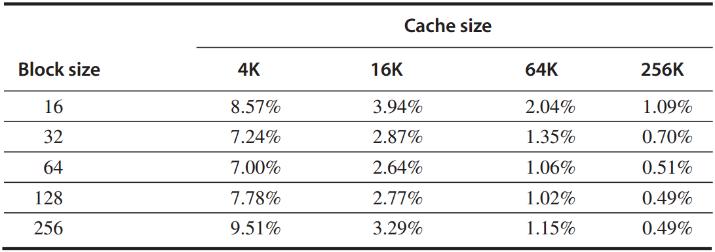
Example
given the above miss rates;
assume memory takes 80 CC overhead,
delivers 16 bytes in 2 CC;
Q: which block size has the smallest average memory access time for each cache size?

Slide 67
Answer
avg mem access time
=hit time + miss rate x miss penalty
*assume 1-CC hit time
for a 256-byte block in a 256 KB cache:
avg mem access time
= 1 + 0.49% x (80 + 2x256/16) = 1.5 cc

Slide 68
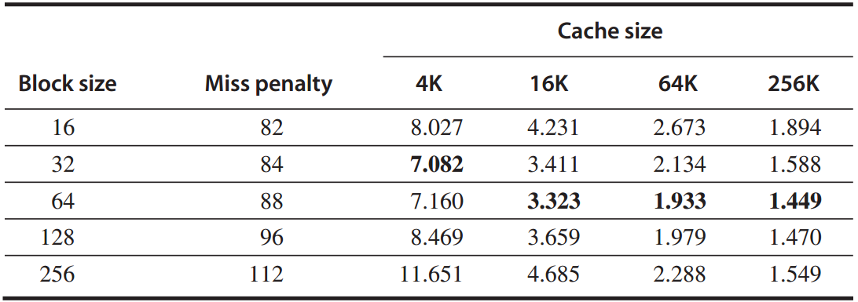
Answer
average memory access time

Slide 69
Opt #2: Larger Cache
Reduce capacity misses
Increase hit time, cost, and power

Slide 70
Opt #3: Higher Associativity
Reduce conflict misses
Increase hit time

Slide 71
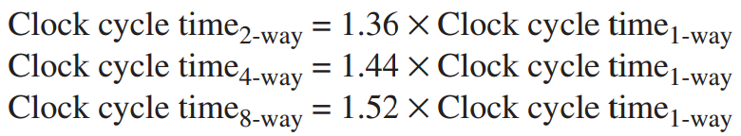
Example
assume higher associativity -> higher clock cycle time:
assume 1-cc hit time,
25-cc miss penalty,
and miss rates in the following table;

Slide 72
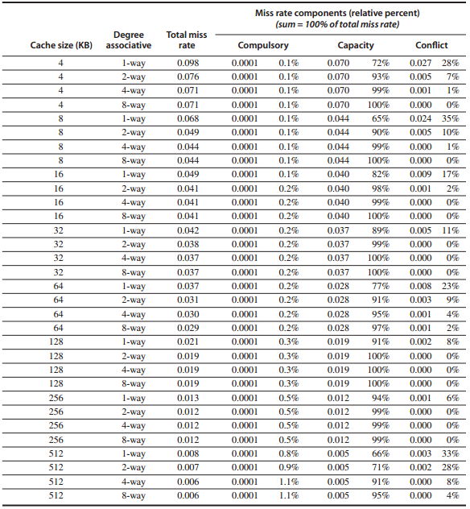
Miss rates

Slide 73
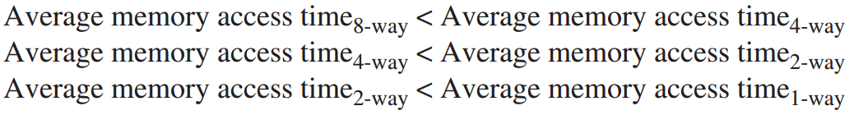
Question:
for which cache sizes
are each of the statements true?

Slide 74
Answer
example, for a 512 KB, 8-way set associative cache:
avg mem access time
=hit time + miss rate x miss penalty
=1.52x1 + 0.006 x 25
=1.66

Slide 75
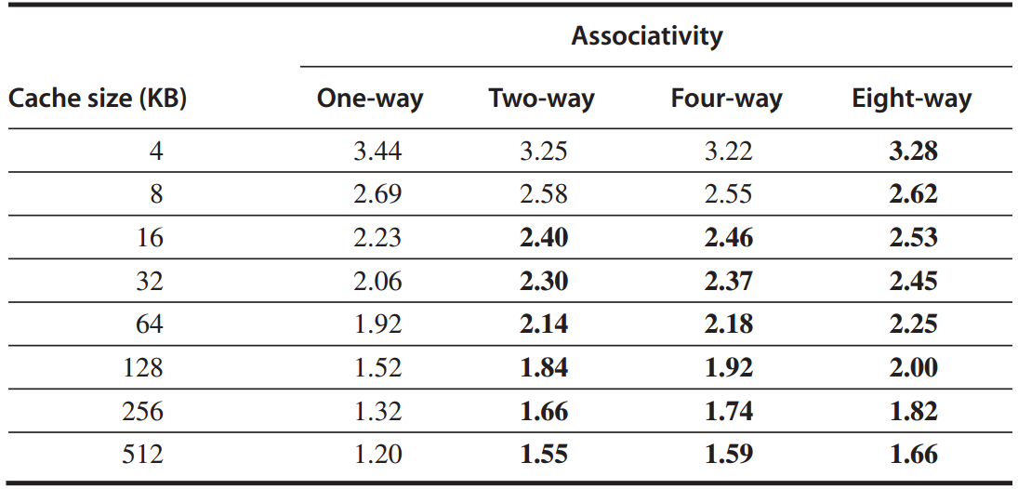
Answer
average memory access time

Slide 76
Average Memory Access Time =
Hit Time + Miss Rate x Miss Penalty
Multilevel caches;
Reads > Writes;

Slide 77
Opt #4: Multilevel Cache
Reduce miss penalty
Motivation
faster/smaller cache to keep pace with the speed of processors?
larger cache to overcome the widening gap between processor and main mem?

Slide 78
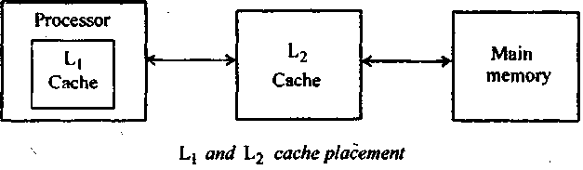
Opt #4: Multilevel Cache
Two-level cache
Add another level of cache between the original cache and memory

Slide 79
Opt #4: Multilevel Cache
Two-level cache
Add another level of cache between the original cache and memory
L1: small enough to match the clock cycle time of the fast processor;
L2: large enough to capture many accesses that would go to main memory, lessening miss penalty

Slide 80
Opt #4: Multilevel Cache
Average memory access time
=Hit time_{L1} + Miss rate_{L1} x Miss penalty_{L1}
=Hit time_{L1} + Miss rate_{L1}
x(Hit time_{L2}+Miss rate_{L2}xMiss penalty_{L2})
Average mem stalls per instruction
=Misses per instruction_{L1} x Hit time_{L2}
+ Misses per instr_{L2} x Miss penalty_{L2}

Slide 81
Opt #4: Multilevel Cache
Average memory access time
=Hit time_{L1} + Miss rate_{L1} x Miss penalty_{L1}
=Hit time_{L1} + Miss rate_{L1}
x(Hit time_{L2}+Miss rate_{L2}xMiss penalty_{L2})
Average mem stalls per instruction
=Misses per instruction_{L1} x Hit time_{L2}
+ Misses per instr_{L2} x Miss penalty_{L2}

Slide 82
(recap) Cache Performance: Equations!!!
Assumption:
Includes the time
to handle
a cache hit/miss

Slide 83
Opt #4: Multilevel Cache
Local miss rate
the number of misses in a cache
divided by the total number of mem accesses to this cache;
Miss rate_{L1}, Miss rate_{L2}
Global miss rate
the number of misses in the cache
divided by the number of mem accesses generated by the processor;
Miss rate_{L1}, Miss rate_{L1} x Miss rate_{L2}

Slide 84
Example
1000 mem references -> 40 misses in L1 and 20 misses in L2;
miss penalty from L2 is 200 cc;
hit time of L2 is 10 cc;
hit time of L1 is 1 cc;
1.5 mem references per instruction;
Q: 1. various miss rates?
2. avg mem access time?
3. avg stall cycles per instruction?

Slide 85
Answer
1. various miss rates?
L1: local = global
40/1000 = 4%
L2:
local: 20/40 = 50%
global: 20/1000 = 2%

Slide 86
Answer
2. avg mem access time?
average memory access time
=Hit time_{L1} + Miss rate_{L1}
x(Hit time_{L2}+Miss rate_{L2}xMiss penalty_{L2})
=1 + 4% x (10 + 50% x 200)
=5.4

Slide 87
Answer
3. avg stall cycles per instruction?
average stall cycles per instruction
=Misses per instruction_{L1} x Hit time_{L2}
+ Misses per instr_{L2} x Miss penalty_{L2}
=(1.5x40/1000)x10+(1.5x20/1000)x200
=6.6

Slide 88
Opt #5: Prioritize read misses over writes
Reduce miss penalty
instead of simply stall read miss until write buffer empties,
check the contents of write buffer,
let the read miss continue
if no conflicts with write buffer & memory system is available

Slide 89
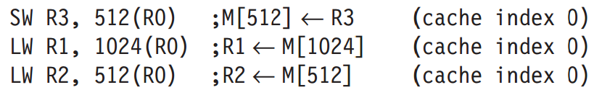
Opt #5: Prioritize read misses over writes
Why
for the code sequence, assume a direct-mapped, write-through cache that maps 512 and 1024 to the same block;
a four-word write buffer is not checked on a read miss.
R2.value ≡ R3.value ?
*read-after-write data hazard
Notes:
Read-after-write data hazard

Slide 90
Average Memory Access Time =
Hit Time + Miss Rate x Miss Penalty
Avoid address translation
during indexing of the cache

Slide 91
Opt #6: Avoid address translation during indexing cache
Cache addressing
virtual address – virtual cache
physical address – physical cache
Processor/program – virtual address
Processor -> address translation -> Cache
virtual cache or physical cache?

Slide 92
Opt #6: Avoid address translation during indexing cache
Virtually indexed, physically tagged
page offset to index the cache;
physical address for tag match;
For direct-mapped cache,
it cannot be bigger than the page size.
Reference: CPU Cache
http://zh.wikipedia.org/wiki/CPU%E9%AB%98%E9%80%9F%E7%BC%93%E5%AD%98
*more in later lectures
Notes:
To be covered in later lectures.

Slide 93

Appendix B.1-B.3
Notes:
All these contents we are going to discuss can be found in Appendix B.

Slide 94
Reminder
Lab 2
Demo Due: November 26, 2018
Report Due: December 03, 2018
Assignment 2
http://list.zju.edu.cn/kaibu/comparch2018/Assignment-2.pdf
Due: November 26, 2018
written/printed copy (of all questions);
meanwhile, Q11: EngName.jpg via qq

Slide 95
?

Slide 96

Thank You
be grateful

Slide 97
#What’s More
Grateful to Be Me
Don't Take Anything In Your Life For Granted
Teach to Learn: A Privilege of Junior Faculty by Kai Bu

