Slide 1
Fundamentals of Computer Design - Trends and Performance
03
Kai Bu
kaibu@zju.edu.cn
http://list.zju.edu.cn/kaibu/comparch2019
Notes:
In today’s lecture session, we’ll continue with computer design basics.

Slide 2
Fundamentals of Computer Design - Trends and Performance
How computer design trends evolve?
Notes:
First, we’ll walk through how did the trends in computer design evolve?
Why evolve compute design techniques?
toward a better performance, right?

Slide 3
Fundamentals of Computer Design - Trends and Performance
How computer design trends evolve?
Performance-driven: Quantitative
Notes:
And this, is exactly the core of quantitative approach, that is, performance-driven;

Slide 4
Fundamentals of Computer Design - Trends and Performance
How computer design trends evolve?
Performance-driven: Quantitative
how to measure performance?
how to improve performance?
Notes:
Then how do we measure computer performance?
In what ways can we improve performance?
All these questions will get answered in today’s discussions.

Slide 5
How do trends evolve?
Notes:
So first,
How do computer design trends evolve?

Slide 6
Trends
Technology
Power and energy
Cost
Notes:
The evolving trends manifest in three major aspects,
they are technology, power and energy, and cost.

Slide 7
Trends
Technology
Power and energy
Cost
Notes:
For technology,

Slide 8
Trends in Technology
5 critical implementation technologies:
Integrated circuit logic technology
Semiconductor DRAM
Semiconductor flash
Magnetic disk technology
Network technology
Notes:
There are five rapidly changing implementation technologies that are critical to modern computer implementations;
Next, We’ll present their key properties or high level description;

Slide 9
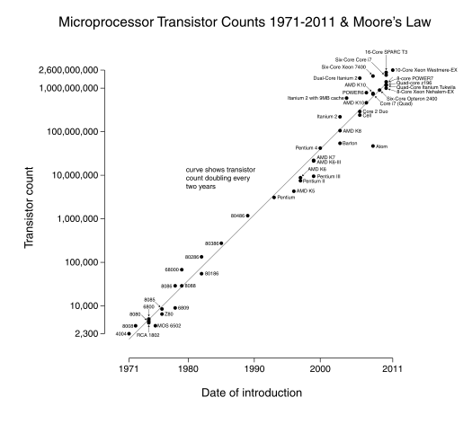
Integrated circuit logic technology
Moore’s Law: a growth rate in
transistor count
on a chip of about
40% to 55%
per year
doubles every
18 to 24 months
Notes:
A very important concept for integrated circuit logic technology is Moore’s law.
It captures the evolving trends of circuit capacity.
Specifically, it suggests that transistor count on a chip doubles about every two years.
You can clearly observe such trend from this figure.

Slide 10
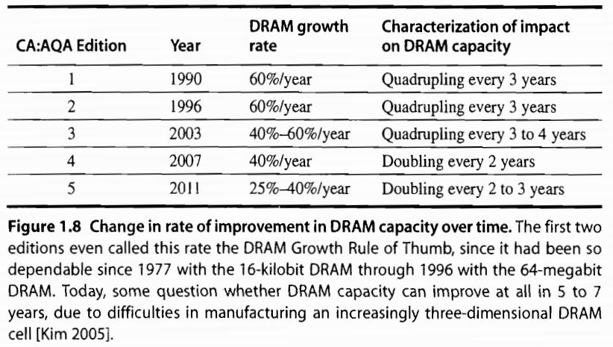
Semiconductor DRAM
Capacity per DRAM chip doubles roughly every 2 or 3 years
Notes:
As we mentioned previously, CPUs on chip work on various data to fulfill our commands.
However, our data stored on disks cannot be directly accessed by cpus;
Instead, they should be first loaded to main memory, where cpu can directly access.
The medium used as main memory is dram, i.e., dynamic random access memory;
As the table shows, capacity per dram chip doubles roughly every 2 or 3 years.
But keep in mind that when you power down the computer, the data in DRAM will be cleared.

Slide 11
Semiconductor Flash
EEPROM: Electronically erasable programmable read-only memory
Standard storage devices in PMDs
Capacity per Flash chip doubles roughly every two years
In 2011, 15 to 20 times cheaper per bit than DRAM
Notes:
Then what medium do we use for permanent storage?
a currently popular one is flash, it uses EEPROM, it’s faster yet expensive than magnetic disk;
So it is more often used as storage devices in personal mobile devices.
Similarly, capacity per flash chip doubles roughly two years.

Slide 12
Magnetic Disk Technology
Since 2004, density doubles every three years
15 to 20 times cheaper per bit than Flash
300 to 500 times cheaper per bit than DRAM
For server and warehouse scale storage
Notes:
For larger scale data storage, magnetic disk is still the mainstream device.
Its density doubles every three years;
It’s a lot cheaper than flash and dram, but it also has the slowest processing speed.

Slide 13
Network Technology
Switches
Transmission systems
Notes:
When putting a single computer into the larger context of network, we should also deal with a lot more design challenges like switches and transmission systems.
You can find more of their details in the course Computer Networks.

Slide 14
Performance Trends
Bandwidth/Throughput
the total amount of work done in a given time;
Latency/Response Time
the time between the start and the completion of an event;
Notes:
for measuring the capacity and performance of the aforementioned computation, storage, and communication technology, we have two metrics to consider:
The first one is bandwidth or throughput, it is quantified as the total amount of work done in a given time; it represents the capacity of a device.
The second one is latency or response time, which captures the time span between the start and the completion of an event. It more directly represents the performance of a device.

Slide 15
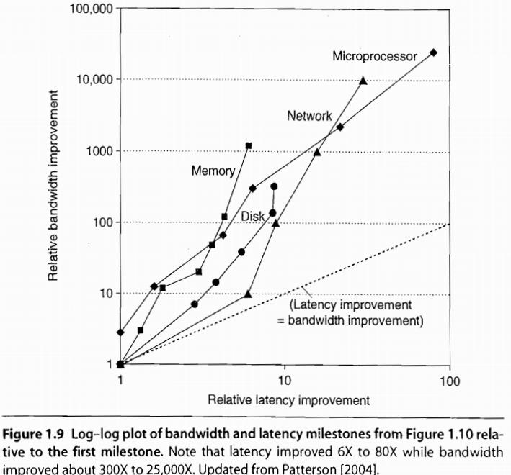
Bandwidth over Latency
For memory and disks
Capacity is generally more important than performance
So capacity improved more than latency
Notes:
Capacity is generally more important than performance for memory and disks
So capacity has improved most in the past years.

Slide 16
Transistor Performance and Wires
Feature Size is decreasing
minimum size of a transistor or a wire in either the x or y dimension
Transistor performance improves linearly with decreasing feature size
feature size shrinks, wires get shorter;
resistance and capacitance per unit length get worse.
Notes:
Finally, let’s discuss a bit more about the fundamental component/unit on chip, i.e., transistor.
Transistor becomes smaller and smaller, while its performance keeps improving.
The reason is that when transistor size shrinks, wires connecting transistors get shorter; this accelerates data transmission speed.
Moreover, when transistor shrinks, a chip can hold more transistor, which further improves the performance.

Slide 17
Trends
Technology
Power and energy
Cost
Notes:
Now let’s move to the second aspect: power and energy

Slide 18
Power vs Energy
How to measure power?
Power = Energy per unit time
1 watt = 1 joule per second
energy to execute a workload =
avg power x execution time
Notes:
First, how to measure them?
The unit for measuring power is watt, while the unit for energy is joule
Actually, power is energy per unit time;
In other words, energy to execute a workload equals to avg power times execution time

Slide 19
Power/Energy vs Efficiency
Example
processor A with 20% higher avg power consumption than processor B;
but A executes the task with 70% of the time by B;
A or B is more efficient?
Notes:
Let’s use an example to better understand the relation between power and energy.

Slide 20
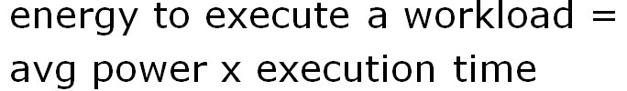
Power/Energy vs Efficiency
Example
processor A with 20% higher avg power consumption than processor B;
but A executes the task with 70% of the time by B;
A or B is more efficient?
EnergyConsumptionA
= 1.2 x 0.7 x EnergyConsumptionB
=0.84 x EnergyConsumptionB
Notes:
Using the calculation method of energy, we can derive that energyconsumptionA is less than energyconsumptionB,
In this sense, we say that A is more efficient;

Slide 21
Where does the energy go?
Notes:
So where does the energy go within a microprocessor?

Slide 22

Primary Energy Consumption within a Microprocessor
Dynamic Energy:
switch transistors
energize pulse of the logic transition:
0->1->0 or 1->0->1
The energy of a single transition
0->1 or 1->0
Notes:
It is mainly for switching transistors, that is, energizing pulse of the logic transition.
Such Dynamic energy is proportional to the product of the capacitive load and the square of voltage

Slide 23
Power Consumption of a Transistor
For a fixed task, slowing clock rate (frequency) reduces power,
but not energy.
Notes:
The power to keep a transistor active can be quantified like this.
As the expression demonstrates, for a fixed task, slowing clock rate / frequency reduces power;
However, it does not necessarily reduce energy.

Slide 24
Power Consumption of a Transistor
For a fixed task, slowing clock rate (frequency) reduces power,
but not energy.
Why?
Notes:
Why is this?

Slide 25
Power Consumption of a Transistor
For a fixed task, slowing clock rate (frequency) reduces power,
but not energy.
Why?
energy = power x execution-time
Notes:
Remember that energy equals to power times execution time

Slide 26
Power Consumption of a Transistor
For a fixed task, slowing clock rate (frequency) reduces power,
but not energy.
Why?
energy = power x execution-time
Notes:
When clock rate reduces, frequency decreases, then the execution time increases.

Slide 27
Challenges
Distributing the power
Removing the heat
Preventing hot spots
Notes:
the challenges faced when designing power and energy solutions are distributing power, removing heat, and preventing hot spots.

Slide 28
How to economize energy?
Notes:
To improve energy efficiency,

Slide 29
Improve Energy-Efficiency
1. do nothing well
turn off the clock of inactive modules
2. DVFS: dynamic voltage-frequency scaling
scale down clock frequency and voltage during periods of low activity
Notes:
we have several possible directions.
A straightforward one is turn off the clock of inactive modules;
Second, since frequency and voltage decide the power, we can carefully tune clock frequency and voltage for lower energy cost while keep the processor functioning at the same time.

Slide 30
Improve Energy-Efficiency
3. design for typical case
PMDs, laptops – often idle
memory and storage with low power modes to save energy
4. overclocking – Turbo mode
the chip runs at a higher clock rate for a short time until temperature rises
Notes:
3. For particular devices like PMDs and laptops, since they are often idle, their memory and storage are designed to offer low power modes to save energy
4. Some processor can also work in Turbo mode, that is, the chip runs at a higher clock rate for a short time toward faster processing speed until temperature rises.

Slide 31
Beyond Transistors
Processor is just a portion of the whole energy cost
Race-to-halt
a faster, less energy-efficient processor
to more quickly complete tasks,
for the rest of the system to go into sleep mode
Notes:
But overall, processor is just a portion of the entire computer system, many other components consume energy;
In this sense, we can use a faster processor to more quickly complete tasks, even though this may induce more energy cost to processor, but less energy cost induced by other system components;

Slide 32
Trends
Technology
Power and energy
Cost
Notes:
Now the third part, how computer cost evolves.

Slide 33
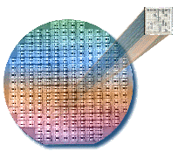
Integrated Circuit
wafer for test; chopped into dies for
packaging
Notes:
During production, integrated circuit is manufactured in the unit of wafer;
A wafer is then chopped into dies for final packaging.

Slide 34
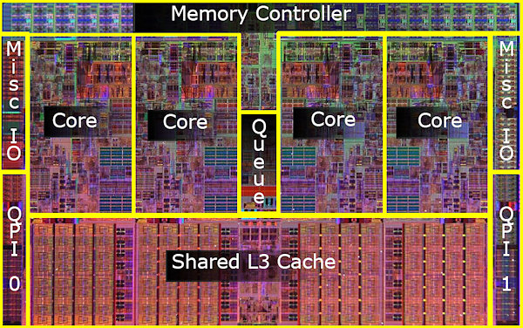
Example: Intel Core i7 Die
Notes:
Here’s an example of what an Intel Core i7 die looks like.

Slide 35

Dies per Wafer
Notes:
How many dies on a wafer?
You might need some geometry knowledge to derive this equation

Slide 36

Cost per Die
percentage of manufactured devices that survives the testing procedure
Notes:
Since not all dies on wafer may function well,
When estimating the cost of functional die, we should take into account the fail rate.
In particular, we introduce a concept called die yield, it represents the percentage of manufactured devices that survives the testing.
Then the cost of die can be defined as cost of wafer over the number of functioning dies chopped from the wafer.

Slide 37
Die Yield
process-complexity factor for measuring manufacturing difficulty
Notes:
Here’s the equation for estimating die yield
It involves a manufacture factor called process-complexity factor;
This is usually not required for exam.

Slide 38
Cost of Integrated Circuit =
Notes:
Putting previous cost together, the cost of integrated circuit can be calculated like this.

Slide 39
Feature size is shrinking
to 32 nm or smaller.
Notes:
As we can see, transistors keep shrinking
Most current transistors are down to 32 nanometers or even smaller;

Slide 40
Transient/permanent faults
will be more commonplace.
Notes:
Such tiny size puts a lot of challenges to manufacturing transistors,
in other words, transient or permanent faults will more often occur to transistors;

Slide 41
How to build
dependable computers?
Notes:
Then how to cope with that?
How can we make our computers as dependable as possible?
Before answering this question,

Slide 42
Dependability
Is a system operating properly?
Notes:
We should know when can we say that a computer is dependable.
When we consider a computer as dependable, the computer should operate properly (according to function requirements)

Slide 43
Dependability
SLA: service level agreements
System states: up or down
Service states
service accomplishment
service interruption
failure
restoration
Notes:
For infrastructure providers to assure their customers the dependability of their networking or power service, they use service level agreements.
Per these agreements, system has up and down states while service has accomplishment and interruption states.
Service accomplishment: the service is delivered as specified;
Service interruption: the delivered service is different from the SLA

Slide 44
How to measure dependability?
Notes:
To measure dependability,

Slide 45
Measures of Dependability
Module reliability
Module availability
Notes:
Two main metrics are module reliability and module availability

Slide 46
Module Reliability
A measure of continuous service accomplishment (or of the time to failure) from a reference initial instant
MTTF: mean time to failure
MTTR: mean time to repair
MTBF: mean time between failures
MTBF = MTTF + MTTR
1st f
2nd f
Notes:
Module reliability is a measure of …
three terms of interest are mttf, mttr, and mtbf;
Obviously, mtbf=mttf+mttr;

Slide 47
Module Reliability
FIT: failures per billion hours
MTTF of 1,000,000 hours
= 1/10⁶ x 10⁹
= 1000 FIT
1 failure per 1 million hours
Notes:
we also use FIT to measure module reliability.
Here’s how FIT is defined and its relation between mttf

Slide 48

Module Availability
Notes:
Module availability represents the time ratio of system working properly till failure

Slide 49
Module Availability
Notes:
Specifically, during mttf, system works properly

Slide 50
Module Availability
Notes:
Then take some time to repair, during which system is not working, not available

Slide 51
Module Availability
Notes:
So the module availability can be quantified as the fraction of the working time over the whole time frame;

Slide 52
How to measure performance?
Notes:
As aforementioned, we have two common metrics to measure performance, right?

Slide 53
Measuring Performance
Execution/response time
the time between the start and
the completion of an event
Throughput
the total amount of work done in a given time
Notes:
One is execution time (or response time, or latency);
The other is throughput…;

Slide 54

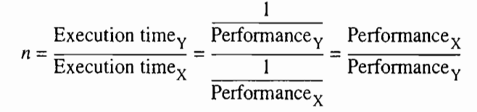
Measuring Performance
Computers: X and Y
X is n times faster than Y, if

Slide 55
Finally,
quantitative principles
of computer design
Notes:
Now we have seen how to define, measure, and summarize/report performance, cost, dependability, energy, and power,
We can explore guidelines and principals that are useful in the design and analysis of computers.
Which are called quantitative principles;

Slide 56
Quantitative Principles
Parallelism
Locality
temporal locality: recently accessed items are likely to be accessed in the near future;
spatial locality: items whose addresses are near one another tend to be referenced close together in time

Slide 57
Quantitative Principles
Focus on the Common Case
in making a design trade-off,
favor the frequent case over
the infrequent case
Notes:
Toward an better average performance

Slide 58
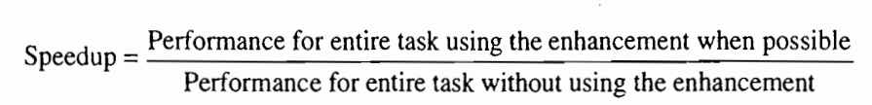
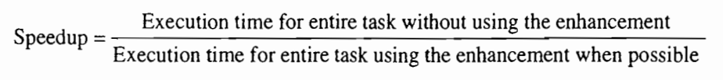
Quantitative Principles
Amdahl’s Law
Notes:
Amdahl’s law defines speedup

Slide 59
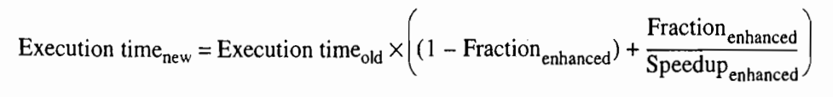
Amdahl’s Law: Two Factors
1. Fraction_{enhanced}:
e.g., 20/60 if 20 seconds out of a 60-second program to enhance
2. Speedup_{enhanced}:
e.g., 5/2 if enhanced to 2 seconds while originally 5 seconds
Notes:
Fraction-enhanced: the fraction of the computation time in the original computer that can be converted to take advantage of the enhancement;
Speedup-enhanced:

Slide 60
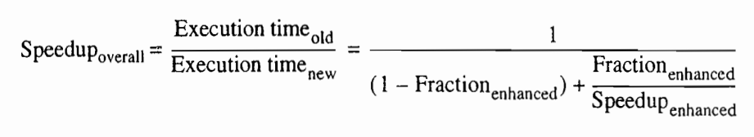
Amdahl’s Law: Overall Speedup
Notes:
Fraction-enhanced: the fraction of the computation time in the original computer that can be converted to take advantage of the enhancement;
Speedup-enhanced:

Slide 61
Processor Performance
Notes:
A series of processor performance equations ahead

Slide 62
CPU Time for Program
CPU time = CPU clock cycles for a program
x clock cycle time
CPU time = CPU clock cycles for a program
Clock rate

Slide 63
CPI: Clock Cycles per Instruction
CPI = CPU clock cycles for a program
Instruction count

Slide 64
CPI: Clock Cycles per Instruction
CPI = CPU clock cycles for a program
Instruction count
Clock cycles = IC x CPI
Instruction Count

Slide 65
CPI: Clock Cycles per Instruction
CPI = CPU clock cycles for a program
Instruction count
Clock cycles = IC x CPI
CPU time = Clock cycles x Clock cycle time
= IC x CPI x Clock cycle time
Notes:
Substitute clock cycles in the equation of cpu time with IC x CPI;

Slide 66
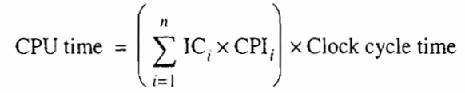
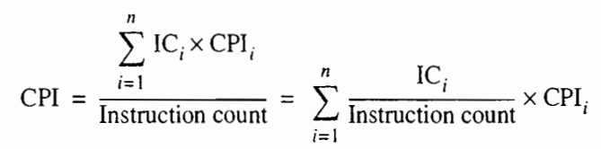
Multiple Instructions

Slide 67
Review
Trends in technology, power, energy, and cost
Dependability
Performance
Quantitative principles

Slide 68

Chapter 1.4-1.9
Notes:
The teaching content corresponds to the second part of chapter 1.

Slide 69
?

Slide 70

Thank You
be you
Notes:
Some seagulls are floating in the ocean, some are hovering in the sky, while some is walking on the edge.
One way or another, just be you.

Slide 71
#What’s More
You and Your Research
by Richard Hamming
How to Write a Great Research Paper
by Simon Peyton Jones
How to Give a Great Research Talk
by Simon Peyton Jones
A Radical New Way to Control the English Language by George Gopen

