Slide 1
Memory Hierarchy Design
10
Kai Bu
kaibu@zju.edu.cn
http://list.zju.edu.cn/kaibu/comparch2019

Slide 2
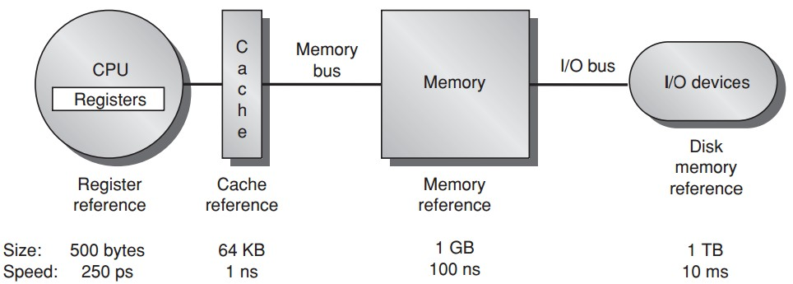
Memory Hierarchy
Notes:
In previous lectures, we took a lot of time to understand memory hierarchy.
It consists of several levels of storage components.
After data reference leaves CPU processor, it first enters cache,
If not found, then goes to memory; then to disk if needed.

Slide 3
Memory Hierarchy
Notes:
As each level goes farther from CPU processor,
storage size increases while processing speed slows down.
So toward faster execution,
we hope that data reference can be accommodated at as higher level as possible.

Slide 4
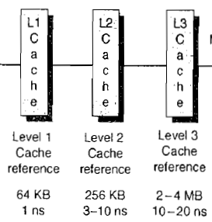
Memory Hierarchy
faster
Notes:
To this end, we may introduce multi-level cache.

Slide 5
Memory Hierarchy
Virtual memory
larger, safer
Notes:
To enhance memory usage efficiency and safety,
we also introduce virtual memory that integrates both physical memory and magnetic disk.
Virtual memory enables each program to independently manage allocated memory space
via indirect mapping from virtual address to physical address.

Slide 6
I know how they work, basically…
Notes:
So most of our discussions were focusing on these basics of memory hierarchy.

Slide 7
They should work better?
Notes:
Obviously, to support our super fast computers, there should be some more magics to enhance system performance. Right?

Slide 8
They should work better?
toward optimization!
Notes:
Such performance enhancement requires various optimization techniques during memory hierarchy design.

Slide 9
They should work better?
toward optimization?
Notes:
Then what optimization techniques are built in our computers?
What are their pros and cons?
This will be the core of today’s lecture

Slide 10
Preview
How to optimize cache?
How to optimize memory?
Notes:
In particular, we’ll explore many of them related to both cache and memory.

Slide 11
Optimization
?
Notes:
So the first question, how to optimize cache performance?

Slide 12
Cache Performance
Average Memory Access Time = Hit Time + Miss Rate x Miss Penalty
Notes:
The key metric to measure cache performance is average memory access time,
which is further determined by three other metrics:
Hit time, miss rate, and miss penalty.
Clearly, reducing any of these metrics could reduce average memory access time and thus enhance cache performance.

Slide 13
six basic optimizations
Notes:
Now let’s recap the six basic optimizations we previously discussed.

Slide 14
Six Basic Cache Optimizations
1. larger block size
reduce miss rate; --- spatial locality;
reduce static power; --- lower tag #;
increase miss penalty, capacity/conflict misses;
2. bigger caches
reduce miss rate; --- capacity misses
increase hit time;
increase cost and (static & dynamic) power;
3. higher associativity
reduce miss rate; --- of conflict misses;
increase hit time;
increase power;

Slide 15
Six Basic Cache Optimizations
4. multilevel caches
reduce miss penalty;
reduce power;
average memory access time =
Hit time_{L1} + Miss rate_{L1} x
(Hit time_{L2} + Miss rate_{L2} x Miss penalty_{L2})
5. giving priority to read misses over writes
reduce miss penalty;
introduce write buffer;

Slide 16
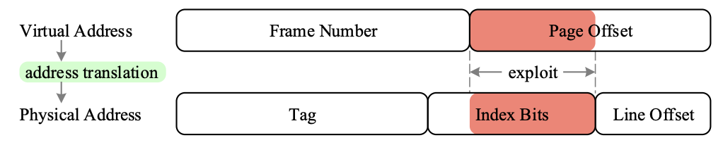
Six Basic Cache Optimizations
6. avoiding address translation during indexing of the cache
reduce hit time;
use page offset to index cache;
virtually indexed, physically tagged;
(indexing cache while querying TLB)

Slide 17
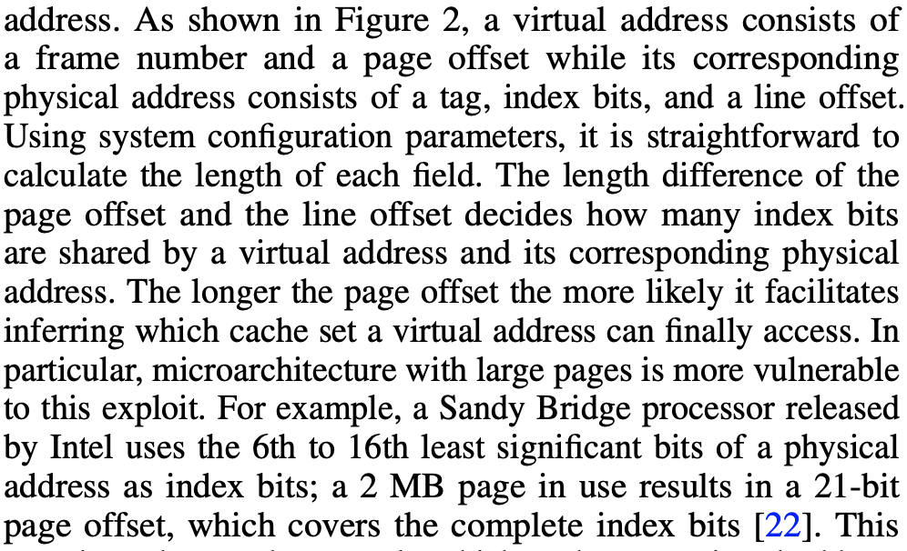
Six Basic Cache Optimizations
virtually indexed, physically tagged

Slide 18
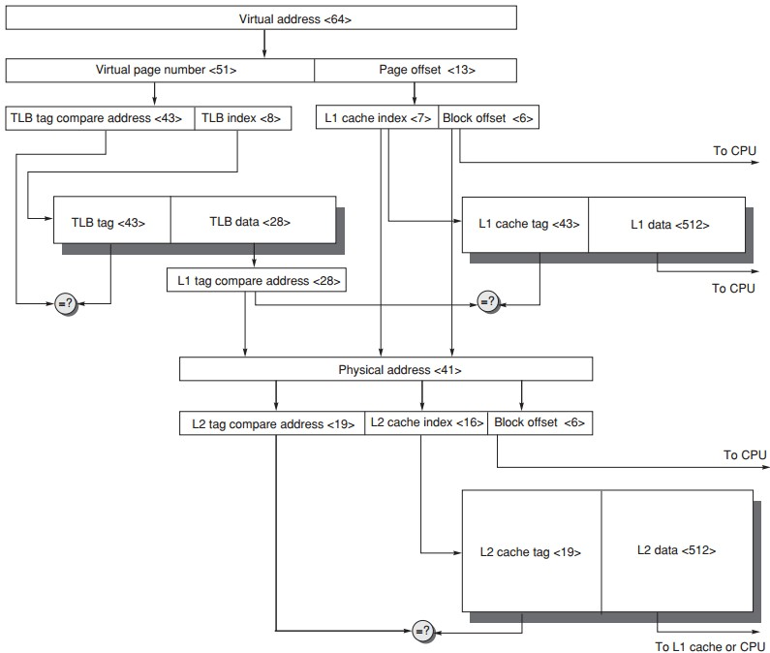
Address Translation
64-bit virtual address
41-bit physical address
page size: 8KB
two-level direct-mapped caches
64-byte blocks
L1: 8KB
L2: 4MB
TLB 256 entries

Slide 19
ten advanced optimizations
Notes:
Next, we’ll get to know ten advanced optimizations.

Slide 20
Ten Advanced Cache Opts
Goal: average memory access time
Metrics to reduce/optimize
hit time
miss rate
miss penalty
cache bandwidth
power consumption
Notes:
Their goal is still to reduce average memory access time.
Besides hit time, miss rate, and miss penalty, they also try to increase cache bandwidth and reduce power consumption.

Slide 21
Ten Advanced Cache Opts
Reduce hit time
small and simple first-level caches;
way prediction;
decrease power;
Increase cache bandwidth
pipelined/multibanked/nonblocking cache;
Reduce miss penalty
critical word first;
merging write buffers;
Reduce miss rate
compiler optimizations; decrease power;
Reduce miss penalty or miss rate via parallelism
hardware/compiler prefetching; increase power;
Notes:
Here’s an overview of which optimizations to enhance which metrics.
Now let’s discuss each one in detail.

Slide 22
Opt #1: Small and Simple First-Level Caches
Small size
support a fast clock cycle
reduce power
Lower associativity
reduce both hit time and power
(direct-mapped caches can overlap the tag check with the transmission of the data,
there’s only one piece of data for each index)
Notes:
The first optimization advocates small and simple first-level caches.
When the cache is small enough, it delivers fast hit time to support a fast clock cycle. Meanwhile, it reduces power consumption.
By simple, it advocates lower associativity. This also reduces both hit time and power.

Slide 23
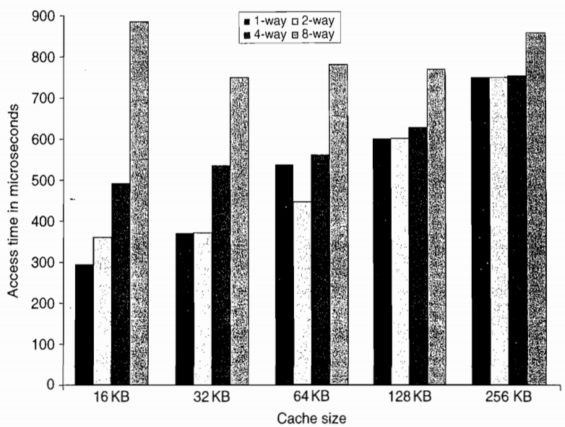
Opt #1: Small and Simple First-Level Caches
Reduce hit time
Notes:
Smaller caches – faster
Lower associatiity

Slide 24
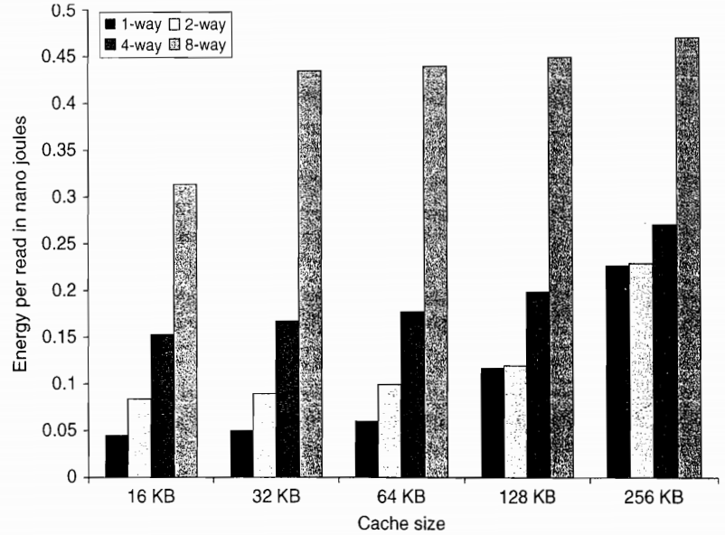
Opt #1: Small and Simple First-Level Caches
Reduce power

Slide 25
Opt #2: Way Prediction
Reduce conflict misses and hit time
Way prediction
block predictor bits are added to each block to predict the way/block within the set of the next cache access
the multiplexor is set early to select the desired block;
only a single tag comparison is performed in parallel with cache reading;
a miss results in checking the other blocks for matches in the next clock cycle;

Slide 26
Opt #3: Pipelined Cache Access
Increase cache bandwidth
Higher latency
Greater penalty on mispredicted branches and more clock cycles between issuing the load and using the data

Slide 27
Opt #4: Nonblocking Caches
Increase cache bandwidth
Nonblocking/lockup-free cache
leverage out-of-order execution
allows data cache to continue to supply cache hits during a miss;

Slide 28
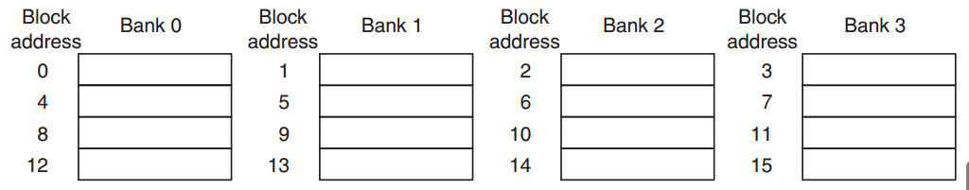
Opt #5: Multibanked Caches
Increase cache bandwidth
Divide cache into independent banks that support simultaneous accesses
Sequential interleaving
spread the addresses of blocks sequentially across the banks

Slide 29
Opt #6: Critical Word First & Early Restart
Reduce miss penalty
Motivation: the processor normally needs just one word of the block at a time
Critical word first
request the missed word first from the memory and send it to the processor as soon as it arrives; processor continues execution while filling the rest of the words in the block
Early restart
fetch the words in normal order,
as soon as the requested word arrives send it to the processor;

Slide 30
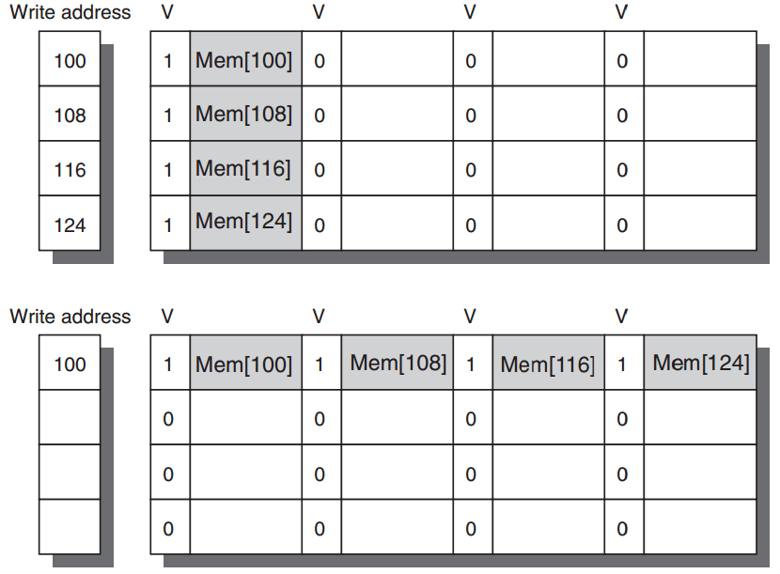
Opt #7: Merging Write Buffer
Reduce miss penalty
Write merging merges four entries (with sequential addresses)
into a single buffer entry
Notes:
discussion

Slide 31
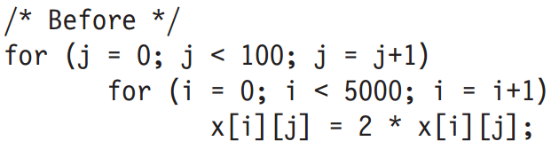
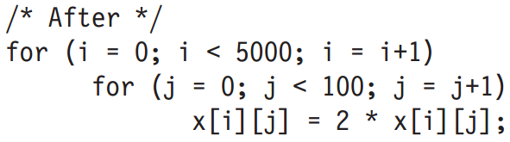
Opt #8: Compiler Optimizations
Reduce miss rates, w/o hw changes
Tech 1: Loop interchange
exchange the nesting of the loops to make the code access the data in the order in which they are stored
x[i,j] and x[i,j+1] are adjacent
Notes:
Without hardware changes

Slide 32
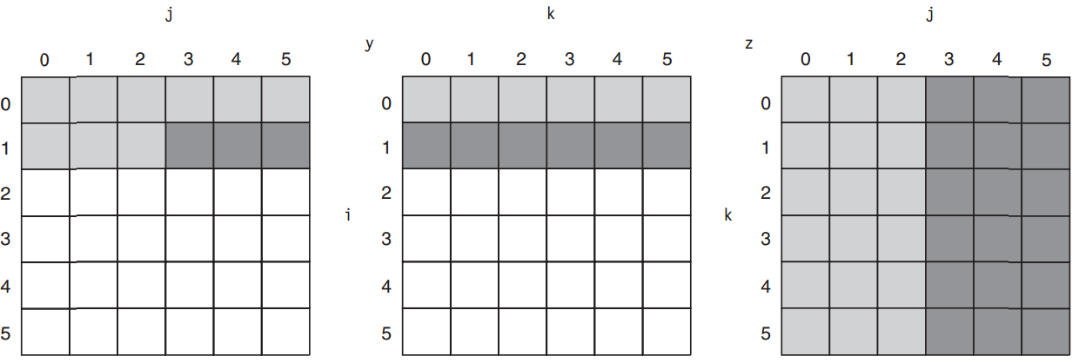
Opt #8: Compiler Optimizations
Reduce miss rates, w/o hw changes
Tech 2: Blocking
x = y*z; both row&column accesses
before
x
Notes:
This optimization tries to reduce misses via improved temporal locality. We are
again dealing with multiple arrays, with some arrays accessed by rows and some
by columns. Storing the arrays row by row (row major order) or column by column
(column major order) does not solve the problem because both rows and
columns are used in every iteration of the loop. Such orthogonal accesses mean
the transformations such as loop interchange are not helpful.
Instead of operating on entire rows or columns of an array, blocked algorithms
operate on submatrices or blocks. The goal is to maximize accesses to the data
loaded into the cache before the data are replaced.

Slide 33
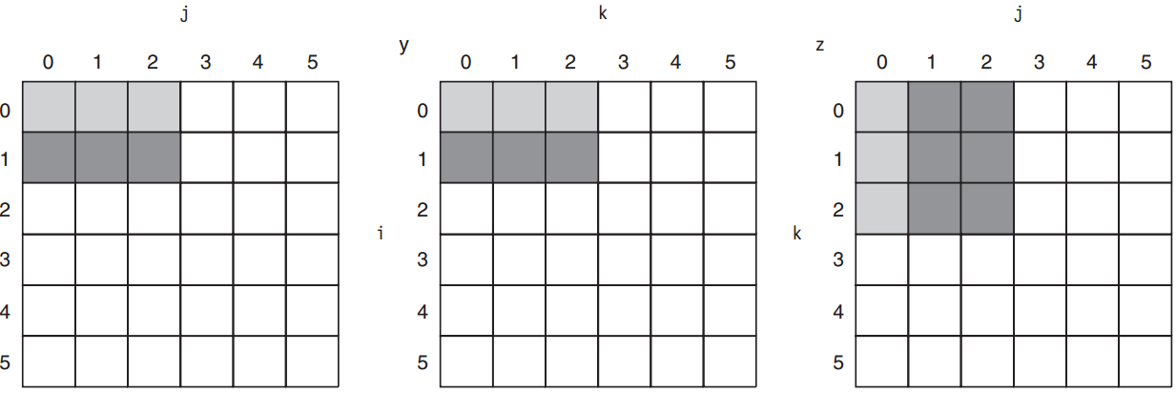
Opt #8: Compiler Optimizations
Reduce miss rates, w/o hw changes
Tech 2: Blocking
x = y*z; compute using submatrices
after; maximize accesses to loaded data before they are replaced
Notes:
More in textbook;

Slide 34
Opt #9: Hardware Prefetching
Reduce miss penalty/rate
Prefetch items before the processor requests them, into the cache or external buffer
Instruction prefetch
fetch two blocks on a miss: requested one into cache + next consecutive one into instruction stream buffer
Similar Data prefetch approaches

Slide 35
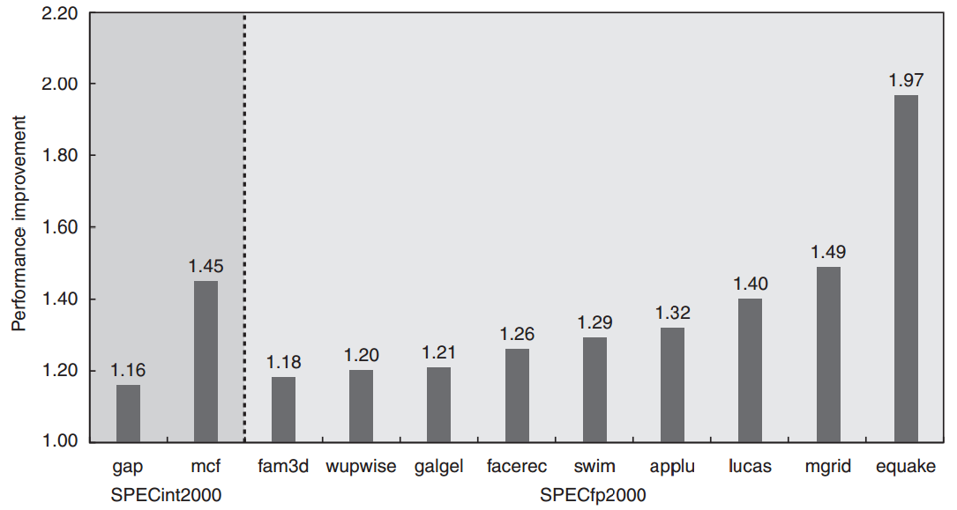
Opt #9: Hardware Prefetching

Slide 36
Opt #10: Compiler Prefetching
Reduce miss penalty/rate
Compiler to insert prefetch instructions to request data before the processor needs it
Register prefetch
load the value into a register
Cache prefetch
load data into the cache

Slide 37
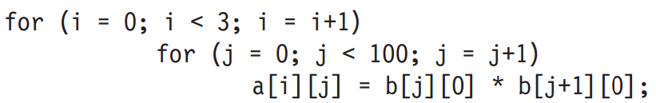
Opt #10: Compiler Prefetching
Example: 251 misses
16-byte blocks;
8-byte elements for a and b;
write-back strategy;
a[0][0] miss, copy both a[0][0],a[0][1] as one block contains 16/8 = 2;
so for a: 3 x (100/2) = 150 misses
b[0][0] – b[100][0]: 101 misses

Slide 38
Opt #10: Compiler Prefetching
Example: 251 misses
16-byte blocks;
8-byte elements for a and b;
write-back strategy;
a[0][0] miss, copy both a[0][0],a[0][1] as one block contains 16/8 = 2;
how many misses?

Slide 39
Opt #10: Compiler Prefetching
Example: 251 misses
16-byte blocks;
8-byte elements for a and b;
write-back strategy;
a[0][0] miss, copy both a[0][0],a[0][1] as one block contains 16/8 = 2;
so for a: 3 x (100/2) = 150 misses
b[0][0] – b[100][0]: 101 misses

Slide 40
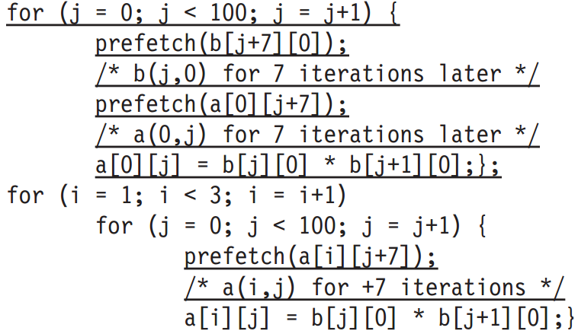
Opt #10: Compiler Prefetching
Example: 19 misses by prefetching
?
7 misses: b[0][0] – b[6][0]
4 misses: 1/2 of a[0][0] – a[0][6]
4 misses: a[1][0] – a[1][6]
4 misses: a[2][0] – a[2][6]

Slide 41
Opt #10: Compiler Prefetching
Example: 19 misses by prefetching
7 misses: b[0][0] – b[6][0]
4 misses: 1/2 of a[0][0] – a[0][6]
4 misses: a[1][0] – a[1][6]
4 misses: a[2][0] – a[2][6]

Slide 42
Optimization
√
Notes:
So now we discuss a lot of tricks to optimize cache performance

Slide 43
Optimization
?
Notes:
still remember memory, another important part in the mem hierarchy, right?
The last defense from entering the slowest disk level; so, the question, is how to optimize memory performance?

Slide 44
Main Memory
Main memory: I/O interface between caches and servers
dst of input & src of output
Processor
Control
Secondary
Storage
(Disk)
Second
Level
Cache
(SRAM)
Main
Memory
(DRAM)
Datapath
On-Chip
Cache
Registers
Compiler
Hardware
Speed:
Fastest
Operating System
Slowest
Size:
Smallest
Biggest
Cost:
Highest
Lowest
Notes:
Main memory plays a very important role in the entire memory hierarchy.
It serves as the I/O interface between caches and servers/disks.
From this point of view, it is the destination of input swapped from the disk as well as the source of output generated by CPU.

Slide 45
Main Memory
Performance measures
Latency the time to retrieve the first word of the block
important for caches;
harder to reduce;
Bandwidth the time to retrieve the rest of this block
important for multiprocessors, I/O, and caches with large block sizes;
easier to improve with new organizations;

Slide 46
Main Memory
Performance measures
Latency
access time: the time between when a read is requested and when the desired word arrives;
cycle time: the minimum time between unrelated requests to memory;
or the minimum time between the start of an access and the start of the next access;
Notes:
Two more specific measures

Slide 47
Main Memory
SRAM for cache
DRAM for main memory
Notes:
medium type of memory

Slide 48
SRAM
Static Random Access Memory
Six transistors per bit to prevent the information from being disturbed when read
Don’t need to refresh, so access time is very close to cycle time

Slide 49
DRAM
Dynamic Random Access Memory
Single transistor per bit
Reading destroys the information
Refresh periodically
cycle time > access time

Slide 50
DRAM
Dynamic Random Access Memory
Single transistor per bit
Reading destroys the information
Refresh periodically
cycle time > access time
DRAMs are commonly sold on small boards called DIMM
(dual inline memory modules),
typically containing 4 ~ 16 DRAMs

Slide 51
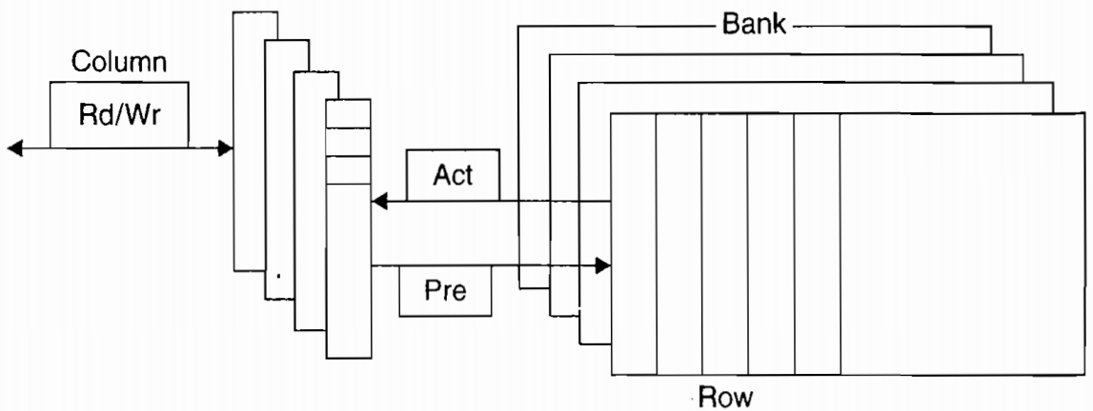
DRAM Organization
DRAMs are organized in banks

Slide 52
DRAM Organization
Each bank consists of a series of rows
RAS: row access strobe

Slide 53
DRAM Organization
Each row consists of a series of columns
CAS: column access strobe

Slide 54
DRAM Organization
Pre (pre.charge) command opens or closes a bank

Slide 55
DRAM Organization
Row address is sent with an Act (activate) command;
Then row is transferred to a buffer

Slide 56
DRAM Organization
For row in the buffer, it can be transferred by successive column addresses

Slide 57
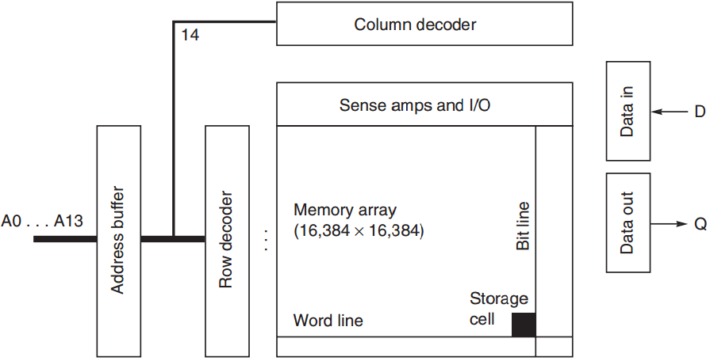
DRAM Organization
Notes:
Could refer to slides here fore more details: https://pubweb.eng.utah.edu/~cs6710/slides/memoryx2.pdf

Slide 58
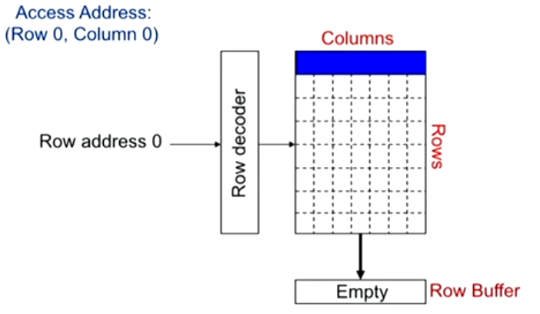
DRAM Access Example

Slide 59
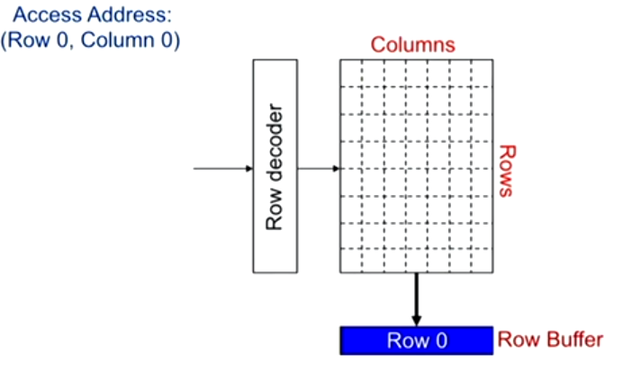
Bring Row into Row Buffer

Slide 60
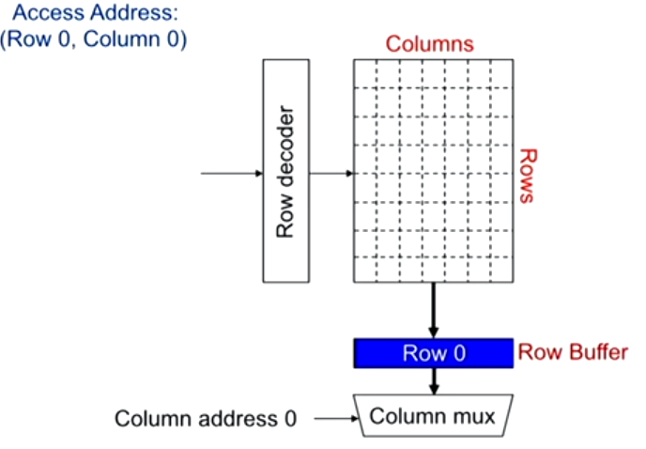
Select Data via Multiplexor

Slide 61
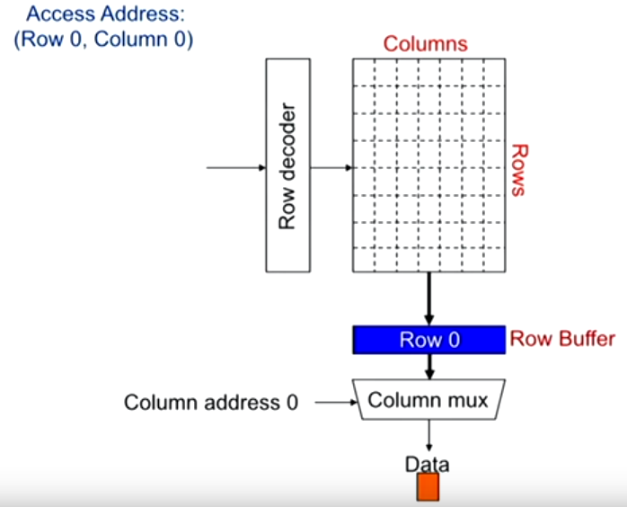
Data Selected

Slide 62
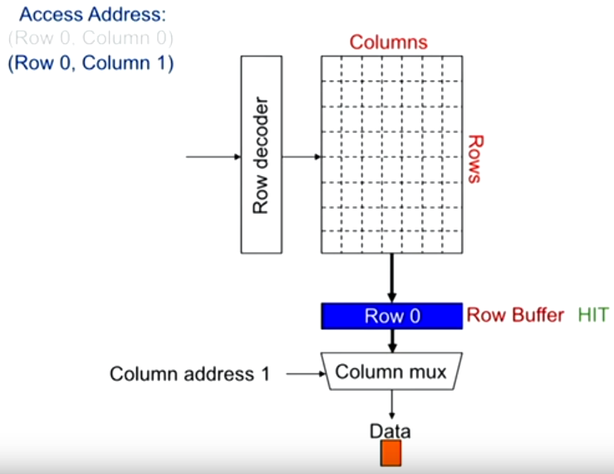
Row Buffer Hit

Slide 63
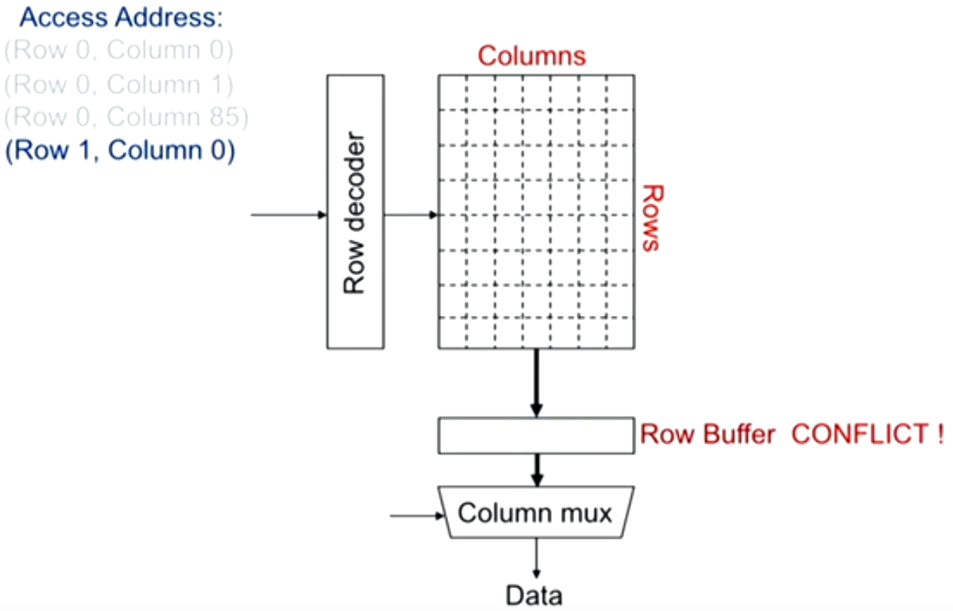
Row Buffer Conflict
Notes:
Row-hit first: service row-hit memory access first
Oldest-first: then service older access first
For maximizing DRAM throughput

Slide 64
DRAM Improvement
Timing signals
allow repeated accesses to the row buffer w/o another row access time;
Leverage spatial locality
each array will buffer 1024 to 4096 bits for each access;

Slide 65
DRAM Improvement
Clock signal
added to the DRAM interface,
so that repeated transfers will not involve overhead to synchronize with memory controller;
SDRAM: synchronous DRAM

Slide 66
DRAM Improvement
Wider DRAM
to overcome the problem of getting a wide stream of bits from memory without having to make the memory system too large as memory system density increased;
widening the cache and
memory widens memory bandwidth;
e.g., 4-bit transfer mode up to 16-bit buses

Slide 67
DRAM Improvement
DDR: double data rate
to increase bandwidth,
transfer data on both the rising edge and falling edge of the DRAM clock signal,
thereby doubling the peak data rate;

Slide 68
DRAM Improvement
Multiple Banks
break a single SDRAM into 2 to 8 blocks;
they can operate independently;
Provide some of the advantages of interleaving
Help with power management
Notes:
Interleaving: some blocks work while some not, save power

Slide 69
DRAM Improvement
Reducing power consumption in SDRAMs
dynamic power: used in a read or write;
static/standby power
Depend on the operating voltage
Power down mode: entered by telling the DRAM to ignore the clock
disables the SDRAM except for internal automatic refresh;

Slide 70
Flash Memory
A type of EEPROM (electronically erasable programmable read-only memory)
Read-only but can be erased
Hold contents w/o any power

Slide 71
Flash Memory
Differences from DRAM
Must be erased (in blocks) before it is overwritten
Static and less power consumption
Has a limited number of write cycles for any block
Cheaper than SDRAM but more expensive than disk
Slower than SDRAM but faster than disk

Slide 72
Memory Dependability
Soft errors
changes to a cell’s contents, not a change in the circuitry
Hard errors
permanent changes in the operation of one or more memory cells

Slide 73
Memory Dependability
Error detection and fix
Parity only
only one bit of overhead to detect a single error in a sequence of bits;
e.g., one parity bit per 8 data bits
ECC only
detect two errors and correct a single error with 8-bit overhead per 64 data bits
Chipkill
handle multiple errors and complete failure of a single memory chip

Slide 74
Memory Dependability
Rates of unrecoverable errors in 3 yrs
Parity only
about 90,000, or one unrecoverable (undetected) failure every 17 mins
ECC only
about 3,500 or about one undetected or unrecoverable failure every 7.5 hrs
Chipkill
6, or about one undetected or unrecoverable failure every 2 months

Slide 75
Virtual Memory
The architecture must limit what a process can access when running a user process yet allow an OS process to access more
Four tasks for the architecture

Slide 76
Virtual Memory
Task 1
The architecture provides at least two modes, indicating whether the running process is a user process or an OS process
(kernel/supervisor process)

Slide 77
Virtual Memory
Task 2
The architecture provides a portion of the processor state that a user process can use but not write

Slide 78
Virtual Memory
Task 3
The architecture provides mechanisms whereby the processor can go from user mode to supervisor mode (system call) and vice versa

Slide 79
Virtual Memory
Task 4
The architecture provides mechanisms to limit memory accesses to protect the memory state of a process w/o having to swap the process to disk on a context switch

Slide 80
Virtual Machines
Virtual Machine
a protection mode with a much smaller code base than the full OS
VMM: virtual machine monitor
hypervisor
software that supports VMs
Host
underlying hardware platform

Slide 81
Virtual Machines
Requirements
1. Guest software should behave on a VM exactly as if it were running on the native hardware
2. Guest software should not be able to change allocation of real system resources directly

Slide 82
VMM: Virtual Machine Monitor
three essential characteristics:
1. VMM provides an environment for programs which is essentially identical with the original machine;
2. programs run in this environment show at worst only minor decreases in speed;
3. VMM is in complete control of system resources;
Mainly for security and privacy
sharing and protection among multiple processes

Slide 83

Chapter 2 Appendix B
Notes:
The following content corresponds to chapter 2
atop the basic working principles of memory hierarchy we have learnt from Appendix B.

Slide 84
Labs 3-5
Lab 3
Demo: December 02, 2019
Report: December 09, 2019
Lab 4
Demo: December 09, 2019
Report: December 16, 2019
Lab 5
Demo: December 30, 2019
Report: January 06, 2020

Slide 85
?

Slide 86

Thank You
wherever you go,
there you are.

Slide 87
#What’s More
The Ten Suggestions by Ben Bernanke
The Lesson of Grace in Teaching
by Francis Su

