Slide 1

Reviving Android Malware with DroidRide: And How Not To
CyberC 2016
Min Huang, Kai Bu,
Hanlin Wang, Kaiwen Zhu
Zhejiang University
Notes:
Thank you,
So today I’m gonna present the design and implementation of DroidRide, on behalf of the authors from Zhejiang University.

Slide 2

Reviving Android Malware with DroidRide: And How Not To
?
Notes:
DroidRide aims at re-examining the security and robustness of current android ecosystem.

Slide 3




Reviving Android Malware with DroidRide: And How Not To
evaded
install
malware
repackaged
obfuscated
WOO
HAH
Notes:
Specifically, it reveals the vulnerabilities of malware detectors and Android OS by implementing a framework of
how to make Android malware less catchable to detectors and more active on phones.

Slide 4
privilege escalation
remote control
financial charges
information stealing
…
malware
Notes:
Malwares have four major behaviors, privilege escalation, remote control, financial charges, and information stealing

Slide 5
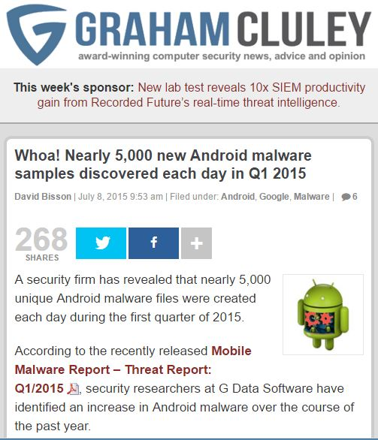
malware
Notes:
Back to the first quarter of 2015, newly 5000 new Android malware samples were revealed each day.

Slide 6
malware
Can scanners/detectors catch all?
Notes:
You might wonder
that’s not a big deal,
Cause we have many powerful malware scanners/detectors to expose them, right?

Slide 7
in 2011, 20.2%~79.6% of
1260 malware samples
were detected
malware
Can scanners/detectors catch all?
Notes:
In 2011, Zhou et al already conducted a measurement study about the performance of malware detectors.
Given more than one thousand collected malware samples,
Four representative detectors caught only 20% to 79% of them.

Slide 8
in 2011, 20.2%~79.6% of
1260 malware samples
were detected
How about now?
malware
Can scanners/detectors catch all?
Notes:
Now, after years of fighting against android malware,
Is it still a problem?

Slide 9
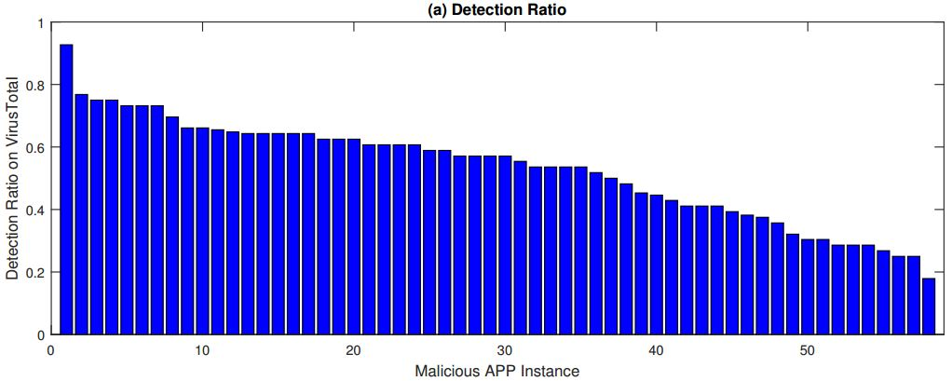
no detector detects all test known malware
in 2016, 17.9%~92.7% of
58 malware samples
were detected on VirusTotal
How about now?
malware
Can scanners/detectors catch all?
Notes:
We answer this question by scanning a public dataset containing 58 known malware samples on VirusTotal, which supports more than 50 built-in detectors.
As shown in this figure, no detector can detect all test known malware samples.
The detection ratio ranges from 17% to 92%.

Slide 10
40% of samples evade >50% of detectors
in 2016, 17.9%~92.7% of
58 malware samples
were detected on VirusTotal
How about now?
malware
Can scanners/detectors catch all?
Notes:
Newly 40% of the test apps can evade more than 50% of built-in detectors.

Slide 11
malware
Can scanners/detectors catch all?
And app store?
Notes:
But app stores will take further check before posting apps, right?
Can they eliminate malware that evades from detectors?

Slide 12
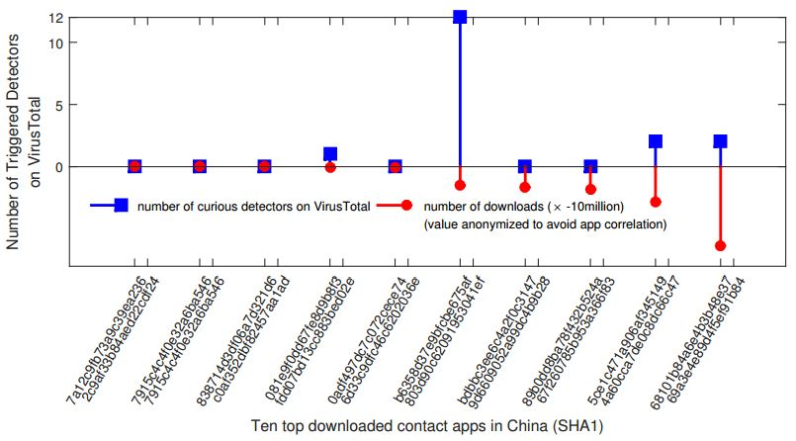
malware
Can scanners/detectors catch all?
And app store?
four out of ten top downloaded contact apps
were detected as malware
Notes:
We select ten top downloaded contact apps in China and test them on VirusTotal,
Surprisingly, four out of the ten apps still trigger alarms from one or more detectors.

Slide 13

malware
Can scanners/detectors catch all?
And app store?
Fixes on OS?
Notes:
Now we have to face that truth that some malware applications will be finally installed on phones.
Then can we add necessary fixes on Android OS to monitor and block malware apps upon their execution?

Slide 14
malware
Can scanners/detectors catch all?
And app store?
Fixes on OS? well…
Notes:
As our measurement results shows, Android os may still not be that mature.

Slide 15
Reviving Android Malware with DroidRide: And How Not To
evaded
install
malware
repackaged
obfuscated
WOO
HAH
hack to secure
Notes:
In order to examine where should we start with toward enhancing current detectors and OS,
we integrate our findings of their vulnerabilities into the DroidRide framework.

Slide 16
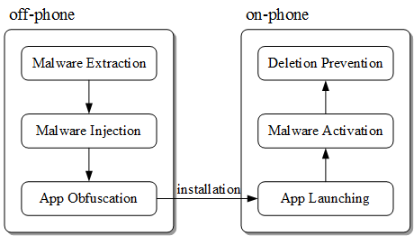
Reviving Android Malware with DroidRide: And How Not To
Notes:
In particular, DroidRide works in two phases, which are off-phone phase and on-phone phase.
The off-phase aims at making malware evade detectors while the on-phone phase aims at making malware applications active on phones as more often as possible.
Next, I’ll highlight our major findings during the two phases.

Slide 17
Reviving Android Malware with DroidRide: And How Not To
Notes:
First, off-phone phase

Slide 18
Reviving Android Malware with DroidRide: And How Not To
repackaging & obfuscation still work
extract exploitable code
(instead of readily available malware samples)
inject it into benign app
Notes:
We find that simple techniques like repackaging and obfuscation are still effective for malware evasion.
For repackaging, we do not use readily available malware samples.
Instead, we analyze source code of apps and extract exploitable code therein, and then inject them into benign apps.
We think that this is more effective to evade signature-based detector.

Slide 19
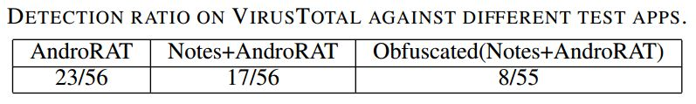
Reviving Android Malware with DroidRide: And How Not To
remote access control
memo app
Notes:
During implementation, we use AndroRAT and MIUI Notes as example apps.
Remote access control function of AndroRAT renders it malicious; it’s thus marked by 23 detectors on virustotal.
We extract the remote access control code from AndroRAT, inject it into Notes and repackage it,
Only 17 detectors detect Notes as malware.
Upon further obfuscation, the repackaged Notes trigger alarms of only 8 detectors.

Slide 20
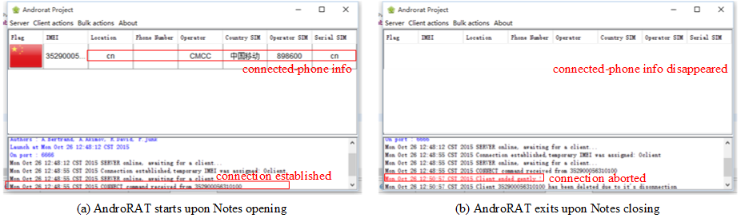
repackaged Notes supports
injected remote access control
Notes:
This snapshots demonstrate that repackeged Notes app successfully supports remote access control function extracted from AndroRAT.

Slide 21
Reviving Android Malware with DroidRide: And How Not To
Notes:
now, let’s move to on-phone phase

Slide 22
Reviving Android Malware with DroidRide: And How Not To
auto activation & uninstall resistance
register for a sys event
Intent.ACTION_TIME_TICK
to control activation rate
Notes:
We find that Android OS features of Broadcast exploitable to enable malicious apps’ automatic activation and uninstall resistance.
For automatic activation, we code the application to register for a system event Intent.ACTION_TIME_TICK, which broadcasts the time every minute.
Thus upon receiving the broadcast message every minute, BroadcastReceiver will activate AndroRAT client if it’s not yet.
It’s straightforward to tune the activation frequency through, for example, using a counter decreased upon every Time_Tick broadcast.

Slide 23
Reviving Android Malware with DroidRide: And How Not To
auto activation & uninstall resistance
root privilege needed
copy app to sys app folder
potential memory-drain attack
Notes:
Uninstall resistance is more difficult to achieve.
But it’s possible on a rooted phone.
The method is to copy the malware application into /system/app folder.
Then the malware application will be escalated to a system app which cannot be deleted via common deletion functions.

Slide 24
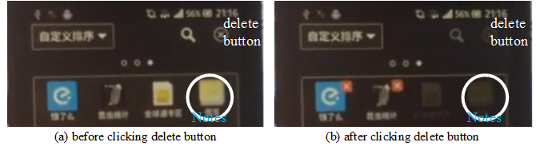
app escalated to sys level
cannot be selected to delete
Notes:
As shown in the snapshots, after copying the repkaged Notes to /system/app folder,
When we click the delete button, its icon turns to unselectable.

Slide 25
Reviving Android Malware with DroidRide: And How Not To
evaded
install
malware
repackaged
obfuscated
WOO
HAH
hack to secure
Notes:
Now we have walked through how DroidRide conducts the hacking part,
Then what can we learn from it to secure current Android ecosystem？

Slide 26
defenses
static/dynamic analysis
behavioral analysis
market policy
…
Notes:
Among many possible enhancements, we find three of them would be necessary to pursue.
First, detectors should integrated more powerful analysis schemes like dynamic analysis. No matter how malware applications are repackaged and obfuscated, the behavior or pattern they exhibit during execution may be same or similar.
Second, Android OS could consider behavioral analysis of running apps. For example, if a user notices that our example Notes app constantly accesses contact and SMS and transfers many of them out, the user can easily identify the repackaged Notes as malicious.
Finally, app stores also play a comparatively critical role in combating malicious apps. They, especially in cooperation, have the largest app base for exercising various detection methods.

Slide 27
Reviving Android Malware with DroidRide: And How Not To
evaded
install
malware
repackaged
obfuscated
WOO
HAH
enhance detectors and Android OS
Notes:
So this is all about the vulnerabilities of current malware detectors and Android OS revealed by DroidRide,
And the necessary enhancements it suggests

Slide 28
Thank You
Min_Huang@cs.cmu.edu, kaibu@zju.edu.cn
demo: https://www.youtube.com/watch?v=uGEcL9jT-a4
code: http://pan.baidu.com/s/1i56QNL7 passwd: xo87
Notes:
Thank you for your time and interest.
Now I’m happy to take any questions. Thank you.
You are also welcome to email your questions to the authors and check their demo and prototype online.

