Slide 1
Comprehensive Laboratory Practice of Information Security
Kai Bu
Zhejiang University
http://list.zju.edu.cn/kaibu/infosec2015/

Slide 2
Welcome

Slide 3
Instructor
Kai Bu 卜凯
Assistant Professor, College of CS, ZJU
Ph.D. from Hong Kong PolyU, 2013
Research Interests
networking and security
(RFID, Software-Defined Networking…)
http://list.zju.edu.cn/kaibu/

Slide 4
What do u think of
information security?

Slide 5
What did u think of
this course?

Slide 6
Might be a bit different…

Slide 7
beyond practicing
hacking tools and skills

Slide 8
Train Your Security Mindset

Slide 9
Hack to Secure
https://www.youtube.com/watch?v=phElxf6MUkU

Slide 10
Group-Project Oriented
https://www.youtube.com/watch?v=phElxf6MUkU

Slide 11
Tentative Projects
RFID Authentication
Hacking Taxi-Hailing Apps
Moving Target Defense

Slide 12

Projects
#1s
Is Being Secret Enough?: Efficiency and Privacy for RFID Authentication
Goal
attack current designs;
design/implement new
ones with improved
efficiency/privacy.

Slide 13
Projects
#1s
Is Being Secret Enough?: Efficiency and Privacy for RFID Authentication
Reference
Privacy and security in library RFID: issues, practices, and architectures, CCS 2004, [video: https://archive.org/details/Microsoft_Research_Video_103482]
RFID Traceability: A Multilayer Problem, FC 2005
A Lightweight RFID Protocol to protect against Traceability and Cloning attacks, SecureComm 2005
An efficient forward private RFID protocol, CCS 2009

Slide 14

Projects
#2s
Hacking Taxi-Hailing Services for Profits
Goal
exploit taxi-hailing apps & driver-passenger collusion for profits;
design/implement detection/prevention
News
http://www.aliyun.com/zixun/content/2_6_1907774.html
http://www.chejiwang.com/news/news-14857.html

Slide 15
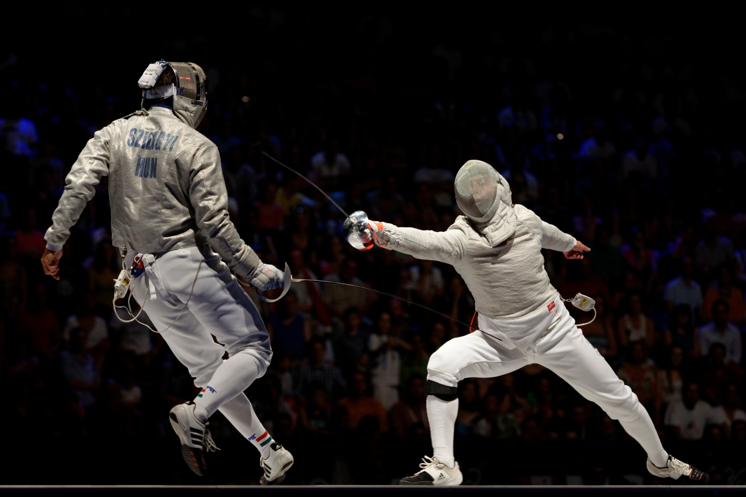
Projects
#3s
Catch Me If You Can: Meet the So Called Moving Target Defense
Goal
design/implement MTD against classic attack like DDoS

Slide 16
Projects
#3s
Catch Me If You Can: Meet the So Called Moving Target Defense
Reference
SDN - Moving Target Defense Controller (POX) [video: https://www.youtube.com/watch?v=E4KqQkcJlqw ]
OpenFlow Random Host Mutation: Transparent Moving Target Defense using Software Defined Networking, HotSDN 2014
cn post: http://drops.wooyun.org/tips/4966
First ACM Workshop on Moving Target Defense (MTD 2014) http://csis.gmu.edu/MTD2014/

Slide 17
Projects
#?s
Open call
How you want to WOW this class?

Slide 18
Schedule
Week 2: Sep 21
project proposal presentation
grouping: 5-6/group
project assignment
Week 3-7
discuss, design, implement… ENJOY
Week 8: Nov 2
demo, presentation, report

Slide 19
Grading
40% Demo
40% Report
20% Presentation
10%+ Research-oriented project

Slide 20
Who’s Who?
Email: kaibu@zju.edu.cn
QQ group: 69730126

Slide 21
Ready?

