Slide 1
Comprehensive Laboratory Practice of Information Security
Kai Bu
Zhejiang University
http://list.zju.edu.cn/kaibu/infosec2016/

Slide 2
thanks & welcome

Slide 3
Instructor
Kai Bu 卜凯
Assistant Professor, College of CS, ZJU
Ph.D. from Hong Kong PolyU, 2013
Research Interests
networking and security
(RFID, Software-Defined Networking…)
http://list.zju.edu.cn/kaibu/

Slide 4
What do u think of
information security?

Slide 5
What did u think of
this course?

Slide 6
Might be a bit different…

Slide 7
other than
hacking tools and skills

Slide 8
Train Your Security Mindset

Slide 9
Hack to Secure
https://www.youtube.com/watch?v=phElxf6MUkU

Slide 10
Group-Project Oriented
https://www.youtube.com/watch?v=phElxf6MUkU

Slide 11
Group-Project Oriented
https://www.youtube.com/watch?v=phElxf6MUkU
traditional vs emerging
theory vs engineering
https://www.youtube.

Slide 12
What We’ve Done
Hacking Taxi-hailing Services
Reviving Android Malware with DroidRide: And How Not To Min Huang (now master at CMU),
Kai Bu, Hanlin Wang, and Kaiwen Zhu in Proc. of The Fourth Int’l Workshop on Cyber Security and Privacy (CSP) Chengdu, China, October 13-15, 2016.

Slide 13
Group-Project Oriented
https://www.youtube.com/watch?v=phElxf6MUkU
one project for entire term? boring…
Theory vs Engineering
https://www.youtube.com/watch?v=phElxf6MUkU

Slide 14
Group-Project Oriented
https://www.youtube.com/watch?v=phElxf6MUkU
one project for entire term? boring…
optional: two small + one large
https://www.youtube.com/watch?v=phElxf6MUkU

Slide 15
Tentative Projects
Small: two compulsory, 2-3 weeks
RFID Authentication
DDoS & Moving Target Defense
Large: choose one, 7 weeks
Lightweight RFID PathChecker
Detect Malicious SDN Forwarding
Bitcoin & Double Spending
??

Slide 16

Projects
#1s
Is Being Secret Enough?: Efficiency and Privacy for RFID Authentication
Goal
attack current designs;
design/implement new
ones with improved
efficiency/privacy.

Slide 17
Projects
#1s
Is Being Secret Enough?: Efficiency and Privacy for RFID Authentication
Reference
Privacy and security in library RFID: issues, practices, and architectures, CCS 2004, [video: https://archive.org/details/Microsoft_Research_Video_103482]
RFID Traceability: A Multilayer Problem, FC 2005
A Lightweight RFID Protocol to protect against Traceability and Cloning attacks, SecureComm 2005
An efficient forward private RFID protocol, CCS 2009

Slide 18
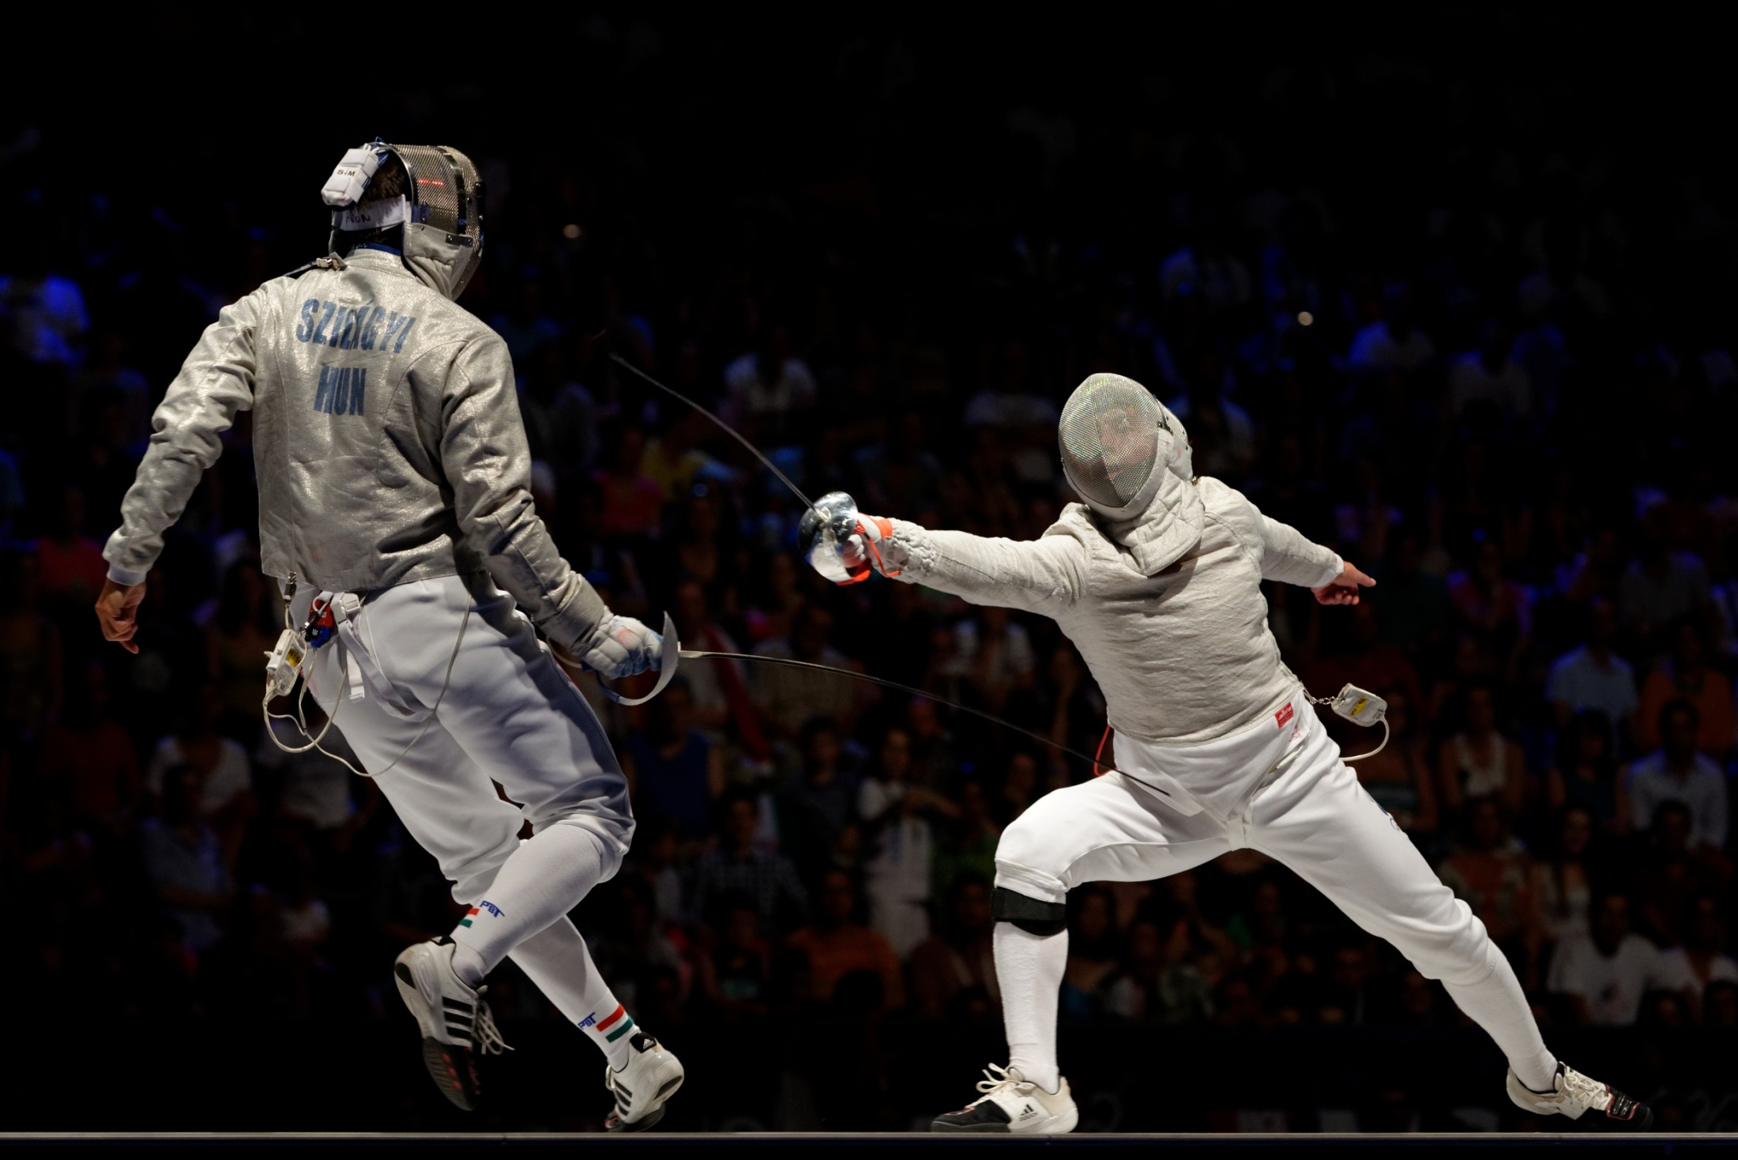
Projects
#2s
Catch Me If You Can: Meet the So Called Moving Target Defense
Goal
design/implement MTD against classic attack like DDoS

Slide 19
Projects
#2s
Catch Me If You Can: Meet the So Called Moving Target Defense
Reference
SDN - Moving Target Defense Controller (POX) [video: https://www.youtube.com/watch?v=E4KqQkcJlqw ]
OpenFlow Random Host Mutation: Transparent Moving Target Defense using Software Defined Networking, HotSDN 2014
cn post: http://drops.wooyun.org/tips/4966
First ACM Workshop on Moving Target Defense (MTD 2014) http://csis.gmu.edu/MTD2014/

Slide 20
Projects
#?s
Open call
How you want to WOW this class?

Slide 21
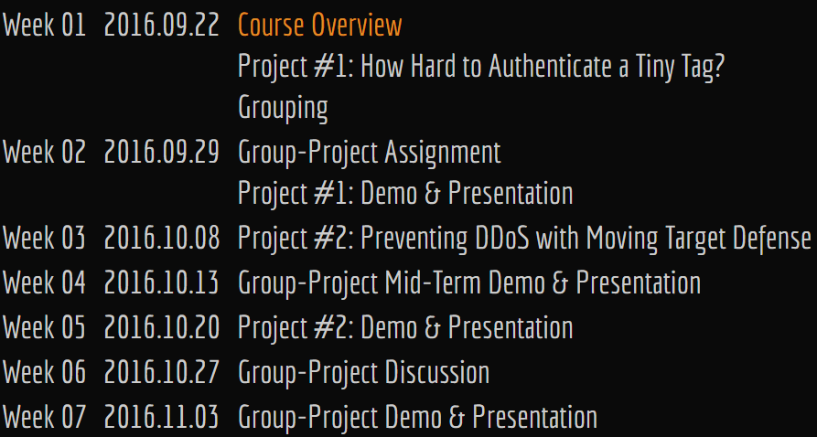
Schedule

Slide 22
Grading #1
20% Project #1
30% Project #2
50% Group Project
10%+ Research-oriented project
15%+ Research-paper—alike report

Slide 23
Grading #2
40% Demo
40% Report
20% Presentation
10%+ Research-oriented project
15%+ Research-paper—alike report

Slide 24
Who’s Who?

Slide 25
Who’s Who?
qq group: 230078248

Slide 26
Ready?

Slide 27
Project Intro

Slide 28
RFID Authentication
ID, key a set of (ID, key)
Tag
Reader/
Server
auth command
Enc(ID, key)
encrypt every ID
compare with received
auth if match

Slide 29
RFID PathChecker
RFID-enabled supply chain
Tagged products have specified paths
Injected counterfeits detour
Goal: lightweight PathChecker
write path-related secrets to tags;
readers can independently verify;
readers require as fewer secrets as possible;

Slide 30
RFID PathChecker
ref@WiSec’12
CHECKER: On-site Checking in RFID-based Supply Chains
K. Elkhiyaoui, E. Blass, R. Molva
Tagged products have specified paths
Tag stores an ID and its signature
Secret key to sign ID is an encoding of the path that the tag went through
By verifying the signature in the tag, each reader thus validates the path taken that far, and by signing the ID the reader updates the path encoding

Slide 31
Malicious SDN Forwarding
MiniNet: constructing network
Controller: Floodlight, Ryu, etc.
Switch: OVS
Detect malicious forwarding/switch using same-path flow statistics variation
ref@NDSS: SPHINX: Detecting Security Attacks in Software-Defined Networks
M. Dhawan, R. Podda, K. Mahajan, V. Mann

Slide 32
Gotta Tell You Switches Only Once Toward Bandwidth-Efficient Flow Setup for SDN
Software-Defined Networking
Notes:
SDN stands for Software-Defined Networking.

Slide 33

Gotta Tell You Switches Only Once Toward Bandwidth-Efficient Flow Setup for SDN
Software-Defined Networking
Notes:
As we know, in traditional networks, management functions reside in distributed switches.
It’s relatively hard to manage such networks due to limited policies are supported and the management needs to be distributed.

Slide 34
Gotta Tell You Switches Only Once Toward Bandwidth-Efficient Flow Setup for SDN
Controller
Controller
App
App
App
Software-Defined Networking
Notes:
To enrich the flexibility of network management, SDN introduces a centralized controller.
[click the mouse] It takes over all these management functions using various applications.

Slide 35

Gotta Tell You Switches Only Once Toward Bandwidth-Efficient Flow Setup for SDN
Controller
Controller
Routing
App
PacketIn
Forwarding
flow
Notes:
When a flow arrives, if the ingress switch doesn’t know how to process corresponding packets,
[click the mouse] it needs to query the controller by encapsulating flow-info into a packetin message.

Slide 36

Gotta Tell You Switches Only Once Toward Bandwidth-Efficient Flow Setup for SDN
Controller
Controller
Routing
App
PacketIn
FlowMod
Forwarding
flow
Notes:
Upon receiving packetin message, the controller instructs switches of how to process the flow via FlowMod messages.
[click the mouse] Then switches accordingly process and forward corresponding packets.

Slide 37
Gotta Tell You Switches Only Once Toward Bandwidth-Efficient Flow Setup for SDN
Switch | Rule
 | Priority | Matching | Action
sw1 | p1 | src_ip=10.20.*.* | fwd(sw2)
sw2 | P2 | src_ip=10.20.*.* | fwd(sw3)
sw3 | p3 | src_ip=10.20.*.* | fwd(out)
Controller
Controller
Routing
App
PacketIn
FlowMod
Forwarding
flow table
sw1
sw2
sw3
flow
p1,
src_ip=10.20.*.*,
fwd(sw2)
p2,
src_ip=10.20.*.*,
fwd(sw3)
p3,
src_ip=10.20.*.*,
fwd(out)
Notes:
Each FlowMod message should contain a rule that corresponding switch can follow to process certain flow.

Slide 38
Gotta Tell You Switches Only Once Toward Bandwidth-Efficient Flow Setup for SDN
Switch | Rule
 | Priority | Matching | Action
sw1 | p1 | src_ip=10.20.*.* | fwd(sw2)
sw2 | P2 | src_ip=10.20.*.* | fwd(sw3)
sw3 | p3 | src_ip=10.20.*.* | fwd(out)
Controller
Controller
Routing
App
PacketIn
FlowMod
Forwarding
flow table
rule
sw1
sw2
sw3
flow
p1,
src_ip=10.20.*.*,
fwd(sw2)
p2,
src_ip=10.20.*.*,
fwd(sw3)
p3,
src_ip=10.20.*.*,
fwd(out)
Notes:
As shown in this example, a rule consists of three key fields, priority, matching, and action.
Matching field regulates which flow a rule to process
while Action field regulates how to process the flow.
Take the rule of switch sw1 for example, it forwards all packets with source IP addresses prefixed by 10.20 to switch 2.
Since SDN rules contain wildcards, a packet may match with multiple rules. To address such matching ambiguity, each rule is assigned with an additional priority value.
Then when a packet matches with more than one rules, it follows the highest-priority one.

Slide 39
Gotta Tell You Switches Only Once Toward Bandwidth-Efficient Flow Setup for SDN
Switch | Rule
 | Priority | Matching | Action
sw1 | p1 | src_ip=10.20.*.* | fwd(sw2)
sw2 | P2 | src_ip=10.20.*.* | fwd(sw3)
sw3 | p3 | src_ip=10.20.*.* | fwd(out)
Controller
Controller
Routing
App
PacketIn
FlowMod
Forwarding
flow table
rule
wildcard
sw1
sw2
sw3
flow
p1,
src_ip=10.20.*.*,
fwd(sw2)
p2,
src_ip=10.20.*.*,
fwd(sw3)
p3,
src_ip=10.20.*.*,
fwd(out)
Notes:
Since SDN rules contain wildcards, a packet may match with multiple rules.

Slide 40
Gotta Tell You Switches Only Once Toward Bandwidth-Efficient Flow Setup for SDN
Switch | Rule
 | Priority | Matching | Action
sw1 | p1 | src_ip=10.20.*.* | fwd(sw2)
sw2 | P2 | src_ip=10.20.*.* | fwd(sw3)
sw3 | p3 | src_ip=10.20.*.* | fwd(out)
Controller
Controller
Routing
App
PacketIn
FlowMod
Forwarding
flow table
rule
wildcard
priority
sw1
sw2
sw3
flow
p1,
src_ip=10.20.*.*,
fwd(sw2)
p2,
src_ip=10.20.*.*,
fwd(sw3)
p3,
src_ip=10.20.*.*,
fwd(out)
Notes:
To address such matching ambiguity, each rule is assigned with an additional priority value.
Then when a packet matches with more than one rules, it follows the highest-priority one.

Slide 41
Gotta Tell You Switches Only Once Toward Bandwidth-Efficient Flow Setup for SDN
Switch | Rule
 | Priority | Matching | Action
sw1 | p1 | src_ip=10.20.*.* | fwd(sw2)
sw2 | P2 | src_ip=10.20.*.* | fwd(sw3)
sw3 | p3 | src_ip=10.20.*.* | fwd(out)
Controller
Controller
Routing
App
PacketIn
FlowMod
Forwarding
malicious
inject/drop
sw1
sw2
sw3
flow
p1,
src_ip=10.20.*.*,
fwd(sw2)
p2,
src_ip=10.20.*.*,
fwd(sw3)
p3,
src_ip=10.20.*.*,
fwd(out)

Slide 42
Bitcoin & Double Spending
Everyone using Bitcoin keeps a complete record of which bitcoin belongs to which person
Block Chain = Record
“I, Alice, am giving Bob one bitcoin, with serial number 1234567”
Bob can use his copy of the block chain to check that, indeed, the bitcoin is Alice’s.
If that checks out then he broadcasts both Alice’s message and his acceptance of the transaction to the entire network, and everyone updates their copy of the block chain.

Slide 43
Bitcoin & Double Spending
Double Spending
“I, Alice, am giving Bob one bitcoin, with serial number 1234567”
“I, Alice, am giving Charlie one bitcoin, with serial number 1234567”
Bob and Charlie verifies and accepts the transaction nearly at the same time
How others update block chains?
How the Bitcoin protocol actually works
The rise and fall of Bitcoin

Slide 44
again, the proj of your own!

Slide 45
thanks & enjoy

