Slide 1

thank you all
as always
Notes:
thank you for not dropping the class:)
truly appreciate your support

Slide 2
Cryptography
02
Kai Bu
kaibu@zju.edu.cn
http://list.zju.edu.cn/kaibu/netsec
Notes:
As the first topic of this course, we will kick off with cryptography basics.

Slide 3
Cryptography
as you were told many times

Slide 4
Cryptography
why?
Notes:
Still remember why do we need cryptography?

Slide 5
Cryptography
why:
prevent third parties from reading private messages
Notes:
Usually the third parties are called adversaries;

Slide 6
Cryptography
how?

Slide 7




Cryptography
how:
encrypt messages before transmission;
decrypt messages upon receipt;
hello, txh
hello, txh
asdfghjkl
enc
dec

Slide 8
Cryptography
what?

Slide 9
Cryptography
what:
confidentiality
integrity
authentication
non-repudiation
Notes:
Confidentiality involves a set of rules or a promise usually executed through confidentiality agreements that limits access or places restrictions on certain types of information.
Data integrity is the maintenance of, and the assurance of the accuracy and consistency of, data over its entire life-cycle,[1] and is a critical aspect to the design, implementation and usage of any system which stores, processes, or retrieves data.
Authentication is the act of confirming the truth of an attribute of a single piece of data claimed true by an entity.
Non-repudiation refers to a situation where a statement's author cannot successfully dispute its authorship or the validity of an associated contract.

Slide 10
Cryptography
what:
confidentiality -- secrecy
integrity -- accuracy
authentication -- ascription
non-repudiation -- liability
Notes:
Confidentiality involves a set of rules or a promise usually executed through confidentiality agreements that limits access or places restrictions on certain types of information.
Data integrity is the maintenance of, and the assurance of the accuracy and consistency of, data over its entire life-cycle,[1] and is a critical aspect to the design, implementation and usage of any system which stores, processes, or retrieves data.
Authentication is the act of confirming the truth of an attribute of a single piece of data claimed true by an entity.
Non-repudiation refers to a situation where a statement's author cannot successfully dispute its authorship or the validity of an associated contract.

Slide 11
Cryptography
which?
Notes:
Which algorithms?

Slide 12
Cryptography
hush, let’s start with a little secret
Notes:
Secret, by which we refer to information two share, that is, key;

Slide 13

too many
concepts ahead
Notes:
An overview chapter, so many concepts to unfold

Slide 14

mrj
jzk
txh
hello, txh
Notes:
It all starts with cryptography, the practice and study of techniques for secure communication in the presence of third parties called adversaries.
Fundamental for any secure communication;
Instant use is to protect confidentiality: in this example…, if directly send the message, easy to be overhead/eavesdropped;

Slide 15
shared secret key
mrj
jzk
txh
hello, txh
Notes:
To avoid the message from being eavesdropped by the adversary,
The two communication entities first agree upon a shared, secret key, through another secure channel that cannot be … by the adversary;
For example, they could meet up with each other while the adversary is not nearby, and exchange the secret key;

Slide 16
secure communication against adversaries
=enc(plaintext, key)
=ciphertext
dec(ciphertext, key)=
plaintext=
mrj
???
jzk
txh
plaintext
plaintext
hello, txh
hello, txh
asdfghjkl
enc
ciphertext
dec
Notes:
The original message – plaintext
Encrypted message – ciphertext
To sum up the encryption/decryption process:
enc(plaintext, key) = ciphertext
dec(ciphertext, key) = plaintext

Slide 17
secure communication against adversaries
=enc(plaintext, key)
=ciphertext
dec(ciphertext, key)=
plaintext=
mrj
???
jzk
txh
plaintext
plaintext
hello, txh
hello, txh
asdfghjkl
enc
ciphertext
dec
Notes:
As both communication entities use the same key,

Slide 18
Symmetric Cryptography
secure communication against adversaries
=enc(plaintext, key)
=ciphertext
dec(ciphertext, key)=
plaintext=
mrj
???
jzk
txh
plaintext
plaintext
hello, txh
hello, txh
asdfghjkl
enc
ciphertext
dec
Notes:
Usually called symmetric cryptography

Slide 19
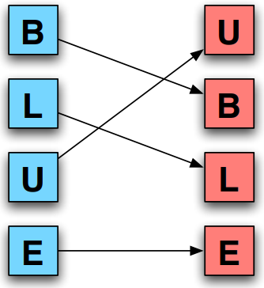
Transposition
Scramble input to produce output
Key: the permutation of input

Slide 20
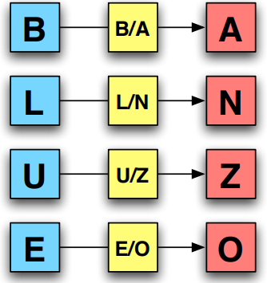
Substitution
Substitute one input for another
Key: the substitution (codebook)

Slide 21
OTP: One-Time Pad
Key: a secret bit string s of length n
When Alice sends a message m of length n to Bob,
Alice generates ciphertext c as:
forall i = 1 to n: c_{i} = m_{i}⊕s_{i}

Slide 22
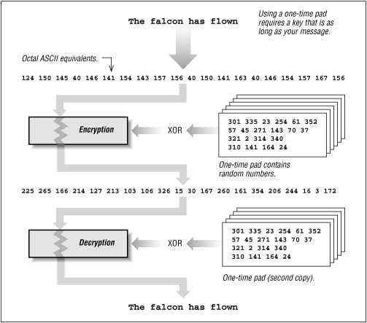
OTP: One-Time Pad

Slide 23
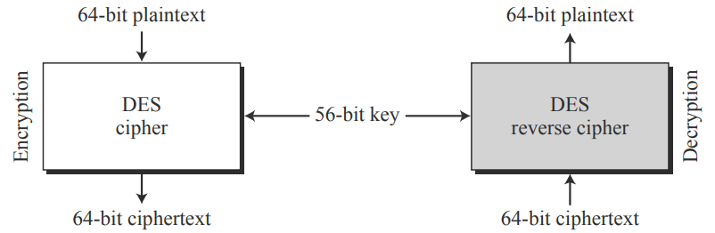
DES: Data Encryption Standard
Block cipher
64-bit plaintext/ciphertext
56-bit key
Notes:
https://academic.csuohio.edu/yuc/security/Chapter_06_Data_Encription_Standard.pdf
A block cipher is an encryption method that applies a deterministic algorithm along with a symmetric key to encrypt a block of text, rather than encrypting one bit at a time as in stream ciphers.

Slide 24
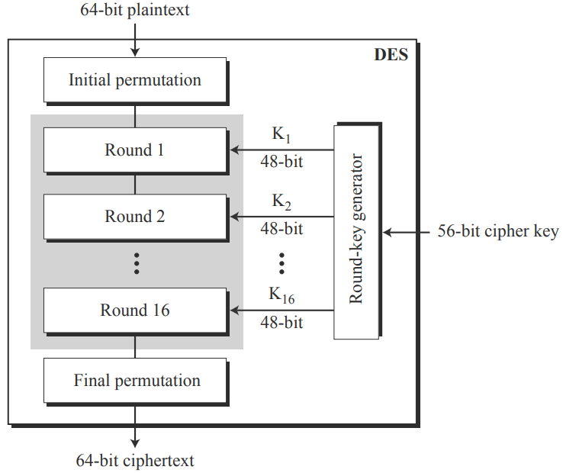
DES: Data Encryption Standard
Encryption:
2 permutations
16 Feistel rounds

Slide 25
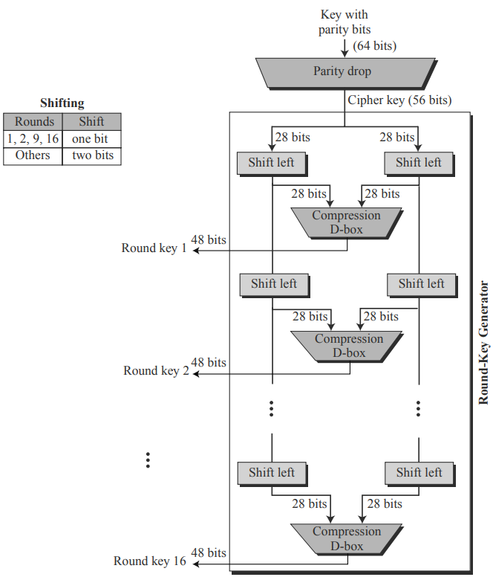
DES: Data Encryption Standard
Key generation

Slide 26
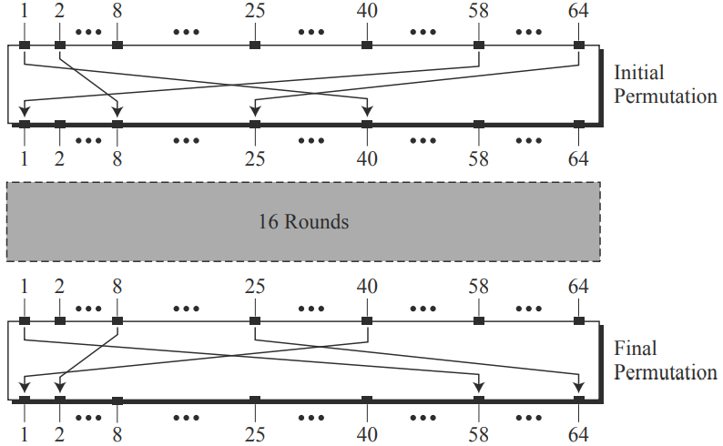
DES: Data Encryption Standard
Permutation: per a predefined rule
Notes:
Each of these permutations takes a 64-bit input and permutes them according to a predefined rule.

Slide 27
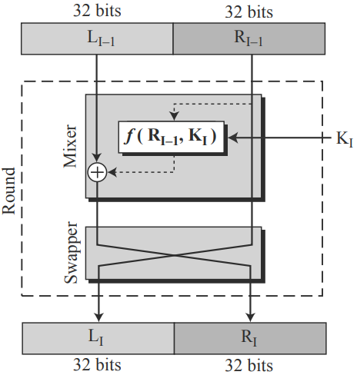
DES: Data Encryption Standard
Round: Feistel cipher per round
L_{I} = R_{I-1}
R_{I} = L_{I-1}⊕f(R_{I-1},K_{I})

Slide 28
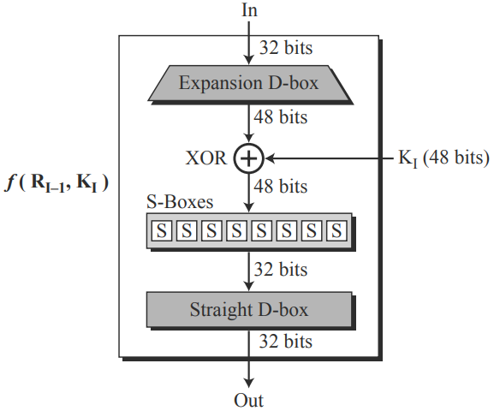
DES: Data Encryption Standard
DES Function f: four sections
Expansion D-box
Whitener (XOR)
S-boxes
Straight D-box
Notes:
D-box: for permutation, also called P-box in some literature
S-box: substitution box

Slide 29
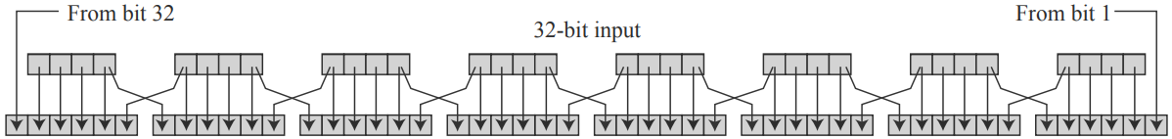
DES: Data Encryption Standard
Expansion D-box: per a predefined rule
32 to 48 expansion permutation
divided into 8 4-bit sections;
4 to 6 expansion permutation per sec;
Notes:
D-box: for permutation, also called P-box in some literature
S-box: substitution box

Slide 30
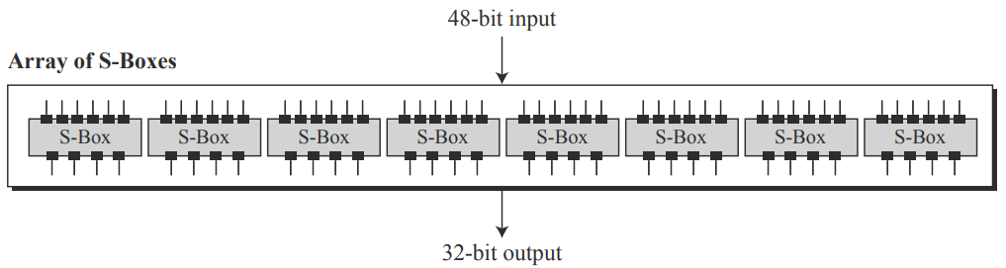
DES: Data Encryption Standard
S-boxes: per a predefined rule
48 to 32 substitution
divided into 8 6-bit sections;
6 to 4 substitution per sec;

Slide 31
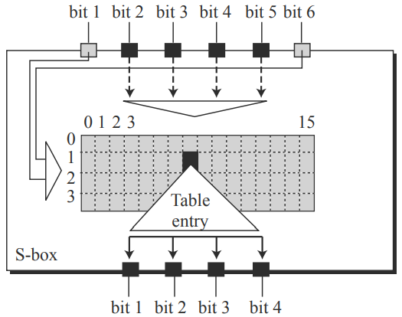
DES: Data Encryption Standard
S-box: per a predefined S-box table
Bits 1 and 6 select one row out of 4
Bits 2-5 select one column out of 16
table

Slide 32
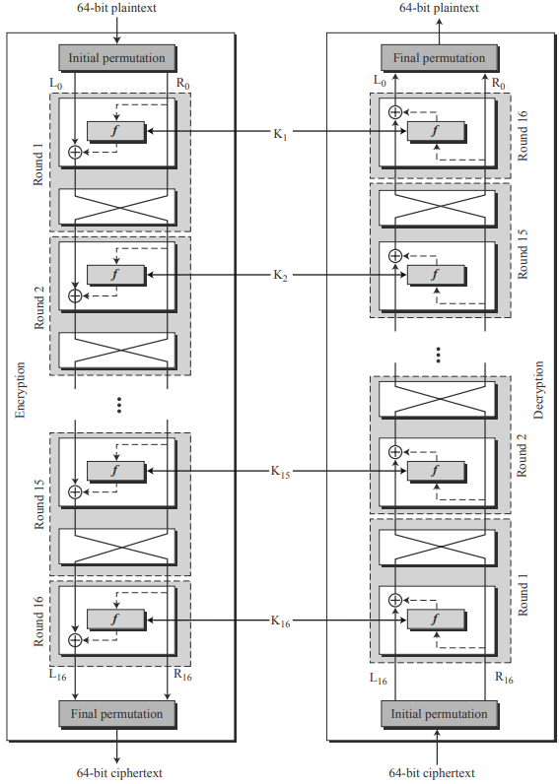
DES: Data Encryption Standard
Decryption
no swapper in last round

Slide 33
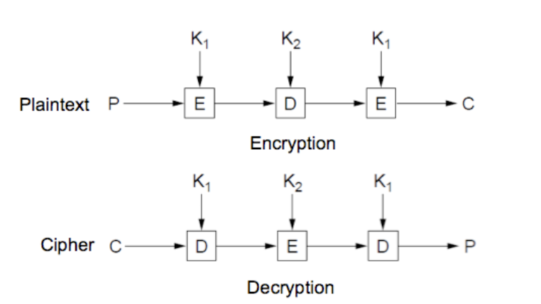
3DES/TDES: Triple DES
Apply DES three times to each block
E: DES encrypt
D: DES decrypt
Notes:
https://en.wikipedia.org/wiki/Triple_DES

Slide 34
AES: Advanced Encryption Standard
Block size: 128 bits
(16 bytes = 4x4 array/state)
Key size:
128 bits for 10 rounds
192 bits for 12 rounds
256 bits for 14 rounds
Notes:
https://en.wikipedia.org/wiki/Advanced_Encryption_Standard

Slide 35
AES: Advanced Encryption Standard
KeyExpansion: Rijndael’s key schedule
derive a 128-bit key for each round
Initial round key addition
AddRoundKey: state XOR round key
9 rounds (assume 10 rounds needed)
SubBytes, ShiftRows, MixColumns,
AddRoundKey
Final round without MixColumns

Slide 36
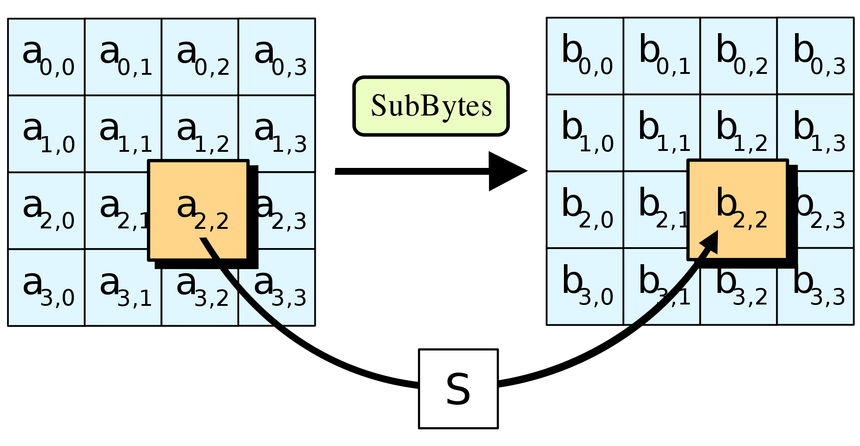
AES: Advanced Encryption Standard
SubBytes
b_{ij} = S(a_{ij})
Notes:
In the SubBytes step, each byte in the state is replaced with its entry in a fixed 8-bit lookup table, S; b_{ij} = S(a_{ij}).

Slide 37
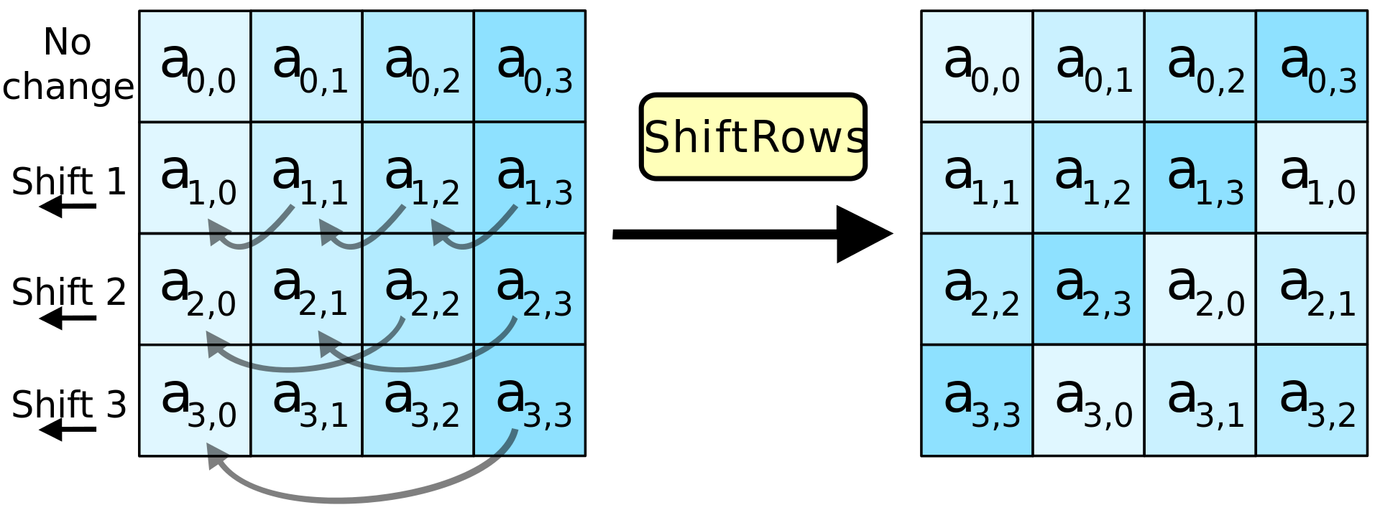
AES: Advanced Encryption Standard
ShiftRows
cyclically shift each row to the left
shifting distance differs for each row
Notes:
In the ShiftRows step, bytes in each row of the state are shifted cyclically to the left. The number of places each byte is shifted differs for each row.

Slide 38
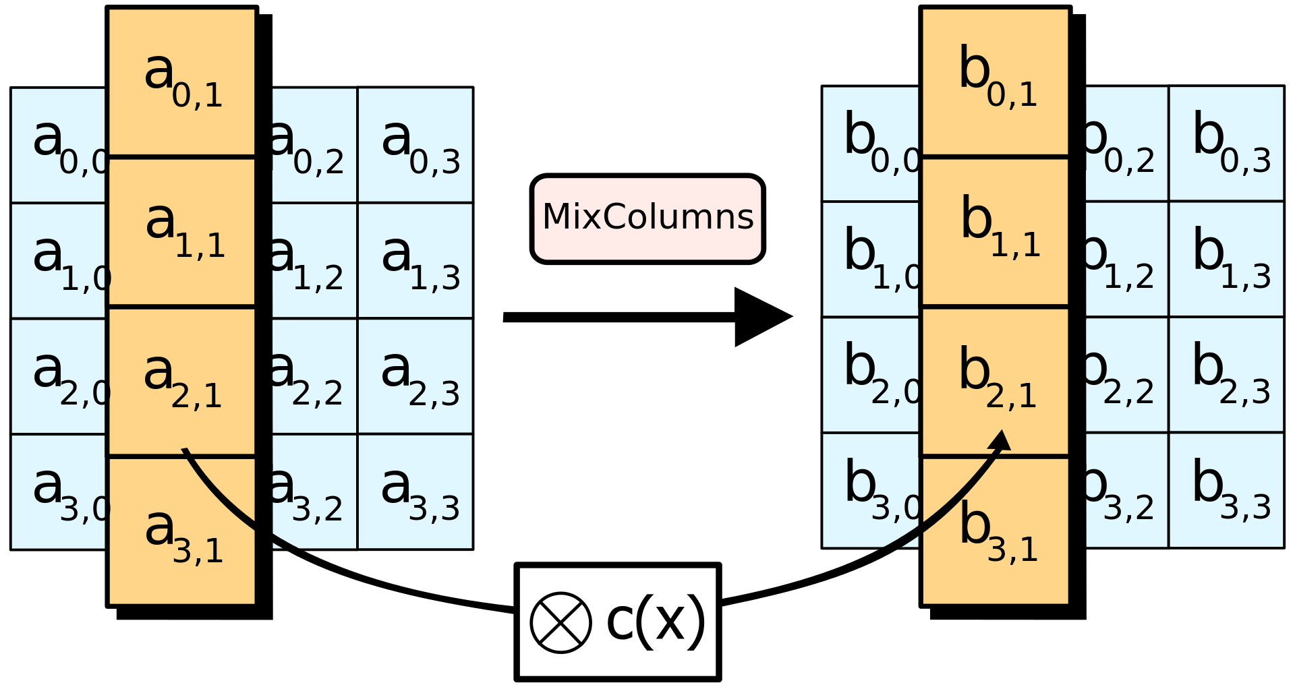
AES: Advanced Encryption Standard
MixColumns
a fixed polynomial
Notes:
In the MixColumns step, each column of the state is multiplied with a fixed polynomial c(x).

Slide 39
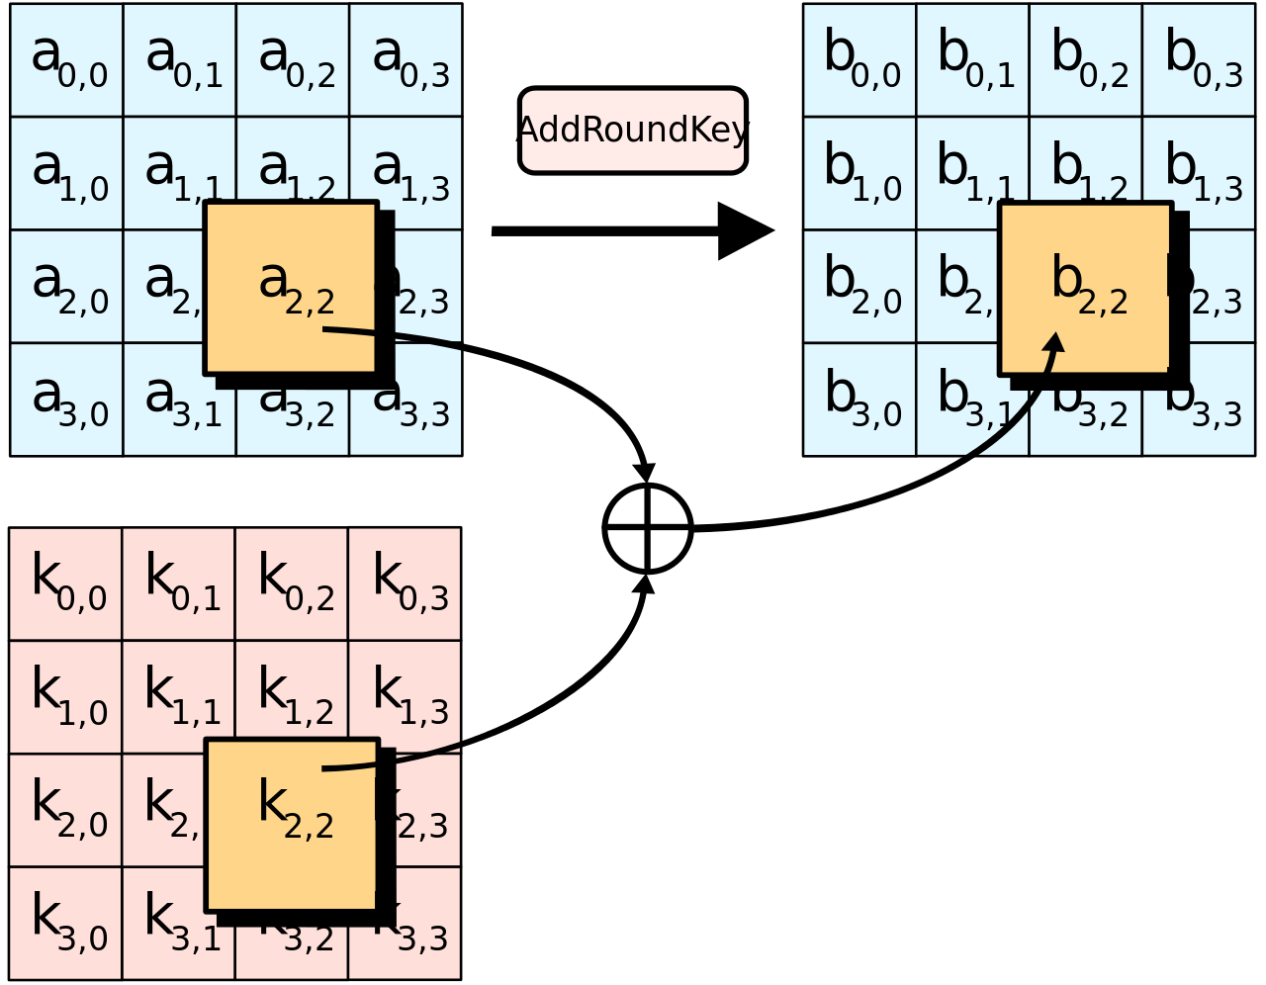
AES: Advanced Encryption Standard
AddRoundKey
Notes:
In the AddRoundKey step, each byte of the state is combined with a byte of the round subkey using the XORoperation (⊕)

Slide 40
Cryptography
secure communication against adversaries
symmetric cryptography
tah
tqh
mrj
jzk
tbh
txh
tch
too many keys!
Notes:
So far, we have covered typical symmetric algorithms for symmetric cryptography;
What if one entity is simultaneously communicating with many other entities; (in particular, receiving messages from many other entities)
Using symmetric key, need to maintain one secret key per entity, too many keys to maintain, high overhead

Slide 41
Cryptography
secure communication against adversaries
symmetric cryptography
a
tah
tqh
mrj
jzk
tbh
txh
tch
public key + private key
Notes:
Turn to asymmetric cryptography
In this case, an entity holds a pair of keys:
one is called public key – broadcast/shared with all others
One is called private key – keep secretly locally

Slide 42
Asymmetric Cryptography
=dec(ciphertext, priv)
=plaintext
tqh
mrj
jzk
enc(plaintext, pub)=
ciphertext=
txh
many-to-one secure comm
public key + private key
Notes:
Use case 1: many-to-one secure communication

Slide 43
Asymmetric Cryptography
=enc(jzk, priv)
=ciphertext
tqh
mrj
jzk
dec(ciphertext, pub)=
jzk=
txh
one-to-many proof
public key + private key
Notes:
Use case 2: one-to-many proof

Slide 44
Asymmetric Cryptography
secure communication against adversaries
symmetric cryptography
a
DO NOT require
secure channels
for key exchange!
tqh
mrj
jzk
txh
public key + private key
Notes:
Fundamental superiority over symmetric cryptography:
No need of a secure channel to share keys, as public key can be known to any one;

Slide 45
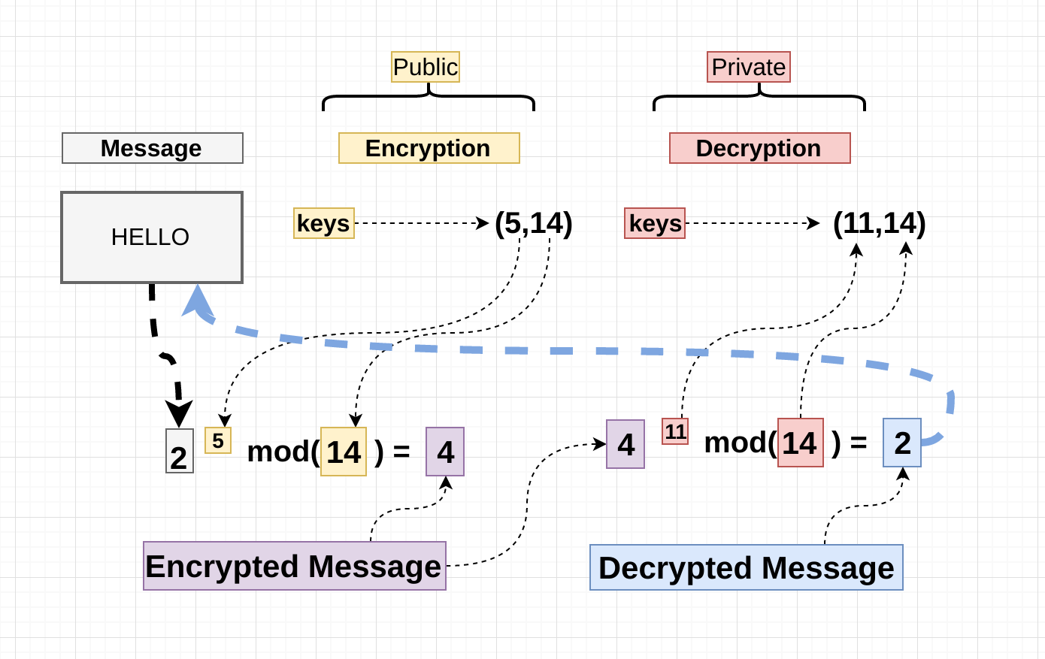
RSA

Slide 46
RSA
How to generate public & private keys?

Slide 47
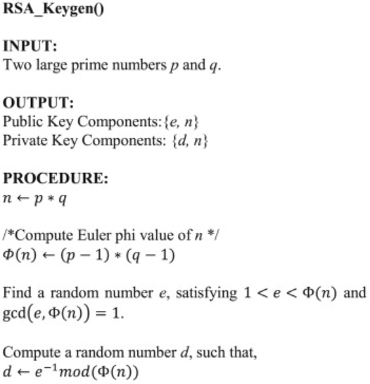
RSA
gcd:
greatest common divisor:
Notes:
In mathematics, the greatest common divisor (gcd) of two or more integers, which are not all zero, is the largest positive integer that divides each of the integers.

Slide 48
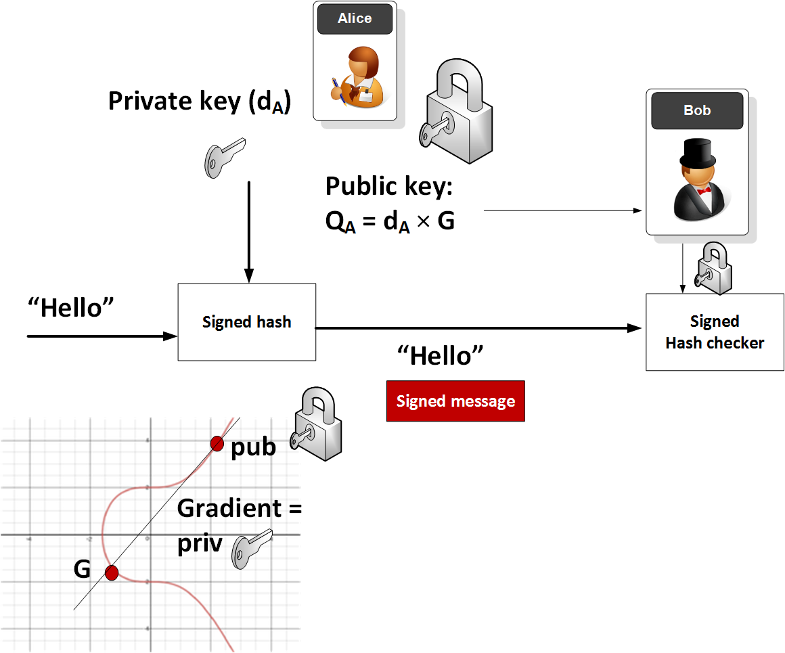
Elliptic Curve Cryptography
ECDSA:
Elliptic Curve:
Digital Signature Algorithm:
Notes:
https://medium.com/coinmonks/the-wonderful-world-of-elliptic-curve-cryptography-b7784acdef50
One application of ECC is in signing, such as for Elliptic Curve Digital Signature Algorithm [here]. With this Alice will generate a key pair, and then encrypt the hash of a message with her private key. She then sends the message and the signed hash to Bob, who takes his own hash of the message, and decrypts Alice’s hashed version with her public key. If the hashes match, he has proven that Alice sent the message and that the message has not changed

Slide 49
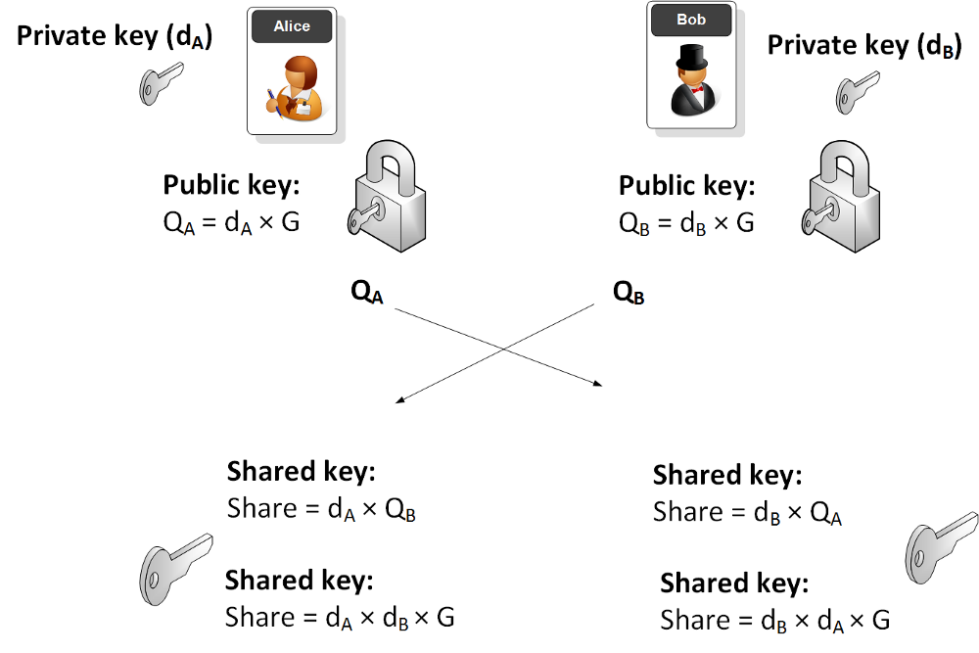
Elliptic Curve Cryptography
key exchange:
:
Notes:
Another application of ECC is for key exchange.
Within key exchange we can take a similar method to the commonly found Diffie-Hellman method: ECDH. With this Bob and Alice both generate their key pairs and then exchange their public key values. Next the multiply these by their own private keys, and the should end up with the same point. The x value of the point is often used as the shared value, and this can be used to generate an encryption key

Slide 50
Elliptic Curve Cryptography
use the keys:
for symmetric crypto:
ECIES:
Elliptic Curve
Integrated Encryption Scheme
:

Slide 51
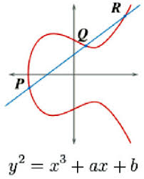
Elliptic Curve Cryptography
Mathematics: Elliptic Curve
4a³+27b² ≠ 0;
private key of Alice d_{A}: random number;
public key of Alice: P = d_{A} x G,
G is a curve point Alice & Bob agree to.
Notes:
where 4a³+27b² ≠ 0 (and which is need to avoid singular points). The most popular curve is a Secp256k1 (or Curve 25519), and is defined with a=0 and b=7:
y² = x³+7

Slide 52
Elliptic Curve Cryptography
Mathematics: Elliptic Curve
knowing P and G
can hardly retrieve d_{A}
4a³+27b² ≠ 0;
private key of Alice d_{A}: random number;
public key of Alice: P = d_{A} x G,
G is a curve point Alice & Bob agree to.
Notes:
where 4a³+27b² ≠ 0 (and which is need to avoid singular points). The most popular curve is a Secp256k1 (or Curve 25519), and is defined with a=0 and b=7:
y² = x³+7

Slide 53

Cryptography
as you were told many times
Notes:
Bored?

Slide 54

Cryptography
like you’ve never heard before
Notes:
Some interesting cryptography algorithms

Slide 55
Cryptography
secure communication against adversaries
reluctant to give out sensitive data?

Slide 56
Cryptography
secure communication against adversaries
reluctant to give out sensitive data?
process data without revealing it

Slide 57
Homomorphic Cryptography
allow computation on encrypted data;
generate an encrypted result that,
after decrypted, matches the result of the operations as if they had been performed on the plaintext
Notes:
Homomorphic encryption is a form of encryption that allows computation on ciphertexts, generating an encrypted result which, when decrypted, matches the result of the operations as if they had been performed on the plaintext.
The purpose of homomorphic encryption is to allow computation on encrypted data.

Slide 58

Homomorphic Cryptography
Application
encrypted-data analysis on cloud
Notes:
http://www2.technologyreview.com/news/423683/homomorphic-encryption/
allows encrypted data to be analyzed in the cloud.
In this example, we wish to add 1 and 2.
The data is encrypted so that 1 becomes 33 and 2 becomes 54.
The encrypted data is sent to the cloud and processed: the result (87) can be downloaded from the cloud and decrypted to provide the final answer (3).

Slide 59

Homomorphic Cryptography
Unpadded RSA
ElGamal
Goldwasser–Micali
Notes:
https://en.wikipedia.org/wiki/Homomorphic_encryption

Slide 60
Homomorphic Cryptography
Benaloh
Paillier
Notes:
https://en.wikipedia.org/wiki/Homomorphic_encryption

Slide 61
Proxy Re-encryption
Allow third parties (proxies) to alter a cipher text which has been encrypted for one party, so that it may be decrypted by another.

Slide 62
Proxy Re-encryption
Allow a proxy to transform a ciphertext computed under Alice’s public key into one that can be opened by Bob’s secret key.
Why need it?

Slide 63
Proxy Re-encryption
Allow a proxy to transform a ciphertext computed under Alice’s public key into one that can be opened by Bob’s secret key.
Delegate untrusted proxy to do re-encryption, without revealing message and secret keys to it.
Notes:
Why need it?
Delegate untrusted proxy to do re-encryption, without revealing the msg and secret keys to proxy;
Especially when Alice wants to send the msg to a set of recipients, (except unwanted ones including the proxy;)

Slide 64
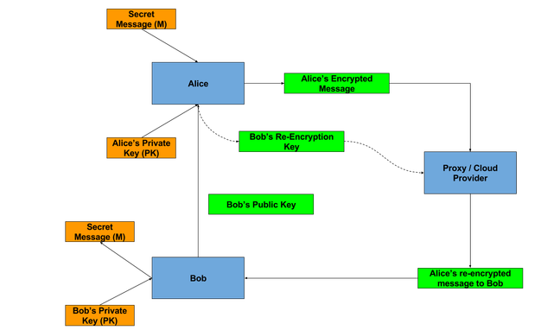
Proxy Re-encryption
use Alice’s pub key
sample algorithm: link
Notes:
https://blog.nucypher.com/proxy-re-encryption-playground-in-python-3bc66170b9bf
Proxy Re-Encryption Playground in Python

Slide 65
Review
Symmetric vs Asymmetric Cryptography
DES, AES
RSA, Elliptic Curve Crypto
Homomorphic Encryption
Proxy Re-encryption

Slide 66
Announcement
Project Grouping
2019.02.26 – 2019.03.05
Proposal Presentation
2019.03.05

Slide 67
?

Slide 68
Thank You
be on the road
Notes:
Run your own race.

Slide 69
Reading
The Internet: Encryption & Public Keys by Mia Epner
Data Encryption Standard (DES)
The Wonderful World of Elliptic Curve Cryptography by Bill Buchanan OBE
Elliptic Curve Integrated Encryption Scheme (ECIES) by Bill Buchanan OBE
Elliptic Curve Cryptography Overview
by John Wagnon

Slide 70
Reading
A Survey on Homomorphic Encryption Schemes: Theory and Implementation
by A. Acar et al.
Proxy Re-encryption
by David Vassallo
Improved Proxy Re-Encryption Schemes with Applications to Secure Distributed Storage
by G. Ateniese et al.

