Slide 1
Cryptanalysis
03
Kai Bu
kaibu@zju.edu.cn
http://list.zju.edu.cn/kaibu/netsec

Slide 2
Cryptanalysis?
Notes:
What’s cryptanalysis?
Dissect the word

Slide 3
Cryptanalysis
the science and art of
breaking ciphers

Slide 4
Cryptography
the science and art of
designing ciphers

Slide 5
Cryptology
Cryptography
Cryptanalysis
Notes:
Together they are the focus of cryptology (crypto)

Slide 6
Cryptology
Cryptography
Cryptanalysis
Notes:
Cryptography was covered in previous lectures;
Today we’ll be focusing on cryptanalysis.

Slide 7
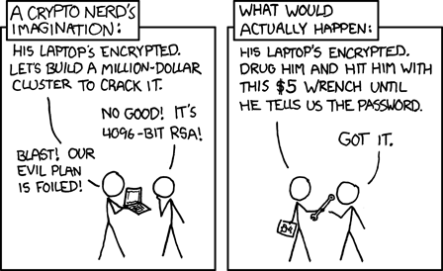
Cryptanalysis
Notes:
Mentioned this comic as an example
Kinda illustrate the goal of cryptanalysis

Slide 8
Cryptanalysis
is hard
Notes:
Obviously, cryptanalysis is hard

Slide 9
Cryptanalysis
is hard
2⁴⁰⁹⁶!
Notes:
2-to-4096 possibilities

Slide 10
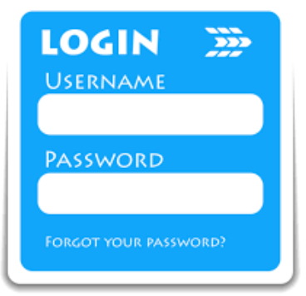
Cryptanalysis
password cracking
2⁴⁰⁹⁶!
Notes:
Consider it as your password of 4096 bits

Slide 11
Cryptanalysis
password cracking
2⁴⁰⁹⁶! – Try them all!
brute force attack

Slide 12

Cryptanalysis
password cracking
2⁴⁰⁹⁶! – Try them all!
brute force attack…meh

Slide 13
Cryptanalysis
password cracking
2⁴⁰⁹⁶! – Try only 3 of them!
strategic random guessing

Slide 14
Cryptanalysis
password cracking
2⁴⁰⁹⁶! – Try only 3 of them!
strategic random guessing?
Notes:
What strategies to use to boost attacking success rate?

Slide 15
Cryptanalysis
password cracking
2⁴⁰⁹⁶! – Try only 3 of them!
strategic random guessing: dictionary attack

Slide 16

nah…
Cryptanalysis
password cracking
2⁴⁰⁹⁶! – Try only 3 of them!
strategic random guessing: dictionary attack

Slide 17
nah…
Cryptanalysis
password cracking
2⁴⁰⁹⁶! – Try only 3 of commonly used ones
strategic random guessing: dictionary attack
Notes:
List of commonly used passwords
A dictionary attack is a method of breaking into a password-protected computer or server by systematically entering every word in a dictionary as a password. Adictionary attack can also be used in an attempt to find the key necessary to decrypt an encrypted message or document.

Slide 18
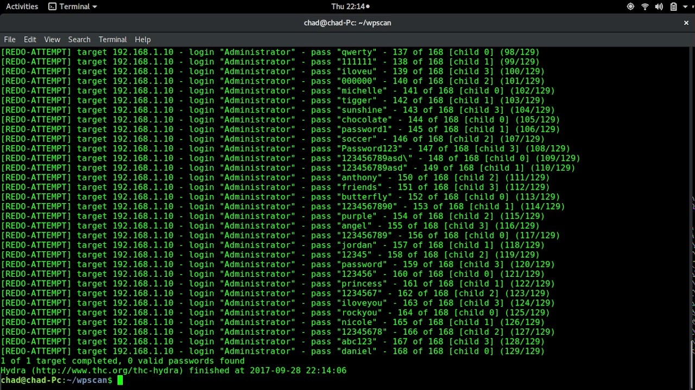
Cryptanalysis
password cracking
2⁴⁰⁹⁶! – Try only 3 of commonly used ones!
strategic random guessing: dictionary attack
Notes:
List of commonly used passwords
A dictionary attack is a method of breaking into a password-protected computer or server by systematically entering every word in a dictionary as a password. A dictionary attack can also be used in an attempt to find the key necessary to decrypt an encrypted message or document.

Slide 19
Cryptanalysis
other attacks? other strategies?

Slide 20
Cryptanalysis
warm up with simple one time pad

Slide 21
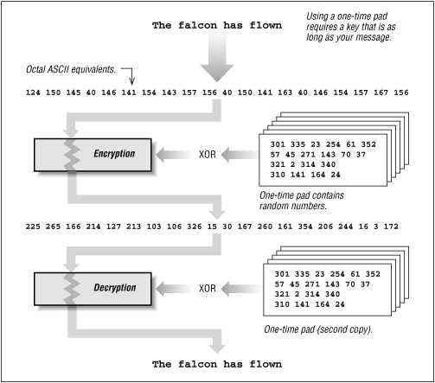
OTP: One-Time Pad
Notes:
Example OTP
Both encryption and decryption require XOR computation;

Slide 22
OTP: One-Time Pad
Key: a secret bit string s of length n
When Alice sends a message m of length n to Bob,
Alice generates ciphertext c as:
forall i = 1 to n: c_{i} = m_{i}⊕s_{i}
How to crack s?
Notes:
Formal definition

Slide 23
OTP: One-Time Pad
Key: a secret bit string s of length n
When Alice sends a message m of length n to Bob,
Alice generates ciphertext c as:
forall i = 1 to n: c_{i} = m_{i}⊕s_{i}
How to crack s?
given c?

Slide 24
OTP: One-Time Pad
Key: a secret bit string s of length n
When Alice sends a message m of length n to Bob,
Alice generates ciphertext c as:
forall i = 1 to n: c_{i} = m_{i}⊕s_{i}
How to crack s?
given c?
know m!

Slide 25
OTP: One-Time Pad
Key: a secret bit string s of length n
When Alice sends a message m of length n to Bob,
Alice generates ciphertext c as:
forall i = 1 to n: c_{i} = m_{i}⊕s_{i}
How to crack s?
given c?
exercise m=0
Notes:
Discussion: cases of knowing plaintext messages m;

Slide 26
OTP: One-Time Pad
Key: a secret bit string s of length n
When Alice sends a message m of length n to Bob,
Alice generates ciphertext c as:
forall i = 1 to n: c_{i} = m_{i}⊕s_{i}
How to crack s?
given c?
exercise m=0
How to know plaintexts?
How to know OTP in use?

Slide 27
OTP: One-Time Pad
Key: a secret bit string s of length n
When Alice sends a message m of length n to Bob,
Alice generates ciphertext c as:
forall i = 1 to n: c_{i} = m_{i}⊕s_{i}
How to crack s?
given c?
exercise m=0
How to know plaintexts?
How to know OTP in use?
all security should reside in the key, not the alg
Notes:
Discussion: cases of knowing plaintext messages m;

Slide 28
Known-Plaintext Attack
Given
ciphertext and plaintext of the corresponding messages;
P₁, C₁ = E_{k}(P₁),…,P_{i}, C_{i}=E_{k}(P_{i})
Task
Find key k;
Or algorithm to infer P_{i+1} from C_{i+1}

Slide 29
Chosen-Plaintext Attack
Given
plaintext and ciphertext pairs;
can choose plaintext:
P₁, C₁ = E_{k}(P₁),…,P_{i}, C_{i}=E_{k}(P_{i})
with chosen P₁…P_{i};
Task
Find key k;
Or algorithm to infer P_{i+1} from C_{i+1}

Slide 30
Adaptive Chosen-Plaintext Attack
Given
plaintext and ciphertext pairs;
can choose plaintext;
can modify choice depending on results of previous encryption:
P₁, C₁ = E_{k}(P₁),…,P_{i}, C_{i}=E_{k}(P_{i})
Task
Find key k;
Or algorithm to infer P_{i+1} from C_{i+1}

Slide 31
Chosen-Ciphertext Attack
Given
ciphertext and plaintext pairs;
can choose ciphertext;
C₁, P₁ = D_{k}(C₁),…,C_{i}, P_{i}=D_{k}(C_{i})
Task
Find key k;
Or algorithm to infer P_{i+1} from C_{i+1}

Slide 32
emm, you can’t always get what you want

Slide 33
Ciphertext-Only Attack
Known-Ciphertext Attack
The attacker has access only to a set of ciphertexts
The attack is completely successful if the corresponding plaintexts or the key can be deduced
Notes:
In cryptography, a ciphertext-only attack (COA) or known ciphertext attack is an attack model for cryptanalysis where the attacker is assumed to have access onlyto a set of ciphertexts. The attack is completely successful if the corresponding plaintexts can be deduced (extracted) or, even better, the key.

Slide 34
do I have to crack the key?

Slide 35





secure communication against adversaries
hack to secure
mrj
???
jzk
txh
meet at lab
meet at lab
asdfghjkl
Notes:
Cryptanalysis is the study of analyzing information systems in order to study the hidden aspects of the systems.
Cryptanalysis is used to breach cryptographic security systems and gain access to the contents of encrypted messages, even if the cryptographic key is unknown.
For example, two entities secretly meet up at lab;
Every time using the same key, and thus get the same ciphertext;
Initially (at the first several rounds), the adversary may not know what the ciphertext means;

Slide 36
secure communication against adversaries
hack to secure
mrj
: see both in lab
: each time a-l
jzk
txh
meet at lab
meet at lab
asdfghjkl
Notes:
However, by coincidences, the adversary notices that every time after two entities say “a-l”, they’ll both appear at the lab;
The adversary then speculates that the ciphertext “a-l” from entity A to entity B syncs their meetup in lab;

Slide 37
Replay Attack
secure communication against adversaries
hack to secure
mrj
: Replay *&#!%$
jzk
txh
asdfghjkl
meet at lab
Notes:
Replay attack:
Based on that observation, the adversary can simply replay the same message/ciphertext “a-l” to entity B,
Making B believes that the message is from entity A, and goes to the lab;

Slide 38
Replay Attack
secure communication against adversaries
how to defend?
mrj
: Replay *&#!%$
jzk
txh
asdfghjkl
meet at lab
Notes:
How to secure the communication against the replay attack?
Discussion

Slide 39
Replay Attack
Defense: Limit Message Freshness
Timestamp
One-time session key

Slide 40
do I have to crack the key?

Slide 41
can I own the key?

Slide 42
secure communication against adversaries
shared secret key
mrj
jzk
txh
hello, txh

Slide 43
what if the attacker hijacks key-channel?
shared secret key
mrj
jzk
txh
hello, txh

Slide 44
Man-In-The-Middle Attack
what if the attacker hijacks key-channel?
shared secret key
hijacked
key1
key2
mrj
jzk
txh
hello, txh

Slide 45
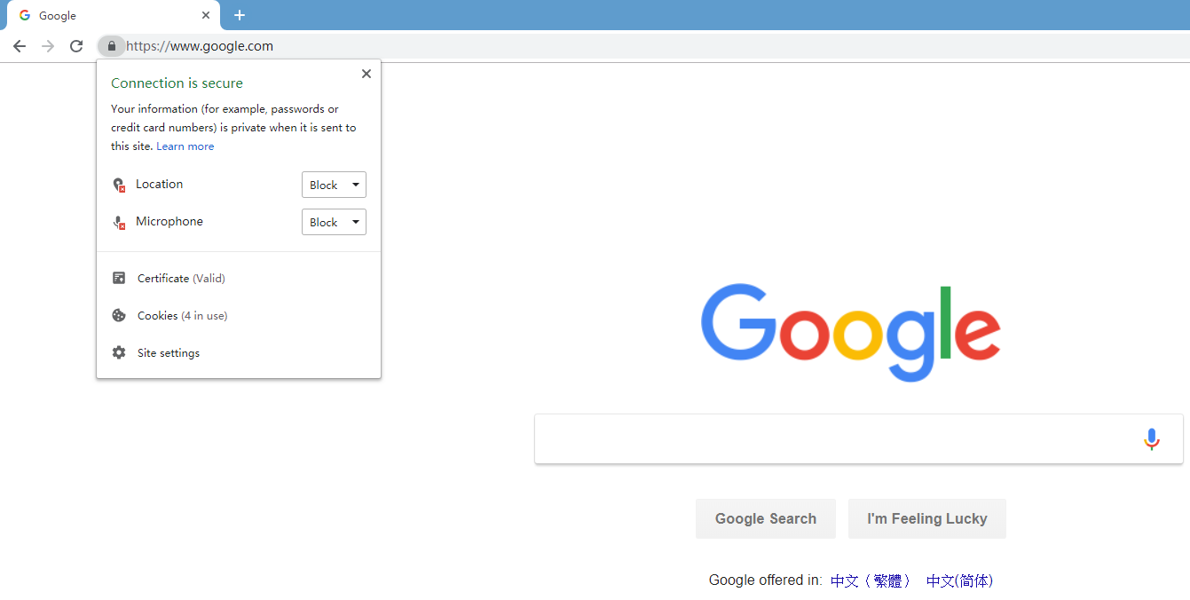
Man-In-The-Middle Attack
MITM Defense:
Guarantee Connection Authenticity

Slide 46
again, do I have to crack the key?

Slide 47
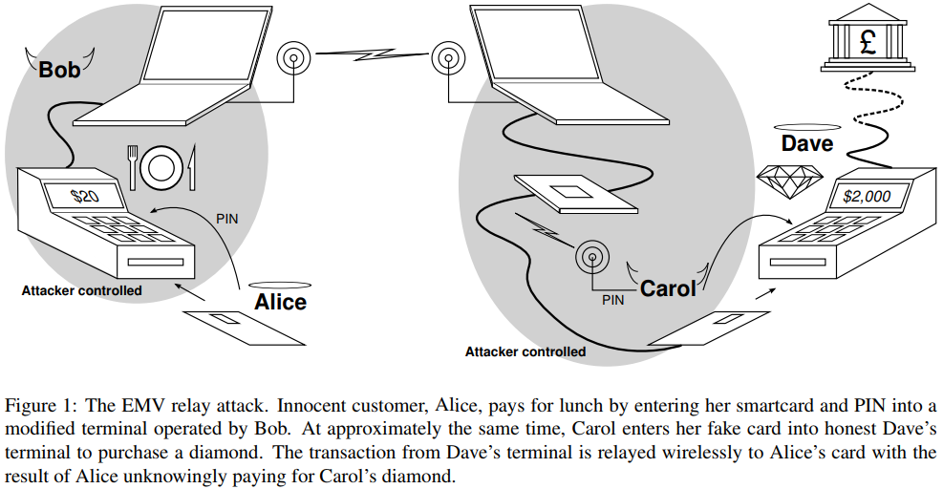

Slide 48
Relay Attack

Slide 49
Relay Attack
how to defend?

Slide 50
Relay Attack
Defense: Distance Bounding?

Slide 51
Relay Attack
Defense: Distance Bounding
is response time impractically long?
RTT = 2*distance/velocity

Slide 52
Relay Attack
Defense: Distance Bounding
is response time impractically long?
RTT = 2*distance/velocity
additional
transmission
delay

Slide 53
finally, can I crack the key w/o tangling w/ messages?

Slide 54
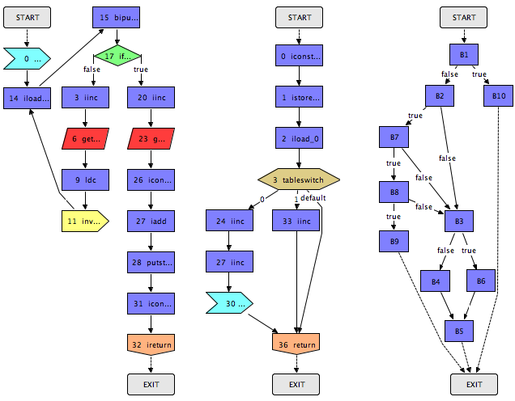
Program: Control Flow Graph

Slide 55
Program: Control Flow Graph
build CFG over
memory access patterns

Slide 56
Program: Control Flow Graph
keybit=0
keybit=1
build CFG over
memory access patterns

Slide 57
Side Channel Attack
keybit=0
keybit=1
use CFG to
infer key bits

Slide 58
Side Channel Attack
keybit=0
keybit=1
defense: obfuscate
memory access patterns

Slide 59
Review
Cryptanalysis Terminology
Replay Attack
MITM Attack
Relay Attack
Side Channel Attack

Slide 60
?

Slide 61
emm, project…

Slide 62
Announcement
Project Proposal: 05%
2019.03.05, 14:05 – 17:30
~ 5 min / group
Requirements | Grading
Topic? Why important? | C
Existing solutions? | B
Limitations? Your solution? | A

Slide 63
Thank You
be on the road
Notes:
Run your own race.

Slide 64
Reading
Cryptanalysis by Sourav Mukhopadhyay

