Slide 1
Anonymous Communication
07
Kai Bu
kaibu@zju.edu.cn
http://list.zju.edu.cn/kaibu/netsec

Slide 2
Anonymous Communication
Disclaimer:
The content to be presented aims only for
helping students understand principles of
anonymous communication. It should not be
used for abusive Internet activities.

Slide 3



Anonymous Communication
jzk
txh
hello, txh
Notes:
Exchange messages

Slide 4

Anonymous Communication
jzk
Internet
txh
hello, txh
Notes:
Through Internet

Slide 5
Anonymous Communication
jzk: ip1
Internet
ip2 :
txh
hello, txh
Notes:
Source IP and Destination IP for specifying users

Slide 6

Anonymous Communication
jzk: ip1
???
Internet
ip2 :
???
hello, txh
Notes:
For an attacker snooping on the communication
Even though he may not know the exact identities of the two users

Slide 7
Anonymous Communication
jzk: ip1
???
Internet
ip2 :
???
asdfghjkl
Notes:
And not know the message content protected by encryption

Slide 8
Anonymous Communication
jzk: ip1
???
Internet
ip2 :
???
asdfghjkl
Notes:
He can using their IP addresses;

Slide 9
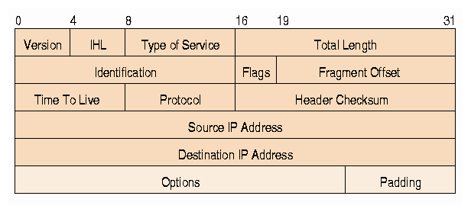
Anonymous Communication
Notes:
Because, for users to communicate via internet, their devices assigned with IP addresses,
which are usually fixed within a communication session or more;
This can be used to infer critical privacy of users

Slide 10
Anonymous Communication
anonymity & privacy:
who is communicating?
who are you talking to?
what type of activities?
what type of information?

Slide 11
Anonymous Communication
why wanted?

Slide 12
Anonymity for Mortals
Unmonitored access to health and medical information
Preservation of democracy:
anonymous election/jury
Censorship circumvention:
anonymous access to otherwise restricted information
…

Slide 13
Anonymity for Attackers
Misbehaviors without getting caught:
Terrorism
Darknet
Spam
Pirate
…

Slide 14
Anonymous Communication
how to?

Slide 15
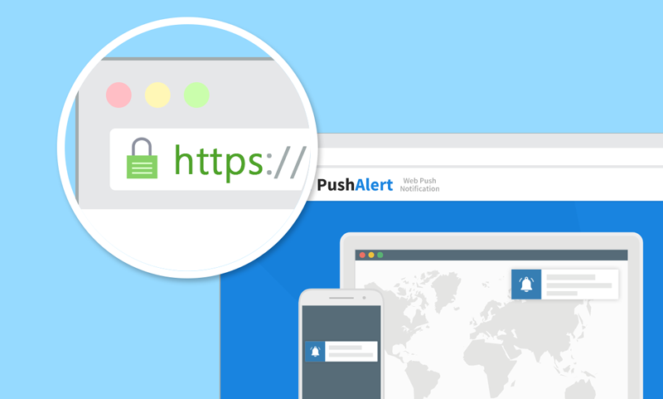
HTTPS?
asdf
Notes:
User types a link in the address bar

Slide 16
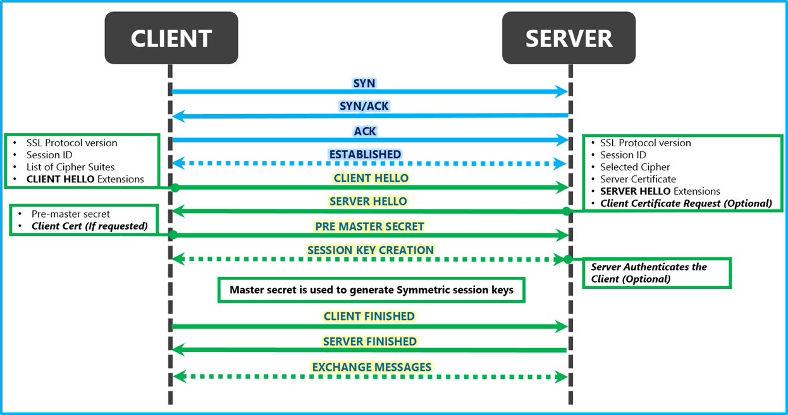

HTTPS for Confidentiality
TCP
handshake
TLS
handshake
connection
termination
FIN
FIN, ACK
ACK

Slide 17
HTTPS Not for Anonymity
TCP
handshake
TLS
handshake
connection
termination
FIN
FIN, ACK
ACK

Slide 18
HTTPS?
https://www.votefor.com
asdf
Notes:
Even if we don’t know what you communicated, knowing with
whom you communicated leaks a lot of information as well

Slide 19
Anonymous Communication
how to?
how to?

Slide 20
Anonymous Communication
hide destination address;

Slide 21
Anonymous Communication
hide destination address;
how to deliver packets to destination?

Slide 22
Anonymous Communication
RELAY!

Slide 23

ip3
ip1
Internet
ip2

Slide 24
monitored:
ip1->ip3, ip3->ip2
protected:
ip1->ip2
ip3
ip1
Internet
ip2

Slide 25
monitored:
ip1->ip3, ip3->ip2
protected:
ip1->ip2
overlay
communication
ip3
ip1
Internet
ip2

Slide 26
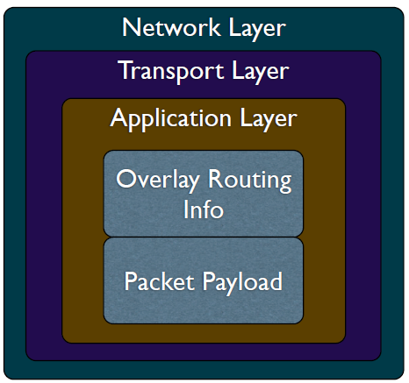
Overlay Network
Handle routing at the application layer
Tunnel messages inside other messages

Slide 27
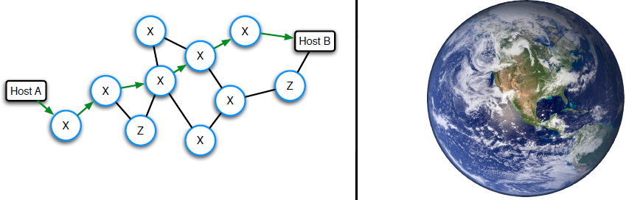
Threat Model
Insider Byzantine attacker
with limited view of network:
an attacker might have tight control over a network (e.g., Z ASes),
yet unlikely to observer entire Internet
vs

Slide 28



Traceforward Attack
passive attacker
traces messages from sender, thwarts receiver anonymity

Slide 29
Marking Attack
active attacker
marks messages,
discovers marked msg elsewhere

Slide 30
Anonymous Communication
anonymizing proxy

Slide 31

Anonymizing Proxy

Slide 32
Anonymizing Proxy
intermediary between sender & receiver
Sender relays all traffic through proxy
Encrypt destination and payload
Asymmetric technique:
receiver not involved (or informed of) anonymity

Slide 33

Anonymizing Proxy
k: shared key of sender and proxy
proxy
sender
receiver
{msg,dest}_{k}
msg
{response}_{k}
response

Slide 34
Anonymizing Proxy
k: shared key of sender and proxy
if attacker is located is located between
sender and proxy:
sender anonymity:
receiver anonymity:
0:
1
proxy
sender
receiver
{msg,dest}_{k}
msg
{response}_{k}
response

Slide 35
Anonymizing Proxy
k: shared key of sender and proxy
if attacker is located is located between
proxy and receiver:
sender anonymity:
receiver anonymity:
1:
0
proxy
sender
receiver
{msg,dest}_{k}
msg
{response}_{k}
response

Slide 36
Anonymizing Proxy
k: shared key of sender and proxy
if two attackers collude to correlate
ingress and egress proxy traffic:
sender anonymity:
receiver anonymity:
0:
0
proxy
sender
receiver
{msg,dest}_{k}
msg
{response}_{k}
response

Slide 37
Anonymizing Proxy
If attacker is the proxy per se:
decrypt all messages;
crack both confidentiality & anonymity;
sender anonymity:
receiver anonymity:
0:
0
proxy
sender
receiver
{msg,dest}_{k}
msg
{response}_{k}
response

Slide 38
what if receiver is attacker?

Slide 39
what if receiver is attacker?
protect sender anonymity from receiver

Slide 40

Receiver as Attacker
Known-location attacker
Use proxy to protect sender anonymity:
do not vote for letting votefor website
know that I accessed votefor /wink
proxy
votefor
sender

Slide 41
Receiver as Attacker
Known-location attacker
Use proxy to protect sender anonymity:
do not vote for letting votefor website
know that I accessed votefor /wink
have to trust
proxy
votefor
sender

Slide 42
Anonymizing Proxy
Advantages
Easy to configure
Require no active participation of
receiver, which need not be aware of
anonymity service
Have been widely deployed on Internet

Slide 43
Anonymizing Proxy
Disadvantages
Require trusted third party
proxy may release logs,
or sell them,
or blackmail sender
Anonymity largely depends on the
(likely unknown) location of attacker

Slide 44
how to evade attacker?

Slide 45
how to evade attacker?
dyanmize proxy location

Slide 46
Crowds Algorithm
Basic idea:
get lost in a crowd
Jump from one crowd to another
Members of a crowd called Jondos

Slide 47
Crowds Algorithm
Algorithm:
Relay message to random jondo
With probability p, jondo forwards
message to another jondo
With probability 1-p, jondo delivers
message to its intended destination

Slide 48

Crowds Algorithm

Slide 49
Crowds Algorithm

Slide 50
Crowds Algorithm
p

Slide 51
Crowds Algorithm
p
1-p

Slide 52
Crowds Algorithm
{@dest, hello}_{k}
p
{@dest, hello}_{k}
1-p
hello

Slide 53
Crowds Algorithm
must trust jondos;
{@dest, hello}_{k}
p
{@dest, hello}_{k}
1-p
hello

Slide 54

Crowds Algorithm
must trust jondos;
if any message is intercepted,
receiver is trivially exposed.
{@dest, hello}_{k}
p
{@dest, hello}_{k}
1-p
hello

Slide 55
how to evade
untrusted proxies?

Slide 56
how to evade
untrusted proxies?

Slide 57
proxy++
how to evade
untrusted proxies?

Slide 58
hard for an attacker
to simultaneously control
too many proxies
proxy++
how to evade
untrusted proxies?

Slide 59
source routing
specify on-path routers by source
Notes:
allows a sender of a packet to partially or completely specify the route the packet takes through the network.
In contrast, in conventional routing, routers in the network determine the path incrementally based on the packet's destination

Slide 60
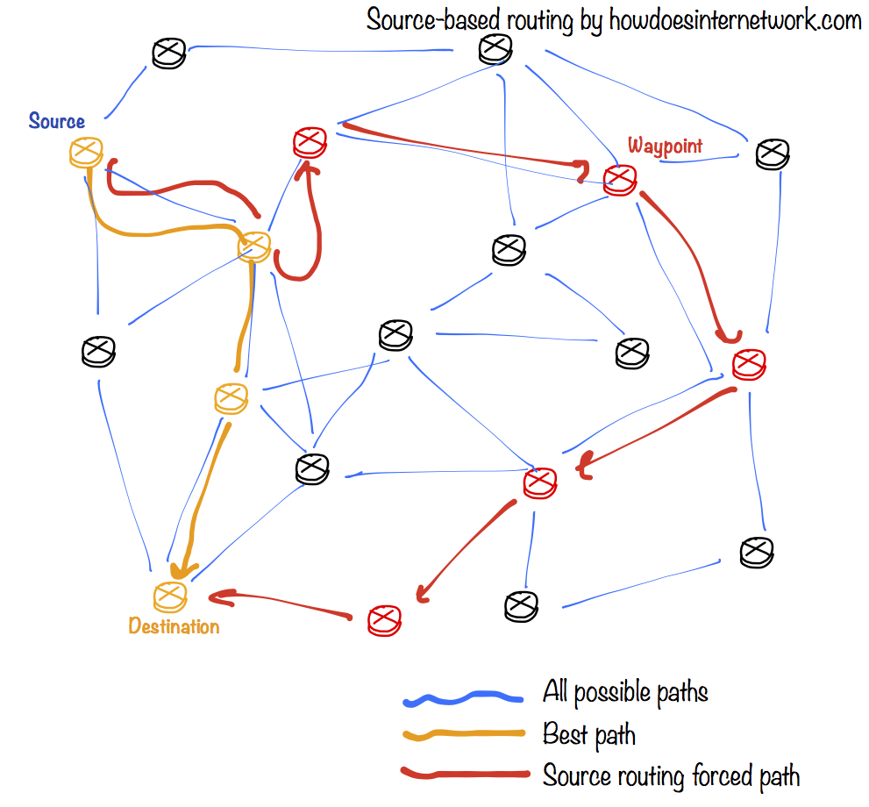

Slide 61
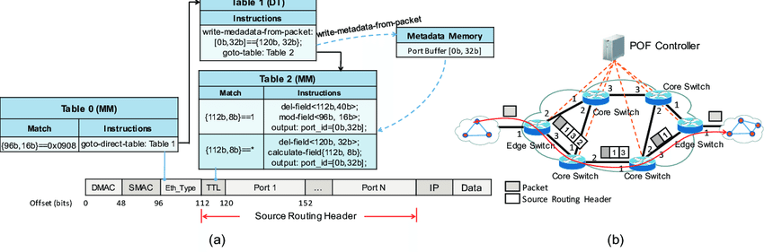
POF-based Source Routing
POF: Protocol Oblivious Forwarding
Port bound
forwarding
table
forwarding
process

Slide 62
POF-based Source Routing
POF: Protocol Oblivious Forwarding
Port bound
forwarding
table
forwarding
process
anonymity protected?

Slide 63
POF-based Source Routing
POF: Protocol Oblivious Forwarding
Port sequence leaked
forwarding
table
forwarding
process
anonymity protected? nah!

Slide 64
source routing
how to anonymize?
Notes:
allows a sender of a packet to partially or completely specify the route the packet takes through the network.
In contrast, in conventional routing, routers in the network determine the path incrementally based on the packet's destination

Slide 65
POF-based Source Routing
POF: Protocol Oblivious Forwarding
Port sequence leaked
forwarding
table
forwarding
process
should hide ports from non-neighbors

Slide 66
onion routing
source-routing based anonymous overlay communication

Slide 67
onion routing
source-routing based anonymous overlay communication
Notes:
Leverage the overlay network architecture
Otherwise, underlying forwarding devices do not support the modification

Slide 68

onion routing
source-routing based anonymous overlay communication
Notes:
Use onion router called Tor

Slide 69
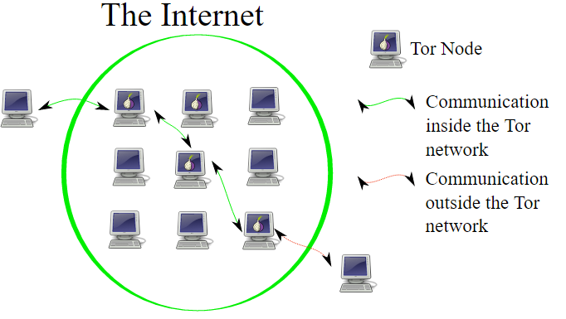
Onion Routing

Slide 70
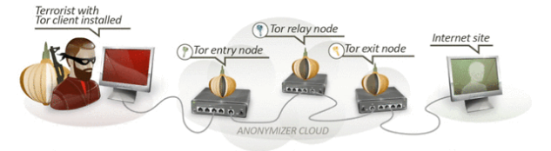
Onion Routing
Connect to Tor entry
Randomly select a series of Tors
Relay messages across them
Tor exit relays messages to destination

Slide 71
Onion Routing
Reply traffic from destination traverses
the reverse path
Maintains a bidirectional persistent
multi-hop path between source and
destination

Slide 72
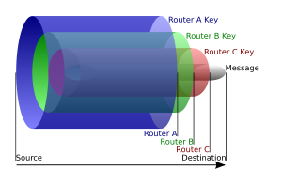
Onion Routing
B
Layered Encryption
A
C
{{{{msg}_{D}}_{C}}_{B}}_{A}
sufficient?

Slide 73
Onion Routing
B
Layered Encryption
Leaked routing info:
neighborship only
A
C
{{{{msg}_{D}}_{C}}_{B}}_{A} ?

Slide 74
onion routing
applications?

Slide 75
Darknet
Portions of the Internet purposefully
not open to public view
or hidden networks whose architecture
is superimposed on that of Internet.
Install Tor
Access darknet.onion through it
Notes:
the portions of the Internet purposefully not open to public view or hidden networks whose architecture is superimposed on that of the Internet.

Slide 76
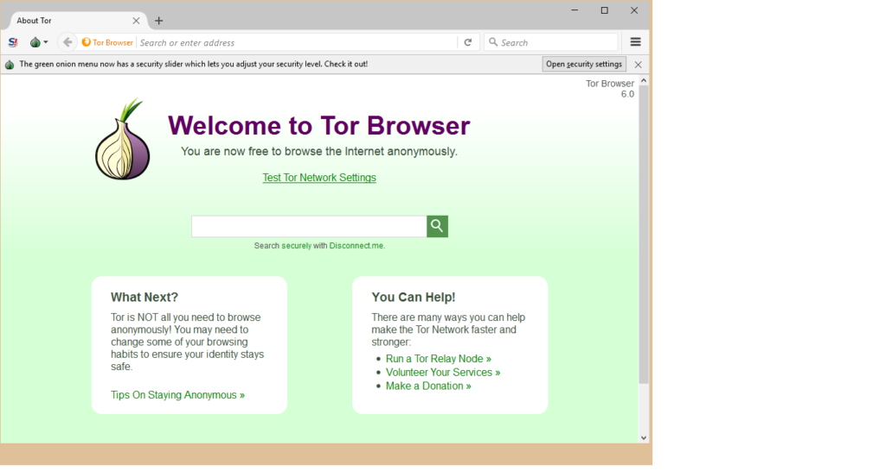
Darknet
Notes:
the portions of the Internet purposefully not open to public view or hidden networks whose architecture is superimposed on that of the Internet.

Slide 77

Darknet
Notes:
the portions of the Internet purposefully not open to public view or hidden networks whose architecture is superimposed on that of the Internet.

Slide 78
how to de-anonymization?

Slide 79
in it to win it!

Slide 80
Tor Traffic Correlation
Passive monitoring
Active attraction:
deploy a Tor router;
attract Tor traffic;
perform traffic analysis and correlation;

Slide 81
Path Selection Attack
Tor path selection algorithm:
weight nodes by selfreported bandwidth;
select each node using weighted
probability distribution;
Attack:
malicious relay reports very high bw to
increase selection probability;
if it controls the first hop, de- sender;
if it controls the last hop, de- receiver;

Slide 82
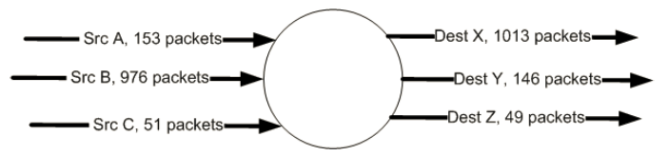
Counting Attack
Correlate incoming and outgoing flows
by counting the number of packets

Slide 83
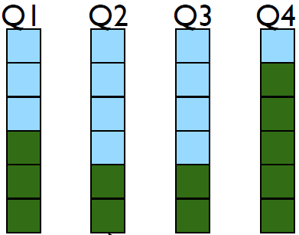
Low Latency Attack
Tor router assigns each anonymous
circuit its own queue
Dequeue one packet from each queue
in round-robin fashion

Slide 84
Low Latency Attack
Tor router assigns each anonymous
circuit its own queue
Dequeue one packet from each queue
in round-robin fashion
new queue affects
latencies of all other
queues;

Slide 85
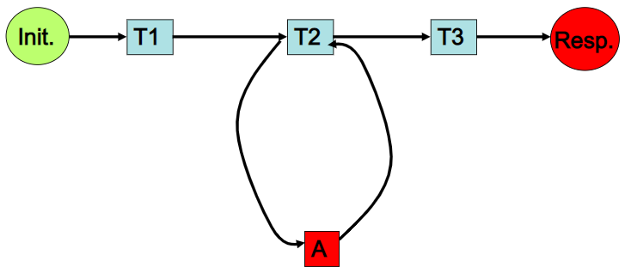
Low Latency Attack
Attacker:
intends to infer Init’s activity

Slide 86
Low Latency Attack
Attacker:
intends to infer Init’s activity
Assumption:
only Init and A occupy T2

Slide 87
Low Latency Attack
Attacker:
loop:
send packets to T2;
measure latency;

Slide 88
Low Latency Attack
larger latency indicate Init’s traffic!
Attacker:
loop:
send packets to T2;
measure latency;

Slide 89
Cross Site Attack
Crawling:
Deploy Tor routers
Access darknet
Crawl transaction information
Extract Bitcoin accounts of interest
Correlation:
Search the accounts on public websites

Slide 90
?

Slide 91
Announcement
Assignment
Due Date: April 15, 2019
Project
Due Date: April 16, 2019
Demo, Presentation, Report

Slide 92
Readings
Anonymous Communication
by Nick Mathewson
Tor: The Second-Generation Onion Router (2012 DRAFT)
by Dingledine et al.
Disclaimer:
The content aims only for helping students understand
principles of anonymous communication. It should not be
used for abusive Internet activities.

Slide 93
Thank You
be on the road
Notes:
Run your own race.

