Slide 1
Wi-Fi Security
08
Kai Bu
kaibu@zju.edu.cn
http://list.zju.edu.cn/kaibu/netsec

Slide 2
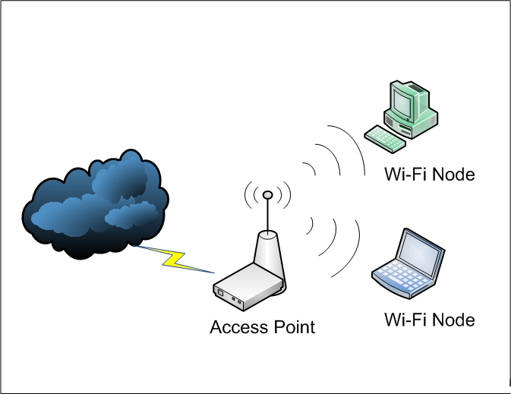
Wi-Fi
Notes:
Wireless networking become prevalent；
Wifi access; - news of wifi breaching …;
Wifi security

Slide 3
Wi-Fi Security?
Notes:
Wireless networking become prevalent；
Wifi access; - news of wifi breaching …;
Wifi security

Slide 4
Wi-Fi Security?
is it just network security?
Notes:
Wireless networking become prevalent；
Wifi access; - news of wifi breaching …;
Wifi security

Slide 5
Wi-Fi Security?
is it just wired network security?
Notes:
Wireless networking become prevalent；
Wifi access; - news of wifi breaching …;
Wifi security

Slide 6
Wi-Fi Security?
MITM
Replay
DoS/Jamming
Traffic Correlation
…
is it just wired network security?
Notes:
Wireless networking become prevalent；
Wifi access; - news of wifi breaching …;
Wifi security

Slide 7
is it just wired net security?

Slide 8
is it just wired net security?
nah
Notes:
Apparently not
Otherwise there would not be a dependent are called wireless security;

Slide 9
is it just wired net security?
nah
what makes wireless security special?
Notes:
then what makes wireless security so special such that, even though there are already many well-investigated security solution for wired network,
We still need to put efforts in developing security solutions for wireless network?

Slide 10
Higher Security Risk
Broadcast Communication
wireless networking typically involves broadcast communication, which is far more susceptible to eavesdropping and jamming than wired networks;
wireless networks are also more vulnerable to active attacks that exploit vulnerabilities in communications protocols;
Notes:
Wireless networks, and the wireless devices that use them, introduce a host of security
problems over and above those found in wired networks. Some of the key factors
contributing to the higher security risk of wireless networks compared to wired
networks include the following [MA10]:
• Channel: Wireless networking typically involves broadcast communications,
which is far more susceptible to eavesdropping and jamming than wired networks.
Wireless networks are also more vulnerable to active attacks that
exploit vulnerabilities in communications protocols.
• Mobility: Wireless devices are, in principal and usually in practice, far more
portable and mobile than wired devices. This mobility results in a number of
risks, described subsequently.
• Resources: Some wireless devices, such as smartphones and tablets, have
sophisticated operating systems but limited memory and processing resources
with which to counter threats, including denial of service and malware.
• Accessibility: Some wireless devices, such as sensors and robots, may be left
unattended in remote and/or hostile locations. This greatly increases their vulnerability
to physical attacks.

Slide 11
Higher Security Risk
Higher Mobility
far more portable and mobile, thus resulting in a number of risks;
Constrained Resource
sophisticated OS but limited memory and processing resources to counter threats, including DoS and malware
Greater Accessibility
may be left unattended in remote and/or hostile locations, thus greatly increasing their vulnerability to physical attacks

Slide 12
what to secure for wi-fi?

Slide 13
what to secure for wi-fi?
confidentiality:
messages sent over wireless links
must be encrypted

Slide 14
what to secure for wi-fi?
authenticity:
origin of messages received over
wireless links must be verified

Slide 15
what to secure for wi-fi?
integrity:
integrity of messages received over
wireless links must be verified

Slide 16
what to secure for wi-fi?
replay detection:
freshness of messages received over
wireless links must be checked

Slide 17
what to secure for wi-fi?
access control:
access to the network services should
be provided only to legitimate entities

Slide 18
how to attack wi-fi?

Slide 19
how to attack wi-fi?
passive attack vs active attack

Slide 20
Passive vs Active
Passive Attack
passive information-gathering;
offline attack over the gathered info of
snooped packets:
e.g., key cracking;
Active Attack
manipulate wireless communication;
e.g., packet injection, DoS;

Slide 21
example wi-fi attacks

Slide 22
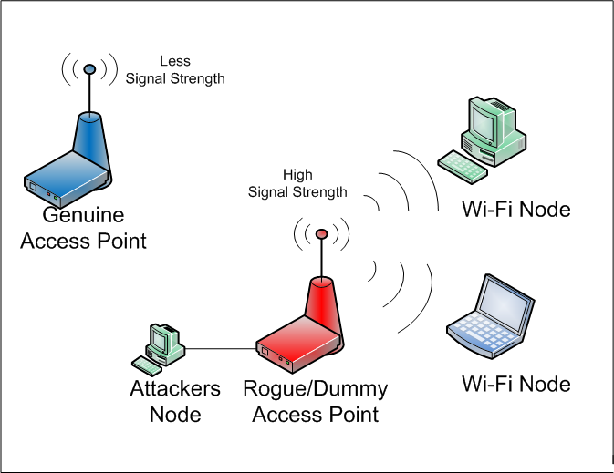
Rogue AP
a wireless access point
that has been
installed on a secure network without explicit authorization from a local admin
Notes:
https://en.wikipedia.org/wiki/Rogue_access_point
A rogue access point is a wireless access point that has been installed on a secure network without explicit authorization from a local network administrator,[1] whether added by a well-meaning employee or by a malicious attacker.
Although it is technically easy for a well-meaning employee to install a "soft access point" or an inexpensive wireless router - perhaps to make access from mobile devices easier - it is likely that they will configure this as "open", or with poor security, and potentially allow access to unauthorized parties.
If an attacker installs an access point they are able to run various types of vulnerability scanners, and rather than having to be physically inside the organization, can attack remotely - perhaps from a reception area, adjacent building, car park, or with a high gain antenna, even from several miles away.
Business network penetration by unknown, unauthorized APs has long been a top worry. Fortunately, most enterprise WLANs now use legitimate APs to scan channels for possible rogues in their spare time. Unfortunately, verifying “true rogues” by tracing their wired network connectivity is a skill that ordinary WLAN gear has yet to perfect. Without accurate classification, automated rogue blocking is a risky proposition. To not just detect, but effectively mitigate rogue APs, deploy a Wireless IPS that can reliably differentiate between harmless neighbors, personal hotspots, and network-connected rogues that pose real danger, taking policy-based action to trace, block, and locate the latter.

Slide 23
Rogue AP
user can select to connect to the “trusted” wi-fi, e.g., ZJUWLAN
Notes:
https://en.wikipedia.org/wiki/Rogue_access_point
A rogue access point is a wireless access point that has been installed on a secure network without explicit authorization from a local network administrator,[1] whether added by a well-meaning employee or by a malicious attacker.
Although it is technically easy for a well-meaning employee to install a "soft access point" or an inexpensive wireless router - perhaps to make access from mobile devices easier - it is likely that they will configure this as "open", or with poor security, and potentially allow access to unauthorized parties.
If an attacker installs an access point they are able to run various types of vulnerability scanners, and rather than having to be physically inside the organization, can attack remotely - perhaps from a reception area, adjacent building, car park, or with a high gain antenna, even from several miles away.
Business network penetration by unknown, unauthorized APs has long been a top worry. Fortunately, most enterprise WLANs now use legitimate APs to scan channels for possible rogues in their spare time. Unfortunately, verifying “true rogues” by tracing their wired network connectivity is a skill that ordinary WLAN gear has yet to perfect. Without accurate classification, automated rogue blocking is a risky proposition. To not just detect, but effectively mitigate rogue APs, deploy a Wireless IPS that can reliably differentiate between harmless neighbors, personal hotspots, and network-connected rogues that pose real danger, taking policy-based action to trace, block, and locate the latter.

Slide 24
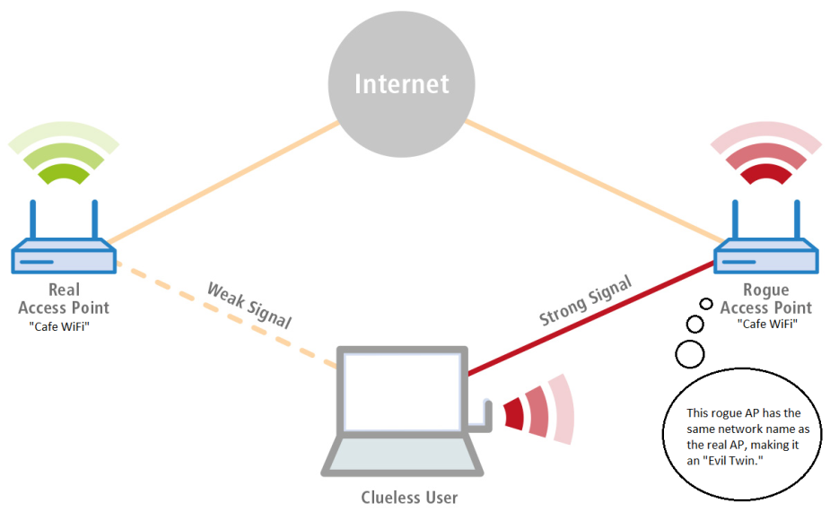
Evil Twin AP
a fraudulent wireless AP
that appears to be legitimate
by faking the same SSID as legitimate AP
ZJUWLAN
ZJUWLAN
Notes:
https://en.wikipedia.org/wiki/Evil_twin_(wireless_networks)
An evil twin is a fraudulent Wi-Fi access point that appears to be legitimate but is set up to eavesdrop on wireless communications.[1] The evil twin is the wireless LAN equivalent of the phishing scam.
This type of attack may be used to steal the passwords of unsuspecting users, either by monitoring their connections or by phishing, which involves setting up a fraudulent web site and luring people there.[2]

Slide 25
Evil Twin AP
a fraudulent wireless AP
that appears to be legitimate
by faking the same SSID as legitimate AP
service set id
ZJUWLAN
ZJUWLAN
Notes:
https://en.wikipedia.org/wiki/Evil_twin_(wireless_networks)
An evil twin is a fraudulent Wi-Fi access point that appears to be legitimate but is set up to eavesdrop on wireless communications.[1] The evil twin is the wireless LAN equivalent of the phishing scam.
This type of attack may be used to steal the passwords of unsuspecting users, either by monitoring their connections or by phishing, which involves setting up a fraudulent web site and luring people there.[2]

Slide 26
Evil Twin AP
a fraudulent wireless AP
that appears to be legitimate
by faking the same SSID as legitimate AP
service set id
ZJUWLAN
ZJUWLAN
phishing
steal password
intercept transactions…
Notes:
The attacker snoops on Internet traffic using a bogus wireless access point. Unwitting web users may be invited to log into the attacker's server, prompting them to enter sensitive information such as usernames and passwords. Often, users are unaware they have been duped until well after the incident has occurred.
When users log into unsecured (non-HTTPS) bank or e-mail accounts, the attacker intercepts the transaction, since it is sent through their equipment. The attacker is also able to connect to other networks associated with the users' credentials.
Fake access points are set up by configuring a wireless card to act as an access point (known as HostAP). They are hard to trace since they can be shut off instantly. The counterfeit access point may be given the same SSID and BSSID as a nearby Wi-Fi network. The evil twin can be configured to pass Internet traffic through to the legitimate access point while monitoring the victim's connection,[3] or it can simply say the system is temporarily unavailable after obtaining a username and password

Slide 27
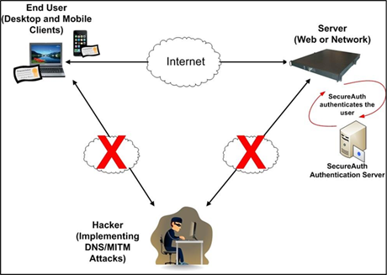
Man-In-The-Middle
similar to mitm
in wired networks
Notes:
After seducing user traffic to rogue or evil twin AP,
The attacker can launch MITM attack.
Here the attacker accesses the information of the AP of any active SSID. Here dummy APs are created. The attacker listens the communication between to end points. Let’s suppose a client is having a TCP connection with any server, then the attacker will be the man in the middle and she/he splits that TCP connection into two separate connections, whose common node will be an attacker himself/herself. So the first connection is from client to an attacker, and the second connection will be from the attacker to the server. So each and every request and response will be taking place between client and server via an attacker. So an attacker can steal information passing in the air between them.

Slide 28
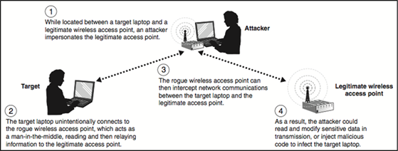
Frame Injection
based on mitm
more actively inject frames
rather than simply intercept communication
Notes:
What man-in-the-middle can to
To perform this kind of attack, an attacker must have a deep understanding and knowledge of the protocol. Any professional hacker will perform this method in order to perform an injection attack on wireless networks. Firstly, she/he will perform passive information gathering of that network. Then the attacker creates wireless protocol frames in order to send it to the targeted network. There are basically two ways of doing so. One can either create a false packet and insert it into that network. The other way is to sniff the network traffic. Once these packets are sent to the server, the response from that wireless network is captured, intercepted and modified by an attacker to perform a man-in-the-middle attack. This is hard to detect, as it happens at layer two.

Slide 29
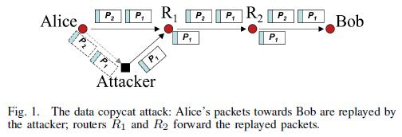
Replay Attack
attacker repeats copies of user packets,
to exhaust victim’s energy or power supply
Notes:
In this process, transmission data is repeated maliciously. An attacker intercepts the data in order to retransmit it further. It’s a part of masquerade attack which can be carried away by substitution of an IP packet. A stream cipher attack can be taken place into that.
An attacker repeats copies of the packets to the victim in order to exhaust the energy or power supply. This kind of attack has an ability to crash applications which are designed poorly.

Slide 30
Denial of Sleep
Wireless devices usually have different
working modes for saving energy
E.g.,
active mode, idle mode, sleep mode
Denial of Sleep
trigger wireless devices by signals,
such that they keep active &drain power;
more drained nodes lead to network
disruption;
Notes:
Sometimes wireless networks don’t use radio transmission. So in order to reduce consumption, it regulates the communication of that particular node. A malicious user can take advantage of this mechanism. An attacker may drain the power supply of the sensor device in order to make node’s life very short, or attack the MAC layer to reduce the sleep period of it. If a number of drained nodes goes high, the whole network can be disrupted. Only the MAC protocol has an ability to create a longer sleep duration. Without that, you cannot extend the lifetime of your wireless network.

Slide 31
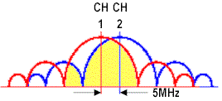
Collision Attack
overlapping channels between user and attacker;
Attacker interferes with user communication
by sending packets that collide with user’s;
then user’s packets are discarded.

Slide 32
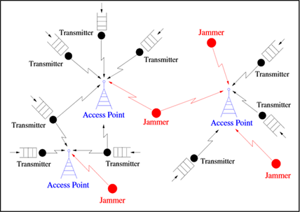
Jamming
jam ap
deliberate jamming, blocking or interference with authorized wireless communication

Slide 33
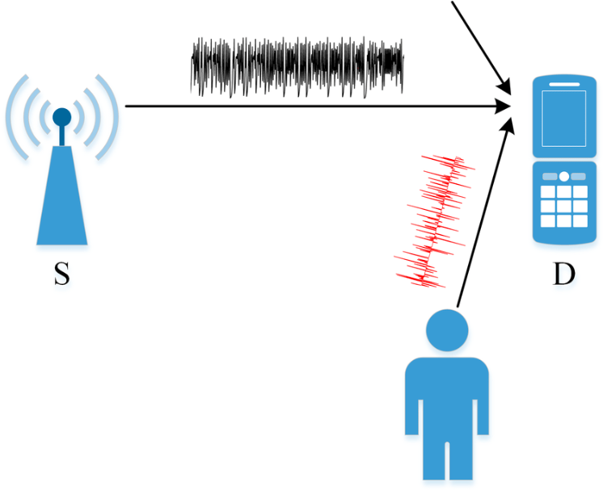
Jamming
jam user
deliberate jamming, blocking or interference with authorized wireless communication

Slide 34
Jamming
an easy to launch wireless DoS attack

Slide 35
how to secure wi-fi?

Slide 36
how to secure wi-fi?
WEP

Slide 37
WEP
Wired Equivalent Privacy
make the Wi-Fi network at least as
secure as a wired LAN (that has no
particular protection mechanisms);
not intended to achieve strong security;
Services
access control to network;
message confidentiality;
message integrity;

Slide 38
Access Control
before association, STA (station, i.e.,
the device) needs to authenticate itself
to AP
Challenge-response authentication:
STA → AP: authenticate request
AP → STA: authenticate challenge r
STA → AP: authenticate response
AP → STA: authenticate success/failure

Slide 39
Access Control
before association, STA (station, i.e.,
the device) needs to authenticate itself
to AP
Challenge-response authentication:
STA → AP: authenticate request
AP → STA: authenticate challenge r
STA → AP: authenticate response
AP → STA: authenticate success/failure
128 bits
E_{k}(r)

Slide 40
Access Control
before association, STA (station, i.e.,
the device) needs to authenticate itself
to AP
Challenge-response authentication
Once authenticated, STA can send an
association request, and AP will
respond with an association response;
If authentication fails, no association is
possible.

Slide 41
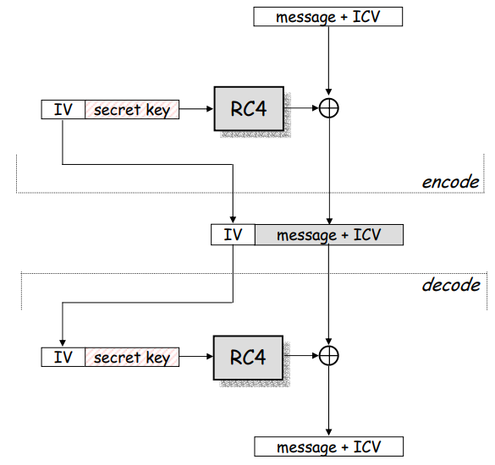
WEP Encryption

Slide 42
WEP Encryption
Message
CRC: for integrity check
Plaintext = Message||CRC
IV (Initialization Vector): 24-bit number
Key: 40 or 104-bit number
Keystream: IV||Key
Ciphertext

Slide 43
WEP Encryption
Message
CRC
Step 1: Compute CRC for the message
CRC-32 polynomial is used

Slide 44
WEP Encryption
Keystream
IV
Key
Step 2: Compute the keystream
IV is concatenated with the key
RC4 encryption algorithm is used on the 64 or 128 bit concatenation

Slide 45
WEP Encryption
Message
CRC
IV
Ciphertext
Keystream
Step 3: Encrypt the plaintext
The plaintext is XORed with the keystream to form the ciphertext
The IV is prepended to the ciphertext

Slide 46
WEP Decryption
IV
Ciphertext
Keystream
Key
Step 1: Build the keystream
Extract the IV from the incoming frame
Prepend the IV to the key
Use RC4 to build the keystream

Slide 47
WEP Decryption
Ciphertext
Message
CRC
Keystream
Step 2: Decrypt the plaintext and verify
XOR the keystream with the ciphertext
Verify the extracted message with the CRC

Slide 48
WEP Weakness
AP not authenticate to STA
24-bit IV in plaintext
CRC is unkeyed function
RC4 cipher: week seeds (IV) make
more easily calculated keystreams

Slide 49
how to attack WEP?

Slide 50
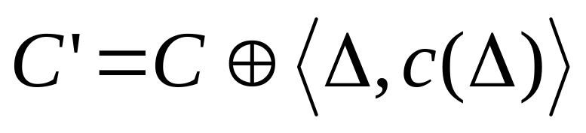
Message Modification
Takes advantage of CRC’s linearity and
unkeyed nature.
C is the original cyphertext
c is the CRC-32 function
Δ is the change in the message
Need to know some of the plaintext, but not all!

Slide 51
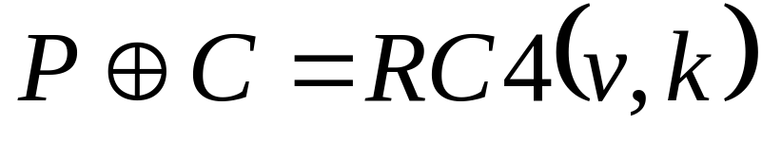
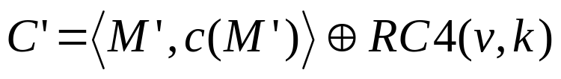
Message Injection
Takes advantage of CRC’s unkeyed
nature and IV reuse.
C is the original cybertext
P is the original plaintext
RC4(v,k) is the keystream for IV v
M’ is the new message
c is the CRC-32 function
Δ is the change in the message
Need to know all of the plaintext

Slide 52
how to secure Wi-Fi more?

Slide 53
how to secure Wi-Fi more?
IEEE 802.11i

Slide 54
802.11i Security Services
Authentication
mutual authentication enforced
STA ←→ AP
Access Control
enforces authentication,
routes messages properly,
facilitates key exchange
Privacy with Message Integrity

Slide 55

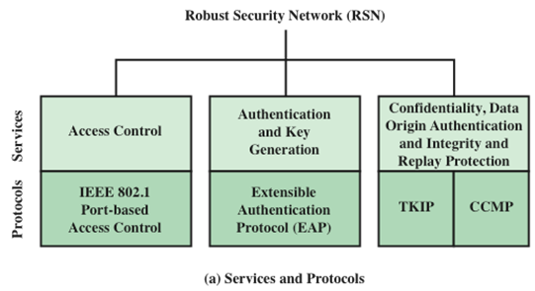
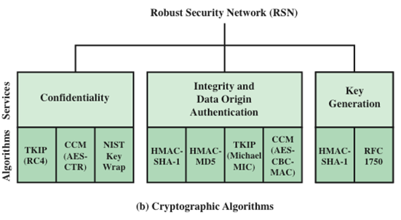
Elements of
802.11i
Notes:
Figure 24.5a indicates the security protocols used to support these services,
while Figure 24.5b lists the cryptographic algorithms used for these services.

Slide 56
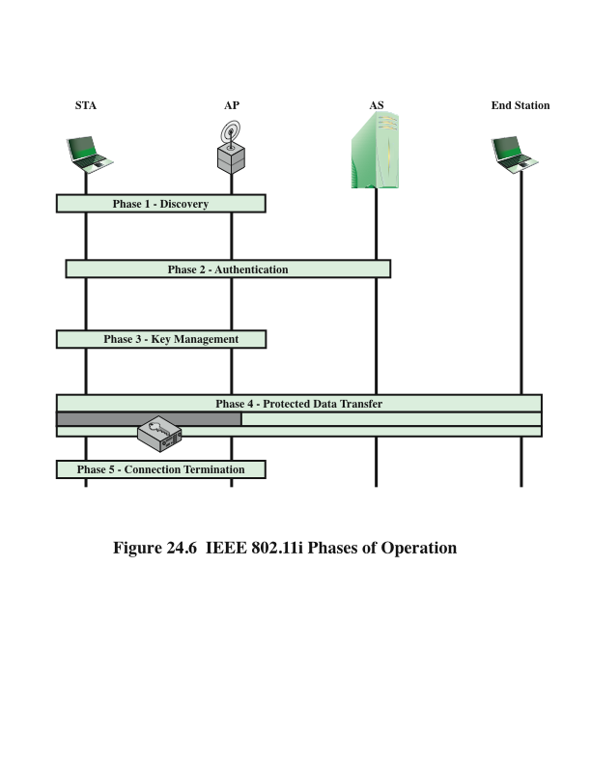
Phases of Operation

Slide 57
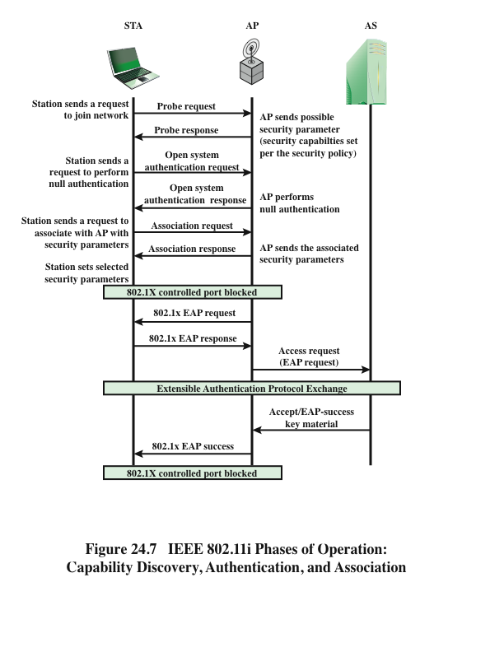
802.11i
Phases of
Operation
Notes:
We now look in more detail at the RSN phases of operation, beginning with the
discovery phase, which is illustrated in the upper portion of Figure 24.7 . The
purpose of this phase is for an STA and an AP to recognize each other, agree on a
set of security capabilities, and establish an association for future communication
using those security capabilities.
During this phase, the STA and AP decide on specific
techniques in the following areas:
• Confidentiality and MPDU integrity protocols for protecting unicast traffic
(traffic only between this STA and AP)
• Authentication method
• Cryptography key management approach
Confidentiality and integrity protocols for protecting multicast/broadcast traffic
are dictated by the AP, since all STAs in a multicast group must use the same
protocols and ciphers. The specification of a protocol, along with the chosen key
length (if variable), is known as a cipher suite . The options for the confidentiality
and integrity cipher suite are:
• WEP, with either a 40-bit or 104-bit key, which allows backward compatibility
with older IEEE 802.11 implementations
• TKIP
• CCMP
• Vendor-specific methods
The other negotiable suite is the authentication and key management (AKM)
suite, which defines (1) the means by which the AP and STA perform mutual
authentication and (2) the means for deriving a root key from which other keys may
be generated. The possible AKM suites are
• IEEE 802.1X
• Pre-shared key (no explicit authentication takes place and mutual authentication
is implied if the STA and AP share a unique secret key)
• Vendor-specific methods
The discovery phase consists of three exchanges.
• Network and security capability discovery: During this exchange, STAs
discover the existence of a network with which to communicate. The AP
either periodically broadcasts its security capabilities (not shown in figure),
indicated by RSN IE (Robust Security Network Information Element), in a
specific channel through the Beacon frame; or responds to a station’s Probe
Request through a Probe Response frame. A wireless station may discover
available access points and corresponding security capabilities by either
passively monitoring the Beacon frames or actively probing every channel.
• Open system authentication: The purpose of this frame sequence, which
provides no security, is simply to maintain backward compatibility with the
IEEE 802.11 state machine, as implemented in existing IEEE 802.11 hardware.
In essence, the two devices (STA and AP) simply exchange identifiers.
• Association: The purpose of this stage is to agree on a set of security
capabilities to be used. The STA then sends an Association Request frame
to the AP. In this frame, the STA specifies one set of matching capabilities
(one authentication and key management suite, one pair-wise cipher suite, and
one group-key cipher suite) from among those advertised by the AP. If there
is no match in capabilities between the AP and the STA, the AP refuses the
Association Request. The STA blocks it too, in case it has associated with a
rogue AP or someone is inserting frames illicitly on its channel. As shown in
Figure 24.7 , the IEEE 802.1X controlled ports are blocked, and no user traffic
goes beyond the AP. The concept of blocked ports is explained subsequently.
As was mentioned, the authentication phase enables mutual authentication between
an STA and an authentication server located in the DS. Authentication is designed
to allow only authorized stations to use the network and to provide the STA with
assurance that it is communicating with a legitimate network.

Slide 58
MPDU Exchange
MPDU: MAC Protocol Data Unit
Three phases of authentication:
connect to AS
    the STA sends a request to its AP that it has an association with for connection to the AS;
    the AP acknowledges this request and sends an access request to the AS
EAP exchange
    authenticates the STA and AS to each other
secure key delivery
    once authentication is established, the AS generates a master session key and sends it

Slide 59
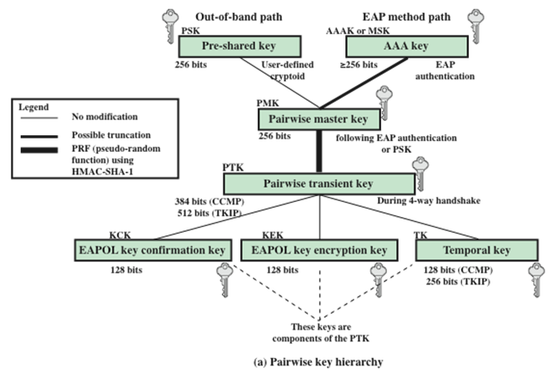
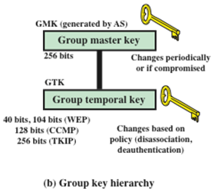
802.11i
Key Hierarchies
Notes:
During the key management phase, a variety of cryptographic keys are generated
and distributed to STAs. There are two types of keys: pairwise keys used for
communication between an STA and an AP and group keys used for multicast
communication. Figure 24.9 , based on [FRAN07], shows the two key hierarchies,
and Table 24.3 defines the individual keys.

Slide 60
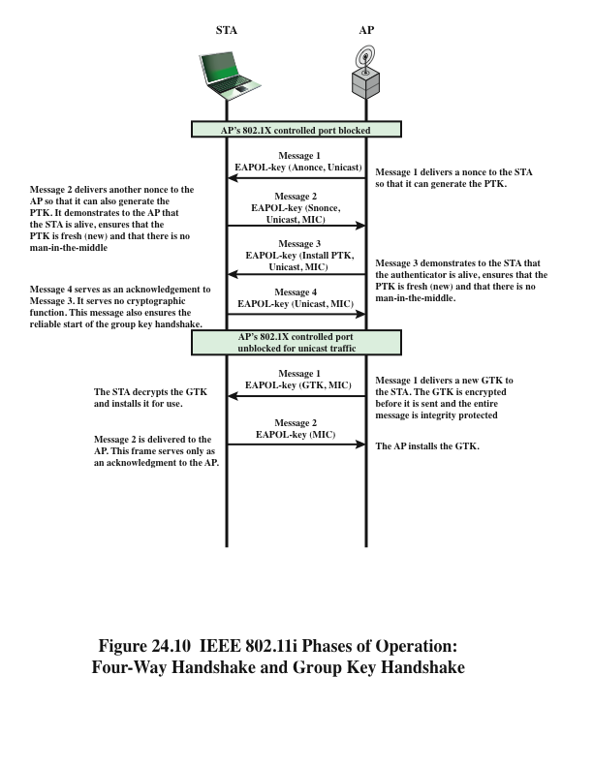
Phases of Operation
Key Exchange
Notes:
The upper part of Figure 24.10 shows the MPDU
exchange for distributing pairwise keys. This exchange is known as the 4-way
handshake . The STA and AP use this handshake to confirm the existence of
the PMK, verify the selection of the cipher suite, and derive a fresh PTK for the
following data session. The four parts of the exchange are as follows.
• AP → STA: Message includes the MAC address of the AP and a nonce (Anonce)
• STA → AP: The STA generates its own nonce (Snonce) and uses both nonces
and both MAC addresses, plus the PMK, to generate a PTK. The STA then
sends a message containing its MAC address and Snonce, enabling the AP to
generate the same PTK. This message includes a message integrity code (MIC) 2
using HMAC-MD5 or HMAC-SHA-1-128. The key used with the MIC is KCK.
• AP → STA: The AP is now able to generate the PTK. The AP then sends a
message to the STA, containing the same information as in the first message,
but this time including a MIC.
• STA → AP: This is merely an acknowledgement message, again protected
by a MIC.
For group key distribution, the AP generates a GTK
and distributes it to each STA in a multicast group. The two-message exchange with
each STA consists of the following:
• AP → STA: This message includes the GTK, encrypted either with RC4 or
with AES. The key used for encryption is KEK. A MIC value is appended.
• STA → AP: The STA acknowledges receipt of the GTK. This message
includes a MIC value.

Slide 61
how to secure data trans?
IEEE 802.11i

Slide 62
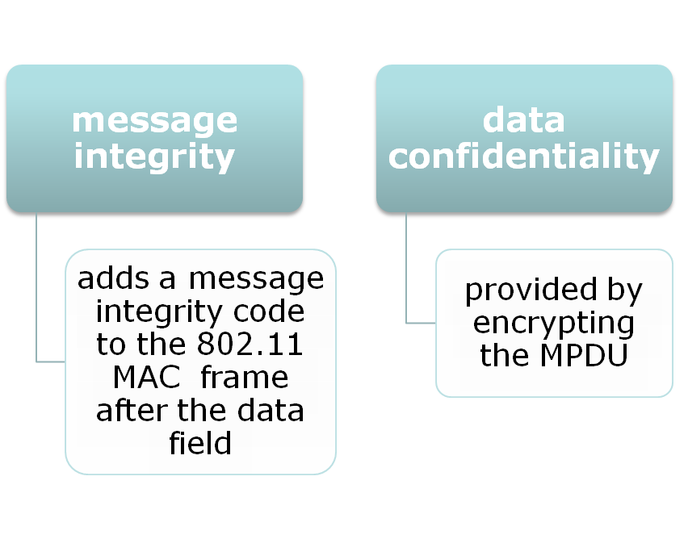
TKIP
Temporal Key Integrity Protocol
designed to require only software
changes to devs that are implemented
with the older WEP
Two services:
Notes:
IEEE 802.11i defines two schemes for protecting data transmitted in 802.11
MPDUs: the Temporal Key Integrity Protocol (TKIP) and the Counter Mode-CBC
MAC Protocol (CCMP).
TKIP is designed to require only software changes to devices that are
implemented with the older wireless LAN security approach called Wired
Equivalent Privacy (WEP). TKIP provides two services:
• Message integrity: TKIP adds a message integrity code to the 802.11 MAC
frame after the data field. The MIC is generated by an algorithm, called
Michael, that computes a 64-bit value using as input the source and destination
MAC address values and the data field, plus key material.
• Data confidentiality: Data confidentiality is provided by encrypting the
MPDU plus MIC value using RC4.
The 256-bit TK ( Figure 24.9 ) is employed as follows. Two 64-bit keys are
used with the Michael message digest algorithm to produce a message integrity
code. One key is used to protect STA-to-AP messages, and the other key is used to
protect AP-to-STA messages. The remaining 128 bits are truncated to generate the
RC4 key used to encrypt the transmitted data.
For additional protection, a monotonically increasing TKIP sequence counter
(TSC) is assigned to each frame. The TSC serves two purposes. First, the TSC is
included with each MPDU and is protected by the MIC to protect against replay attacks.
Second, the TSC is combined with the session TK to produce a dynamic encryption key
that changes with each transmitted MPDU, thus making cryptanalysis more difficult.

Slide 63
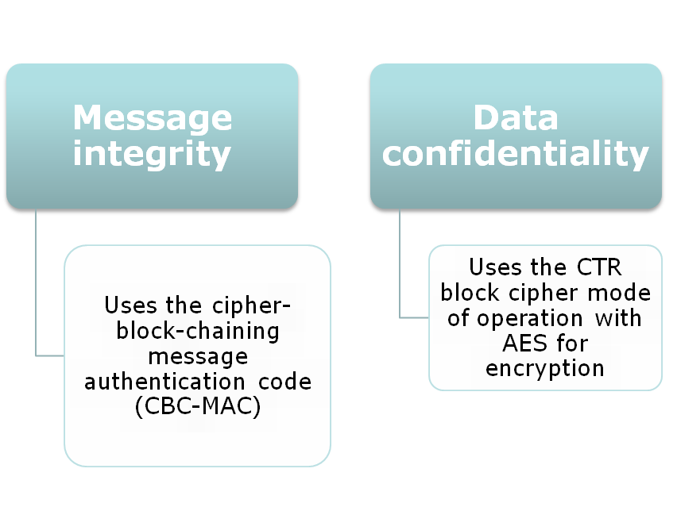
CCMP
Counter Mode CBC MAC Protocol
Intended for newer IEEE 802.11 devs
that are equipped with the hardware to support this scheme
Two services:
Notes:
CCMP is intended for newer IEEE 802.11 devices that are equipped with
the hardware to support this scheme. As with TKIP, CCMP provides two services:
• Message integrity : CCMP uses the cipher-block-chaining message
authentication code (CBC-MAC), described in Chapter 12.
• Data confidentiality : CCMP uses the CTR block cipher mode of operation
with AES for encryption. CTR is described in Chapter 20.
The same 128-bit AES key is used for both integrity and confidentiality.
The scheme uses a 48-bit packet number to construct a nonce to prevent replay
attacks.

Slide 64
?

Slide 65
Announcement
Assignment
Due Date: April 15, 2019
Project
Demo&Pre Due Date: April 16, 2019
e-Report Due date: April 23, 2019
05% | Presentation
15% | Demo
15% | Report

Slide 66
Readings
WiFi Security by Nick Kartsioukas
How does WPA and WPA2 Work?
Top Ten Wi-Fi Security Threats
by Lisa Phifer
Wireless Attacks Unleashed
by Chintan Gurjar

Slide 67
Thank You
be on the road
Notes:
Run your own race.

