Slide 1
Zero Knowledge Proof
09
Kai Bu
kaibu@zju.edu.cn
http://list.zju.edu.cn/kaibu/netsec
Notes:
Hi All,
One more topic to go!
The final topic to be covered in this course is zero knowledge proof.

Slide 2
Zero Knowledge Proof
Notes:
Prover, verifier,
Two entities…;
Anonymity, membership in a group/class, student ID, simply comparison/query, revealing student ID and identity

Slide 3
Zero Knowledge Proof
if a statement is true?
Notes:
Prover, verifier,
Two entities…;
Anonymity, membership in a group/class, student ID, simply comparison/query, revealing student ID and identity

Slide 4


Zero Knowledge Proof
if a statement is true?
prover
verifier
Notes:
Prover, verifier,
Two entities…;
Anonymity, membership in a group/class, student ID, simply comparison/query, revealing student ID and identity

Slide 5

Zero Knowledge Proof
if a statement is true?
example: building access control
prover
verifier
“I’m in Dormitory #5”
Notes:
Prover, verifier,
Two entities…;
Anonymity, membership in a group/class, student ID, simply comparison/query, revealing student ID and identity

Slide 6
Zero Knowledge Proof
if a statement is true?
example: group membership request
prover
verifier
“I’m in KG’s class”
Notes:
Prover, verifier,
Two entities…;
Anonymity, membership in a group/class, student ID, simply comparison/query, revealing student ID and identity

Slide 7
Zero Knowledge Proof
to prove a statement is true,
use certain knowledge as evidence.
Notes:
Knowledge based
Some knowledge revealing to verifier …, from prover…;

Slide 8
Zero Knowledge Proof
to prove a statement is true,
use certain knowledge as evidence.
prover
verifier
“I’m in Dormitory #5”
“Here’s my student ID, name…”
Notes:
Knowledge based
Some knowledge revealing to verifier …, from prover…;

Slide 9
Zero Knowledge Proof
to prove a statement is true,
use certain knowledge as evidence.
prover
verifier
“I’m in KG’s class”
“Here’s my student ID, name…”
Notes:
Knowledge based
Some knowledge revealing to verifier …, from prover…;

Slide 10
Zero Knowledge Proof
to prove a statement is true,
reveal more knowledge than stat truth.
Notes:
Knowledge based
Some knowledge revealing to verifier …, from prover…;

Slide 11
Zero Knowledge Proof
to prove a statement is true,
reveal more knowledge than stat truth.
ex.: compare netsec grade with zdl
prover: zdl
ml :verifier
“my netsec grade is 100.”
Notes:
Knowledge based
Some knowledge revealing to verifier …, from prover…;

Slide 12

Zero Knowledge Proof
to prove a statement is true,
reveal more knowledge than stat truth.
ex.: compare netsec grade with zdl
prover: zdl
ml :verifier
“my netsec grade is 100.”
Notes:
Knowledge based
Some knowledge revealing to verifier …, from prover…;

Slide 13
Zero Knowledge Proof
how to prove a statement is true,
w/o revealing more info than needed?
ex.: compare netsec grade with zdl
prover: zdl
ml :verifier
???
“my netsec grade is 100.”
Notes:
Knowledge based
Some knowledge revealing to verifier …, from prover…;

Slide 14
Zero Knowledge Proof
Notes:
more than necessary?

Slide 15
Zero Knowledge Proof
fully convince that a statement is true
w/o yielding any additional knowledge
Notes:
Definition
Zero knowledge proofs are proofs that fully convince that a statement is true without yielding any additional knowledge.
The essence of zero-knowledge proofs is that it is trivial to prove that one possesses knowledge of certain information by simply revealing it; the challenge is to prove such possession without revealing the information itself or any additional information.
In cryptography, a zero-knowledge proof or zero-knowledge protocol is a method by which party (the prover) can prove to another party (the verifier) that they know a value x, without conveying any information apart from the fact that they know the value x.
Zero Knowledge Protocol (or Zero Knowledge Password Proof, ZKP) is a way of doing authentication where no passwords are exchanged, which means they cannot be stolen. This is cool because it makes your communication so secure and protected that nobody else can find out what you’re communicating about or what files you are sharing with each other.

Slide 16

Zero-Knowledge Proof
80
85
90
95
100
prover: zdl
ml :verifier
Notes:
https://hackernoon.com/eli5-zero-knowledge-proof-78a276db9eff

Slide 17
Zero-Knowledge Proof
80
85
90
95
100
prover: zdl
ml :verifier
Notes:
https://hackernoon.com/eli5-zero-knowledge-proof-78a276db9eff

Slide 18
Zero-Knowledge Proof
80
85
90
95
100
x
x
x
x
√
prover: zdl
ml :verifier
Notes:
https://hackernoon.com/eli5-zero-knowledge-proof-78a276db9eff

Slide 19
Zero-Knowledge Proof
80
85
90
95
100
x
x
x
x
√
prover: zdl
ml :verifier
Notes:
https://hackernoon.com/eli5-zero-knowledge-proof-78a276db9eff

Slide 20

Zero-Knowledge Proof
80
85
90
95
100
x
x
x
x
√
yyy, not the same,
yet not know exactly.
prover: zdl
ml :verifier
Notes:
https://hackernoon.com/eli5-zero-knowledge-proof-78a276db9eff

Slide 21
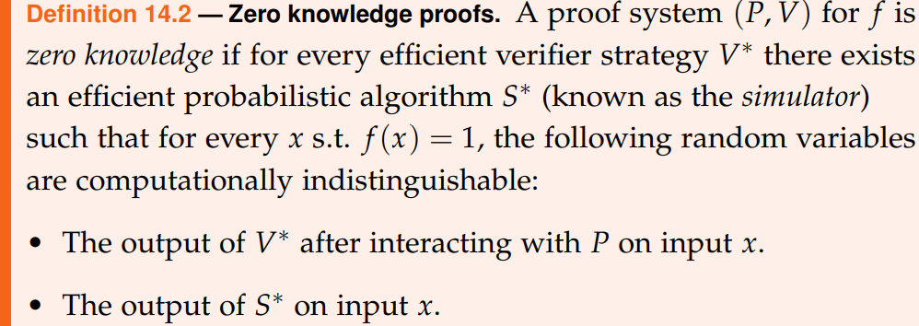
Zero Knowledge Proof
https://courses.csail.mit.edu/6.857/2018/files/L22-ZK-Boaz.pdf

Slide 22
Zero Knowledge Proof
three criteria to meet:
completeness
soundness
zero-knowledgeness

Slide 23
Criteria
Completeness
any true statement can be proven
Soundness
any false statement cannot be proven
Zero-Knowledgeness
any verifier does not learn anything
except that a statement is true
Notes:
https://www.cs.jhu.edu/~susan/600.641/scribes/lecture3.pdf

Slide 24
Interative&Prob Proof
Completeness – assume true stat
verifier will eventually be convinced
after k trials
Soundness – assume false stat
prover tries to convince verifier;
prover would have to guess which case
the verifier chooses with prob ½;
when repeated, the prob is negligible
that prover guesses correctly every time
Notes:
https://www.cs.jhu.edu/~susan/600.641/scribes/lecture3.pdf

Slide 25
Interative&Prob Proof
Zero-Knowledgeness – black box access
*ppt: probabilistic polynomial time
https://www.cs.jhu.edu/~susan/600.641/scribes/lecture3.pdf
Notes:
https://www.cs.jhu.edu/~susan/600.641/scribes/lecture3.pdf

Slide 26
Zero Knowledge Proof
examples

Slide 27
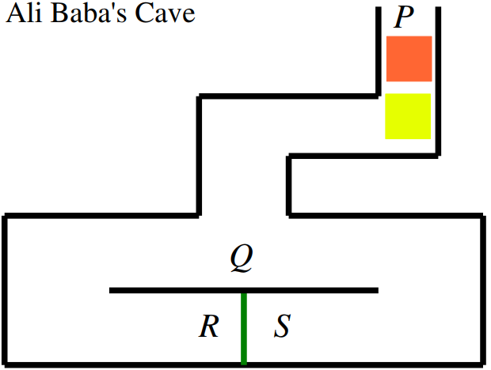
Ali Baba’s Cave
Prover tries to convince
verifier that he knows
the key to green door
Initially, both at entrance P
Q: a location
to observe exit from R or S
verifier
prover
Notes:
http://gauss.ececs.uc.edu/Courses/c472/lectures/PDF/zero.pdf

Slide 28
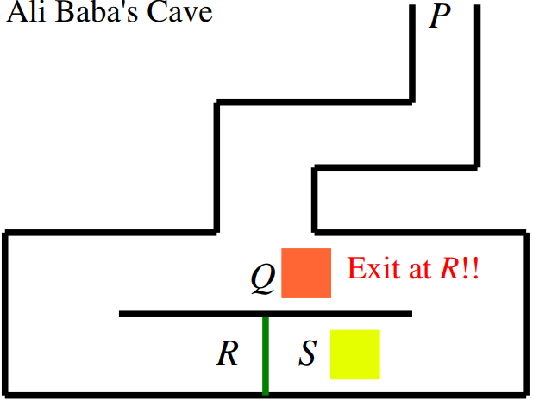
Ali Baba’s Cave
Prover moves to one side of door
Verifier moves to spot Q
Verifier commands
prover to exit at R
Without key,
verifier has
½ success probability
verifier
prover

Slide 29
Ali Baba’s Cave
Prover moves to one side of door
Verifier moves to spot Q
Verifier commands
prover to exit at R
Without key,
verifier has
½ success probability
Repeat many times,
verifier is confident of prover w/wo key
verifier
prover

Slide 30
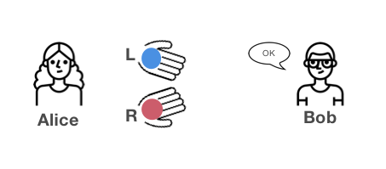
Two Color Balls
Bob tries to prove to Alice that he can
differentiate the colors of two balls
Alice shows color balls to Bob
Alice’s gonna switch them or not and
then show them to Bob again
Notes:
https://blog.goodaudience.com/understanding-zero-knowledge-proofs-through-simple-examples-df673f796d99

Slide 31
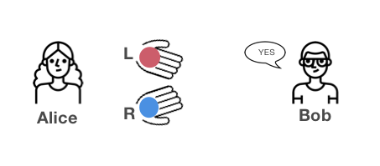
Two Color Balls
Bob tries to prove to Alice that he can
differentiate the colors of two balls
Alice switches balls and challenges Bob
Bob correctly answers
Notes:
https://blog.goodaudience.com/understanding-zero-knowledge-proofs-through-simple-examples-df673f796d99

Slide 32

Two Color Balls
Bob tries to prove to Alice that he can
differentiate the colors of two balls
Repeat many times,
Alice is convinced of Bob being capable
of differentiating colors
Notes:
https://blog.goodaudience.com/understanding-zero-knowledge-proofs-through-simple-examples-df673f796d99

Slide 33
Two Color Balls
Bob tries to prove to Alice that he can
differentiate the colors of two balls
Alice switches balls and challenges Bob
Bob correctly answers
Notes:
https://blog.goodaudience.com/understanding-zero-knowledge-proofs-through-simple-examples-df673f796d99

Slide 34
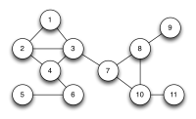
Frequency Allocation
Given a network of base stations with
three frequencies to use, no
overlapping base stations should be
assigned with the same frequency to
avoid interference.
Notes:
https://blog.cryptographyengineering.com/2014/11/27/zero-knowledge-proofs-illustrated-primer/

Slide 35
Frequency Allocation
Given a network of base stations with
three frequencies to use, no
overlapping base stations should be
assigned with the same frequency to
avoid interference.
3-color map?
Notes:
https://blog.cryptographyengineering.com/2014/11/27/zero-knowledge-proofs-illustrated-primer/

Slide 36
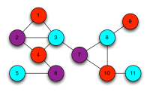
Frequency Allocation
Prover got a correct assignment
Prover tries to convince verifier without
revealing the solution

Slide 37
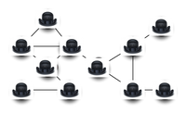
Frequency Allocation
Prover covers colored nodes with hats
Prover allows verifier to challenge two
adjacent nodes each time

Slide 38
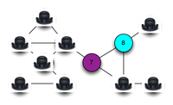
Frequency Allocation
Prover covers colored nodes with hats
Prover allows verifier to challenge two
adjacent nodes each time
If same color, proof fails

Slide 39
Frequency Allocation
Prover covers colored nodes with hats
Prover allows verifier to challenge two
adjacent nodes each time
If different colors, proof continues

Slide 40
Frequency Allocation
Prover covers colored nodes with hats
Prover allows verifier to challenge two
adjacent nodes each time
If different colors, proof continues
Repeat many times,

Slide 41
Frequency Allocation
Prover covers colored nodes with hats
Prover allows verifier to challenge two
adjacent nodes each time
If different colors, proof continues
Repeat many times, wait!

Slide 42
Frequency Allocation
Prover covers colored nodes with hats
Prover allows verifier to challenge two
adjacent nodes each time
If different colors, proof continues
Repeat many times, solution leakage!

Slide 43
Frequency Allocation
Prover covers colored nodes with hats
Prover allows verifier to challenge two
adjacent nodes each time
If different colors, proof continues
Substitute colors of each node

Slide 44
Frequency Allocation
Prover covers colored nodes with hats
Prover allows verifier to challenge two
adjacent nodes each time
P responds to verifier’s new challenges
Repeat many times, proof succeeds

Slide 45
Use Cases
Anonymous verifiable voting
Private exchange and settlement of
digital assets
Privacy on public blockchains
Zero-knowledge nuclear warhead
verification
…

Slide 46
Limitations
While reducing the probability of fake
proof, yet still possible
Computation intensive algorithm,
either a large number of interactions
between verifier and prover,
or requires much computation such
that it cannot be run on slow devices
not exchanging information,
susceptible to knowledge loss

Slide 47
?

Slide 48
Announcement
Project
Demo&Pre Due Date: April 16, 2019
e-Report Due date: April 23, 2019
05% | Presentation
15% | Demo
15% | Report

Slide 49
Readings
Explain Like I'm 5: Zero Knowledge Proof (Halloween Edition)
by Cossack Labs
Zero Knowledge Proofs
by Adam Smallhorn
Zero Knowledge Proofs
Zero Knowledge Proofs: An illustrated primer by Matthew Green

Slide 50
Thank You
be on the road
Notes:
Run your own race.

