Slide 1
Cryptanalysis
03
Kai Bu
kaibu@zju.edu.cn
http://list.zju.edu.cn/kaibu/netsec2020

Slide 2
Cryptanalysis?
Notes:
What’s cryptanalysis?
Dissect the word

Slide 3
Cryptanalysis
the science and art of
breaking ciphers

Slide 4
Cryptography
the science and art of
designing ciphers

Slide 5
Cryptology
Cryptography
Cryptanalysis
Notes:
Together they are the focus of cryptology (crypto)

Slide 6
Cryptology
Cryptography
Cryptanalysis
Notes:
Cryptography was covered in previous lectures;
Today we’ll be focusing on cryptanalysis.

Slide 7
Cryptology
Cryptography
Cryptanalysis
breaking ciphers
Notes:
Cryptography was covered in previous lectures;
Today we’ll be focusing on cryptanalysis.

Slide 8
Cryptology
Cryptography
Cryptanalysis
breaking ciphers
is hard
Notes:
Cryptography was covered in previous lectures;
Today we’ll be focusing on cryptanalysis.

Slide 9
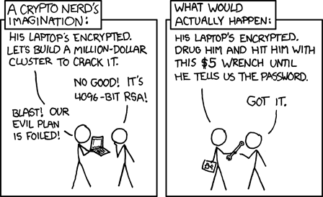
Cryptanalysis
Notes:
Mentioned this comic as an example
Kinda illustrate the goal of cryptanalysis

Slide 10
Cryptanalysis
2⁴⁰⁹⁶!
Notes:
2-to-4096 possibilities

Slide 11
Cryptanalysis
is hard
2⁴⁰⁹⁶!
Notes:
Obviously, cryptanalysis is hard

Slide 12
Cryptanalysis
is hard
2⁴⁰⁹⁶!
Notes:
Obviously, cryptanalysis is hard

Slide 13
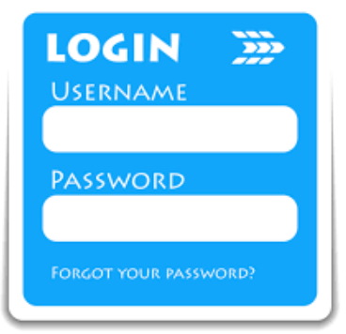
Cryptanalysis
password cracking
2⁴⁰⁹⁶!
Notes:
Consider it as your password of 4096 bits

Slide 14
Cryptanalysis
password cracking
2⁴⁰⁹⁶! – Try them all!
brute force attack

Slide 15

Cryptanalysis
password cracking
2⁴⁰⁹⁶! – Try them all!
brute force attack…meh

Slide 16
Cryptanalysis
password cracking
2⁴⁰⁹⁶! – Try only 3 of them!
strategic random guessing

Slide 17
Cryptanalysis
password cracking
2⁴⁰⁹⁶! – Try only 3 of them!
strategic random guessing?
Notes:
What strategies to use to boost attacking success rate?

Slide 18
Cryptanalysis
password cracking
2⁴⁰⁹⁶! – Try only 3 of them!
strategic random guessing: dictionary attack

Slide 19

nah…
Cryptanalysis
password cracking
2⁴⁰⁹⁶! – Try only 3 of them!
strategic random guessing: dictionary attack

Slide 20
Cryptanalysis
password cracking
2⁴⁰⁹⁶! – Try only 3 of commonly used ones
strategic random guessing: dictionary attack
Notes:
List of commonly used passwords
A dictionary attack is a method of breaking into a password-protected computer or server by systematically entering every word in a dictionary as a password. Adictionary attack can also be used in an attempt to find the key necessary to decrypt an encrypted message or document.

Slide 21
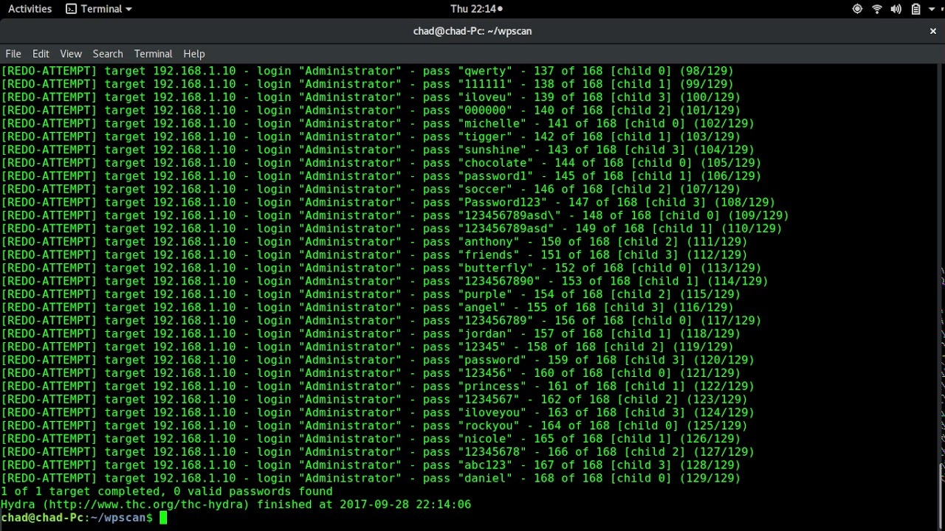
Cryptanalysis
password cracking
2⁴⁰⁹⁶! – Try only 3 of commonly used ones!
strategic random guessing: dictionary attack
Notes:
List of commonly used passwords
A dictionary attack is a method of breaking into a password-protected computer or server by systematically entering every word in a dictionary as a password. A dictionary attack can also be used in an attempt to find the key necessary to decrypt an encrypted message or document.

Slide 22
Cryptanalysis
other attacks? other strategies?

Slide 23
Cryptanalysis
warm up with simple one time pad

Slide 24
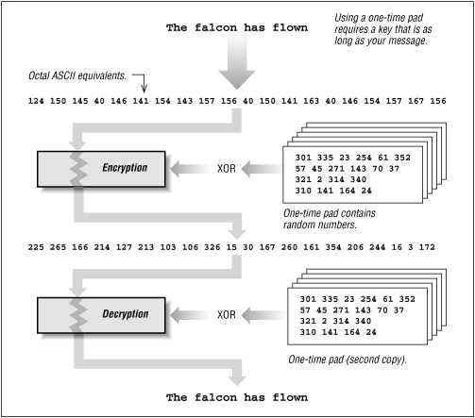
OTP: One-Time Pad
Notes:
Example OTP
Both encryption and decryption require XOR computation;

Slide 25
OTP: One-Time Pad
Key: a secret bit string s of length n
When Alice sends a message m of length n to Bob,
Alice generates ciphertext c as:
forall i = 1 to n: c_{i} = m_{i}⊕s_{i}
How to crack s?
Notes:
Formal definition

Slide 26
OTP: One-Time Pad
Key: a secret bit string s of length n
When Alice sends a message m of length n to Bob,
Alice generates ciphertext c as:
forall i = 1 to n: c_{i} = m_{i}⊕s_{i}
How to crack s?
given c?

Slide 27
OTP: One-Time Pad
Key: a secret bit string s of length n
When Alice sends a message m of length n to Bob,
Alice generates ciphertext c as:
forall i = 1 to n: c_{i} = m_{i}⊕s_{i}
How to crack s?
given c?
know m!

Slide 28
OTP: One-Time Pad
Key: a secret bit string s of length n
When Alice sends a message m of length n to Bob,
Alice generates ciphertext c as:
forall i = 1 to n: c_{i} = m_{i}⊕s_{i}
How to crack s?
given c?
exercise m=0
Notes:
Discussion: cases of knowing plaintext messages m;

Slide 29
OTP: One-Time Pad
Key: a secret bit string s of length n
When Alice sends a message m of length n to Bob,
Alice generates ciphertext c as:
forall i = 1 to n: c_{i} = m_{i}⊕s_{i}
How to crack s?
given c?
exercise m=0
not a trouble for OTP
as c is used only once
Notes:
Discussion: cases of knowing plaintext messages m;

Slide 30
OTP: One-Time Pad
Key: a secret bit string s of length n
When Alice sends a message m of length n to Bob,
Alice generates ciphertext c as:
forall i = 1 to n: c_{i} = m_{i}⊕s_{i}
How to crack s?
given c?
exercise m=0
Observations:
How to know plaintexts?
How to know OTP in use?

Slide 31
OTP: One-Time Pad
Key: a secret bit string s of length n
When Alice sends a message m of length n to Bob,
Alice generates ciphertext c as:
forall i = 1 to n: c_{i} = m_{i}⊕s_{i}
How to crack s?
given c?
exercise m=0
How to know plaintexts?
How to know OTP in use?
all security should reside in the key, not the alg
Notes:
Discussion: cases of knowing plaintext messages m;

Slide 32
Known-Plaintext Attack
Given
ciphertext and plaintext of the corresponding messages;
P₁, C₁ = E_{k}(P₁),…,P_{i}, C_{i}=E_{k}(P_{i})
Task
Find key k;
Or algorithm to infer P_{i+1} from C_{i+1}

Slide 33
Chosen-Plaintext Attack
Given
plaintext and ciphertext pairs;
can choose plaintext:
P₁, C₁ = E_{k}(P₁),…,P_{i}, C_{i}=E_{k}(P_{i})
with chosen P₁…P_{i};
Task
Find key k;
Or algorithm to infer P_{i+1} from C_{i+1}

Slide 34
Adaptive Chosen-Plaintext Attack
Given
plaintext and ciphertext pairs;
can choose plaintext;
can modify choice depending on results of previous encryption:
P₁, C₁ = E_{k}(P₁),…,P_{i}, C_{i}=E_{k}(P_{i})
Task
Find key k;
Or algorithm to infer P_{i+1} from C_{i+1}

Slide 35
Chosen-Ciphertext Attack
Given
ciphertext and plaintext pairs;
can choose ciphertext;
C₁, P₁ = D_{k}(C₁),…,C_{i}, P_{i}=D_{k}(C_{i})
Task
Find key k;
Or algorithm to infer P_{i+1} from C_{i+1}

Slide 36
emm, you can’t always get what you want

Slide 37
Ciphertext-Only Attack
Known-Ciphertext Attack
The attacker has access only to a set of ciphertexts
The attack is completely successful if the corresponding plaintexts or the key can be deduced
Notes:
In cryptography, a ciphertext-only attack (COA) or known ciphertext attack is an attack model for cryptanalysis where the attacker is assumed to have access onlyto a set of ciphertexts. The attack is completely successful if the corresponding plaintexts can be deduced (extracted) or, even better, the key.

Slide 38
do I have to crack the key?

Slide 39





secure communication against adversaries
hack to secure
zzs
???
zjs
txy
meet at lab
meet at lab
asdfghjkl
Notes:
Cryptanalysis is the study of analyzing information systems in order to study the hidden aspects of the systems.
Cryptanalysis is used to breach cryptographic security systems and gain access to the contents of encrypted messages, even if the cryptographic key is unknown.
For example, two entities secretly meet up at lab;
Every time using the same key, and thus get the same ciphertext;
Initially (at the first several rounds), the adversary may not know what the ciphertext means;

Slide 40
secure communication against adversaries
hack to secure
zzs
: see both in lab
: each time a-l
zjs
txy
meet at lab
meet at lab
asdfghjkl
Notes:
However, by coincidences, the adversary notices that every time after two entities say “a-l”, they’ll both appear at the lab;
The adversary then speculates that the ciphertext “a-l” from entity A to entity B syncs their meetup in lab;

Slide 41
Replay Attack
secure communication against adversaries
hack to secure
zzs
: Replay *&#!%$
zjs
txy
asdfghjkl
meet at lab
Notes:
Replay attack:
Based on that observation, the adversary can simply replay the same message/ciphertext “a-l” to entity B,
Making B believes that the message is from entity A, and goes to the lab;

Slide 42
Replay Attack
secure communication against adversaries
how to defend?
zzs
: Replay *&#!%$
zjs
txy
asdfghjkl
meet at lab
Notes:
How to secure the communication against the replay attack?
Discussion

Slide 43
Replay Attack
Defense: Limit Message Freshness
Timestamp
One-time session key

Slide 44
do I have to crack the key?

Slide 45
can I own the key?

Slide 46
secure communication against adversaries
shared secret key
zzs
zjs
txy
hello, txh

Slide 47
what if the attacker hijacks key-channel?
shared secret key
zzs
zjs
txy
hello, txh

Slide 48
Man-In-The-Middle Attack
what if the attacker hijacks key-channel?
shared secret key
hijacked
key1
key2
zzs
zjs
txy
hello, txh

Slide 49
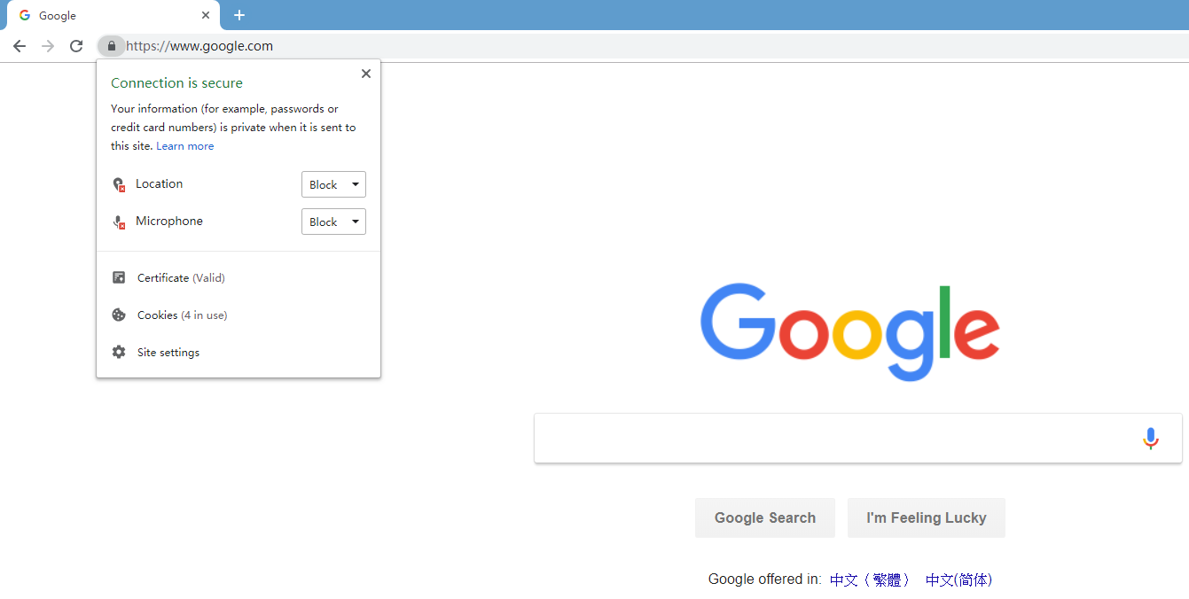
Man-In-The-Middle Attack
MITM Defense:
Guarantee Connection Authenticity

Slide 50
again, do I have to crack the key?

Slide 51
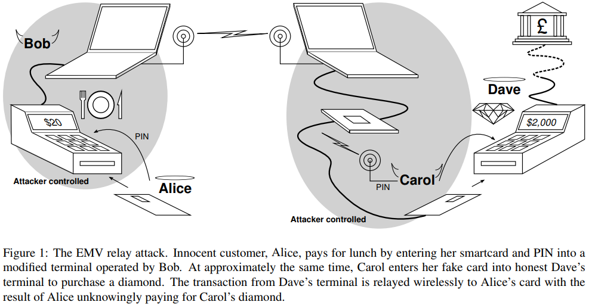

Slide 52
Relay Attack

Slide 53
Relay Attack
how to defend?

Slide 54
Relay Attack
Defense: Distance Bounding?

Slide 55
Relay Attack
Defense: Distance Bounding
is response time impractically long?
RTT = 2*distance/velocity

Slide 56
Relay Attack
Defense: Distance Bounding
is response time impractically long?
RTT = 2*distance/velocity
additional
transmission
delay

Slide 57
finally, can I crack the key w/o tangling w/ messages?

Slide 58
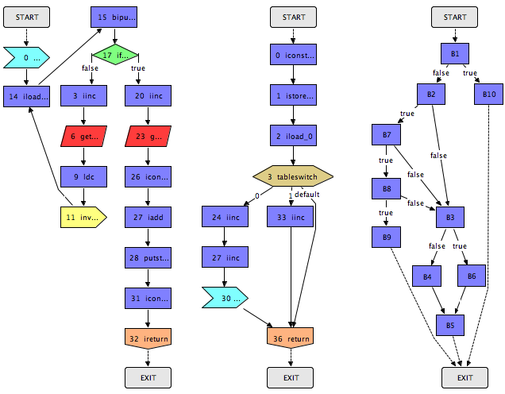
Program: Control Flow Graph

Slide 59
Program: Control Flow Graph
build CFG over
memory access patterns

Slide 60
Program: Control Flow Graph
keybit=0
keybit=1
build CFG over
memory access patterns

Slide 61
Side Channel Attack
keybit=0
keybit=1
use CFG to
infer key bits

Slide 62
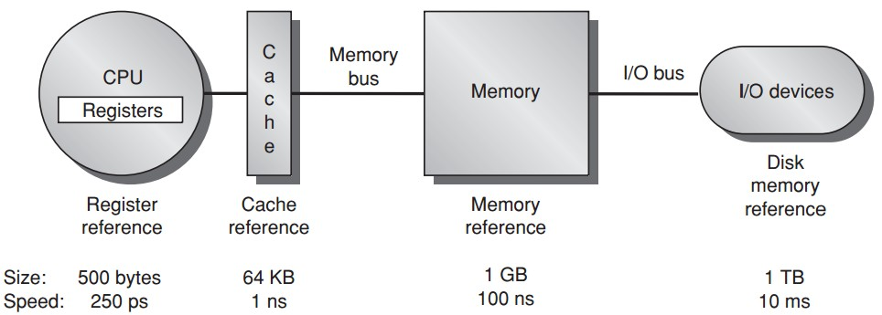
access patterns over cache
Notes:
Cpu first enter cache

Slide 63
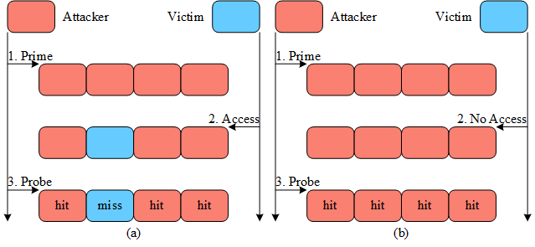
Prime+Probe Attack

Slide 64
Prime+Probe Attack
cache conflicts in the same set

Slide 65
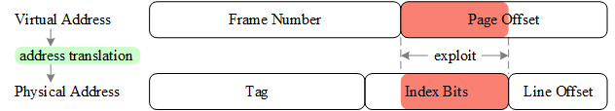
Eviction Set
virtual addresses that likely
map to the same cache set with
a victim physical address
specify set index,
overlapped in vir&phy addr;
Notes:
For sampling initial candidate
addresses, the attacker exploits the deterministic memoryto-
cache mapping strategy on modern processors. That is,
the index bits of a physical address is directly used as the
index of the cache set that the address maps to. What makes
it exploitable is that part or even all of the index bits can be
overlapped by a virtual address and its corresponding physical
address. As shown in Figure 2, a virtual address consists
of a frame number and a page offset while its corresponding
physical address consists of a tag, index bits, and a line offset.
Using system configuration parameters, it is straightforward
to calculate the length of each field. The length difference of
the page offset and the line offset decides how many index
bits are shared by a virtual address and its corresponding
physical address. The longer the page offset the more likely
it facilitates inferring which cache set a virtual address can finally
access. In particular, microarchitecture with large pages
is more vulnerable to this exploit.

Slide 66
how to de-conflict?

Slide 67
how to de-conflict?
random replacement:
upon a cache miss, randomly select a cache line to replace;
an address unnecessarily maps to the same cache line each time;

Slide 68
how to de-conflict?
random replacement: slow search, L1 cache only
upon a cache miss, randomly select a cache line to replace;
an address unnecessarily maps to the same cache line each time;

Slide 69
how to de-conflict?
dynamic remapping:
use implicit mapping to lengthen the time for finding;
conduct dynamic remapping to change mapping strategy for defeating the attacker’s accumulated inference;

Slide 70
how to de-conflict?
dynamic remapping: overhead vs security
use implicit mapping to lengthen the time for finding;
conduct dynamic remapping to change mapping strategy for defeating the attacker’s accumulated inference;

Slide 71
is de-conflicting cache sufficient?

Slide 72
access patterns over memory
Notes:
Cpu first enter cache

Slide 73
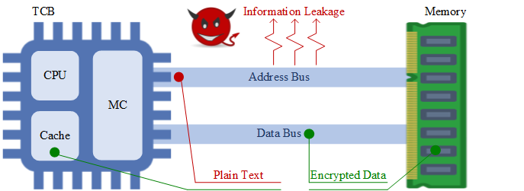
Plaintext Memory Address

Slide 74
how to obfuscate?

Slide 75
how to obfuscate?
ORAM: Oblivious RAM
hide real accesses among dummy accesses;

Slide 76
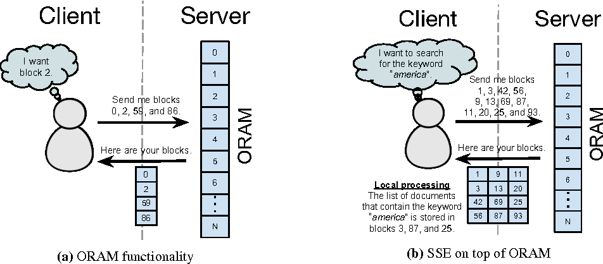
ORAM

Slide 77
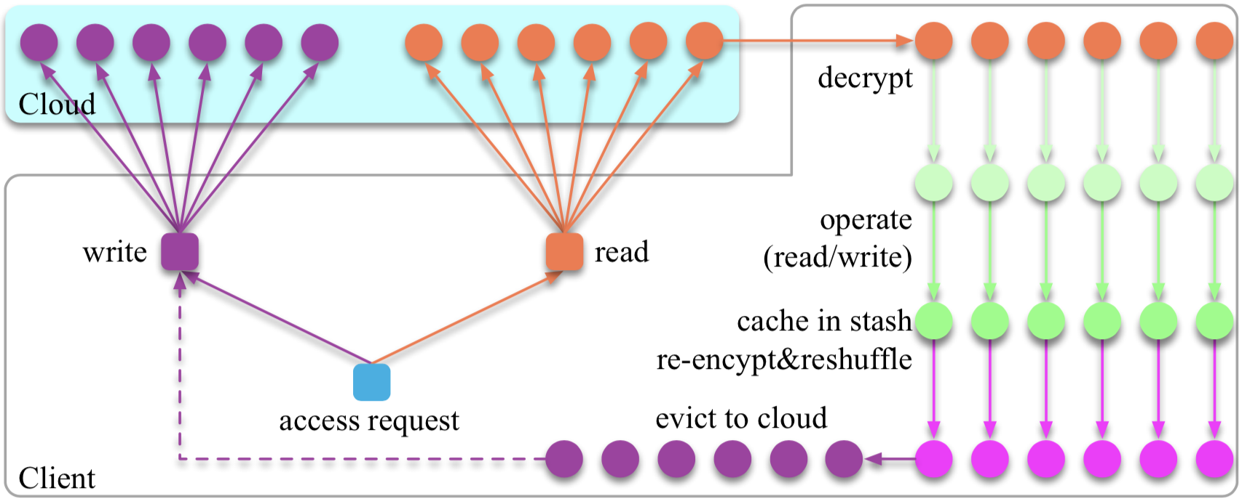
ORAM
the data life cycle in a typical ORAM framework

Slide 78
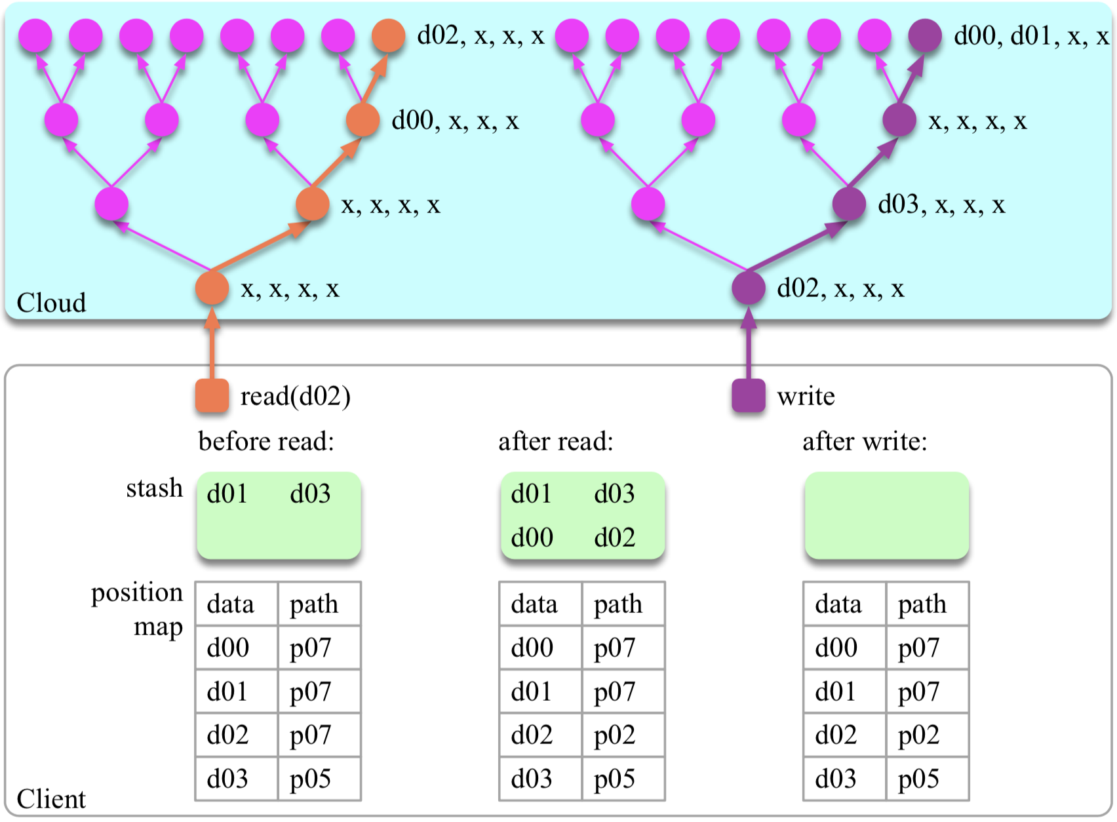
Path
ORAM

Slide 79
Path
ORAM
O(log₂n) blocks to secure obfuscation

Slide 80
Path
ORAM
too high an overhead for architecture!

Slide 81
Path
ORAM
tailored more often for network

Slide 82
Review
Cryptanalysis Terminology
Replay Attack
MITM Attack
Relay Attack
Side Channel Attack

Slide 83
?

Slide 84
emm, project…

Slide 85
Announcement
Project Proposal: 05%
2020.03.03, 08:00 – 11:25
~ 10 min / group
Requirements | Grading
Topic? | C
Why important? | C+
Existing solutions? | B
Limitations? | A
Your solution? | A+

Slide 86
Thank You
be on the road
Notes:
Run your own race.

Slide 87
Reading
Cryptanalysis by Sourav Mukhopadhyay
Cryptanalysis Examples

