Slide 1
Blockchain
04
Kai Bu
kaibu@zju.edu.cn
http://list.zju.edu.cn/kaibu/netsec2020

Slide 2
Blockchain?
Notes:
What’s blockchain, although it’s a super hot topic nowadays, it may still be unfamiliar to someone,
This is very so years ago,

Slide 3

Bitcoin
Notes:
However, even if you have never heard of blockchain, you probably have heard of Bitcoin,

Slide 4
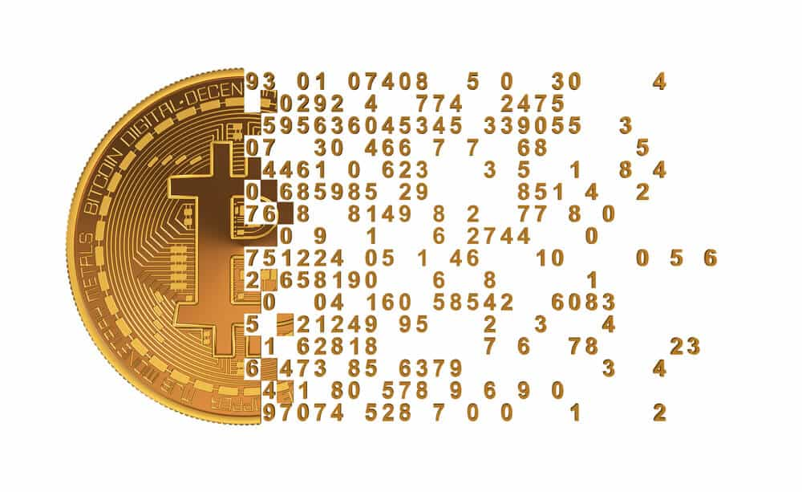
Bitcoin
a cryptocurrency;
a form of electronic cash;
a decentralized digital currency
w/o central bank or single admin
Notes:
https://en.wikipedia.org/wiki/Bitcoin
is a cryptocurrency, a form of electronic cash. It is a decentralized digital currency without a central bank or single administrator

Slide 5
Bitcoin
can be sent from user to user
on peer-to-peer bitcoin network
w/o the need for intermediaries
Notes:
can be sent from user to user on the peer-to-peer bitcoin network without the need for intermediaries

Slide 6
Bitcoin
build it from scratch
Michael Nielsen http://www.michaelnielsen.org/ddi/how-the-bitcoin-protocol-actually-works/
Notes:
Build it from scratch

Slide 7
Bitcoin
possession
Notes:
How to prove the possession of a bitcoin?

Slide 8
Bitcoin
possession
transaction = I, Alice, am giving Bob one bitcoin.
is it really from Alice?

Slide 9
Bitcoin
possession
transaction = I, Alice, am giving Bob one bitcoin.
digital signature
transaction || signature

Slide 10
Bitcoin
possession
transaction = I, Alice, am giving Bob one bitcoin.
digital signature using Alice’s private key
transaction || Enc_{priv}(hash(transaction))

Slide 11
Bitcoin
possession
transaction = I, Alice, am giving Bob one bitcoin.
digital sig verification using Alice’s public key
transaction || Enc_{priv}(hash(transaction))
hash( ) == Dec_{pub}( ) ?

Slide 12
Bitcoin
uniqueness
Notes:
Against replay attack:
For digital signature, what if it’s replayed, and one more bitcoin transferred from Alice to Bob?

Slide 13
Bitcoin
uniqueness
transaction = I, Alice, am giving Bob one bitcoin.
transaction = I, Alice, am giving Bob one bitcoin.
is Alice paying two bitcoins?
or is it a replay attack?
Notes:
Against replay attack:
For digital signature, what if it’s replayed, and one more bitcoin transferred from Alice to Bob?

Slide 14
Bitcoin
uniqueness
transaction = I, Alice, am giving Bob one bitcoin.
transaction = I, Alice, am giving Bob one bitcoin.
serial number
transaction = I, Alice, am giving Bob bitcoin sn1.
transaction = I, Alice, am giving Bob bitcoin sn2.
Notes:
Assign a serial number to each bitcoin for uniqueness

Slide 15
Bitcoin
transaction = I, Alice, am giving Bob bitcoin sn1.
transaction = I, Alice, am giving Bob bitcoin sn2.
any caveats?
Notes:
Now, with bitcoin designed in this way?
Any questions?

Slide 16
Bitcoin
transaction = I, Alice, am giving Bob bitcoin sn1.
transaction = I, Alice, am giving Charlie bitcoin sn1.
any caveats:
is sn1 really belonging to Alice?
who issues serial numbers?
what if Alice pays sn1 to Charlie as well?

Slide 17
Bitcoin
transaction = I, Alice, am giving Bob bitcoin sn1.
transaction = I, Alice, am giving Charlie bitcoin sn1.
any caveats:
is sn1 really belonging to Alice?
who issues serial numbers?
what if Alice pays sn1 to Charlie as well?

Slide 18
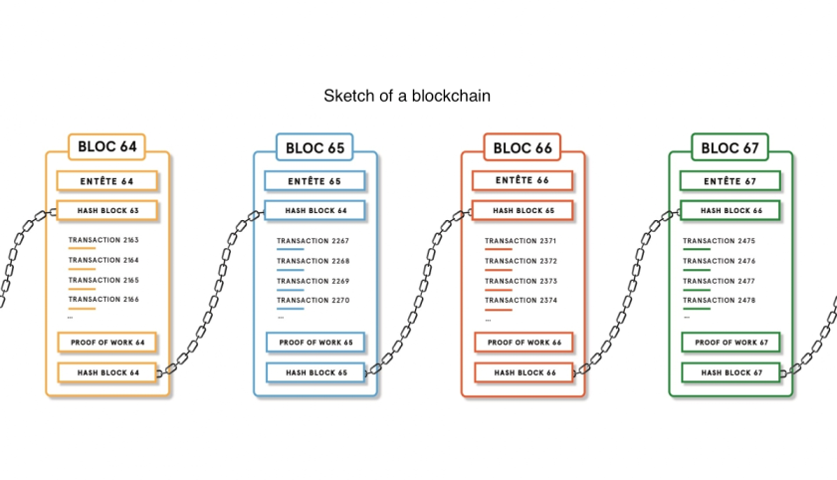
Bitcoin
ledger = blockchain
everyone keeps complete record of which bitcoin belongs to which person,
showing all bitcoin transactions;
make everyone collectively the bank.
Notes:
A block contains one or more transactions

Slide 19

Bitcoin
ledger = blockchain
follow transaction order,
a block points to its previous transaction’s block
Notes:
A block contains one or more transactions

Slide 20
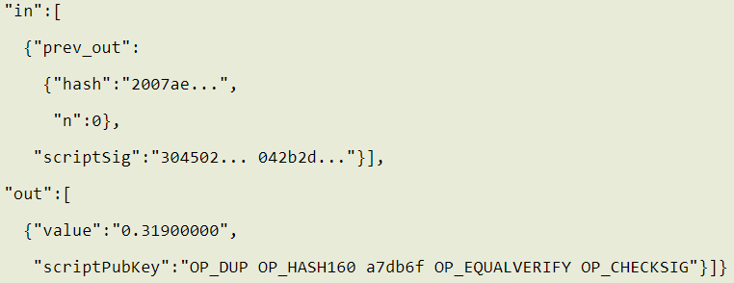
Bitcoin
ledger = blockchain
check output in that block
signature
input: sender’s pub key
output: recipient’s pub key
Notes:
A block contains one or more transactions

Slide 21
Bitcoin
transaction = I, Alice, am giving Bob bitcoin sn1.
transaction = I, Alice, am giving Charlie bitcoin sn1.
any caveats:
is sn1 really belonging to Alice?
who issues serial numbers?
what if Alice pays sn1 to Charlie as well?
Notes:
Using the ledger/blockchain,
After receiving this transaction request, Bob searches the blockchain and determines that sn1 belongs to Alice.
However, who issues the serial numbers in the first place?

Slide 22
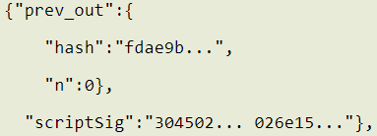
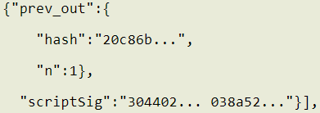
Bitcoin
hash of a block
maybe more transactions in a block;
specify the exact transaction for use;

Slide 23
Bitcoin
transaction = I, Alice, am giving Bob bitcoin sn1.
transaction = I, Alice, am giving Charlie bitcoin sn1.
any caveats:
is sn1 really belonging to Alice?
who issues serial numbers?
what if Alice pays sn1 to Charlie as well?

Slide 24
Bitcoin
double spending
Notes:
This issues is usually called double spending
Several cases for possible double spending attack

Slide 25
Bitcoin
double spending
what if Alice first pays sn1 to Bob,
and after a while, pays sn1 to Charlie?
Notes:
First case

Slide 26
Bitcoin
double spending
what if Alice first pays sn1 to Bob,
and after a while, pays sn1 to Charlie?
sn1 appears in two [in] fields in prev blocks!
Notes:
First case

Slide 27
Bitcoin
double spending
what if Alice simultaneously pays sn1
to Bob and Charlie?
Notes:
First case

Slide 28
Bitcoin
double spending
what if Alice simultaneously pays sn1
to Bob and Charlie?
some users validate Alice-Bob;
some Alice-Charlie
Notes:
First case

Slide 29
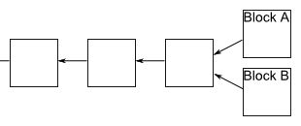
Bitcoin
double spending
what if Alice simultaneously pays sn1
to Bob and Charlie?
some users validate Alice-Bob;
some Alice-Charlie:
fork!
Notes:
Forks emerge
Which one to follow? How to handle?

Slide 30
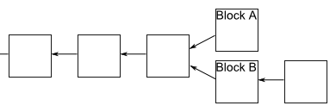
Bitcoin
double spending
what if Alice simultaneously pays sn1
to Bob and Charlie?
follow the longest fork
Notes:
Forks emerge
Which one to follow? How to handle?

Slide 31
Bitcoin
double spending
what if Alice simultaneously pays sn1
to Bob and Charlie?
follow the longest fork;
accept the transaction
until at least 5 more blocks follow it;
Notes:
Forks emerge
Which one to follow? How to handle?

Slide 32
Bitcoin
double spending
what if Alice simultaneously puts sn1 related
Alice-Bob and Alice-Charlie in Block B?
Notes:
Forks emerge
Which one to follow? How to handle?

Slide 33
Bitcoin
double spending
what if Alice simultaneously puts sn1 related
Alice-Bob and Alice-Charlie in Block B?
hehe, easily spotted!
Notes:
Forks emerge
Which one to follow? How to handle?

Slide 34
Bitcoin
double spending
now what?

Slide 35


Bitcoin
double spending
what if Alice pays sn1 to Bob, wait till accepted;
then repays sn1 to Charlie, compute another
longer fork?
catch up
hhh
Bob

Slide 36
Bitcoin
double spending
what if Alice pays sn1 to Bob, wait till accepted;
then repays sn1 to Charlie, compute another
longer fork?
make it hard to catch up
!!!
Bob
Notes:
How to make it hard to catch up

Slide 37
Bitcoin
proof-of-work
make validating a block computationally costly;
require enormous computation power to forge;
make it hard to catch up
!!!
Bob
Notes:
How to make it hard to catch up

Slide 38
Bitcoin
proof-of-work
example:
find a nonce x,
such that h(msg,x) leads with 10 zeros (hex).
how hard to find x?
Notes:
Hexadecimal

Slide 39
Bitcoin
proof-of-work
example:
find a nonce x,
such that h(msg,x) leads with 10 zeros (hex).
a digit with prob 1/16 being zero
Notes:
Hexadecimal

Slide 40
Bitcoin
proof-of-work
example:
find a nonce x,
such that h(msg,x) leads with 10 zeros (hex).
prob 1/16¹⁰ for all 10 zeros
Notes:
Hexadecimal

Slide 41
Bitcoin
proof-of-work
example:
find a nonce x,
such that h(msg,x) leads with 10 zeros (hex).
no. of tries for finding a 10-zero leading string:
1/(1/16¹⁰) = 16¹⁰ = 10¹²
Notes:
Hexadecimal

Slide 42
Bitcoin
proof-of-work
find a nonce x,
such that h(blockheader,x) <= target.
Notes:
Hexadecimal

Slide 43
Bitcoin
proof-of-work
find a nonce x,
such that h(blockheader,x) <= target.
how much comp power should Alice have to win?
make it hard to catch up
!!!
Bob
Notes:
Hexadecimal

Slide 44
Bitcoin
51% attack
(a group of) attacker controls more than 50%
of the network’s computing power;
how much comp power should Alice have to win?
make it hard to catch up
!!!
Bob
Notes:
https://www.mycryptopedia.com/51-percent-attack-explained/

Slide 45
Bitcoin
wow, incredible!
Notes:
Hexadecimal

Slide 46
Bitcoin
just too much power…
Notes:
Hexadecimal

Slide 47
Bitcoin
just too much power…
for pow computation
Notes:
Hexadecimal

Slide 48
Bitcoin
another design direction
Notes:
Hexadecimal

Slide 49
Bitcoin
proof of stake
Notes:
Proof of stake (PoS) is a type of algorithm by which a cryptocurrency blockchain network aims to achieve distributed consensus.
In PoS-based cryptocurrencies the creator of the next block is chosen via various combinations of random selection and wealth or age (i.e., the stake).

Slide 50
Bitcoin
every participant joins blockchain
by paying stake

Slide 51
Bitcoin
when choosing creator of a block,
more stake with high probability

Slide 52
Bitcoin
creator gets stake reward
if created block passes verification

Slide 53
Bitcoin
creator gets stake reward
if created block passes verification;
otherwise, penalty

Slide 54
Bitcoin
proof of stake:
only one creator per block;
no huge computation waste.

Slide 55
?

Slide 56
Bitcoin
so far so… simple

Slide 57
Bitcoin
welcome to the hardcores!
https://www.apriorit.com/dev-blog/578-blockchain-attack-vectors
Notes:
https://www.apriorit.com/dev-blog/578-blockchain-attack-vectors

Slide 58
Bitcoin
selfish mining attack
Attacker increases the share of the reward by not broadcasting mined blocks to the network for some time and then releasing several blocks at once, making other miners lose their blocks.
Notes:
A block contains one or more transactions

Slide 59
Bitcoin
selfish mining attack
Attacker increases the share of the reward by not broadcasting mined blocks to the network for some time and then releasing several blocks at once, making other miners lose their blocks.
block withholding attack
Notes:
A block contains one or more transactions

Slide 60
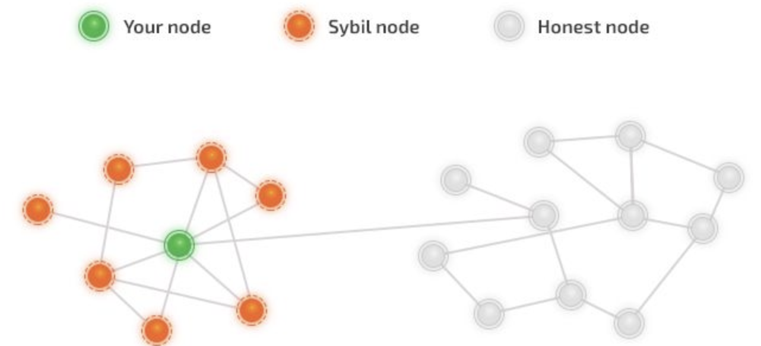
Bitcoin
sybil attack
Hacker takes control of multiple nodes
Victim is surrounded by fake nodes that close up all their transactions.

Slide 61
Bitcoin
eclipse attack
Hacker controls a large number of IP addresses or a distributed botnet.
Victim directs all outgoing connections to the IP addresses controlled by the attacker
Notes:
A block contains one or more transactions

Slide 62
Bitcoin
routing attack
https://vanbever.eu/pdfs/vanbever_bitcoin_routing_attacks_slides_epfl_2017.pdf
Notes:
More generic routing attacks

Slide 63
Discussions
Is Bitcoin purely decentralized?
Is Bitcoin truly anonymous?
Is Bitcoin really eternal?

Slide 64
Readings
How the Bitcoin Protocol Actually Works by Michael Nielsen
Bitcoin: A Peer-to-Peer Electronic Cash System by Satoshi Nakamoto
51% Attack Explained by Bisade Asolo
Bitcoin and Cryptocurrency Technologies Online Course

Slide 65
Thank You
be on the road
Notes:
Run your own race.

