Slide 1
Secure Connection
05
Kai Bu
kaibu@zju.edu.cn
http://list.zju.edu.cn/kaibu/netsec2020
Notes:
The topic to be covered this week is secure connection.
Apparently, the goal is build a secure channel between two communication entities
such that data transmission on this secure channel keeps private from attackers.

Slide 2




insecure at first
Insecure at first
zzs
zjs
txy
hello, txy
Notes:
Without such a secure channel,
Whenever you send a message to the other, the message has to stay in a plaintext form, which can be easily eavesdropped by the attacker.

Slide 3

crypto as savior
secure communication against adversaries
shared secret key
zzs
???
zjs
txy
hello, txy
hello, txy
asdfghjkl
enc
dec

Slide 4
insecure still…
secure communication against adversaries
shared secret key
zzs
!!!
zjs
txy
Notes:
But the question is, we are given with only an insecure channel;
When we share the secret key through this channel, the attacker can still overhear it;

Slide 5
insecure still…
secure communication against adversaries
shared secret key
zzs
!!!
hello, txy
zjs
dec
txy
hello, txy
hello, txy
asdfghjkl
enc
dec
Notes:
With the overheard secret key, the attacker can still crack subsequent messages even though they might be encrypted.

Slide 6
insecure still…
secure communication against adversaries
shared secret key how to securely share it?
zzs
!!!
hello, txy
zjs
dec
txy
hello, txy
hello, txy
asdfghjkl
enc
dec
Notes:
Now the question becomes, how to securely share the secret key?

Slide 7
public key cryptography
secure communication against adversaries
zzs
zjs
txy
Notes:
Remember that now we can turn to public key cryptography

Slide 8


public key cryptography
secure communication against adversaries
pub
priv
zzs
zjs
txy
Notes:
In this case, the receiver owns a pair of public key and private key

Slide 9
public key cryptography
secure communication against adversaries
pub
priv
zzs
zjs
txy
Notes:
Since public key is allowed to be known by everyone by design,
The receiver can simply send it to the sender over the insecure channel without any concern.

Slide 10
public key cryptography
secure communication against adversaries
shared secret key protected from attacker
pub
priv
zzs
zjs
txy
asdfghjkl
enc
dec

Slide 11
symmetric crypto it is
secure communication against adversaries
shared secret key protected from attacker
zzs
???
zjs
txy
hello, txy
hello, txy
asdfghjkl
enc
dec

Slide 12
wow

Slide 13
private communication
over public internet
Notes:
protect their data during transfer by creating a uniquely encrypted channel for private communications over the public Internet.

Slide 14
Secure Connection
private communication
over public internet
Notes:
This is exactly what secure connection assures us.

Slide 15
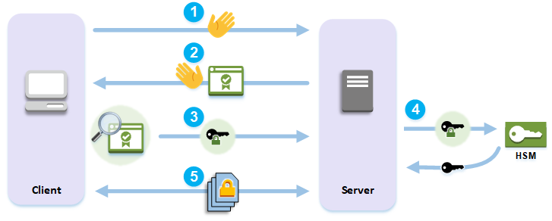
Secure Connection
Protocol: SSL/TLS
Application: HTTPS
Notes:
https://docs.aws.amazon.com/cloudhsm/latest/userguide/ssl-offload-overview.html
1. The client sends a hello message to the server.
2. The server responds with a hello message and sends the server's certificate.
3. The client performs the following actions:
Verifies that the SSL/TLS server certificate is signed by a root certificate that the client trusts.
Extracts the public key from the server certificate.
Generates a premaster secret and encrypts it with the server's public key.
Sends the encrypted premaster secret to the server.
4. To decrypt the client's premaster secret, the server sends it to the HSM. The HSM uses the private key in the HSM to decrypt the premaster secret and then it sends the premaster secret to the server. Independently, the client and server each use the premaster secret and some information from the hello messages to calculate a master secret.
5. The handshake process ends. For the rest of the session, all messages sent between the client and the server are encrypted with derivatives of the master secret.

Slide 16
Secure Connection
The client sends a hello message to the server
Protocol: SSL/TLS
Application: HTTPS
Notes:
https://docs.aws.amazon.com/cloudhsm/latest/userguide/ssl-offload-overview.html
1. The client sends a hello message to the server.
2. The server responds with a hello message and sends the server's certificate.
3. The client performs the following actions:
Verifies that the SSL/TLS server certificate is signed by a root certificate that the client trusts.
Extracts the public key from the server certificate.
Generates a premaster secret and encrypts it with the server's public key.
Sends the encrypted premaster secret to the server.
4. To decrypt the client's premaster secret, the server sends it to the HSM. The HSM uses the private key in the HSM to decrypt the premaster secret and then it sends the premaster secret to the server. Independently, the client and server each use the premaster secret and some information from the hello messages to calculate a master secret.
5. The handshake process ends. For the rest of the session, all messages sent between the client and the server are encrypted with derivatives of the master secret.

Slide 17
Secure Connection
The server responds with a hello message and sends its certificate
Protocol: SSL/TLS
Application: HTTPS
Notes:
https://docs.aws.amazon.com/cloudhsm/latest/userguide/ssl-offload-overview.html
1. The client sends a hello message to the server.
2. The server responds with a hello message and sends the server's certificate.
3. The client performs the following actions:
Verifies that the SSL/TLS server certificate is signed by a root certificate that the client trusts.
Extracts the public key from the server certificate.
Generates a premaster secret and encrypts it with the server's public key.
Sends the encrypted premaster secret to the server.
4. To decrypt the client's premaster secret, the server sends it to the HSM. The HSM uses the private key in the HSM to decrypt the premaster secret and then it sends the premaster secret to the server. Independently, the client and server each use the premaster secret and some information from the hello messages to calculate a master secret.
5. The handshake process ends. For the rest of the session, all messages sent between the client and the server are encrypted with derivatives of the master secret.

Slide 18
Secure Connection
The client:
verifies certificate;
extracts server’s pub key;
generates a premaster secret;
encrypts it using server’s pub key and sends it to server;
Protocol: SSL/TLS
Application: HTTPS
Notes:
https://docs.aws.amazon.com/cloudhsm/latest/userguide/ssl-offload-overview.html
1. The client sends a hello message to the server.
2. The server responds with a hello message and sends the server's certificate.
3. The client performs the following actions:
Verifies that the SSL/TLS server certificate is signed by a root certificate that the client trusts.
Extracts the public key from the server certificate.
Generates a premaster secret and encrypts it with the server's public key.
Sends the encrypted premaster secret to the server.
4. To decrypt the client's premaster secret, the server sends it to the HSM. The HSM uses the private key in the HSM to decrypt the premaster secret and then it sends the premaster secret to the server. Independently, the client and server each use the premaster secret and some information from the hello messages to calculate a master secret.
5. The handshake process ends. For the rest of the session, all messages sent between the client and the server are encrypted with derivatives of the master secret.

Slide 19
Secure Connection
The server:
sends msg-3 to hardware security module (HSM);
HSM decrypts premaster secret and sends it to server;
The server and The client:
calculate a master secret using premaster secret and some other info in hello msg;
Protocol: SSL/TLS
Application: HTTPS
Notes:
https://docs.aws.amazon.com/cloudhsm/latest/userguide/ssl-offload-overview.html
1. The client sends a hello message to the server.
2. The server responds with a hello message and sends the server's certificate.
3. The client performs the following actions:
Verifies that the SSL/TLS server certificate is signed by a root certificate that the client trusts.
Extracts the public key from the server certificate.
Generates a premaster secret and encrypts it with the server's public key.
Sends the encrypted premaster secret to the server.
4. To decrypt the client's premaster secret, the server sends it to the hardware security module HSM. The HSM uses the private key in the HSM to decrypt the premaster secret and then it sends the premaster secret to the server. Independently, the client and server each use the premaster secret and some information from the hello messages to calculate a master secret.
5. The handshake process ends. For the rest of the session, all messages sent between the client and the server are encrypted with derivatives of the master secret.

Slide 20
Secure Connection
handshake process ends;
all messages between server and client are encrypted with derivatives of the master secret;
Protocol: SSL/TLS
Application: HTTPS
Notes:
https://docs.aws.amazon.com/cloudhsm/latest/userguide/ssl-offload-overview.html
1. The client sends a hello message to the server.
2. The server responds with a hello message and sends the server's certificate.
3. The client performs the following actions:
Verifies that the SSL/TLS server certificate is signed by a root certificate that the client trusts.
Extracts the public key from the server certificate.
Generates a premaster secret and encrypts it with the server's public key.
Sends the encrypted premaster secret to the server.
4. To decrypt the client's premaster secret, the server sends it to the hardware security module HSM. The HSM uses the private key in the HSM to decrypt the premaster secret and then it sends the premaster secret to the server. Independently, the client and server each use the premaster secret and some information from the hello messages to calculate a master secret.
5. The handshake process ends. For the rest of the session, all messages sent between the client and the server are encrypted with derivatives of the master secret.

Slide 21
HTTPS
Notes:
Use HTTPS as an example to walk through SSL/TLS principles

Slide 22
HTTPS
hypertext transfer protocol secure
Notes:
Use HTTPS as an example to walk through SSL/TLS principles

Slide 23
Threats
Eavesdropping
Manipulation
Impersonation
Notes:
SSL stands for

Slide 24
Solutions
Eavesdropping
Encryption
Manipulation
Integrity (MAC)
Impersonation
Signature
Notes:
MAC: message authentication code

Slide 25
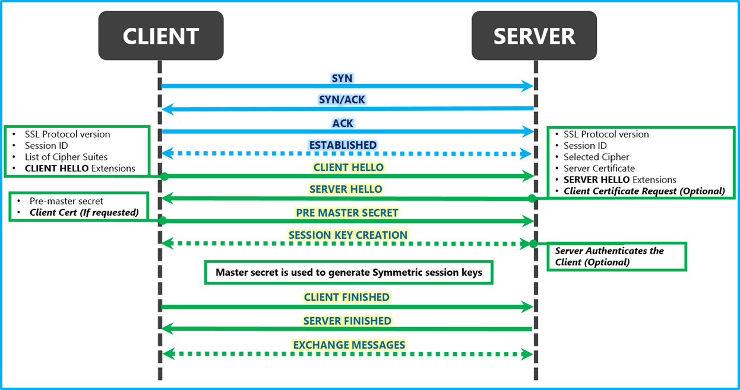
Protocol
FIN
FIN, ACK
ACK

Slide 26
Protocol
TCP
handshake
TLS
handshake
connection
termination
FIN
FIN, ACK
ACK

Slide 27

Protocol
TCP
handshake
TLS
handshake
connection
termination
FIN
FIN, ACK
ACK

Slide 28
HTTPS
step by step
Notes:
Use HTTPS as an example to walk through SSL/TLS principles

Slide 29
HTTPS
step 1: connection request

Slide 30
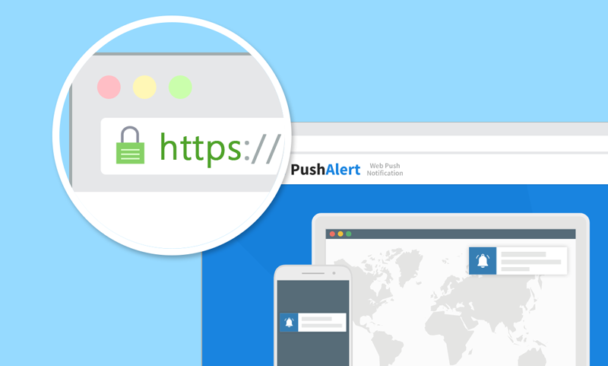
https://www.votefor.com
asdf
Notes:
User types a link in the address bar

Slide 31
https://www.votefor.com
where is votefor?
asdf
Notes:
User types a link in the address bar

Slide 32
https://www.votefor.com
what’s votefor’s IP?
asdf
Notes:
User types a link in the address bar

Slide 33
https://www.votefor.com
votefor → IP
DNS: Domain Name System
asdf
Notes:
User types a link in the address bar

Slide 34
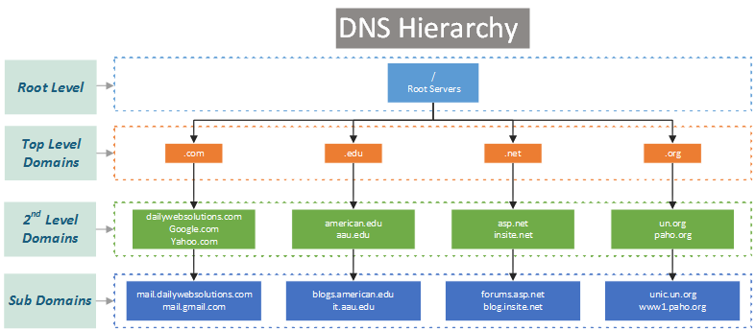
DNS Hierarchy

Slide 35
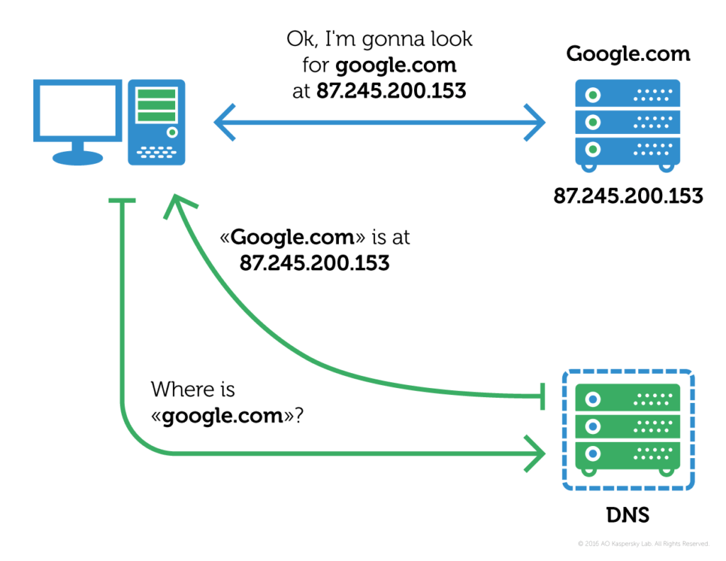
DNS Resolution
Notes:
DNS resolution. Each web server (and indeed any host connected to the internet) has a unique IP address in textual form, translating it to an IP address (in this case, 207.142.131.248) is a process known asDNS resolution or DNS lookup; here DNS stands forDomain Name Service.

Slide 36
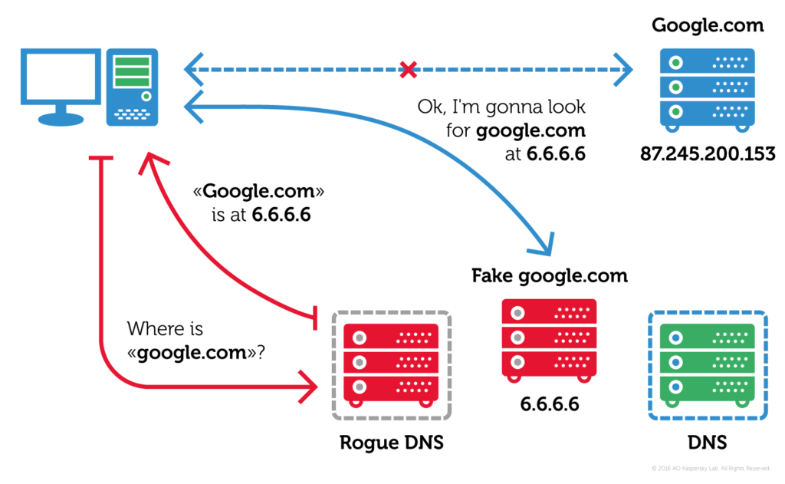
DNS Hijacking

Slide 37
https://www.votefor.com
avoid link camouflage:
www.vote4.com
www.votef0r.com
asdf
Notes:
Now make sure that you have correctly typed the address you want to connect in the address bar;

Slide 38
Connection Request
CLIENT HELLO
SSL Protocol version
Session ID
List of Cipher Suites
CLIENT HELLO Extensions
Notes:
Given the secure DNS resolution process and correct input of the website address,
User sends a CLIENT HELLO message to the server

Slide 39
HTTPS
step 2: sever response

Slide 40
Server Response
SERVER HELLO
SSL Protocol version
Session ID
Selected Cipher
Server Certificate
SERVER HELLO Extensions
Client Certificate Request (optional)

Slide 41
Server Response
SERVER HELLO
SSL Protocol version
Session ID
Selected Cipher
Server Certificate Public Key?
SERVER HELLO Extensions
Client Certificate Request (optional)

Slide 42
Server Response
SERVER HELLO
SSL Protocol version
Session ID
Selected Cipher
Server Certificate Public Key?
SERVER HELLO Extensions
Client Certificate Request (optional)

Slide 43
SERVER HELLO
SSL Protocol version
Session ID
Selected Cipher
Server Certificate Public Key?
SERVER HELLO Extensions
Client Certificate Request (optional)
why not directly transfer
SERVER HELLO Extensions
Client Certificate Request (optional)

Slide 44
what if the attacker hijacks key-channel?
zzs
zjs
txy
hello, txy

Slide 45
Man-In-The-Middle Attack
what if the attacker hijacks key-channel?
key1
key2
zzs
zjs
txy
hello, txy

Slide 46
SERVER HELLO
SSL Protocol version
Session ID
Selected Cipher
Server Certificate Public Key?
SERVER HELLO Extensions
Client Certificate Request (optional)

Slide 47
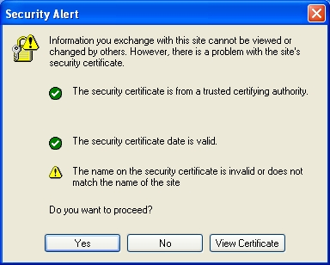
Certificate
Issued by a trusted third party
Certificate Authority (CA)
VeriSign, GeoTrust, Digicert, etc.

Slide 48
Certificate
Goal:
vouch for server public key
Principle:
signed by CA’s private key
verifiable by CA’s public key

Slide 49
HTTPS
step 3: certificate verification

Slide 50
What to Verify?
Certificate Authority

Slide 51
What to Verify?
Certificate Authority
trusted?
certificate integrity?

Slide 52
What to Verify?
Certificate Authority
trusted?
certificate integrity?
Certificate Date

Slide 53
What to Verify?
Certificate Authority
trusted?
certificate integrity?
Certificate Date
expired?

Slide 54
What to Verify?
Certificate Authority
trusted?
certificate integrity?
Certificate Date
expired?
Certificate Revocation List

Slide 55
What to Verify?
Certificate Authority
trusted?
certificate integrity?
Certificate Date
expired?
Certificate Revocation List
valid?

Slide 56
What to Verify?
Certificate Authority
trusted?
certificate integrity?
Certificate Date
expired?
Certificate Revocation List
valid?
Domain Name

Slide 57
What to Verify?
Certificate Authority
trusted?
certificate integrity?
Certificate Date
expired?
Certificate Revocation List
valid?
Domain Name
intended?

Slide 58
How to Verify?
Domain Name
Public Key
CA Name
CA Signature

Slide 59
How to Verify?
Domain Name
Public Key
CA Name
CA Signature
should I trust the CA?

Slide 60
How to Verify?
Domain Name
Public Key
CA Name
CA Signature
should I trust the CA?
query locally built-in certificate store
CA Name
Public Key
CA Signature

Slide 61
How to Verify?
Domain Name
Public Key
CA Name
CA Signature
I trust the CA?
query locally built-in certificate store
CA Name
Public Key
verify integrity and authenticity
CA Signature

Slide 62

How to Verify?
Domain Name
Public Key
CA Name
CA Signature
I trust the CA?
query locally built-in certificate store
CA Name
Public Key
verify integrity and authenticity
CA Signature

Slide 63
How to Verify?
Domain Name
Public Key
CA Name
CA Signature
I trust the CA?
query locally built-in certificate store
CA Name
Public Key
verify integrity and authenticity
CA Signature

Slide 64
How to Verify?
Domain Name
Public Key
CA Name
I trust the Public Key?
CA Signature
CA Name
Public Key
verify integrity and authenticity
CA Signature

Slide 65
How to Verify?
Domain Name
Public Key
CA Name
I trust the Public Key?
CA Signature
Root CA?
CA Name
Public Key
verify integrity and authenticity
CA Signature

Slide 66
hmm, what if signed by
“branch” CA?

Slide 67
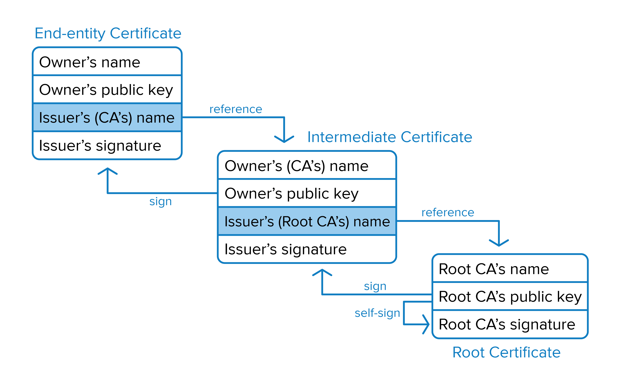
Certificate Chain
Notes:
https://developer.okta.com/books/api-security/tls/certificate-verification

Slide 68
wait, is a valid certificate
still valid?

Slide 69
wait, is a valid certificate
still valid?
enable CRL check

Slide 70
Certificate Revocation List
Certificates that have been revoked by the issuing CA
before their scheduled expiration date and should no longer be trusted
Two states
revoked:
irreversibly revoked
hold:
only temporary invalidity, reversible
Notes:
Revoked: A certificate is irreversibly revoked if, for example, it is discovered that the certificate authority (CA) had improperly issued a certificate, or if a private-key is thought to have been compromised. Certificates may also be revoked for failure of the identified entity to adhere to policy requirements, such as publication of false documents, misrepresentation of software behaviour, or violation of any other policy specified by the CA operator or its customer. The most common reason for revocation is the user no longer being in sole possession of the private key (e.g., the token containing the private key has been lost or stolen).
Hold: This reversible status can be used to note the temporary invalidity of the certificate (e.g., if the user is unsure if the private key has been lost). If, in this example, the private key was found and nobody had access to it, the status could be reinstated, and the certificate is valid again, thus removing the certificate from future CRLs.

Slide 71
Certificate Revocation List
Periodically issued by a CRL issuer
CA per se,
or some other trusted third parties
Query supported as well
Tradeoff between security and efficiency

Slide 72
Certificate Revocation List
Periodically issued by a CRL issuer
CA per se,
or some other trusted third parties
Query supported as well
Tradeoff between security and efficiency
Always a time gap between
when a certificate is revoked AND
when its revocation approaches a client

Slide 73
Certificate Revocation List
Further Discussion:
CRLite: A Scalable System for Pushing All TLS Revocations to All Browsers
IEEE S&P 2017
James Larisch ; David Choffnes ; Dave Levin ; Bruce M. Maggs ; Alan Mislove ; Christo Wilson

Slide 74
nitpicking:
do I have to trust Root CA?

Slide 75
HTTPS
step 4: key exchange

Slide 76
HTTPS
step 5: secure communication

Slide 77
HTTPS
step 6: bye

Slide 78
?

Slide 79
Readings
SSL and HTTPS by Nickolai Zeldovich
Everything About HTTPS and SSL (Java) by Akhil Raj
How does HTTPS actually work? by Robert Heaton
TLS Security 6: Examples of TLS Vulnerabilities and Attacks by Agathoklis Prodromou

Slide 80
Announcement
Project Mid-term Presentation: 05%
2020.03.24, 08:00 – 11:25
~ 10 min / group
Requirements | Grading
Existing solutions? | C
Classification? | C+
Comparison? | B
Reproduction? | A
Your solution? | A+

Slide 81
Thank You
be on the road
Notes:
Run your own race.

