Slide 1
Structural interpretation of emergency unemployment assistance
Model 15: mechanisms, calibration, weaknesses and a submission-ready research agenda
Labour economics teaching deck | Based on manuscript v10 and structural model 15 | August 2026

Slide 2
Motivation
Model anatomy
Calibration
Assessment
Roadmap
What this deck is designed to teach
Read the mechanism
Interrogate identification
Use the model honestly
Translate benefits, work wedges and matching conditions into search, acceptance and employment exits.
See which moments discipline which parameters—and why near-equivalent fits do not identify a unique mechanism.
Separate a useful quantitative interpretation exercise from welfare analysis or a fully structural equilibrium model.
The goal is not to defend every current modelling choice; it is to show what can be learned now and what must change before journal submission.

Slide 3
Motivation
Model anatomy
Calibration
Assessment
Roadmap
Bottom line on model 15
Real advance
Main empirical message
Binding limitation
Model 15 gives bounded, surplus-sensitive exit probabilities; shares a common surplus index across finding and exits; and genuinely holds out Australian post JFR.
In the benchmark, the benefit-only job-finding DiD is −1.50 pp versus −1.31 pp in the full environment. For exits, nonlinear interaction is central.
The selected benchmark is weakly identified. Near-fitting parameterisations imply held-out errors from roughly −2.84 to +0.48 pp and work wedges from 5% to 41% of wages.
Treat the current model as a partially identified interpretation model. Do not present its point decomposition as uniquely estimated.

Slide 4
Motivation
Model anatomy
Calibration
Assessment
Roadmap
Roadmap
Part I — Learn the current model
Part II — Decide what to keep
1. Empirical moments
2. Worker problem and search
3. Acceptance and exit hazards
4. Firms, matching and dynamics
5. Calibration mapping
6. Benchmark results
7. Identification audit
8. Internal-consistency audit
9. Minimal submission-ready model
10. Ambitious extensions and paper write-up
Slides deliberately alternate equations, intuition, diagnostics and recommended decisions.

Slide 5
01
What must the model explain?
Start from transition moments; ask which mechanisms can rationalise them.

Slide 6
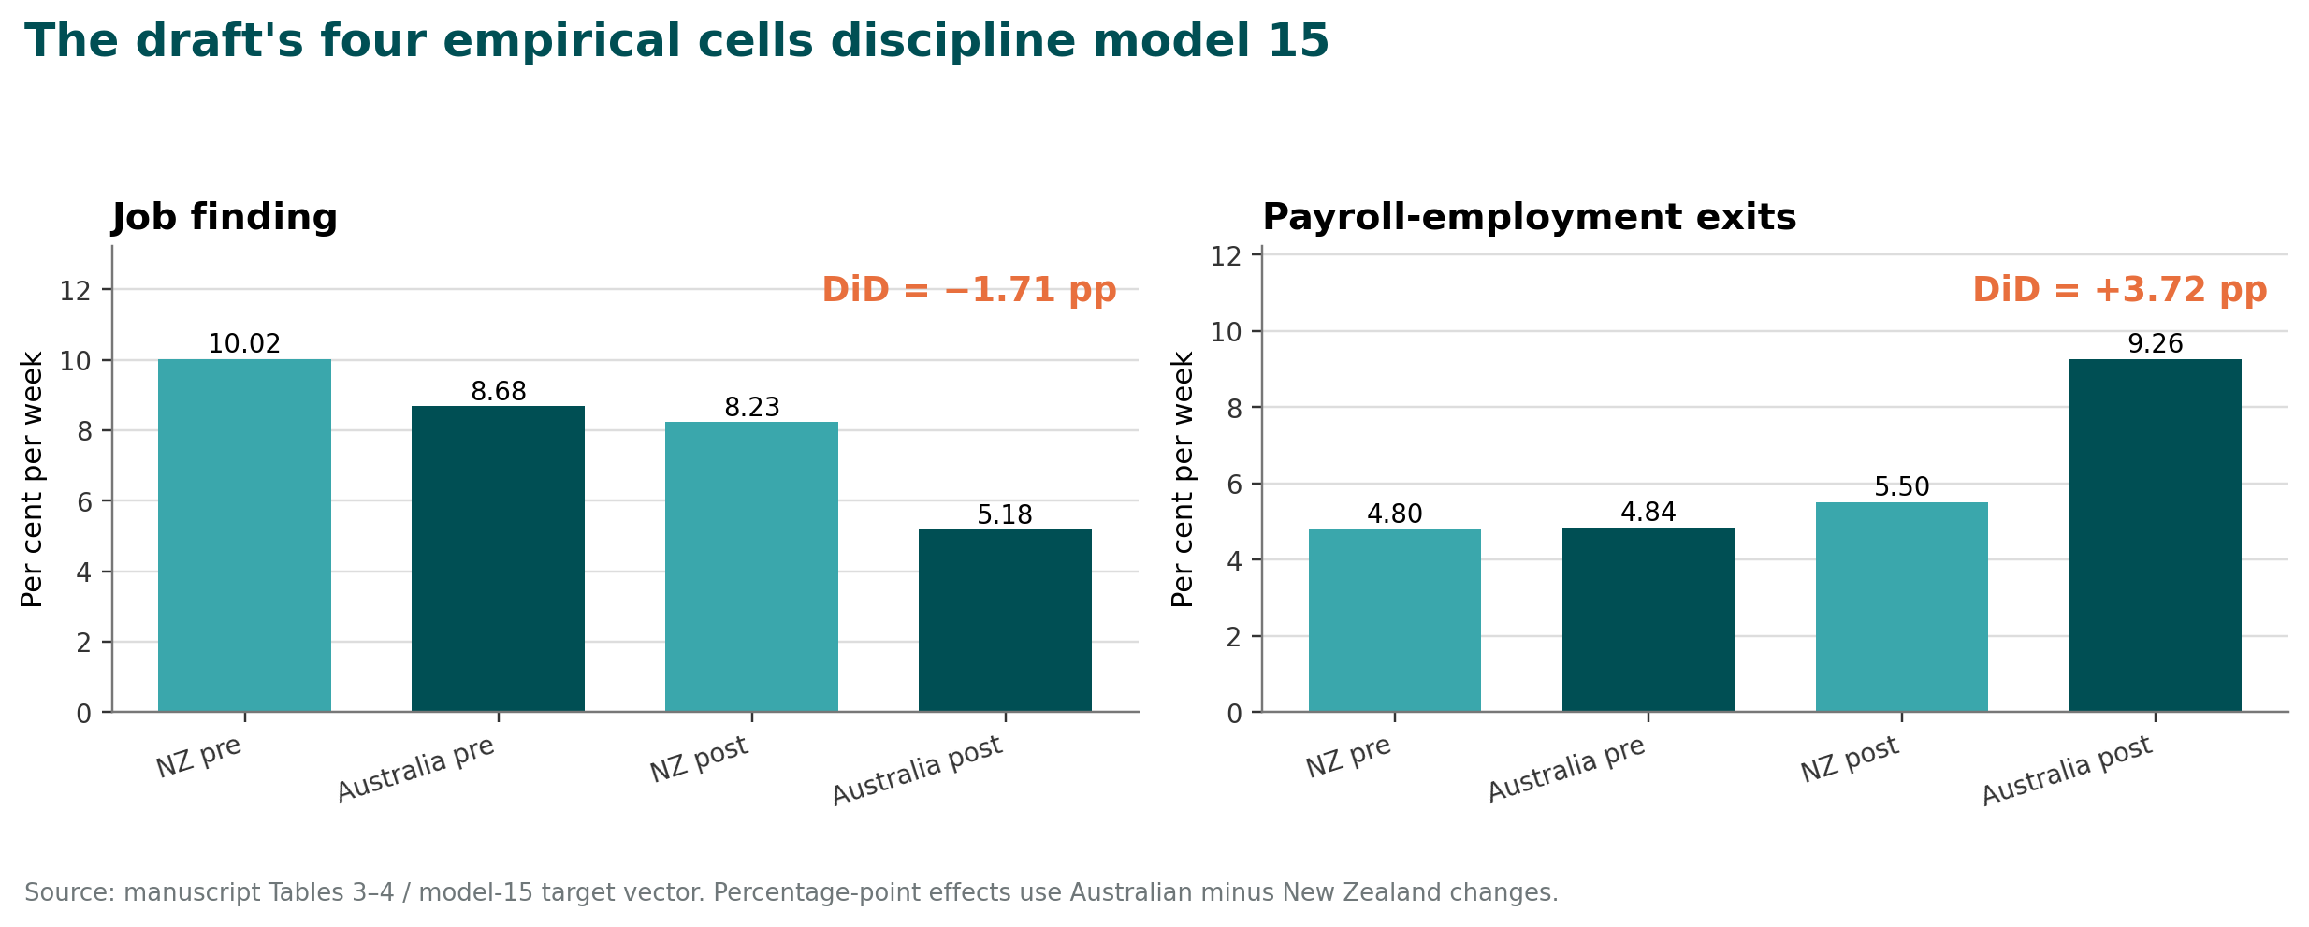
Motivation
Model anatomy
Calibration
Assessment
Roadmap
The draft supplies four transition cells—and two DiD contrasts
These numbers are provisional until the empirical risk sets and inference are rebuilt.
Source: manuscript Tables 3–4 and model-15 Targets().

Slide 7
Motivation
Model anatomy
Calibration
Assessment
Roadmap
Why add structure to a credible reduced-form design?
Reduced form can estimate
Structure can organise
• The change in Australian-minus-NZ job finding
• The change in Australian-minus-NZ payroll exits
• Heterogeneity by predicted policy exposure
• Dynamic responses around announcements
• Benefits versus common job-opportunity shocks
• Search versus acceptance margins
• Complementarity in match continuation
• Counterfactual changes outside the observed episode
Structure does not repair a selected empirical sample. Revised target moments must come first.

Slide 8
Motivation
Model anatomy
Calibration
Assessment
Roadmap
What changed from the manuscript model to version 15?
Dimension
Manuscript / earlier model
Model 15
Implication
Employment exits
Largely exogenous or additively shifted
Smooth, bounded hazard of net flow surplus
Benefits and work wedges interact nonlinearly
Post calibration
Fits both groupsʼ post JFRs
NZ post JFR fitted; AU post JFR held out
Creates a genuine validation target
Search costs
May vary pre/post
Restricted model holds κ fixed
Common post shock is channelled through μ
Decomposition
Narrative «health versus benefits»
Four scenario environments
Scenarios are not additive contributions
Exit language
Match-quality interpretation
Static group-level logistic hazard
Must be described as reduced-form unless quality state is implemented
The paperʼs current structural section and abstract must be rewritten from model 15 outputs—not patched line by line.
Source: manuscript section 7; 15_structural_separation_model.jl.

Slide 9
02
Model anatomy
Two types, two states, a common market, and a surplus-sensitive exit hazard.

Slide 10
Motivation
Model anatomy
Calibration
Assessment
Roadmap
The model has two worker types and two labour-market states
Non-employed: Uⱼ
find: fⱼ = aⱼ[1−exp(−csⱼ)]
Employed: Wⱼ
Outside option bⱼ + ℓ
Choose search sⱼ
Receive/accept offers
Receive wage w − hⱼ
Continue or exit
Match surplus governs hazard
exit: δⱼ = δ₀ + ξ + AΛ(·)
j ∈ {R, N}: R is benefit-eligible / Australian; N is ineligible / New Zealand comparison.
This is a partial-equilibrium interpretation model. The two types share job opportunities, but their outside options and residual work wedges differ.

Slide 11
Motivation
Model anatomy
Calibration
Assessment
Roadmap
Flow payoffs create the net work-surplus index
Eligible / Australian type R
Ineligible / NZ type N
Outside: bᴿ + ℓ
Work: w − hᴿ
Flow surplus: zᴿ = w − hᴿ − bᴿ − ℓ
The supplement raises bᴿ and lowers zᴿ.
Outside: bᴺ + ℓ, with bᴺ = 0 in code
Work: w − hᴺ
Flow surplus: zᴺ = w − hᴺ − bᴺ − ℓ
Normalisation sets hᴺ = 0 post-shock.
The code labels h as «health»; empirically it is a residual differential net work-surplus wedge that may absorb composition, policy interactions and measurement.

Slide 12
Motivation
Model anatomy
Calibration
Assessment
Roadmap
A job is found only if an offer arrives and is accepted
Offer arrival
Acceptance
o(s,c) = 1 − exp(−cs)
c is the contact probability from the matching block; s is chosen search effort. The exponential form keeps offers in [0,1].
a(z) = Λ[(z − z̄)/σₐ]
Job-finding probability:
f = a(z) × o(s,c).
Threshold z̄ and dispersion σₐ are fixed, not estimated.
Observed job finding is a product of search, contacts and acceptance. Aggregate transition rates cannot separately identify all three.

Slide 13
Motivation
Model anatomy
Calibration
Assessment
Roadmap
Search effort solves a dynamic marginal-cost condition
First-order condition
Interpretation
κ s^η = β · a · c · exp(−cs) · [W′ − U′]
Marginal cost rises with curvature η; the gain depends on acceptance, contact and next-period value surplus.
Higher benefits reduce W−U and acceptance; both lower the return to search. Poor matching lowers c. Anticipated policy expiry changes W′−U′ before the cash payment ends.
In the selected calibration η = 100. That pins s close to one, so the modelʼs «labour-supply» response is mostly an acceptance response.

Slide 14
Motivation
Model anatomy
Calibration
Assessment
Roadmap
Employment exits are a smooth hazard of static flow surplus
Implemented equation
Economic meaning
δⱼ = clamp[δ₀ + ξ + A Λ((z̄ₛ − zⱼ)/σₛ)]
δ₀: baseline
ξ: common post shock
A: endogenous component amplitude
A lower zⱼ moves a group into the steep region of the hazard. Benefits and hᴿ therefore complement each other: the effect of one depends on the level of the other.
There is no explicit match-quality state or joint continuation rule. Near term: call this a smooth reduced-form employment-exit hazard.

Slide 15
Motivation
Model anatomy
Calibration
Assessment
Roadmap
The matching block turns μ into contact opportunities
Current firm side
Internal inconsistency
Firm surplus = y − w
J = (y−w)/[1−β(1−δfirm)]
θ = [β μ J / vacancy cost]^(1/α)
c = μ θ^(1−α)
Firm continuation uses δfirm = 1% weekly, while worker-side exits are about 4.8%–9.3%. Policy-induced exits do not reduce J or feed back into vacancy creation.
Choose: integrate the same exit hazard into firm value, or treat c/μ as an exogenous opportunity process and drop free-entry language.

Slide 16
Motivation
Model anatomy
Calibration
Assessment
Roadmap
Bellman equations make the shock dynamic
Employed value
Non-employed value
Wⱼ,t = (w − hⱼ,t) + β[(1−δⱼ,t)Wⱼ,t+1 + δⱼ,t Uⱼ,t+1]
Uⱼ,t = (bⱼ,t + ℓ) − C(sⱼ,t) + β[fⱼ,t Wⱼ,t+1 + (1−fⱼ,t)Uⱼ,t+1]
Backward induction solves values and search over the announced shock horizon; forward simulation averages weeks 12–36.

Slide 17
Motivation
Model anatomy
Calibration
Assessment
Roadmap
Timing assumptions are economically important
• Weekly model: T = 60; shock weeks 12–36 inclusive (25 weeks).
• Shock is unanticipated at onset, then its end date is known with certainty.
• The manuscriptʼs empirical window, announcement date and supplement payment window do not currently line up with the model averaging window.
• β = 0.99 weekly implies an annual discount factor near 0.59—far below conventional calibrations.
• The real policy was announced, paid, extended and tapered in stages; expectations should follow that history.
Create a date-to-model-week table and set βweek = βannual^(1/52). Re-run every quantitative result.

Slide 18
03
Calibration and what the model says
A close fit can coexist with severe mechanism uncertainty.

Slide 19
Motivation
Model anatomy
Calibration
Assessment
Roadmap
Calibration is sequential: each empirical cell is assigned a job
1. Pre exits
2. Pre JFRs
3. NZ post exit
Fit baseline + amplitude of smooth exit hazard
Fit matching efficiency μ and search-cost level κ
Fit common background destruction shock ξ
4. AU post exit
5. NZ post JFR
6. AU post JFR
Fit residual differential work-surplus wedge hᴿ
Fit post matching efficiency μ; hold κ fixed
Held out as a prediction in the restricted model
Teaching point: «held out» is useful only if specification choices were not tuned after seeing the held-out result.

Slide 20
Motivation
Model anatomy
Calibration
Assessment
Roadmap
Core fixed and calibrated quantities in the benchmark
Object
Benchmark
How set
Interpretation / concern
Weekly β
0.99
Fixed
Implies implausibly low annual discounting
Wage / output
0.55 / 1.00
Fixed normalisation
No wage bargaining or wage distribution
Benefit RR
0.28 → 0.56
Stylised doubling
Actual policy is a flat $550/fortnight plus means tests
Search curvature η
100
Selected from restricted grid
Pins search close to one
Exit threshold / dispersion
0.10 / 0.04
Selected from grid
Many near-ties have radically different predictions
μ pre / post
0.0739 / 0.0677
Fit JFR moments
Post μ fitted to NZ JFR
Differential wedge hᴿ
0.0368 = 6.69% wage
Fit AU post exits
Residual wedge, not identified health disutility
A manuscript calibration table should label every item fixed, externally calibrated, fitted or held out.
Source: 15_structural_separation_summary.csv and model code.

Slide 21
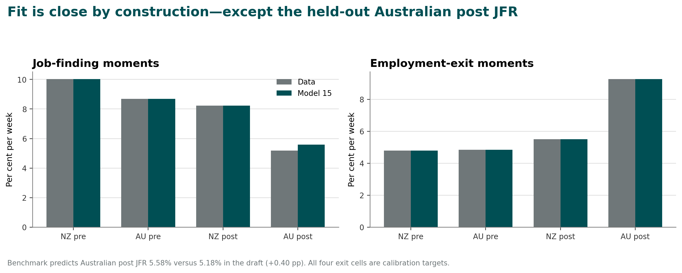
Motivation
Model anatomy
Calibration
Assessment
Roadmap
Benchmark fit: the held-out error is visible but modest
The fit bars are not standard errors; targets are treated as exact in the current code.
Source: model-15 summary CSV.

Slide 22
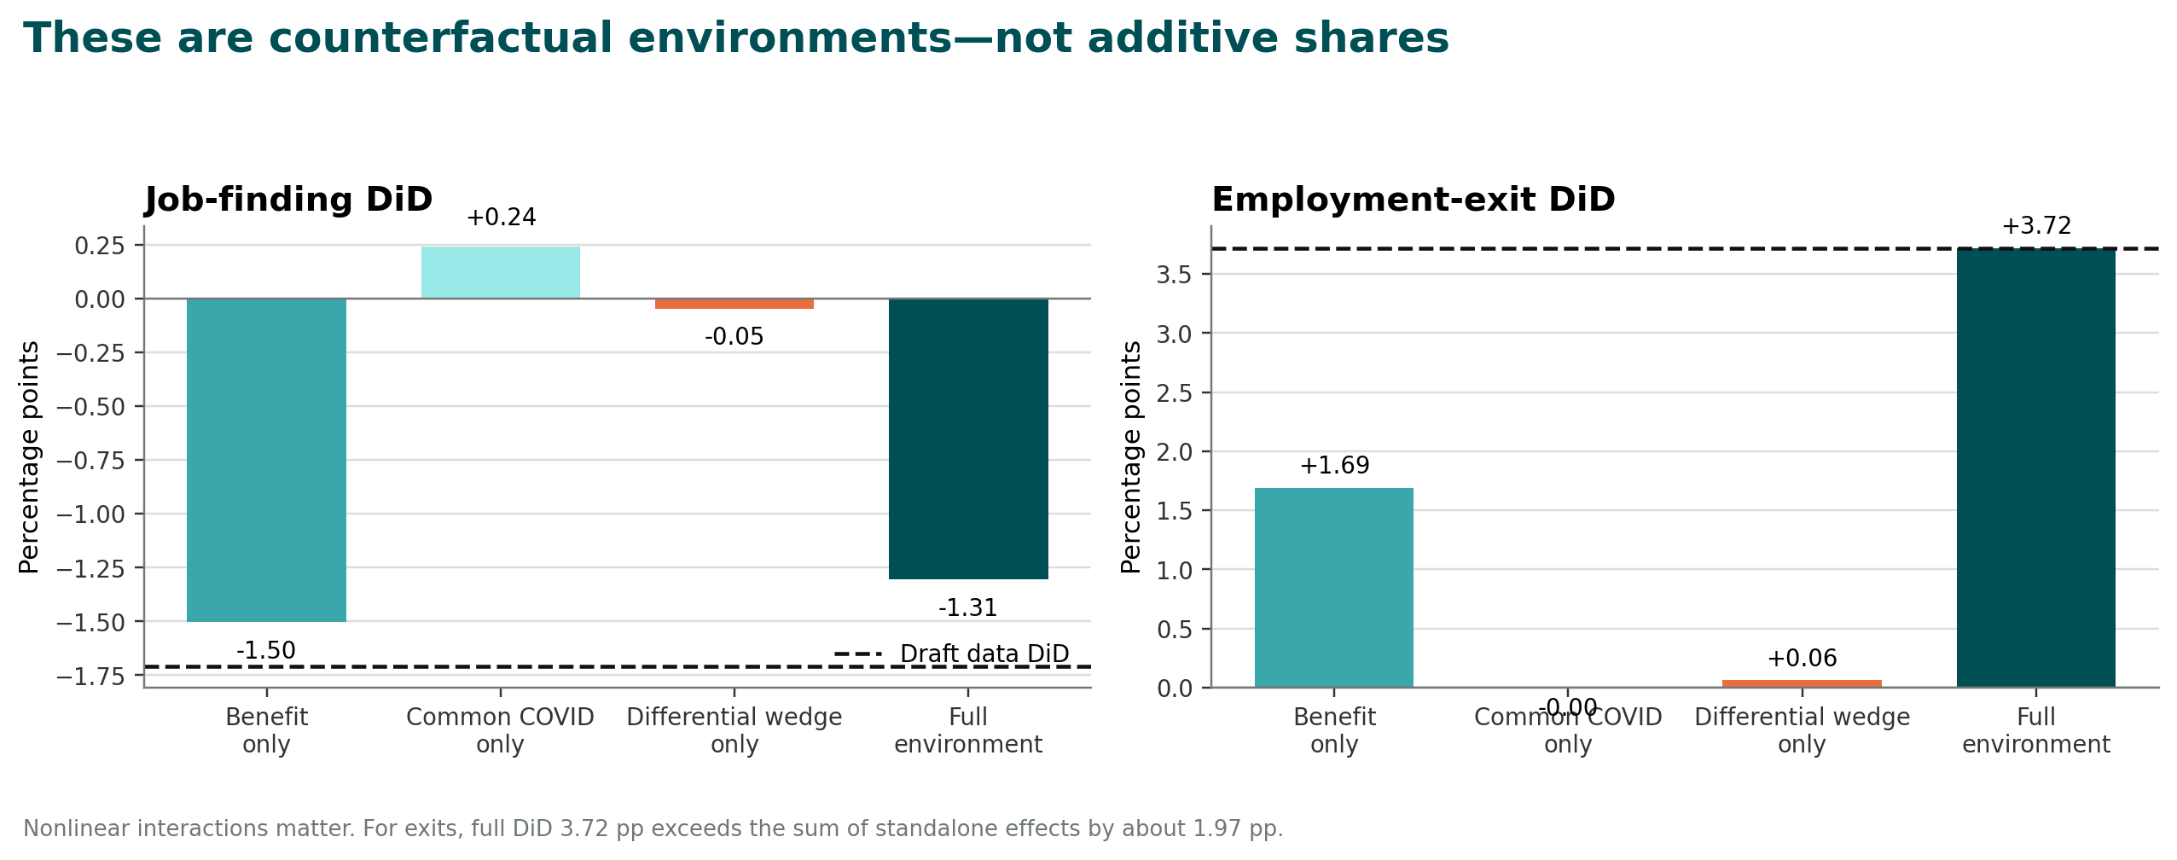
Motivation
Model anatomy
Calibration
Assessment
Roadmap
Scenario results: benefit effects and pandemic wedges interact
Do not divide standalone bars by the full bar and call the result a «share».
Source: model-15 decomposition CSV.

Slide 23
Motivation
Model anatomy
Calibration
Assessment
Roadmap
The model reverses the manuscriptʼs current job-finding headline
What the manuscript says
What model 15 says
Most of the labour response came from pandemic work disutility rather than benefit generosity; benefit effects were smaller in normal conditions.
Benefit-only job-finding DiD: −1.50 pp.
Full model DiD: −1.31 pp.
Common COVID only: +0.24 pp.
Differential wedge only: −0.05 pp.
For job finding, the benefit channel is at least as large in the no-COVID counterfactual as in the full benchmark. Rewrite abstract, introduction and conclusion.

Slide 24
Motivation
Model anatomy
Calibration
Assessment
Roadmap
For exits, complementarity—not «health versus benefits»—is the result
Standalone DiD effects
Full environment
Benefit only: +1.688 pp
Common COVID only: ≈0.000 pp
Differential wedge only: +0.061 pp
Sum: +1.749 pp
Full exit DiD: +3.720 pp
Residual interaction: 3.720 − 1.749 = +1.971 pp
The interaction exceeds every standalone wedge other than benefits.
Compute all 2³ counterfactual combinations and report a Shapley or explicit interaction decomposition.

Slide 25
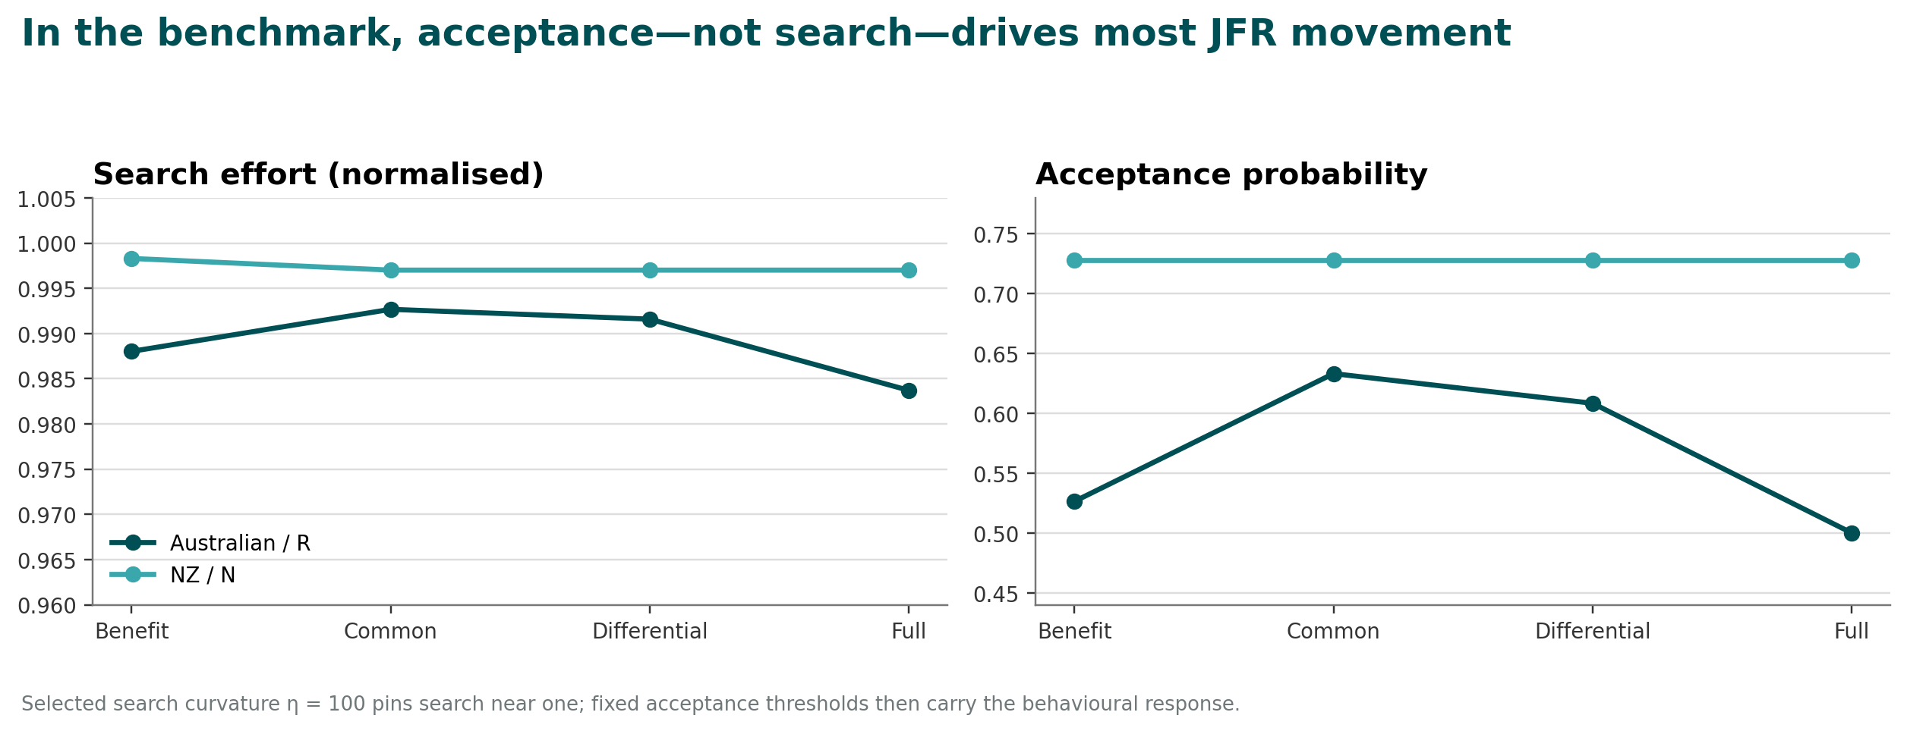
Motivation
Model anatomy
Calibration
Assessment
Roadmap
The benchmarkʼs job-finding mechanism is mainly acceptance
This mechanism is imposed partly by η = 100 and fixed acceptance parameters; it is not directly validated by applications or offer data.
Source: model-15 scenario CSV.

Slide 26
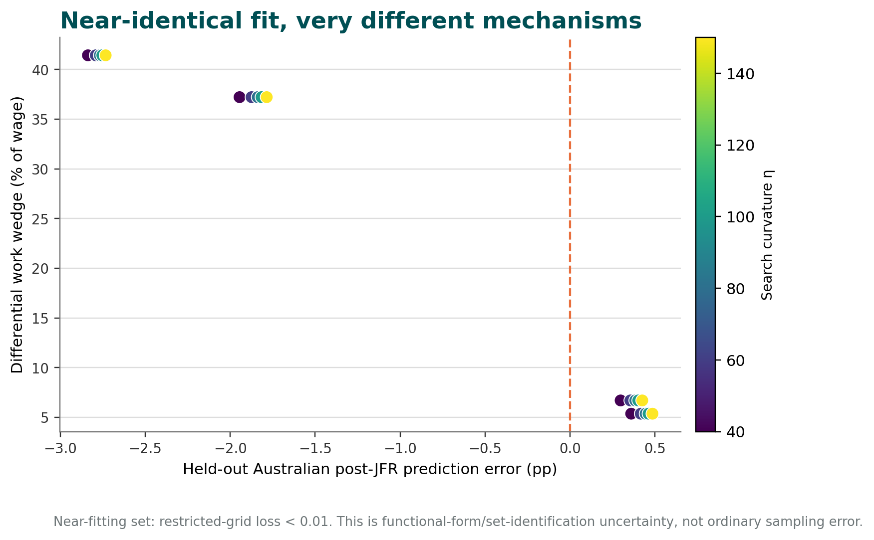
Motivation
Model anatomy
Calibration
Assessment
Roadmap
Weak identification appears in the near-fitting parameter set
A single «best» grid point is selected by tiny numerical differences in a loss many specifications match almost exactly.
Source: model-15 restricted grid; plotted points have fitted loss < 0.01.

Slide 27
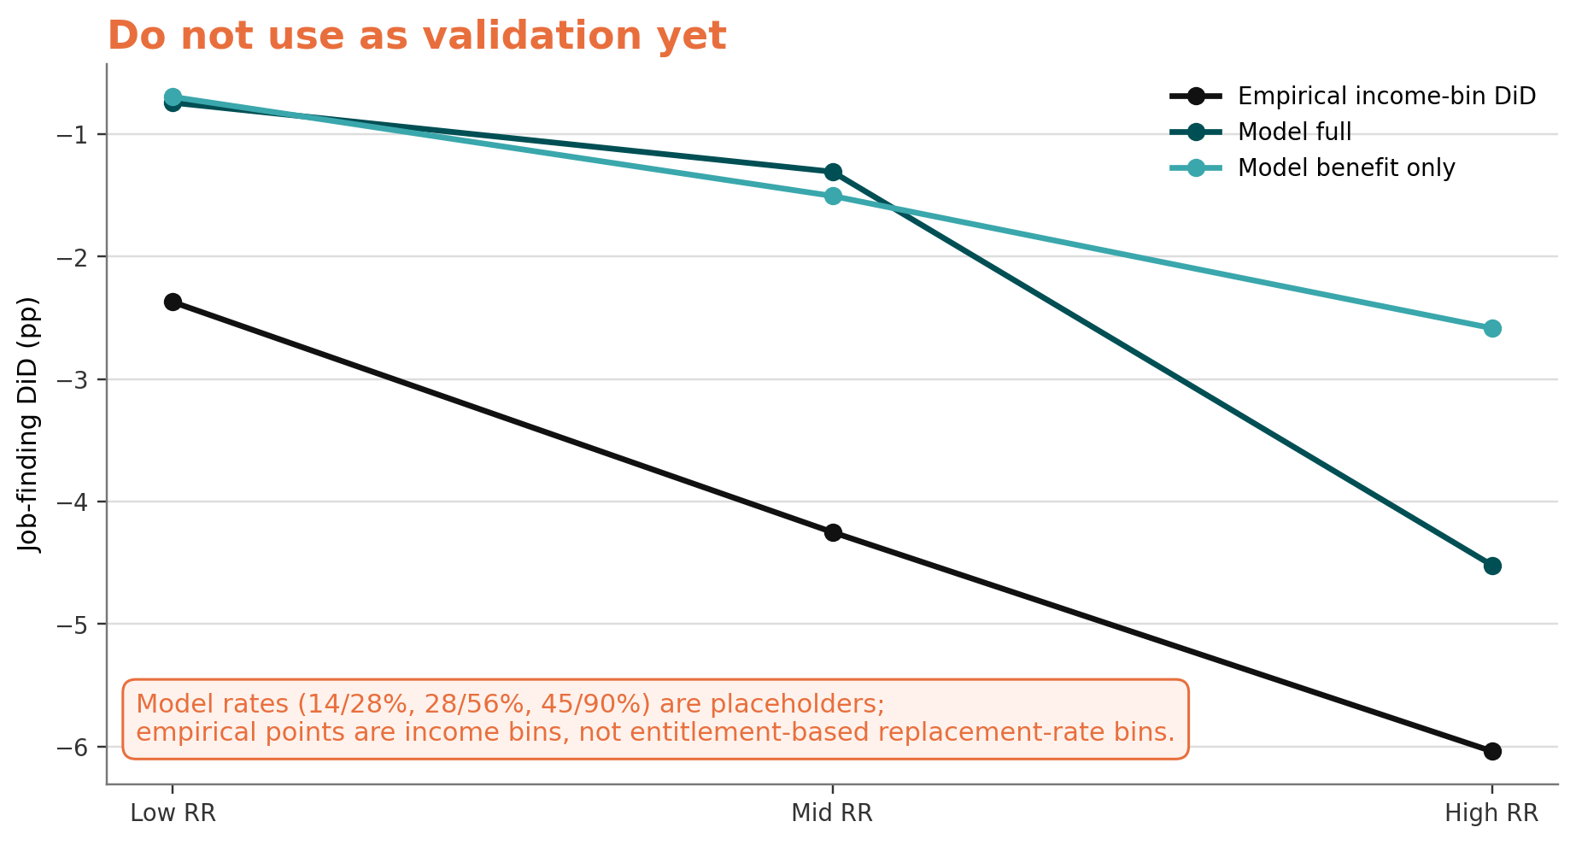
Motivation
Model anatomy
Calibration
Assessment
Roadmap
The replacement-rate gradient file is a diagnostic—not a paper result
Rebuild using statutory predicted entitlements and pre-displacement wages before using it as external validation.
Source: model-15 replacement-rate validation CSV; code marks rates as placeholders.

Slide 28
04
What is strong, what is fragile?
Separate useful structure from claims the current model cannot carry.

Slide 29
Motivation
Model anatomy
Calibration
Assessment
Roadmap
What should be retained
Common surplus index
Held-out prediction
Transparent outputs
Benefits and work costs enter the same economic object, creating interpretable nonlinear responses across margins.
The restricted calibration reserves Australian post job finding rather than mechanically fitting every target.
Self-contained Julia code writes fit, scenario, grid and validation CSVs that can feed a reproducible paper pipeline.
These are solid foundations for an interpretation model once empirical targets, time units and uncertainty are corrected.

Slide 30
Motivation
Model anatomy
Calibration
Assessment
Roadmap
What the current aggregate moments cannot identify
Search-and-finding block
Exit block
κ level and η curvature
Matching/contact efficiency μ
Offer-arrival responsiveness
Acceptance threshold and dispersion
Dynamic value surplus
Background firm destruction
Voluntary versus involuntary exits
Match-specific quality distribution
Worker and firm continuation values
Differential work-surplus wedge
Add external moments or report a set of observationally admissible mechanisms. Six aggregate cells do not identify this many margins.

Slide 31
Motivation
Model anatomy
Calibration
Assessment
Roadmap
The residual work wedge needs a neutral label
Current normalisation
What it may include
Set hᴺ = 0.
Fit common NZ exit increase with ξ.
Fit hᴿ to the remaining Australian exit increase.
Any R-specific omitted force loads into hᴿ.
Health risk and caregiving
Industry/employer composition
JobKeeper interactions
Benefit administration
Payroll reporting and sample selection
Call hᴿ−hᴺ a differential net work-surplus wedge unless independent moments identify health or work disutility.

Slide 32
Motivation
Model anatomy
Calibration
Assessment
Roadmap
The current model is not a welfare model
Missing insurance side
Missing externalities
No consumption or saving
No risk aversion or liquidity constraints
No household heterogeneity
No taxes, budget or marginal cost of funds
No epidemiological/contact externality
No congestion or job-rationing externality
No firm survival or vacancy externality
No value of improved match quality
Valid conclusion: the paper estimates behavioural transitions and interprets channels. Invalid conclusion: the supplement had positive or negative net social welfare.

Slide 33
Motivation
Model anatomy
Calibration
Assessment
Roadmap
Uncertainty must pass through both empirical and structural stages
• Resample the person-week design using blocks and, where relevant, matched pairs.
• Recompute the empirical target vector and covariance matrix in every draw.
• Recalibrate the model; record failures, bound hits and optimiser status.
• For each draw, retain the full economically admissible parameter set—not only one tie-broken optimum.
• Report intervals combining sampling uncertainty with set/functional-form uncertainty.
• Show model fit and counterfactual ranges, not only point bars.
Microdata improve measurement, but the policy still supplies one aggregate shock. Structural precision cannot exceed empirical identification.

Slide 34
05
A submission-ready model roadmap
Make a credible minimal model first; treat richer welfare and equilibrium extensions as optional.

Slide 35
Motivation
Model anatomy
Calibration
Assessment
Roadmap
Prioritised structural work before submission
Priority
Action
Why it is binding
Deliverable
1
Recalibrate to redesigned person-week risk-set moments
Current exit targets inherit post-treatment selection
Frozen target table + covariance matrix
2
Correct β, dates and actual benefit entitlements
Current dynamics and replacement rates are not policy-consistent
Date map + entitlement distribution
3
Report an admissible parameter set
Numerical tie-breaking hides weak identification
Ranges for fit, held-out prediction and counterfactuals
4
Complete 2³ / Shapley decomposition
Current scenarios are non-additive
Mechanism table with interactions
5
Fix firm-exit consistency or simplify matching block
Free entry ignores the modelʼs own exits
Integrated J or exogenous contact interpretation
6
Add numerical tests and reproducible environment
Grid silently omits failures; no project lockfile
Project/Manifest, driver, tests and logs
Stop/go rule: if the redesigned empirical cells are unstable, pause structural refinement and narrow the paperʼs causal claims.

Slide 36
Motivation
Model anatomy
Calibration
Assessment
Roadmap
Minimal model for the main paper
Keep in main text
Move to appendix
Two types and states
Flow-surplus index
Search FOC and acceptance
Reduced-form smooth exit hazard
Moment-to-parameter table
Fit + held-out prediction range
Factorial/Shapley decomposition
Bellman derivations
Full parameter grid
Optimiser diagnostics
All shock-path sensitivities
Alternative normalisations
Bootstrap/set-construction details
All subgroup validations
Aim for a transparent quantitative interpretation section, not a second paper inside the empirical paper.

Slide 37
Motivation
Model anatomy
Calibration
Assessment
Roadmap
Ambitious extension: explicit match quality and consistent vacancy creation
State extension
Equilibrium extension
Each match draws quality x.
Worker and firm continuation depend on x.
Joint surplus Sⱼ(x) determines an endogenous continuation cutoff x*ⱼ.
Exit probability is F(x*ⱼ).
Firm value integrates over type and quality.
Vacancy free entry uses the same exit process.
Benefits affect vacancy value through duration and destruction.
Validate tightness against vacancy data.
This would justify «structural match-quality threshold» language. It is valuable, but not necessary if the current hazard is labelled modestly.

Slide 38
Motivation
Model anatomy
Calibration
Assessment
Roadmap
Ambitious extension: insurance, households and public-health externalities
Household block
Social block
CRRA utility, assets and borrowing limits
Flat benefits + taper/means tests
Heterogeneous wages and household composition
Consumption response and insurance value
Benefit financing and marginal cost of funds
Contact intensity by employment state
Epidemiological transmission externality
Vacancy/job-rationing effects
State-contingent optimal benefit paths
This is the route to welfare. It materially expands scope and data requirements; do not let it delay a strong behavioural paper.

Slide 39
Motivation
Model anatomy
Calibration
Assessment
Roadmap
Additional moments with the highest identification value
• Applications/search contacts or reported search hours—discipline κ and η.
• Offer receipt, rejection and reservation wages—discipline acceptance threshold and dispersion.
• Vacancies/applications by local market—discipline contact efficiency and tightness.
• Employment-exit reason, stand-down, firm closure and JobKeeper exposure—separate worker continuation from firm destruction.
• Duration dependence in job finding—tests value dynamics and search technology.
• Actual predicted replacement-rate changes—tests the benefit mechanism across policy intensity.
• Post-taper and expiry paths—validate expectations and forward-looking behaviour.
Pre-register which moments are fitted and which are held out. Validation is strongest when the held-out set is chosen before specification search.

Slide 40
Motivation
Model anatomy
Calibration
Assessment
Roadmap
How the structural section should be written in the paper
Subsection
Purpose
One main exhibit
Purpose and scope
Interpret transition gaps; explicitly exclude welfare and full GE
One-paragraph mechanism map
Environment
Define types, states, outside options, search, acceptance and exits
State-transition diagram
Equations
Show Bellman equations, search FOC, finding probability and exit hazard
Four-equation box
Identification
Map every fixed/fitted/held-out object to a source or moment
Parameter–moment table
Fit and validation
Show data, benchmark and near-fitting range
Fit + held-out interval figure
Counterfactuals
Report factorial/Shapley effects and underlying margins
Mechanism decomposition
Limits
Partial equilibrium, residual wedge, no welfare, functional-form sensitivity
Short boxed limitations
The benchmark is a visual anchor; conclusions must be based on the admissible range.

Slide 41
Motivation
Model anatomy
Calibration
Assessment
Roadmap
Claim discipline: what the model can and cannot support
Defensible
Not yet defensible
«Model 15 shows that benefits can reduce job finding through surplus and acceptance.»
«Benefits and work-surplus wedges interact in employment exits.»
«A range of mechanisms is consistent with the aggregate moments.»
«Most of the response is health rather than benefits.»
«The differential wedge is a health preference.»
«The exit hazard is a structural match-quality cutoff.»
«The supplement increased net welfare.»
Good modelling language distinguishes mechanism possibility, quantitative consistency and identified causal decomposition.

Slide 42
Motivation
Model anatomy
Calibration
Assessment
Roadmap
Discussion questions for the research team
• Is the modelʼs central contribution job-finding mechanisms, employment-exit complementarity, or state-contingent policy? Choose one.
• Can the secure data identify applications, offer acceptance, exit reason, JobKeeper exposure or actual entitlement replacement rates?
• Should vacancy creation remain endogenous if its firm value does not share the exit process?
• What economically admissible restrictions rule out 40% wage-equivalent differential wedges?
• Which moments will be genuinely held out before the next calibration?
• Would a simpler reduced-form hazard model tell the same durable story more credibly?
• What quantitative conclusion survives across every near-fitting specification?
Recommended seminar stance: lead with what the model teaches; volunteer the identification limits before the audience does.

