Slide 1
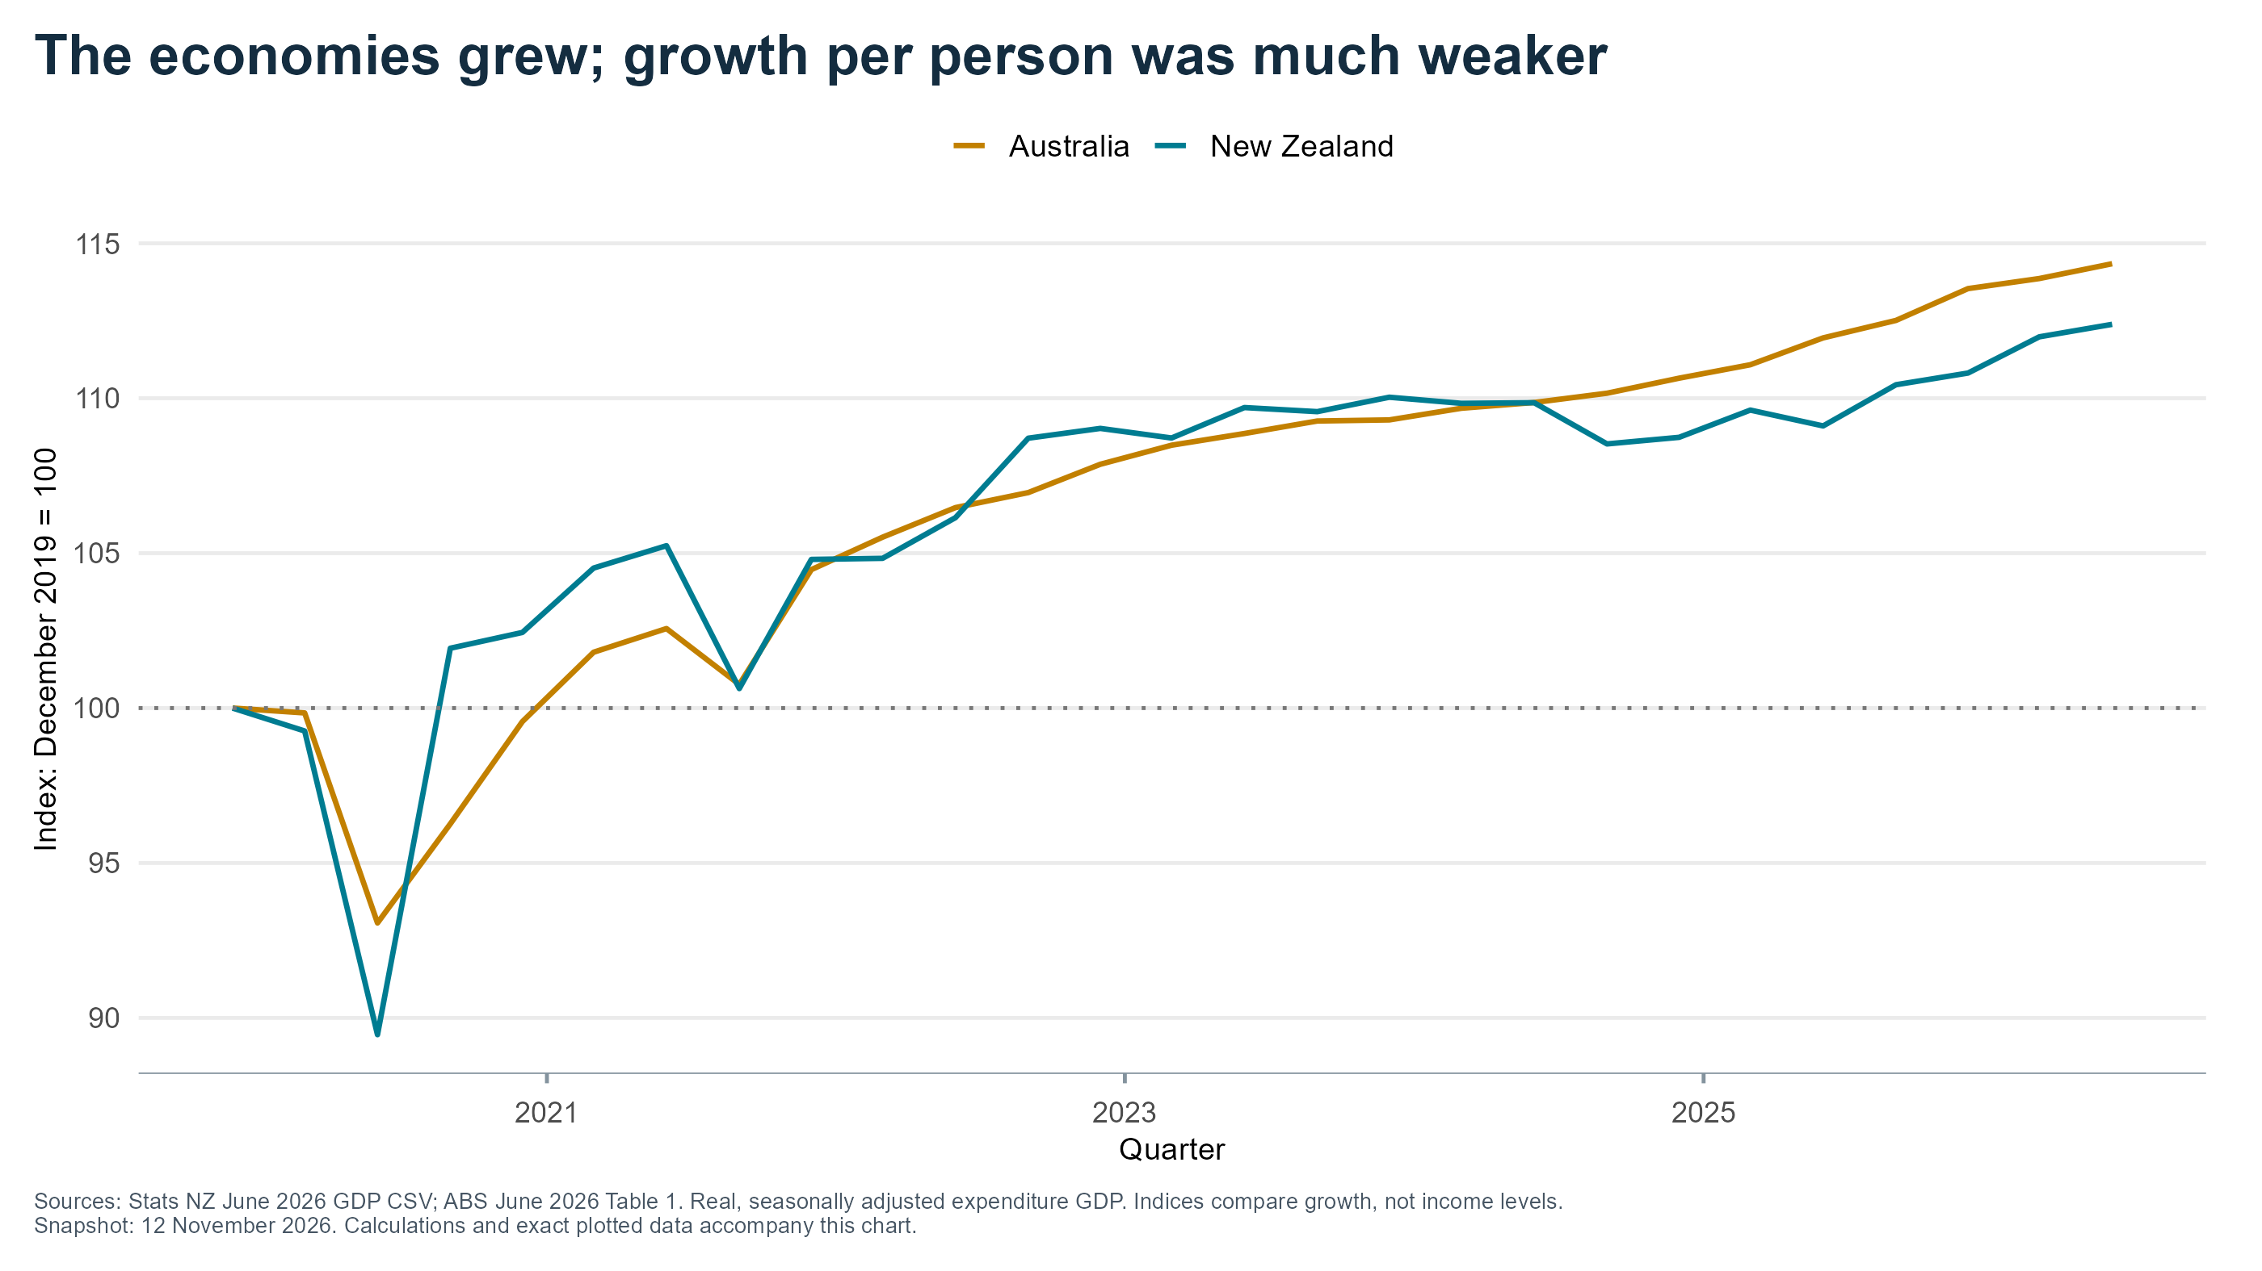
Notes:
P01: The economies grew; growth per person was much weaker
Priority: Main deck
Sources: Stats NZ June 2026 GDP CSV; ABS June 2026 Table 1. Real, seasonally adjusted expenditure GDP. Indices compare growth, not income levels.
X axis: Quarter
Y axis: Index: December 2019 = 100
Source/method: see data/series_selection.csv, data/source_manifest.csv and matching figures/P01.csv.
Evidence cutoff 12 November 2026; preliminary election results.

Slide 2
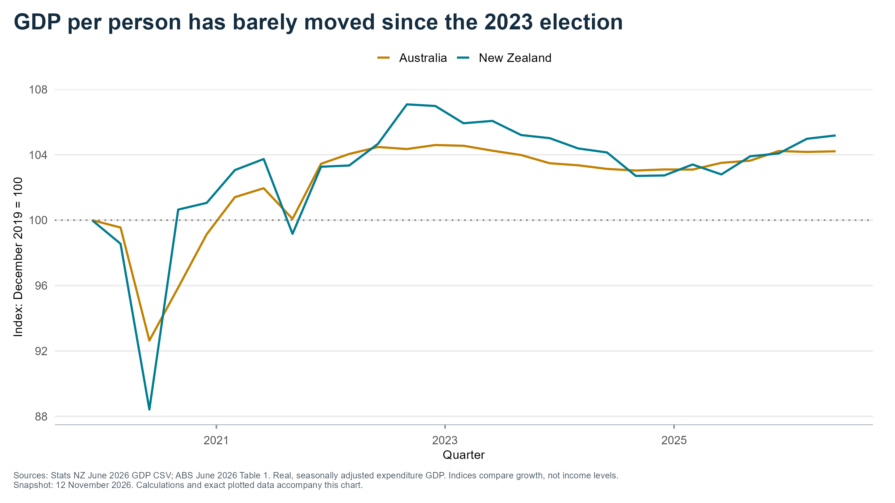
Notes:
P02: GDP per person has barely moved since the 2023 election
Priority: Main deck
Sources: Stats NZ June 2026 GDP CSV; ABS June 2026 Table 1. Real, seasonally adjusted expenditure GDP. Indices compare growth, not income levels.
X axis: Quarter
Y axis: Index: December 2019 = 100
Source/method: see data/series_selection.csv, data/source_manifest.csv and matching figures/P02.csv.
Evidence cutoff 12 November 2026; preliminary election results.

Slide 3
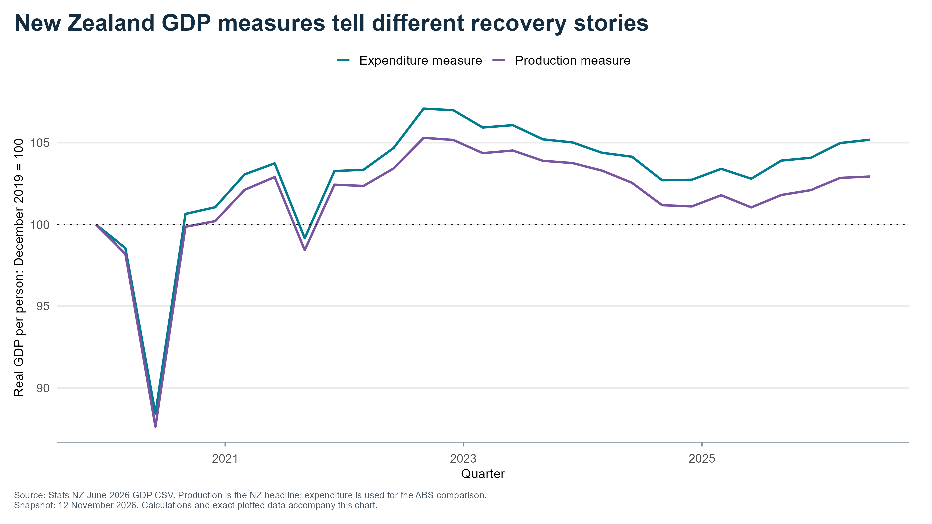
Notes:
P03: New Zealand GDP measures tell different recovery stories
Priority: Appendix
Source: Stats NZ June 2026 GDP CSV. Production is the NZ headline; expenditure is used for the ABS comparison.
X axis: Quarter
Y axis: Real GDP per person: December 2019 = 100
Source/method: see data/series_selection.csv, data/source_manifest.csv and matching figures/P03.csv.
Evidence cutoff 12 November 2026; preliminary election results.

Slide 4
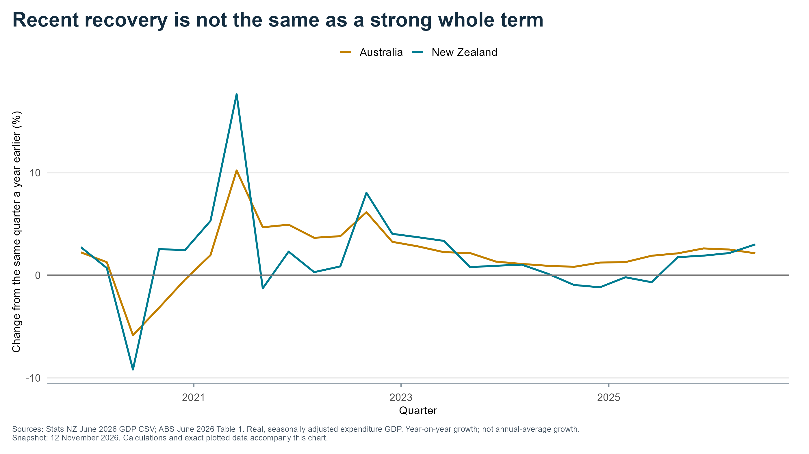
Notes:
P04: Recent recovery is not the same as a strong whole term
Priority: Appendix
Sources: Stats NZ June 2026 GDP CSV; ABS June 2026 Table 1. Real, seasonally adjusted expenditure GDP. Year-on-year growth; not annual-average growth.
X axis: Quarter
Y axis: Change from the same quarter a year earlier (%)
Source/method: see data/series_selection.csv, data/source_manifest.csv and matching figures/P04.csv.
Evidence cutoff 12 November 2026; preliminary election results.

Slide 5
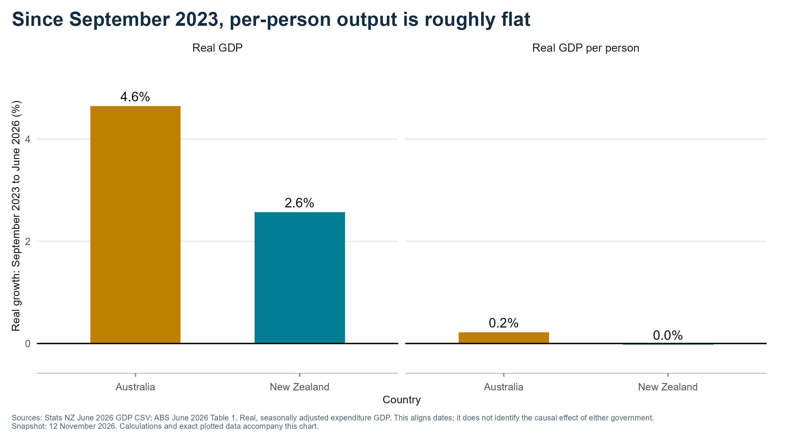
Notes:
P05: Since September 2023, per-person output is roughly flat
Priority: Main deck
Sources: Stats NZ June 2026 GDP CSV; ABS June 2026 Table 1. Real, seasonally adjusted expenditure GDP. This aligns dates; it does not identify the causal effect of either government.
X axis: Country
Y axis: Real growth: September 2023 to June 2026 (%)
Source/method: see data/series_selection.csv, data/source_manifest.csv and matching figures/P05.csv.
Evidence cutoff 12 November 2026; preliminary election results.

Slide 6
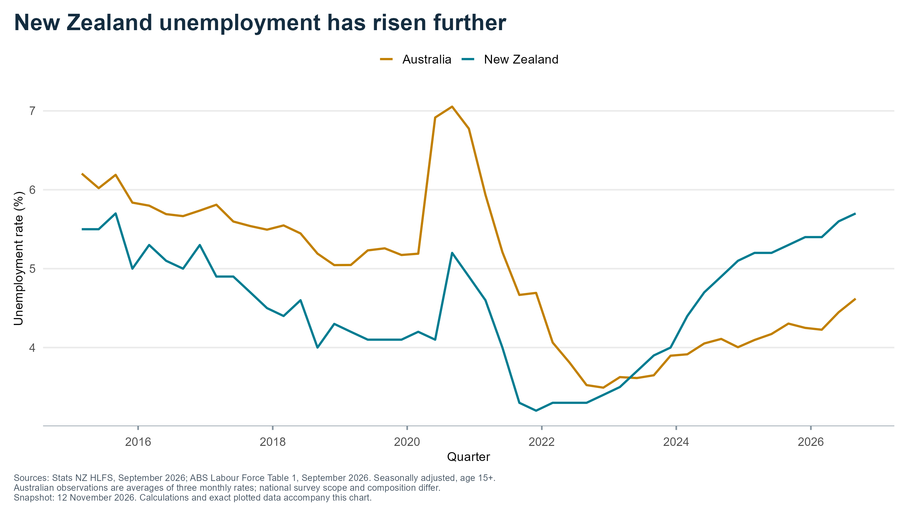
Notes:
P06: New Zealand unemployment has risen further
Priority: Main deck
Sources: Stats NZ HLFS, September 2026; ABS Labour Force Table 1, September 2026. Seasonally adjusted, age 15+.
Australian observations are averages of three monthly rates; national survey scope and composition differ.
X axis: Quarter
Y axis: Unemployment rate (%)
Source/method: see data/series_selection.csv, data/source_manifest.csv and matching figures/P06.csv.
Evidence cutoff 12 November 2026; preliminary election results.

Slide 7
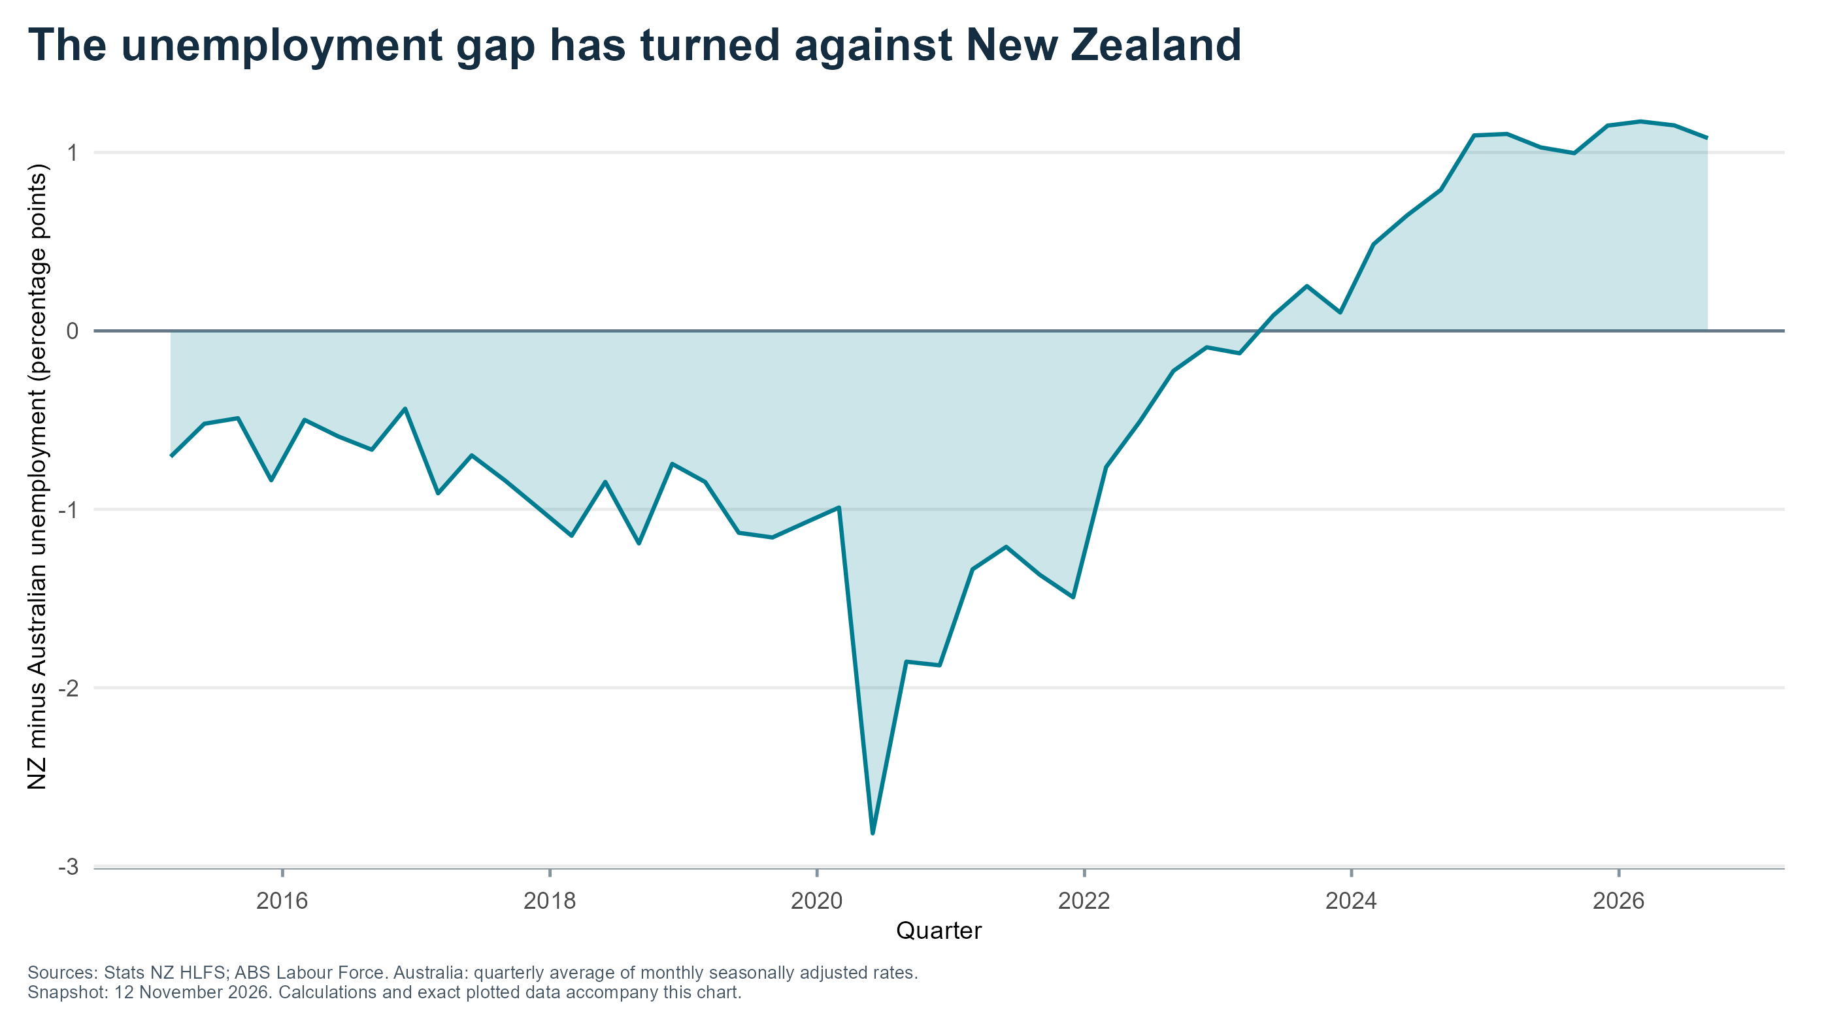
Notes:
P07: The unemployment gap has turned against New Zealand
Priority: Appendix
Sources: Stats NZ HLFS; ABS Labour Force. Australia: quarterly average of monthly seasonally adjusted rates.
X axis: Quarter
Y axis: NZ minus Australian unemployment (percentage points)
Source/method: see data/series_selection.csv, data/source_manifest.csv and matching figures/P07.csv.
Evidence cutoff 12 November 2026; preliminary election results.

Slide 8
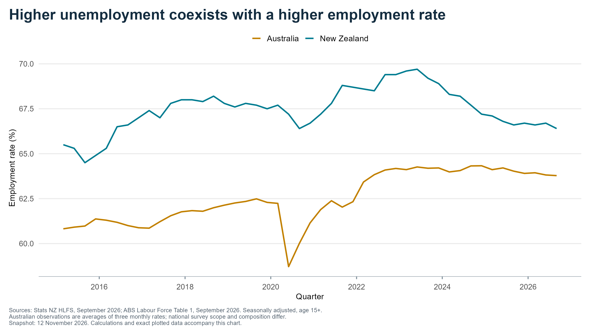
Notes:
P08: Higher unemployment coexists with a higher employment rate
Priority: Appendix
Sources: Stats NZ HLFS, September 2026; ABS Labour Force Table 1, September 2026. Seasonally adjusted, age 15+.
Australian observations are averages of three monthly rates; national survey scope and composition differ.
X axis: Quarter
Y axis: Employment rate (%)
Source/method: see data/series_selection.csv, data/source_manifest.csv and matching figures/P08.csv.
Evidence cutoff 12 November 2026; preliminary election results.

Slide 9
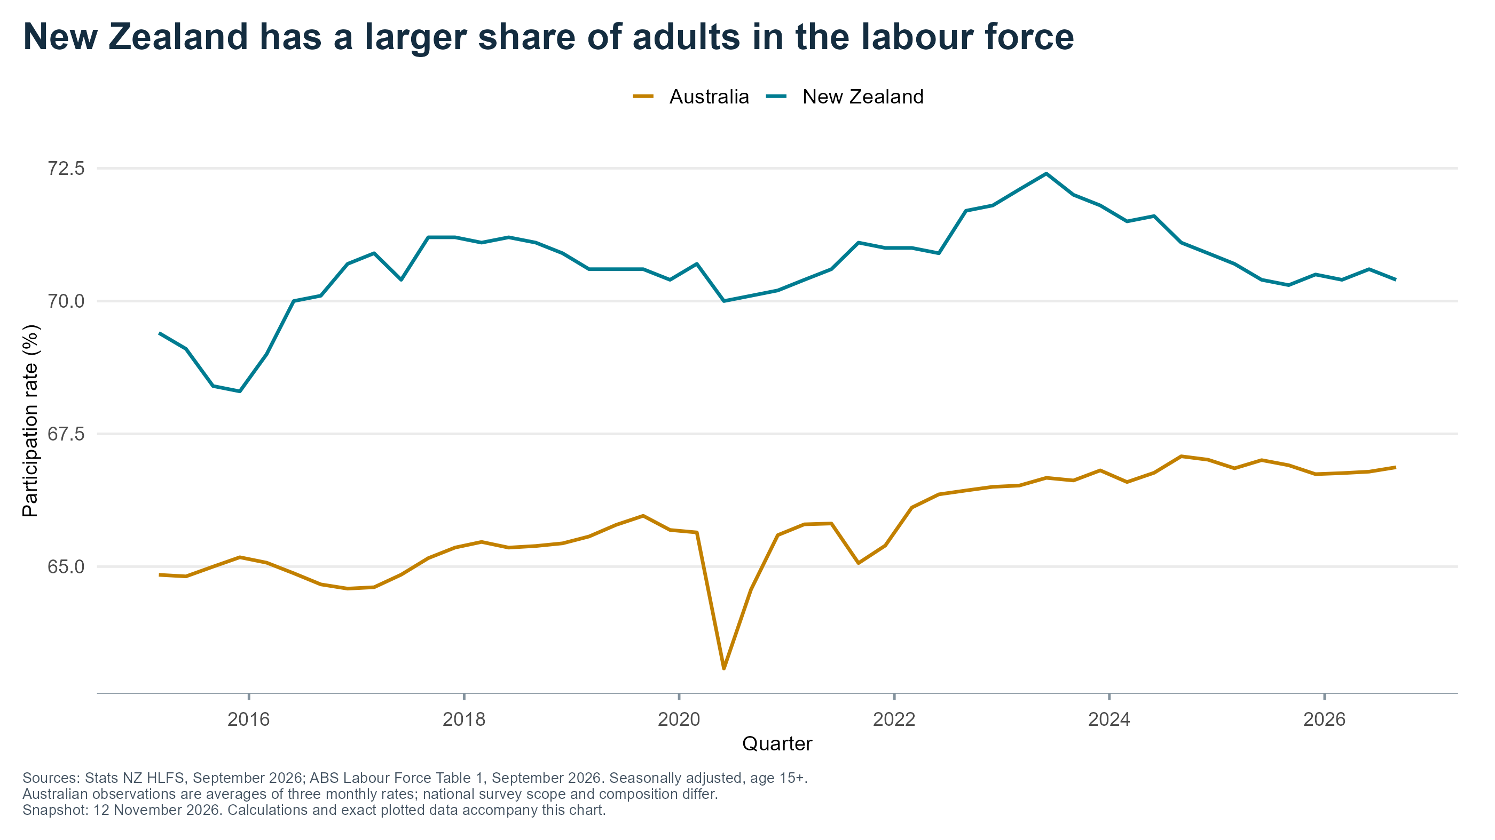
Notes:
P09: New Zealand has a larger share of adults in the labour force
Priority: Appendix
Sources: Stats NZ HLFS, September 2026; ABS Labour Force Table 1, September 2026. Seasonally adjusted, age 15+.
Australian observations are averages of three monthly rates; national survey scope and composition differ.
X axis: Quarter
Y axis: Participation rate (%)
Source/method: see data/series_selection.csv, data/source_manifest.csv and matching figures/P09.csv.
Evidence cutoff 12 November 2026; preliminary election results.

Slide 10
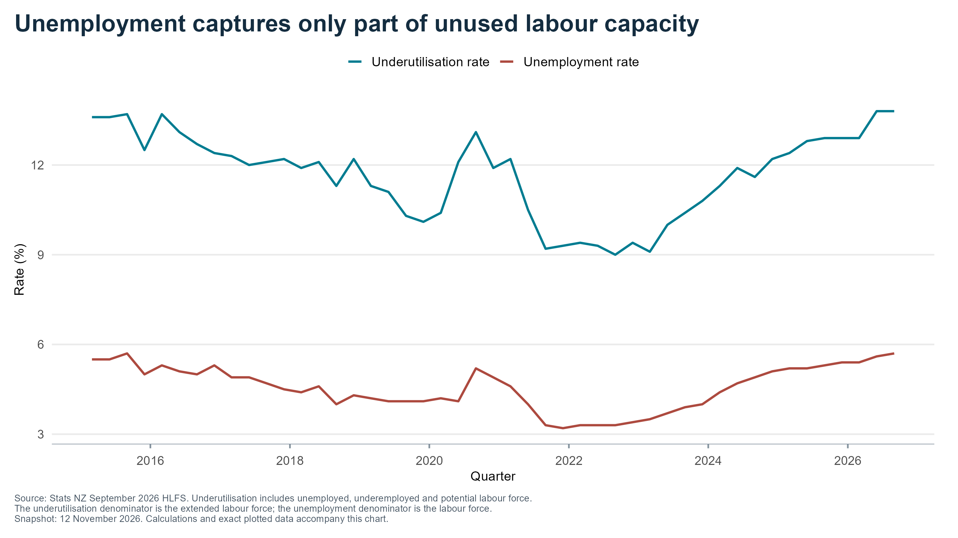
Notes:
P10: Unemployment captures only part of unused labour capacity
Priority: Appendix
Source: Stats NZ September 2026 HLFS. Underutilisation includes unemployed, underemployed and potential labour force.
The underutilisation denominator is the extended labour force; the unemployment denominator is the labour force.
X axis: Quarter
Y axis: Rate (%)
Source/method: see data/series_selection.csv, data/source_manifest.csv and matching figures/P10.csv.
Evidence cutoff 12 November 2026; preliminary election results.

Slide 11
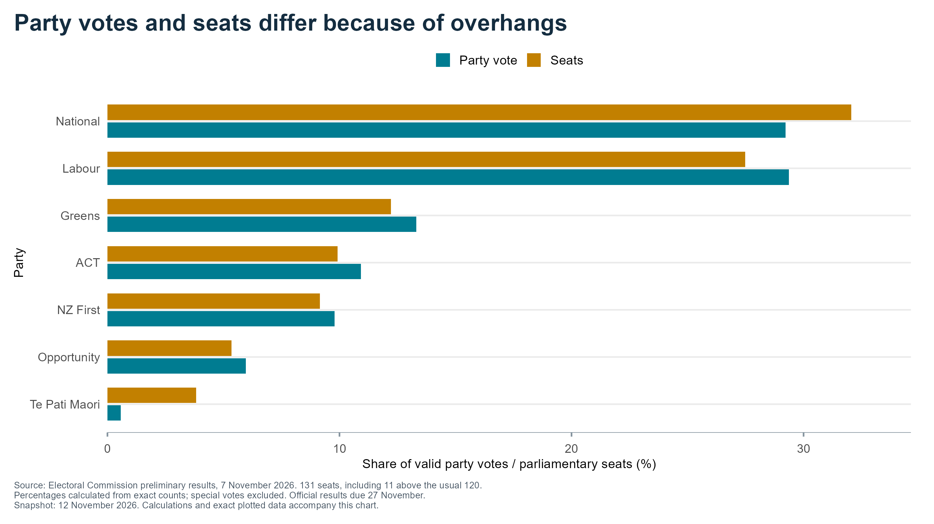
Notes:
P11: Party votes and seats differ because of overhangs
Priority: Main deck
Source: Electoral Commission preliminary results, 7 November 2026. 131 seats, including 11 above the usual 120.
Percentages calculated from exact counts; special votes excluded. Official results due 27 November.
X axis: Share of valid party votes / parliamentary seats (%)
Y axis: Party
Source/method: see data/series_selection.csv, data/source_manifest.csv and matching figures/P11.csv.
Evidence cutoff 12 November 2026; preliminary election results.

Slide 12
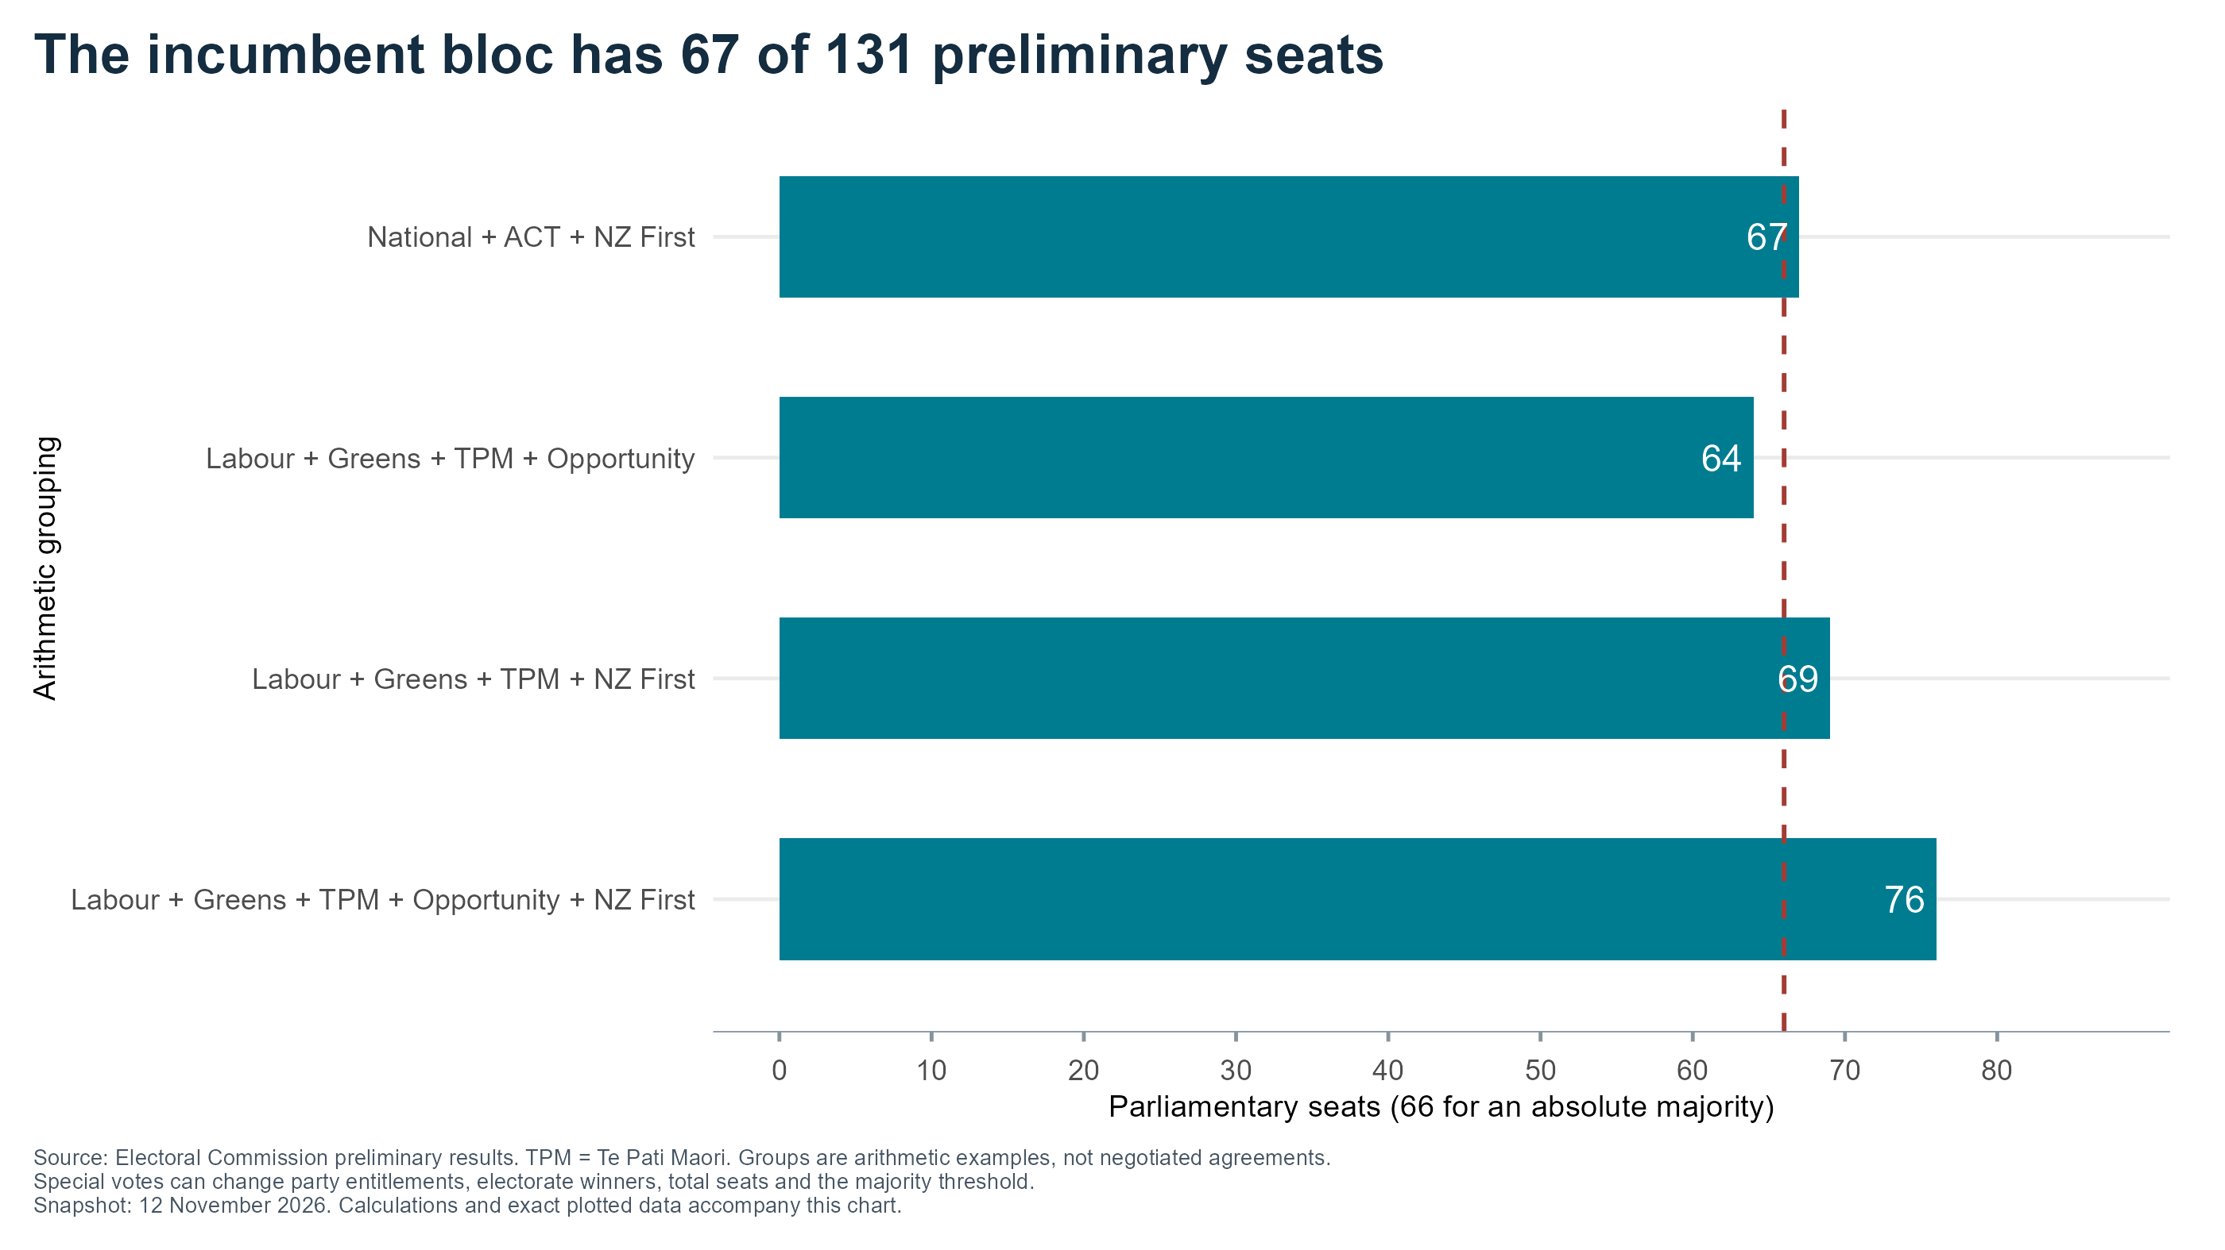
Notes:
P12: The incumbent bloc has 67 of 131 preliminary seats
Priority: Main deck
Source: Electoral Commission preliminary results. TPM = Te Pati Maori. Groups are arithmetic examples, not negotiated agreements.
Special votes can change party entitlements, electorate winners, total seats and the majority threshold.
X axis: Parliamentary seats (66 for an absolute majority)
Y axis: Arithmetic grouping
Source/method: see data/series_selection.csv, data/source_manifest.csv and matching figures/P12.csv.
Evidence cutoff 12 November 2026; preliminary election results.

Slide 13
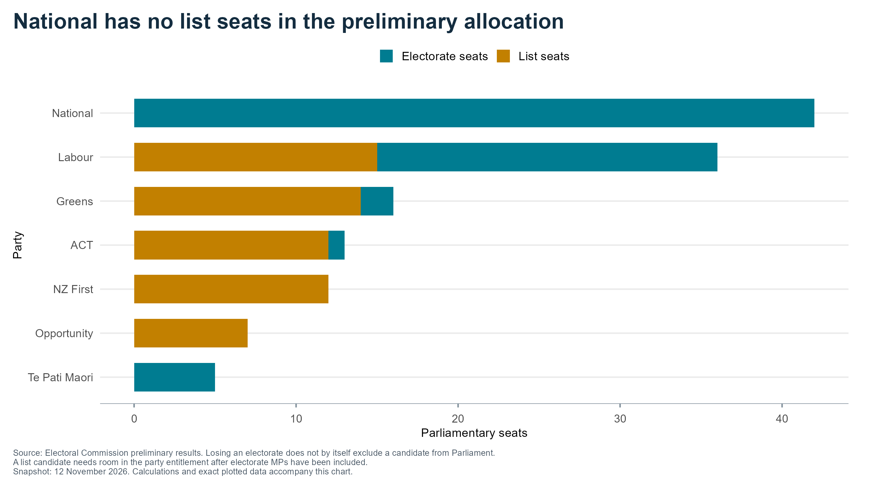
Notes:
P13: National has no list seats in the preliminary allocation
Priority: Appendix
Source: Electoral Commission preliminary results. Losing an electorate does not by itself exclude a candidate from Parliament.
A list candidate needs room in the party entitlement after electorate MPs have been included.
X axis: Parliamentary seats
Y axis: Party
Source/method: see data/series_selection.csv, data/source_manifest.csv and matching figures/P13.csv.
Evidence cutoff 12 November 2026; preliminary election results.

Slide 14
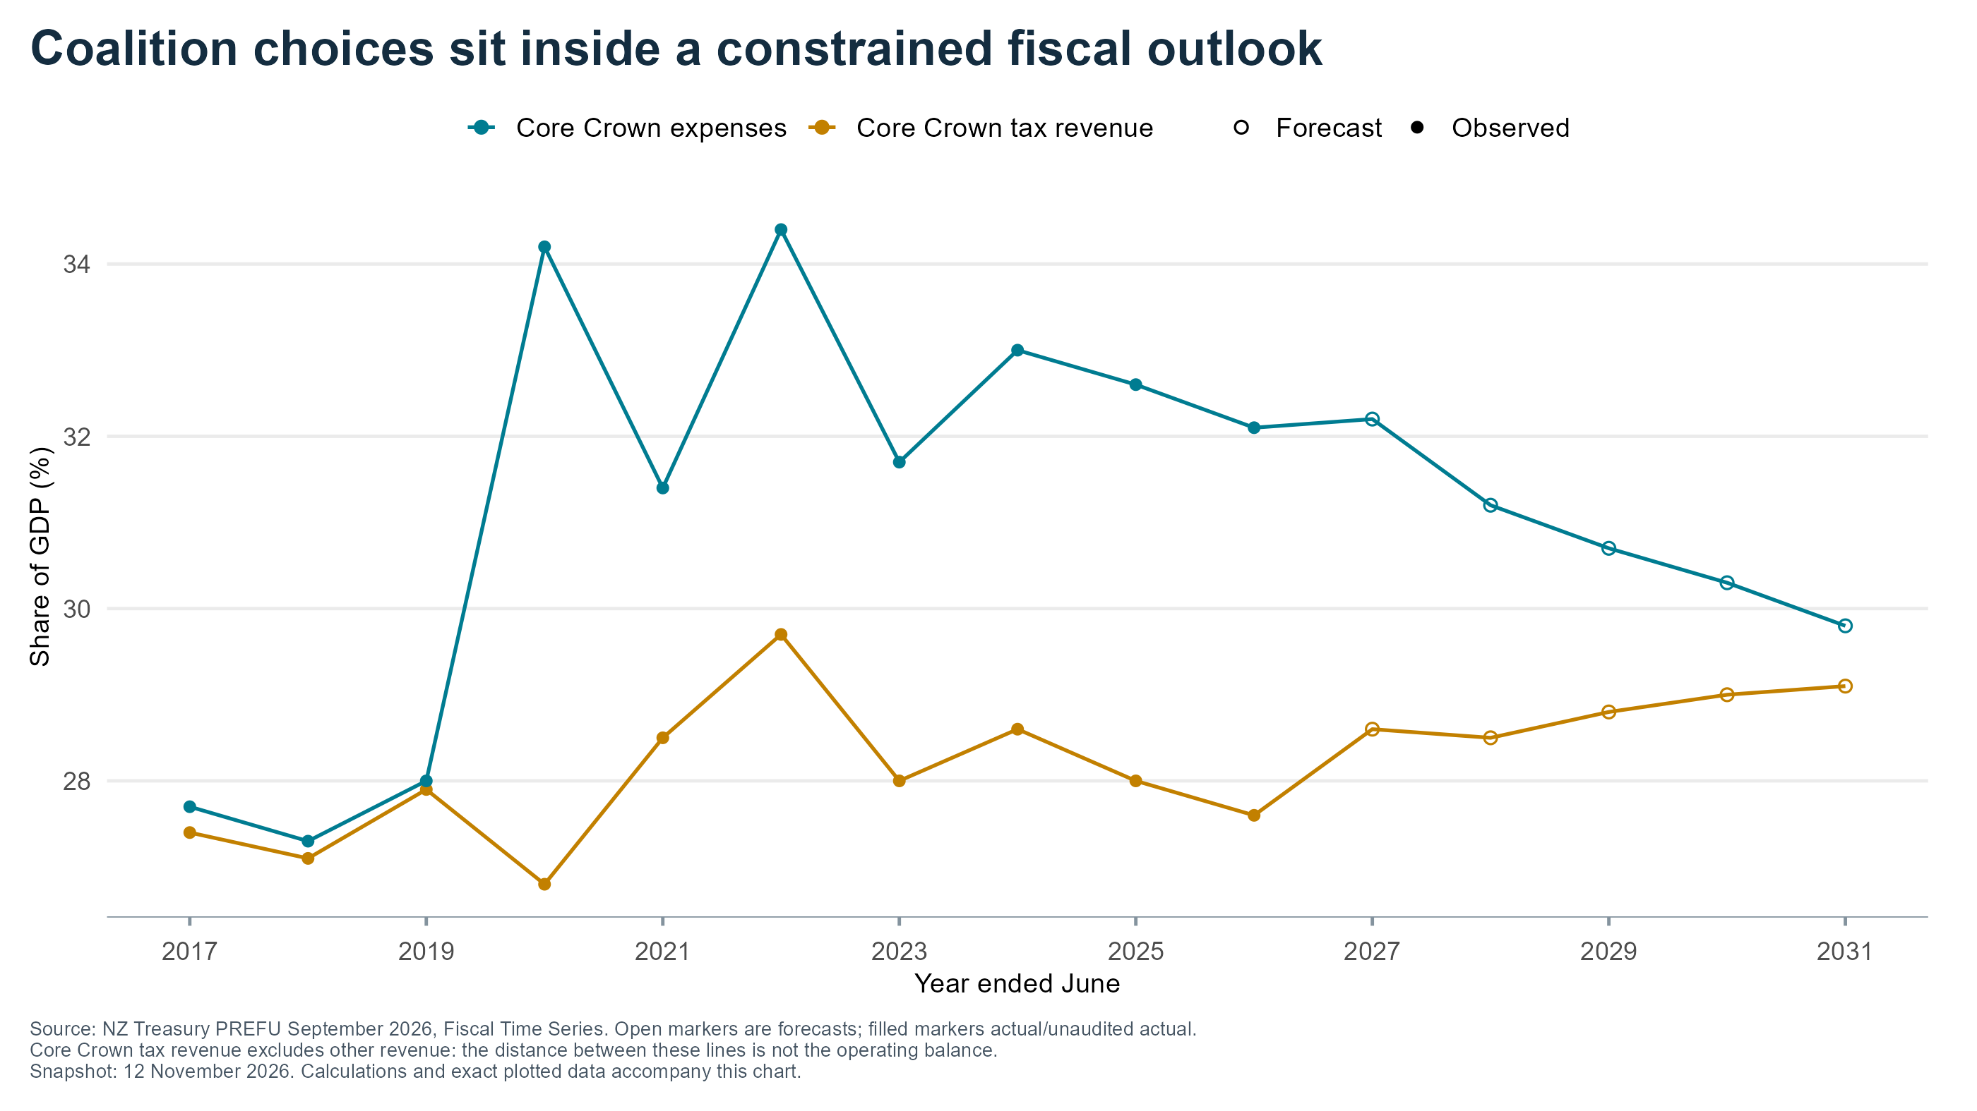
Notes:
P14: Coalition choices sit inside a constrained fiscal outlook
Priority: Appendix
Source: NZ Treasury PREFU September 2026, Fiscal Time Series. Open markers are forecasts; filled markers actual/unaudited actual.
Core Crown tax revenue excludes other revenue: the distance between these lines is not the operating balance.
X axis: Year ended June
Y axis: Share of GDP (%)
Source/method: see data/series_selection.csv, data/source_manifest.csv and matching figures/P14.csv.
Evidence cutoff 12 November 2026; preliminary election results.

Slide 15
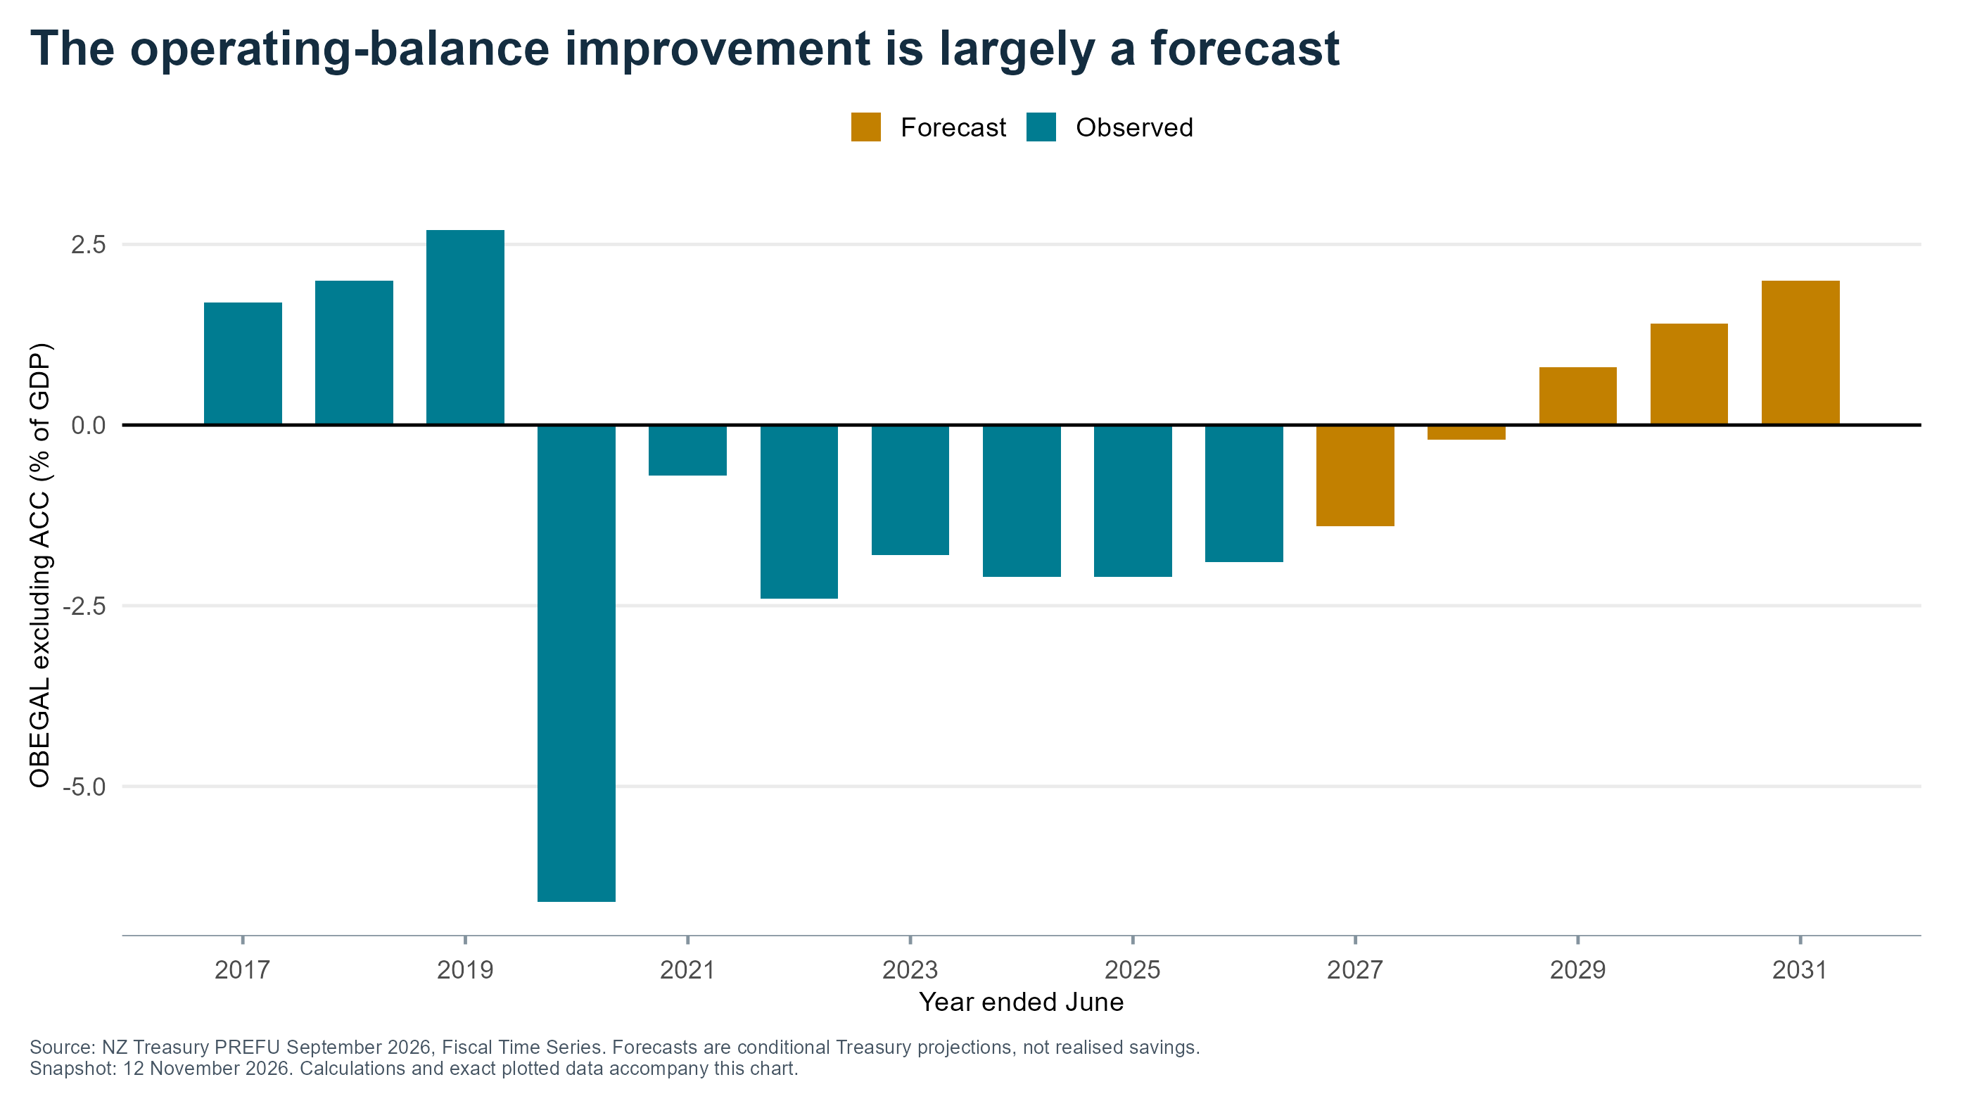
Notes:
P15: The operating-balance improvement is largely a forecast
Priority: Appendix
Source: NZ Treasury PREFU September 2026, Fiscal Time Series. Forecasts are conditional Treasury projections, not realised savings.
X axis: Year ended June
Y axis: OBEGAL excluding ACC (% of GDP)
Source/method: see data/series_selection.csv, data/source_manifest.csv and matching figures/P15.csv.
Evidence cutoff 12 November 2026; preliminary election results.

Slide 16
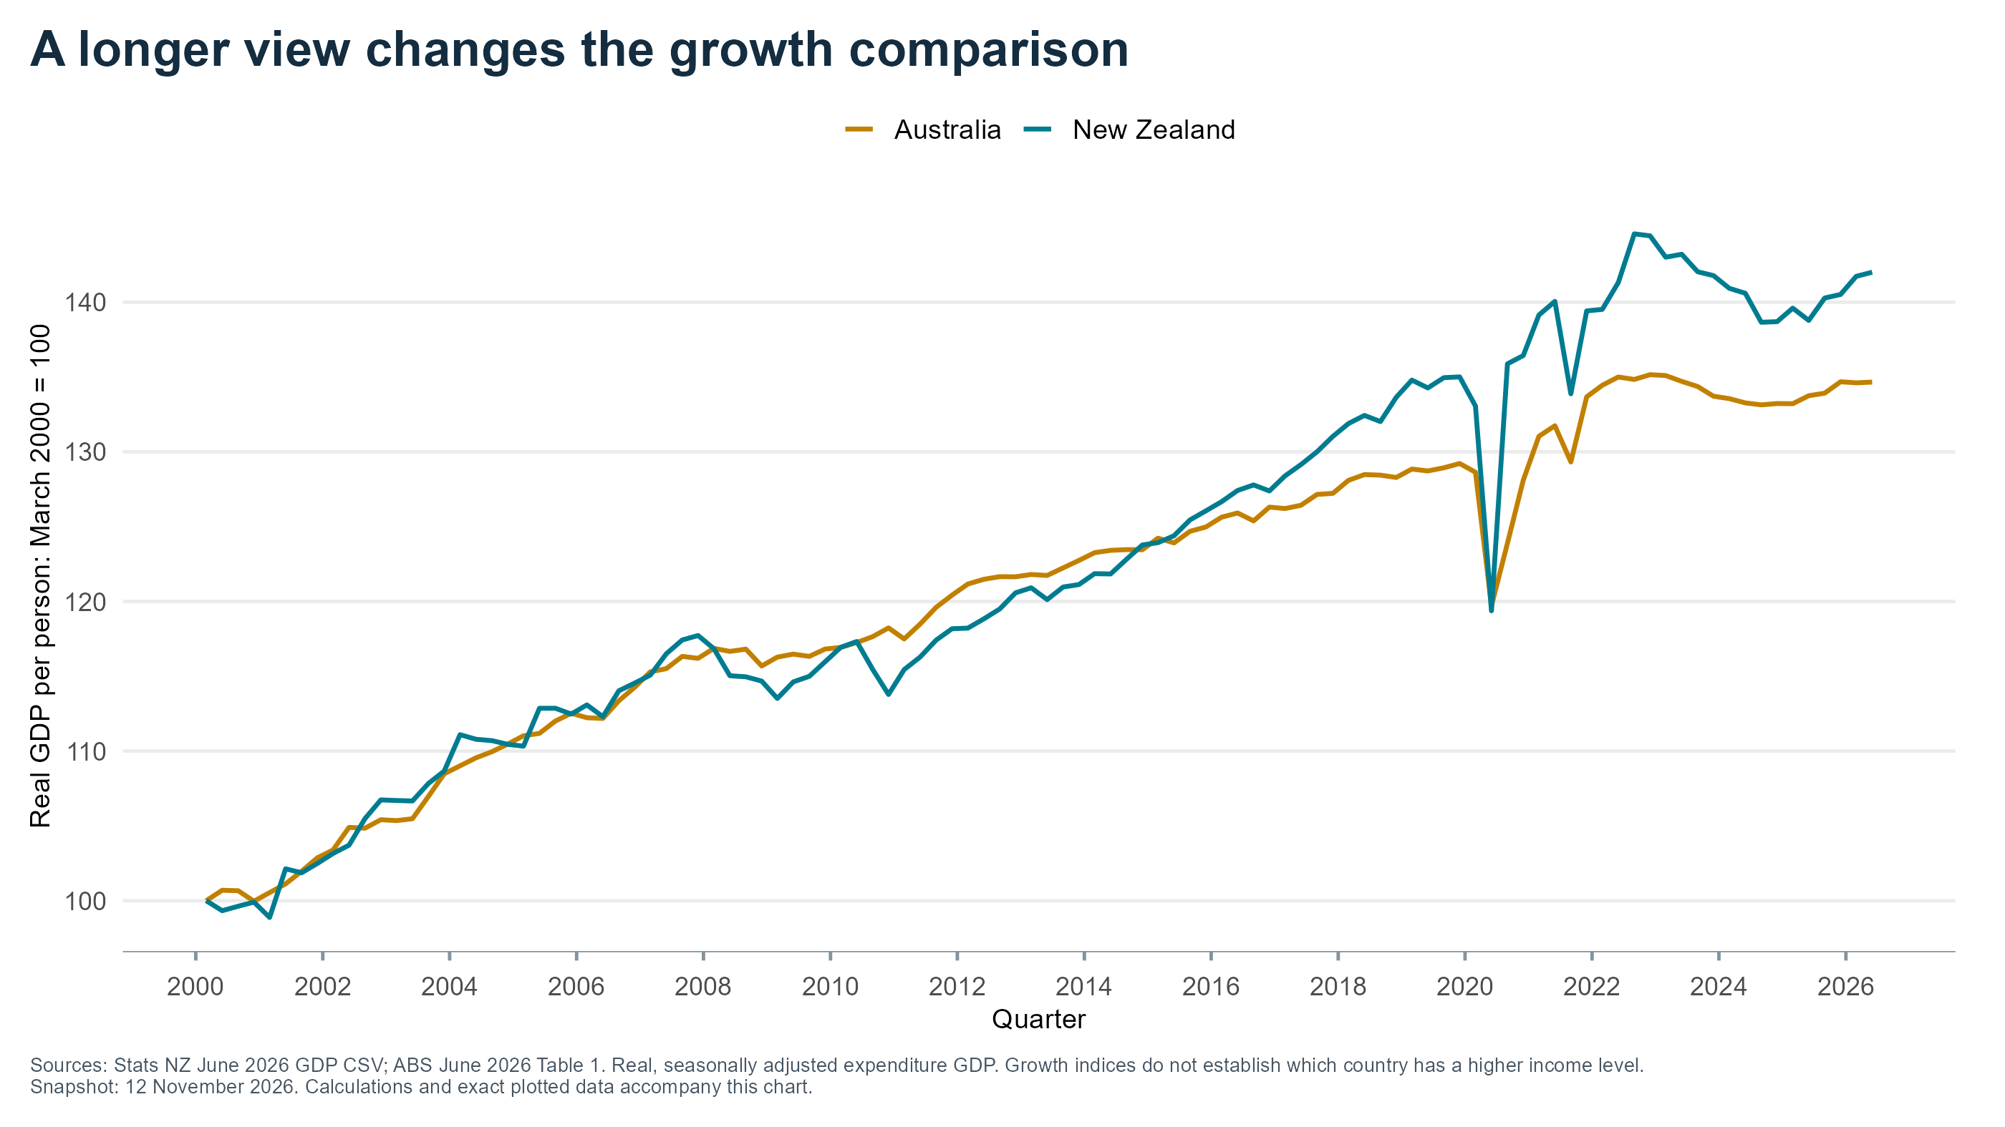
Notes:
P16: A longer view changes the growth comparison
Priority: Appendix
Sources: Stats NZ June 2026 GDP CSV; ABS June 2026 Table 1. Real, seasonally adjusted expenditure GDP. Growth indices do not establish which country has a higher income level.
X axis: Quarter
Y axis: Real GDP per person: March 2000 = 100
Source/method: see data/series_selection.csv, data/source_manifest.csv and matching figures/P16.csv.
Evidence cutoff 12 November 2026; preliminary election results.

Slide 17
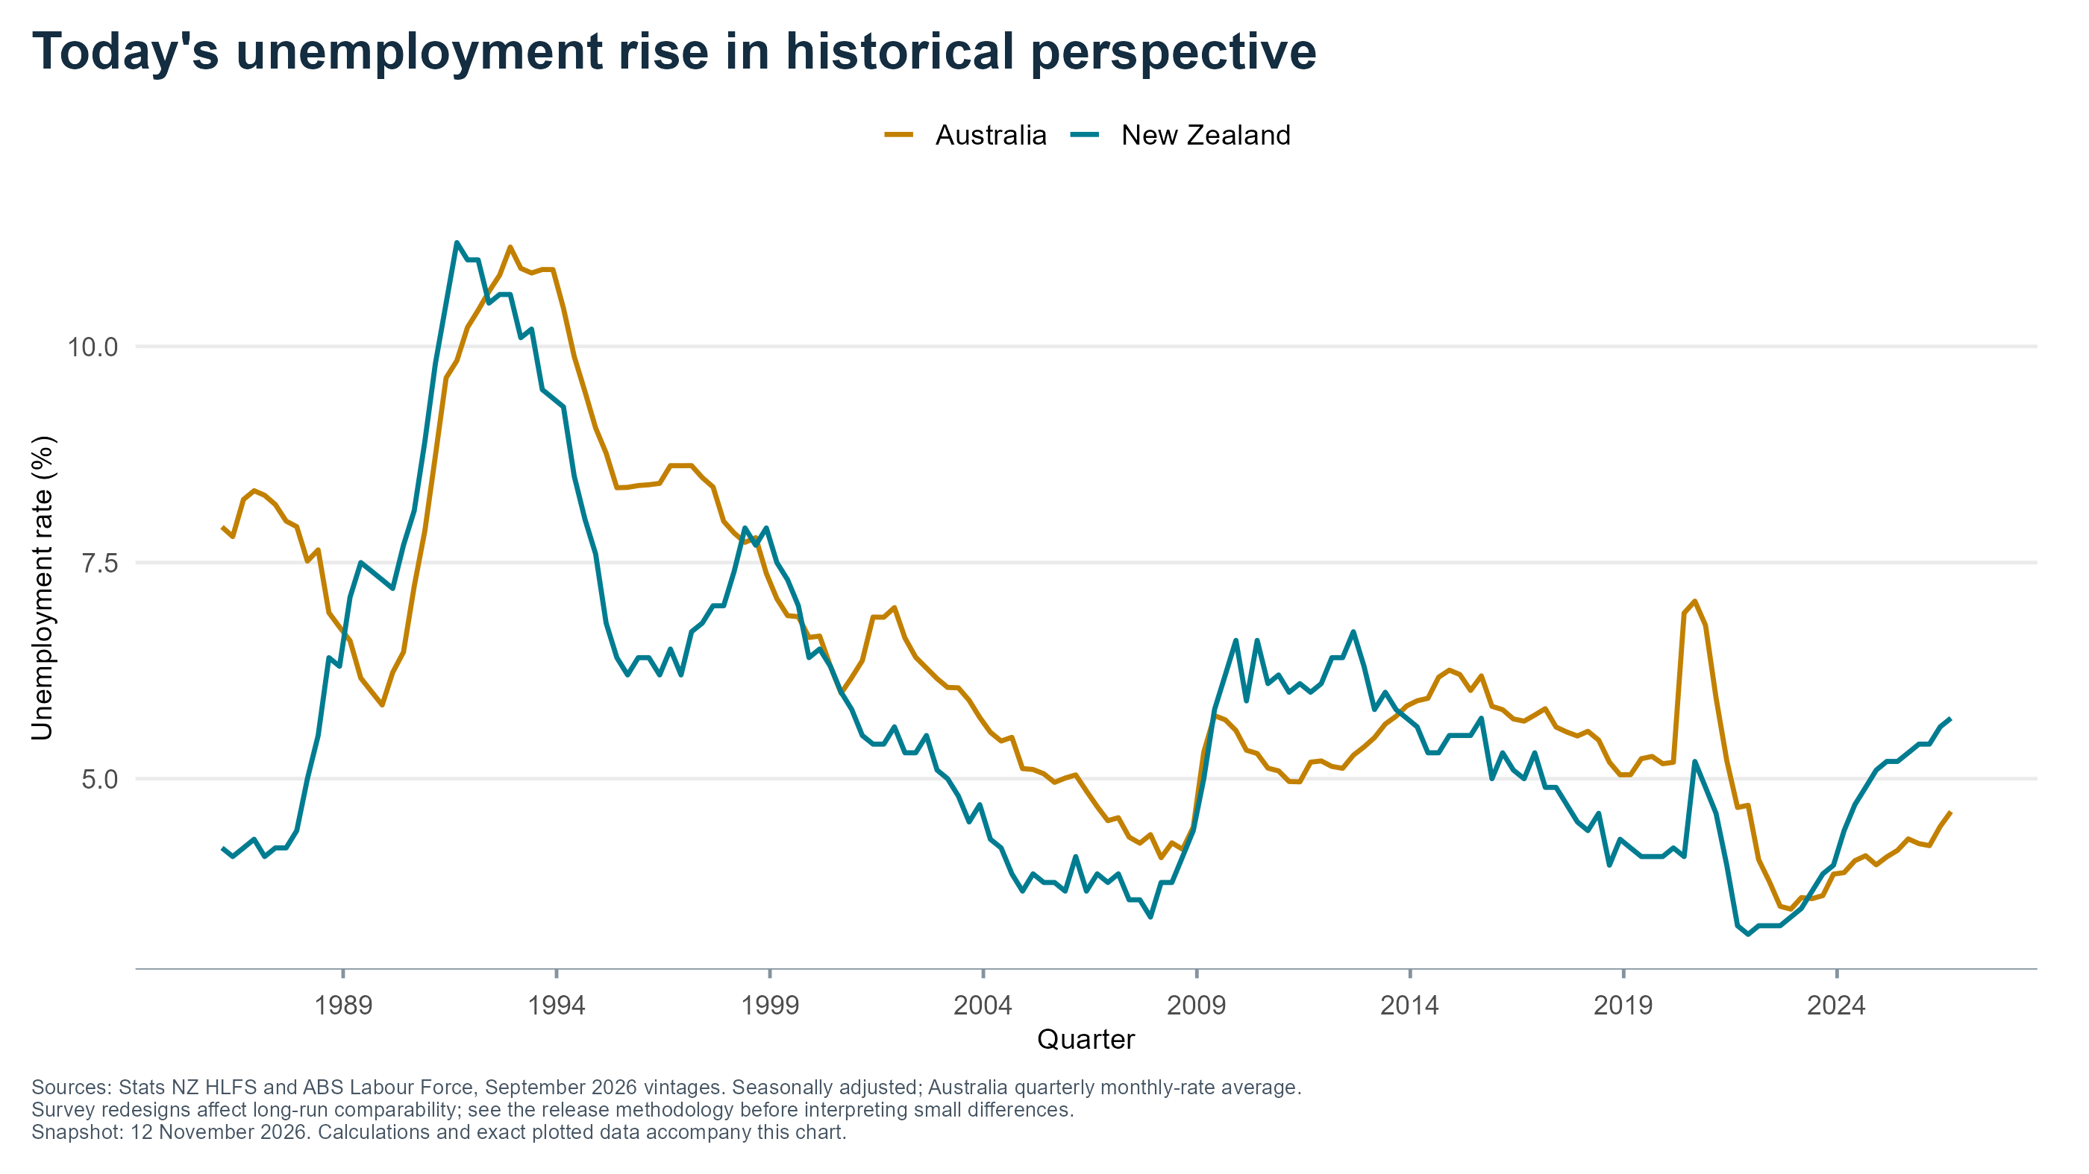
Notes:
P17: Today's unemployment rise in historical perspective
Priority: Appendix
Sources: Stats NZ HLFS and ABS Labour Force, September 2026 vintages. Seasonally adjusted; Australia quarterly monthly-rate average.
Survey redesigns affect long-run comparability; see the release methodology before interpreting small differences.
X axis: Quarter
Y axis: Unemployment rate (%)
Source/method: see data/series_selection.csv, data/source_manifest.csv and matching figures/P17.csv.
Evidence cutoff 12 November 2026; preliminary election results.

Slide 18
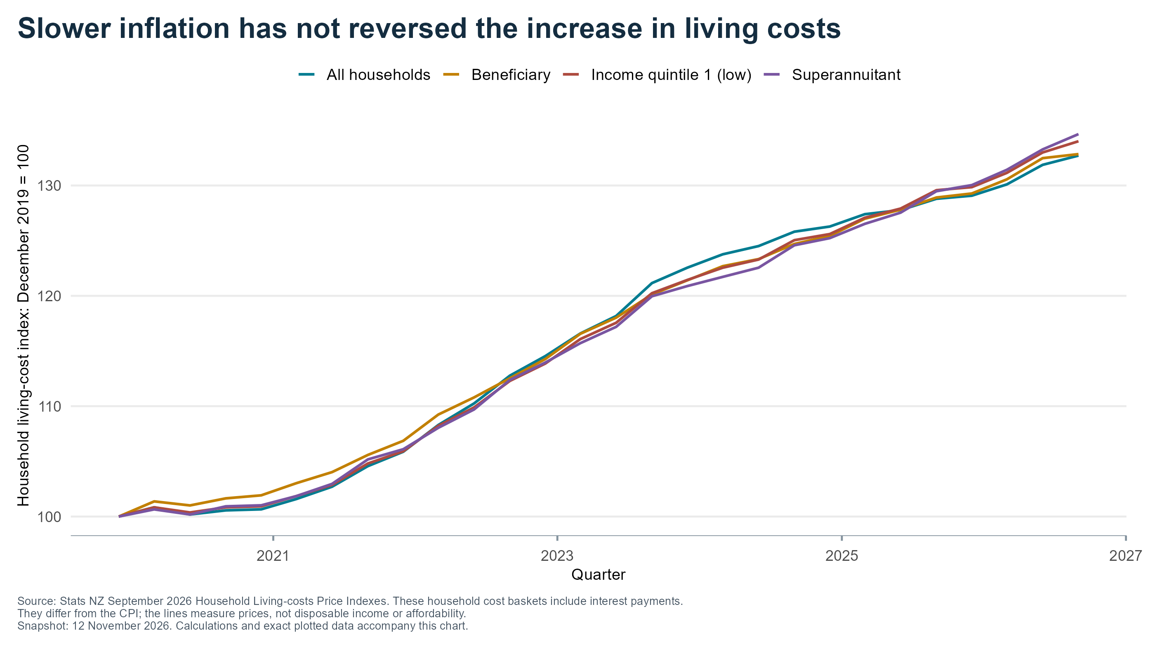
Notes:
P18: Slower inflation has not reversed the increase in living costs
Priority: Main deck
Source: Stats NZ September 2026 Household Living-costs Price Indexes. These household cost baskets include interest payments.
They differ from the CPI; the lines measure prices, not disposable income or affordability.
X axis: Quarter
Y axis: Household living-cost index: December 2019 = 100
Source/method: see data/series_selection.csv, data/source_manifest.csv and matching figures/P18.csv.
Evidence cutoff 12 November 2026; preliminary election results.

Slide 19
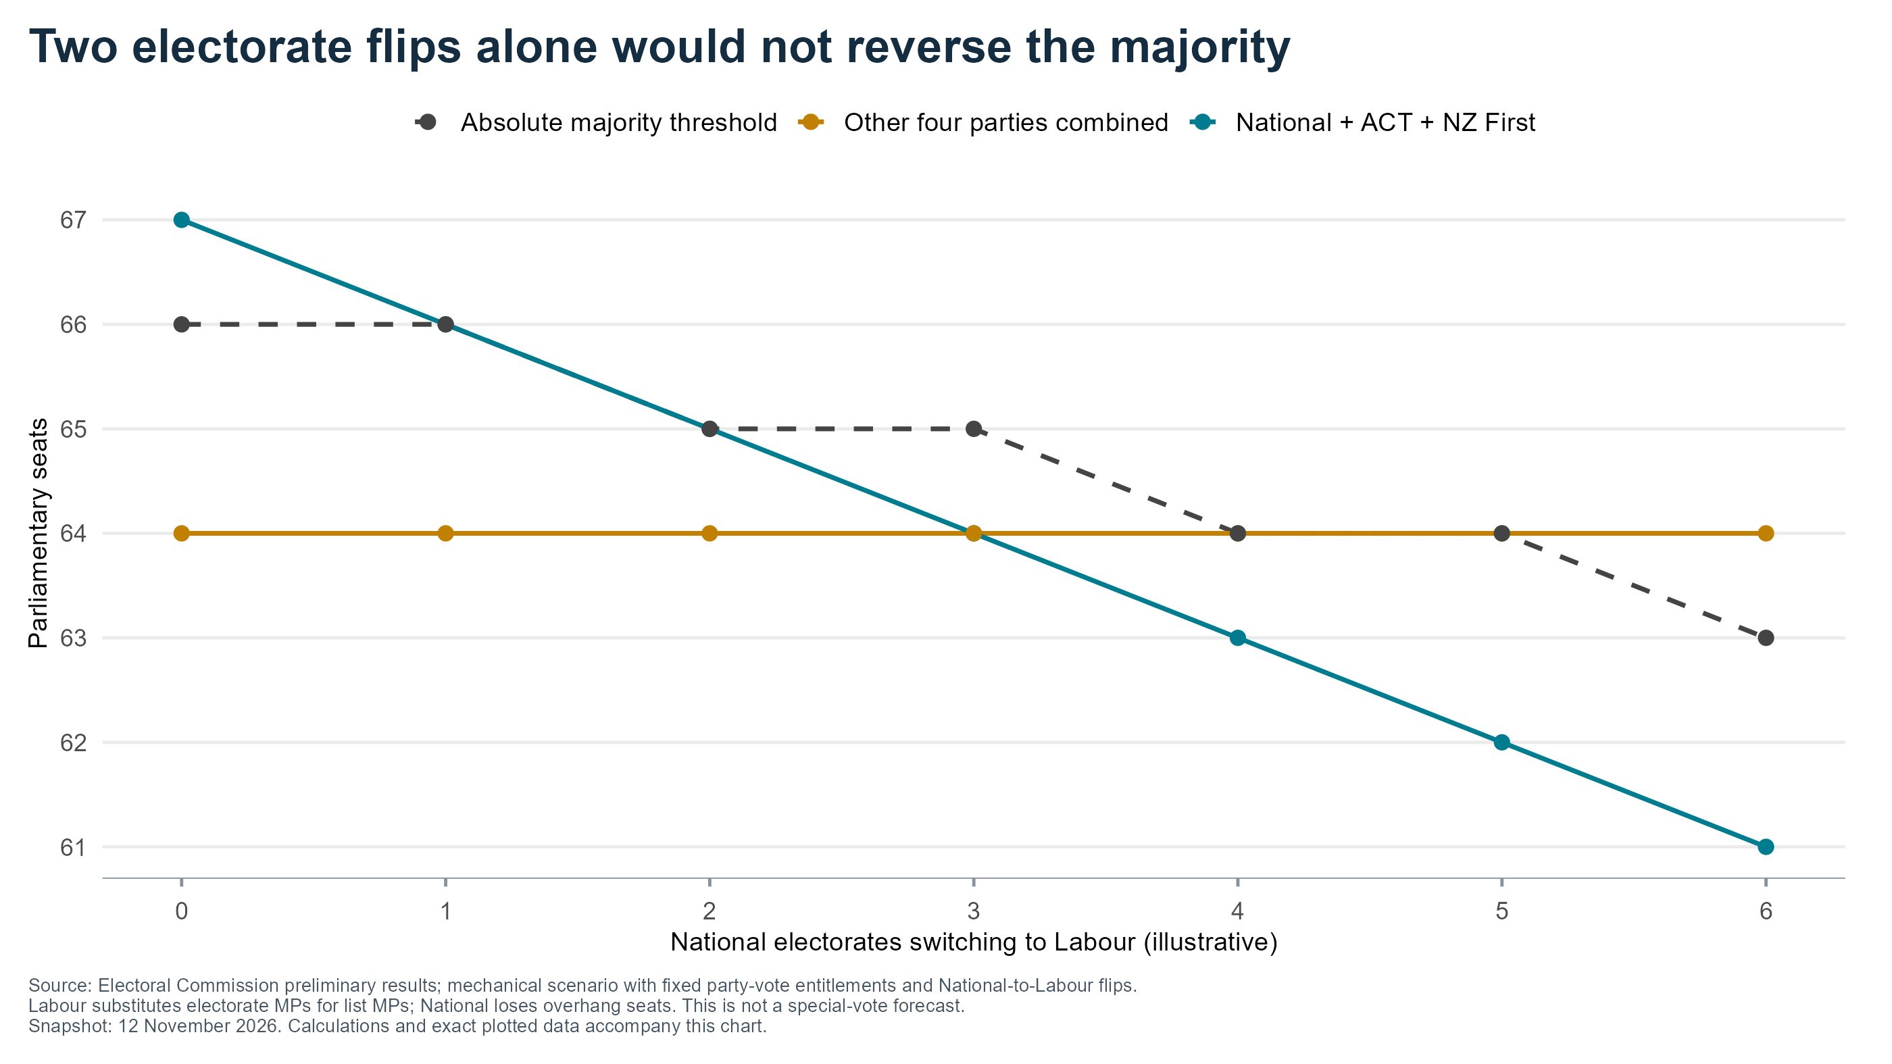
Notes:
P19: Two electorate flips alone would not reverse the majority
Priority: Appendix
Source: Electoral Commission preliminary results; mechanical scenario with fixed party-vote entitlements and National-to-Labour flips.
Labour substitutes electorate MPs for list MPs; National loses overhang seats. This is not a special-vote forecast.
X axis: National electorates switching to Labour (illustrative)
Y axis: Parliamentary seats
Source/method: see data/series_selection.csv, data/source_manifest.csv and matching figures/P19.csv.
Evidence cutoff 12 November 2026; preliminary election results.

Slide 20
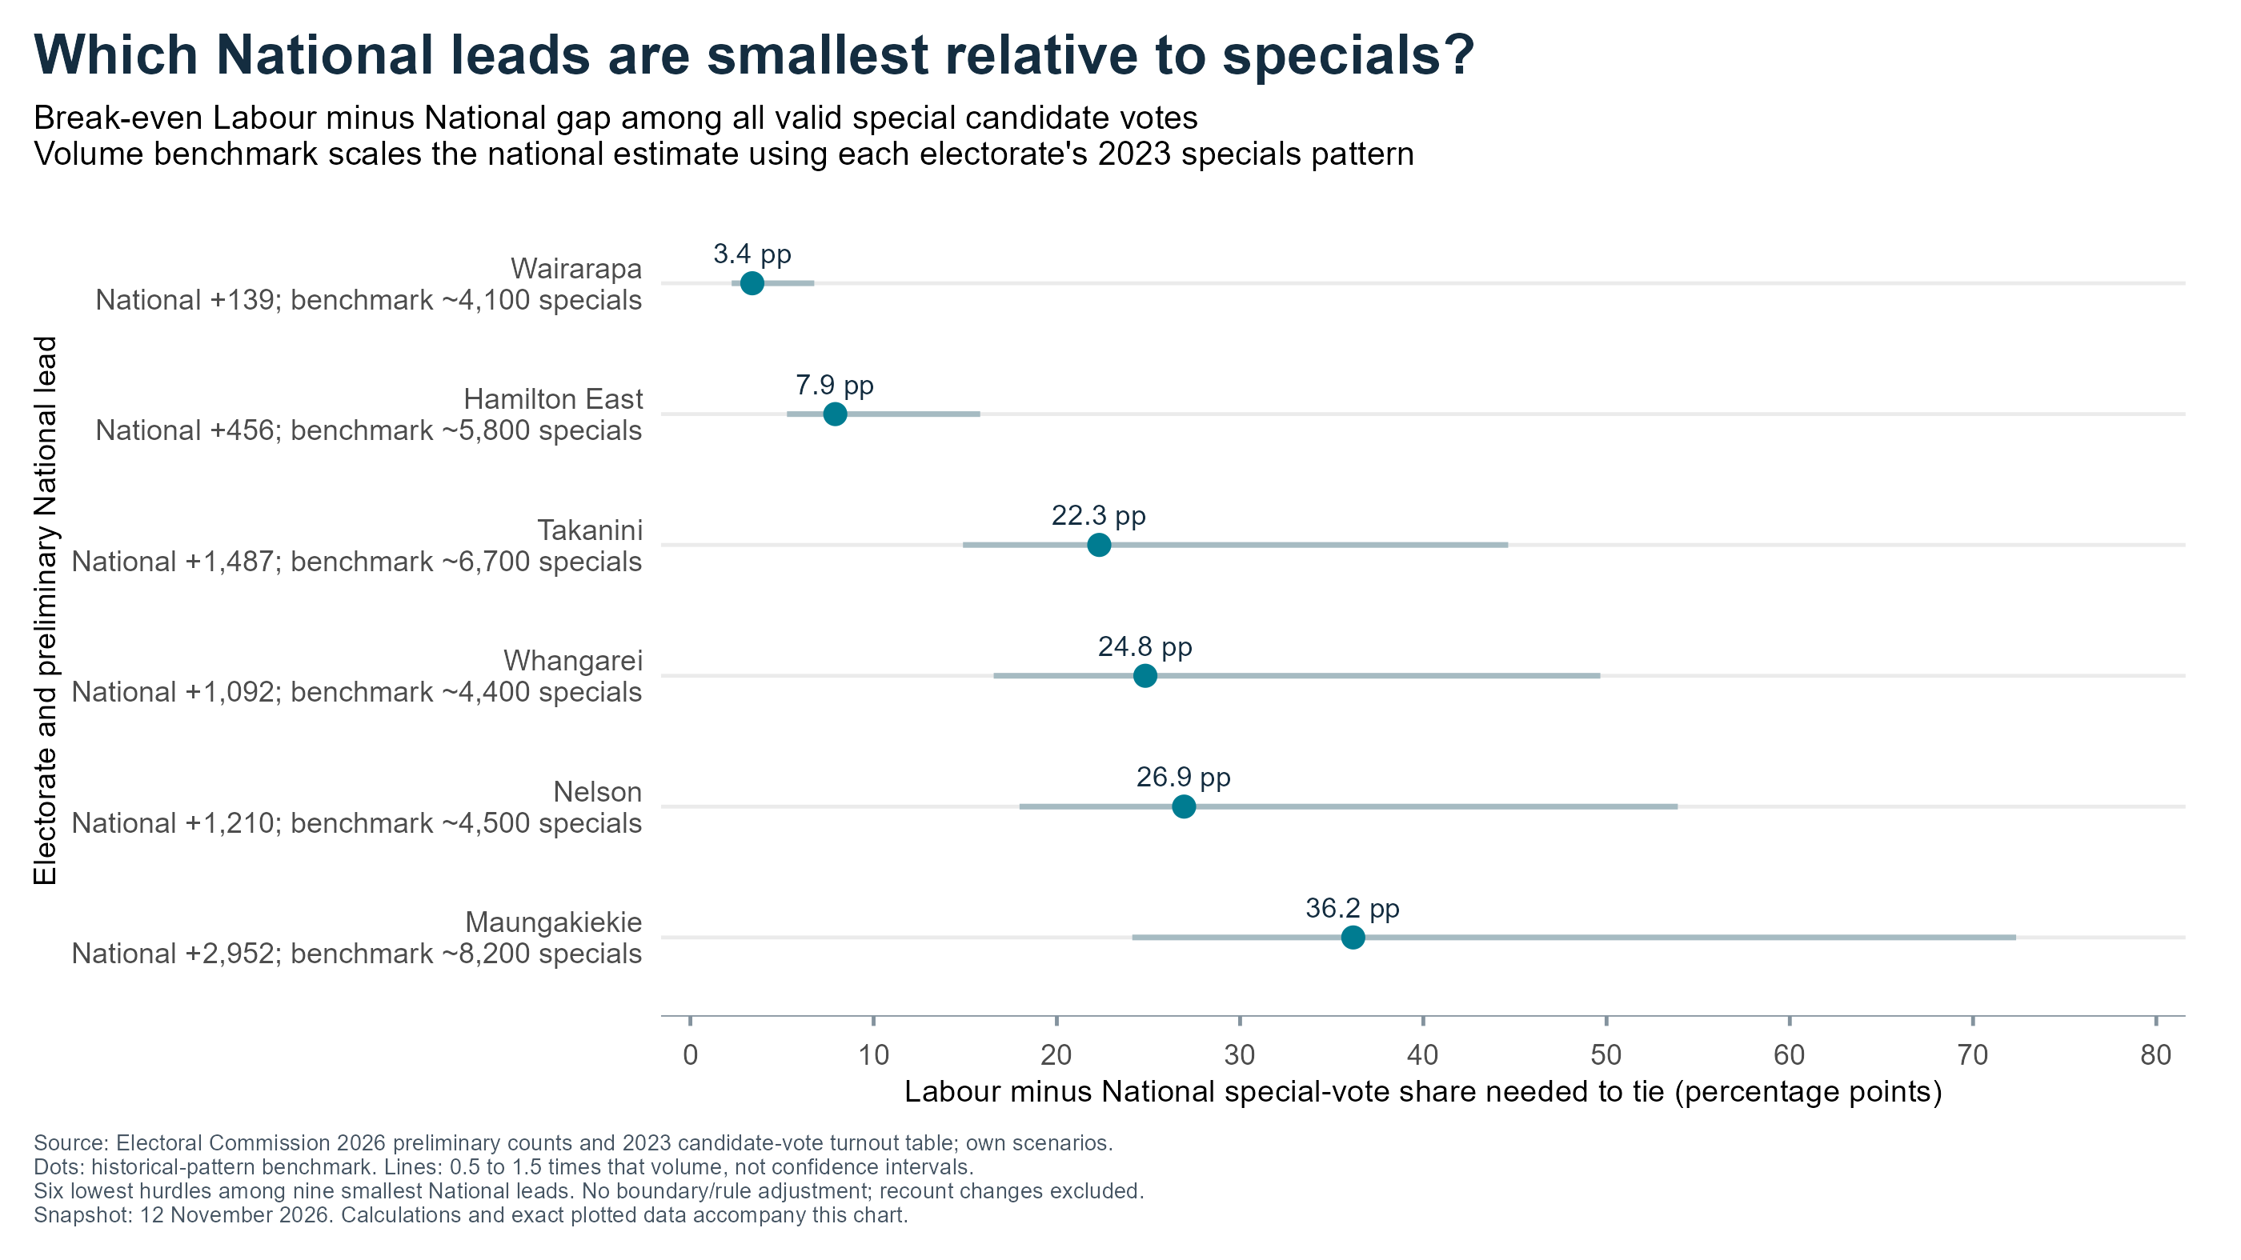
Notes:
P20: Which National leads are smallest relative to specials?
Priority: Main deck
Source: Electoral Commission 2026 preliminary counts and 2023 candidate-vote turnout table; own scenarios.
Dots: historical-pattern benchmark. Lines: 0.5 to 1.5 times that volume, not confidence intervals.
Six lowest hurdles among nine smallest National leads. No boundary/rule adjustment; recount changes excluded.
X axis: Labour minus National special-vote share needed to tie (percentage points)
Y axis: Electorate and preliminary National lead
Source/method: see data/series_selection.csv, data/source_manifest.csv and matching figures/P20.csv.
Evidence cutoff 12 November 2026; preliminary election results.

Slide 21
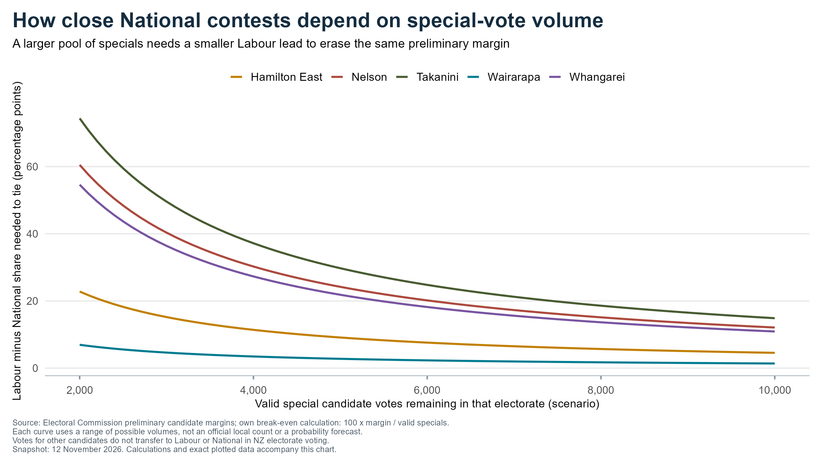
Notes:
P21: How close National contests depend on special-vote volume
Priority: Appendix
Source: Electoral Commission preliminary candidate margins; own break-even calculation: 100 x margin / valid specials.
Each curve uses a range of possible volumes, not an official local count or a probability forecast.
Votes for other candidates do not transfer to Labour or National in NZ electorate voting.
X axis: Valid special candidate votes remaining in that electorate (scenario)
Y axis: Labour minus National share needed to tie (percentage points)
Source/method: see data/series_selection.csv, data/source_manifest.csv and matching figures/P21.csv.
Evidence cutoff 12 November 2026; preliminary election results.

Slide 22
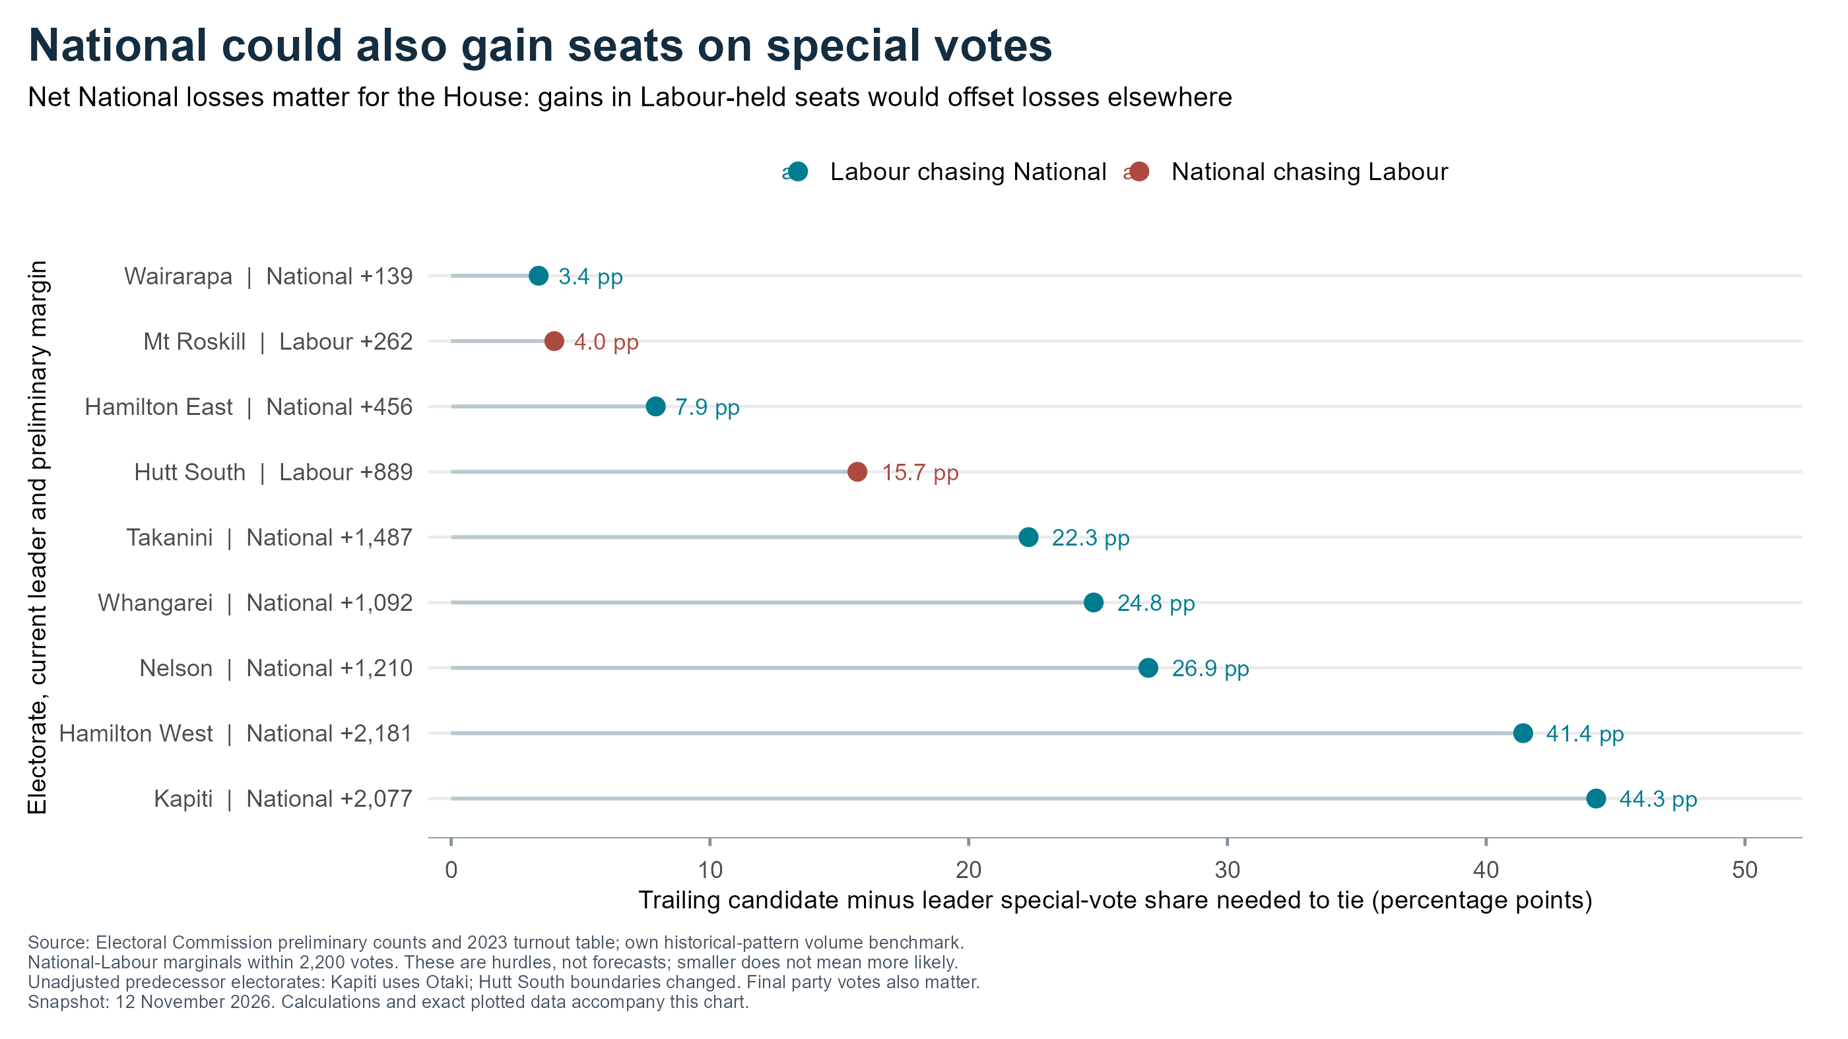
Notes:
P22: National could also gain seats on special votes
Priority: Appendix
Source: Electoral Commission preliminary counts and 2023 turnout table; own historical-pattern volume benchmark.
National-Labour marginals within 2,200 votes. These are hurdles, not forecasts; smaller does not mean more likely.
Unadjusted predecessor electorates: Kapiti uses Otaki; Hutt South boundaries changed. Final party votes also matter.
X axis: Trailing candidate minus leader special-vote share needed to tie (percentage points)
Y axis: Electorate, current leader and preliminary margin
Source/method: see data/series_selection.csv, data/source_manifest.csv and matching figures/P22.csv.
Evidence cutoff 12 November 2026; preliminary election results.

Slide 23
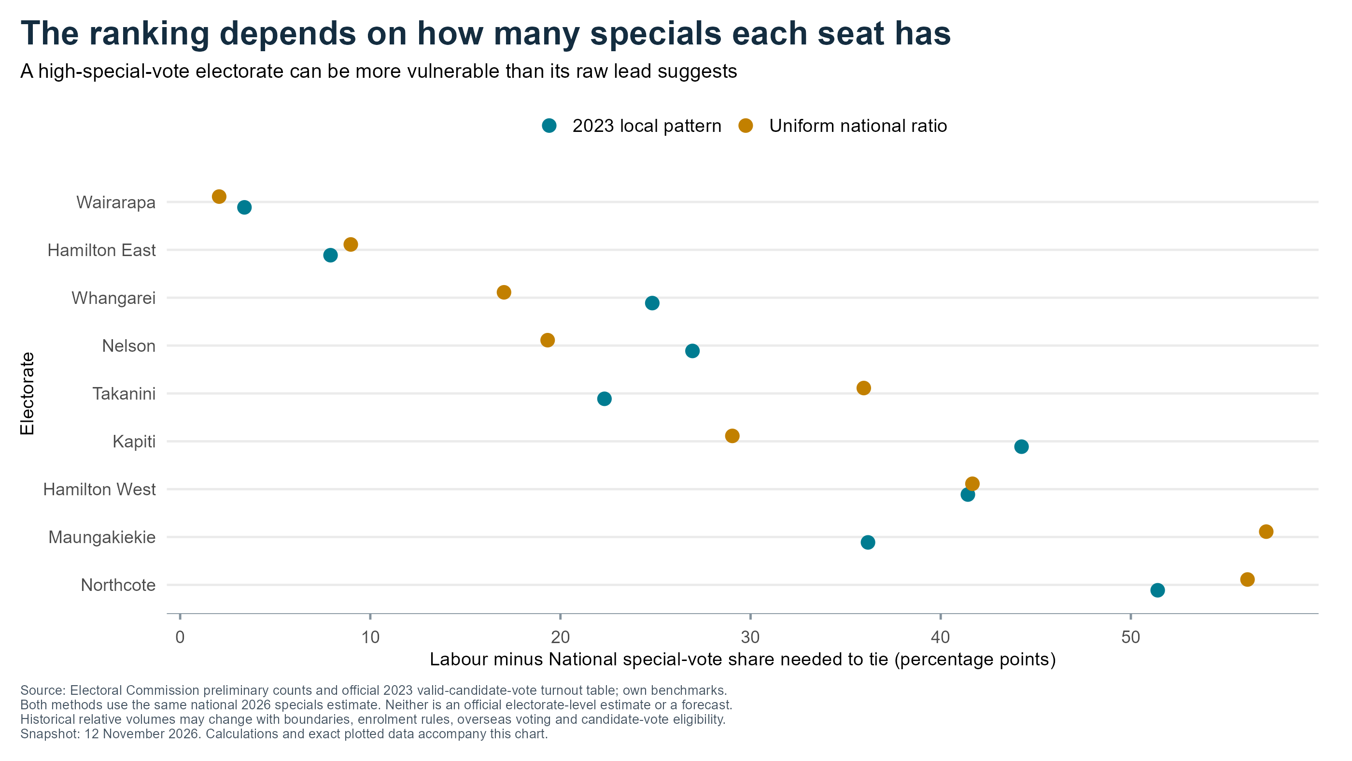
Notes:
P23: The ranking depends on how many specials each seat has
Priority: Appendix
Source: Electoral Commission preliminary counts and official 2023 valid-candidate-vote turnout table; own benchmarks.
Both methods use the same national 2026 specials estimate. Neither is an official electorate-level estimate or a forecast.
Historical relative volumes may change with boundaries, enrolment rules, overseas voting and candidate-vote eligibility.
X axis: Labour minus National special-vote share needed to tie (percentage points)
Y axis: Electorate
Source/method: see data/series_selection.csv, data/source_manifest.csv and matching figures/P23.csv.
Evidence cutoff 12 November 2026; preliminary election results.

