Slide 1
CS 2200 Interrupts, Traps, and Exceptions

Slide 2
How useful is our datapath so far?
No way to do I/O
No way to detect or handle errors
Polling vs. Interrupts
Synchronous vs. Asynchronous

Slide 3
Interrupts
What is an interrupt?
Idea is an unsolicited procedure call.
Actual procedure is called an exception/trap/interrupt handler
Why do we need them? Or put another way, what would we have to do if we didn’t have them?

Slide 4
Interrupts (In generic sense)
How can interrupts be generated?
?

Slide 5
Interrupts (In generic sense)
Different Types (2200 Definitions)
Exception - Associated with certain instruction
Overflow
Illegal Instruction
Traps – System calls (i.e. read/write file)
Interrupt - Asynchronous event not associated with a certain instruction (e.g. I/O device).

Slide 6
Interrupts/Exceptions/Traps
 | Synchronicity | Source | Intentional? | Example
Exception | Synch | Internal | No | Overflow, Illegal Instruction
Trap | Synch | Internal | Yes | System Call
Interrupt | Asynch | External | Yes | I/O Device Completion

Slide 7
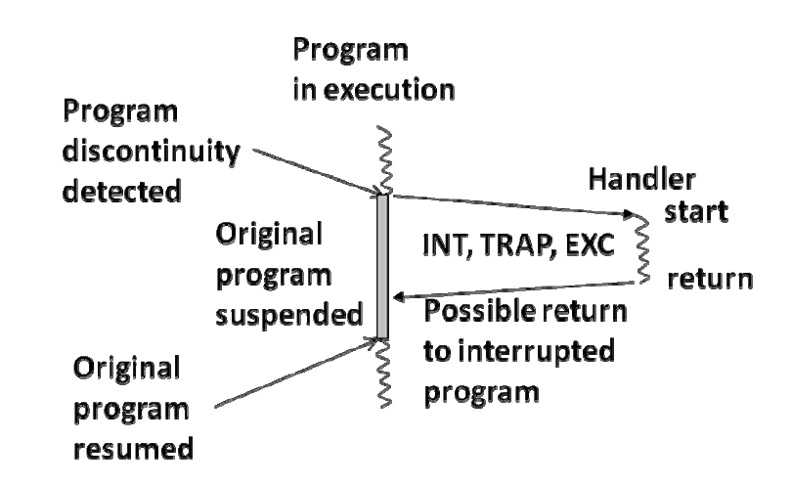

Slide 8
Dealing with Program Discontinuities
Tricky parts:
Discontinuity can happen anywhere – i.e., in the middle of instruction execution
Discontinuity is unplanned for and may be unrelated to the current program – i.e., hardware has to save the PC value implicitly before executing handler
When discontinuity is detected, hardware has to determine the handler’s address
Since PC is saved implicitly, handler has to discover how to resume normal program execution

Slide 9
Interrupt Vector Table
Dealing with interrupts is a partnership between the processor architecture and the operating system.
What makes it possible?
A fixed-size table of handler addresses, one address for each type of anticipated interrupts (it may also handle system calls).
This table is set up at boot time

Slide 10
Interrupt Vector Table
Handler code for divide by zero exception
0
Handler address
for divide by zero exception
Handler code for overflow exception
1
Handler address
for arithmetic overflow
Table entries for
exceptions
……..
Handler code for system call trap
.
.
.
.
.
.
.
.
Handler address
for system call trap
Table entries for
traps
Handler address
for page fault trap
Handler code for page fault trap
……..
Handler address
for KBD interrupt
Handler code for KBD interrupt
Table entries for
External interrupts
Handler address
for mouse interrupt
………
Handler code for mouse interrupt
n-1

Slide 11
Handling Exceptions/Traps
In the case of exceptions/traps, the hardware generates the interrupt vector internally.
When exception/trap is encountered, the unique number associated with that exception/trap is placed in ETR (exception/trap register)

Slide 12
New internal processor register
Exception/Trap number
ETR

Slide 13
How does our state machine need to change?

Slide 14
How Do We Need to Change FSM?
Fetch
Decode
Execute
INT = y
INT = n
INT
$k0 PC
PC Mem[ETR]

Slide 15
Handler:
save processor registers;
execute device code;
restore processor registers;
return to original program;

Slide 16
Simple Handler
Handler:
save $k0;
save processor registers;
execute device code;
restore processor registers;
restore $k0;
return to original program;

Slide 17
How to Handle Cascaded Interrupts?
Original program
$ko return address for
original program
First interrupt handler
$ko return address for
first interrupt handler
Second interrupt handler

Slide 18
Question?
Consider the following program. An interrupt occurs during the execution of ADD instruction.
100 ADD
101 NAND
102 LW
103NAND
104 BEQ
What is the PC value that needs to be preserved to resume this program after the interrupt?
100
101
102
103
104

Slide 19
Question?
Consider the following program. An interrupt occurs during the execution of ADD instruction.
100 ADD
101 NAND
102 LW
103NAND
104 BEQ
At this time, the only registers in use by the program are R2, R3, and R4. What registers are saved and restored by the interrupt handler?
R2
R3
R4
R2, R3, R4
All the program-visible registers

Slide 20
Handling Interrupts
Fetch
Decode
Execute
INT = n
INT = y
INT
$k0 PC
PC new PC
Disable interrupts

Slide 21
Handler:
/* The interrupts are disabled when we enter */
save $k0;
enable interrupts;
save processor registers;
execute device code;
restore processor registers;
disable interrupts;
restore $k0;
return to original program; /* how? */
Jalr $k0 ? – interrupts have to be enabled before return
Enable interrupts
Jalr $k0
- no, new interrupt may rewrite $k0

Slide 22
Interrupt Handler
Handler:
/* The interrupts are disabled when we enter */
save $k0;
enable interrupts;
save processor registers;
execute device code;
restore processor registers;
disable interrupts;
restore $k0;
return from interrupt (RETI);
/* interrupts enabled by return from interrupt */

Slide 23
Interrupts
Address Bus
Processor
Data Bus
Device 1
Device 2

Slide 24
Interrupts
Address Bus
Processor
Data Bus
Int
Device 1
Device 2
Add an interrupt request line. A device wishing to interrupt asserts this line

Slide 25
Interrupts
Address Bus
Processor
Data Bus
Int
Device 1
Device 2
The interrupt line is connected to the processor control (state machine)

Slide 26
Interrupts
Address Bus
Processor
Data Bus
Int
Device 1
Device 2
At the beginning of every instruction execution sequence a check is made on the status of the "int" line

Slide 27
Interrupts
Address Bus
Processor
Data Bus
Int
Device 1
Device 2
If "int" is asserted special states can be used to handle the interrupt

Slide 28
Interrupts
Address Bus
Processor
Data Bus
Int
Inta
Device 1
Device 2
If the processor decides to handle the interrupt it asserts the inta (interrupt acknowledege) line

Slide 29
Interrupts
Address Bus
Processor
Data Bus
Int
Inta
Device 1
Device 2
If Device 1 was one of the devices asserting "int" it receives the acknowledgement and doesn't pass it on

Slide 30
Interrupts
Address Bus
Processor
Data Bus
Int
Inta
Device 1
Device 2
If Device 1 wasn't one of the devices asserting "int" it receives the acknowledgement and passes it on

Slide 31
Interrupts
Address Bus
Processor
Data Bus
Int
Inta
Device 1
Device 2
Assume it's Device 2 that wants to interrupt.

Slide 32
Interrupts
Address Bus
Processor
Data Bus
Int
Inta
Device 1
Device 2
Now knowing that the processor is listening Device 2 can put the address of it's entry in the interrupt vector table onto the data bus

Slide 33
Memory
0x12345678
0x3579BDFA
0x12345678
0x3579BDFE
Address Bus
Processor
Data Bus
Int
Inta
Device 1
Device 2
The interrupt vector table is located in very low memory and consists of a table of pointers and stack pointers for interrupt handling routines

Slide 34
Memory
0x12345678
0x3579BDFA
0x12345678
0x3579BDFE
Address Bus
Processor
Data Bus
Int
Inta
Device 1
Device 2
This allows the processor to jump to the code to handle the interrupt

Slide 35
Address of handler
KEYBOARD
80
81
….
Address of handler
MOUSE
82
83
….
Memory
.
.
.
.
Interrupt vector table
Address Bus
Processor
Data Bus
INT
INTA
Device 1
Device 2

Slide 36
Memory
0x12345678
0x3579BDFA
0x12345678
0x3579BDFE
Address Bus
Processor
Data Bus
Int
Inta
Device 1
Device 2
Once complete the handler executes a "return from interrupt" instruction

Slide 37
Questions?

Slide 38
INT8
INTA 8
Device 1
Device 2
.
.
.
.
.
.
.
.
Priority
Encoder
Processor
INT
INT1
INTA
INTA 1
Device 1
Device 2

Slide 39
Stack for Saving/Restoring
Where do we save processor registers?
How does handler know which part of the memory can be used by the stack?
It does not know☺
For this reason, the architecture has two stacks: user stack and system stack.
Duplicate stack pointer $sp and change FSM to perform state switching in INT macro state

Slide 40
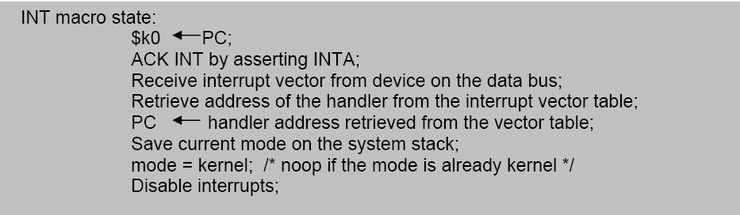
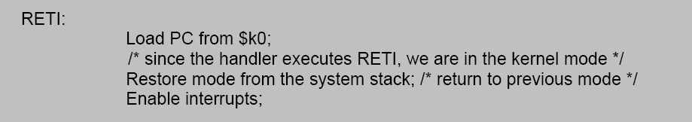

Slide 41
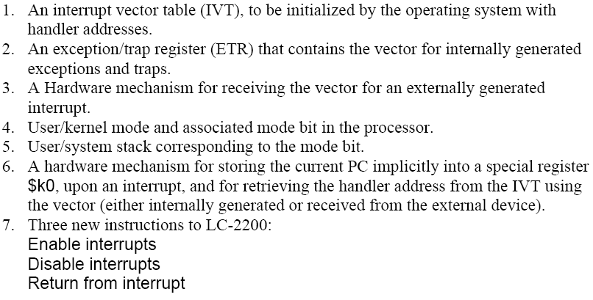
Arch enhancements to LC-2200

Slide 42
A.
INT REQ
1
MODE
USER
Executing instruction at 19999. The PC has already been incremented. Device signals interrupt in middle of instruction. $sp points to user stack
INT ACK
0
Register File
INT Enable
1
$k0
300
PC
20000
$sp
user
stack
ADDR
40
41
•
•
•
299
300
•
•
•
1000
1001
•
•
•
19999
20000
CONT
1000
...
...
...
inst
inst
inst
inst
Vector Table
System Stack
Handler Code
Original Program

Slide 43
B.
INT REQ
1
MODE
USER
Interrupt has been sensed. $k0 gets PC. Interrupts are disabled. Interrupt is acknowledged. Device puts vector on bus.
INT ACK
1
Register File
INT Enable
0
$k0
20000
BUS
40
PC
20000
$sp
user
stack
ADDR
40
41
•
•
•
299
300
•
•
•
1000
1001
•
•
•
19999
20000
CONT
1000
...
...
...
inst
inst
inst
inst
Vector Table
System Stack
Handler Code
Original Program

Slide 44
C.
Handler address is put into PC;
Current mode is saved in system stack; New mode is set to kernel; $sp now points to system stack; Interrupt code at 1000 is set to handle the interrupt.
INT REQ
0
MODE
KERNEL
INT ACK
0
Register File
INT Enable
0
$k0
20000
PC
1000
$sp
299
ADDR
40
41
•
•
•
299
300
•
•
•
1000
1001
•
•
•
19999
20000
CONT
1000
...
...
mode
inst
inst
inst
inst
Vector Table
System Stack
Handler Code
Original Program

Slide 45
D.
INT REQ
0
MODE
USER
RETI instruction restores mode from system stack; since returning to user program in this example, $sp now points to user stack; also, copies $k0 into PC, re-enables interrupts and sets Mode to User
INT ACK
0
Register File
INT Enable
1
$k0
20000
PC
20000
$sp
user
stack
ADDR
40
41
•
•
•
299
300
•
•
•
1000
1001
•
•
•
19999
20000
CONT
1000
...
...
...
inst
inst
inst
inst
Vector Table
System Stack
Handler Code
Original Program

Slide 46
A.
INT REQ
1
MODE
USER
Executing instruction at 19999. The PC has already been incremented. Device signals interrupt in middle of instruction. $sp points to user stack
INT ACK
0
Register File
INT Enable
1
$k0
300
PC
20000
$sp
user
stack
ADDR
40
41
•
•
•
299
300
•
•
•
1000
1001
•
•
•
19999
20000
CONT
1000
...
...
...
inst
inst
inst
inst
Vector Table
System Stack
Handler Code
Original Program
B.
INT REQ
1
MODE
USER
Interrupt has been sensed. $k0 gets PC. Interrupts are disabled. Interrupt is acknowledged. Device puts vector on bus.
INT ACK
1
Register File
INT Enable
0
$k0
20000
BUS
40
PC
20000
$sp
user
stack
ADDR
40
41
•
•
•
299
300
•
•
•
1000
1001
•
•
•
19999
20000
CONT
1000
...
...
...
inst
inst
inst
inst
Vector Table
System Stack
Handler Code
Original Program
C.
Handler address is put into PC;
Current mode is saved in system stack; New mode is set to kernel; $sp now points to system stack; Interrupt code at 1000 is set to handle the interrupt.
INT REQ
0
MODE
KERNEL
INT ACK
0
Register File
INT Enable
0
$k0
20000
PC
1000
$sp
299
ADDR
40
41
•
•
•
299
300
•
•
•
1000
1001
•
•
•
19999
20000
CONT
1000
...
...
mode
inst
inst
inst
inst
Vector Table
System Stack
Handler Code
Original Program
D.
INT REQ
0
MODE
USER
RETI instruction restores mode from system stack; since returning to user program in this example, $sp now points to user stack; also, copies $k0 into PC, re-enables interrupts and sets Mode to User
INT ACK
0
Register File
INT Enable
1
$k0
20000
PC
20000
$sp
user
stack
ADDR
40
41
•
•
•
299
300
•
•
•
1000
1001
•
•
•
19999
20000
CONT
1000
...
...
...
inst
inst
inst
inst
Vector Table
System Stack
Handler Code
Original Program

