Slide 1
CS 2200 Performance

Slide 2
Time
Wall clock
elapsed (total time including io waits)
response time (time from input to response)
CPU Time
User CPU Time (user space)
System CPU Time (kernel space)
System Performance: Elapsed (unloaded)
CPU Performance: User CPU Time

Slide 3
Other considerations
Space (Memory Footprint of program code)
Time (Execution Time of program)
RISC (Reduced Instruction Set)
CISC (Complex Instruction Set)
Static Instruction Count
Dynamic Instruction Count
Latency
Throughput

Slide 4
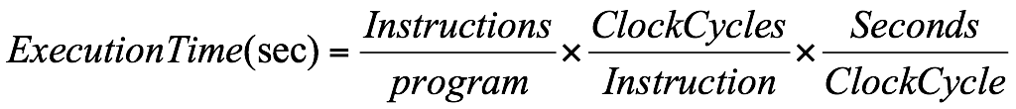
Execution Time

Slide 5
Execution Time
What is the execution time for a program containing 10,000,000 instructions where each instruction takes 4 clock cycles and the clock runs at 500 MHz.

Slide 6
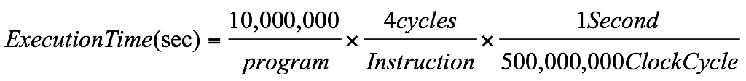
Execution Time
What is the execution time for a program containing 10,000,000 instructions where each instruction takes 4 clock cycles and the clock runs at 500 MHz.

Slide 7
Execution Time
What is the execution time for a program containing 10,000,000 instructions where each instruction takes 4 clock cycles and the clock runs at 500 MHz.

Slide 8
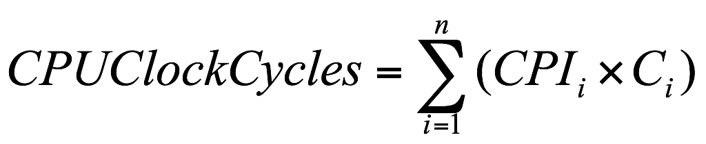
Also...
Dealing with different “classes” of instructions...
where CPI_{i} is the number of cycles per instruction for class i
C_{i} is the count of the number of instructions of class i
n is the number of instruction classes

Slide 9
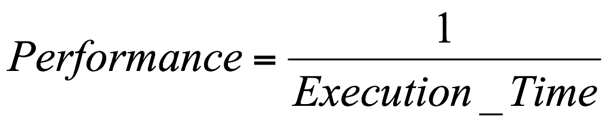
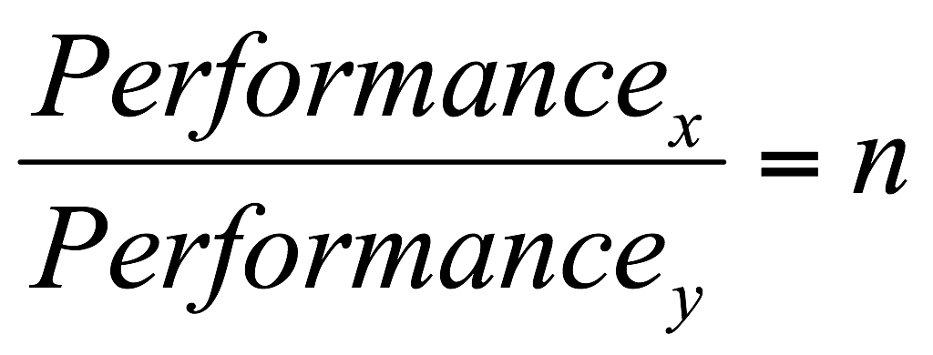
Quantifying
Machine x is n times faster than machine y:

Slide 10
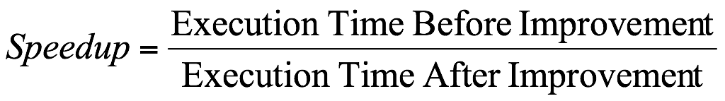
Speedup
Old machine takes 10 seconds
New machine takes 8 seconds
Speedup = 1.25
Note this is different than percentage improvement! (2/10 = 20%)

Slide 11
Questions

Slide 12
Benchmarks
Best choice is real programs
Should choose from typical applications
Small code segments encourage cheating
Types:
real programs
kernels
toy benchmarks
synthetic benchmarks

Slide 13
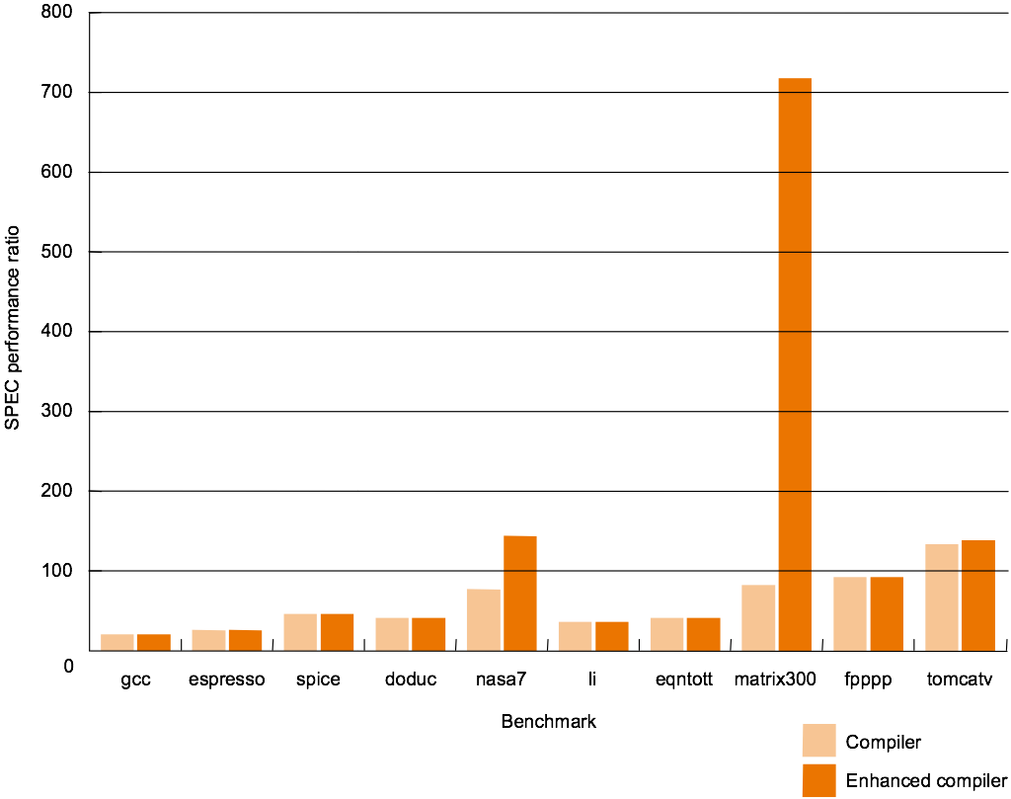
COPYRIGHT 1998 MORGAN KAUFMANN PUBLISHERS, INC. ALL RIGHTS RESERVED

Slide 14
Benchmarks
Best choice is real programs
Should choose from typical applications
Small code segments encourage cheating
Small benchmarks common with new machine
Still confusing? Consider:
Execution Time
A
B
Program 1
1
10
Program 2
1000
100
Total Time
1001
110

Slide 15
Benchmarks
Arithmetic mean: This metric may bias the summary value towards a time-consuming benchmark program (e.g. P1 = 100; P2 = 1; AM = 50.5).
Weighted arithmetic mean: This metric takes into account the relative frequency of execution of the programs in the benchmark mix (e.g. P1 = 100; P2 = 1; fP1 = 0.1; fP2 = 0.9; WAM = 5.45).
Geometric mean: (nth root of product) This metric removes the bias present in arithmetic mean (e.g. P1 = 100; P2 = 1; GM = 10).
Harmonic mean: It is computed by taking the arithmetic mean of the reciprocals (e.g. P1 = 100; P2 =1; HM = 1/( ( (1/100) + (1/1) )/2 ) = 1.9801. (bias to lower values)

Slide 16
Questions

Slide 17
Execution Time

Slide 18
Execution Time
How can we lower this?

Slide 19
Execution Time
How can we lower this?

Slide 20
Execution Time
How can we lower this?

Slide 21
Example
An architecture has three types of instructions that have the following CPI (clock per instruction):
Type CPI
A 2
B 5
C 1
An architect determines that he can reduce the CPI for B to 3, with no change to the CPIs of the other two instruction types, but with an increase in the clock speed of the processor. What is the maximum permissible increase in clock cycle time that will make this architectural change still worthwhile? Assume that all the workloads that execute on this processor use 30% of A, 10% of B, and 60% of C types of instructions.

Slide 22
ExecutionTimeold = N * (Freqa * CPIa + Freqb * CPIb + Freqc * CPIc) * Clockold
ExecutionTimeold = N* (.3*2 + .1*5 + .6*1) * Clockold = N * 1.7 * Clockold
ExecutionTimenew = N * (.3*2 + .1 * 3 + .6 * 1) * Clocknew = N * 1.5 * Clocknew
We want the ExecutionTimenew < ExecutionTimeold
N * 1.5 * Clocknew < N * 1.7 * Clockold
Clocknew < (1.7 / 1.5) * Clockold
Clocknew < 1.13 * Clockold
Max permissible increase in clock cycle time = 13%

Slide 23
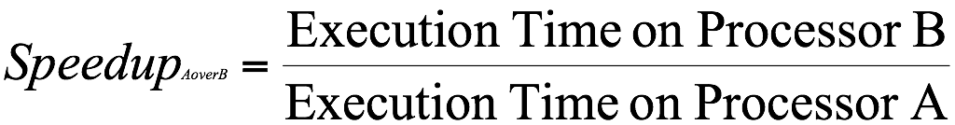
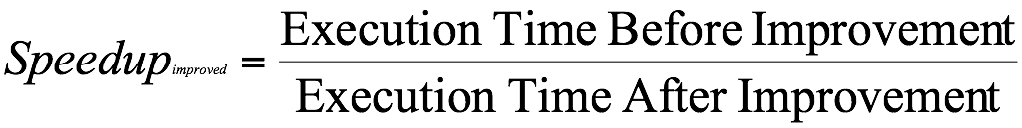
Speedup
old execution time – new execution time
Improvement in execution time = ----------------------------------------------------
old execution time

Slide 24
Example
Instruction CPI
Add 2
Shift 3
Others 2
Add/Shift 4
If the sequence ADD followed by SHIFT appears in 20% of the dynamic frequency of a program, what is the speedup of the of the program with all {ADD, SHIFT} replaced by the new instruction?

Slide 25
Speedup
ExecutionTimeorig = N*freq Add/Shift * (2+3) + N * freqOtherInst * 2
= N * .2 * 5 + N * .8 * 2 = 2.6 N
New instruction count = .9N since we are eliminating instruction
ExecutionTimenew = .9N*freq Add/Shift * 4 + .9N * freqOtherInst * 2
= .9N * (1/9) * 4 + .9N * (8/9) *2
= 2N
Speedup = old / new = 2.6N / 2N = 1.3

Slide 26
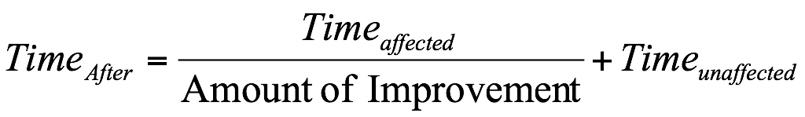
Amdahl's Law

Slide 27
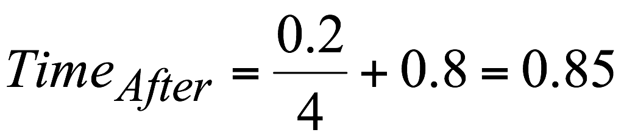
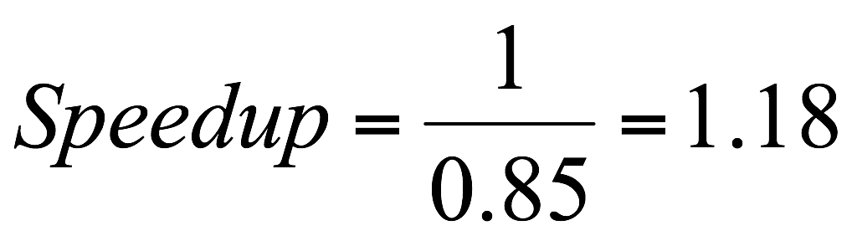
Example
A processor spends 20% of its time on
add instructions. An engineer proposes to
improve the add instruction by 4 times.
What is the speedup achieved because
of the modification?

Slide 28
Name | Notation | Units | Comment
Memory footprint | - | Bytes | Total space occupied by the program in memory
Execution time | (∑ CPI_{j}) * clock cycle time, where 1 ≤ j ≤ n | Seconds | Running time of the program that executes n instructions
Arithmetic mean | (E₁+E₂+…+E_{p})/p | Seconds | Average of execution times of constituent p benchmark programs
Weighted Arithmetic mean | (f₁*E₁+f₂*E₂+…+f_{p}*E_{p}) | Seconds | Weighted average of execution times of constituent p benchmark programs
Geometric mean | p^{th} root (E₁*E₂* …*E_{p)} | Seconds | p^{th} root of the product of execution times of p programs that constitute the benchmark
Static instruction frequency |  | % | Occurrence of instruction i in compiled code
Dynamic instruction frequency |  | % | Occurrence of instruction i in executed code
Speedup (M_{A} over M_{B}) | E_{B}/E_{A} | Number | Speedup of Machine A over B
Speedup (improvement) | E_{Before}/E_{After} | Number | Speedup After improvement
Improvement in Exec time | (E_{old}-E_{new})/E_{old} | Number | New Vs. old
Amdahl’s law | Time_{after} = Time_{unaffected} + Time_{affected}/x | Seconds | x is amount of improvement

Slide 29
Questions

