Slide 1
CS 2200
Memory Management Techniques

Slide 2
Functionalities of Memory Manager
How operating system manages memory?
What functionalities do we want to provide?
Improved resource utilization
Incremental allocation and dynamic reallocation

Slide 3
Memory footprint of a user program
Low memory
Use by the OS
Program code
Memory footprint
of
User program
Program global data
Program heap
Program stack
Use by the OS
High memory

Slide 4
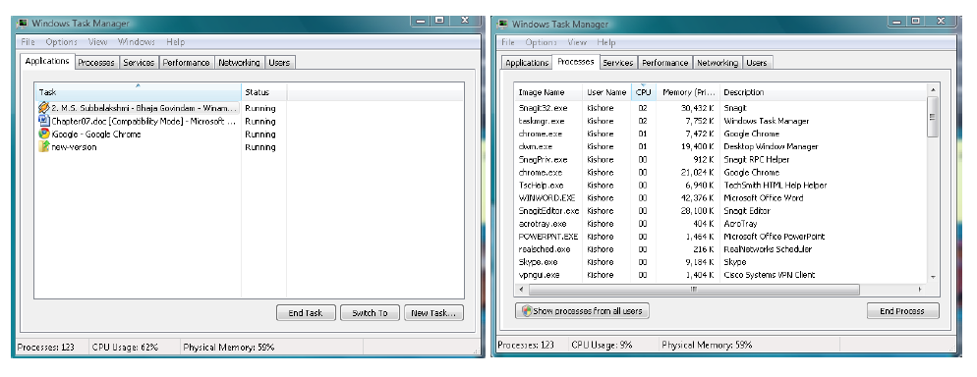

Slide 5
Functionalities of Memory Manager
What functionalities do we want to provide?
Improved resource utilization
  Incremental allocation and dynamic reallocation
Independence and Protection (from malicious code)
  Memory manager ensures independence for each process and memory protection from one another
Liberation from resource limitations
  Programmer should not worry about memory space when writing code (Overlays and Segments)
Sharing of memory by concurrent processes
  Multiple browser windows; copy/paste image from ppt to word

Slide 6
Overall Goals of Memory Manager
Require minimal hardware support
Keep impact on memory accesses low
Keep memory management overhead low (for allocation and de-allocation of memory)

Slide 7
A slight Digression
Memory Address generation (Address Binding)
Compile Time – Absolute Address The actual physical memory address is created at compile time. If any memory addresses change (i.e. starting load address), then the code would need to be recompiled. Programmer manages memory and overlays. MS-DOS .com files
Load Time – Relocatable Code Final binding of addresses takes place at load time. If start address changes, then code is just reloaded, not recompiled.
Execution Time – Relocatable code that can be moved in memory during execution from one memory segment to another.
Loading of Programs
Static – Process code and data must fit into physical memory when loaded.
Dynamic – Code not loaded until called. Code kept on disk in relocatable format until needed.

Slide 8
Hardware or Software?
Mechanism vs Management
B
R
O
K
E
R
CPU
Memory
CPU generated
Address
Memory
Address
A generic schematic of a memory manager

Slide 9
Simple Schemes for Memory Management
1. Separation of user and kernel
Fence register
Memory
Low
Broker
Kernel
Y
CPU
>
User
CPU generated
Address
N
MemoryAddress
High
Trap
Really old school, not used by most modern general-purpose machines

Slide 10
Static Relocation
Part of PCB
Memory
Kernel
Low
Lower bound
Upper bound
P1
Y
Y
.
.
.
.
CPU
>
<
CPU
Address
N
N
Memory
Address
Trap
Trap
P2
Pn
High
Code is statically bound and compiled to match a specific load address
How would we swap processes with this technique?

Slide 11
Static Relocation
Memory bounds for process set at linking time when executable is created.
Memory bounds in PCB (process control block) & hardware registers
Process can be swapped in & out (to same location)
Process is non-relocatable (the addresses in the program cannot be changed either during loading into memory or during execution)
Downside: executable occupies a fixed spot in memory, so two different programs that happen to have the same memory bounds cannot coexist in memory simultaneously.

Slide 12
Dynamic Relocation
Ability to place executable into any region of memory that can accommodate the memory needs of the process.
  This is done by allowing memory address generated by a program to be changed during the execution of the program

Slide 13
Dynamic Relocation
Memory
Low
Kernel
Base
Limit
P1
Y
.
.
.
.
CPU
+
<
CPU
Address
N
Memory
Address
Trap
P2
Pn
High

Slide 14
Dynamic Relocation
Ability to place executable into any region of memory that can accommodate the memory needs of the process.
  This is done by allowing memory address generated by a program to be changed during the execution of the program
Can swap out and then swap in to a different location
Code must be position independent
The additional hardware (registers and ALU ops) is same as fixed scheme.

Slide 15
PCB
enum state_type {new, ready, running, waiting, halted};
typedef struct control_block_type {
enum state_type state;
address PC;
int reg_file[NUMREGS];
struct control_block *next_pcb;
int priority;
address memory_footprint;
….
….
} control_block;

Slide 16
Memory Allocation Schemes
We can have different processes in memory
What options are available to divide up memory for each process?
Assume Base plus Limit hardware exists

Slide 17
Fixed Size Partitions
Partitions fixed at boot time
Fixed (Different) Sized Partitions
This would be an OS data structure:
Memory
Allocation table
Occupied bit
Partition Size
Process
5K
0
5K
XXX
8K
0
8K
XXX
0
1K
XXX
1K
Am I using this partition

Slide 18
Fixed Size Partitions
Partitions fixed at boot time
Internal fragmentation = Size of Fixed partition - Actual memory request = 8 – 6 = 2K
memory
Allocation table
Occupied bit
Partition Size
Process
5K
0
5K
XXX
6K
1
8K
P1
2K
0
1K
XXX
1K
P1 is only using 6K of the partition

Slide 19
Fixed Size Partitions
External fragmentation =
∑All non-contiguous memory partitions
memory
Allocation table
Occupied bit
Partition Size
Process
5K
0
5K
XXX
6K
1
8K
P1
2K
0
1K
XXX
1K
What if P2 wants to be scheduled for 6K?

Slide 20
Variable Size Partitions
To overcome internal fragmentation problems we introduce variable size partitions
Allocation table is dynamic

Slide 21
Variable Size Partitions
Memory
Allocation table
Start address
Size
Process
0
13K
FREE
13K

Slide 22
Variable Size Partitions
After requests for 2K, 6K and 3K
Memory
Allocation table
Start address
Size
Process
11K
0
2K
P1
2K
6K
P2
2K
8K
3K
P3
11K
2K
FREE

Slide 23
Variable Size Partitions
After P1 terminates
Memory
Allocation table
2K
Start address
Size
Process
9K
0
2K
FREE
2K
6K
P2
2K
8K
3K
P3
11K
2K
FREE
What happens if P4 requests 4K?
Do variable size partitions solve the external fragmentation problem?

Slide 24
Variable Size Partitions
Memory
Allocation table
2K
Start address
Size
Process
9K
0
2K
FREE
2K
6K
P2 -> FREE
2K
8K
3K
P3
11K
2K
FREE
As P2 terminates the memory allocator can look for adjacent free blocks

Slide 25
Variable Size Partitions
After coalescing adjacent free blocks
Memory
Allocation table
Start address
Size
Process
8K
0
8K
FREE
3K
8K
3K
P3
2K
11K
2K
FREE

Slide 26
Compaction
If external fragmentation becomes excessive, we can compact memory by moving processes
Memory
Allocation table
Start address
Size
Process
8K
0
8K
FREE
3K
8K
3K
P3
2K
11K
2K
FREE
Memory
Allocation table
3K
Start address
Size
Process
0
3K
P3
10K
3K
10K
FREE

Slide 27
Variable Size Partitions
When space is requested several possible options
  Best Fit
    Lower internal fragmentation
    Longer search time
  First Fit
    Faster allocation

Slide 28
Paged Virtual Memory
As memory size increases problem of external fragmentation increases

Slide 29
Paged Virtual Memory
B
R
O
K
E
R
CPU
Memory
Virtual
Address
Physical
Address
Need a system to take user virtual addresses and translate into physical address corresponding to the physical memory present

Slide 30
Paged Virtual Memory
Conceptually break up both virtual memory and physical memory into equal sized blocks
Virtual
Memory
Physical
Memory
Frame
Page
Frame
Page
Frame
Page
Frame
Page
Frame
Page
Frame
Page Size = Frame Size

Slide 31
Paged Virtual Memory
Where is virtual memory?
Need mechanism to translate from virtual pages to physical frames
BROKER
CPU
Memory
Page
Table
Virtual
Address
Physical
Address

Slide 32
Paged Virtual Memory
Physical
Memory
LOW
12
Page Table
User’s view
Page 0
35
15
Page 1
52
Page 2
12
Page 3
15
35
52
HIGH

Slide 33
Key Point
The user still perceives a contiguous memory space
The space is not necessarily contiguous in physical memory
External fragmentation is eliminated!

Slide 34
Page Table
Virtual addresses generated by CPU consist of:
  Virtual page number (VPN)
  Offset (within the page)
VPN
Page Offset

Slide 35
Page Table
Consider a memory system with 32-bit virtual memory addresses. Assume that the page size is 4096 bytes long.
What do virtual addresses look like?
0 00000000000000000000000000000000
4095 00000000000000000000111111111111
4096 00000000000000000001000000000000
32456 00000000000000000111111011001000
Virtual
Page
Number
Offset

Slide 36
Address Translation
Virtual
Address
Physical
Address
CPU
VPN
Page offset
PFN
Page offset
Memory
PFN
Page table
PFN- physical frame number

Slide 37
Example
Consider a memory system with 32-bit virtual addresses and 24-bit physical memory addresses. Assume that the page size is 4K Bytes. Show the layout of the virtual and physical addresses. How big is the page table? How many page frames are there in this memory system?
31
12 11
0
VPN
Page Offset
23
12 11
0
PFN
Page Offset
No. of page table entries = 2^(Number of bits in VPN)=2^20
The size of page table =4*2^20=4 MB (assuming 4 byte entries)
Number of page frames=2^(Number of bits in PFN)=2^12

Slide 38
Where to put the page table?
In CPU data path?
Not realistic, page table is too big and each process needs its own page table.
Memory?
We need to add page table base register (PTBR) because CPU needs to know the location of the page table in memory.

Slide 39
Physical Memory
Low
Memory
manager
PTPn
Kernel
Space
…
PTP2
PTP1
User
Space
High

Slide 40
PCB
enum state_type {new, ready, running, waiting, halted};
typedef struct control_block_type {
enum state_type state;
address PC;
int reg_file[NUMREGS];
struct control_block *next_pcb;
int priority;
address PTBR;
….
….
} control_block;

Slide 41
Hardware for Paging
PTBR
Translation hardware VPN to PFN
Page table is in kernel memory space
Note: each process has a page table
How many memory accesses are required for each memory request by the CPU?
  Hardware makes two trips to the memory for each access: first to retrieve PFN and second to retrieve the memory content
Solution: translation look-a-side buffer (TLB) in CPU

Slide 42
Demand Paging
Paging as described in Chapter 7 implied whole program was in memory
But does it have to be?
On average
  30% of a programs memory footprint is the primary logic of program
  70% is little used error handling
Therefore, prudent for memory manager not to load entire program into memory on startup.
Basic idea is to load parts of the program that are not in memory on demand.
This technique, referred to as demand paging results in better memory utilization.

Slide 43
Hardware for Demand Paging
Note that with demand paging, the page may not be in the memory yet.
Need to add a valid bit to the page table entry (PTE)
If valid=0, this is unintended interruption, i.e., fault exception or trap
Valid
PFN

Slide 44
Hardware for Demand Paging
I5
I4
I3
I2
I1
B
U
F
F
E
R
B
U
F
F
E
R
B
U
F
F
E
R
B
U
F
F
E
R
IF
ID/RR
EX
MEM
WB
Instruction
in
Instruction
out
Potential page faults
Let I1 complete and squash I3-I5 before INT.
INT needs to save PC corresponding to I2 for re-starting I2 after servicing page fault.
Note that there is no harm in squashing instructions I3-I5 since they have not modified permanent state of program
If I5 page faults…handle
If I2 page faults

Slide 45
Page Fault Handler
Find a free physical page frame
Load the faulting virtual page from the disk into the free physical frame
Update the page table for the faulting process
Place the PCB of the process back in the ready queue of the scheduler

Slide 46
Data Structures for Demand-paged Memory Management
Free-list of physical page frames
Frame table
Disk map

Slide 47
Data structures for Demand-paged Memory Management
Free-list of physical page frames
  contains the numbers of currently unused page frames that can be used in case of page fault
  Contains all physical page frames at boot time, later one dynamically changes its the size
Free-list
Pframe 52
Pframe 20
Pframe 200
…
Pframe 8

Slide 48
Data Structures for Demand-paged Memory Management
Frame table – contains reverse mapping
0
<P2, 20>
free
Process ID
1
2
<P5, 15>
Pframe
3
<P1, 32>
<PID, VPN>
free
Note: There are
different ways
of implementing
this.
4
5
<P3, 0>
6
<P4, 0>
7
free

Slide 49
Data Structures for Demand-paged Memory Management
Disk map – maps virtual space to locations on the disk that contain the contents of the pages
Disk map for P1
0
disk address
1
disk address
disk address
P1
P2
…..
pn
2
VPN
3
disk address
4
disk address
disk address
Swap space
5
6
disk address
7
disk address

Slide 50
Anatomy of Page Fault
Find a free physical page frame
What if there is no free physical page frame?
Pick victim page and evict (use frame table for that)
When evicting a page we must consider its status
  Clean: the page has not been written to and thus matches its counterpart on disk
  Dirty: the page has been written to and no longer matches what is on disk
  Clean pages may be simply evicted
  Dirty pages must be written back to disk
Load faulting page (using disk map)
Update page table for faulting process and frame table
Restart faulting process

Slide 51
Example
  process P1 page fault at VPN = 20.
  free-list is empty.
  selects page frame PFN = 52 as the victim.
  frame currently houses VPN = 33 of process P4.

Slide 52
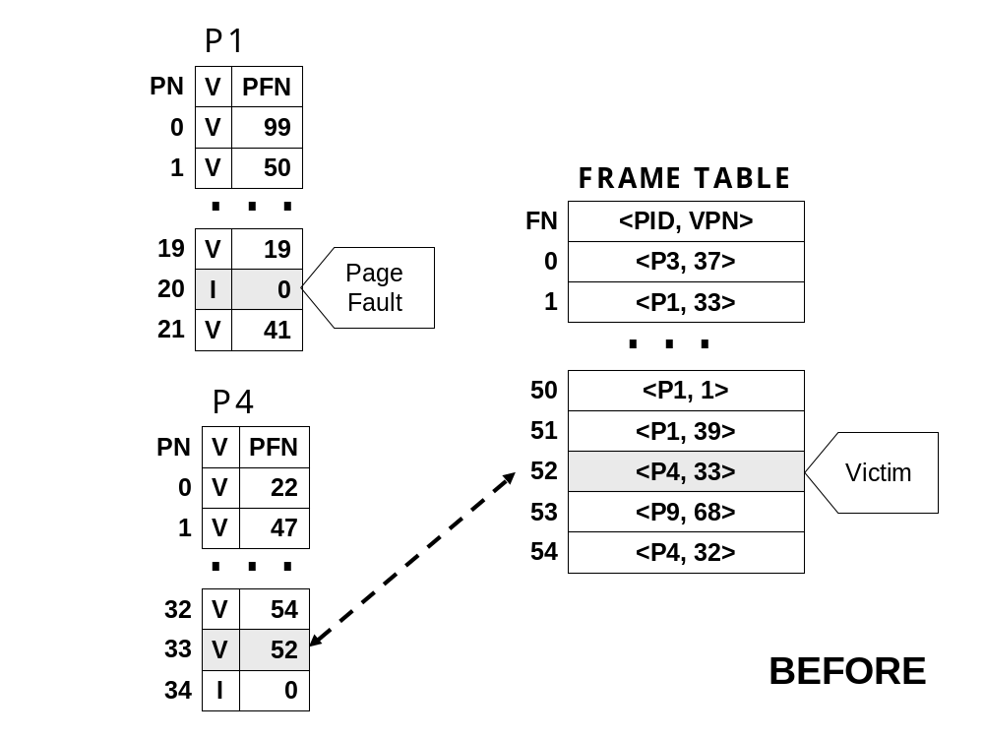
process P1 page fault at VPN = 20.
free-list is empty.
selects page frame PFN = 52 as the victim.
frame currently houses VPN = 33 of process P4.

Slide 53
