Slide 1
CS 2200 Memory Hierarchy

Slide 2
Ideally one would desire an indefinitely large capacity memory such that any particular...word would be immediately available.... We are...forced to recognize the possibility of constructing a hierarchy of memories, each of which has greater capacity than the preceding but which is less quickly accessible.
A. W. Burks, H. H. Goldstine, and J. von Neumann
Preliminary Discussions of the Logical Design of an Electronic Computing Instrument, 1946

Slide 3
Memory Hierarchy
Up to now…
Reality…
Processors have cycle times of ~1 ns
Fast DRAM (dynamic random access memory) has a cycle time of ~100 ns
Paging from disk is milliseconds
We have to bridge this gap for pipelining to be effective!
Black Box
MEMORY

Slide 4
Memory Hierarchy
DRAM (Dynamic random access memory)
Uses 1 transistor to store 1 bit
Reading the bit depletes the charge and requires a replenishment before it can be read gain
Fast memory is possible (How?)
Register files made of flip flops operate at processor speeds
Such memory is Static RAM (SRAM)
6 transistors needed for storing 1 bit, but no replenishment before reading bit again
Tradeoff
SRAM is fast
Economically unfeasible for large memories

Slide 5
Memory Hierarchy
SRAM
High power consumption
Large area on die
Costly per bit
DRAM
Low power consumption
Suitable for Large Scale Integration (LSI)
Small size
Ideal for large memories
Circa 2007, a single DRAM chip may contain up to 256 Mbits with an access time of 70 ns.

Slide 6
The Concept of a Cache
Feasible to have small amount of fast memory and/or large amount of slow memory.
Want
Size advantage of DRAM
Speed advantage of SRAM.
Increasing speed as we get closer to the processor
Increasing size as we get farther away from the processor
CPU
Cache
Main memory

Slide 7
The Concept of a Cache
CPU looks in cache for data it seeks from main memory.
If data not there it retrieves it from main memory.
If the cache is able to service "most" CPU requests then effectively we will get speed advantage of cache.
All addresses in cache are also in memory
Increasing speed as we get closer to the processor
Increasing size as we get farther away from the processor
CPU
Cache
Main memory

Slide 8
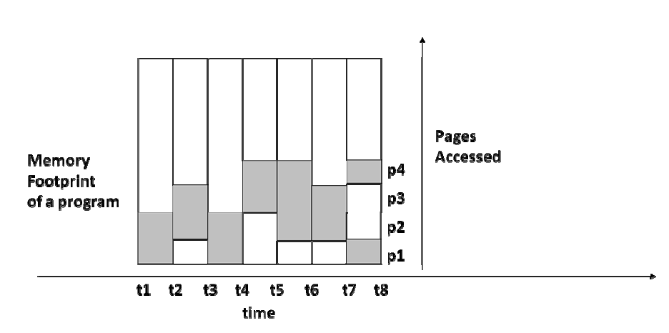
Principle of Locality

Slide 9
Principle of Locality
A program tends to access a relatively small region of memory irrespective of its actual memory footprint in any given interval of time.
While the region of activity may change over time, such changes are gradual

Slide 10
Principle of Locality
Spatial Locality: Tendency for locations close to a location that has been accessed to also be accessed
Temporal Locality: Tendency for a location that has been accessed to be accessed again
Example
for(i=0; i<100000; i++)
a[i] = b[i];

Slide 11
Basic Terminologies
Hit: CPU finding contents of memory address in cache
Hit rate (h) is probability of successful lookup in cache by CPU.
Miss: CPU failing to find what it wants in cache (incurs trip to deeper levels of memory hierarchy
Miss rate (m) is probability of missing in cache and is equal to 1-h.

Slide 12
Basic Terminologies
Miss penalty: Time penalty associated with servicing a miss at any particular level of memory hierarchy
Effective Memory Access Time (EMAT): Effective access time experienced by the CPU when accessing memory.
Time to lookup cache to see if memory location is already there
Upon cache miss, time to go to deeper levels of memory hierarchy
EMAT = Tc + m * Tm
where m is cache miss rate, Tc the cache access time and Tm the miss penalty

Slide 13
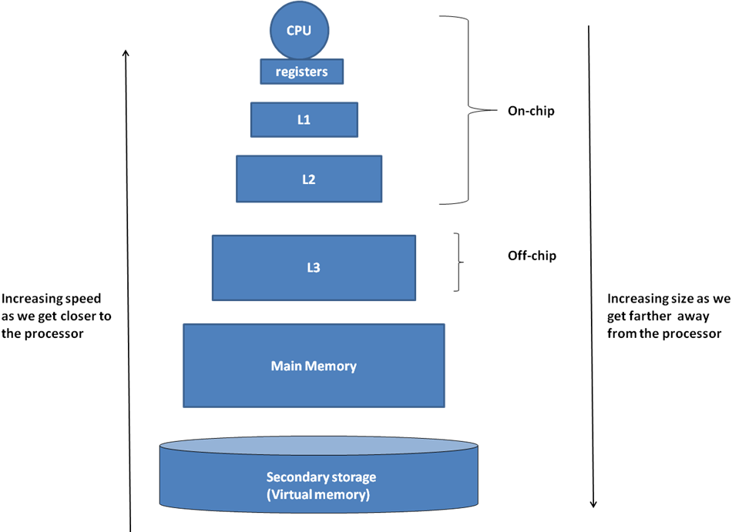
Multilevel Memory Hierarchy

Slide 14
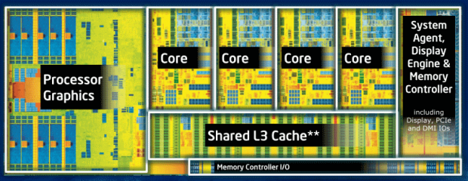
Intel i7 Chip
L1 – 32K I / 32K D
L2 256K
L3 4-12 M

Slide 15
Multilevel Memory Hierarchy
Modern processors use multiple levels of caches.
As we move away from processor, caches get larger and slower
EMAT_{i} = T_{i} + m_{i} * EMAT_{i+1}
where T_{i} is access time for level i
and m_{i} is miss rate for level i

Slide 16
CPU
L1- cache
h₁ = 0.95; T_{L1} = 2 ns
EMAT?
L2- cache
h₂ = 0.80; T_{L2} = 10 ns
T_{m} = 100 ns
Main memory
EMAT=
TL1+(1-h1)*EMAT_12=2+0.05*(TL2+(1-h2)*Tm)=2+0.05*(10+0.2*100)=2+1.5=3.5ns

Slide 17
Cache organization
There are three facets to the organization of the cache:
Placement: Where do we place in the cache the data read from the memory?
Algorithm for lookup: How do we find something that we have placed in the cache?
Validity: How do we know if the data in the cache is valid?

Slide 18
Direct Mapped Cache
0
1
2
3
0
4
1
5
2
6
3
7
4
8
5
9
6
10
7
11
12
13
14
Given a memory address,
What is the numerical value of cache index?
15

Slide 19
Compulsory misses
hits
Memory reference: 0, 1, 2, 3, 1, 3, 0, 8, 0, 9, 10
Cache
0
mem loc 0
1
mem loc 1
2
mem loc 2
3
mem loc 3
4
empty
5
empty
6
empty
7
empty

Slide 20
Compulsory miss
Memory reference: 0, 1, 2, 3, 1, 3, 0, 8, 0, 9, 10
0
mem loc 0 8
1
mem loc 1
2
mem loc 2
3
mem loc 3
4
empty
5
empty
6
empty
7
empty

Slide 21
Conflict miss
Memory reference: 0, 1, 2, 3, 1, 3, 0, 8, 0, 9, 10
0
mem loc 0 8 0
1
mem loc 1
2
mem loc 2
3
mem loc 3
4
empty
5
empty
6
empty
7
empty

Slide 22
How do we disambiguate?
tag
data
0
1
mem loc 0 8
1
0
mem loc 1
2
0
mem loc 2
3
0
mem loc 3
4
empty
5
empty
6
empty
7
empty

Slide 23
How do we know it is valid?
valid
tag
data
0
1
loc 8
1
1
1
loc 1
0
2
1
loc 2
0
3
1
loc 3
0
4
empty
0
X
5
0
empty
X
6
X
0
empty
7
0
empty
X
Valid
Tag
data

Slide 24
Interpreting memory address
Cache Tag
Cache Index

Slide 25
Cache Lookup
000
001
010
Cache_Index = Memory_Address mod Cache_Size
011
100
101
110
00000
01000
10000
11000
111
00001
01001
10001
11001
00010
01010
10010
11010
00011
01011
10011
11011
00100
01100
10100
11100
00101
01101
10101
11101
00110
01110
10110
11110
00111
01111
10111
11111

Slide 26
Cache Lookup
Tag
Contents
00
000
00
001
00
010
Cache_Index = Memory_Address mod Cache_Size
Cache_Tag = Memory_Address/Cache_Size
00
011
00
100
00
101
00
110
00000
01000
10000
11000
00
111
00001
01001
10001
11001
00010
01010
10010
11010
00011
01011
10011
11011
00100
01100
10100
11100
00101
01101
10101
11101
00110
01110
10110
11110
00111
01111
10111
11111

Slide 27
Fields of a Cache Entry
Is the sequence of fields significant?
Would this work?
Tag
00000000000000
Index
0000000000000000
Index
0000000000000000
Tag
00000000000000

Slide 28
valid
tag
data
valid
tag
data
valid
tag
data
valid
tag
data
1
loc 0
0
1
0
1
1
1
loc 0 1 0
1
loc 0 1 0 1
0
0
loc 0 1
0
0
1
0
empty
1
0
empty
1
0
empty
1
0
empty
X
X
X
X
2
0
empty
2
0
empty
2
0
empty
2
0
empty
X
X
X
X
3
0
empty
3
0
empty
3
0
empty
3
0
empty
X
X
X
X
4
empty
empty
4
empty
4
empty
0
X
4
0
X
0
X
0
X
5
0
empty
5
empty
5
empty
5
empty
X
0
X
0
X
0
X
X
X
X
X
6
0
empty
6
0
empty
6
0
empty
6
0
empty
7
0
empty
7
empty
7
empty
7
empty
X
0
X
0
X
0
X
Access location 0
Access location 1
Access location 0
Access location 1
Cache occupancy if we switch index and tag
BAD!!

Slide 29
Hardware for Direct Mapped Cache
Memory address
Cache Tag
Valid
Tag
Data
Cache Index
.
.
.
.
.
.
Data
To
CPU
=
hit
y

Slide 30
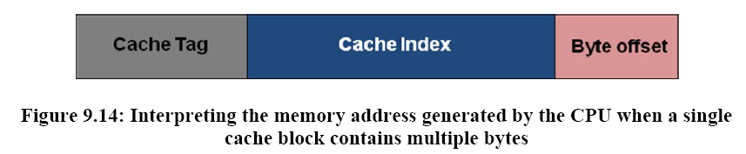
Addressing Bytes in Cache

Slide 31
Example
Let us consider the design of a direct-mapped cache for a realistic memory system.
Assume that the CPU generates a 32-bit byte-addressable memory address.
Each memory word contains 4 bytes.
A memory access brings in a full word into the cache.
The direct-mapped cache is 64K Bytes in size (this is the amount of data that can be stored in the cache), with each cache entry containing one word of data.
Compute the additional storage space needed for the valid bits and the tag fields of the cache.

Slide 33
Example
Number of cache entries:
64Kb/4bytes/word=16Kb entries, i.e., index=14 bits, tag=16bits
1 bit for valid bit
17bits x 16Kb=278,528 bits
Total space= 64 Kb+278,528 bits=802,816 bits

Slide 34
Repercussion on Pipelined Processor Design
IF
ID/RR
EXEC
MEM
WB
B
U
F
F
E
R
B
U
F
F
E
R
B
U
F
F
E
R
B
U
F
F
E
R
PC
DPRF
ALU-1
I-Cache
D-Cache
data
A
B
ALU-2
Decode
logic
DPRF
ALU
Miss on I-Cache: Insert bubbles until contents supplied
Miss on D-Cache: Insert bubbles into WB stall IF, ID/RR, EXEC

Slide 35
Read Access to Cache from CPU
CPU sends index to cache. Cache looks it up and if a hit sends data to CPU.
If cache says miss CPU sends request to main memory. All in same cycle (IF or MEM in pipeline)
Upon sending address to memory CPU sends NOP's down to subsequent stage until data read. When data arrives it goes to CPU and the cache.

Slide 36
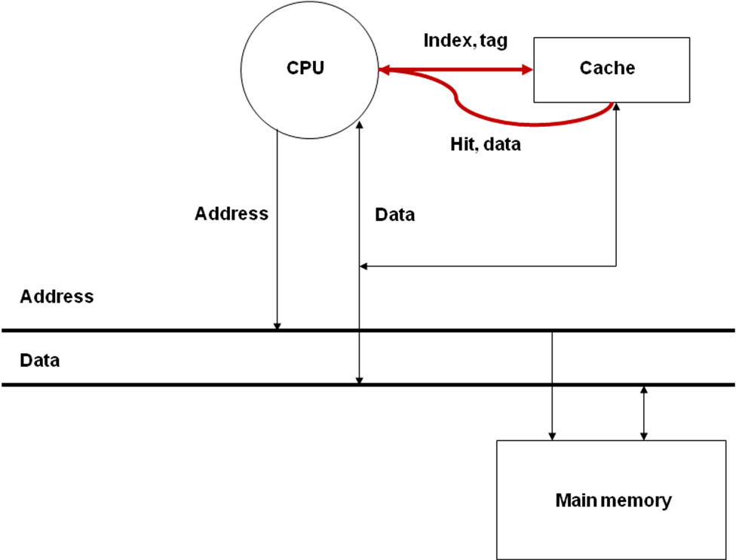
Cache read/write algorithms
Read Hit

Slide 37
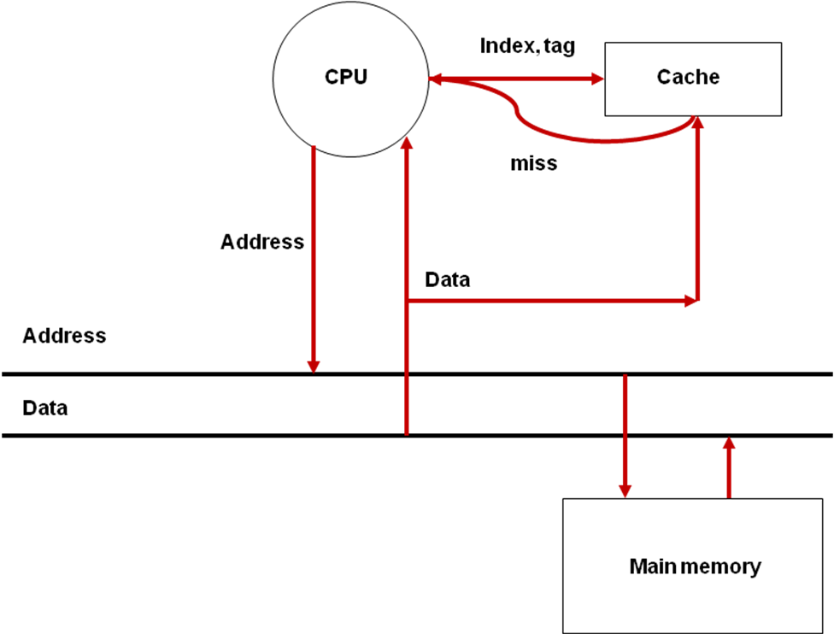
Basic cache read algorithms
Read Miss

Slide 38
Write Access to Cache from CPU
Two choices
Write through policy
Write allocate
No-write allocate
Write back policy

Slide 39
Write Through Policy
On each CPU write – both cache and main memory are updated
Each write goes to cache. Tag is set and valid bit is set
Each write also goes to main memory (through write buffer)
If write buffer is full at the time CPU wants to write, pipeline will stall

Slide 40
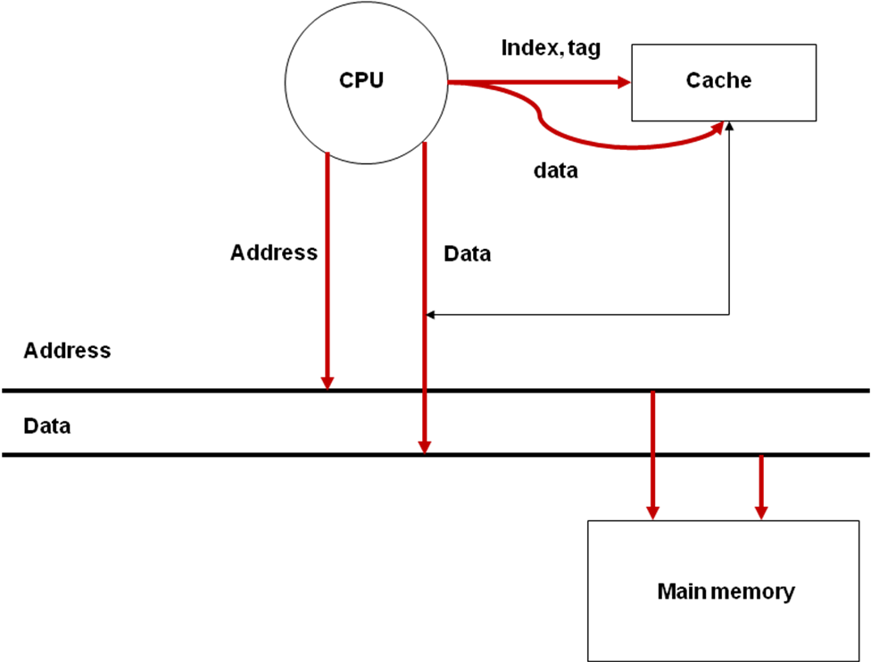
Write-Through

Slide 41
Write Through Policy
CPU
Address
Data
Address
Data
Address
Data
Write Buffer
Address
Data
Address
Address
Data
Data
Main memory
Write-Buffer for Write-Through Efficiency

Slide 42
Write Through Policy
Each write goes to cache. Tag is set and valid bit is set
This is write allocate
There is also a no-write allocate where the cache is not written to if there was a write miss
Each write also goes to write buffer
Write buffer writes data into main memory
Will stall if write buffer full

Slide 43
Write back policy
We write to the cache
We don't bother to update main memory
Is the cache consistent with main memory?
Is this a problem?
Will we ever have to write to main memory?

Slide 44
Write Back Policy
On each CPU write – only cache is updated
CPU-cache interaction same as for write-through
CPU writes data to cache setting dirty bit
Note: Cache and memory are now inconsistent but the dirty bit tells us that
Cache clears the dirty bit upon processing a miss that brings a memory location into this cache entry
Write buffer is used to service write miss
Cache sets the dirty bit upon a CPU write operation
The cache writes back the data into the memory upon replacement

Slide 45
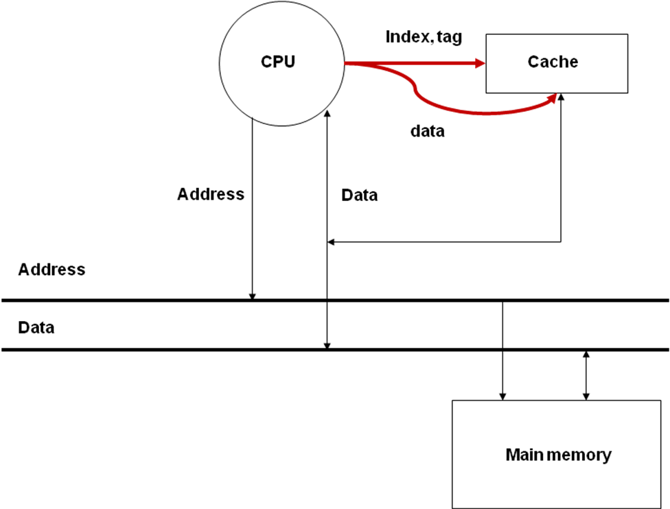
Write-Back

Slide 46
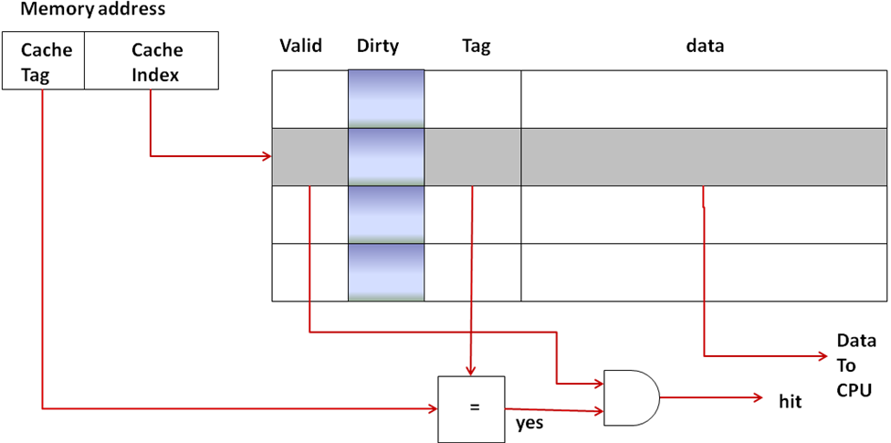
Write Back Policy

Slide 47
Comparison of the Write Policies
Write Through
Cache logic simpler and faster
Creates more bus traffic
Write back
Requires dirty bit and extra logic
Faster
Multilevel cache processors may use both
L1 Write through
L2/L3 Write back

Slide 48
Dealing with cache misses in the processor pipeline
Read miss in the MEM stage:
I1: ld r1, a ; r1 <- MEM[a]
I2: add r3, r4, r5 ; r3 <- r4 + r5
I3: and r6, r7, r8 ; r6 <- r7 AND r8
I4: add r2, r4, r5 ; r2 <- r4 + r5
I5: add r2, r1, r2 ; r2 <- r1 + r2
Write miss in the MEM stage: The write-buffer alleviates the ill effects of write misses in the MEM stage. (Write-Through with write-allocate)

Slide 49
Execution time with caches
Execution time = N * CPI_{Avg} * cycle time
Execution time = N * CPI_{eff} * cycle time
CPI_{eff} = CPI_{Avg} + Memory-stalls_{Avg}
Execution time = N * (CPI_{Avg} + M-stalls_{Avg}) * cycle time
Memory-stalls_{Avg} = misses per instruction_{Avg} * miss-penalty_{Avg}
Total memory stalls = N * Memory-stalls_{Avg}

Slide 50
Example
Consider a pipelined processor that has an average CPI of 1.8 without accounting for memory stalls.
I-Cache has a hit rate of 95% and the D-Cache has a hit rate of 98%. Assume that memory reference instructions account for 30% of all the instructions executed. Out of these, 80% are loads and 20% are stores.
On average, the read-miss penalty is 20 cycles and the write-miss penalty is 5 cycles.
Compute the effective CPI of the processor accounting for the memory stalls.

Slide 51
Example
Effective CPI= base CPI+ Effect of I-cache on CPI + Effect of D-cache on CPI=1.8+1+0.096+0.006=2.902
Base CPI=1.8
Cost of instruction misses=I-cache miss rate*read-miss penalty=(1-0.95)*20=1
Cost of data read misses=0.3*0.8*(1-0.98)*20=0.096
Cost of data write misses=0.3*0.2*(1-0.98)*5=0.006

Slide 52
Improving cache performance
Bottom line…Improving miss rate and reducing miss penalty are keys to improving performance

